Slide 1



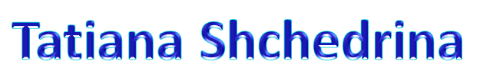

Slide 2



Slide 3
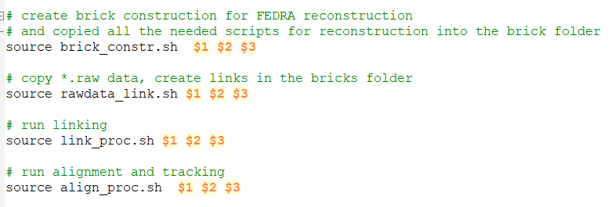


$1 is brick-ID
$2 is start reconstruction plate-ID
$3 is last reconstruction plate-ID

Slide 4

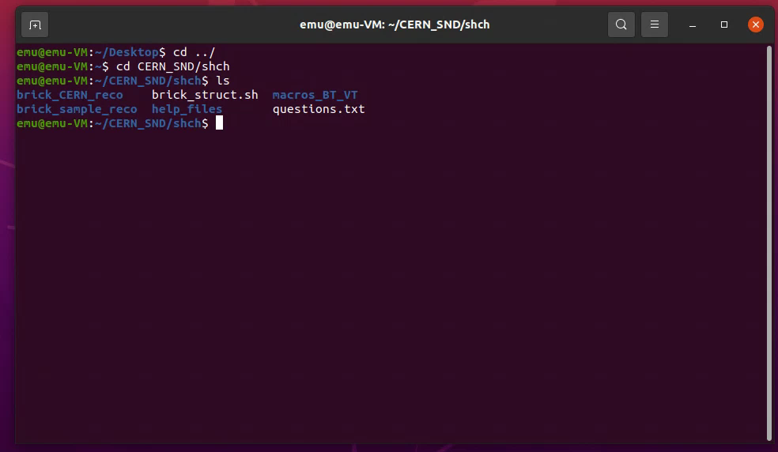


Slide 5
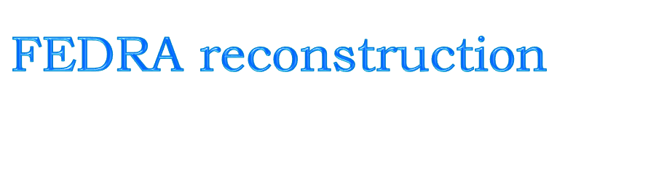


$1 is brick-ID
$2 is start reconstruction plate-ID
$3 is last reconstruction plate-ID
Final tracking
3 step of alignment
Linking
Create brick structure
Scanning

Slide 6
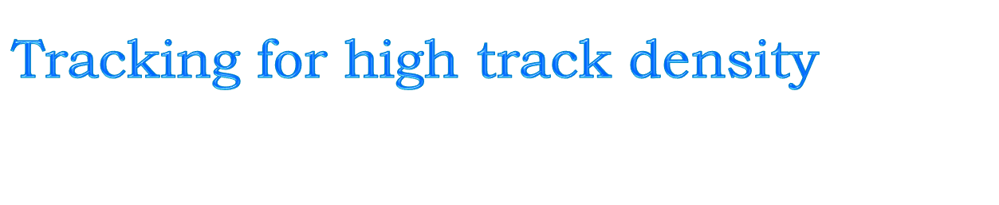
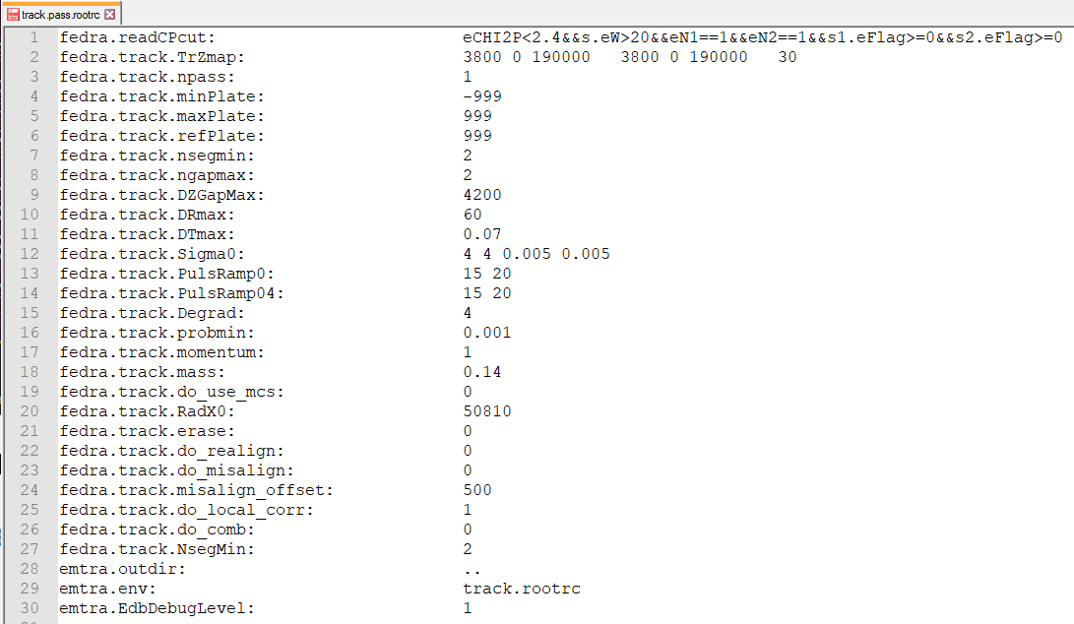


Parameters do not work equally well
for standard and big angle reconstruction
Need to be modified !

Slide 7
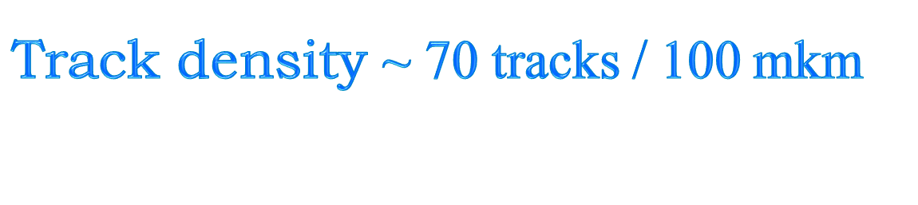
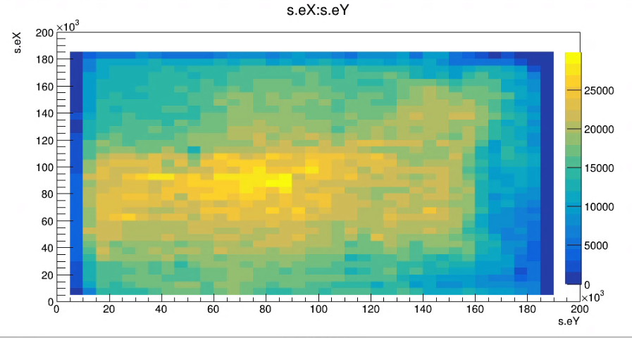


Slide 8


The scripts for the mass production of track reconstruction is written with using only 3 external parameters:
BrickID, startPlateID, finalPlateID
for the all the chain of FEDRA reconstruction.
The reconstruction algorithm needs to be modified
for standard and big angle data with high density tracks

