Slide 1

Improved Parameters
Computer language processing 2022
Group 16
Abel Théo Bernard Gérard
Jimenez Antonio

Slide 2
Summary
Overview of the extension
What is improved parameters
Why “improved parameters” are important
Example to illustrate the importance of the extension
Extension features and Compiler phases
Parser
Tree Module
Name analyzer
Conclusion
Question and answer

Slide 3



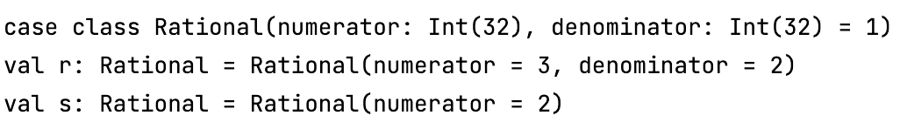
What does improved parameters mean?

Slide 4
Why Improved parameters are important?

Slide 5
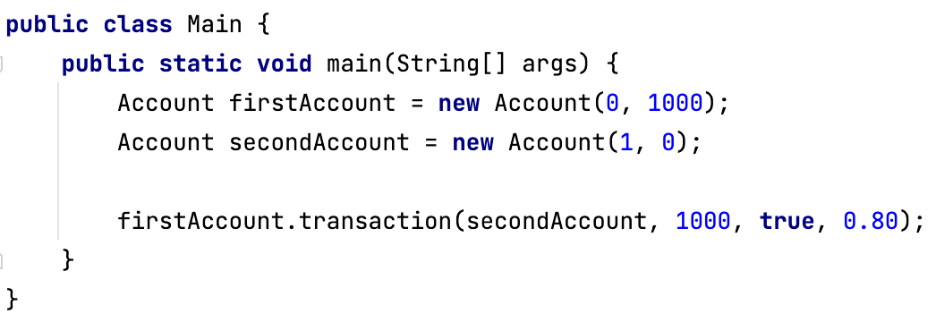
Importance of improved parameters
Example

Slide 6
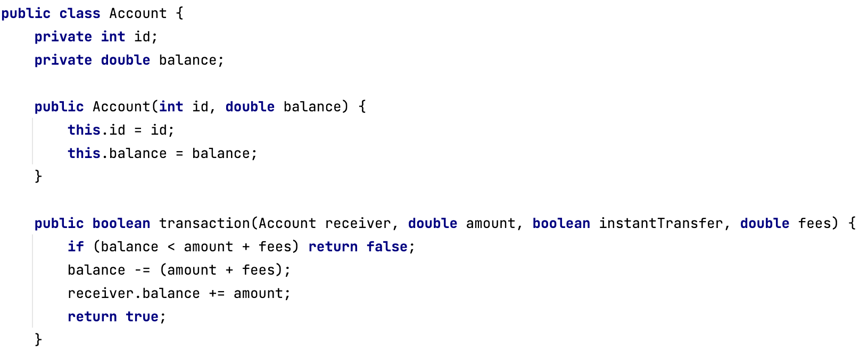
Importance of improved parameters
Example

Slide 7
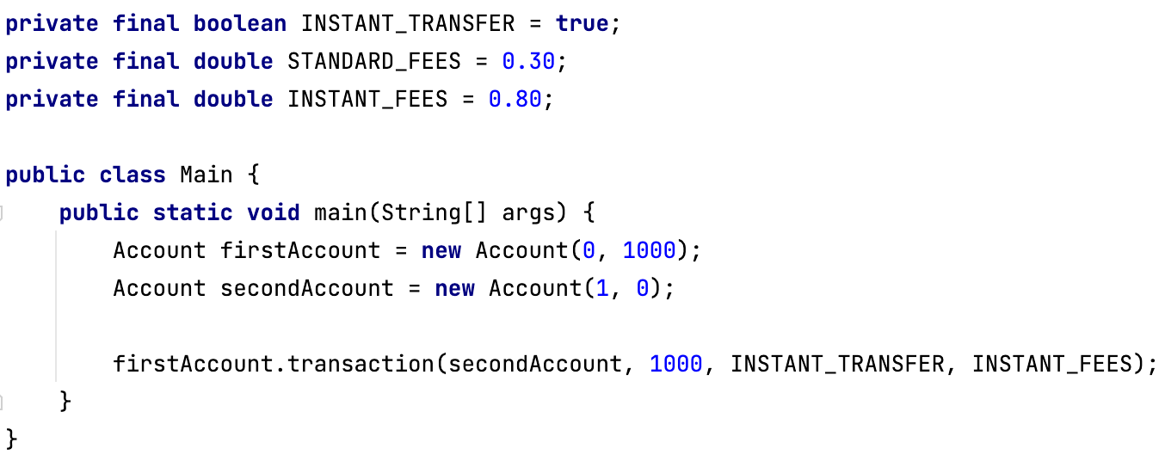
Importance of improved parameters
Example

Slide 8
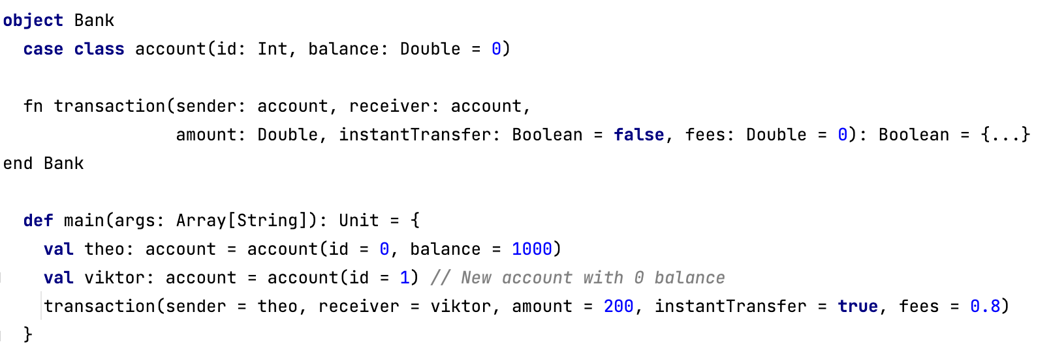
Importance of improved parameters
Example

Slide 9
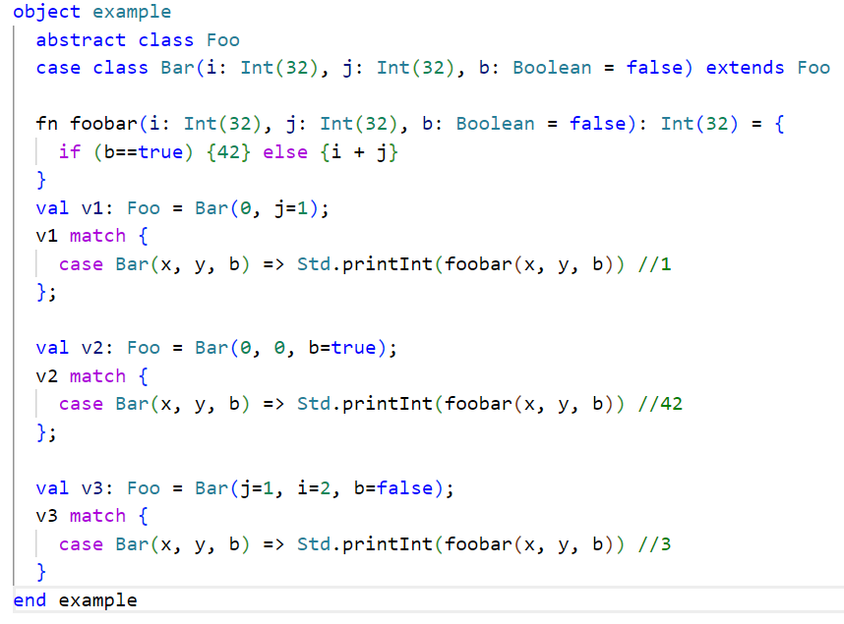
Importance of improved parameters
Example

Slide 10
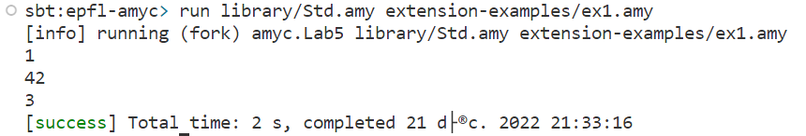
Importance of improved parameters
Example

Slide 11
Compiler phases

Slide 12
Parser

Slide 13

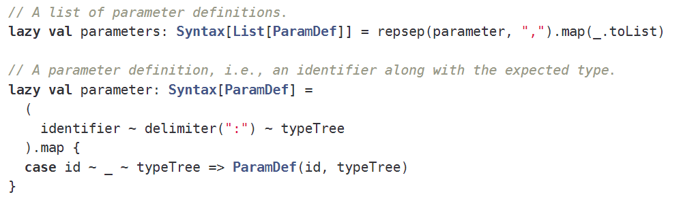
Parser
Initial implementation

Slide 14
Parser
Initial implementation

Slide 15
Parser
Initial implementation

Slide 16
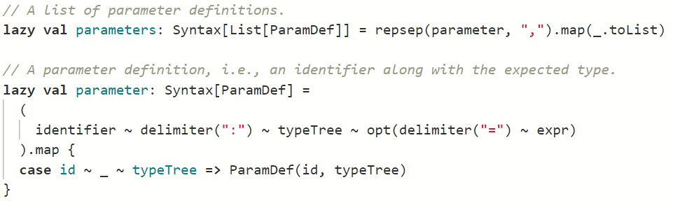
Parser
Initial implementation

Slide 17
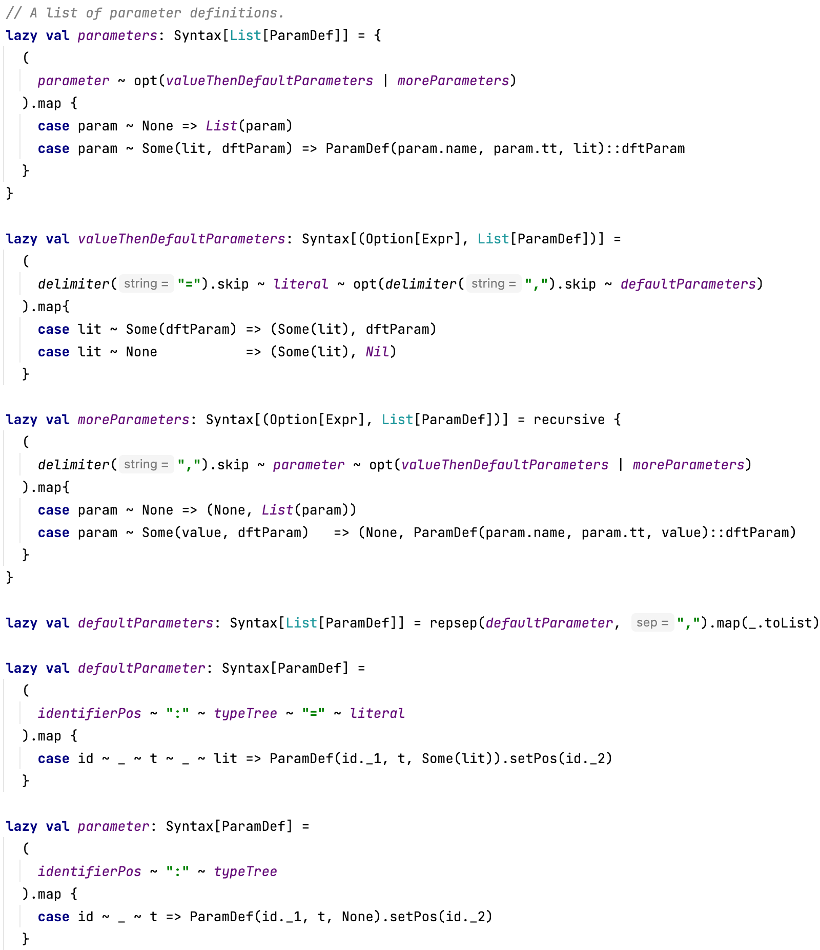
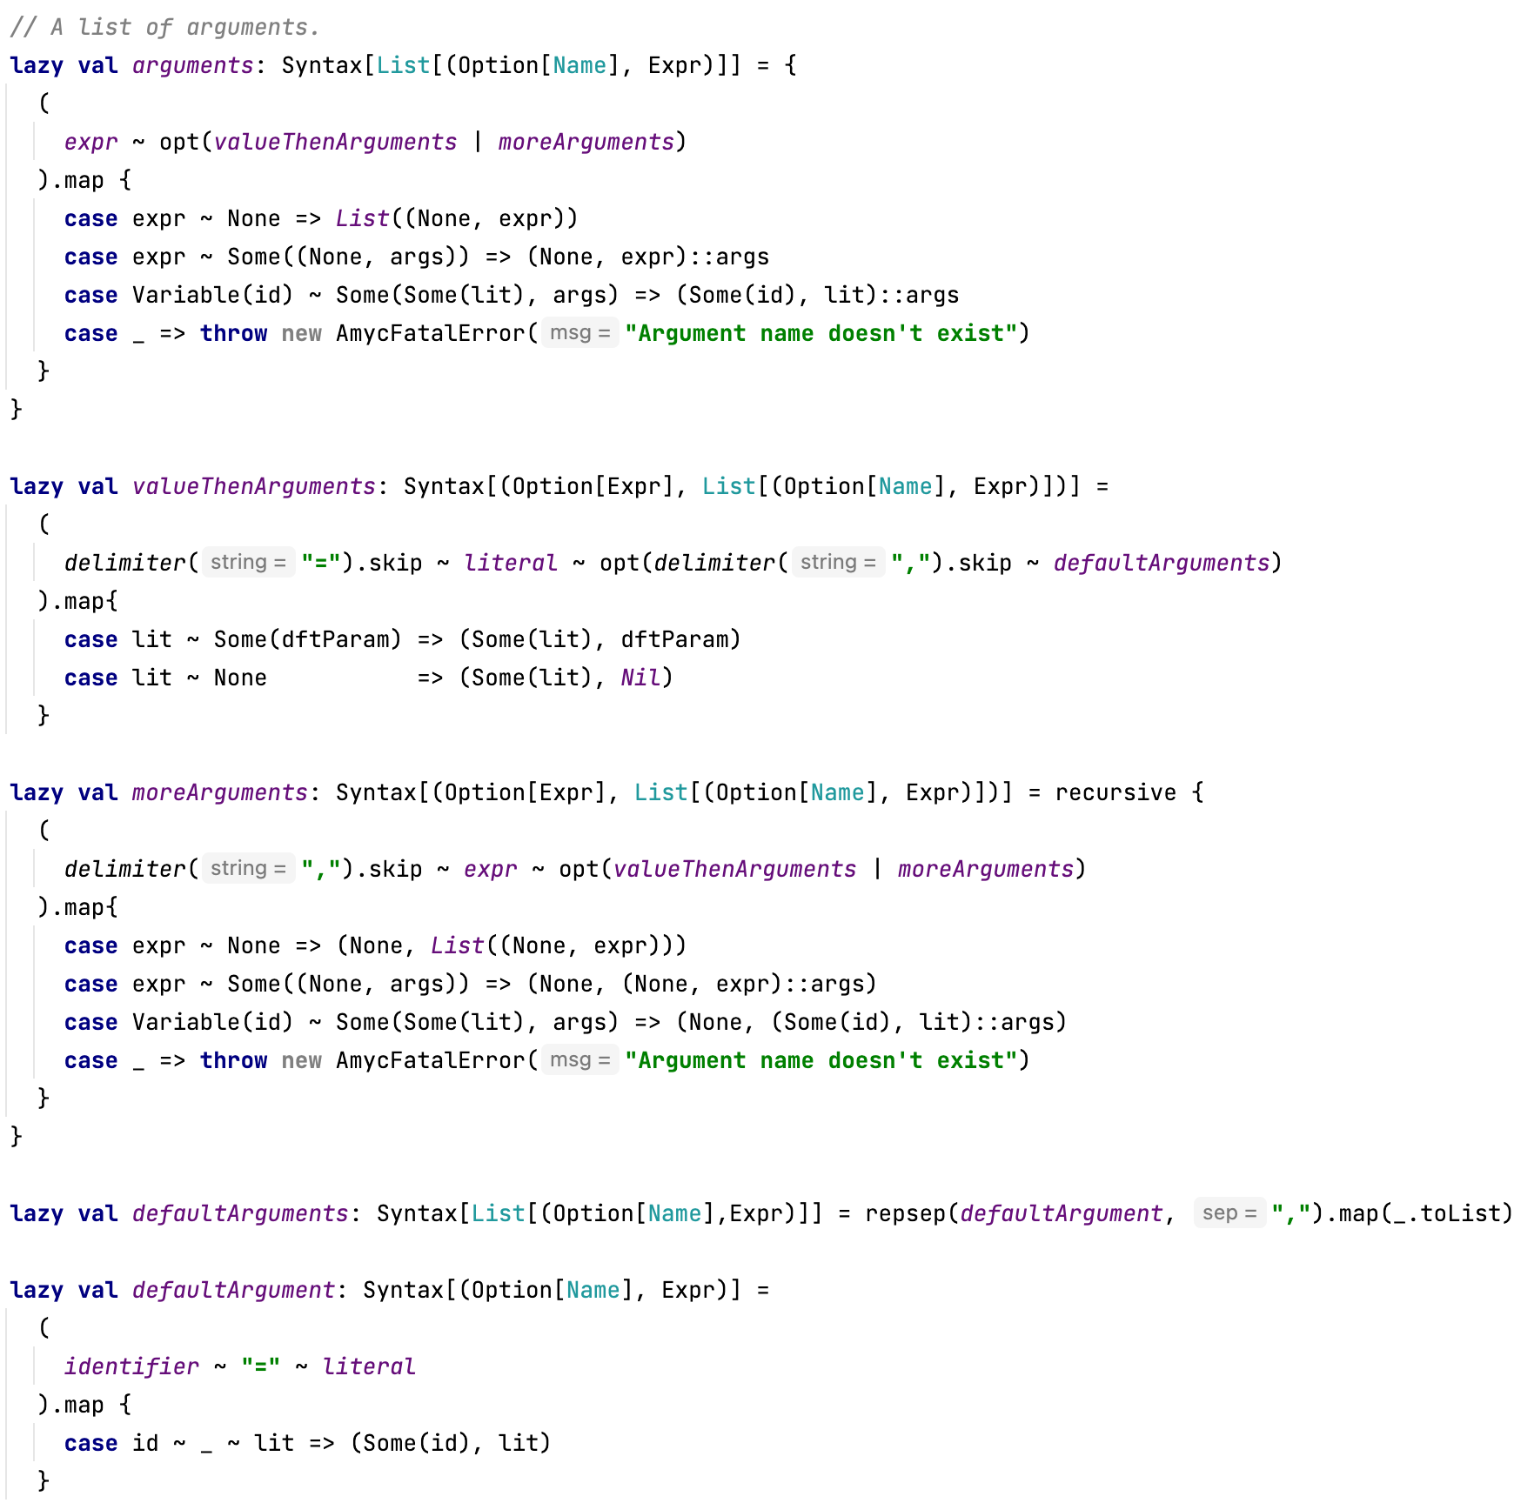
Parser
Accepting default and named parameters

Slide 18
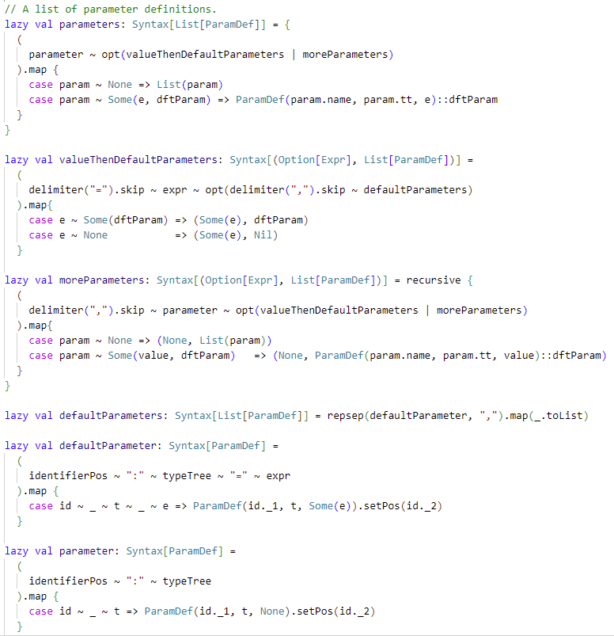
Parser
Accepting default and named parameters

Slide 19
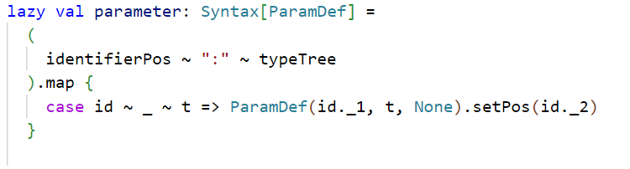
Parser
Accepting default and named parameters

Slide 20
Parser
Accepting default and named parameters

Slide 21
Parser
Accepting default and named parameters

Slide 22
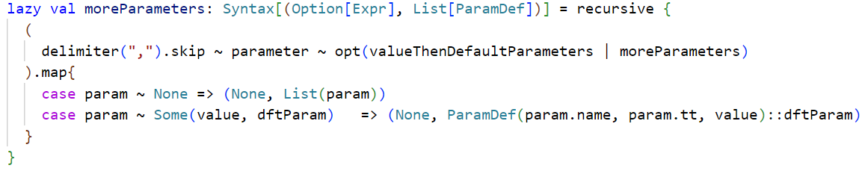
Parser
Accepting default and named parameters

Slide 23
Parser
Accepting default and named parameters

Slide 24
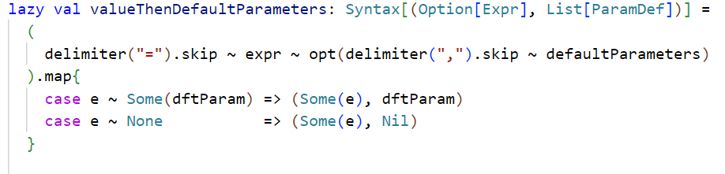
Parser
Accepting default and named parameters

Slide 25
Parser
Accepting default and named parameters

Slide 26
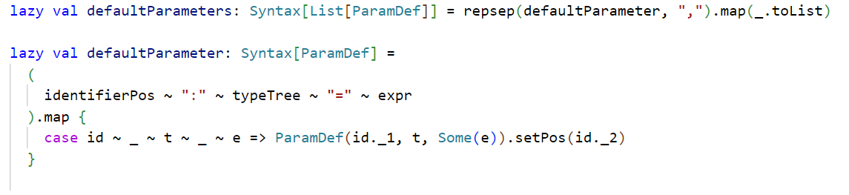
Parser
Accepting default and named parameters

Slide 27
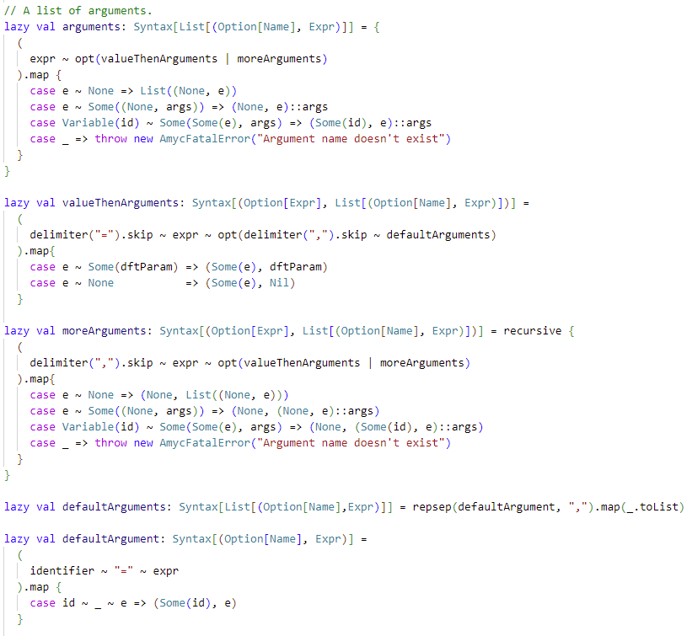
Parser
Accepting default and named parameters

Slide 28

Parser
Accepting default and named parameters
// Wrong, named argument have to be at the end

Slide 29
Parser
Accepting default and named parameters

Slide 30
Parser
Accepting default and named parameters

Slide 31

Parser
Accepting default and named parameters
?

Slide 32
Parser
Accepting default and named parameters

Slide 33
Tree Module

Slide 34



Tree Module
Storing default and named parameters

Slide 35
Tree Module
Storing default and named parameters

Slide 36
Name analyzer

Slide 37
Name analyzer
Taking into account default and named parameters
Idea : Take the nominal node of a call and use the new information stored to correctly apply the parameters to the symbolic call.
Procedure :
Store the nominal nodes during discovery process
Create a new list Args that will contain the arguments
for (parameter in classOrFunDefs) {
Put the argument or default parameter in the correct position in Args
}

Slide 38
Name analyzer
Taking into account default and named parameters

Slide 39
Name analyzer
Taking into account default and named parameters
Nominal Tree
to
Symbolic Tree
?
?
?

Slide 40
Name analyzer
Taking into account default and named parameters
Nominal Tree
to
Symbolic Tree
?
?
?

Slide 41
Name analyzer
Taking into account default and named parameters
Nominal Tree
to
Symbolic Tree
?
?

Slide 42
Name analyzer
Taking into account default and named parameters
Nominal Tree
to
Symbolic Tree
?

Slide 43
Name analyzer
Taking into account default and named parameters
Nominal Tree
to
Symbolic Tree

Slide 44
Contribution
Defined improved parameters: Named and default parameters
Argued the importance of improved parameters: Readability
Detailed the development process to implement the extension:
Parser
Tree Module
Name analyzer

Slide 45
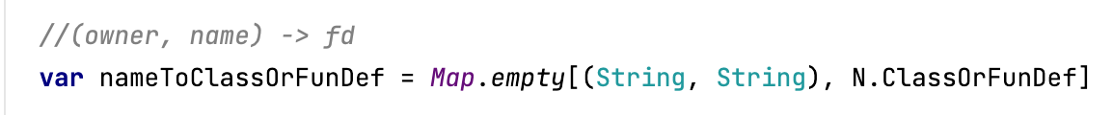
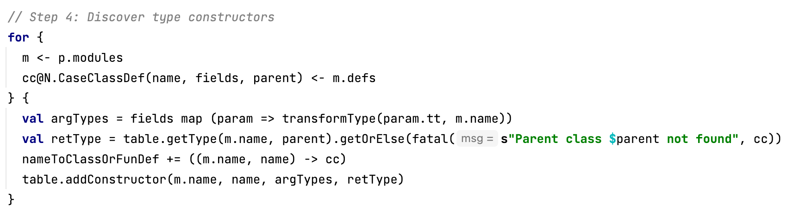
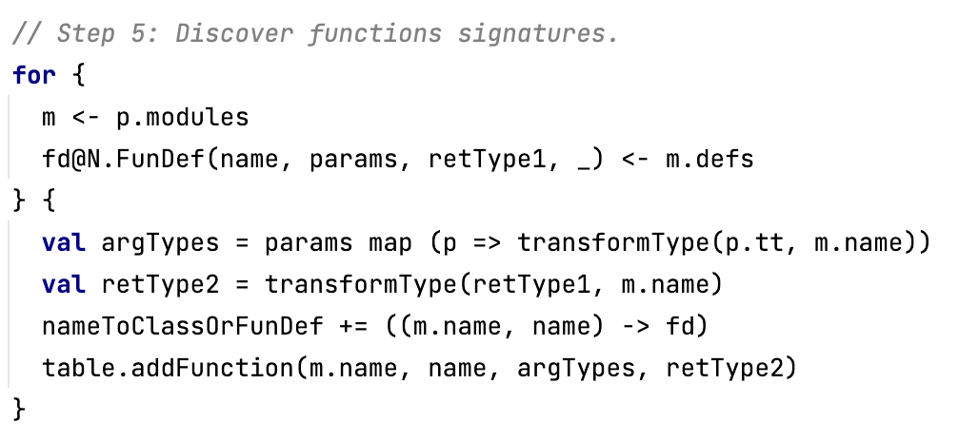
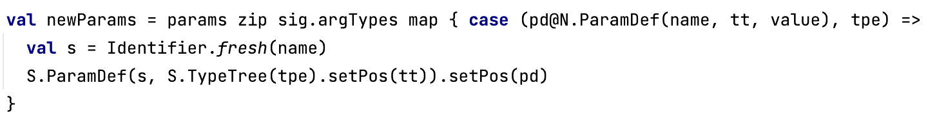
Name analyzer
Taking into account default and named parameters

Slide 46
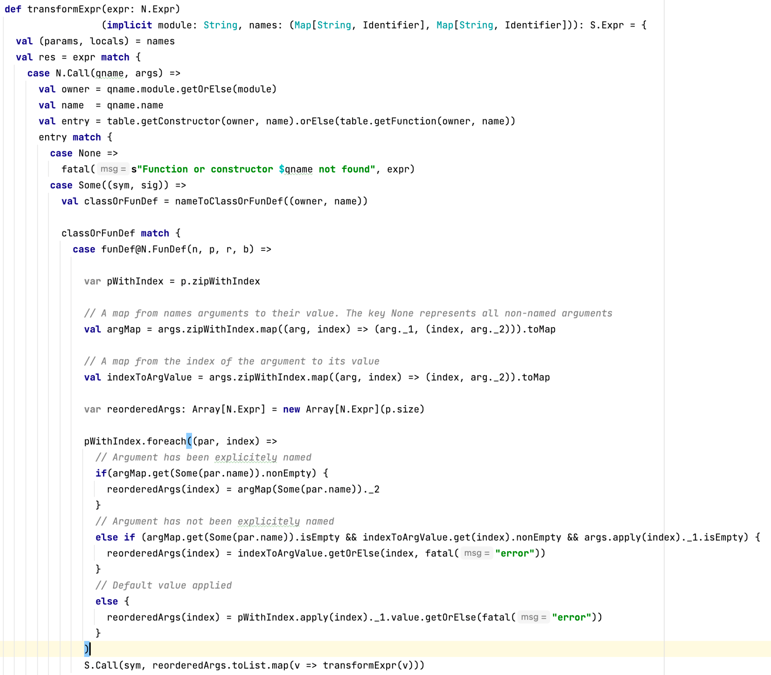
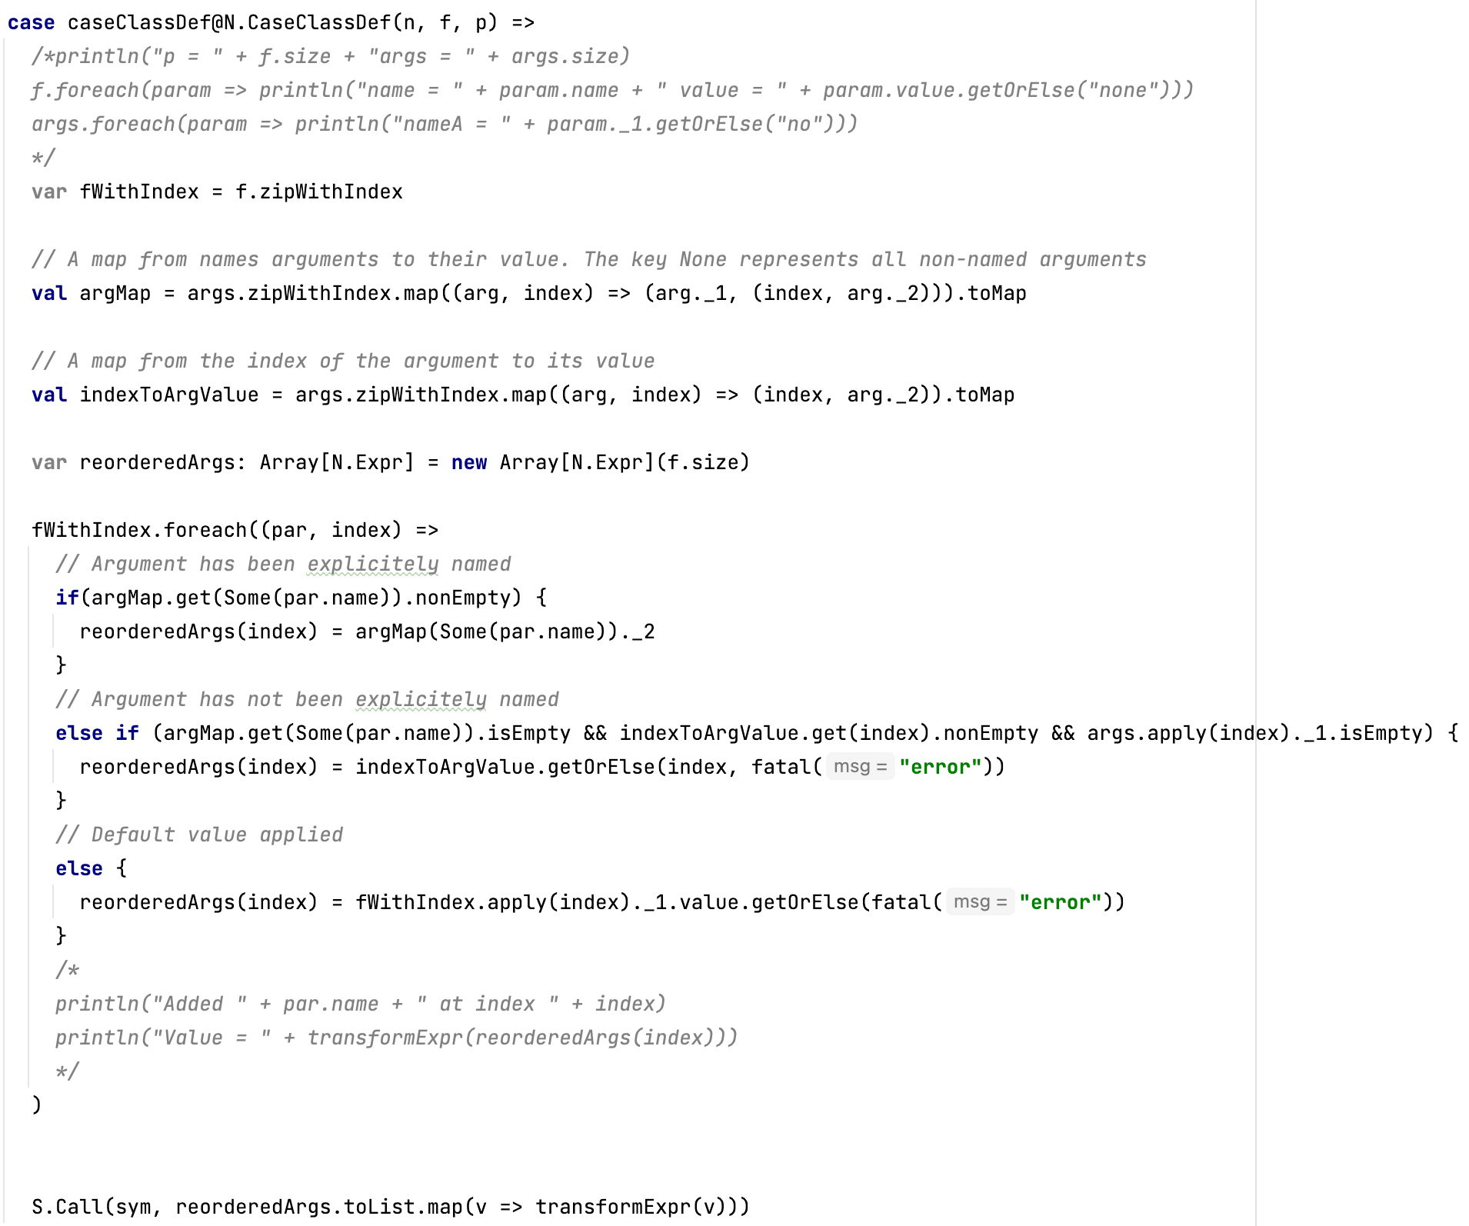
Name analyzer
Taking into account default and named parameters

