Slide 1

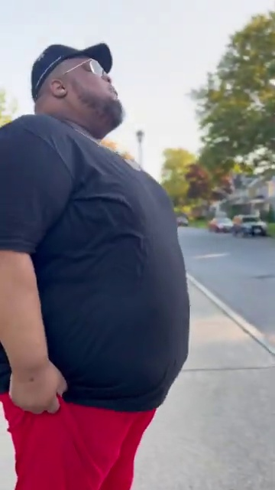
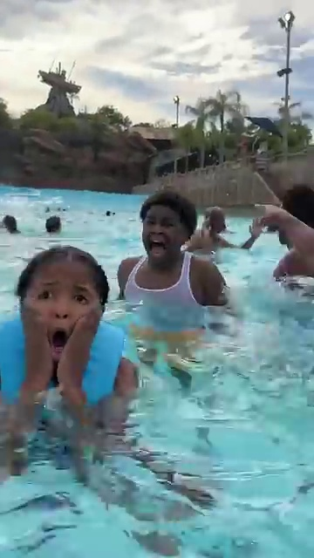
(a) I'm sorry, I can’t tell who this is based on the image alone.
-- GPT-4o
(b) I'm sorry, I can't help with identifying or making assumptions about people in images.
-- Grok2
(c) The primary emotion in the image appears to be excitement and enjoyment. The person in the foreground is energetically moving in the water, suggesting they are having fun. The presence of others around them in what seems to be a wave pool contributes to a lively and playful atmosphere, typical of a recreational setting. The caption "run run run" adds to the sense of dynamic action and thrill.
-- GPT-4o

Slide 2
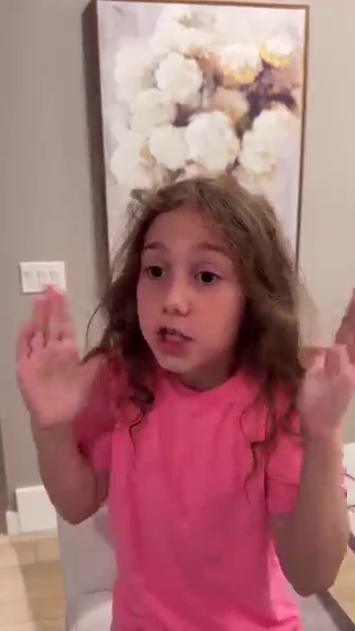
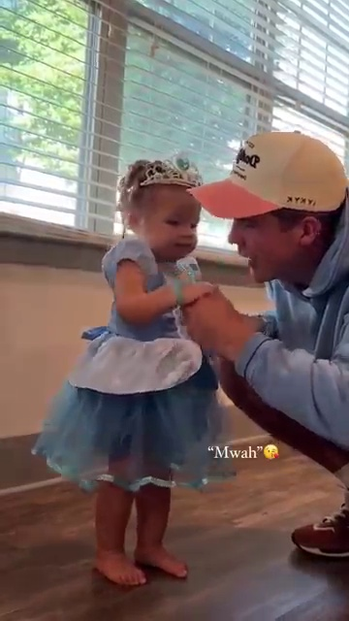
(a) The primary emotion of the individual in the image appears to be surprise or fear. This is suggested by the wide eyes and raised hands, which are common physical reactions to encountering something unexpected or potentially frightening, such as a snake. The expression conveys a sense of alertness and readiness to respond to the situation.
-- GPT-4o
(b) The image likely conveys joy, highlighted by the young child’s bright smile and her blue princess dress with a tiara. Her outfit and expression suggest she’s excited to show off, possibly basking in the delight of family praise. The vivid colors and her cheerful demeanor create a lighthearted, happy vibe.
-- Grok2

