Slide 2
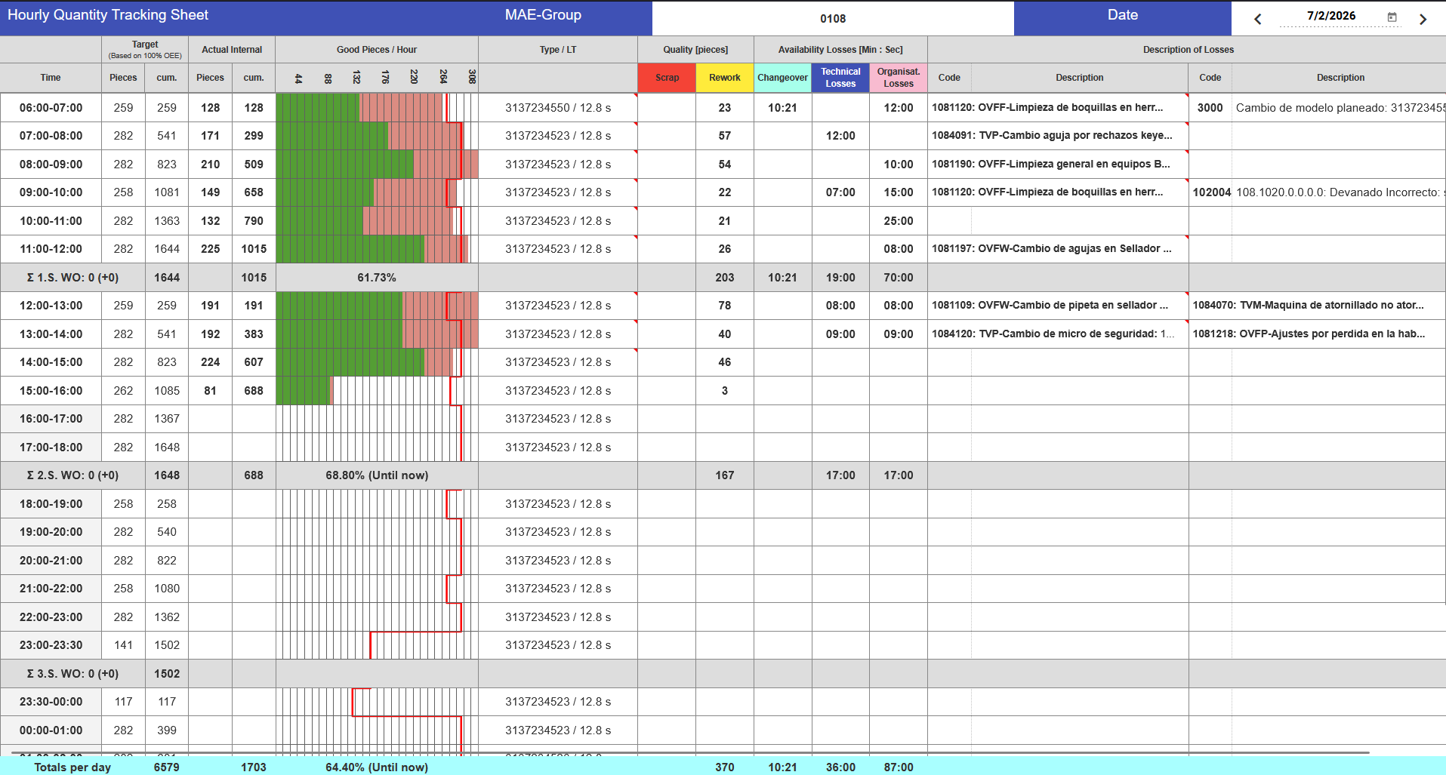
Current State
There is a critical deviation in meeting our production targets on the floor.
In specific cases, the difference between the actual parts produced and the target is up to half of the projected volume.
Conversely, there are times when production spikes so much that Relative Utilization exceeds 100%, which indicates a lack of accuracy in our metrics.

Slide 3
Root Cause
There is a critical deviation in meeting our production targets on the floor.
In specific cases, the difference between the actual parts produced and the target is up to half of the projected volume.

