Slide 1
Cycle Time Service
Jose Antonio Gonzalez Vazquez
TlP/MFD

Slide 2
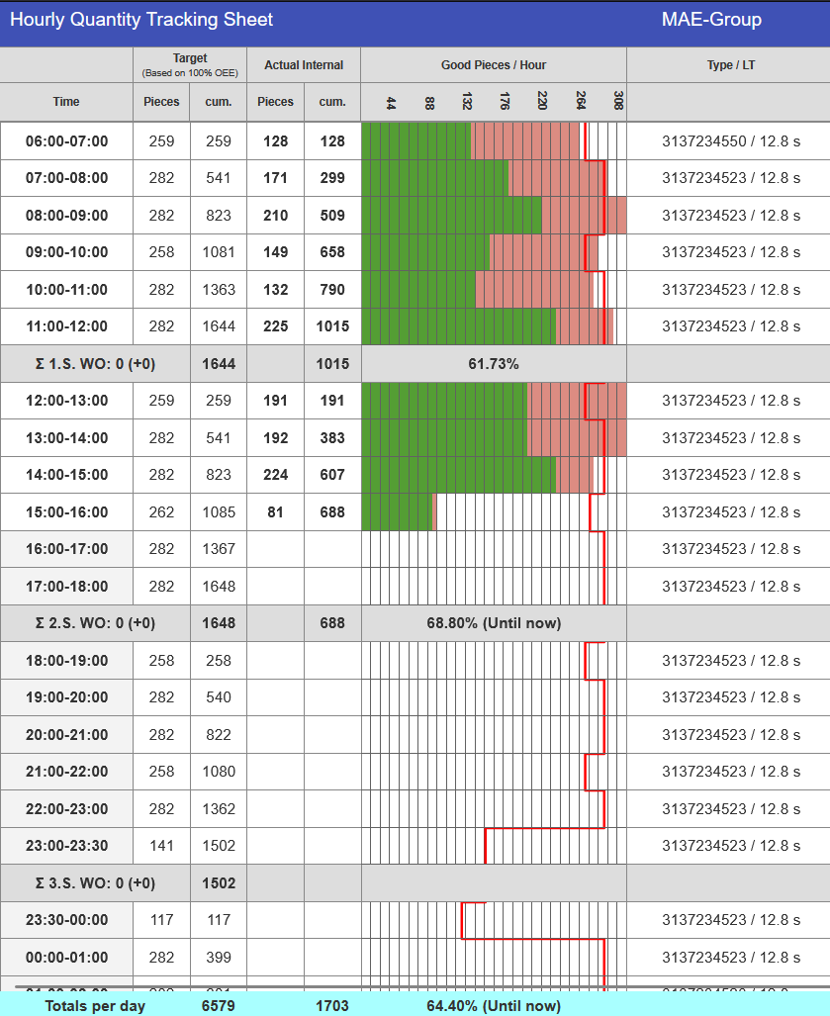
Background
No Real-Time Metrics
No centralized view of cycle time across production lines.
Current cycle time calculation has limited effectiveness.
Deviations from target are not inmediately visible.
Manual Reviews
Line-by-line analysis.
Delayed issue detection.
Slower decision-making.

Slide 3
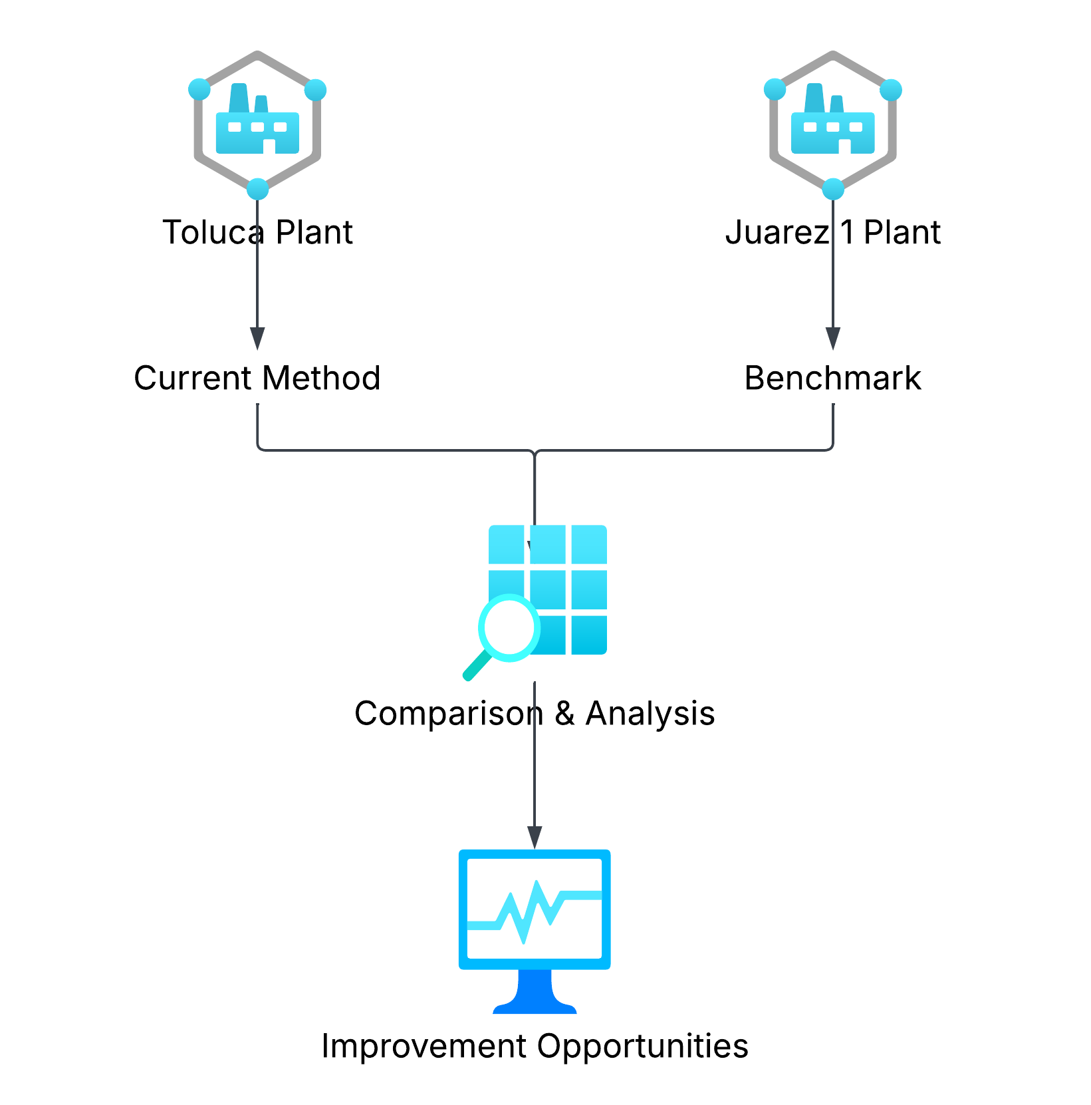
Benchmark
Root Cause
1
Benchmark performed with Juárez 1 to compare operational practices.
2
Differences were identified in the approach used to obtain cycle time.
3
The analysis showed that our current methodology had opportunities for improvement.

Slide 4
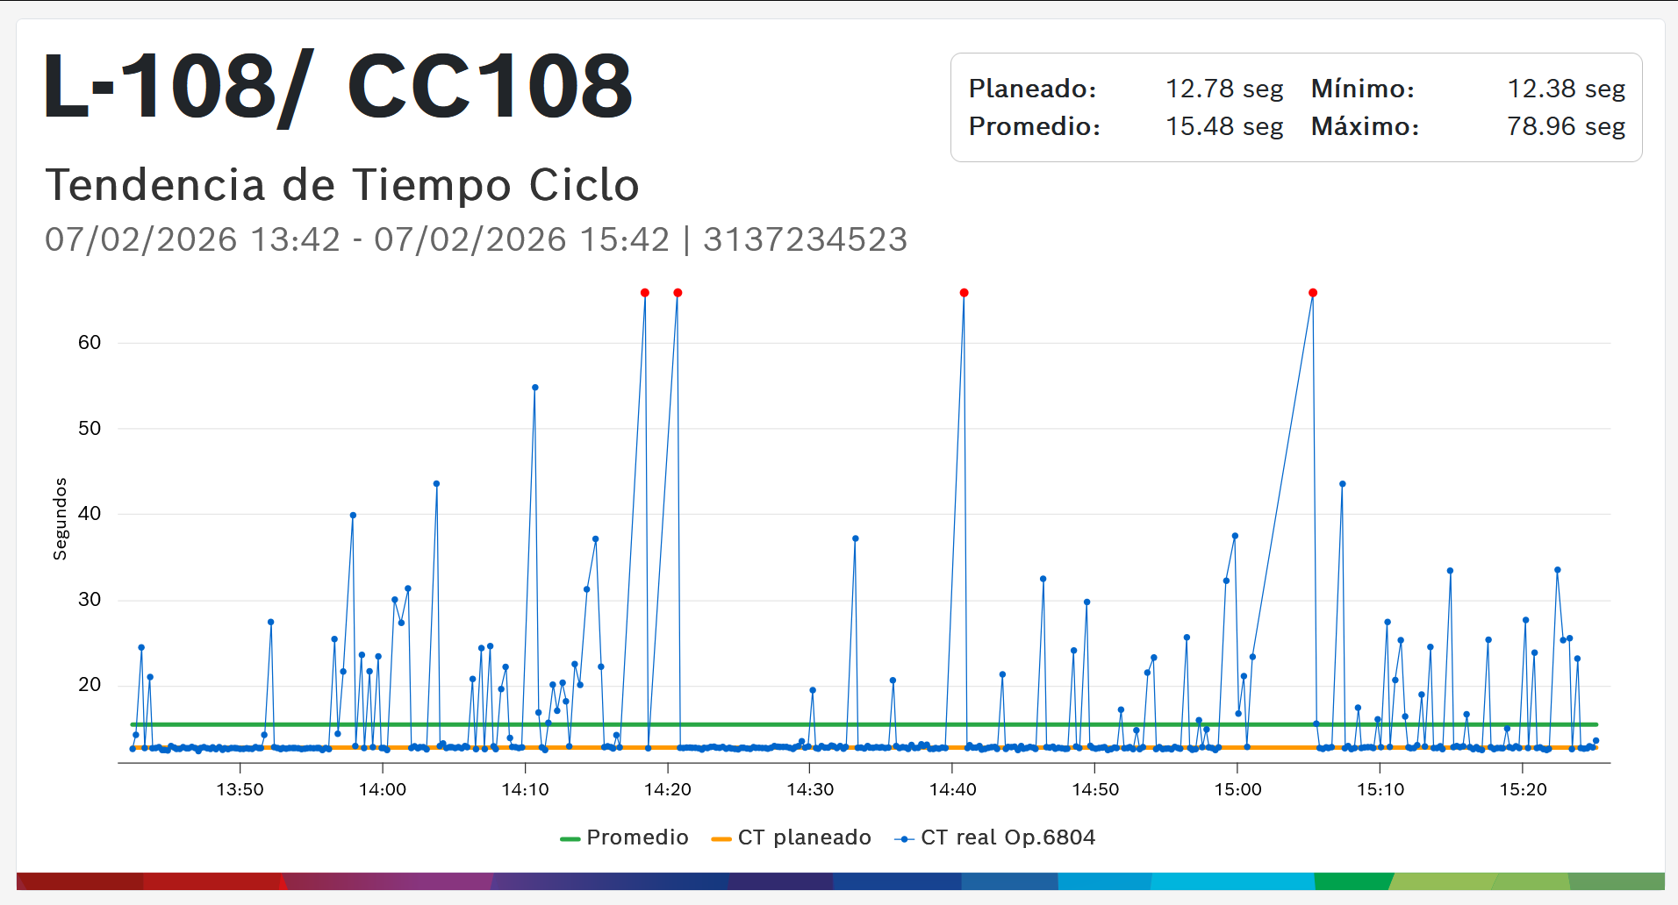
Current Cycle Time Calculation Limitation
Root Cause
1
The current calculation only considers the previous 2 hours of data.
2
Cycle time metrics are not available for day-to-day historical analysis.
3
The current calculation approach is not suitable for data inflation scenarios.
4
Historical cycle time data is not available.

Slide 5
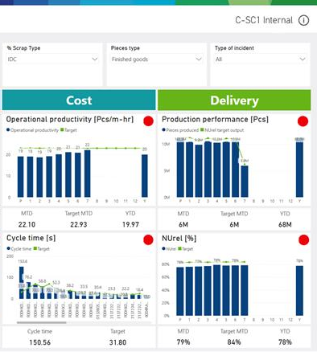
Target State
Real-Time Cycle Time Visibility
Provide complete and processed cycle time metrics to compare actual production cycle time vs. planned cycle time.
Enable clear visibility of lines with the largest gaps from cycle time targets.
Support faster identification of issues and data-driven decision-making.

Slide 6
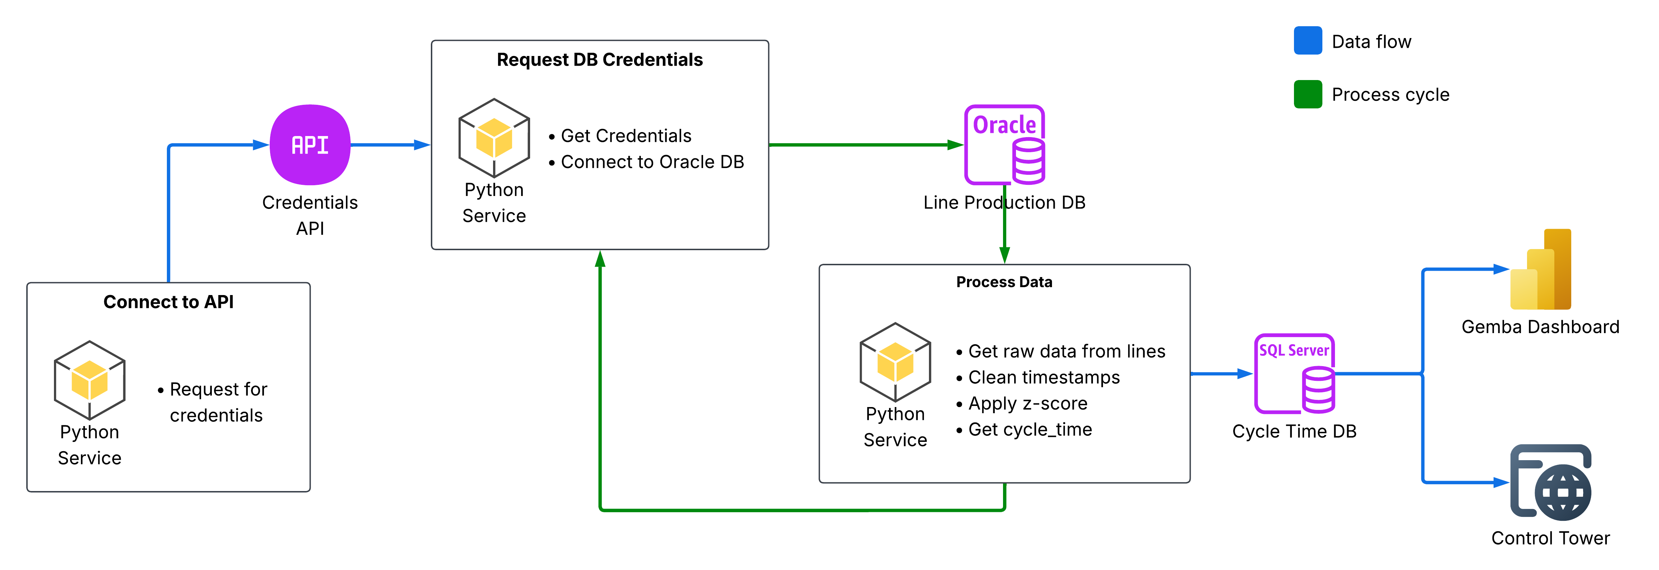
Cycle Time Service
Proposed Solution

Slide 7
Cycle Time Service - Data Cleaning
Root Cause
1
Current Situation
Non-production events distort cycle time calculations.
2
Service Action
Removes invalid time records and filters production-relevant data.
3
Result
Accurate cycle time measurement for actual vs. planned comparison.

Slide 8
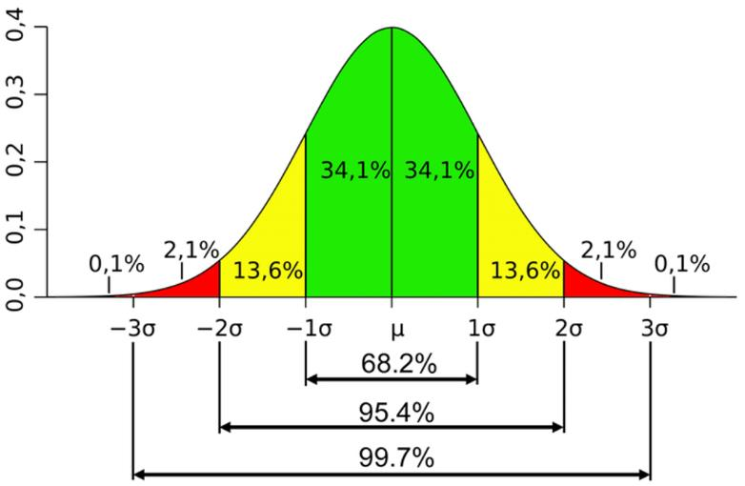
Cycle Time Service - Data Processing
Root Cause
1
Methodology
Applies statistical analysis to identify the normal cycle time behavior.
Uses Z-score analysis to group and filter cycle time data.
Selects the representative data range using a 3-sigma approach.
2
Result
Calculates a more accurate cycle time based on actual production behavior.

Slide 9

Gemba Dashboard
Results & Next Steps

Slide 10
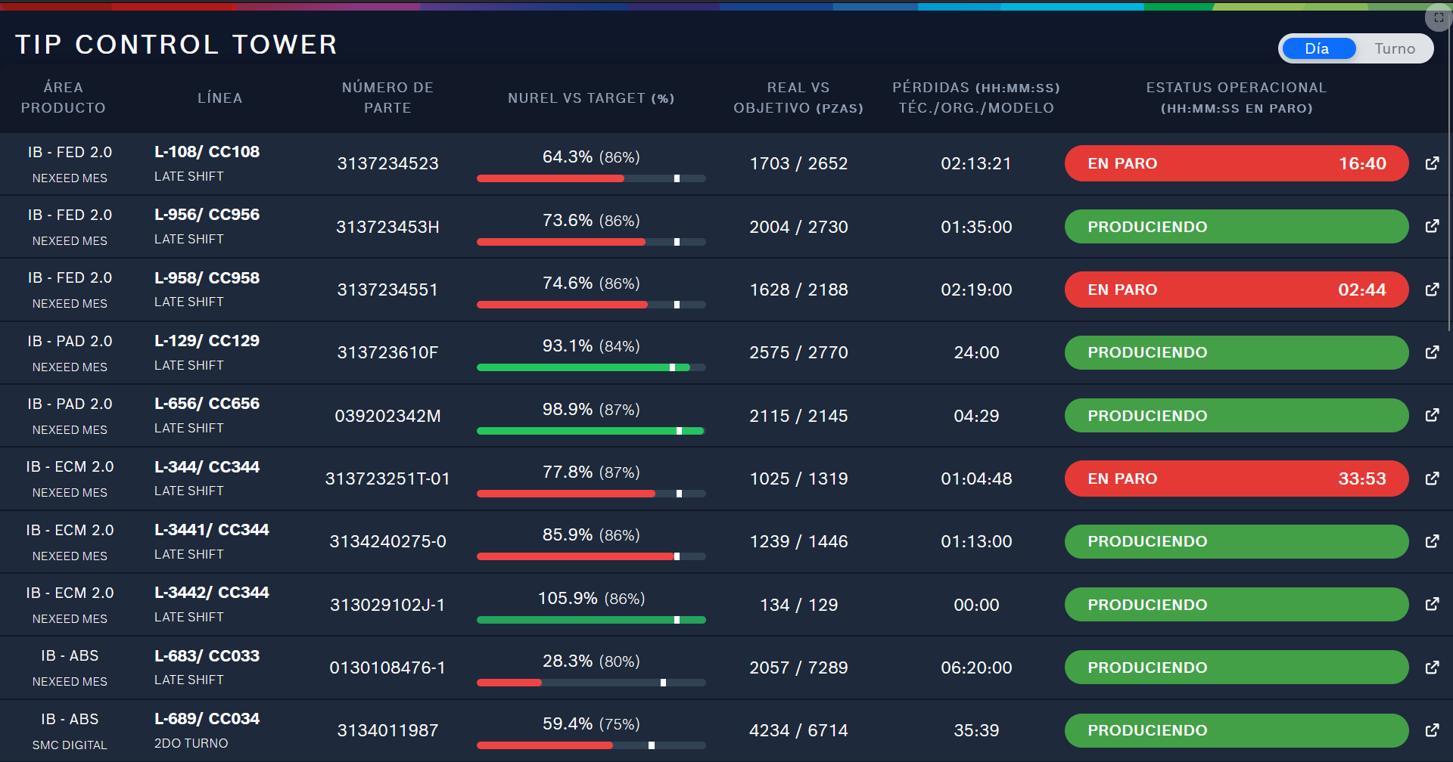
Control Tower
Results & Next Steps

Slide 11
Next Steps
Roadmap
Planning
Defines project scope, requirements, objectives, and execution plan.
Testing
Validates functionality and identifies defects before deployment.
Documentation
Records key technical and functional information for future reference.
 | APR | MAY | JUN | JUL | AUG | Next Steps
SMC Implementation
Implement this solution with SMC system.
Coding
Builds the solution based on defined requirements and design.
Deployment
Releases the validated solution to the production environment.

