Slide 1
Capstone Project Analyzing Sales Regions Using Python
Antonio Kasaiah Colorado & South Carolina Sales Analysis May 2026
Notes:
---

Slide 2

Introduction
Project Background
The project analyzes sales for EmporiUM, a multi-category bookstore chain across several states.
Territory Assignment
I was assigned the West and South regions, specifically the state of Colorado and South Carolina.
Analysis Objectives
The analysis aims to answer sales questions on revenue, trends, comparisons, and recommendations using Jupyter notebook.

Slide 3

Sales Analysis Questions
Who are the territory managers for the sales territories assigned? What are the store IDs and cities for the stores in each assigned sales territory?
What is monthly total revenue for in-store sales in each of the two sales territories, over the full period covered by the data?
How would you rank the sales performance of each store in each sales territory? Which are the top-performing stores?
Comparing the customer ID from the customer list data with the rewards ID from the sales data, who were the top customers in each sales territory?
What is the number of transactions per month by product category in each assigned territory? What is total sales revenue per month by category? What might this tell you about the most popular products, and where could there be opportunity for growth?
What is your recommendation for where to focus marketing attention in the next quarter?
Notes:
For this project, I used the business questions on the screen to analyze sales performance, customer activity, store rankings, and product trends for the Colorado and South Carolina sales territories. I used Python and libraries such as Pandas, NumPy, and Matplotlib in Jupyter Notebook to organize, clean, and analyze the data. For this presentation, I will answer each business question to produce meaningful insights that can support future business decisions.

Slide 4
Creating Classes & Loading Data
Code Example
Imported core Python libraries
Built a class for data organization
Loaded datasets using pandas (pd.read_csv)
Created methods to preview data and display info
Instantiated class and executed methods
import numpy as np import pandas as pd import matplotlib.pyplot as plt
class EmpAnalysis:
def __init__(self): self.sales = pd.read_csv('StoreSales.csv')
def preview_data(self): print("\nCustomers List ") print(self.customer_list.head())
data_info = EmpAnalysis()
data_info.preview_data()
data_info.tableinfo()
Notes:
This section of the capstone project demonstrates how I used Jupyter Notebook to import three important Python libraries: NumPy for numerical operations, Pandas for data analysis and working with dataframes, and Matplotlib for creating charts and visualizations.
To keep the project organized, I created a Python class called EmpAnalysis. Using a class allows all datasets, methods, and analysis tools to be stored inside one structured project object rather than scattered throughout the notebook. The __init__ constructor method automatically loads all CSV files when an object is created, while additional methods such as preview_data() and tableinfo() allow me to quickly review and inspect the datasets throughout the project.

Slide 5
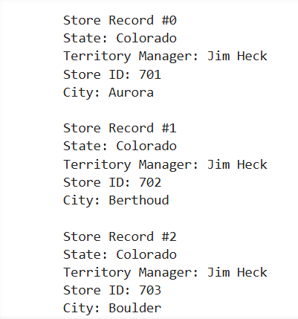
Territory Analysis
The analysis identified all stores located within the assigned sales territories of Colorado and South Carolina. Colorado stores are managed by Jim Heck, while South Carolina stores are managed by Len Jensen.
The filtered data frame displayed the territory manager, store ID, and city location for each assigned store. A total of 18 stores were identified in Colorado, and 2 stores were identified in South Carolina.
Code Example
# Filter Territories
self.filtered_territory_data = self.storedetails[
(self.storedetails["State"] == "Colorado") |
(self.storedetails["State"] == "South Carolina") ]
# Filter Columns
self.filtered_territory_columns = self.filtered_territory_data[
["Store Location","State","Store ID","Territory Manager"]]
# Printing Results
for index, x in self.filtered_territory_columns.iterrows():
print(
f"\nState: {x['State']}"
f"\nTerritory Manager: {x['Territory Manager']}"
f"\nStore ID: {x['Store ID']}"
f"\nCity: {x['Store Location']}")
Notes:
How I got my results. First, I filtered the Store Details dataset to include only my assigned territories, Colorado and South Carolina. I then selected the State, Territory Manager, Store ID, and Store Location columns and used a for loop to display the territory manager, store ID, and city for each store in the assigned territories.

Slide 6
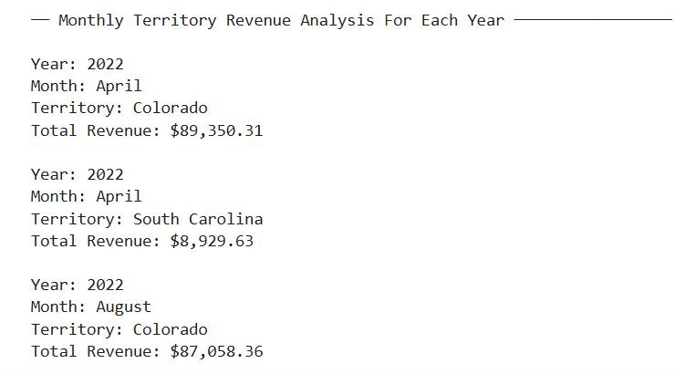
Monthly Territory Analysis By Year
The revenue analysis shows that Colorado consistently generated significantly higher sales revenue than South Carolina from 2022–2025, making it the company’s strongest-performing territory.
Both territories experienced steady year-over-year growth, with the highest sales occurring during 2025, indicating expanding business performance and increasing customer demand.
Code Example
# Merging dataframes(tables) using an attribute
self.table_merge = pd.merge(self.storedetails, self.storesales,on = "Store ID")
# Convert Transaction Date column to datetime
self.table_merge["Transaction Date"] = pd.to_datetime( self.table_merge["Transaction Date"])
# Create Month and Year column from Transaction Date
self.table_merge["Month"] = self.table_merge[ "Transaction Date"].dt.month_name() self.table_merge["Year"] = self.table_merge[ "Transaction Date"].dt.year
# Grouping By Month,State,and Year
self.grouped_merge = self.filter_merge.groupby( ["Year","Month","State"])["Sale Amount"].sum()
Notes:
How I got my results. I merged the Store Details and Store Sales dataframes using the Store ID column so that sales transactions could be connected to their corresponding sales territories. I then converted the transaction dates into month and year values, filtered the data to include only Colorado and South Carolina, and grouped the sales data by year, month, and territory. Finally, I calculated the total revenue for each month using the Sale Amount field, allowing me to compare monthly revenue for both territories between 2022 and 2025.

Slide 7
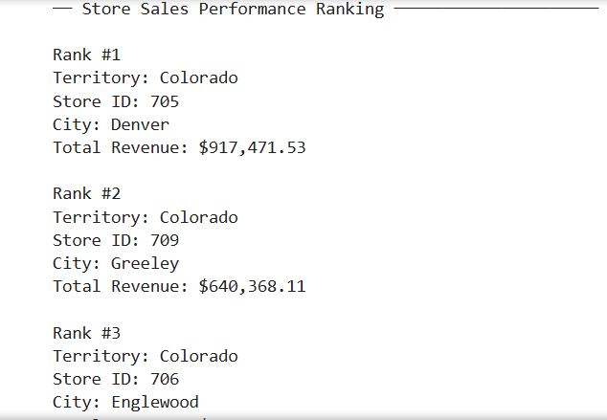
Store Ranking Analysis
Colorado was the strongest overall sales territory, accounting for 18 of the top 20 ranked stores in total revenue performance. Store 705 in Denver was the highest-performing location, generating more than $917,000 in total revenue during the reporting period.
The lowest-performing store in the rankings was Store 715 in Parker, Colorado, with approximately $279,000 in total revenue.
Code Example
# Group by Store, Location, and State
self.grouped_merge = self.filter_merge.groupby( ["State", "Store ID", "Store Location"] )["Sale Amount"].sum()
# Sort from greatest to least
self.sorted_merge = self.grouped_merge.sort_values( ascending=False)
# Rank stores
for rank, ((state, store_id, city), revenue) in enumerate(self.sorted_merge.items(),start=1):
print(
f"\nRank #{rank}" f"\nTerritory: {state}" f"\nStore ID: {store_id}" f"\nCity: {city}"
f"\nTotal
Revenue: ${revenue:,.2f}")
Notes:
How I got my results, I merged the Store Details and Store Sales datasets using the Store ID field so that each sales transaction could be connected to its corresponding store and sales territory. I then filtered the data to include only my assigned territories, Colorado and South Carolina, and grouped the sales records by state, store ID, and store location. Using the Sale Amount field, I calculated the total revenue generated by each store and sorted the results from highest to lowest revenue to create a performance ranking. Finally, I used a for loop to iterate through each ranked store and enumerate() to automatically assign a ranking number starting at one, allowing me to display the stores in order of performance.

Slide 8
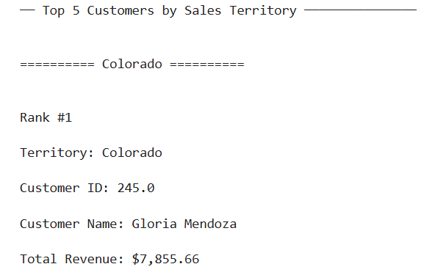
Top Customer Per Territory Analysis
Colorado was the strongest performing territory overall, with Gloria Mendoza generating the highest customer revenue at approximately $7,855.66, while Adrian Veidt was the lowest-ranked top-five customer in the territory with about $4,365.77 in sales.
In South Carolina, Jin Kwon was the highest-performing customer with approximately $1,786.05 in revenue, while Cal Abar ranked lowest among the top five customers with about $1,396.50 in sales. Overall, Colorado significantly outperformed South Carolina in total customer revenue, indicating a stronger concentration of high-value customers within the territory.
Code Example
# Merge customer list with sales data
self.customer_sales_merge = pd.merge( self.storesales,self.customer_list, left_on="RewardsID",right_on="cust_id", how="inner")
# Merge with store details
self.customer_territory_merge = pd.merge( self.customer_sales_merge,self.storedetails, on="Store ID",how="inner")
# Sort highest revenue customers
self.sorted_top_customers = self.top_customers.sort_values( ascending=False)
Notes:
How I got my results, I merged the Store Details and Store Sales datasets using the Store ID field so that each sales transaction could be connected to its corresponding store and sales territory. I then filtered the data to include only my assigned territories, Colorado and South Carolina, and grouped the sales records by state, store ID, and store location. Using the Sale Amount field, I calculated the total revenue generated by each store and sorted the results from highest to lowest revenue to create a performance ranking. Finally, I used a for loop to iterate through each ranked store and enumerate() to automatically assign a ranking number starting at one, allowing me to display the stores in order of performance.

Slide 9
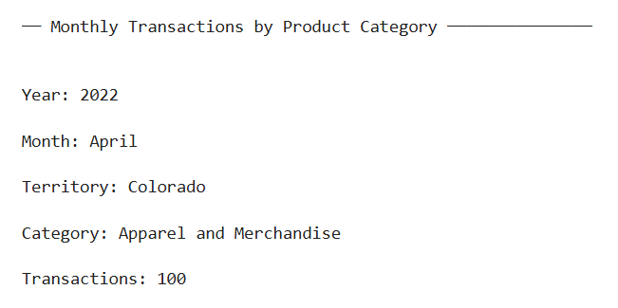
Monthly Product Category Performance Analysis
The monthly category analysis helps identify which product categories generate the highest transaction volume and sales revenue within the Colorado and South Carolina territories. Categories with consistently high transaction counts and strong monthly revenue likely represent the company’s most popular products and strongest-performing merchandise segments.
Colorado is expected to generate significantly higher transaction volume and revenue because it consistently outperformed South Carolina in previous territory sales analyses. Product categories with lower transaction counts or weaker sales revenue may present opportunities for growth through additional marketing campaigns, inventory expansion, product promotions, or improved store placement strategies.
Seasonal sales trends may also reveal months where certain product categories become more popular, helping management make better decisions related to forecasting, inventory management, and future business planning.
Code Example
# Create Month and Year columns
self.storesales["Month"] = ( self.storesales["Transaction Date"].dt.month_name()) self.storesales["Year"] = ( self.storesales["Transaction Date"].dt.year)
# Group transaction counts
self.transaction_summary = self.filtered_territories.groupby(["Year", "Month", "State", "Category"] )["Prod Num"].count()
# Add Method to Class
EmpAnalysis.monthly_category_analysis = monthly_category_analysis
# Run Method
data_info.monthly_category_analysis()
Notes:
How I got my results, I first converted the transaction dates into month and year values so the sales data could be analyzed over time. I then used a series of pd.merge() methods to combine the sales, product, product category, and store datasets, allowing each transaction to be connected to its product category and sales territory. After filtering the data to include only Colorado and South Carolina, I used the groupby() method to calculate both the number of transactions and total sales revenue for each product category by month and territory. The count() method was used to measure transaction activity, while the sum() method was used to calculate revenue totals. Finally, I used for loops to display the results, making it possible to identify the most popular product categories, compare revenue performance, and uncover potential opportunities for future business growth.

Slide 10

Business Recommendation
Based on the analysis, I recommend focusing marketing efforts on the Colorado territory because it consistently generated the highest sales revenue and contained most of the top performing stores.
Marketing campaigns should emphasize high demand categories such as Technology & Accessories, Stationery and Supplies, and Textbooks while also using targeted promotions to increase sales in lower performing categories.
Notes:
How I got my results, I first converted the transaction dates into month and year values so the sales data could be analyzed over time. I then used a series of pd.merge() methods to combine the sales, product, product category, and store datasets, allowing each transaction to be connected to its product category and sales territory. After filtering the data to include only Colorado and South Carolina, I used the groupby() method to calculate both the number of transactions and total sales revenue for each product category by month and territory. The count() method was used to measure transaction activity, while the sum() method was used to calculate revenue totals. Finally, I used for loops to display the results, making it possible to identify the most popular product categories, compare revenue performance, and uncover potential opportunities for future business growth.

Slide 11
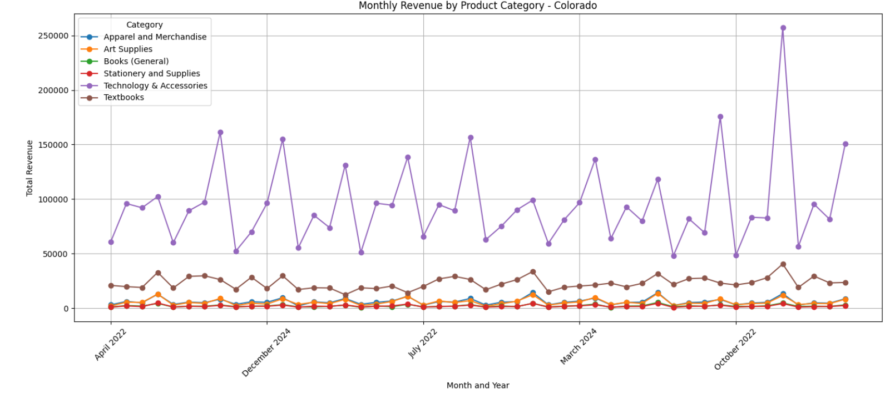
Monthly Revenue by Product Category – Colorado
Notes:
This chart depicts the monthly sales revenue generated by each product category in the Colorado sales territory throughout the reporting period. I chose a line chart because it is effective for showing changes and trends over time, making it easier to compare how each product category performed from month to month. To improve readability, I customized the chart by adding markers to highlight each monthly data point, a legend to identify the product categories, descriptive titles and axis labels, rotated the x-axis labels by 45 degrees, and included grid lines to make revenue comparisons easier. The chart shows that Technology & Accessories consistently generated the highest revenue and experienced the largest spikes throughout the reporting period, while categories such as Textbooks, Stationery and Supplies, and Art Supplies generated lower but more stable revenue levels, helping identify both top-performing categories and potential opportunities for future marketing efforts.

Slide 12
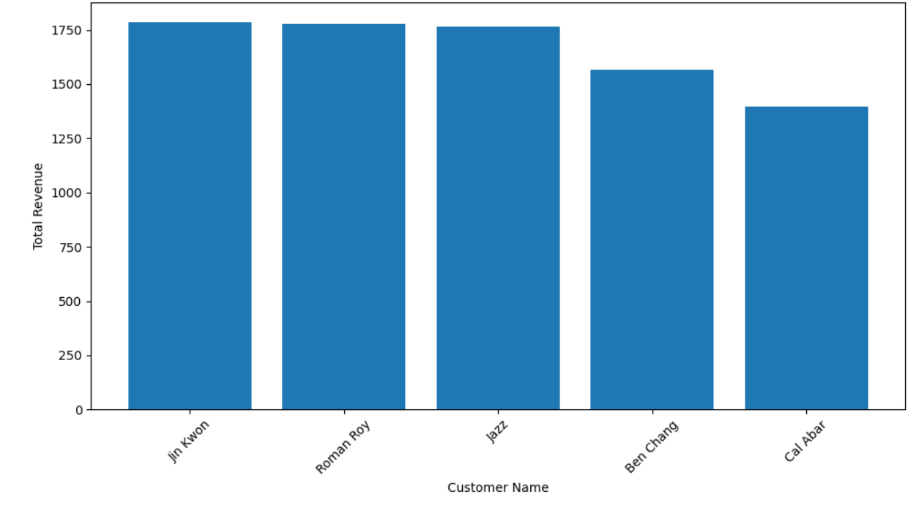
Top 5 Customers by Revenue- South Carolina
Notes:
This chart depicts the top five customers in the Colorado sales territory based on total revenue generated during the reporting period. I chose a bar chart because it clearly compares customer revenue and makes it easy to identify the highest-performing customers. To create the chart, I used the State, name, and Sale Amount attributes from the top_customers_df dataframe, filtered the data by territory, and selected the top five customers using head(5). I used a for loop to create a separate chart for each territory and customized the chart by adding a title, axis labels, rotating the customer names by 45 degrees, and using tight_layout() to improve readability. The chart shows that Jin Kwon generated the highest revenue in Colorado, making them the top customer in the territory.

Slide 13
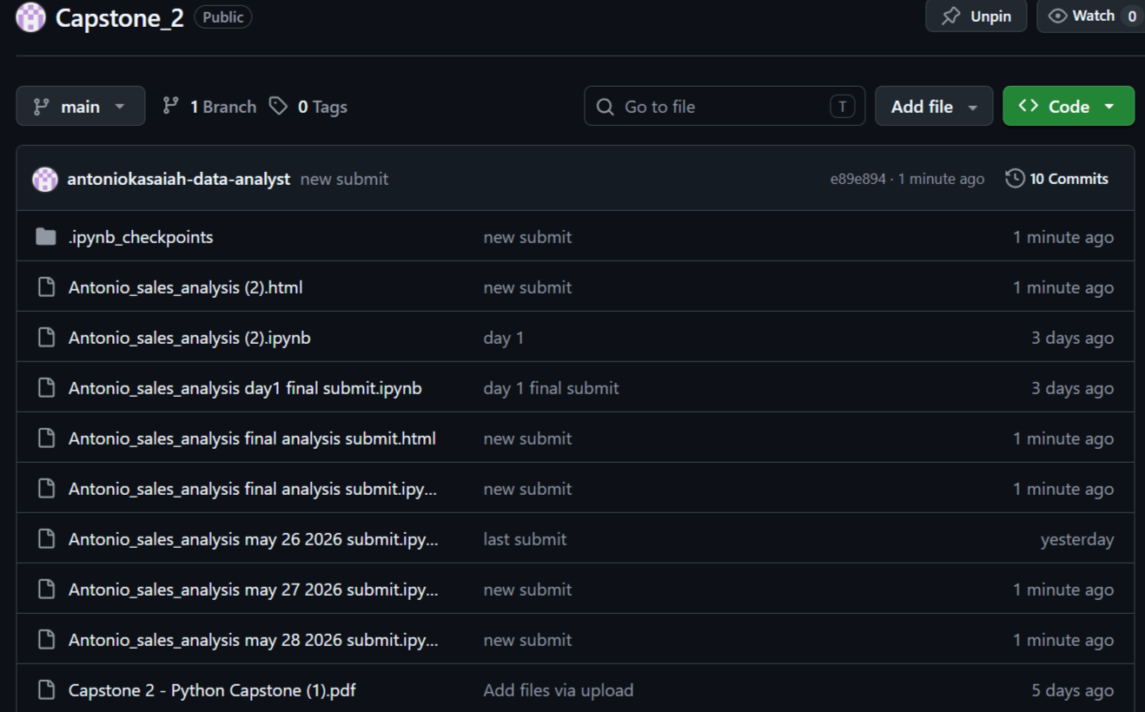
GitHub Repository: https://github.com/antoniokasaiah-data-analyst/Capstone_2.git
Notes:
This chart depicts the top five customers in the Colorado sales territory based on total revenue generated during the reporting period. I chose a bar chart because it clearly compares customer revenue and makes it easy to identify the highest-performing customers. To create the chart, I used the State, name, and Sale Amount attributes from the top_customers_df dataframe, filtered the data by territory, and selected the top five customers using head(5). I used a for loop to create a separate chart for each territory and customized the chart by adding a title, axis labels, rotating the customer names by 45 degrees, and using tight_layout() to improve readability. The chart shows that Jin Kwon generated the highest revenue in Colorado, making them the top customer in the territory.

