Slide 1


Antonio Gondim
07/29/23

Slide 2

Outline
Executive Summary
Introduction
Methodology
Results
Conclusion
Appendix

Slide 3
Executive Summary
The research attempts to identify the factors for a successful rocket landing. To make this determination, the following methodologies where used:
Collect data using SpaceX REST API and web scraping techniques
Wrangle data to create success/fail outcome variable
Explore data with data visualization techniques, considering the following factors: payload, launch site, flight number and yearly trend
Analyze the data with SQL, calculating the following statistics: total payload, payload range for successful launches, and total # of successful and failed outcomes
Explore launch site success rates and proximity to geographical markers
Visualize the launch sites with the most success and successful payload ranges
Build Models to predict landing outcomes using logistic regression, support vector machine (SVM), decision tree and K-nearest neighbor (KNN)

Slide 4
Introduction
Project background:
SpaceX, a leader in the space industry, strives to make space travel affordable for everyone. Its accomplishments include sending spacecraft to the international space station, launching a satellite constellation that provides internet access and sending manned missions to space. SpaceX can do this because the rocket launches are relatively inexpensive ($62 million per launch) due to its novel reuse of the first stage of its Falcon 9 rocket. Other providers, which are not able to reuse the first stage, cost upwards of $165 million each. By determining if the first stage will land, we can determine the price of the launch. To do this, we can use public data and machine learning models to predict whether SpaceX – or a competing company – can reuse the first stage.
Answers we wanted to find:
How payload mass, launch site, number of flights, and orbits affect first-stage landing success
Rate of successful landings over time
Best predictive model for successful landing (binary classification)

Slide 5

Section 1

Slide 6
Methodology
Executive Summary
Data collection methodology
Perform data wrangling
Perform exploratory data analysis (EDA) using visualization and SQL
Perform interactive visual analytics using Folium and Plotly Dash
Perform predictive analysis using classification models

Slide 7
Data Collection:
Request data from SpaceX API (rocket launch data)
Decode response using .json() and convert to a dataframe using .json_normalize()
Request information about the launches from SpaceX API using custom functions
Create dictionary from the data
Create dataframe from the dictionary
Filter dataframe to contain only Falcon 9 launches
Replace missing values of Payload Mass with calculated .mean()
Export data to csv file

Slide 8
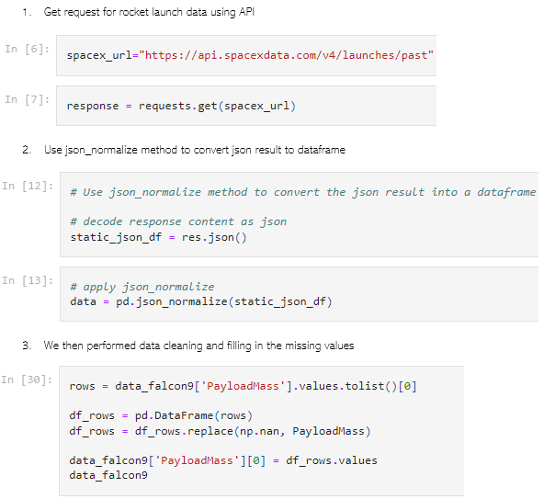
Data Collection – SpaceX API
We used the get request to the SpaceX API to collect data, clean the requested data and did some basic data wrangling and formatting.
GitHub URL of the completed SpaceX API calls notebook:
https://github.com/antoniombgondim/Capstone-Project-Professional-Certificate/blob/567adad9aef86dabf1bcca641632be5ee6401cea/spacex-data-collection-api.ipynb
Place your flowchart of SpaceX API calls here

Slide 9
Data Collection: Web Scraping
Request data (Falcon 9 launch) from Wikipedia
Create beautifulSoup object from HTML response
Extract column names from HTM table header
Collect data from parsing HTML tables
Create dictionary from the data
Create dataframe from the dictionary
Export data to csv file

Slide 10
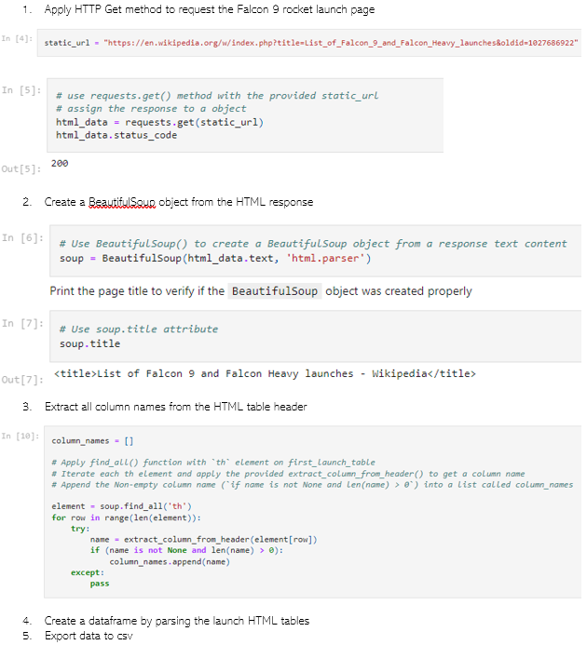
Data Collection - Scraping
We applied web scrapping to webscrap Falcon 9 launch records with BeautifulSoup.We parsed the table and converted it into a pandas dataframe.
GitHub URL of the completed web scraping notebook: https://github.com/antoniombgondim/Capstone-Project-Professional-Certificate/blob/7d18421a4ee636f6726853b1311cdfbfc18b0b83/spacex-webscraping%20(2).ipynb

Slide 11
Data Wrangling
We performed exploratory data analysis and determined the training labels.
We calculated the number of launches at each site, and the number and occurrence of each orbits
We created landing outcome label from outcome column and exported the results to csv.
GitHub URL:
https://github.com/antoniombgondim/Capstone-Project-Professional-Certificate/blob/38d48d78a8d80b3811dccd2f0d720501918ab781/spacex-data_wrangling_jupyterlite.jupyterlite.ipynb

Slide 12
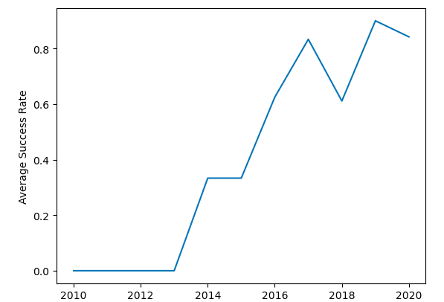
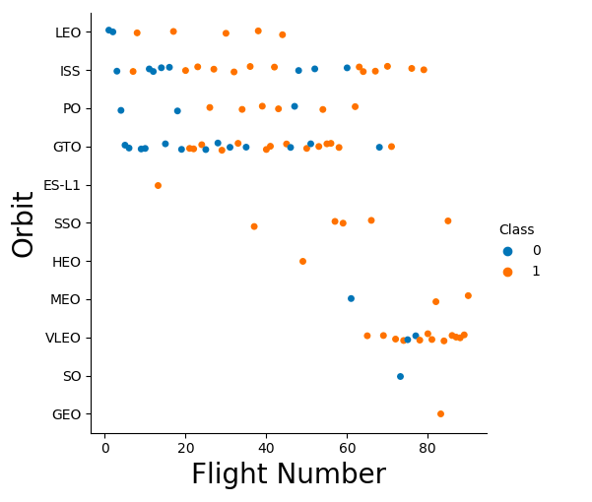
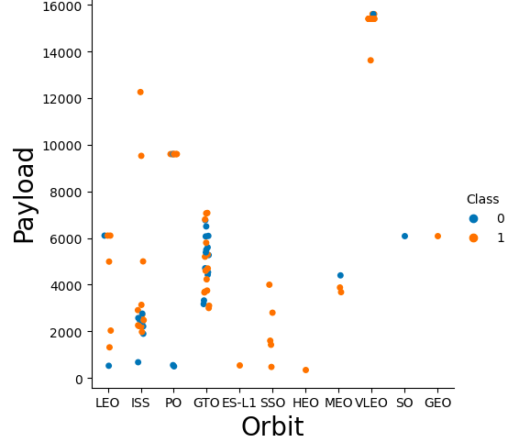
EDA with Data Visualization
We explored the data by visualizing the relationship between flight number and launch Site, payload and launch site, success rate of each orbit type, flight number and orbit type, the launch success yearly trend.
https://github.com/antoniombgondim/Capstone-Project-Professional-Certificate/blob/5b941409aa39aa57150078060b0cf48002168cbb/data_vizualization.ipynb.jupyterlite.ipynb

Slide 13
EDA with SQL
We loaded the SpaceX dataset into a SQLite database without leaving the jupyter notebook.
We applied EDA with SQL to get insight from the data. We wrote queries to find out for instance:
The names of unique launch sites in the space mission.
The total payload mass carried by boosters launched by NASA (CRS), the average payload mass carried by booster version F9 v1.1
The date when the first successful landing outcome in ground pad was acheived.
The names of the booster_versions which have carried the maximum payload mass.
The total number of successful and failure mission outcomes, the failed landing outcomes in drone ship, their booster version and launch site names.
Link to notebook:
https://github.com/antoniombgondim/Capstone-Project-Professional-Certificate/blob/7513b8a16ceb459f052e6421346bec9edc38c78c/eda-sql-sqllite.ipynb

Slide 14
Build an Interactive Map with Folium
We marked all launch sites, and added map objects such as markers, circles, lines to mark the success or failure of launches for each site on the folium map.
We assigned the feature launch outcomes (failure or success) to class 0 and 1.i.e., 0 for failure, and 1 for success.
Using the color-labeled marker clusters, we identified which launch sites have relatively high success rate.
We calculated the distances between a launch site to its proximities. We answered some question for instance:
Are launch sites near railways, highways and coastlines.
Do launch sites keep certain distance away from cities.
https://github.com/antoniombgondim/Capstone-Project-Professional-Certificate/blob/f88bcb1b28e22b8b0cf3cea3cdb9f8f82c00df26/SpaceXFolium.ipynb

Slide 15
Build a Dashboard with Plotly Dash
We built an interactive dashboard with Plotly dash, then plotted pie charts showing the total launches by a certain sites, and lastly plotted scatter graph showing the relationship with Outcome and Payload Mass (Kg) for the different booster version.
Link to notebook:
https://github.com/antoniombgondim/Capstone-Project-Professional-Certificate/blob/eda77bcb1d4d3e55122ed4509a0804a6e42dcbc0/Spacex-DashApp.ipynb

Slide 16
Predictive Analysis (Classification)
We loaded the data using numpy and pandas, transformed the data, split our data into training and testing.
We built different machine learning models and tune different hyperparameters using GridSearchCV.Plus, was used accuracy as the metric for our model, improved the model using feature engineering and algorithm tuning. We found the best performing classification model being the decision tree.
Link: https://github.com/antoniombgondim/Capstone-Project-Professional-Certificate/blob/4c1319d5ca749a6e759ea631da48c5bf84d1fa67/SpaceX_Machine_Learning_lab.ipynb

Slide 17
Results
Exploratory data analysis results
Interactive analytics demo in screenshots
Predictive analysis results

Slide 18

Section 2

Slide 19
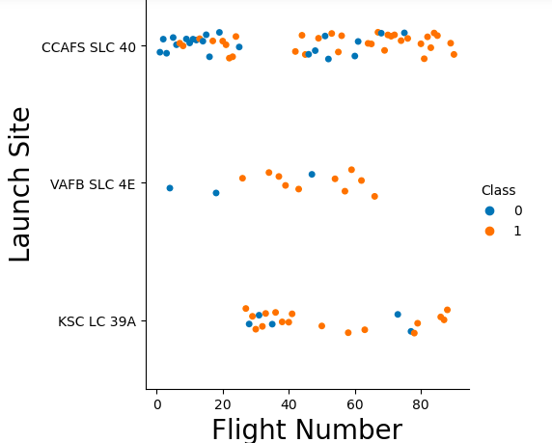
Flight Number vs. Launch Site
In average the greatest number of succeeded missions is on the site KSC LC 39A., and the least one is CCAFS SLC 40.

Slide 20
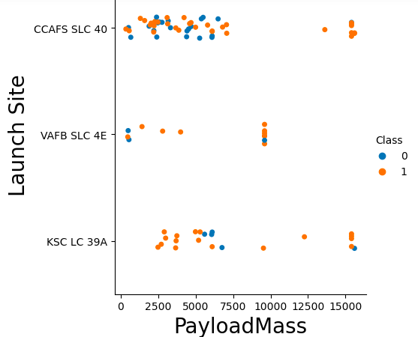
Payload vs. Launch Site
Except for the site KSC LC 39A, the lesser is the payload mass, greater is the probability of unsuccessful mission.

Slide 21
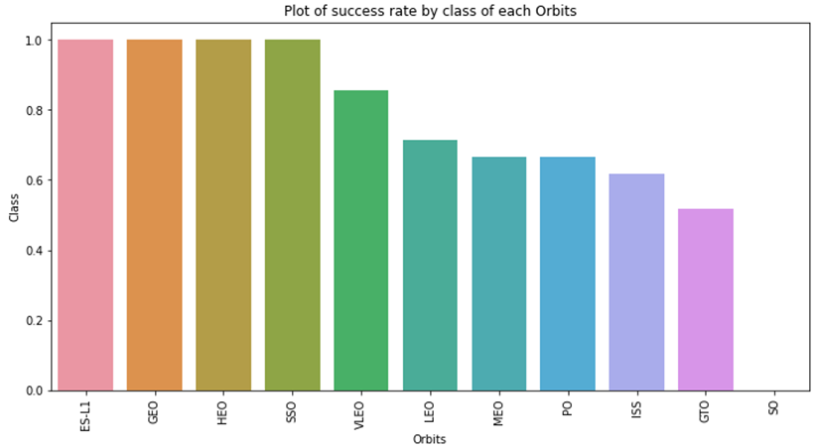
Success Rate vs. Orbit Type
In the plot it is presented the success rate for each orbit. Notice that ES L2, GEO, HEO, SSO are the best orbit types.

Slide 22
Flight Number vs. Orbit Type
We observe that in the LEO orbit-and possibly in MEO orbit-, success is related to the number of flights whereas in the GTO orbit, there is no relationship between flight number and the orbit.

Slide 23
Payload vs. Orbit Type
For VLEO orbit, if the payload is higher than 16000, there is more probability for unsuccess-the same for LEO, but here the payload is 6000-, whereas for GTO it is not possible to see any relation.
For LEO, ISS, PO a reduced payload increases the unsuccess probability.

Slide 24
Launch Success Yearly Trend
The moments with greatest average was by the end of 2019 and 1st half of 2019, but the success average decreased during the second half of 2019.
The largest slope on success rate was: 2015-2017, and 2018-2019.

Slide 25
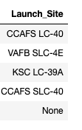
All Launch Site Names
There are 4 site launches at total, the first 4 rows in this table:

Slide 26
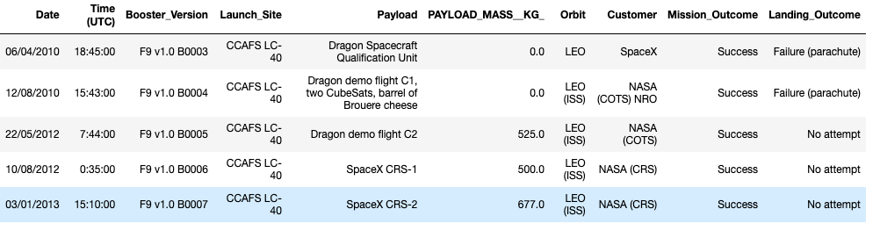
Launch Site Names Begin with 'CCA'
These are 5 records of site names beginning with CCA, the code was: %sql SELECT * FROM SPACEXTBL WHERE Launch_Site LIKE'%CCA%' LIMIT 5;

Slide 27

Total Payload Mass
Below is shown the total payload carried by boosters from NASA, I.e, the sum of all payload masses of NASA boosters:
The code was: %sql SELECT AVG(PAYLOAD_MASS__KG_) FROM SPACEXTBL WHERE Booster_Version LIKE '%F9 v1.1%';

Slide 28

Average Payload Mass by F9 v1.1
Below is presented the average payload mass carried by booster version F9 v1.1, the code was: %sql SELECT AVG(PAYLOAD_MASS__KG_) FROM SPACEXTBL WHERE Booster_Version LIKE '%F9 v1.1%';

Slide 29
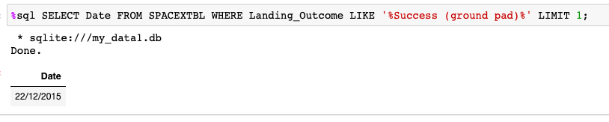
First Successful Ground Landing Date
Above is the date of the 1st successful ground landing

Slide 30
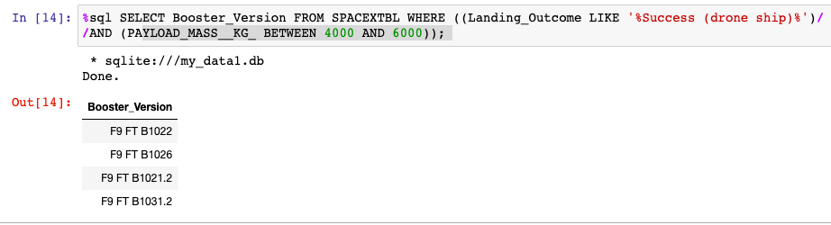
Successful Drone Ship Landing with Payload between 4000 and 6000
names of boosters which have successfully landed on drone ship and had payload mass greater than 4000 but less than 6000

Slide 31
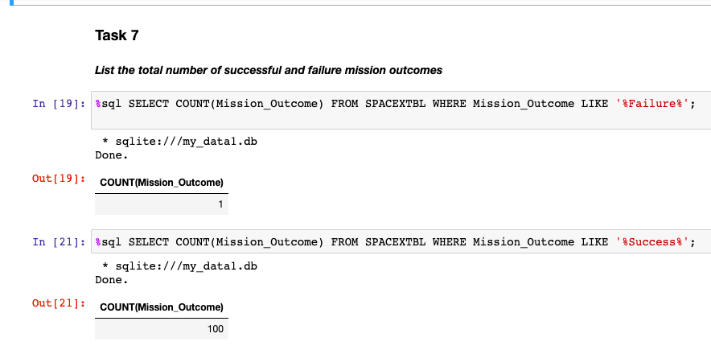
Total Number of Successful and Failure Mission Outcomes
Calculated below the total number of successful and failure mission outcomes

Slide 32
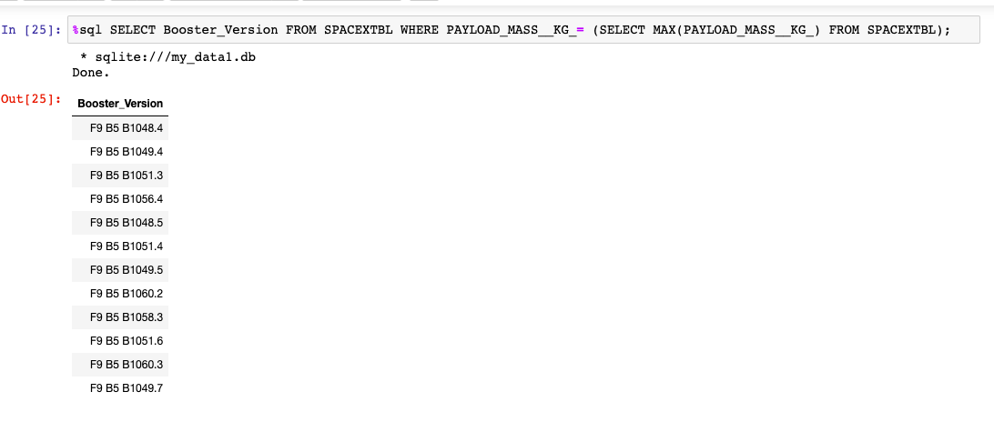
Boosters Carried Maximum Payload
Below are listed the names of the booster which have carried the maximum payload mass

Slide 33
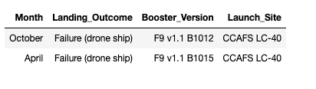
2015 Launch Records
List the failed landing_outcomes in drone ship, their booster versions, and launch site names for in year 2015, and here is the query code: %sql SELECT CASE WHEN\
SUBSTR(Date, 4, 2) = '01' THEN 'January'\
WHEN SUBSTR(Date, 4, 2) = '02' THEN 'February'\
WHEN SUBSTR(Date, 4, 2) = '03' THEN 'March'\
WHEN SUBSTR(Date, 4, 2) = '04' THEN 'April'\
WHEN SUBSTR(Date, 4, 2) = '05' THEN 'May'\
WHEN SUBSTR(Date, 4, 2) = '06' THEN 'June'\
WHEN SUBSTR(Date, 4, 2) = '07' THEN 'July'\
WHEN SUBSTR(Date, 4, 2) = '08' THEN 'August'\
WHEN SUBSTR(Date, 4, 2) = '09' THEN 'September'\
WHEN SUBSTR(Date, 4, 2) = '10' THEN 'October'\
WHEN SUBSTR(Date, 4, 2) = '11' THEN 'November'\
WHEN SUBSTR(Date, 4, 2) = '12' THEN 'December'\
END AS Month,\
Landing_Outcome,\
Booster_Version,\
Launch_Site\
FROM SPACEXTBL\
WHERE SUBSTR(Date, 7, 4) = '2015' AND Landing_Outcome LIKE '%Failure (drone ship)%';

Slide 34
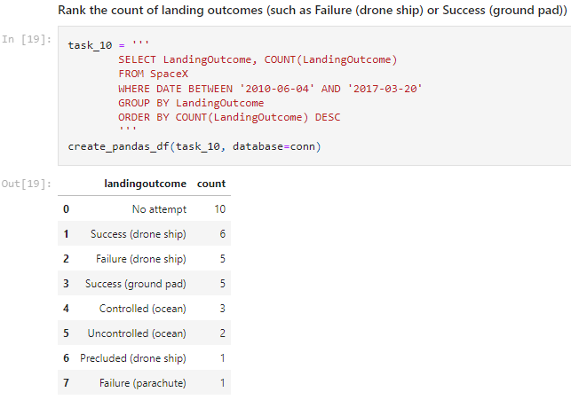
Rank Landing Outcomes Between 2010-06-04 and 2017-03-20
Here are ranked the count of landing outcomes (such as Failure (drone ship) or Success (ground pad)) between the date 2010-06-04 and 2017-03-20, in descending order

Slide 35

Section 3

Slide 36
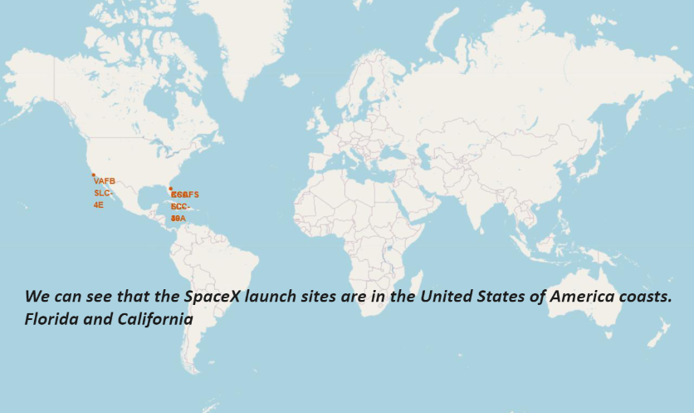
All launch sites global map markers

Slide 37
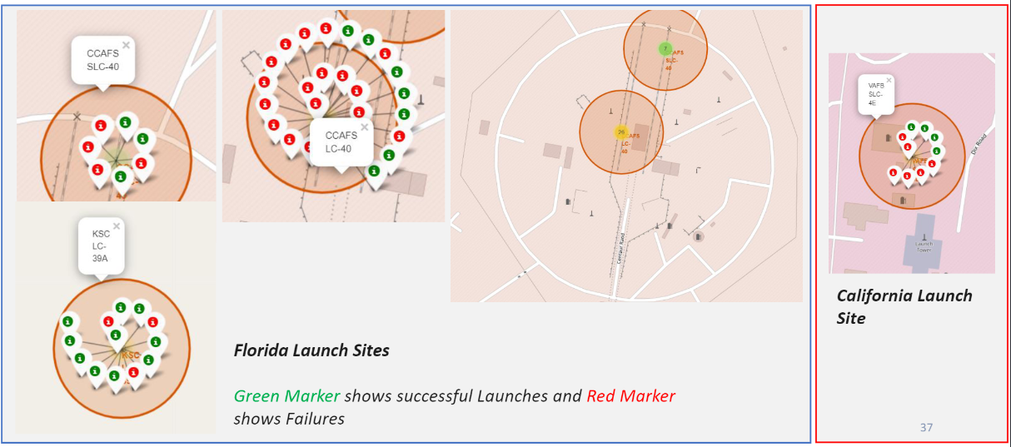
Markers showing launch sites with color labels

Slide 38

Section 4

Slide 39
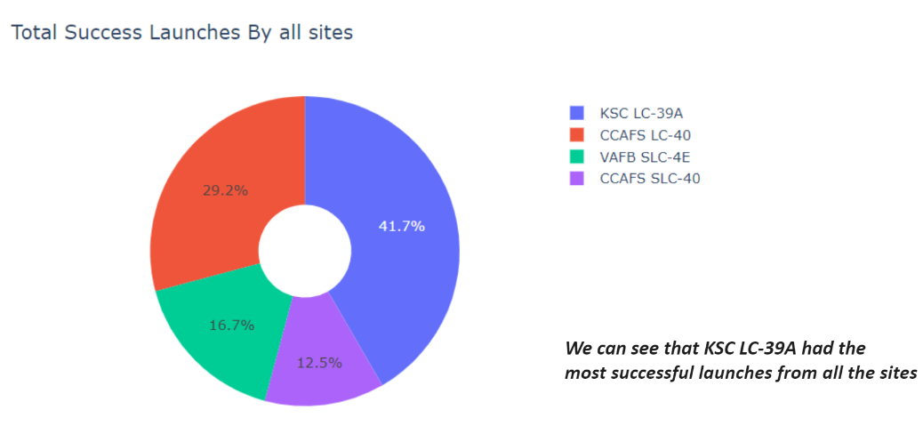
Pie Chart-Total success launches by all sites
Replace <Dashboard screenshot 1> title with an appropriate title
Show the screenshot of launch success count for all sites, in a piechart
Explain the important elements and findings on the screenshot

Slide 40
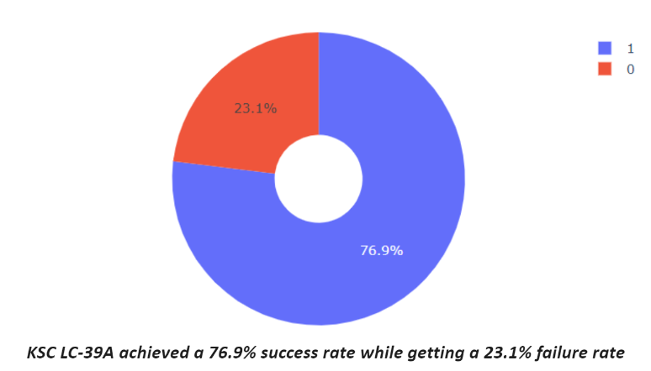
Success rate ok the Launch Site KSC LC-39A

Slide 41
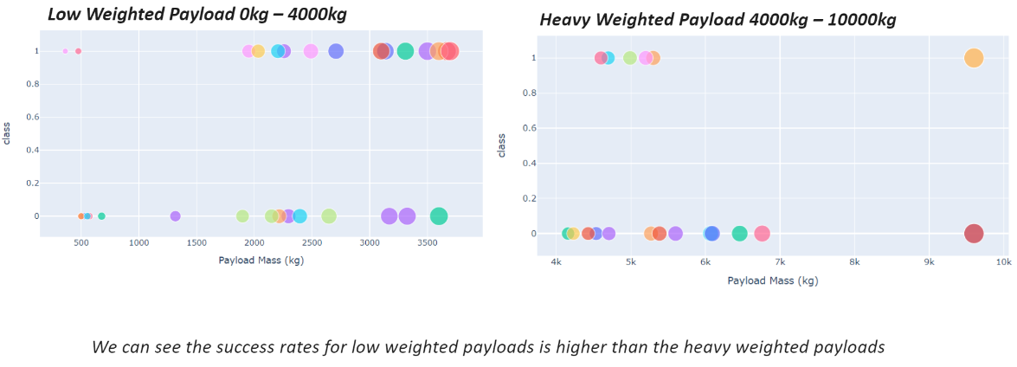
Scatter plot of Payload vs Launch Outcome for all sites, for payloads in two distinct ranges

Slide 42

Section 5

Slide 43
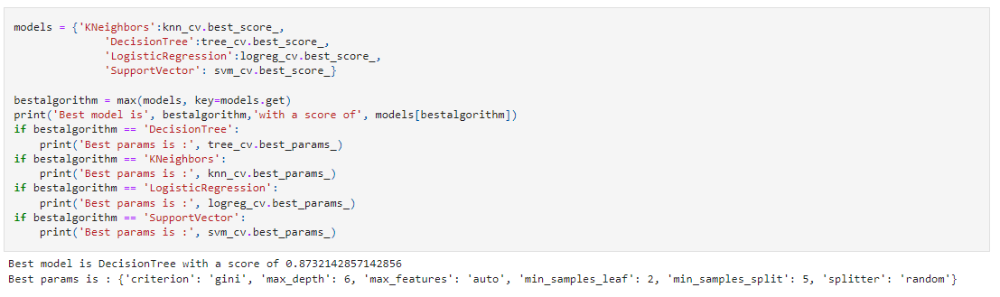
Classification Accuracy

Slide 44
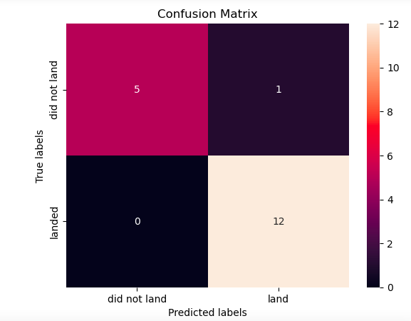
Confusion Matrix
Confusion matrix of the decision tree model, notice that there is only one false positive, what is a good accuracy.

Slide 45
Conclusions
The larger the flight amount at a launch site, the greater the success rate at a launch site.
Launch success rate started to increase in 2013 till 2020.
Orbits ES-L1, GEO, HEO, SSO, VLEO had the most success rate.
KSC LC-39A had the most successful launches of any sites.
The Decision tree classifier is the best machine learning algorithm for this task.

Slide 46


