Slide 1

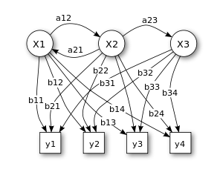

Markov Models
Applied to Anomaly Detection
By Saab Group

Slide 2

The paper

Slide 3
What is a Markov Model?
In probability theory, a Markov model is a stochastic model used to model randomly changing systems.
It is assumed that future states depend only on the current state, not on the events that occurred before it (that is, it assumes the Markov property).

Slide 4

What is a Markov Model?

Slide 5
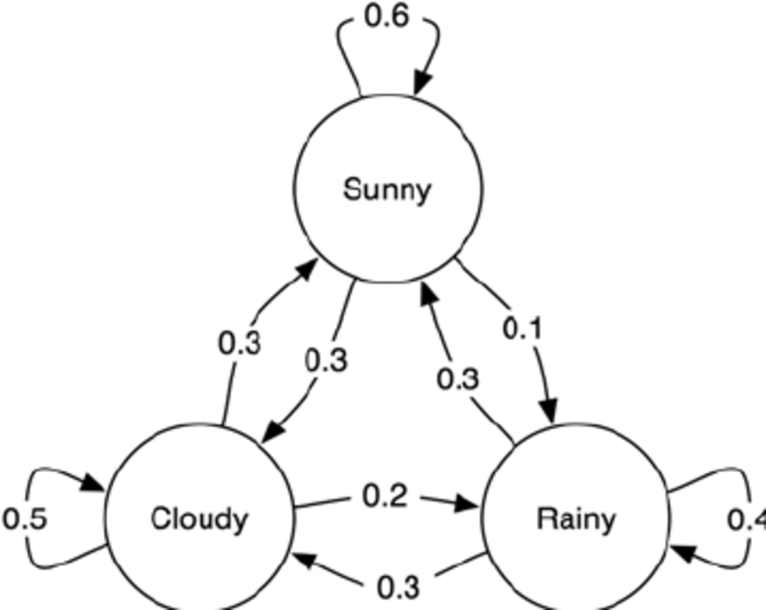
What is a Markov Model?

Slide 6
Why is this helpful in anomaly detection?
P(sunny|cloudy) = 0.3
P(rainy | rainy) = 0.4
P(rainy|sunny) = 0.1

Slide 7






Why is this helpful in anomaly detection?
P(sunny|cloudy) = 0.3
P(rainy | rainy) = 0.4
P(cloudy|sunny) = 0.1

Slide 8

Why can this be applied to our Project?

Slide 9
Why can this be applied to our Project?

Slide 10
Why can this be applied to our Project?

Slide 11
Why can this be applied to our Project?
x2
x3
x1
x4
x5

Slide 12
Transitions

Slide 13
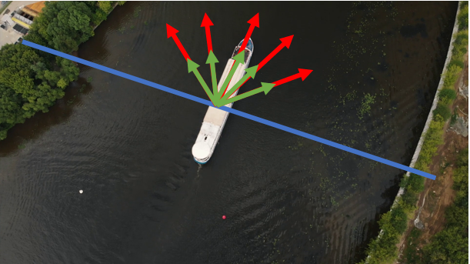
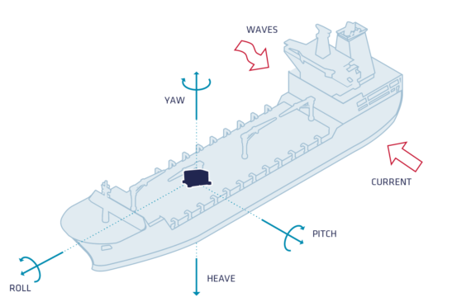
And… if we have other interesting features?
Velocity
Direction

Slide 14
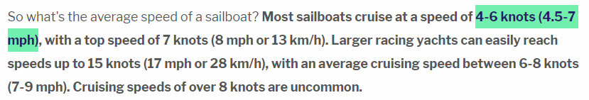
Since all measurements are bounded
We can partitionate them and classify them
E.g:

Slide 15
Since all measurements are bounded
We can partitionate them and classify them
E.g:
0 km/h
30 km/h

Slide 16
Since all measurements are bounded
We can partitionate them and classify them
E.g:
slow normal fast
0 km/h
30 km/h

Slide 17
Since all measurements are bounded
We can partitionate them and classify them.
Now each classification is a substate of the measurement, so that for speed we have both slow, normal and fast sub-states.
Position could be partitioned into suspicious and non-suspicious according to the history of anomalies detected in a certain port.
The direction can also be partitioned(we Will see it in the following slides).

Slide 18
Since all measurements are bounded
So if we use in out model 3 states representing the speed, 2 states representing the position and 5 states representing the direction, there Will be:

Slide 19
Since all measurements are bounded
So if we use in out model 3 states representing the speed, 2 states representing the position and 5 states representing the direction, there Will be:
This might be too much (or not)
?

Slide 20
Data
More
=
More information per state

Slide 21
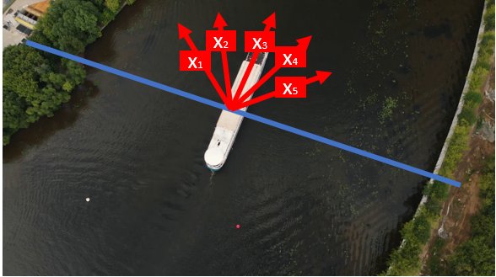
An example focusing only in direction
We can extract much more features (depends on the data)
x1
x2
x3
x4
x5

Slide 22
Basic Model
EXTREMELY LOW
x1
HIGH
x2
x3
x4
x5
HIGH
LOW

Slide 23
Basic Model What could we extract from the data?
EXTREMELY LOW
x1
HIGH
x2
x3
x4
x5
HIGH
LOW

Slide 24
Basic Model Finally…
EXTREMELY LOW
x1
HIGH
x2
x3
x4
x5
HIGH
LOW
If there is a transition from x1 to x5:
WE ARE JUST IN FRONT OF AN ANOMALY

Slide 25
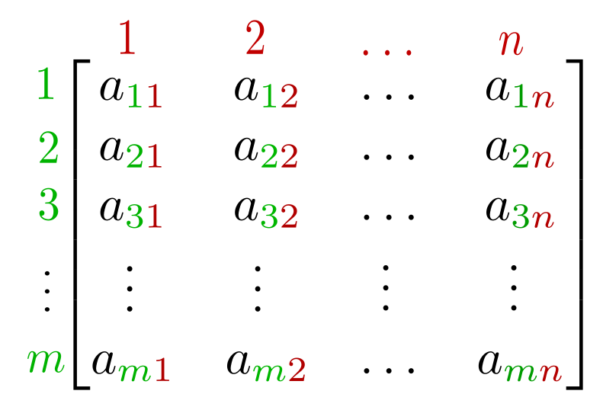
Implementation Finally…
Once defined the states, we can compute probabilities of transition between one state to another and represent them on a matrix
Transition Probability Matrix
aij = Probability of transition from i to j
Idea:
Get the probability values from a training set
Evaluate the model with the test set
Whenever a transition happen, check
the probability of that to have ocurred and
if it is under a tested threshold → ANOMALY

Slide 26
Also Interesting
Problem
Speed and size of the ships should get evaluated in conjunction.
Higher speeds are supossed to be adopted by smaller ships
High speeds are not anomalous for big ships
Markov Models allow us to evaluate speed and length together
Given a range of posible values for speed and length, we can partitionate both so that given a transition pair
(speed1, length)→ (speed1, length)
Initially: (100km/h, 500m) → → (type 7, type 5) → STATE 4
Finally: (20 km/h, 500m) → → (type 4, type 5) → STATE 7
SO
STATE 4 to STATE 7

Slide 27


