Slide 1

Saab Vessel traffic anomaly detection

Slide 2
Goal: Detect anomalies in vessel traffic

Slide 3
What is an anomaly?
3-4 times out of the standard deviation when following a route
If ship speed deviates more than 2 times the standard deviation(95%) in that particular block
Making sudden course changes / movements

Slide 4
What is an anomaly?
A deviation from normality

Slide 5
RNN plan
Step 1
Predict 1 point from 2 points using just Lat, Lon
Step 2
Add more features as input (speed, timesteps, orientation/course * sin+cos)
Step 3
Stack LSTM layer on top, adjust to LSTM model
Step 4
Stack Classifier on top
Step 5
Add random routes as anomalies
Make them realistic (based on existing routes) but add extreme values (like speed)
Step 6
Get classification results (Anomaly/Non anomaly)

Slide 6
The Saab plan Clustering
Latitude,Longitude
Speed
Rate of Turn
Course

Slide 7
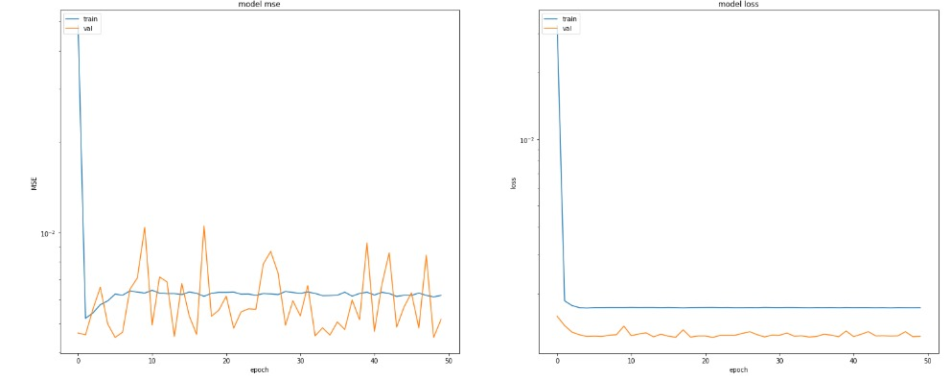
RNN plan results First step Uncleaned

Slide 8
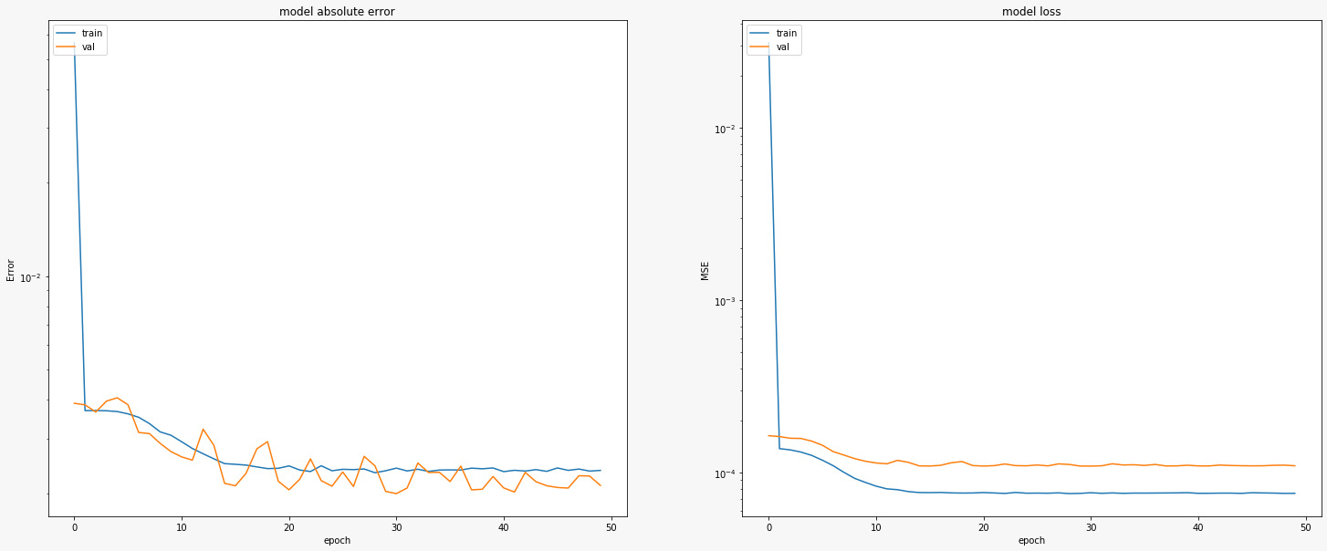
RNN plan results First step Cleaned

Slide 9
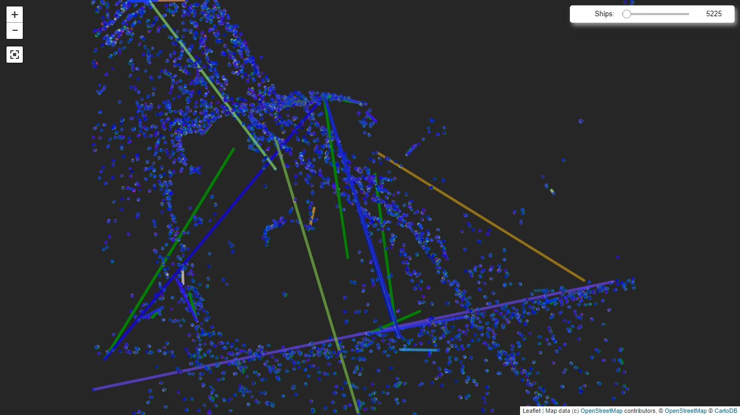
Whole map - Uncleaned

Slide 10
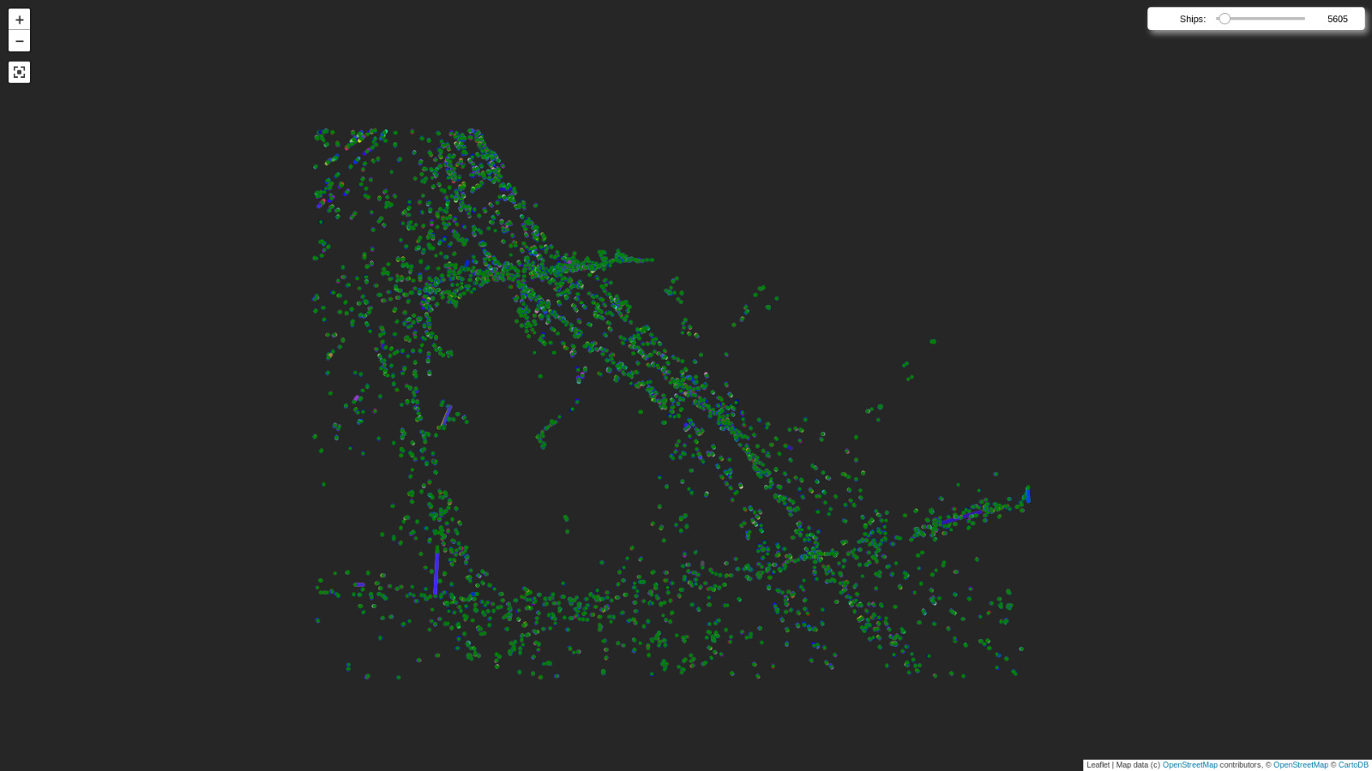
Whole map - Cleaned

Slide 11
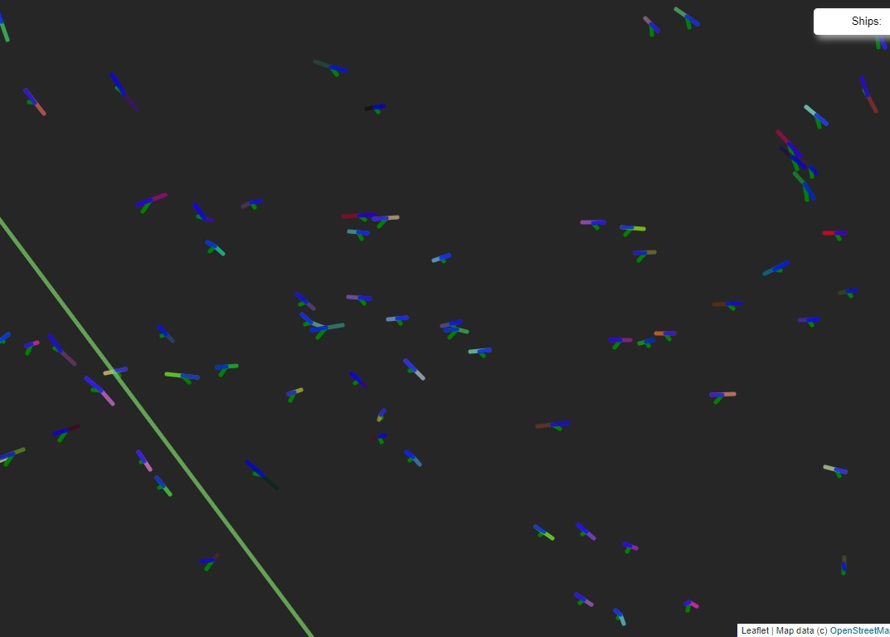
RNN plan results Predictions from first NN - Uncleaned
Green = prediction
Blue = Real course

Slide 12
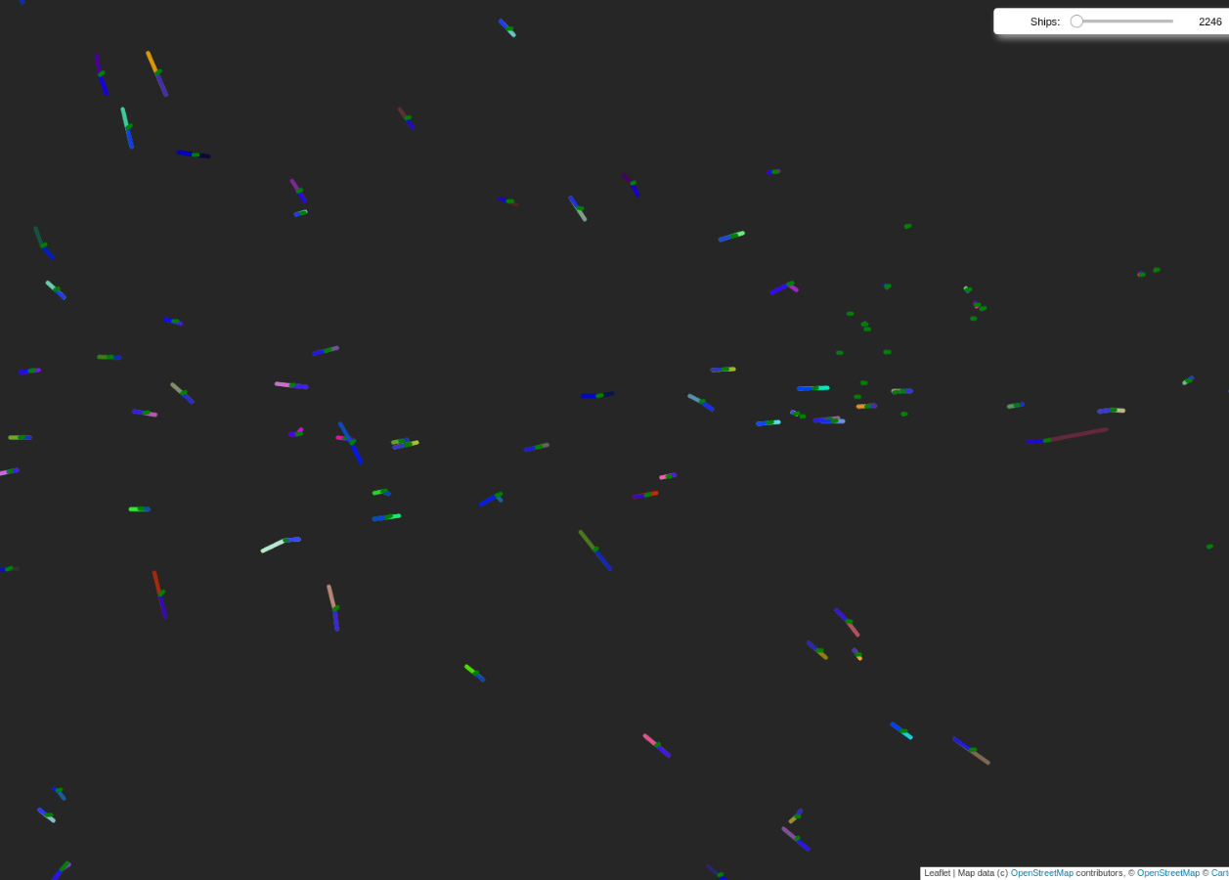
RNN plan results Predictions from first NN - cleaned
Same route
Crossing
Green = prediction
Blue = Real course

Slide 13
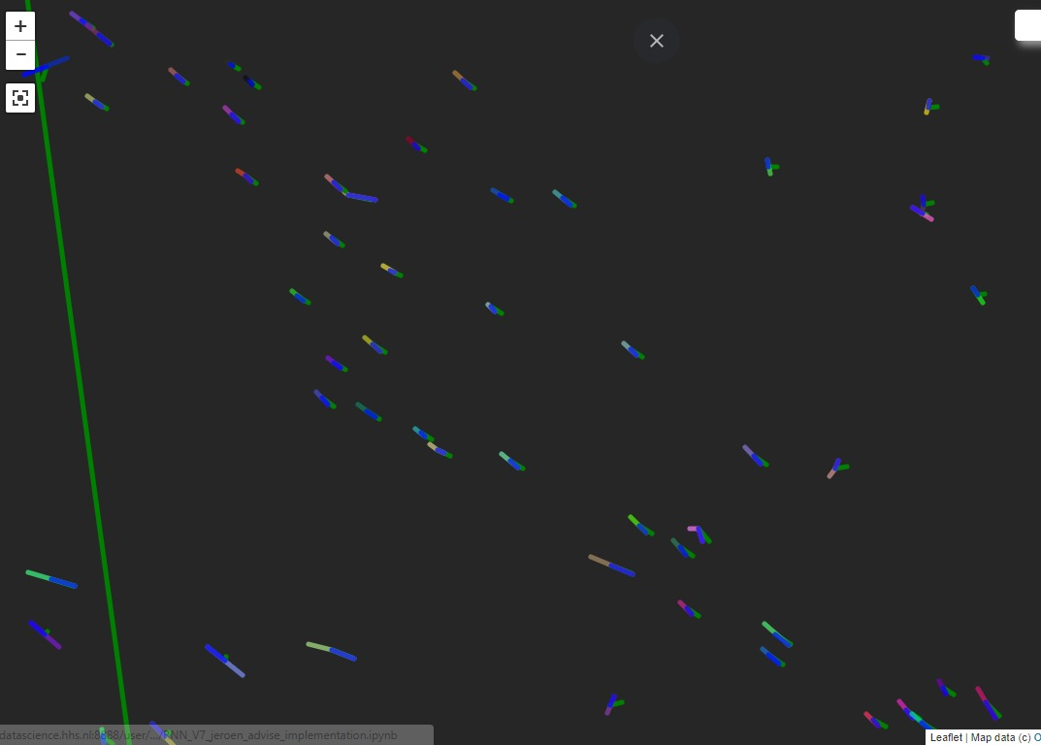
More predictions from first NN - Uncleaned
Green = prediction
Blue = Real course

Slide 14
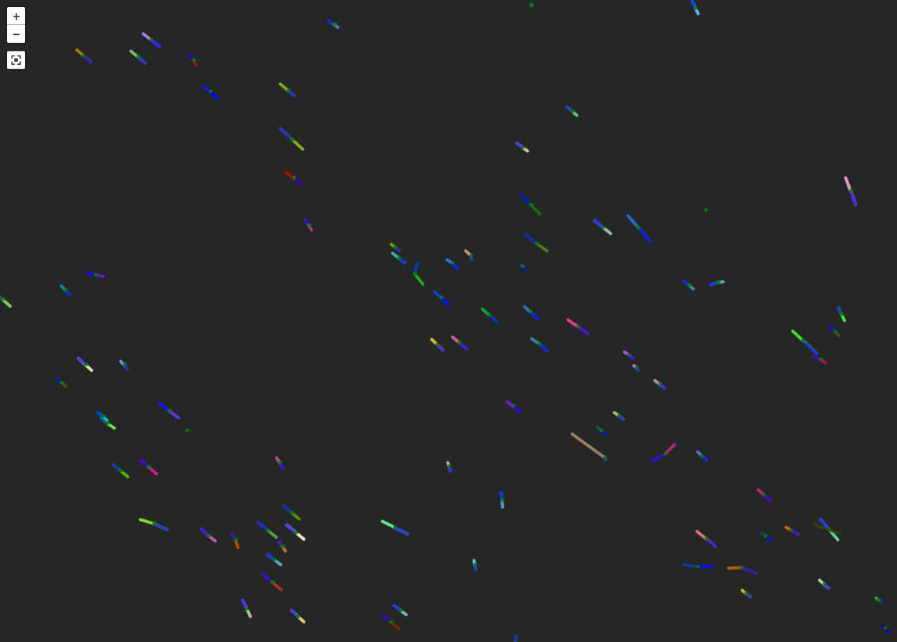
More predictions from first NN - Cleaned
Green = prediction
Blue = Real course

Slide 15
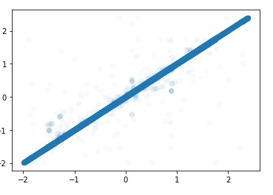
First step results - Uncleaned
Real values vs Predicted values
Normalized data

Slide 16
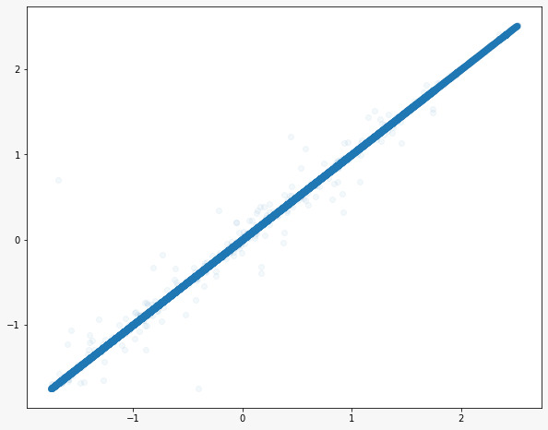
First step results - Cleaned
Changed alpha
Even less outliers

Slide 17
Questions/Feedback?

