Slide 1
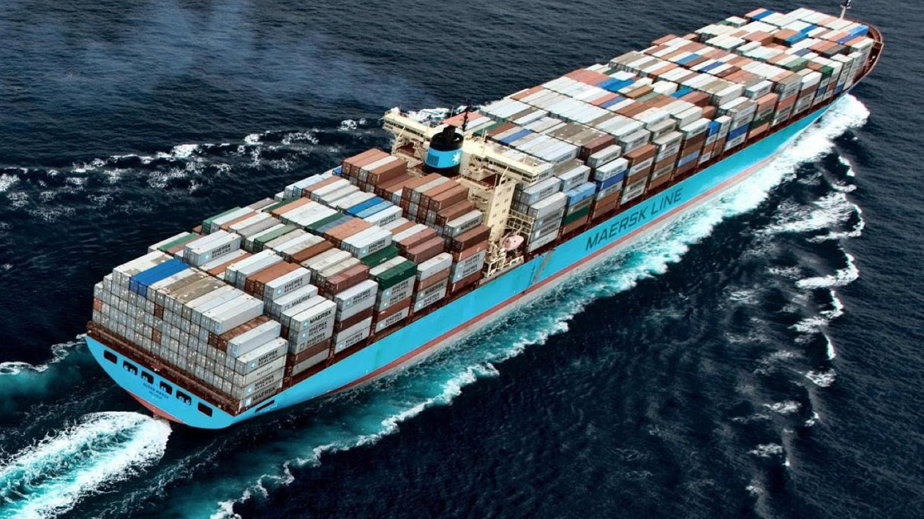
Dynamic Markov Models and clustering
A Saab “tutorial” on why markov might be handy

Slide 2
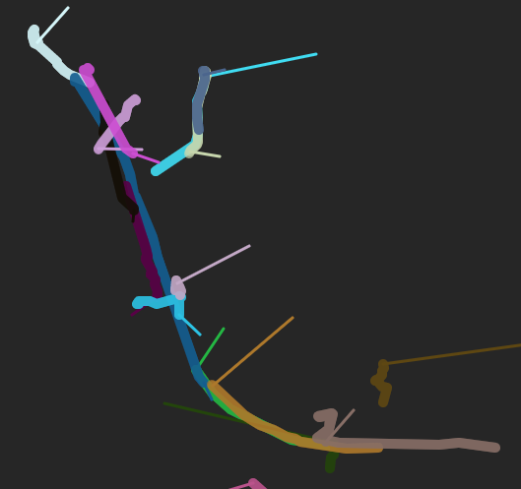
Quick Recap
Last week :
RNN predict ship’s course
Had some issues in accuracy
Really difficult to predict
Thick line is the original course
Thin line the predicted next point
☹

Slide 3

What is a Dynamic Markov Model

Slide 4
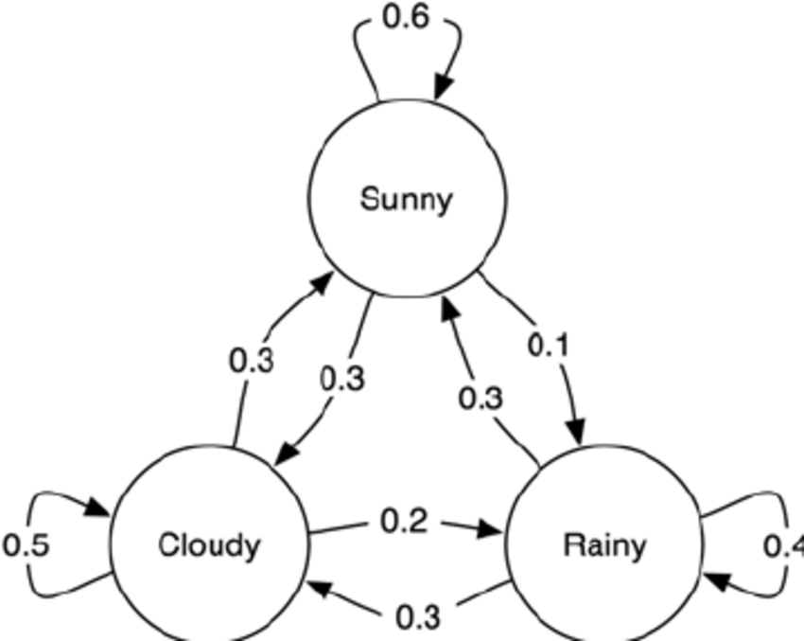
What is a Dynamic Markov Model

Slide 5
Why is this helpful in anomaly detection?
P(sunny|cloudy) = 0.3
P(rainy | rainy) = 0.4
P(rainy|sunny) = 0.1

Slide 6
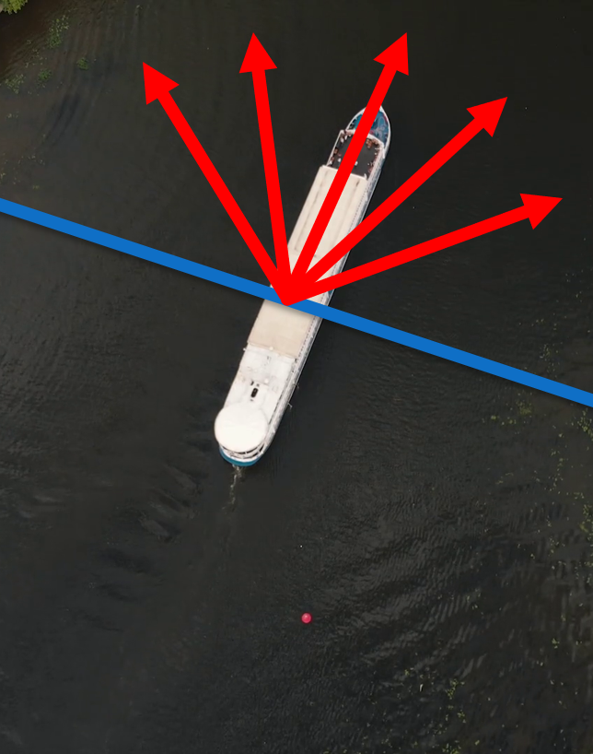
How does this apply to our project
E.g: Orientation
5 partitions = 5 states

Slide 7
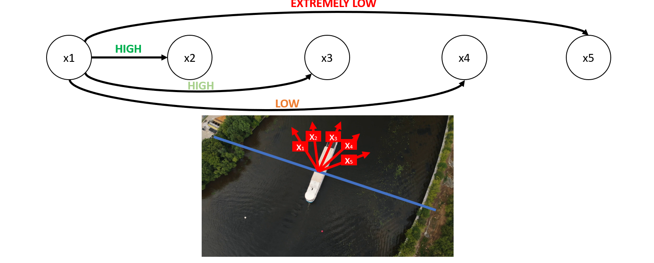
Chances and changes

Slide 8
Why is this related to clustering
Features outside of lat and long
Ex: Speed

Slide 9
The problem with speed{and the rest of the lot}
SPEED:
take most common length
ignoring size if 0
if no further option remains -> remove
If Speed of ship within range of lengthType (Markov model)
Output: A /NA

Slide 10
Clustering labels
Lat/Long anomaly?
Anchored
Ship
Speed/Size anomaly?
Not Anchored
Rate of turn/Size anomaly?
Course/Heading anomaly?

Slide 11
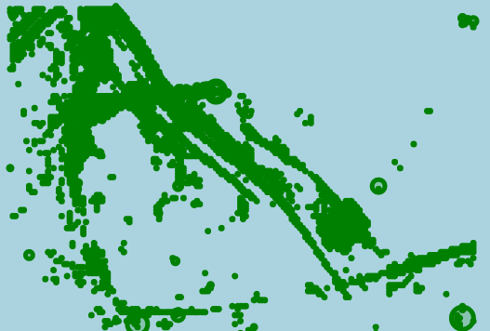

Lat/Long Clustering
Denisity points map

Slide 12
So why the clustering
Data
Clustering
RNN
Anomaly or not!
To get labeled data
Will become the input for RNN

Slide 13
Questions and Feedback?

