Slide 1
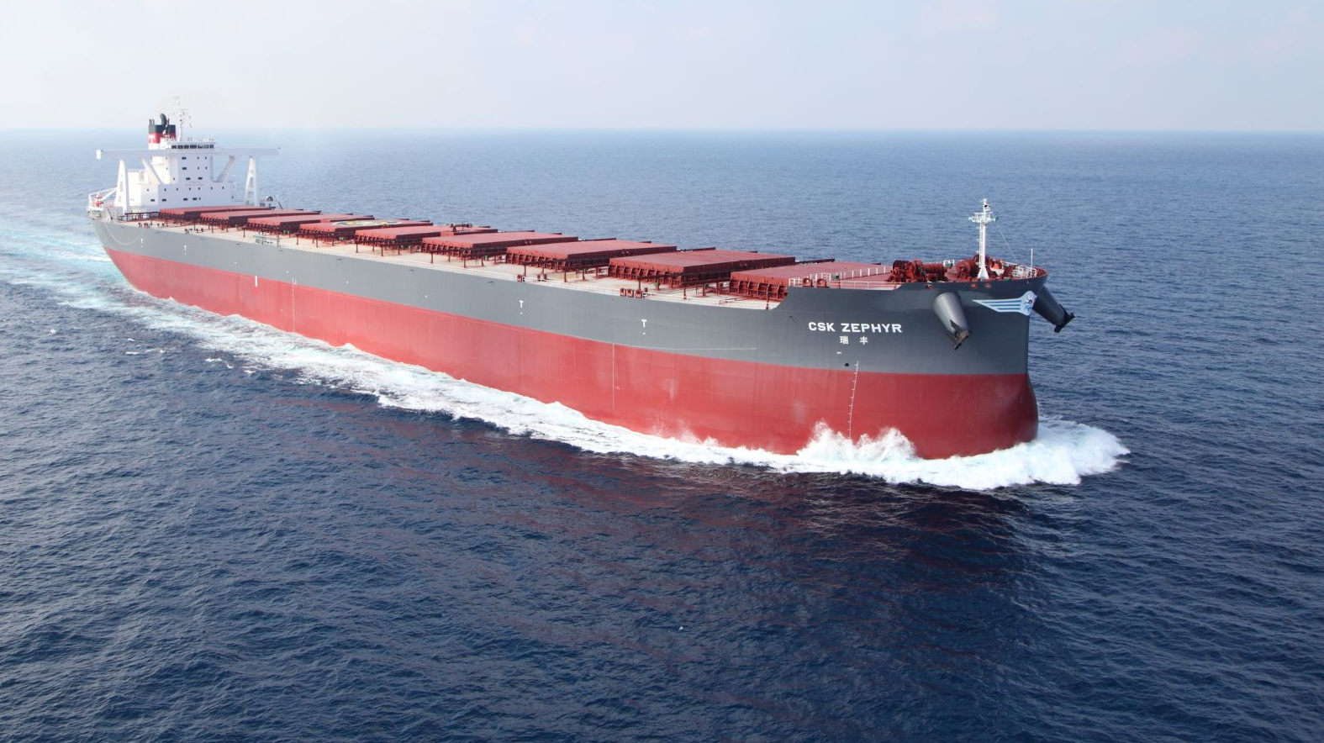
RNN & US
Team Saab

Slide 2
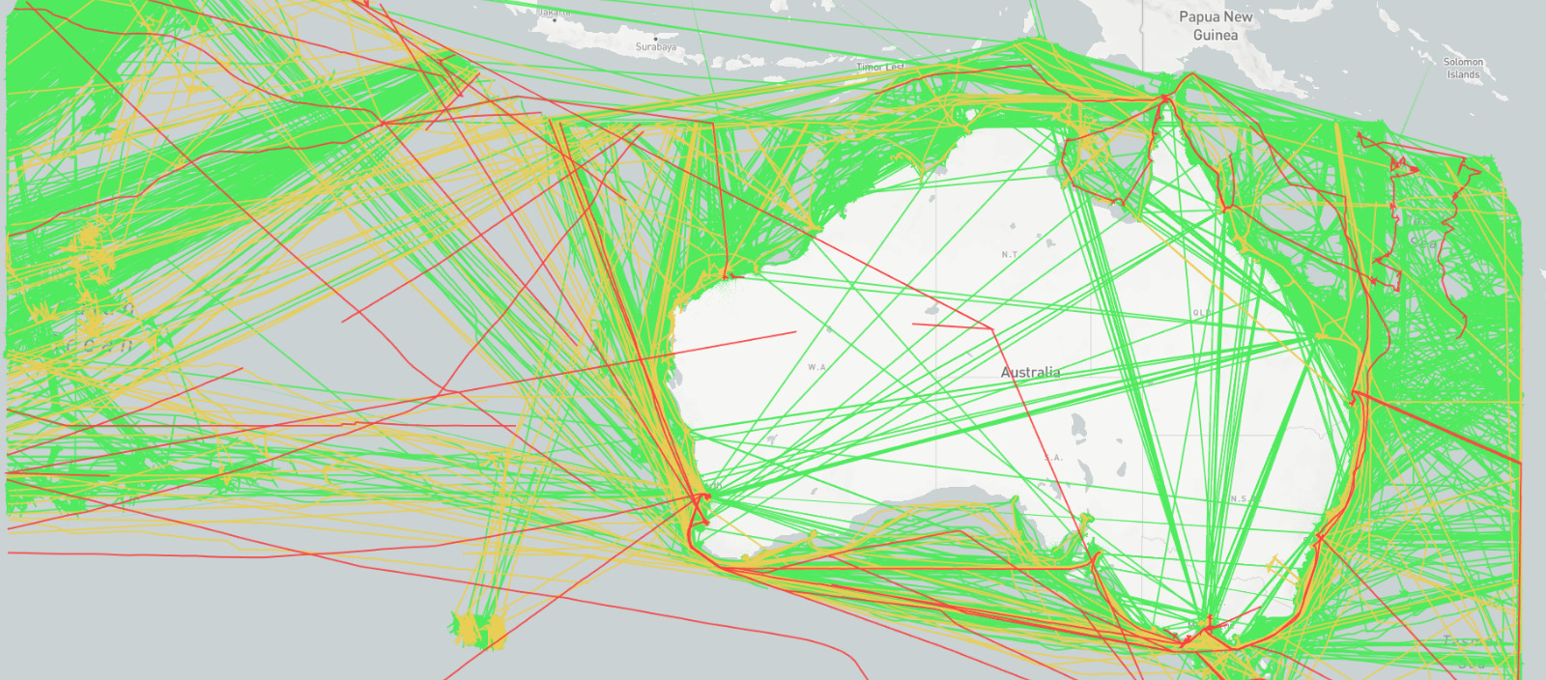
Clustering
“More data > better algorithms”
-Jeroen

Slide 3
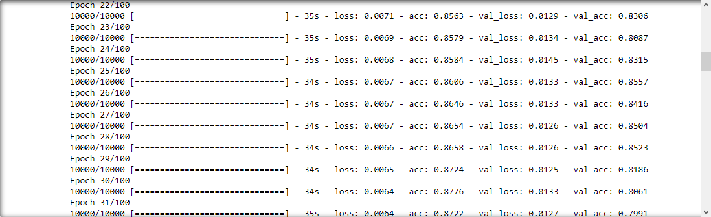
RNN
85% cap?
More nodes
More layers
Overfitting?

Slide 4
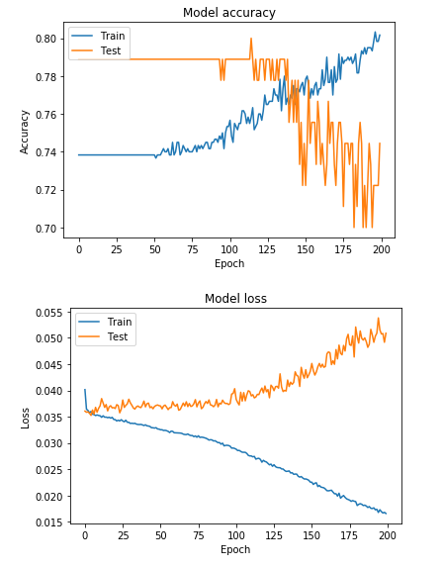
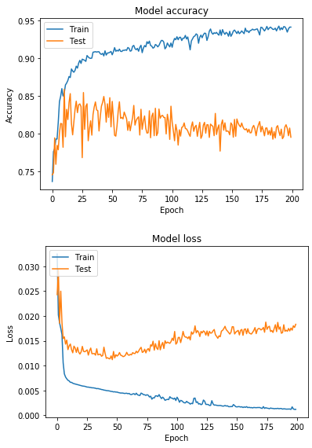
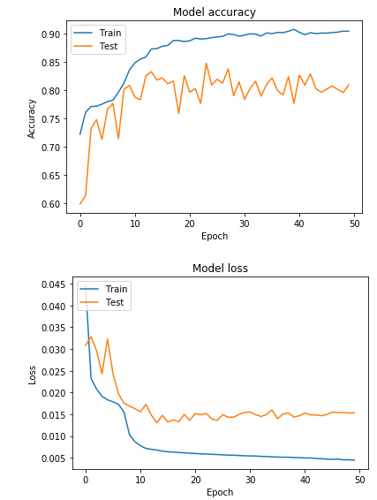
RNN Epoch

Slide 5
Recommendations?

