Slide 1
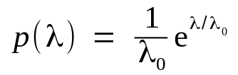
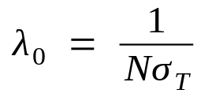
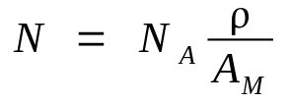
Free path model
Free path considered as a statistical variable with exponential distribution
Its mean value (MFP) is related to total cross section
Macroscopic relationship aproximation in ideal gases
→
→
→

Slide 2
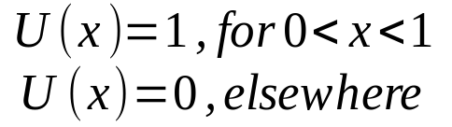
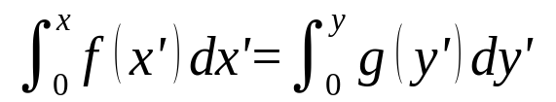
Free path model (2)
Computer algorithms are good generating random numbers uniformly distributed uniformly
Inverse transform method: given a statistical variable x distributed with probability density f(x) obtain another variable y distributed as g(y):

Slide 3
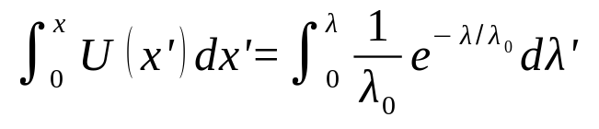


Free path model (3)
Our problem: obtain free path variable (λ) distributed exponentialy from uniform distributed numeric variable (x), sampling equation reads:
Solving integrals:
And inverting:

Slide 4
Free path model (4)
Numerical algoritm:
  Get numeric (pseudo) random number uniformly distributed
  Compute its natural logarith, multiply by mean value λ₀ and change sign
  New variable has exponential distribution with desired mean value

Slide 5


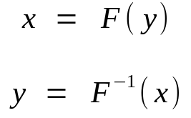
Coloured distributions
General case, solving sampling equation is not straightforward (right side)
LEPTS example : Energy loss distro from measurements, dispersion angle from calculations, emission spectrum, … numerical functions
  At initialization construct numerical integral
  of f(y) → F(y)
  At each step new equation to solve (invert)
  Given flat random number x find y according a numerical distribution
  Efficiency:
    Bisection method used for numerical inverse
    Newman rejection also possible
    Inverse transform method (cumbersome)

Slide 6
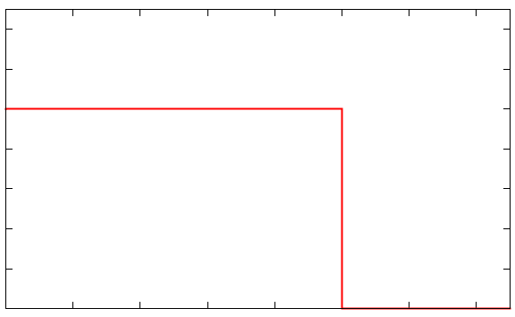
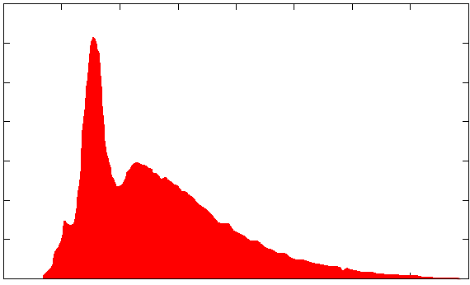
Coloured distributions (2)

