Slide 1
Geant4 LEPTS (Low Energy Particle Tracking Simulation): Modeling low energy particle interactions (electrons, positrons and radicals) in biological media
Gustavo García^{1, 2}
Antonio Muñoz³, Pedro Arce⁴
¹Instituto de Física Fundamental
Consejo Superior de Investigaciones Científicas (IFF-CSIC), Madrid, Spain
²Centre for Medical Radiation Physics, University of Wollongong, NSW, Australia
³Scientific Computing Unit, CIEMAT, Madrid, Spain
⁴Medical Applications Unit, CIEMAT, Madrid, Spain

Slide 2
LEPTS team
Madrid (CSIC-CIEMAT-UAM): F. Blanco, A. Muñoz, M. Fuss, A. G. Sanz, P. Arce
Lisbon (UNL): P. Limão-Vieira, F. Ferreira, D. Almeida
Flinders University (Adelaide): M. Brunger
ANU (Canberra): S. Buckman, J. Sullivan, R. McEachran
J. Cook University (Townsville): R. White
University of Liège: M. J. Hubin-Fraskin, J. Delviche
IOP (Belgrade): B. Marinkovic, Z. Petrovic
Open University (UK): J. Gorfinkiel, N. J. Mason
University of Rome: F. Gianturco
University of Erlangen: E. Carrasco

Slide 3
What is LEPTS?
Set of Geant4 physics models and data to simulate interactions of low energy (eV-.keV) interactions of electrons, positrons (and ions):
Based on data mostly collected by the LEPTS collaboration
+ theoretical calculations to complete the data
Materials: WATER, HCO, PYRIMIDINE, Au, ...
Notes:
Which materials

Slide 4
General data needed for the simulation (0-10 keV)
Electron scattering integral cross sections (ICS):
Total scattering cross sections (used to check sum of processes XS),
Elastic cross sections,
Inelastic cross sections: total and partial ionisation , electronic excitation, neutral dissociation, vibrational excitation, rotational excitation, electron attachment and positronium formation
Electron scattering differential cross sections (DCS):
Elastic DCS (angle)
Inelastic DCS (angle and energy loss)
Electron energy loss distribution functions

Slide 5
Low energy electron interaction data
Experimental data sources:
Electron and positron scattering cross sections with molecules: CSIC, Flinders University (FU), Université de Liège (UL), Sophia University (SU), Australian National University (ANU)
Electron transfer to molecules: CSIC, New University of Lisbon (UNL)
Thoretical methods:
Electron and positron scattering with molecules: CSIC (IAM-SCAR), Open University (R-matrix), University of Rome (Single-Centre Expansion)

Slide 6
Data sources
Electron scattering experiments:
Transmission measurements (Madrid, Canberra)
Crossed beam experiments: EEL spectroscopy and TOF measurements (Madrid, Lisbon, Canberra, Adelaide)
Electron scattering calculations:
IAM-SCAR (Madrid), SCE (Rome), R-Matrix (UK)
Notes:
Que se mide en cada uno?

Slide 7
Experimental systems
Notes:
Tipo de cada uno Que se mide en cada uno?
2 rotating analyser to measure angle XS (target is beam, so to get a point-like interaction)
3 distinguish OH and H2O+ with TOF

Slide 8
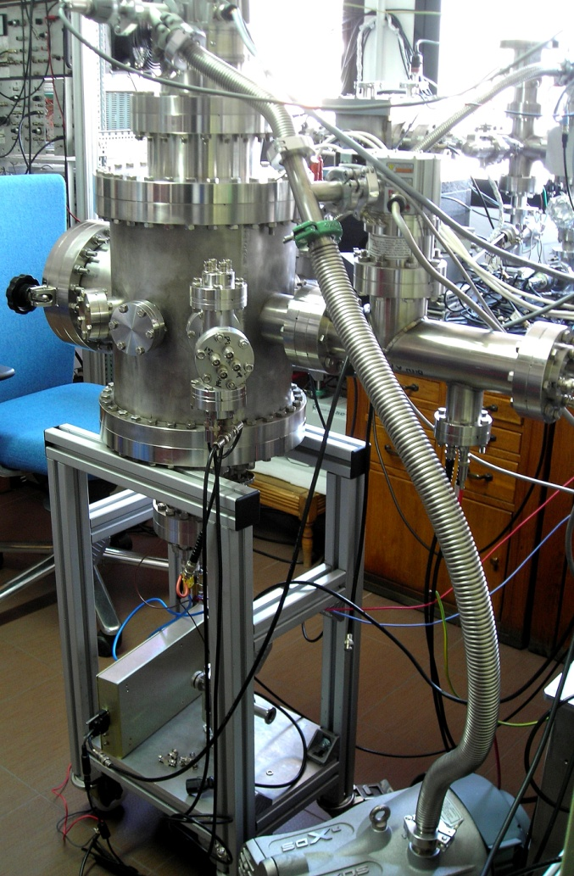
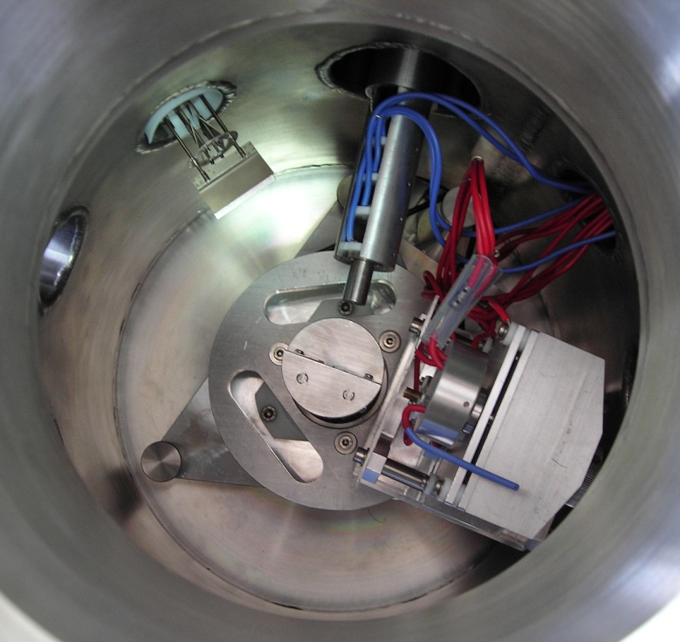
Validation experiment: currently in progress at CSIC (STSM-CELINA)
TOF spectrometer
Electron gun
Adsorbed ethylene
Electrostatic spectrometer
Si monocristal substrate

Slide 9
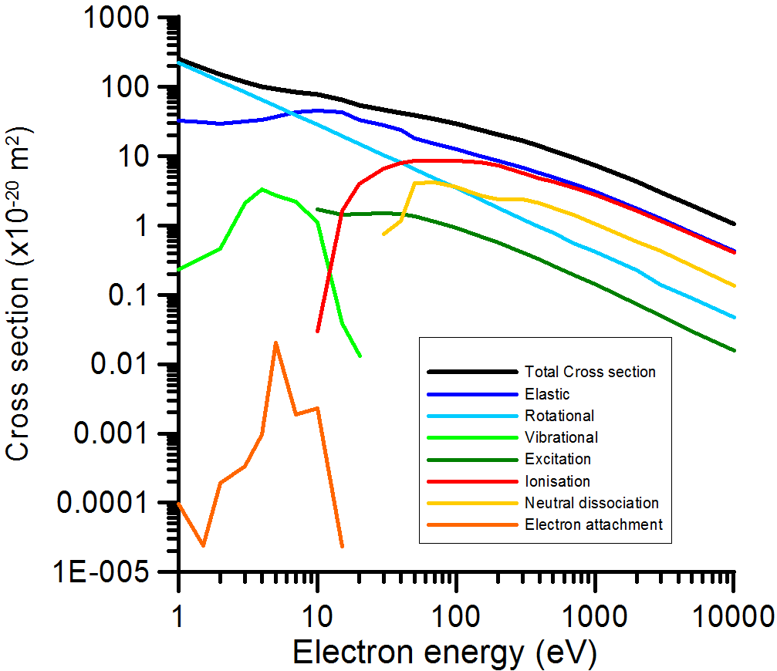
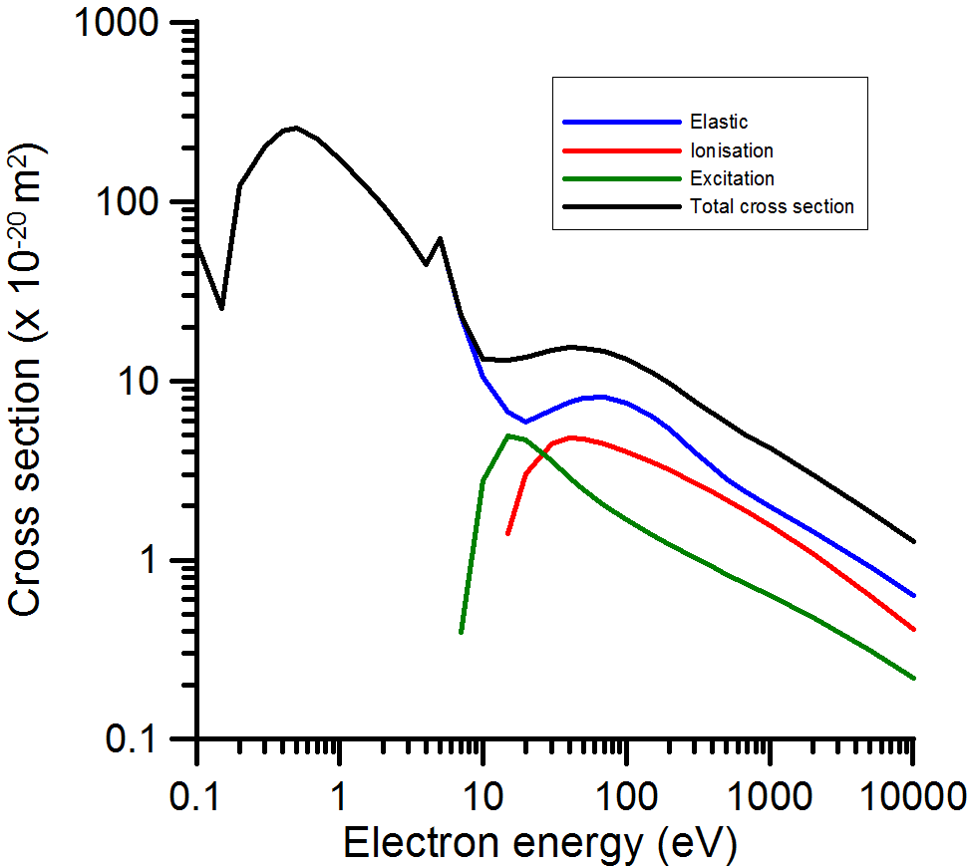
Input data: ICS
Pyrimidine
Gold

Slide 10
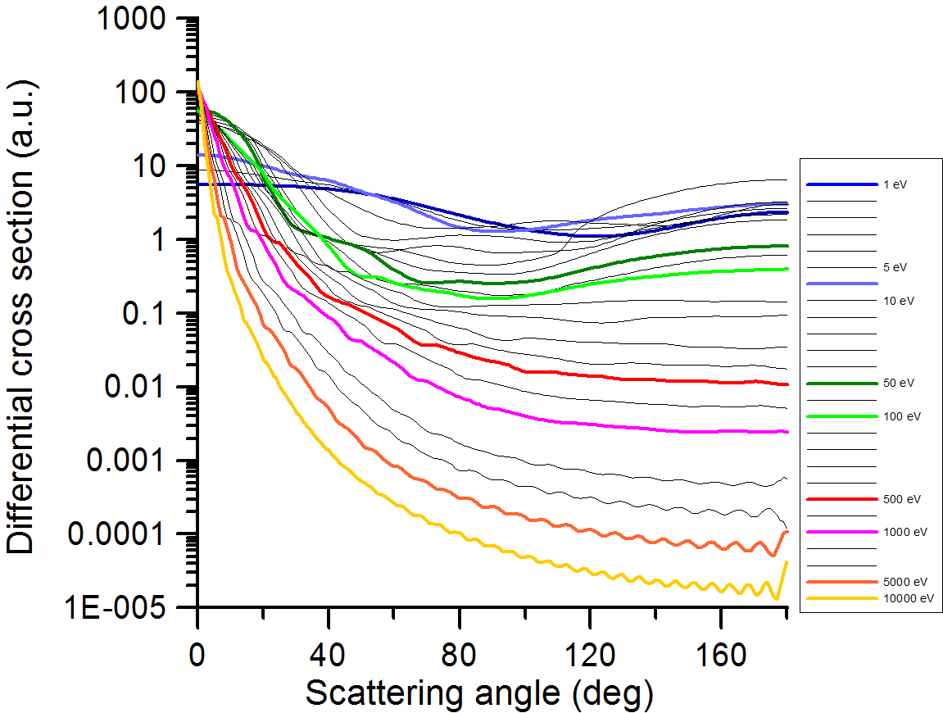
Input data: Angular distribution functions (DCS)
Pyrimidine

Slide 11
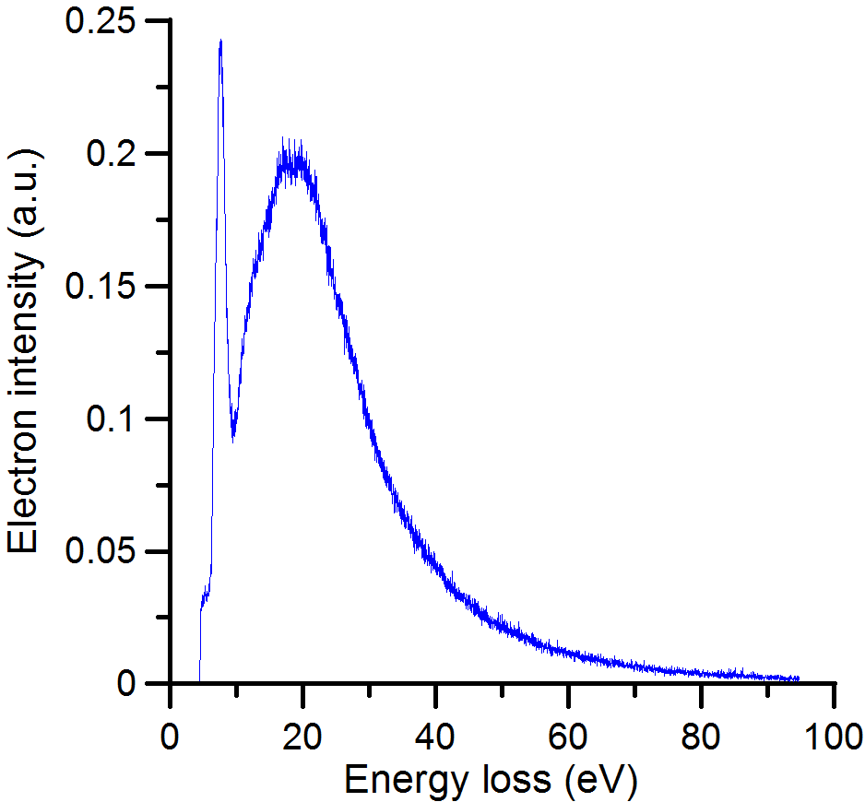
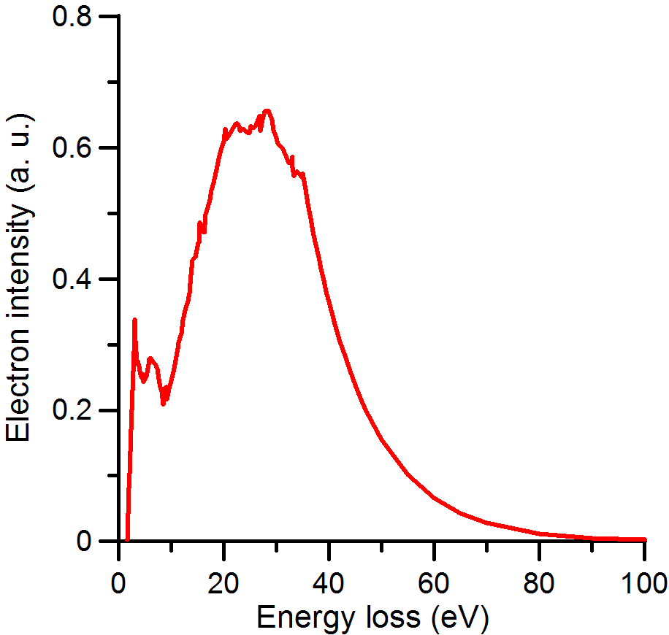
Input data: Energy loss distribution functions
Pyrimidine
Gold
Function truncated for energy < tail
Different function for low energy
High incident energy: include higher order ionisations
No angle dependency (being introduced…)

Slide 12
Calculations Electron scattering in molecular and condensed media
Atoms: Model potential representation,
Molecules:
Independent atom model (IAM), Aditivity rule (AR) with screening corrections (SCAR)
Additional dipole rotational excitations (FBA)
Condensation effects: Atomic and molecular clusters, liquids, solids (IAM-SCAR)
Low energy (< 20 eV) extension : Single-Centre Expansion and R-Matrix procedures
V(r)= V_{st}(r)+V_{ex}(r)+V_{pol}(r)+i[V_{abs}(r)]
Notes:
Optical potencial= static + exchange + polarisation (interaction with cloud of e-) + i*inelastic: elastic ICS and DCS, inelastic ICS and total ICS
No translational excitations!

Slide 13
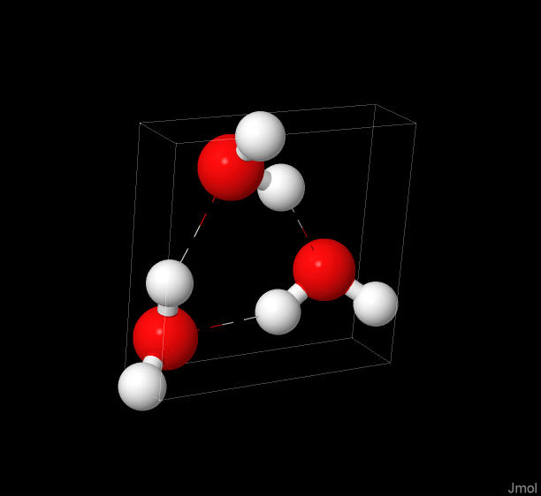
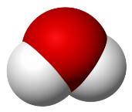

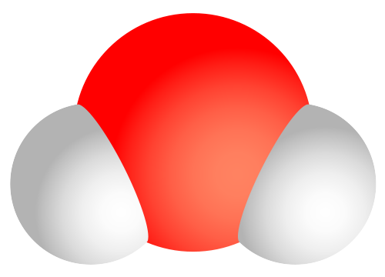
IAM-SCAR
water
(H₂O)₃ cluster
Liquid water
H₂O molecule
e⁻ , e⁺ -track

Slide 14
Total electron scattering cross section from pyrimidine
μ=2.3 D

Slide 15
Total electron scattering cross section from pyrazine
μ=0

Slide 16
Particle track simulation
Interaction cross section data
General MC Programme GEANT4
Energy loss distribution functions
LEPTS Code
GAMOS Architecture
Angular distribution functions
Laboratory verification

Slide 17
Total cross section (used for consistency check
Differential elastic cross section
Integral cross sections
(E,θ₁)
Elastic
Electron generation (E,θ_{o})
Collision event
Elastic/ inelastic
Differential inelastic cross section
Inelastic
(E’,θ’₁)
Fragment generation
Energy loss
spectra
Ionisation
New electron generation (E’’,θ₂)

Slide 18
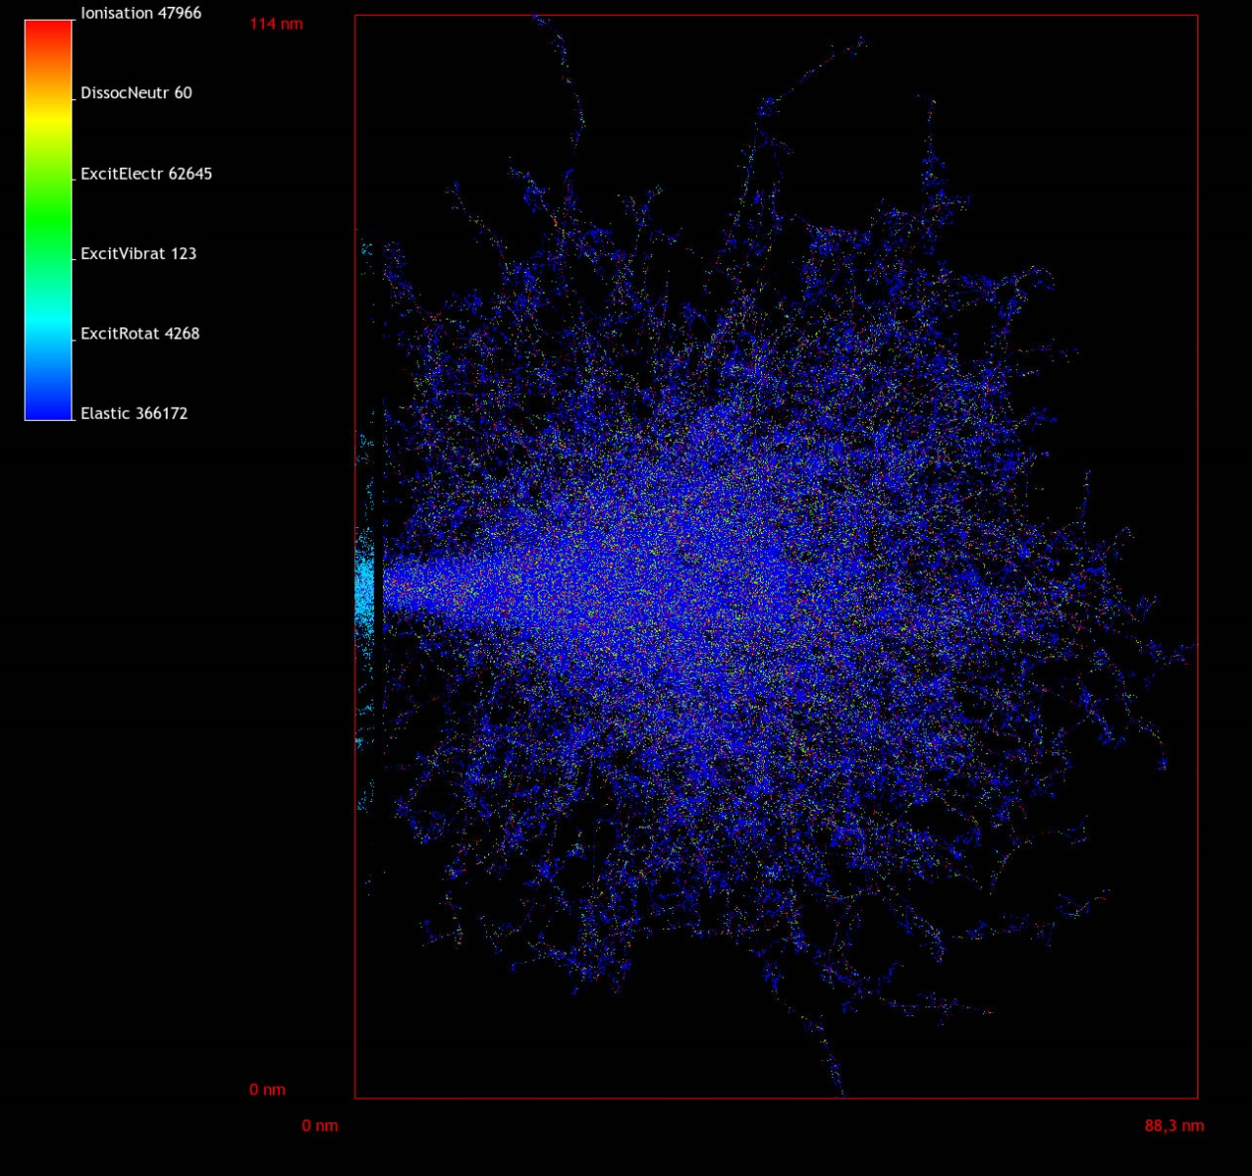
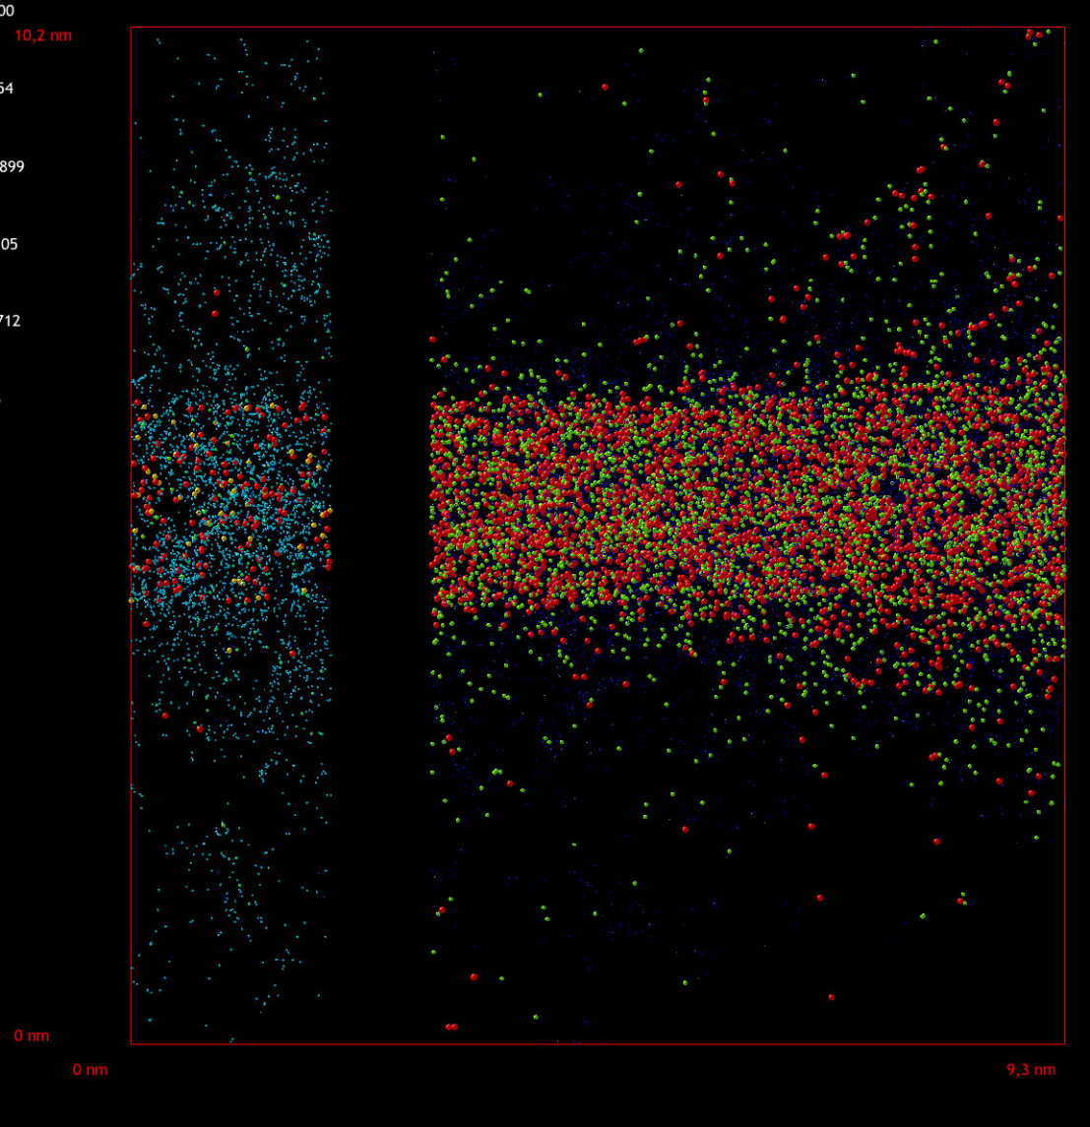
5keV electrons – pyrimidine on Au substrate
Pyrimidine
Gold

Slide 19
LEPTS into GEANT4
LEPTS has been ported to GEANT4 (removed all GAMOS dependencies)
source/processes/electromagnetic/lepts
source/physics_lists/constructors/electromagnetic/src/G4EmLEPTSPhysics
$G4EMLOW6.37/lepts

Slide 20
LEPTS vs DNA
 | LEPTS | DNA
Energy range | 0.1 eV – 100 keV | 10 eV – 10 keV
Processes | Elastic Ionisation Attachment Excitation Vibrational Excit. Rotational Excit. Neutron dissociation Positronium formation (e+) | Elastic Ionisation Attachment Excitation Vibrational Excit.
Materials | Water(liquid) Water (gas) Pyrimidine Pyrazine HCO Gold | Water (liquid)

Slide 21
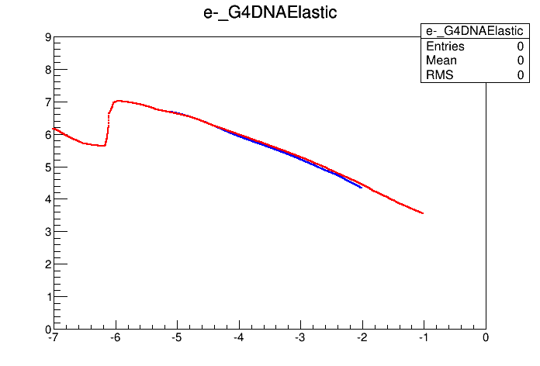
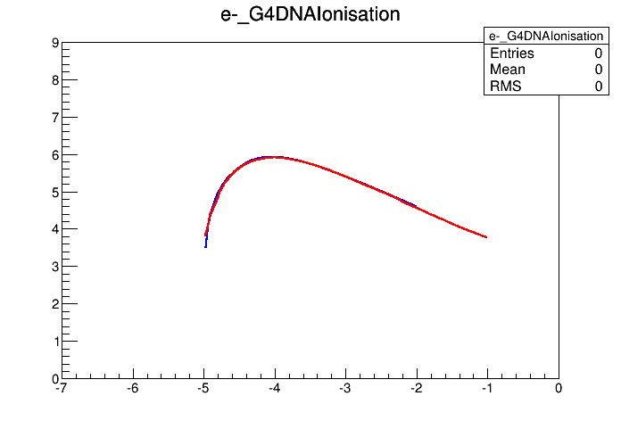
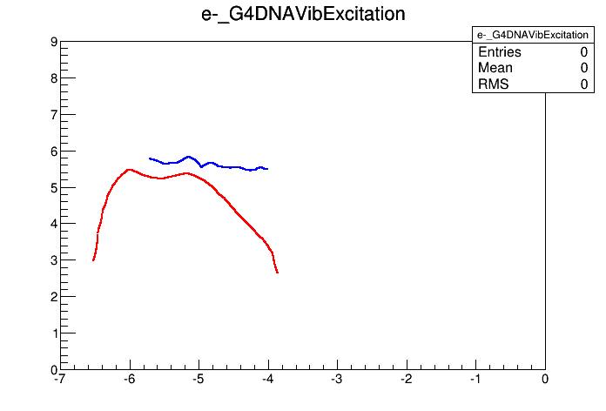
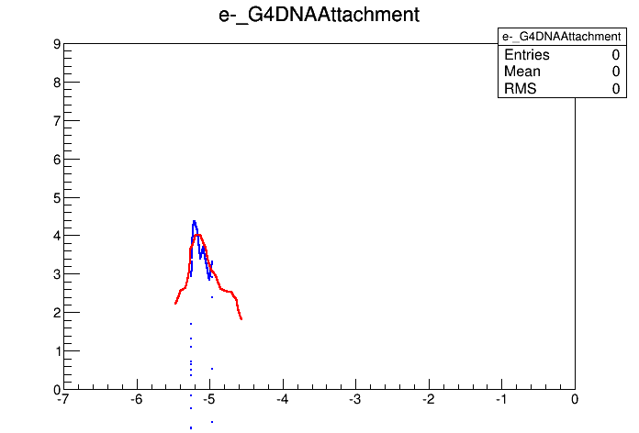
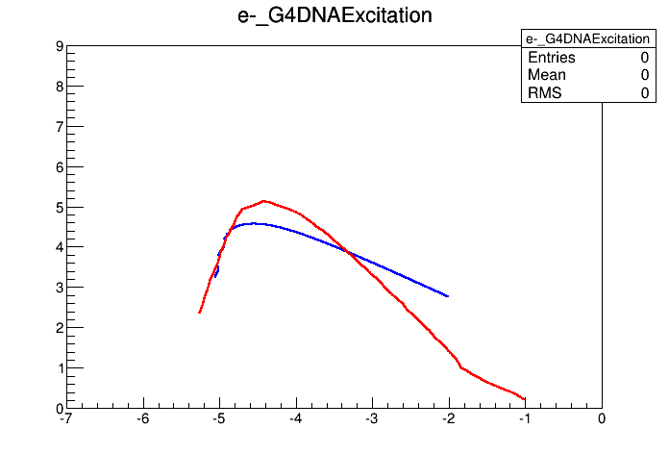
LEPTS vs DNA
Microscopic cross sections: liquid water
DNA
LEPTS
DNA
LEPTS
log10(XS) (mm⁻¹)
log10(XS) (mm⁻¹)
DNA
LEPTS
log10(XS) (mm⁻¹)
eV
keV
eV
keV
log10(energy) (MeV)
log10(energy) (MeV)
log10(energy) (MeV)
DNA
LEPTS
log10(XS) (mm⁻¹)
eV
keV
log10(energy) (MeV)
eV
keV
log10(energy) (MeV)
eV
keV
log10(energy) (MeV)

Slide 22
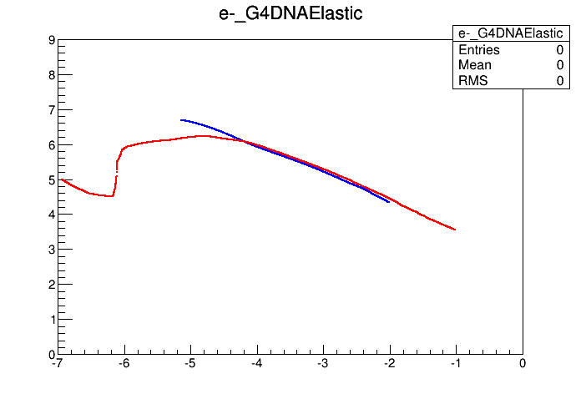
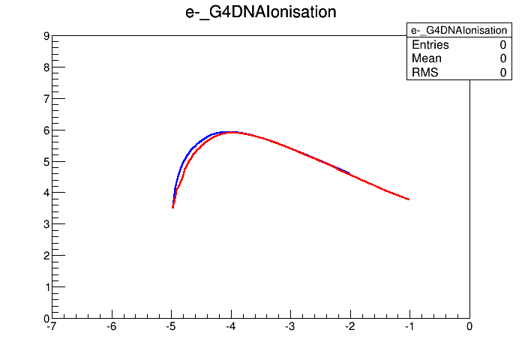


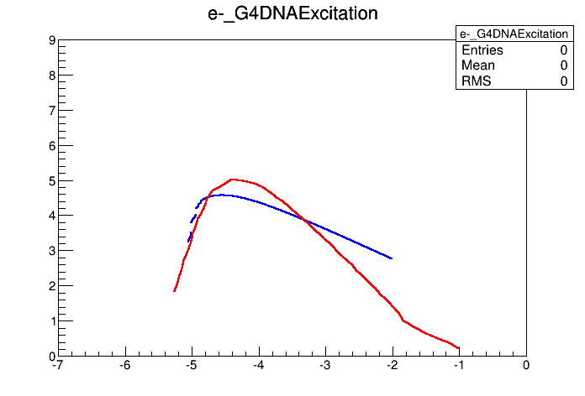
LEPTS vs DNA
Microscopic cross sections: gaseous water
DNA (liquid)
LEPTS
DNA (liquid)
LEPTS
log10(XS) (mm-1)
DNA (liquid)
LEPTS
log10(energy) (MeV)
DNA (liquid)
LEPTS

Slide 23
LEPTS vs DNA
1 keV e- in infinite water
 | LEPTS (E < 10 eV) | DNA | LEPTS
CPU | 0.035 sec | 0.090 sec | 23 sec
N elastic | 524 | 2529 | 59320
N ionisation | 36 | 51 | 36
N Attachment | 0.12 | 0.92 | 3.3
N Excitation | 4.5 | 6.4 | 5.1
N Vibrati. Exc. | 18 | 284 | 465
N Rotat. Exc. | 345 | - | 3098
N Neutral Dissoc. | 19 | - | 19
N total | 948 | 2872 | 59683

Slide 24
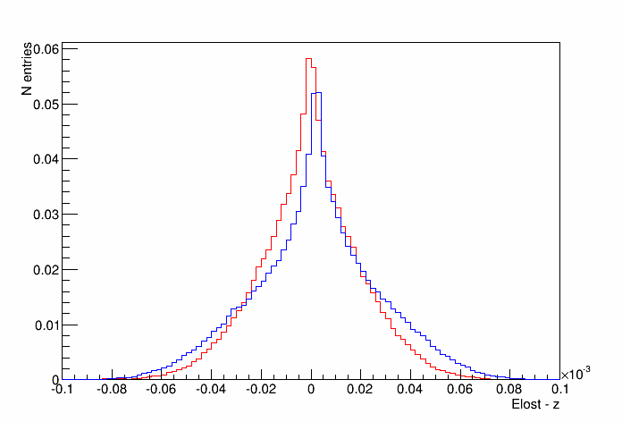
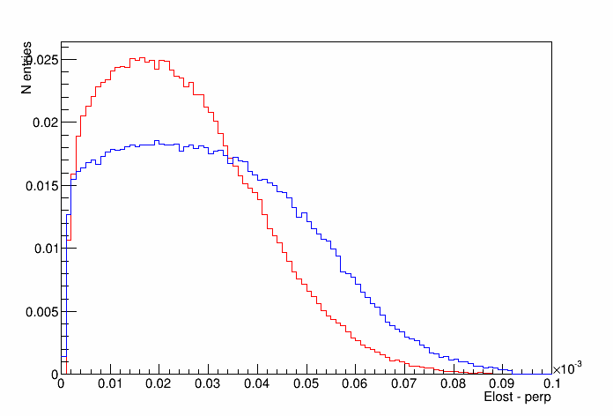
LEPTS vs DNA
1 keV e- in infinite water
E- sent along Z axis
LEPTS
DNA
LEPTS
DNA
Elost per event
Elost per event
Z (micron)
XY (micron)

Slide 25
Conclusions
By integrating GEANT4 (high energy)+ GAMOS (geometry)+LEPTS (low energy) we obtained a suitable tool to simulate single particle tracks over a wide energy range.
This modelling procedure provides a detailed map of induced dissociation in molecular targets adsorbed on solid substrates.
Validation experiments are currently in progress
New measurements on further interactions of produced radicals are needed
LEPTS vs DNA:
LEPTS 0.1 eV – 100 keV, DNA 10 eV – 10 keV
LEPTS has more processes: rotational excitation, neutral dissociation, positronium formation
LEPTS has more materials: water gaseous, pyrimidine, pyrazine, HCO, Au
Cross sections are similar for elastic and ionisation
Cross sections are significantly different for attachment, electro. Excit., vib. excit.

