Slide 1
ARTIFICIAL INTELLIGENCE
Sokobond - pygame
up202108689 – António Azevedo
up202108794 – José Martins
up202108776 – Tomás Martins

Slide 2
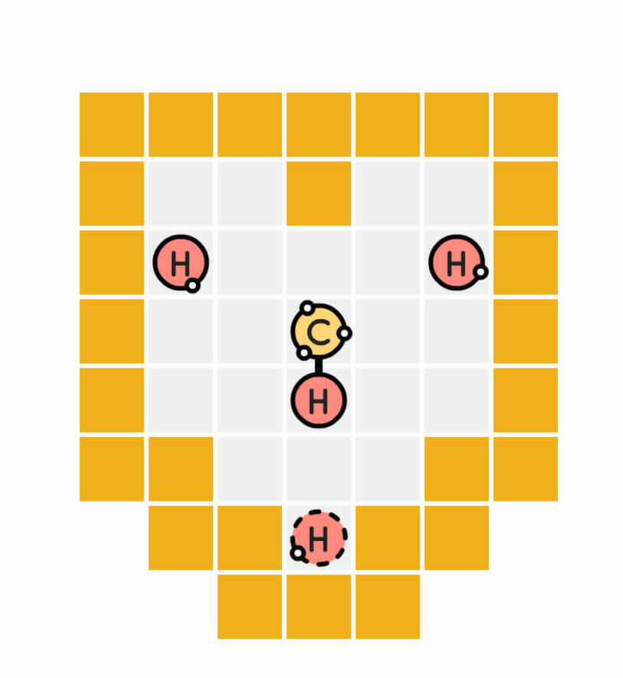
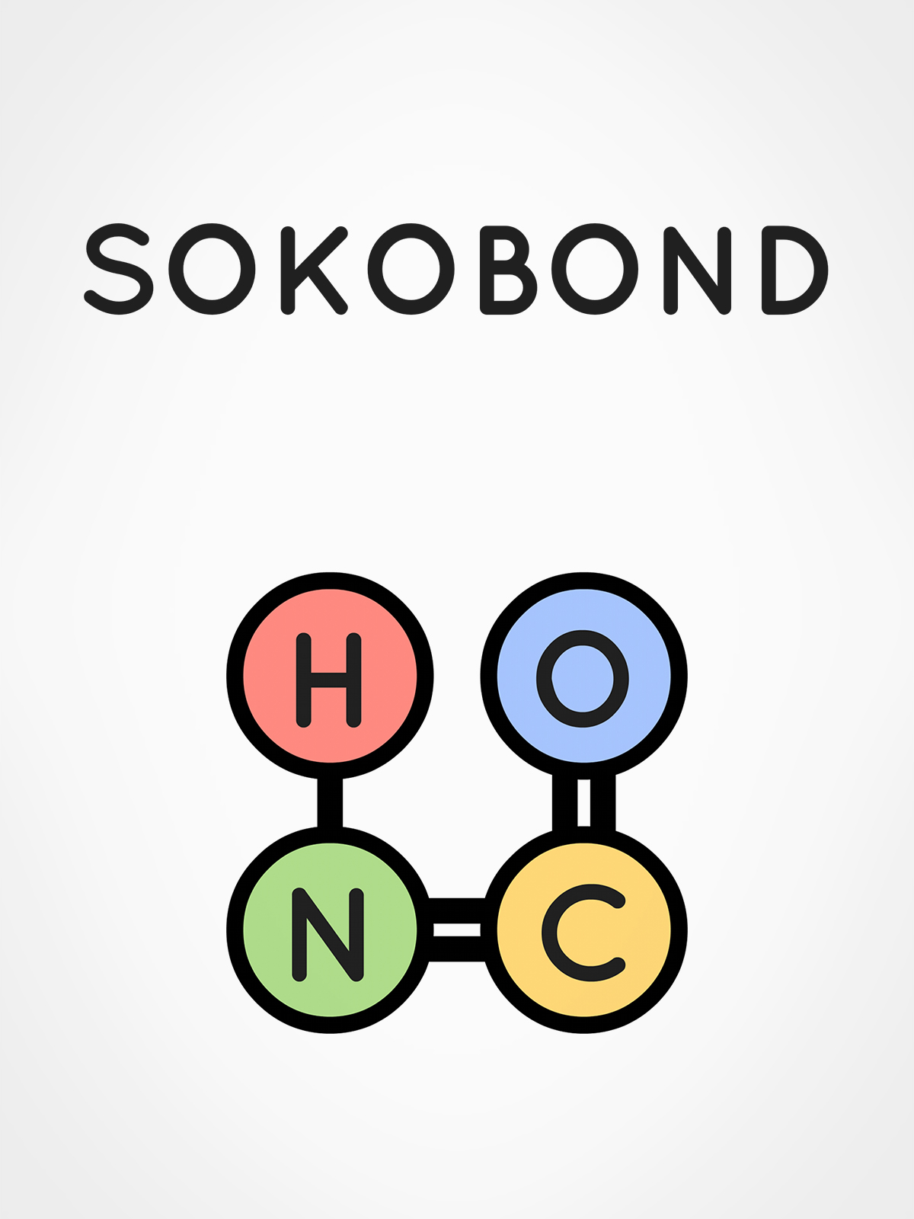
Sokobond
Sokobond offers a unique puzzle experience that blends logic with chemistry. Players strategically move atoms on a grid, aiming to form specific molecules by bonding with other atoms located on the grid
For this game, the player is expected to bond all the atoms together, forming the desired molecule, while ensuring that no electrons are left unconnected

Slide 3
Problem Formulation
State Representation
Initial State
Objective test
Configuration of all atoms on the grid as well as the available bonding connections and connections made
The positions of atoms on the grid, their bonding connections, and the player-controlled atom.
Each solution is a sequence of actions leading to one merged molecule with all bonds utilized
Preconditions
Efects
Cost
Operators
- move operator -
Can only move up, down, left, or right.
Must move to an empty cell or push an atom to an empty cell
Moves to the new cell.
Forms a bond if adjacent to another atom and bonding limit not exceeded.
Pushes an atom if no bonding connection possible.
The cost is 1

Slide 4
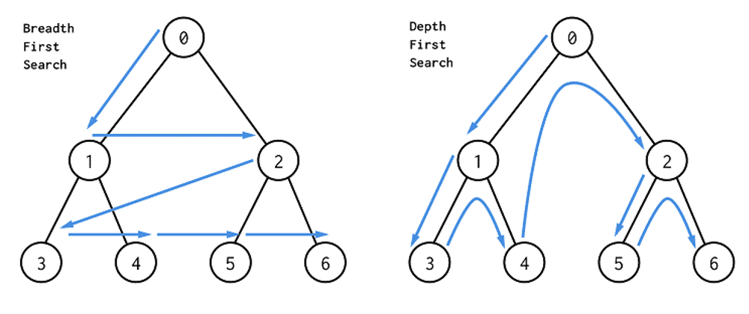
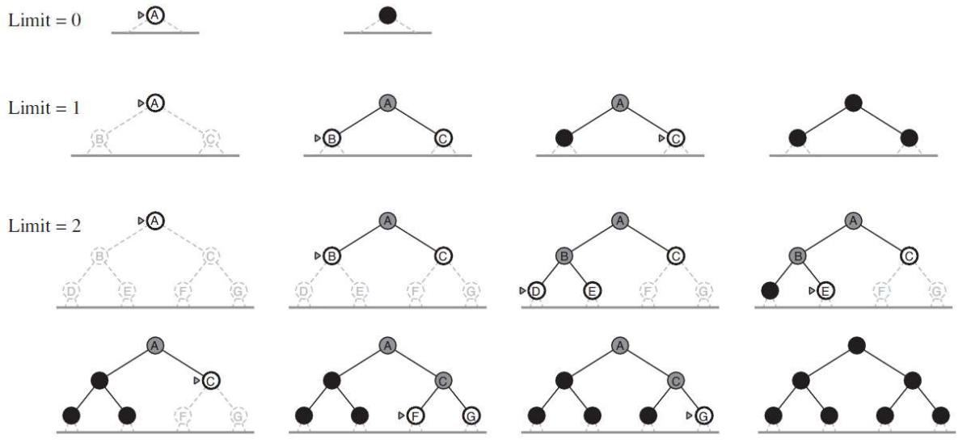
Uninformed algorithms
01.
02.
03.
Breadth-First Search (BFS)
Depth-First Search (DFS)
Iterative deepening search (IDS)
BFS explores the shortest path by examining all possible moves from the current state before moving to the next level of possibilities.
DFS explores as far as possible along each branch of the move tree before backtracking, prioritizing depth over breadth in its search for a solution.
Iterative Deepening Search combines the benefits of both BFS and DFS by repeatedly performing DFS with increasing depth limits until the solution is found.

Slide 5
Heuristics and algorithms
Heuristics
Algorithms
Manhattan Distance
A* Algorithm
Prioritize Free Electrons
Greedy search
Minimize Free Electrons

Slide 6
Uninformed algorithms - analysis
01.
02.
03.
Breadth-First Search (BFS)
Depth-First Search (DFS)
Iterative deepening search (IDS)
While it was anticipated that this algorithm would eventually reach the optimal solution, it was pleasantly surprising to observe that it achieved this outcome within a short timeframe without using too much memory resources.
DFS's high memory usage can impede its ability to find a solution as level complexity increases. However, in theory, on a computer without memory constraints, DFS would always find a solution. Despite not getting the optimal solution, DFS manages to produce results within a reasonable timeframe.
While it was anticipated that this algorithm would surpass BFS in finding optimal solutions, it fails due to its poor search pace and inability to operate within memory constraints, often failing to find solutions within feasible limits.

Slide 7
informed algorithms - analysis
01.
02.
A* aLGORITHM
Greedy search
Regardless of the chosen heuristic, the A* algorithm impresses by consistently discovering optimal solutions while excelling in both search time and efficient utilization of memory resources.
This algorithm was able to frequently find optimal or near-optimal solutions in a short time, regardless of the chosen heuristic. Unfortunately, challenges arise with highly complex levels, where the algorithm struggles to operate within memory limits, impeding its ability to find solutions.

Slide 8
algorithms - analysis
Both the Breadth-First Search (BFS) and A* algorithms excel in finding optimal solutions while maintaining impressive speed being the fastest and most capable of all algorithms
The significant number of nodes stored in memory directly influences the time required for the Iterative Deepening Search (IDS) algorithm to reach a solution.

Slide 9
Heuristics - analysis
01.
02.
03.
Manhattan Distance
Prioritize Free Electrons
Minimize Free Electrons
This heuristic prioritizes states where the controlled atom/molecule is nearer to a potential bonding atom. The Manhattan distance heuristic exceed expectations, delivering excellent results even with the greedy algorithm, which can sometimes struggle to find feasible solutions.
This heuristic prioritizes bonding by connecting the player molecule to atoms with more free electrons. While not as promising as the Manhattan distance heuristic, it still achieved good solutions. However, when paired with the greedy algorithm, it often struggled to calculate feasible solutions.
This heuristic evaluates the number of free electrons and favors states with fewer free electrons. While it operates within a reasonable search time frame, solutions generated may not be as optimal as with other heuristics. Additionally, this heuristic when paired with the greedy search can struggle to find feasible solutions.

Slide 10
Heuristics - analysis
The Manhattan Distance heuristic consistently outperformed the others with both algorithms, delivering superior results in execution time, memory usage, and finding mostly optimal solutions;
The Free Electrons heuristic, despite demanding a significant amount of memory resources and correlating with longer execution times compared to the third heuristic, yields substantially better solutions without compromising too much of the overall performance.

Slide 11
Conclusion and sources
liNKS
This project provided us with a valuable opportunity to understand how search algorithms work in the context of single-player games. We gained a clear understanding of the importance of optimization, ensuring the usage of algorithms with a balance between solution quality, system stability, and time efficiency. Moreover, we understood the significance of developing effective heuristics to speed up the solution finding process. Overall, this project strengthened our comprehension of game development, algorithm optimization, and problem-solving techniques.
Sources
STEAM PAGE: Sokobond on Steam;
Alternative implementation: JavaScript version on GitHub;
Ai uc books:
Stuart Russell, Peter Norvig: "Artificial Intelligence" ISBN: 978-0-13-207148-2;
Richard S. Sutton: "Reinforcement Learning" ISBN: 978-0-262-03924-6;
Stuart Russell, Peter Norvig: "Artificial Intelligence: A Modern Approach“;
Pygame Documentation: Official Pygame Documentation
It’s the closest planet to the Sun and the smallest one in the Solar System. This planet's name has nothing to do with the liquid metal, since Mercury was named after the Roman messenger god

