Slide 1
ARTIFICIAL INTELLIGENCE
Sokobond - pygame
up202108689 – António Azevedo
up202108794 – José Martins
up202108776 – Tomás Martins

Slide 2
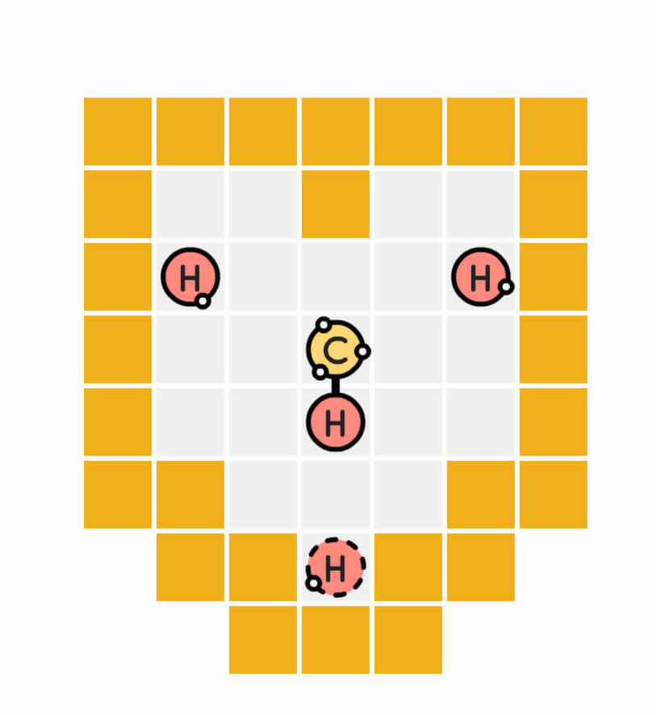
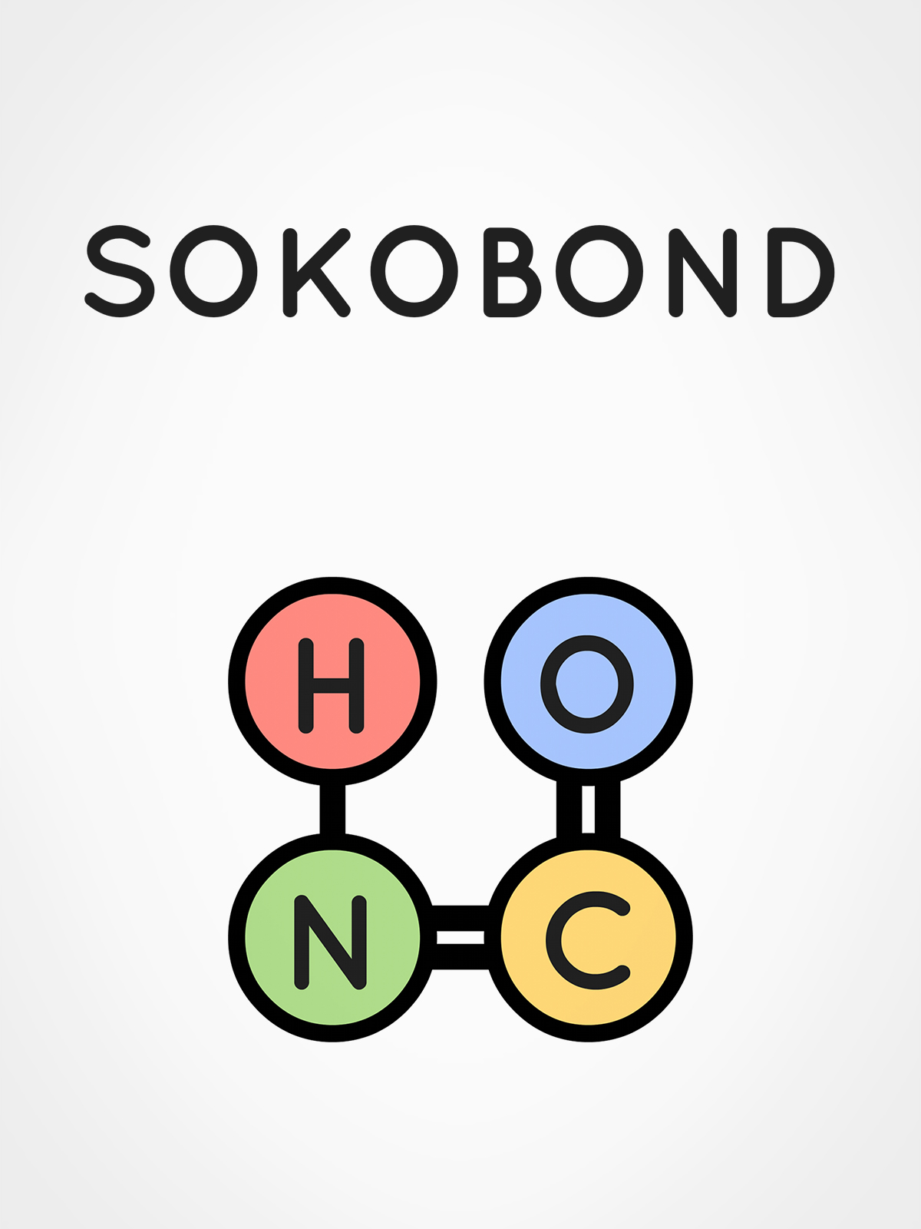
Sokobond
Sokobond offers a unique puzzle experience that blends logic with chemistry. Players strategically move atoms on a grid, aiming to form specific molecules by bonding with other atoms located on the grid
For this game, the player is expected to bond all the atoms together, forming the desired molecule, while ensuring that no electrons are left unconnected

Slide 3
Problem Formulation
State Representation
Initial State
Objective test
Configuration of all atoms on the grid as well as the available bonding connections
The positions of atoms on the grid, their bonding connections, and the player-controlled atom.
Each solution is a sequence of actions leading to one merged molecule with all bonds utilized
Preconditions
Efects
Cost
Operators
- move operator -
Can only move up, down, left, or right.
Must move to an empty cell or push an atom to an empty cell
Moves to the new cell.
Forms a bond if adjacent to another atom and bonding limit not exceeded.
Pushes an atom if no bonding connection possible.
The cost is 1

Slide 4
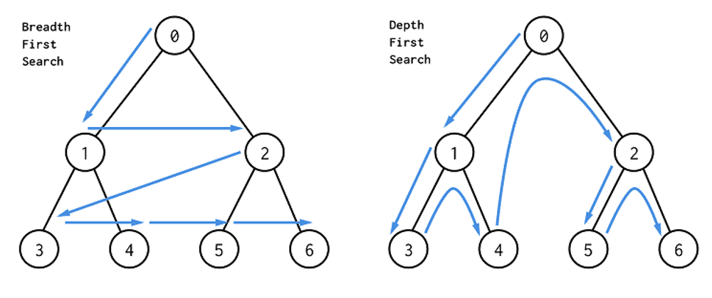
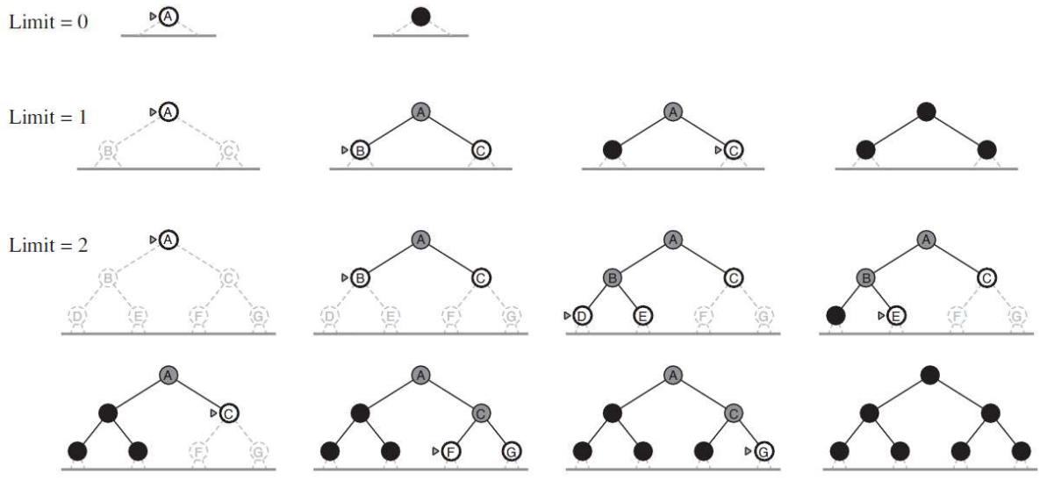
Uninformed algorithms
01.
02.
03.
Breadth-First Search (BFS)
Depth-First Search (DFS)
Iterative deepening search (IDS)
BFS explores the shortest path by examining all possible moves from the current state before moving to the next level of possibilities
DFS explores as far as possible along each branch of the move tree before backtracking, prioritizing depth over breadth in its search for a solution.
Iterative Deepening Search combines the benefits of both BFS and DFS by repeatedly performing DFS with increasing depth limits until the solution is found

Slide 5
Heuristics and algorithms
A* Algorithm
A* Algorithm
w/prunning
Manhattan Distance heuristic;
Manhattan Distance heuristic;
Prunes non-goal children;
Greedy search
A* Algorithm
Minimizing links
Prioritize atoms with more free electrons;
Minimize remaining connections;

Slide 6
Work done and sources
Engine: Pygame-powered (sokobond.py). Handles rendering, input, and state;
Loop: In sokobond.py. Controls FPS, updates, and rendering;
Data:
Atom class (entities.py): Defines atoms and bonding.
Game class (game.py): Manages game state and conditions.
Rendering: Using Pygame in sokobond.py, with atom sprites.
Input: Arrow keys defined in sokobond.py.
liNKS
Sources
STEAM PAGE: Sokobond on Steam;
Alternative implementation: JavaScript version on GitHub;
Ai uc books:
Stuart Russell, Peter Norvig: "Artificial Intelligence" ISBN: 978-0-13-207148-2;
Richard S. Sutton: "Reinforcement Learning" ISBN: 978-0-262-03924-6;
Stuart Russell, Peter Norvig: "Artificial Intelligence: A Modern Approach“;
Pygame Documentation: Official Pygame Documentation
It’s the closest planet to the Sun and the smallest one in the Solar System. This planet's name has nothing to do with the liquid metal, since Mercury was named after the Roman messenger god

