Slide 1

— Titanic data set analysis—
Iart proj2
Up202108689 – António Azevedo
Up202108794 – José Martins
Up202108776 – Tomás Martins

Slide 2

— The data set features —
1. Passenger class;
NaN Values
10. Fare;
2. Survived;
11. Cabin;
3. Home destination;
12. Embarked;
4. Name;
13. Boat;
5. Sex;
14. Body;
6. Age;
7. Sibling/Spouse;
8. Parent/Children;
9. Ticket;

Slide 3
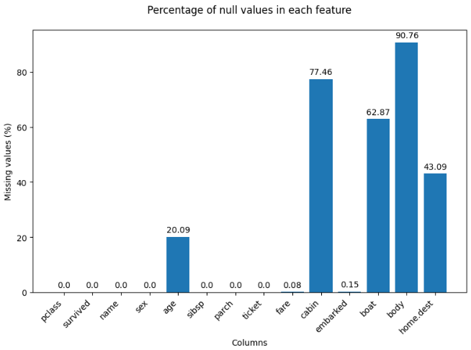

Data cleaning and goal
— The analysis—
To predict whether an individual survived the Titanic disaster using machine learning, we needed to clean our dataset. We removed features with a high percentage of missing values and handled other missing values by various methods, such as replacing them with the column's mean.

Slide 4
— Algorithms—
Logistic Regression
Random Forest
Decision Tress
MLP
Extra Trees
Multinomial Naive Bayes
SVM
KNN
Bernoulli Naive Bayes
Gradient Boosting
Gaussian Naive Bayes

Slide 5



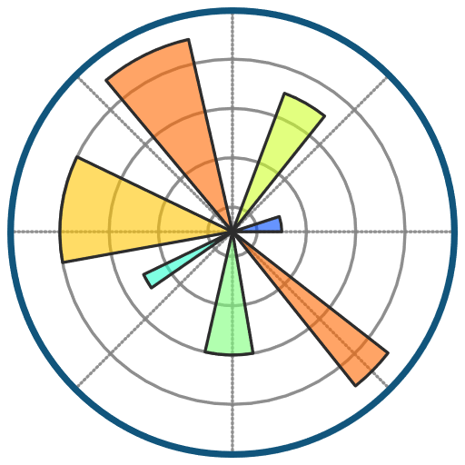
— Tools—
Pandas
Scikit-Learn
“Pandas is a Python library used for (…) analyzing, cleaning, exploring, and manipulating data.”
“Scikit-learn is a library in Python that provides many unsupervised and supervised learning algorithms.”
Seaborn
Matplot
“Seaborn is a Python data visualization library based on matplotlib. It provides a high-level interface for drawing attractive and informative statistical graphics.”
“Matplotlib is a comprehensive library for creating static, animated, and interactive visualizations in Python.”

Slide 6
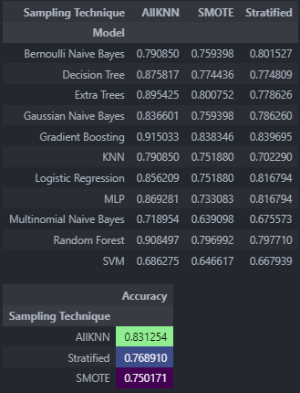
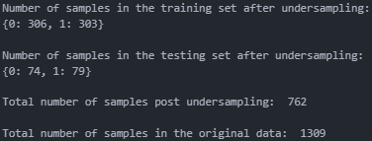
— Train-test split—
Upon concluding that our dataset was significantly unbalanced, we evaluated various balancing techniques: stratification, oversampling, and undersampling. We used accuracy as our metric due to being sufficiently descriptive and easy to use. Although undersampling gave the highest accuracy, it risked substantial information loss by reducing the dataset size. Consequently, we opted for stratification, which preserves the survival ratio between the training and test datasets, ensuring a more robust model without sacrificing data integrity. Then we split the data into 80% testing and 20% training.

Slide 7
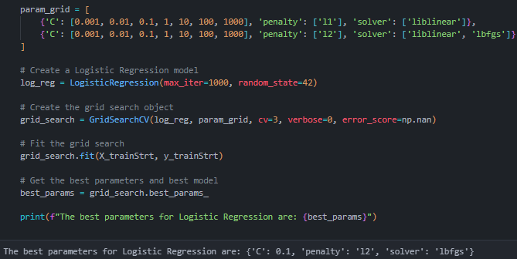
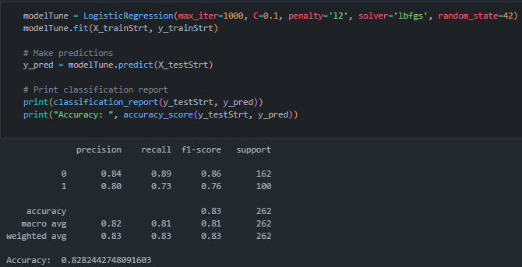
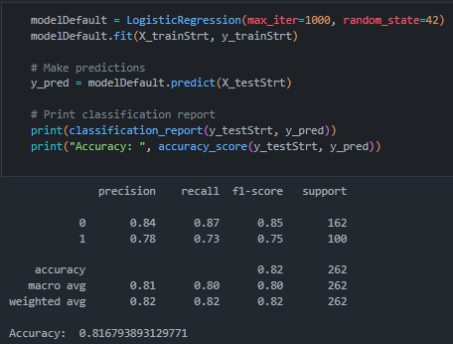
— Model testing and parameters tuning—
For each algorithm we tested, we generated a classification report that included accuracy, precision, recall, F1-score, and support metrics. To maximize each algorithm's performance, we used GridSearchCV to find the optimal hyperparameters, aiming for the best overall results. Finally, we compared the performance of the tuned models to those with default parameters, highlighting the improvements achieved through hyperparameter optimization.

Slide 8
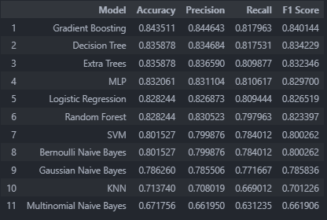
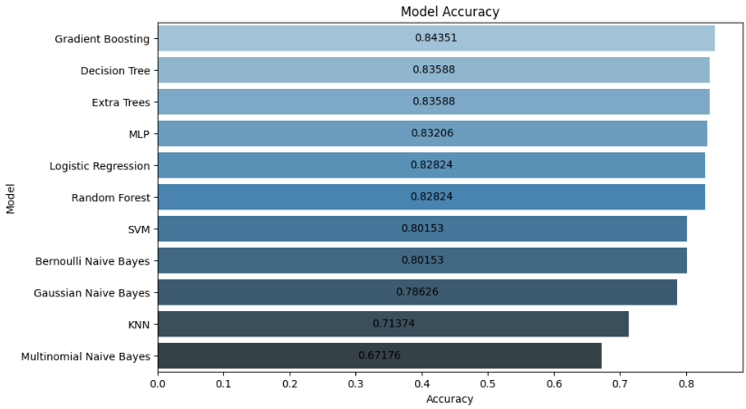
— Model’s results comparison—
After identifying the optimal parameters for each model, we compared their performance to determine the best model for our dataset. We ran all the algorithms and compiled their results into a table, sorted by accuracy. To enhance visual clarity, we created a bar plot displaying the accuracy of each algorithm. This visual representation facilitated the comparison between models, even though accuracy alone may not fully capture all aspects of model effectiveness. Despite its limitations, accuracy provided a sufficiently descriptive overview to highlight the relative performance of each algorithm.

Slide 9
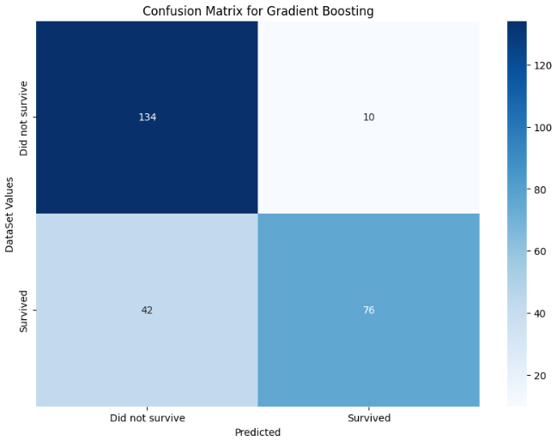
— Model’s results comparison—
Following this initial analysis, we conducted a deeper investigation into the results of the top-performing model, which was Gradient Boosting. To gain further insights, we generated a confusion matrix for this model. This allowed us to better understand its performance by examining the distribution of true positives, false positives, true negatives, and false negatives, providing a more detailed evaluation of its predictive capabilities.

Slide 10
—Sources—
LINKS
Titanic Dataset – Kaggle;
What is a Linear Regression – IBM;
What is a Decision Tree – IBM;
Random Forest – GeeksForGeeks;
What is a Neural Network – IBM;
Pandas – W3School;
Seaborn – Seaborn;
Scikit-learn – Codecademy;
Matplot – Matplotlib;

