Slide 1

— Titanic data set analysis—
Iart proj2
Up202108689 – António Azevedo
Up202108794 – José Martins
Up202108776 – Tomás Martins

Slide 2

— The data set features —
1. Passenger class;
NaN Values
10. Fare;
2. Survived;
11. Cabin;
3. Home destination;
12. Embarked;
4. Name;
13. Boat;
5. Sex;
14. Body;
6. Age;
7. Sibling/Spouse;
8. Parent/Children;
9. Ticket;

Slide 3

Goal
— The analysis—
NaN Value
Predict the survival of a Titanic passenger using the features mentioned before. This fall into a binary classification task, where we check whether a passenger survived (1) or not (0).
Some features contain a substantial number of NaN values, which can decrease their usefulness in predicting passenger survival. Given their limited contribution, these attributes will be removed from consideration.

Slide 4
— Algorithms—
Logistic Regression
Neural Networks
Random Forest
Decision Tress
Estimates the probability of an event occurring
Uses strategies that replicate how real neurons collaborate to identify phenomena, weight options, and reach conclusions.
An algorithm that uses different decision trees in order to improve the overall accuracy
A representation of the features that may lead to our goal in a tree-like structure

Slide 5


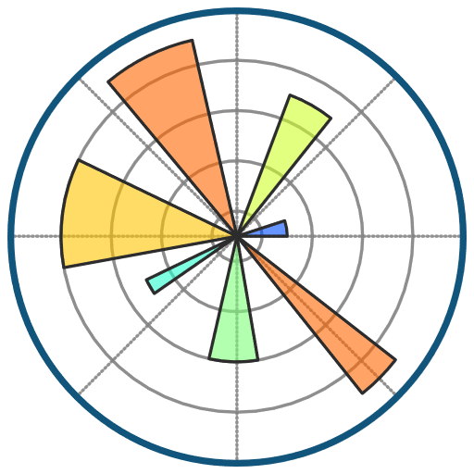


— Tools—
Pandas
Scikit-Learn
“Scikit-learn is a library in Python that provides many unsupervised and supervised learning algorithms.”
“Pandas is a Python library used for (…) analyzing, cleaning, exploring, and manipulating data.”
Matplot
“Matplotlib is a comprehensive library for creating static, animated, and interactive visualizations in Python.”
Seaborn
“Seaborn is a Python data visualization library based on matplotlib. It provides a high-level interface for drawing attractive and informative statistical graphics.”
TensorFlow
“TensorFlow makes it easy to create ML models that can run in any environment.”

Slide 6
— Work Done and Sources—
LINKS
Titanic Dataset – Kaggle;
What is a Linear Regression – IBM;
What is a Decision Tree – IBM;
Random Forest – GeeksForGeeks;
What is a Neural Network – IBM;
Pandas – W3School;
Seaborn – Seaborn;
Scikit-learn – Codecademy;
Matplot – Matplotlib;
Tensorflow – Tensorflow;
WORK ALREADY DONE
NaN values cleaned;
Necessary features chosen;
Simple analys of the data provided;

