Slide 1
Simulation of a Carpool System in an Artificial Road Traffic Network using NetLogo

Slide 2
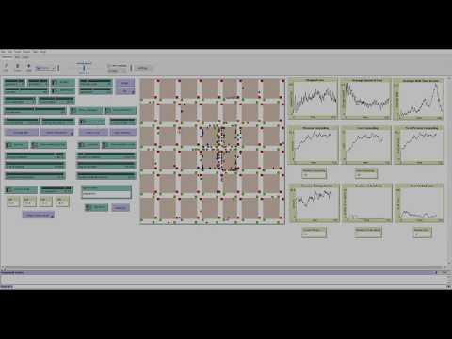
This is a slide title

Slide 3
Problem and motivation
1
What needs to be solved?

Slide 4
Problem
Under which conditions is a society capable of efficiently serve its citizens with a carpooling system?

Slide 5
Motivation
As students, a lot of our colleagues go to school using a carpool system
Many of them have problems finding suitable rides
We figured that providing relevant information through simulations could be a nice contribution to the various interested parties trying to develop apps or other solutions to facilitate the matching of rides

Slide 6
Methodology
2
How to tackle the problem?

Slide 7
Simulation and results analysis
Research of influencing factors to a traffic network
Development of a model that emulates a real world traffic network using NetLogo
Run the simulation in several different conditions
Analyse the results, study our findings and take conclusions from them

Slide 8
Model and Implementation
3
How was it done?

Slide 9
Model Classification
Our model can be classified as:
Dynamic because it evolves over time
Stochastic as it considers random variables (such as accident probability and car speed)
Continuous in space and discrete in time

Slide 10
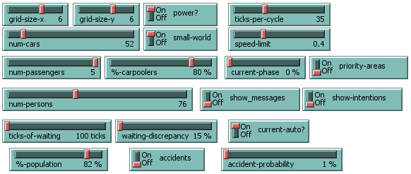
System variables

Slide 11
A little more info
Our model was developed as a multi-agent system using an already existing traffic grid model as a starting point upon which several additions were made. To do so we adopted two existing extensions to make the simulation more reliable: one of them to allow us to model BDI agents and another one to exchange messages between them complying with FIPA standards.

Slide 12
Results analysis
4
How do they compare?

Slide 13
And tables to compare data
 | 1 | 2 | 3 | 4 | 5 | 6
Cars | 50 | 50 | 50 | 50 | 50 | 100
Persons | 50 | 50 | 50 | 50 | 50 | 100
Priority areas | off | 4 blocks | 4 blocks | 8 blocks | 4 blocks | 4 blocks
Parking probability | 0.6% | 0.6% | 0.9% | 0.6% | 0% | 0.6%
Accident probability | 0.005% | 0.005% | 0.05% | 0.005% | 0% | 0.005%
Persons carpooling | 2 | 23 | 14 | 9 | 22 | 57
Vehicles carpooling | 2 | 12 | 8 | 5 | 12 | 31
Parked cars | 9 | 8 | 12 | 9 | n/a | 18
Accidents | 0 | 0 | 2 | 0 | n/a | 1

Slide 14
Conclusions
5
What did we learn?

Slide 15
Our findings
The main conclusion is that is perfectly possible to integrate a carpooling system in a society under the right circumstances, once there’s a suitable number of people offering rides and there’s a good matching algorithm between all the parties involved. Accidents and parking can influence the best possible outcomes, but usually the more people, the merrier.

