Slide 1
Empirical Study of the
Online Extra Trees (OXT) Regressor
Data Stream Mining · FEUP
António Romão (up202108704) · Bruno Moreira (up202107143)
River · Python 3.11 · OXT · ARF · HTR · Friedman Generator · Bike Sharing

Slide 2
Problem & Context
1
2
3
Incremental Learning
Strict Constraints
Concept Drift
Data arrives sequentially — no second pass. Models must learn one instance at a time without storing history.
Algorithms must operate under tight memory limits and real-time computational budgets in a single pass.
Underlying data distributions can shift over time (abruptly or gradually), causing previously learned patterns to become obsolete.
This study evaluates the Online Extra Trees (OXT) regressor — an ensemble method adapted for streaming data — comparing it against ARF (state-of-the-art) and HTR (structural baseline) across accuracy, resource efficiency, and drift adaptation.

Slide 3
OXT Algorithm — Main Idea
What is OXT?
Comparison of Approach
Online Extra Trees (OXT)
is an adaptation of the batch Extremely Randomized Trees algorithm, redesigned for data stream mining.
Traditional streaming tree ensembles compute the Hoeffding bound for every feature at every node — an expensive operation. OXT circumvents this by strongly randomizing both attribute selection and split-point cutoffs.
Key innovation: evaluate only a random subset of features and a random split value — drastically reducing mathematical overhead while maintaining ensemble diversity.
OXT
Random attribute subset + random split-point per node. No Hoeffding bound calculation.
ARF
Online bagging (Poisson) + Hoeffding bounds. Trains background trees on drift detection.
HTR
Single tree. Exact Hoeffding bound guarantees. Structural baseline.
Hypothesis: OXT maintains accuracy with lower time & memory than heavier ensembles.

Slide 4
OXT in a Streaming Setting — State & Updates
01
Leaf Statistics (State)
02
Instance Update
03
Concept Drift Detection
N · Σy · Σy²
predict → update
ADWIN
Each leaf tracks sufficient statistics for regression — instance count N, sum of targets Σy, and sum of squared targets Σy². No raw data is stored; only these aggregates.
When a new instance arrives, it traverses the tree. It updates the statistics at the matching leaf. Only random feature–cutoff combinations are evaluated — skipping exhaustive Hoeffding bound computation.
ADWIN drift detectors monitor each tree's sequential error. A statistically significant increase triggers a localized reset or replacement of that specific tree, allowing seamless adaptation without stopping the stream.
Key advantage: By skipping exhaustive Hoeffding bound calculations, OXT achieves significantly faster node creation — at the cost of less optimal split quality.

Slide 5
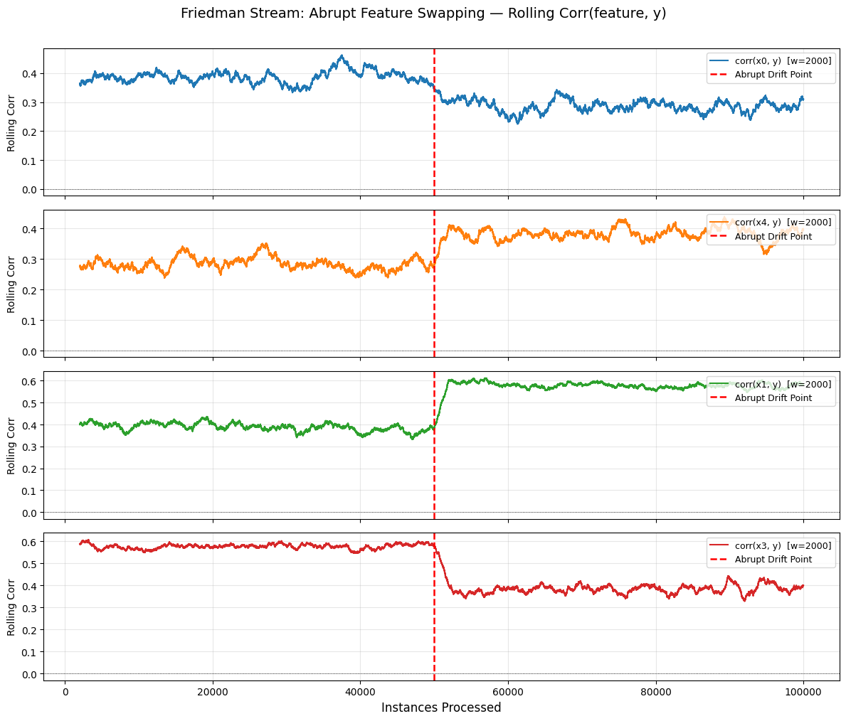
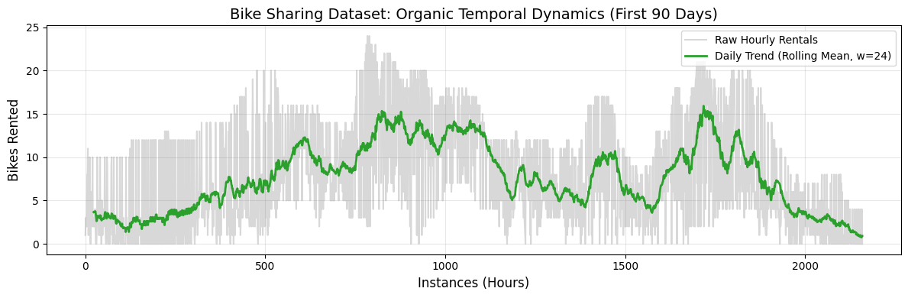
OXT — Concept Drift Handling
ADWIN Drift Detection
Stream Characterization — Concept Drift Visualization
OXT uses two-level ADWIN monitoring:
Warning detector (δ=0.01): Signals that a tree may be degrading — prepares attention.
Drift detector (δ=0.001): Triggers a statistically confirmed drift event — resets the obsolete tree.
Localized adaptation: Only the affected tree is reset, not the whole ensemble. Stream processing continues uninterrupted.
Limitation: Unlike ARF, OXT does NOT pre-train a background tree. After reset, the new tree must learn from scratch — causing a vulnerability window with temporarily degraded accuracy.
Abrupt drift: rolling correlation between features and target flips instantly at instance 50,000 after x0↔x4 and x1↔x3 feature-role swaps.
Bike Sharing: organic seasonal/daily dynamics visible in rolling mean.

Slide 6
Experimental Setup
Datasets
Algorithms & Metrics
Friedman Generator (Synthetic)
OXT
100,000 instances · 10 features
3 variants: Stationary, Abrupt Drift (i=50,000), Gradual Drift (window=10,000)
Drift: swap feature roles x0↔x4, x1↔x3 (5 random values total)
n_models=10, max_features=0.5/sqrt, bagging/subbagging. Pareto-score tuning (RMSE + throughput + memory). 25 random-search configs.
ARF
Bike Sharing (Real-World)
n_models=10, max_features=sqrt/log2, λ=1/6. "Gold Standard" ensemble baseline. Mirrors OXT grid where parameters are shared.
182,470 instances · 8 features
Hourly count of rented bicycles + meteorological/temporal data
UCI/OpenML benchmark — organic seasonal & daily dynamics
HTR
grace_period=100–500, RMSE-only tuning. Single-tree structural baseline — floor OXT must beat.
Evaluation: Prequential (test-then-train) · Rolling RMSE/MAE/R² (w=1,000) · Throughput (inst/sec) · Heap memory in KB (tracemalloc-corrected for ARF ×5.3) · 25 random-search configs per model

Slide 7
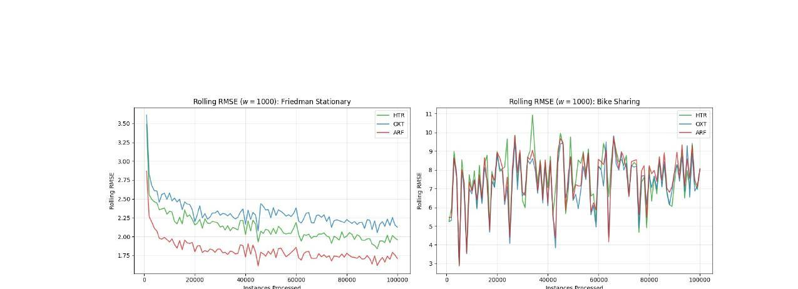
Results — Predictive Accuracy
Dataset / Model | RMSE | MAE | R²
Friedman · ARF | 1.821 | 1.407 | 0.868
Friedman · HTR | 2.126 | 1.633 | 0.820
Friedman · OXT | 2.319 | 1.805 | 0.785
Bikes · OXT ★ | 7.413 | 5.749 | 0.288
Bikes · ARF | 7.680 | 6.018 | 0.236
Bikes · HTR | 7.753 | 5.932 | 0.222
★ On real-world data: OXT wins — extreme randomization acts as a regularizer against noise. On synthetic data: ARF leads; OXT cannot offset small ensemble size vs. exact Hoeffding bounds.

Slide 8
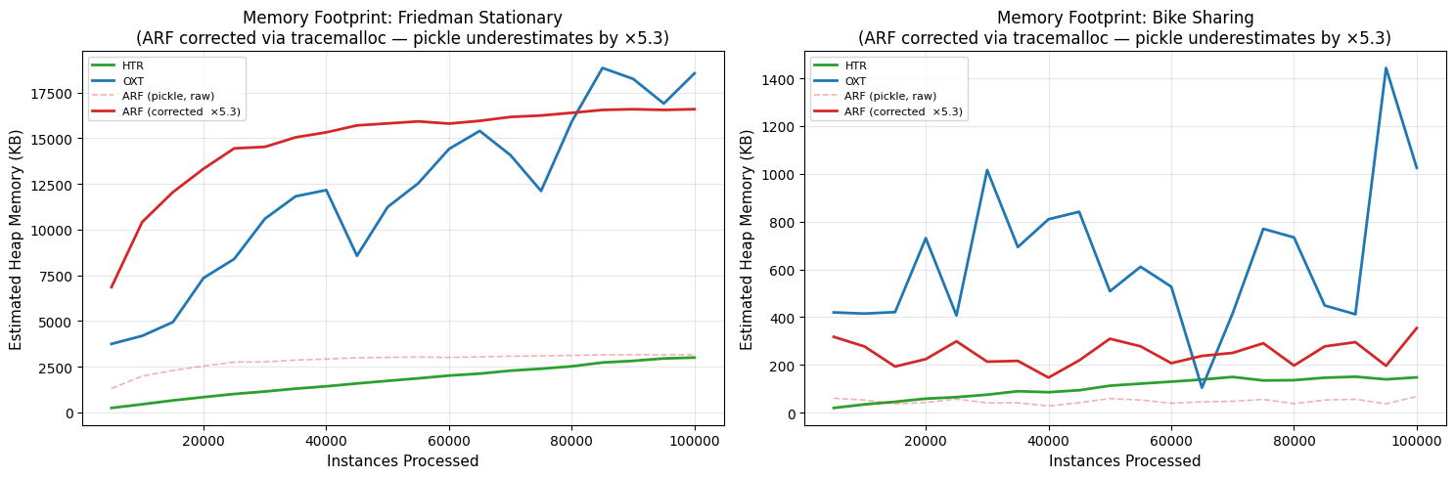
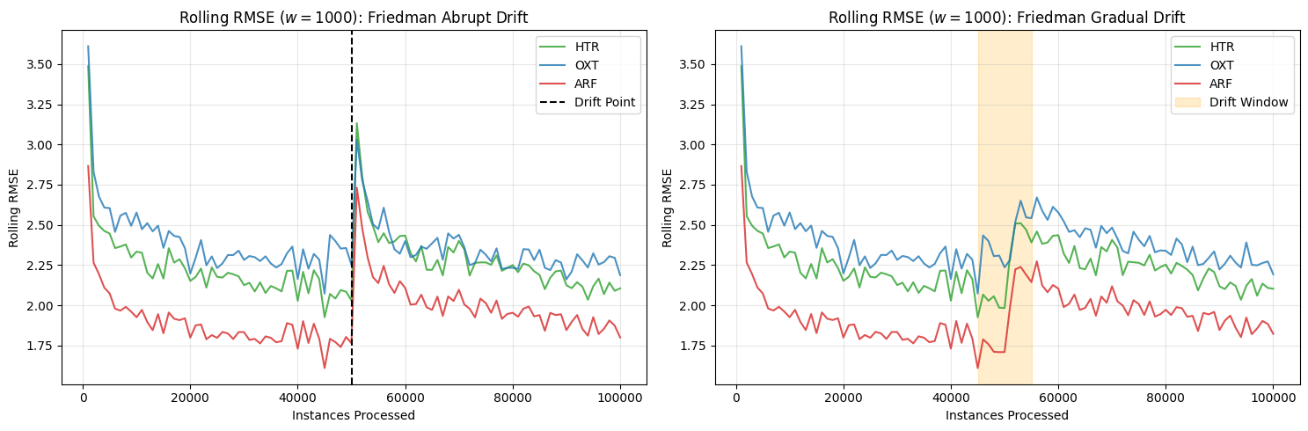
Results — Resource Efficiency & Drift Recovery
Memory Footprint (heap, tracemalloc-corrected)
Drift Recovery (Rolling RMSE w=1,000)
Throughput (inst/sec)
Model | Friedman | Bikes
HTR | 17,051 /s | 24,628 /s
OXT | 4,186 /s | 8,581 /s
ARF | 3,831 /s | 8,797 /s
OXT Memory:
Most volatile & heaviest (up to 19,000 KB Friedman vs ARF's corrected baseline). Uncontrolled tree growth from random splits.
HTR:
Drift Scenarios (Friedman)
Fastest (~4× ensembles) and lightest (<3,000 KB). Single-tree advantage.
Model | Abrupt RMSE | Gradual RMSE
ARF | 1.957 | 1.944
HTR | 2.265 | 2.249
OXT | 2.383 | 2.402
Drift recovery:
ARF's background-tree mechanism allows steeper, faster recovery. OXT resets trees from scratch — longer vulnerability window.

Slide 9
Strengths & Limitations
✓ Strengths
✗ Limitations
Superior generalization on noisy data
Underperforms on clean synthetic data
OXT won on Bike Sharing (RMSE 7.413 vs 7.680 ARF vs 7.753 HTR). Extreme randomization prevents overfitting to local noise — a common pitfall of strict Hoeffding-bound models.
OXT (RMSE 2.319) failed to beat the single HTR (RMSE 2.126) on Friedman Stationary. Extreme randomization needs a larger ensemble to approximate smooth mathematical functions.
Volatile, heavy memory footprint
Reliable concept drift detection
Contrary to the hypothesis, OXT was the most memory-intensive model — up to 19,000 KB on Friedman vs ~3,000 KB for HTR. Random splits produce bloated, asymmetric trees.
ADWIN-triggered localized tree resets work correctly for both abrupt and gradual drift. The ensemble recovers from structural distribution changes without stopping the stream.
No speed advantage over ARF; slower drift recovery
OXT matched ARF throughput (~4,000–8,600 inst/sec each). Without background-tree pretraining, OXT has a longer degraded-accuracy window post-drift.

Slide 10
Conclusions
Primary hypothesis REJECTED on resource efficiency: OXT did not process data faster than ARF and suffered from a heavier, more volatile memory footprint under strict hyperparameter constraints.
★
Best for noisy, organic environments
OXT's extreme randomization acts as a built-in regularizer. It excels when the primary risk is overfitting to noise — outperforming both ARF and HTR on Bike Sharing.
⚠
Avoid for clean, mathematical streams
On Friedman Stationary, OXT failed to surpass even the single-tree HTR baseline. A resource-constrained Pareto tuning exacerbates the effect of small ensemble size.
→
Deployment recommendation
Deploy OXT in organic data stream applications where generalization and noise-robustness matter most — but ensure the deployment environment can accommodate fluctuating memory demands.
Mastelini et al. (2023) · Online Extra Trees Regressor · IEEE TNNLS 34, 6755–6767

Slide 11
References
Martiello Mastelini, S., Nakano, F. K., Vens, C., & de Leon Ferreira de Carvalho, A. C. P. (2023). Online Extra Trees Regressor. IEEE Transactions on Neural Networks and Learning Systems, 34, 6755–6767. https://doi.org/10.1109/tnnls.2022.3212859
[1]
Ikonomovska, E., Gama, J., & Džeroski, S. (2010). Learning model trees from evolving data streams. Data Mining and Knowledge Discovery, 23, 128–168. https://doi.org/10.1007/s10618-010-0201-y
[2]
River Documentation. (n.d.). River: Machine learning for streaming data in Python. Retrieved from https://riverml.xyz
[3]
OpenML. (n.d.). OpenML: Democratizing Machine Learning. Retrieved from https://openml.org
[4]

Slide 12
Annex A — Hyperparameter Grids & Best Configurations
Parameter | OXT Grid | Friedman Best | Bikes Best
n_models | [10, 25, 50] | 10 | 10
max_features | [sqrt, log2, 0.5, None] | 0.5 | sqrt
resampling_strategy | [subbagging, bagging] | bagging | subbagging
resampling_rate | [0.5, 0.75, 1] | 1.0 | 1.0
leaf_prediction | [mean, model, adaptive] | model | mean
grace_period | [50, 100, 200] | 100 | 200
delta | [1e-7, 1e-3, 0.01] | 1e-7 | 0.01
max_depth | [None, 10, 20] | None | 10
ARF — Friedman Best | ARF — Bikes Best
n_models: 10 | n_models: 10
max_features: sqrt | max_features: log2
lambda_value: 6 | lambda_value: 1
leaf_prediction: model | leaf_prediction: mean
grace_period: 200 | grace_period: 200
delta: 0.001 | delta: 0.01
max_depth: 10 | max_depth: None
HTR — Friedman Best | HTR — Bikes Best
grace_period: 100 | grace_period: 500
max_depth: 20 | max_depth: 10
delta: 0.01 | delta: 0.01
tau: 0.05 | tau: 0.05
leaf_prediction: model | leaf_prediction: adaptive
binary_split: False | binary_split: True
Tuning: 25 random-search configs per model. Stationary Friedman (20,000 instances). OXT/ARF: Pareto score (0.75×RMSE + 0.15×throughput + 0.10×memory). HTR: RMSE only.

Slide 13
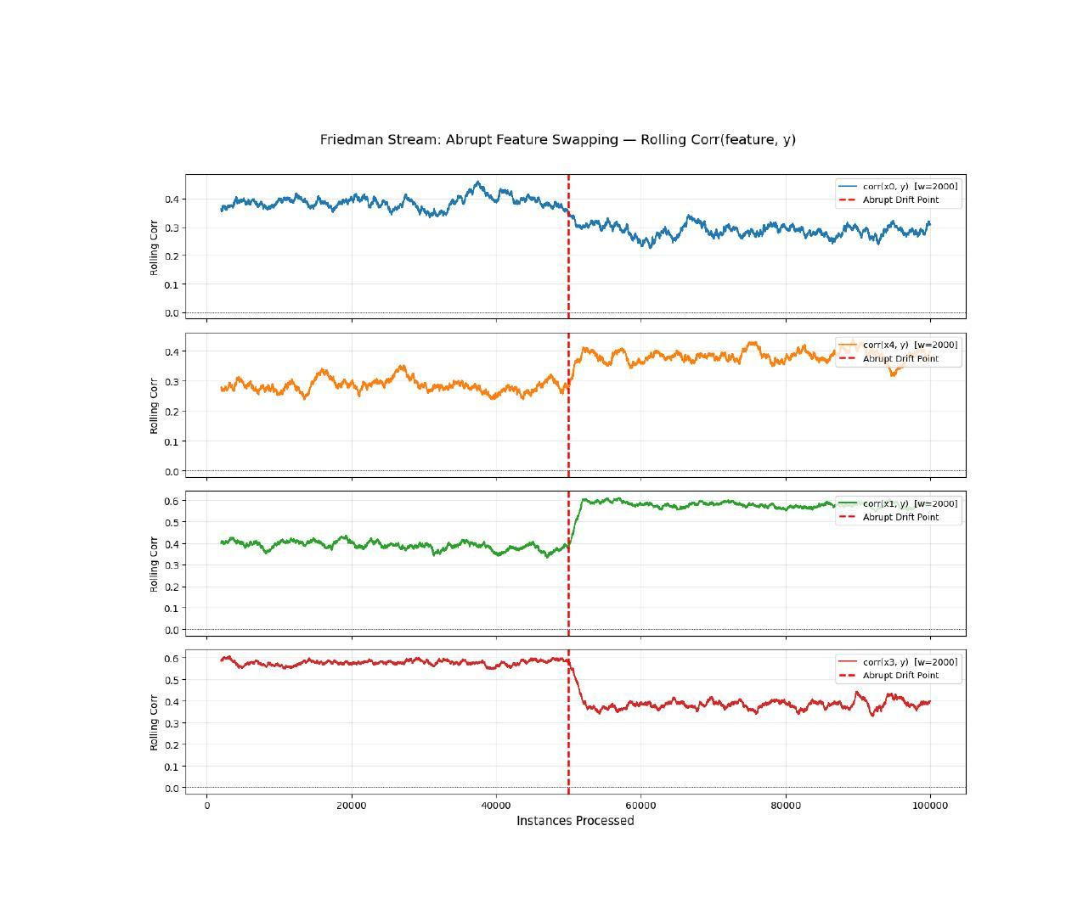
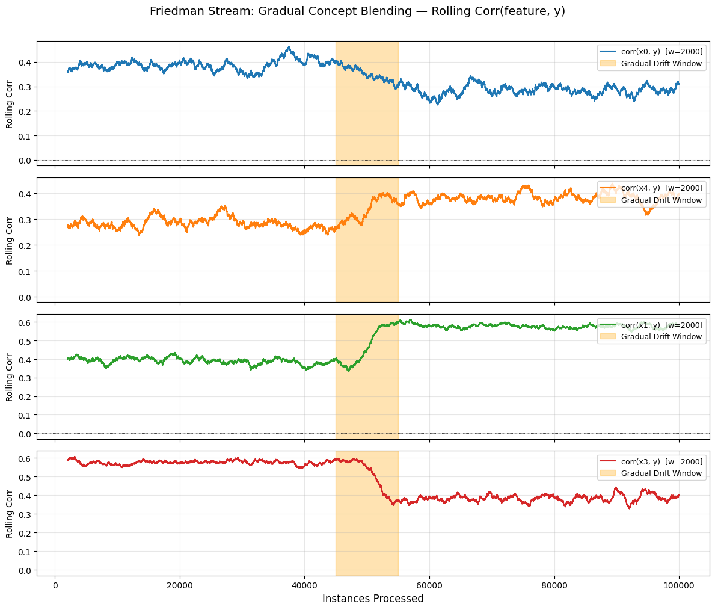
Annex B — Stream Characterization: Concept Drift Visualization
Friedman Abrupt Drift — Rolling Corr(feature, y), window=2,000
Friedman Gradual Drift — Rolling Corr(feature, y), window=2,000
At instance 50,000, the feature-target correlations flip instantaneously, confirming the abrupt swap of roles (x0↔x4, x1↔x3).
Orange band (45,000–55,000): sigmoid blend between concepts. Correlations transition smoothly, not instantly.

