Slide 1
Risk-Parity Allocation: A tree-based approach
Antônio Salomão

Slide 2
Data

Slide 3
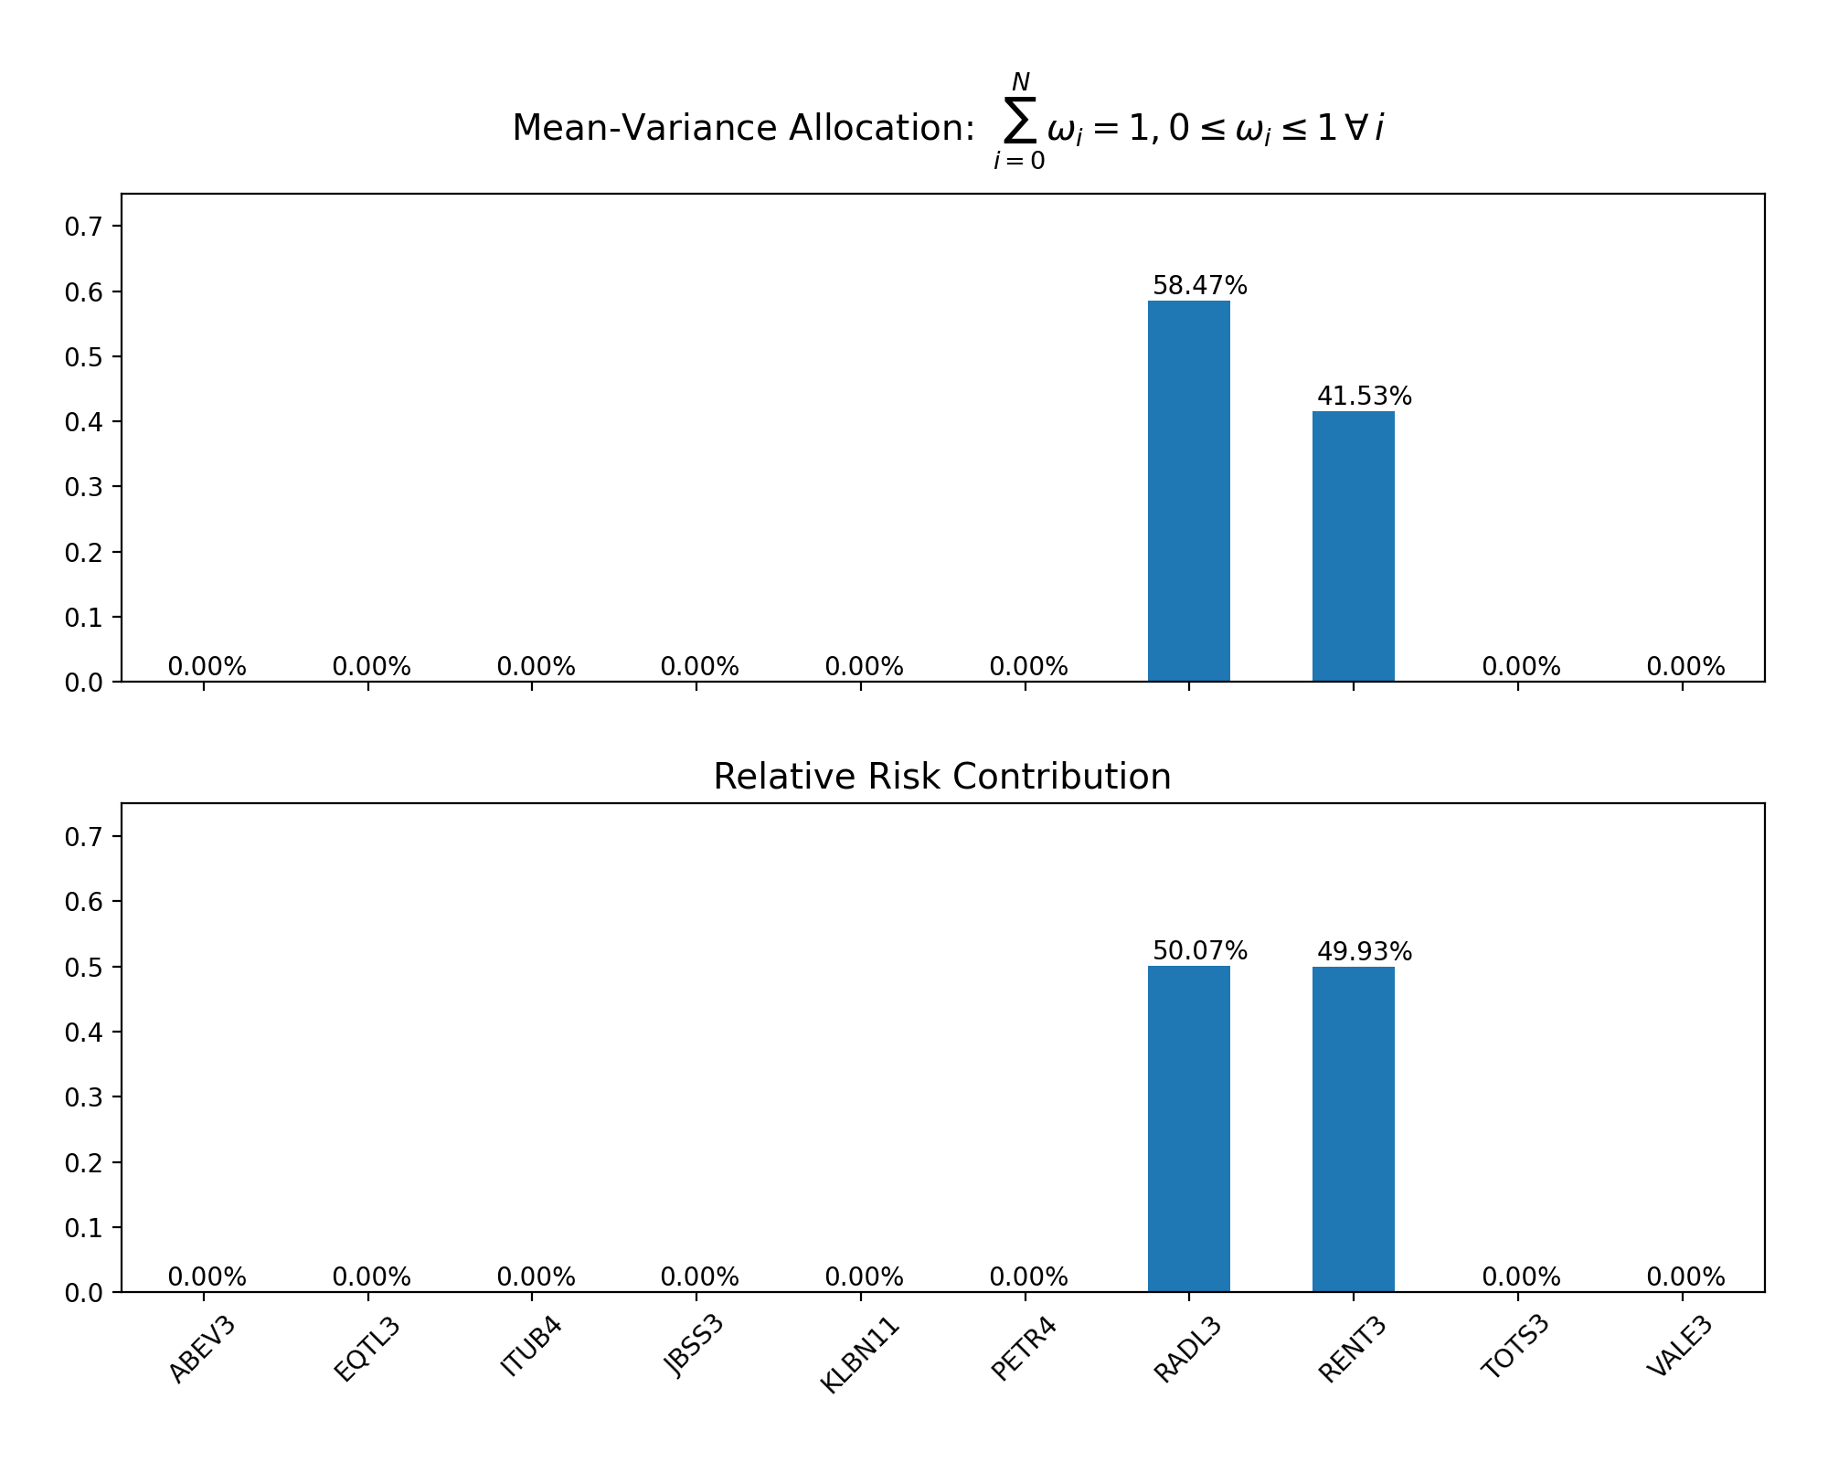
Portfolio metrics (ex-ante)
Expected Return:
Variance:
Sharpe:

Slide 4
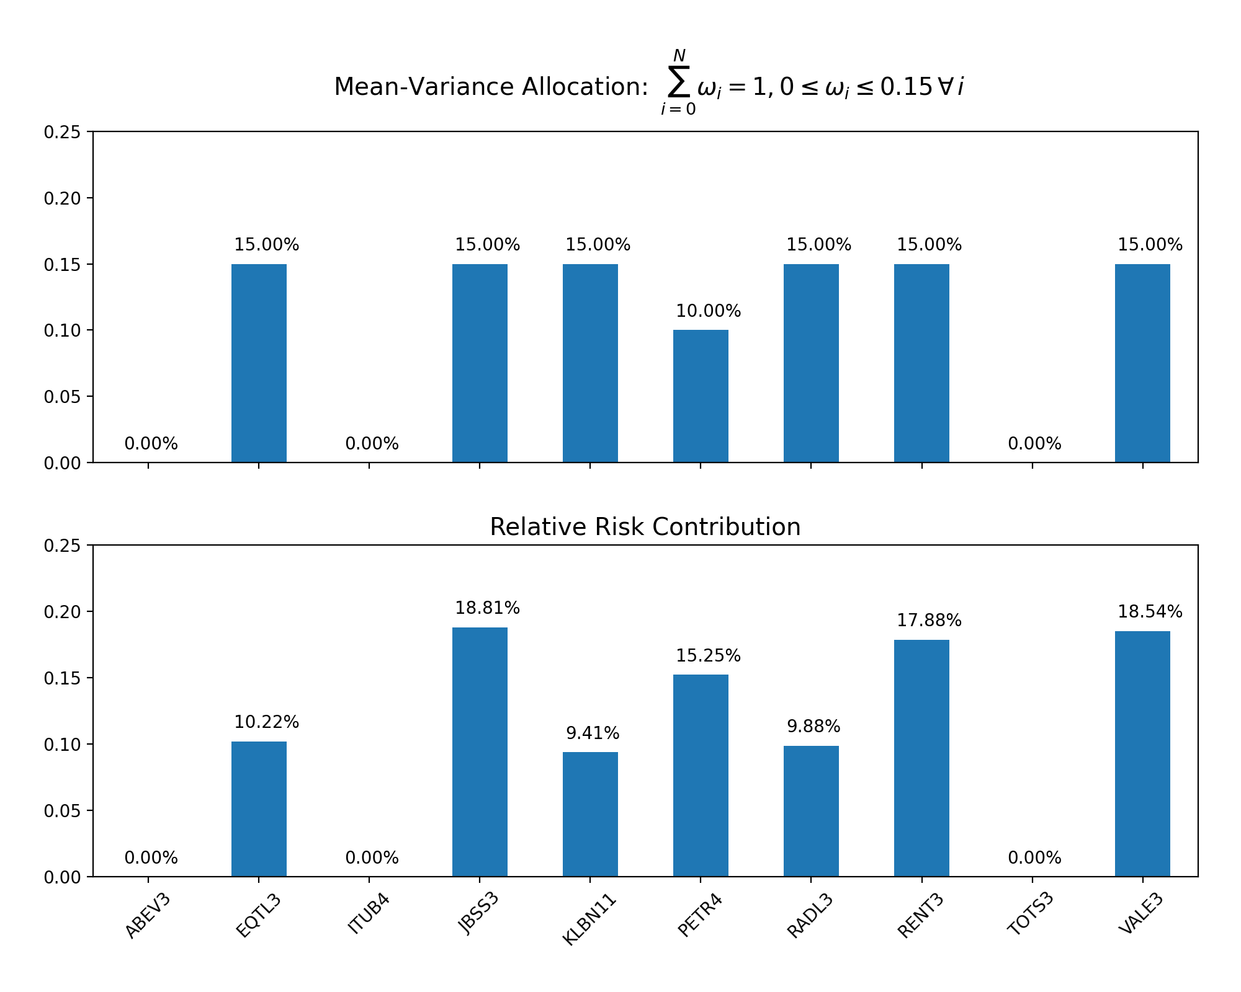
Portfolio metrics (ex-ante)
Expected Return:
Variance:
Sharpe:

Slide 5
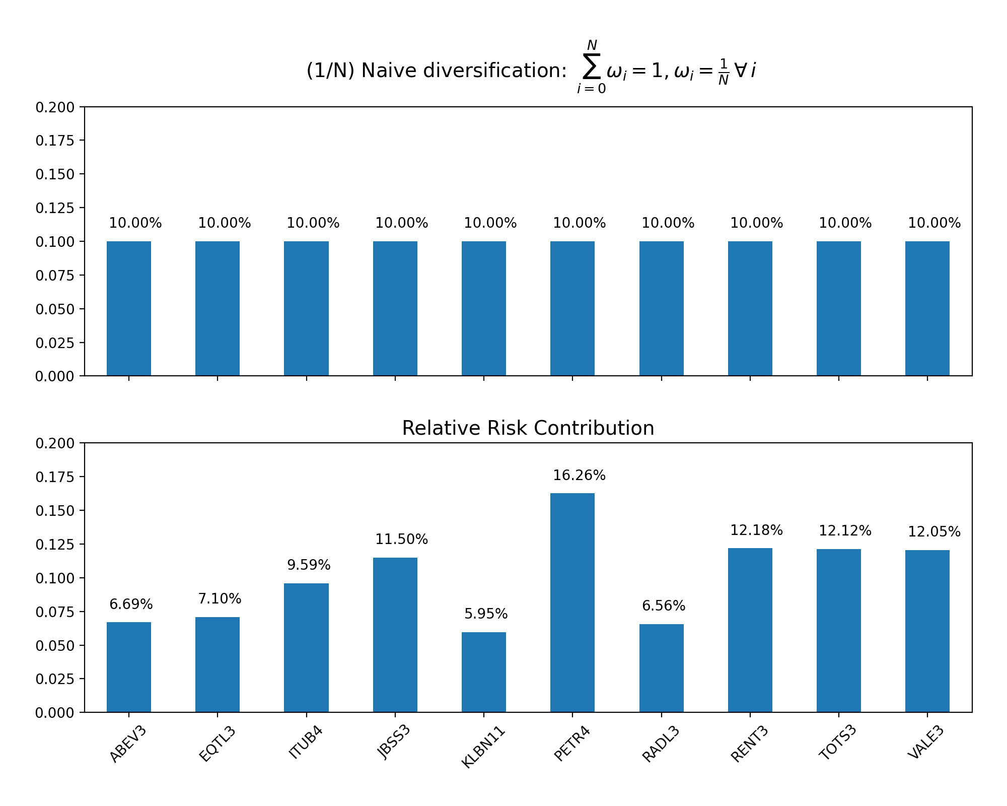
Portfolio metrics (ex-ante)
Expected Return:
Variance:
Sharpe:

Slide 6
Risk-Contribution
Risk Contribution
Relative Risk Contribution
Formulas

Slide 7
Risk-Parity: Long-only (Maillard et. al, 2009)

Slide 8
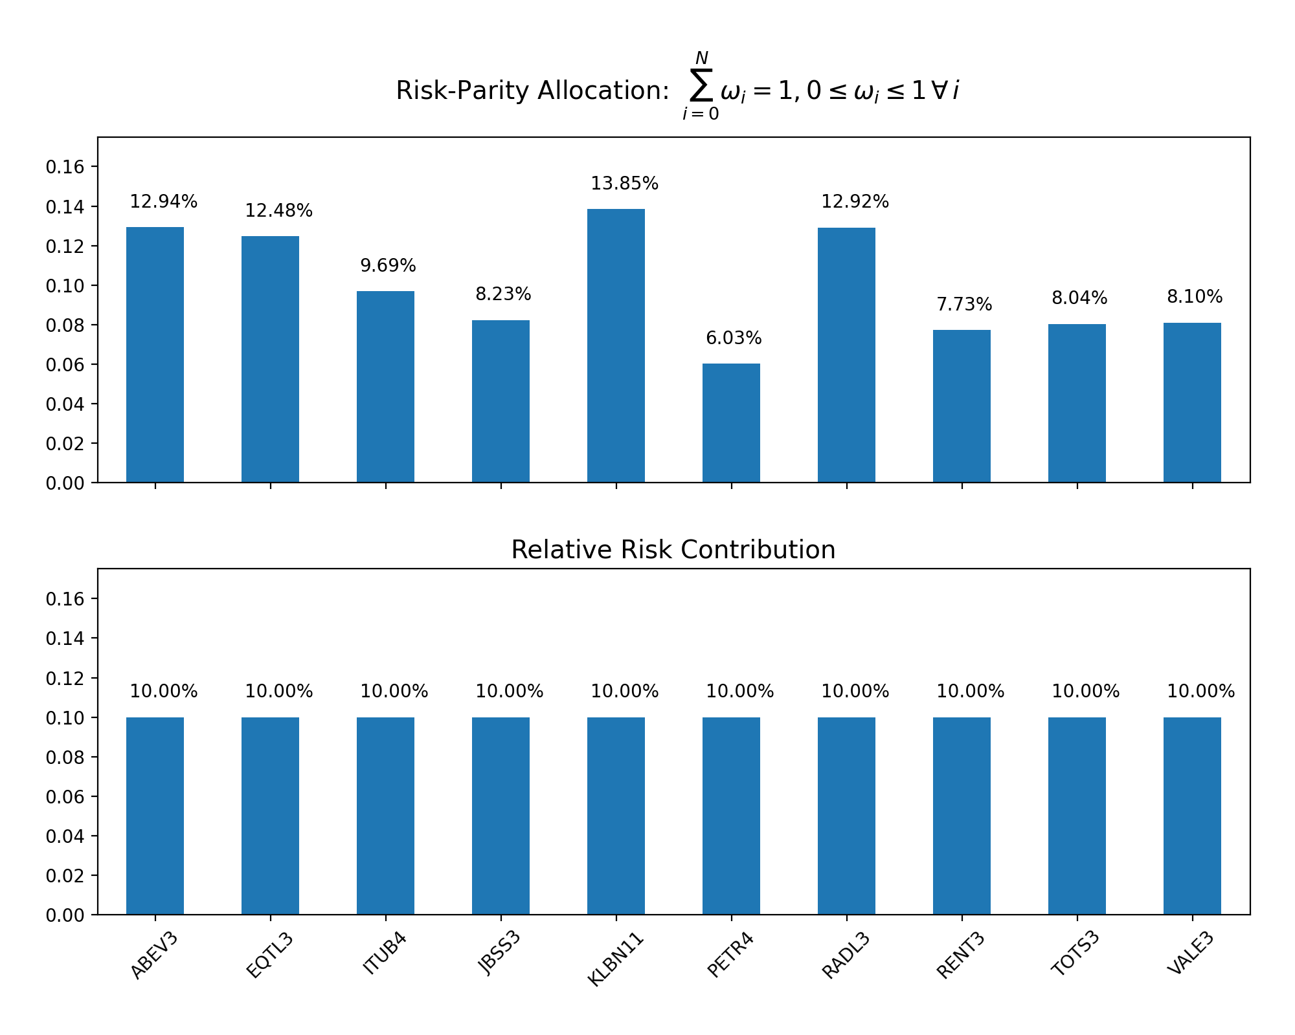
Portfolio metrics (ex-ante)
Expected Return:
Variance:
Sharpe:

Slide 9
Hierarchical Portfolios

Slide 10
Code snippet
# Long-Only Formulation (Karush-Khun-Tucker conditions ... )
obj_fun_rp_weights = []
n_trials = 100
ln_constraint = {'type': ‘eq', 'fun': lambda y: np.sum(np.log(y)) - 1}
for i in range(n_trials):
initial_guess_rp = np.random.uniform(low=0.01, high=5, size=(len(eq_univ)))
G_bounds_rp = get_bounds(weights=initial_guess_rp, LB=0.01, UB=5)
rp_opt_dict = { 'fun': lambda y: math.pow((y.T@covar_numpy@y*252), 0.5),
'x0': initial_guess_rp,
'bounds': G_bounds_rp,
'constraints': [ln_constraint]}
try:
opt_results_rp = minimize(**rp_opt_dict, tol=math.pow(10, -100))
except ValueError as e:
continue

