Slide 1
Risk-Parity Allocation
Antônio Salomão

Slide 2
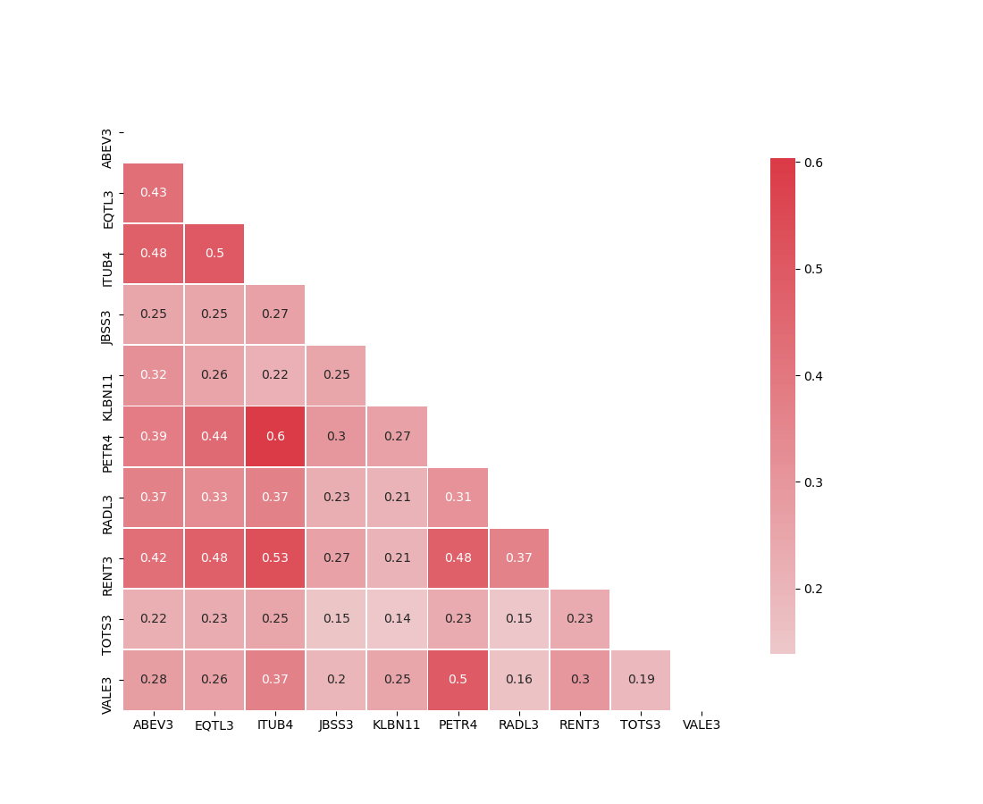
Data
Daily ticker data
Period:
Start date: 01/01/2015
End date: 30/10/2019

Slide 3
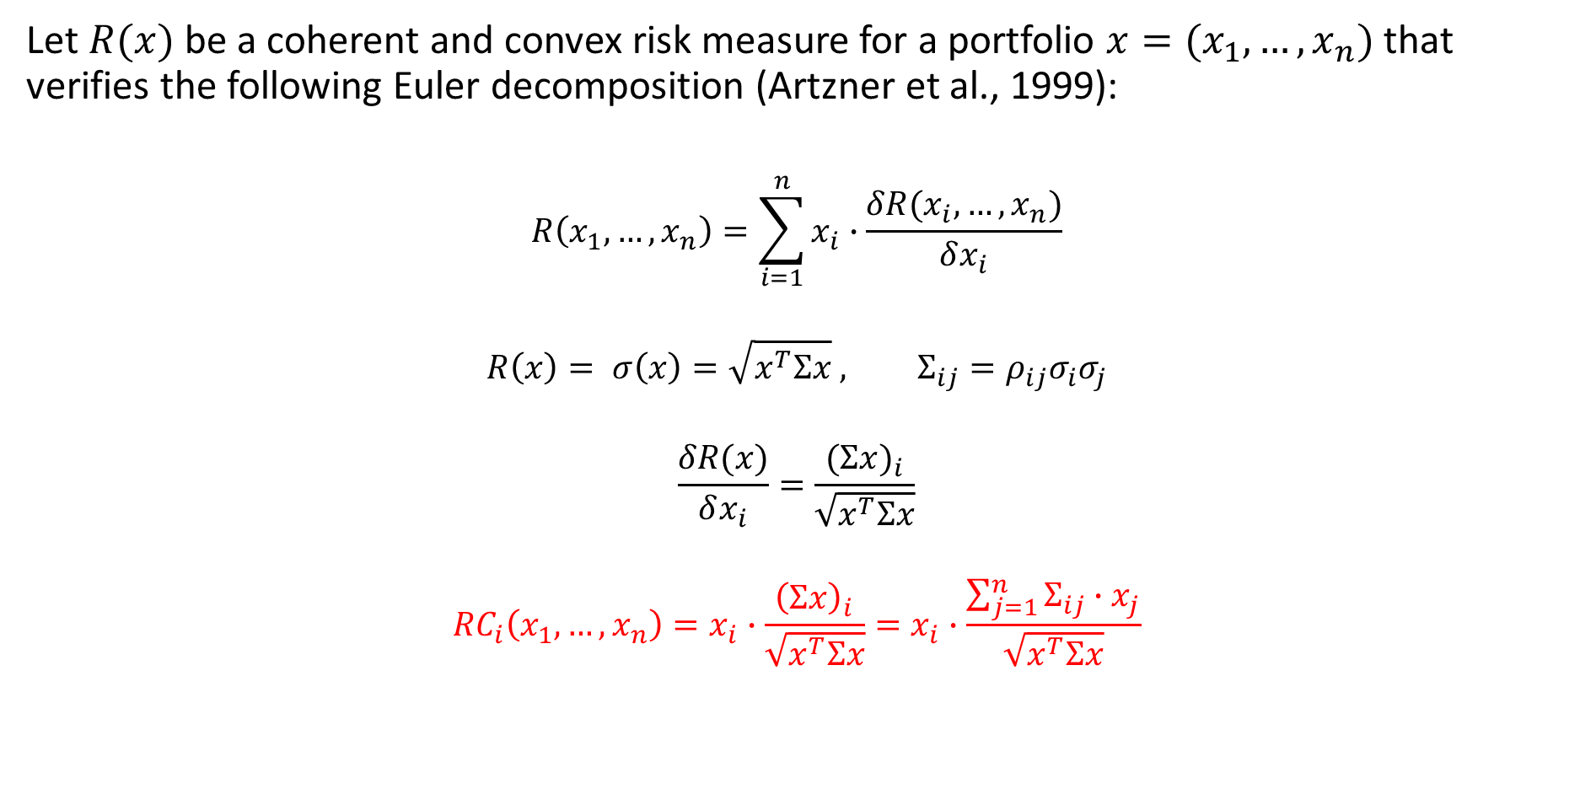
Risk-Contribution
Let $R(x)$be a coherent and convex risk measure for a portfolio ${x=(x}_{1}, …,x_{n})$ that verifies the following Euler decomposition (Artzner et al., 1999):
$$R\left(x_{1}, …,x_{n}\right)=\sum_{i=1}^{n}{x_{i}}∙\frac{δR(x_{i}, …,x_{n})}{δx_{i}}$$
$$R\left(x\right)= σ\left(x\right)=\sqrt{x^{T}Σx} , Σ_{ij}=ρ_{ij}σ_{i}σ_{j}$$
$$\frac{δR(x)}{δx_{i}}=\frac{{(Σx)}_{i}}{\sqrt{x^{T}Σx}}$$
$${RC}_{i}\left(x_{1}, …,x_{n}\right)=x_{i}∙\frac{{\left(Σx\right)}_{i}}{\sqrt{x^{T}Σx}}=x_{i}∙\frac{\sum_{j=1}^{n}{Σ_{ij}∙x_{j}}}{\sqrt{x^{T}Σx}}$$

Slide 4
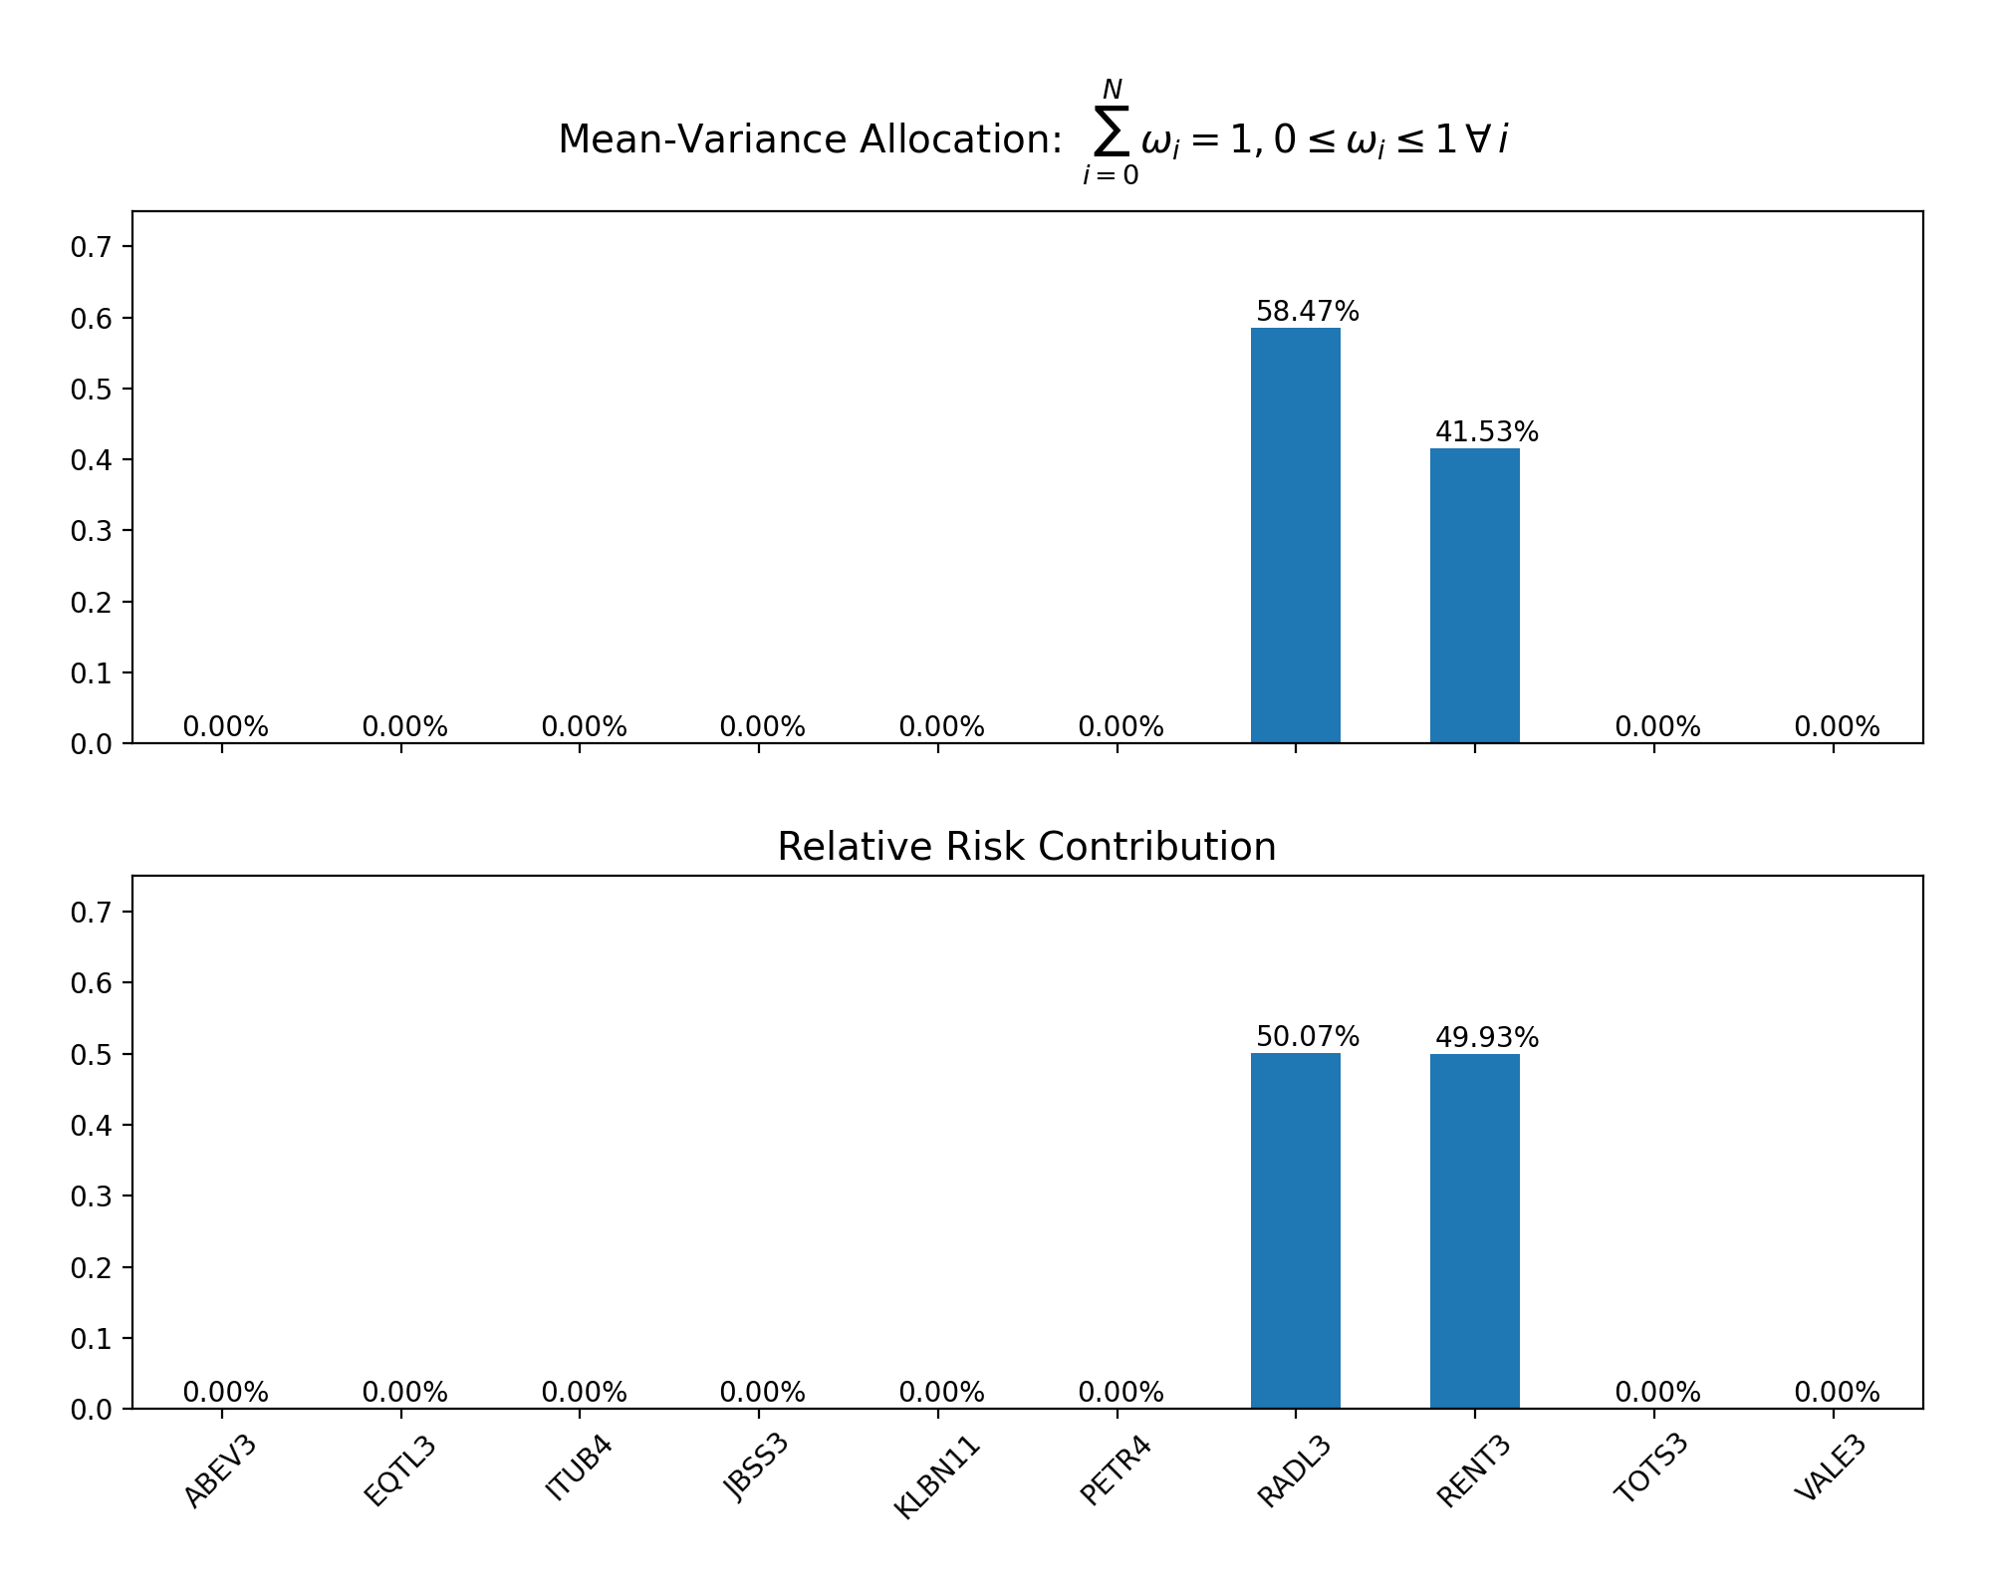
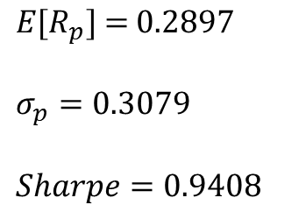

$\min{w} (\frac{1}{2}x^{T}Σx−\frac{1}{δ}μ^{T}x)$
$$E\text{[}R_{p}\text{] = 0.2897}$$
$$σ_{p}=0.3079$$
$$Sharpe=0.9408$$

Slide 5
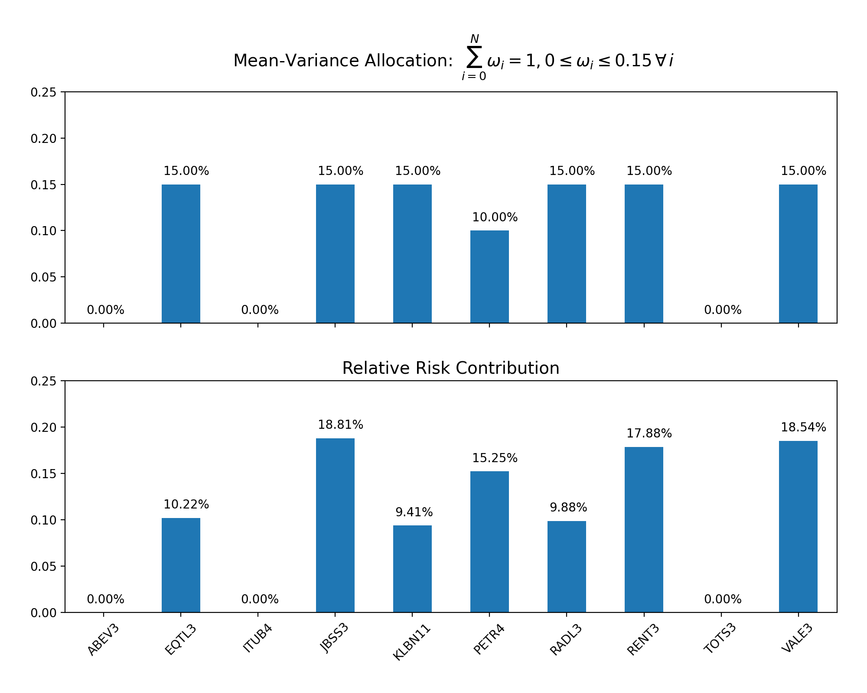

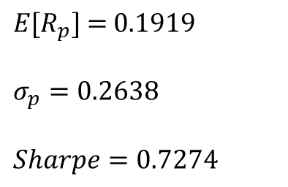
$\min{w} (\frac{1}{2}x^{T}Σx−\frac{1}{δ}μ^{T}x)$
$$E\text{[}R_{p}\text{] =} \text{0.1919}$$
$$σ_{p}=0.2638$$
$$Sharpe=0.7274$$

Slide 6
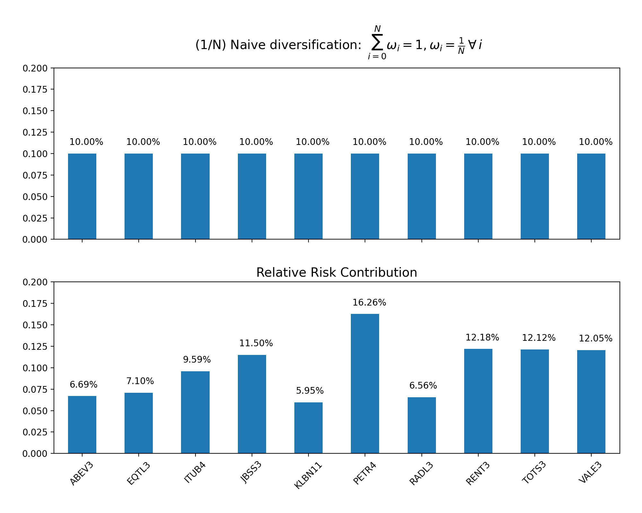
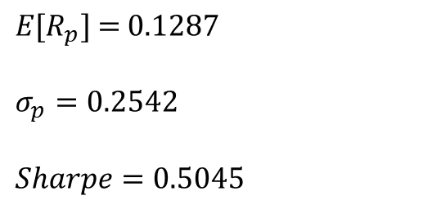
$$E\text{[}R_{p}\text{] =}\text{ 0.}\text{1287}$$
$$σ_{p}=0.2542$$
$$Sharpe=0.5045$$

Slide 7
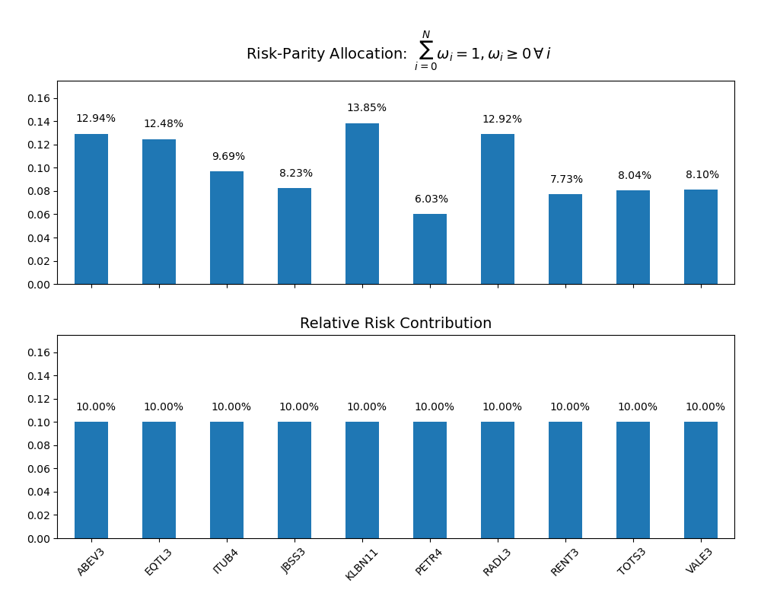
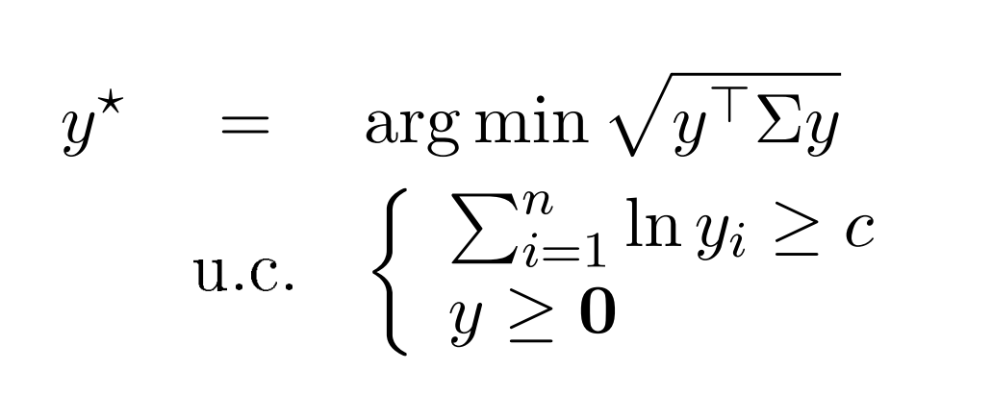
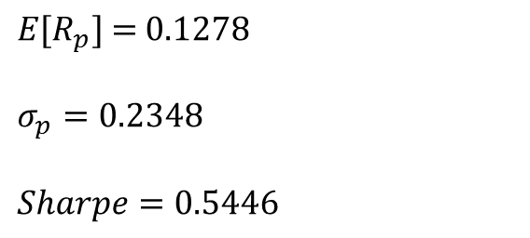
Long-only formulation (Maillard et al. 2009)
$$E\text{[}R_{p}\text{] = 0.}\text{12}\text{78}$$
$$σ_{p}=0.2348$$
$$Sharpe=0.5446$$

Slide 8
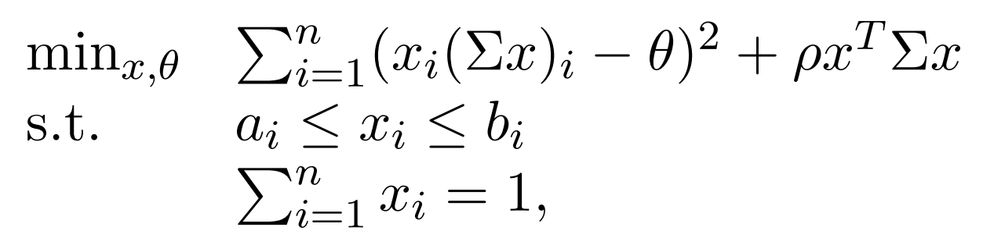
Sequential minimum-variance risk parity algorithm (Bai et al. 2013)

Slide 9
Code snippet
Q = covariance_matrix
rho_L = []
rho_start = 4
for k in list(range(0, 12)):
rho_i = math.pow(10, rho_start)
rho_start -= 1
rho_L.append(rho_i)
RP_solutions = []
n_RP_trials = 50
for rho_i in rho_L:
print('\n====== Rho i: {} '.format(rho_i))
for trial in range(n_RP_trials):
rp_opt_dict = { 'covariance_matrix': Q,
'LB_UB_x': tuple((LB_x, UB_x)),
'X_sum': X_sum,
'rho': rho_i}
result = RP_opt(**rp_opt_dict)
RP_X = result.x[:len(Q)]
# Check RP solution
RP_variance = RP_X@Q@RP_X
RP_vol = math.pow(RP_variance, 0.5)
RC_target = (RP_variance)/len(RP_X)
RC_L = ([RP_X[N]*Q[N]@RP_X for N, i in enumerate(RP_X)])
RC_tolerance = math.pow(10, -5)
RC_test = [abs(RC_i - RC_target) for RC_i in RC_L]
if ((all(i <= RC_tolerance for i in RC_test)) == True):
RP_solutions.append(tuple((RP_X, RP_vol)))
RP_X_sorted = sorted(RP_solutions, key= lambda x: x[1])
RP_X = RP_X_sorted[0]

