Slide 1


Industry insights
Web Scraping Project
Antonio Salvador

Slide 2
Background information
INC. is a weekly business magazine (1979) - startups/small businesses-
The Inc. 5000 list of the fastest-growing private companies in America
Rank according to % revenue growth over a three-year period.
Microsoft, Dell, Domino’s Pizza, Pandora, Timberland, LinkedIn, Yelp, Zillow - first national exposure Inc. 5000.

Slide 3
OBJECTIVE
Insights on industry type, size, years on list, location
Trends and changes comparing 2017 - 2012
Industries that are more likely to remain in the list
Potential IPOs?

Slide 4

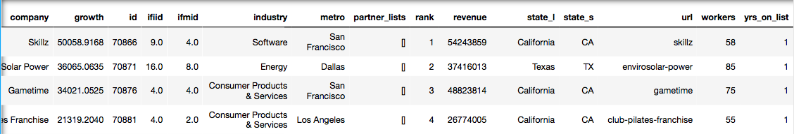
DATASET & WEB SCRAPING
Python: JSON (JavaScript Object Notation)
pd.DataFrame
json.load: “Deserialize a JSON document to aPython object using this conversion table
pandas.io.json.normalize : “Normalize” semi-structured JSON data into a flat table

Slide 5

DATA INSIGHTS
 | 2017 | 2012
avg. growth med. growth | 481% 141% | 377% 97%
avg. revenue med. revenue | 48MM 10MM | 56MM 11MM
avg. workers med. workers | 256 49 | 285 53
avg. yrs list | 2.96 2.00 | 2.72 2.00

Slide 6
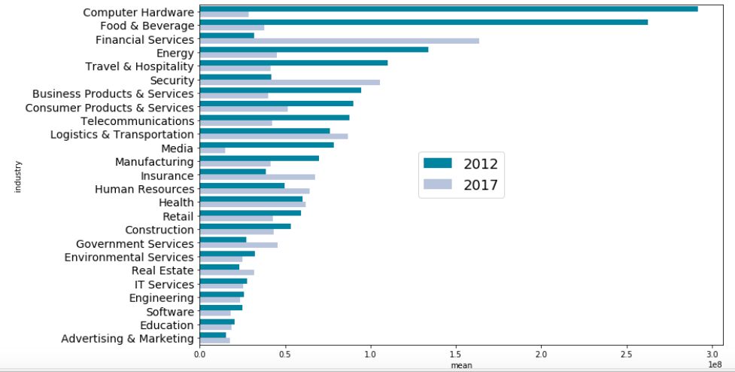
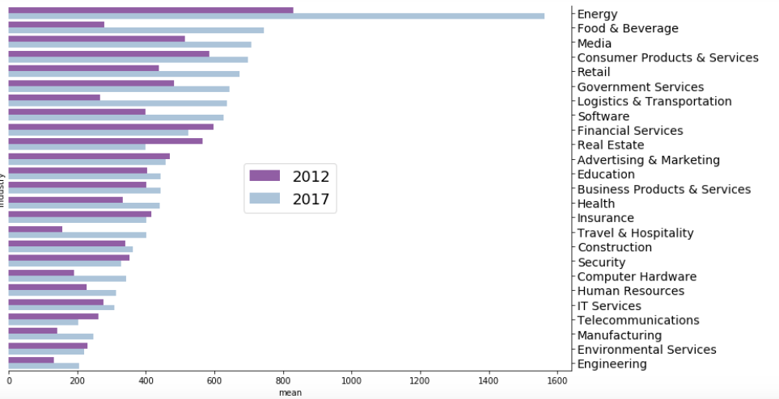
IndustrIES
REVENUE
GROWTH

Slide 7
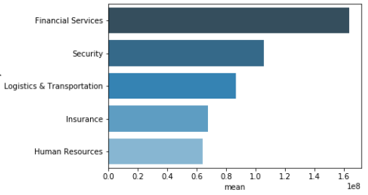
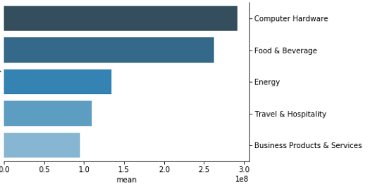
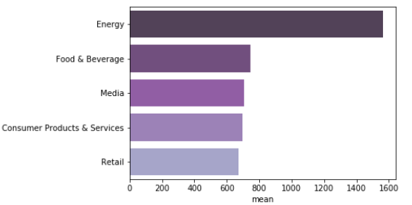
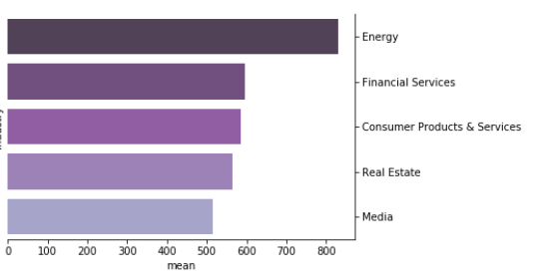
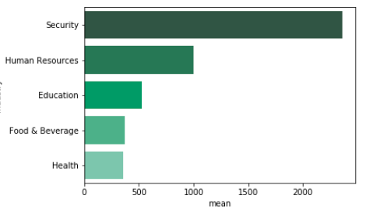
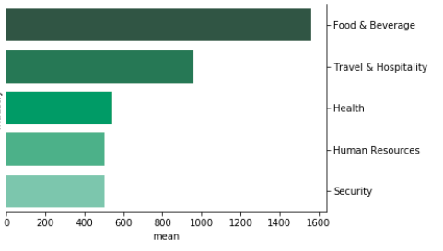
TOP performers
 | 2017 | 2012
REVENUE
GROWTH
WORKERS

Slide 8
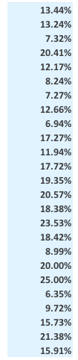
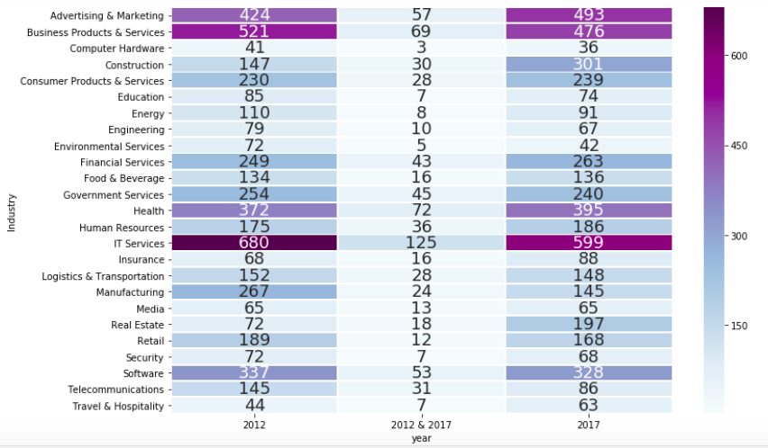
Number of ComPanies
15% of the companies in 2012 made the list in 2017
>20% repeats: Real Estate, Insurance, Communication, Human Resources and Construction
Lowest repeats: Retail, Environmental Services, Energy, Computer Hardware, Education

Slide 9
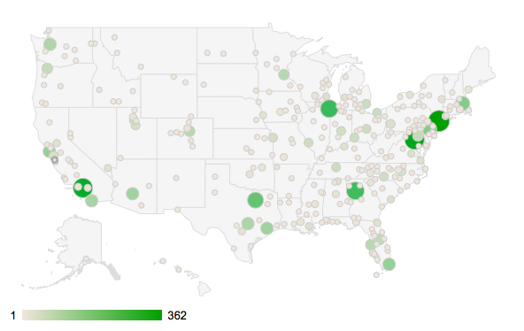
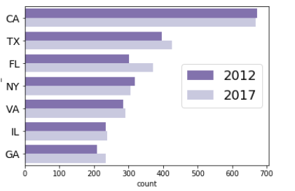
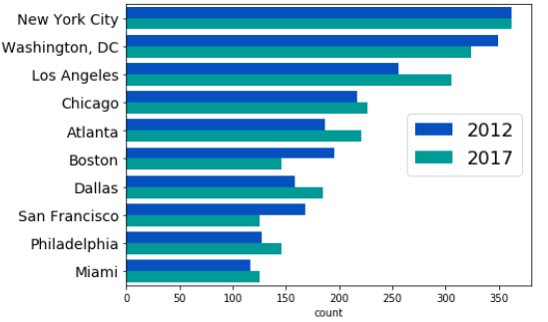
location

Slide 10
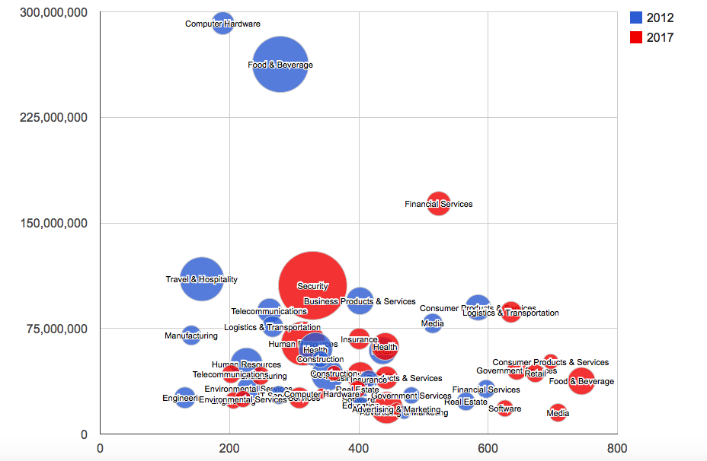
Scatter Plot
AVG. REVENUE
AVG. GROWTH

Slide 11
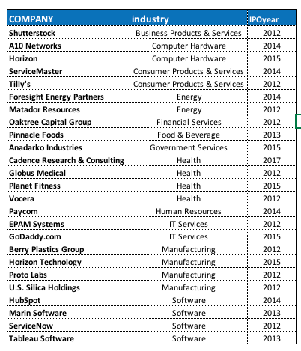
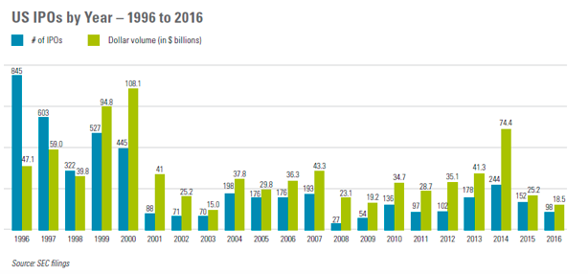
IPO LIST
25 companies identified went to IPO
IPOs in general have been declining
Relevance of private funds investors

Slide 12
CONCLUSIONS
2017 shows higher avg. growth but lower avg. revenue than2012
Dynamic environment in terms of revenue by industry
Energy, Consumer Products & Services, and Media industry show top performance in both 2012 and 2017
Security, Human Resources, Food & Beverage seem the more relevant in terms of labor size.
Real Estate, Insurance, Communication, Human Resources and Construction show more repeats (consistency) to remain in 5000 list.
Among main metro areas, LA, Atlanta and Dallas show greater increase in businesses that made 5000 list; similarly to TX and FL at state level.
No apparent linear relationship between growth and revenue.
Few IPOs identified from 2012 list

