Slide 1

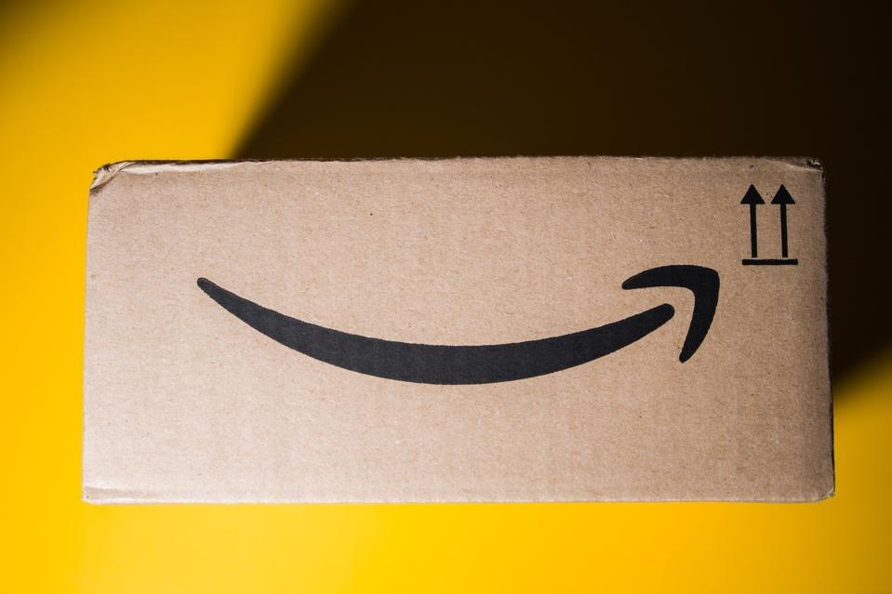
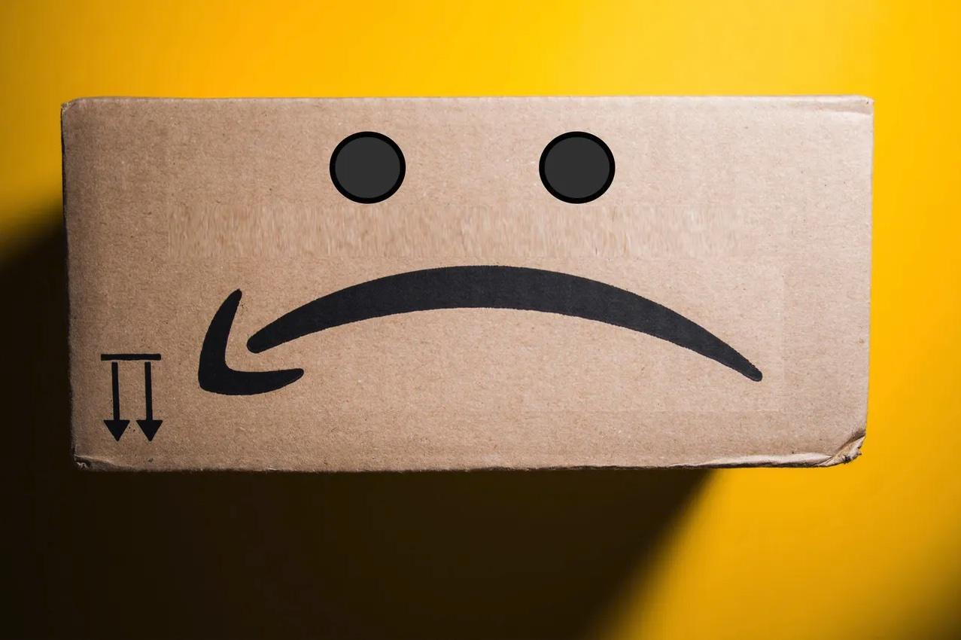
Recommender System
User’s review Amazon products
https://github.com/antoniosh97/Recommender-System-2023

Slide 2



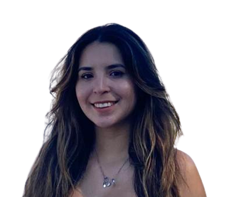
Recommender System - Our Team
“A” Team
Antonio
Brenda
Evaristo
Joan

Slide 3




Recommender System – 1. Motivation
Improve user experience: help users to discover new products and services based on their own interests.
User loyalty: encourage customers to return.
User engagement: encourage users to engage with the content based on the recommendation of the products or services.
More direct and personalized marketing campaigns
The ultimate goal of
a recommender systems is to unlock the maximum potential of customer purchases,
making them a crucial component of a successful personalized marketing strategy.
Notes:
Objective to unlock the maximum potential of customers purchases
This impact businesses or e-commerce by for example…

Slide 4

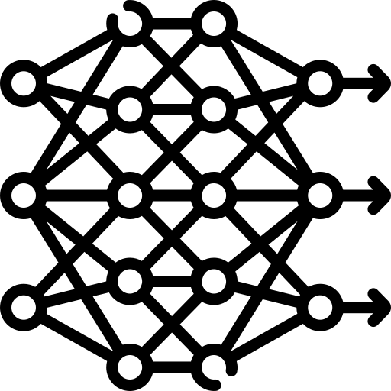

Recommender System - 2. Goals
Baseline
Deep learning models
Business sense of a recommender system
Propose two simple approaches to give a recommendation: most popular products (1) and random products (2).
Define and develop the initial ETL and data preparation for modelling.
Develop two different deep learning approaches for the recommender system: Factorization machines (FM) and Neural matrix Factorization model (NeuMF).
Perform ablation experiments to give an intuition on hyperparameter tuning.
Understand the performance of the different models based on a business perspective.
Conclude the project with next steps to perform in the future.
Notes:
Lo que queremos es dar el mejor recomendador posible dados unos datos de amazon. Para ello fijamos unos objetivos concretos: 1. establecer un modelo maseline y hacer la preparacion de los datos
2. Proponer modelos mas complejos basados en metodologias de deep learning.
3. Estudiamos finalmente el problema no solo desde una perspectiva matematica, sino que tambien atendemos a las necesidades de negocio concretas y sacamos insights de los recomendadores. Enfasis en que los negocios garantizas valores en la recomendacion (compliance). Se alinea con valores de la empresa. Depndiendo de la empresa y sector esto es mas o menos estricto

Slide 5

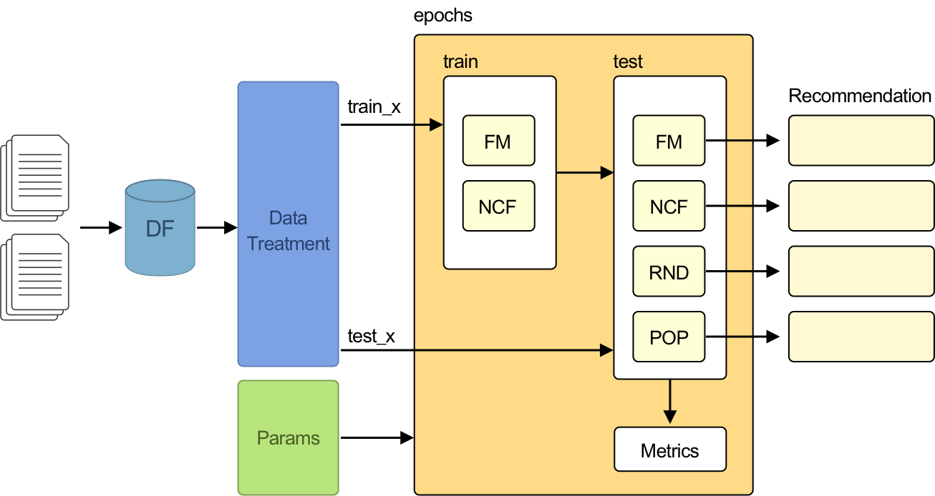
Recommender System - 3. Proposal
Strategy
Models: FM, RND, POP, NCF
Different Datasets: Amazon and MovieLens
Data transformation and Sampling strategy
Training and Test
Metrics: HR, NDGC, Coverage
Histograms and Graphics: Plot and Tensorboard
Tuning parameters
Custom parametrization
Pipeline
Notes:
Objective to unlock the maximum potential of customers purchases
This impact businesses or e-commerce by for example…

Slide 6
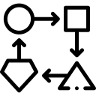
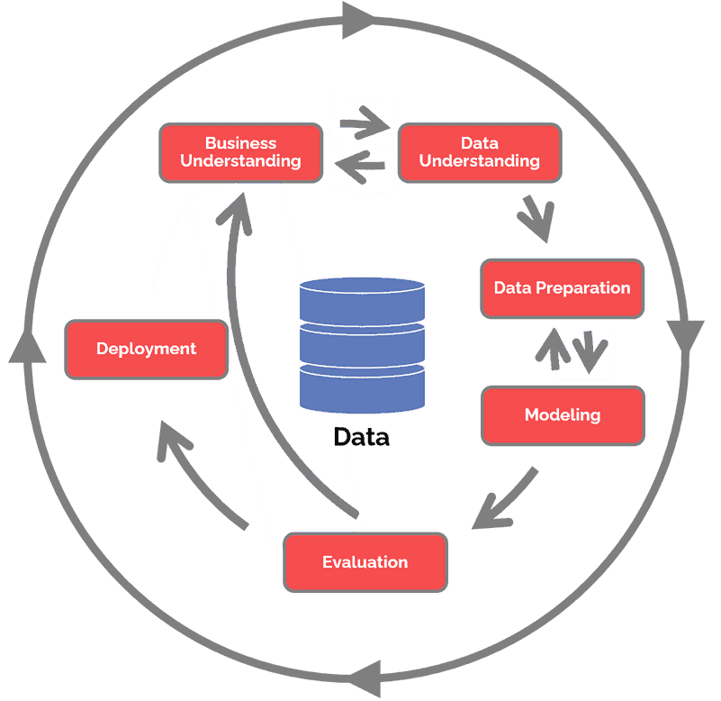
Recommender System - 3. Proposal
Methodology
CRISP-DM
Cross Industry Standard Process for Data Mining
Business understanding
Data understanding
Data preparation
Modeling
Evaluation
Deployment
Waterfall

Slide 7
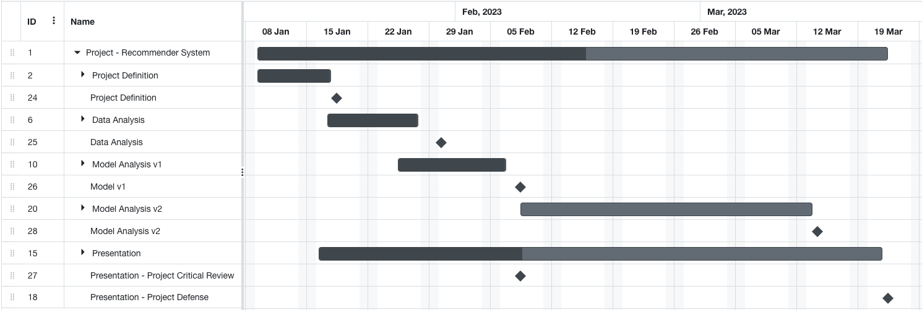
Recommender System - 3. Proposal
Project Plan and Milestones

Slide 8
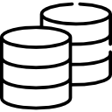
Recommender System - 4. Implementation
Datasets
Amazon: Original
Subset: Musical Instruments
Total Reviews
233.1 million
Reviews
1,512,530
Products
112,222
Users
903,330
MovieLens-100k
Reviews
100.000
Movies
1,682
Users
943
Structure: User, Item, Review(1-5), Timestamp
Notes:
Recommend a product to one user
Try to apply other models to the dataset
Collaborative - Implicit (review=1, no_review=0)
NFM - Neural Factorization Machine
DeepFM - Deep Factorization Machine
xDeepFM -
WD - Wide&Deep
IPNN
DeepCrossNet
Establish a baseline model (MF model), based on interactions.
Add more explainable variables and do not use only interactions.
Use more complex models (beat the baseline).
To be defined: Study biases in recommendations/ recommend based on last seen etc.

Slide 9
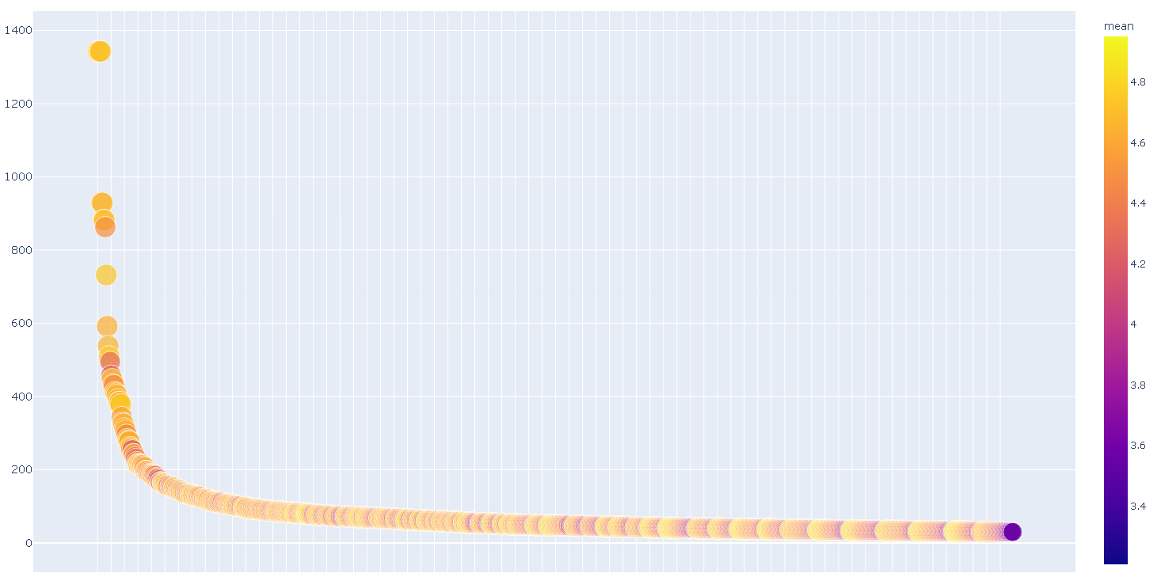
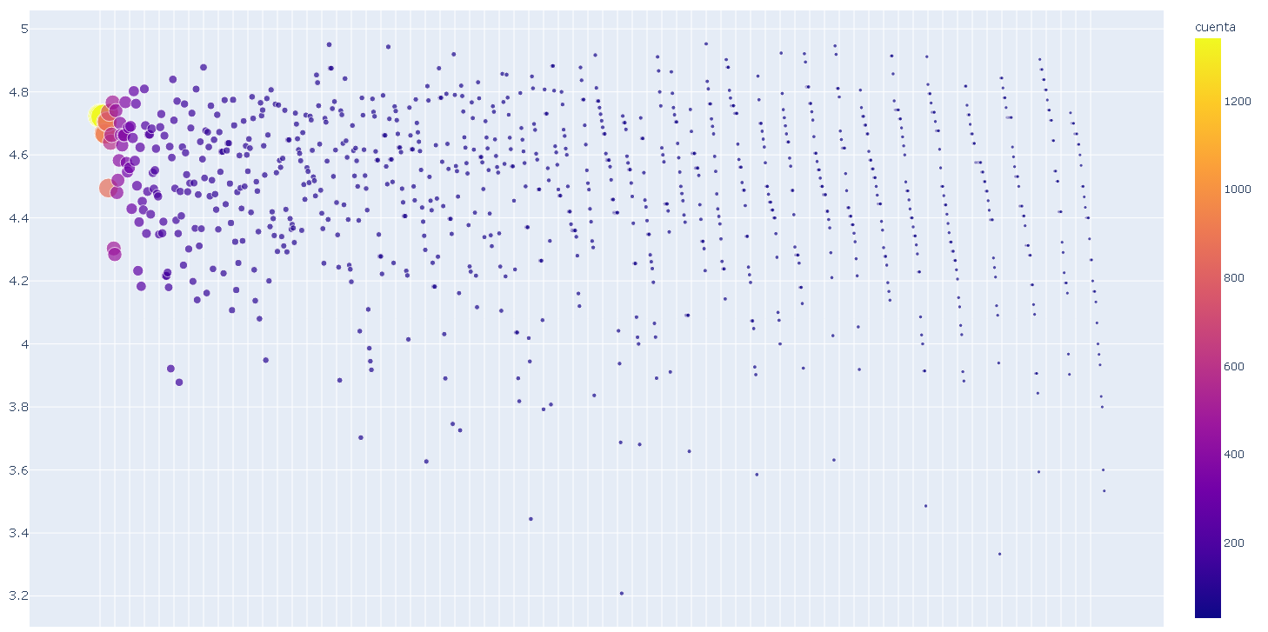
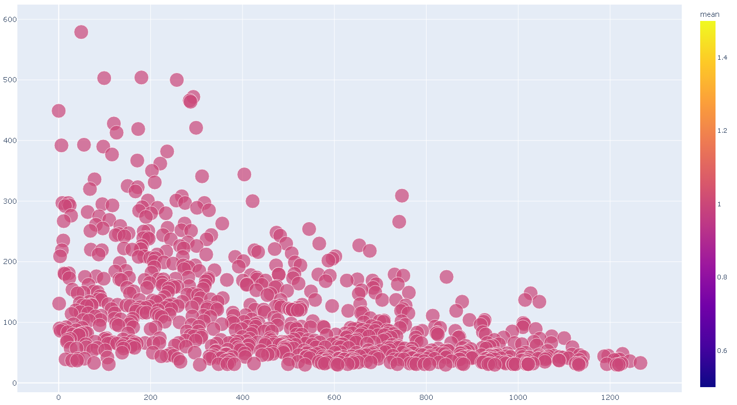
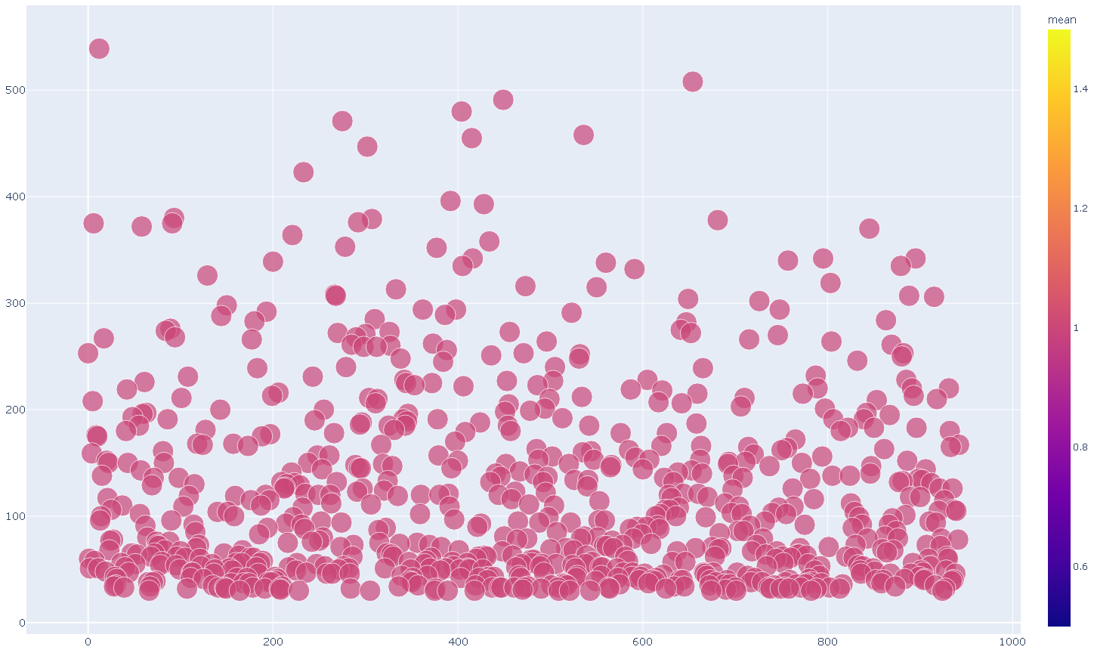
Recommender System - 4. Implementation
Datasets
Amazon
1 . Reviews for Items: >29, 952 of 137364
2 . Reviews 1-5: >29, 952 of 137364
MovieLens
3 . Reviews for Items: >29, 806 of 94443
4 . Reviews by User: >29, 732 of 94443

Slide 10
Recommender System - 4. Implementation
Datasets
Data: Transformation and cleaning
Format data types
Remove duplicates
Reduce reviews by user and item
 | Amazon |  | MovieLens
Users | 4.275 | 14.138 | 943
Items | 2.080 | 6.178 | 1.682
Reviews | 52.023 | 137.364 | 100.000
RxUxI | 8x8 | 6x6 | 20 reviews

Slide 11


Recommender System - 4. Implementation
Sampling
Implicit feedback (1-5 -> 1)
Training
Negative Sampling (k=4-6)
TLOO Time Leave One Out (x=1) RLOO Random Leave One Out (x=1)
Test
Full Ranking (add neg all items/user)
Notes:
Objective to unlock the maximum potential of customers purchases
This impact businesses or e-commerce by for example…

Slide 12
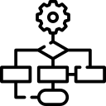
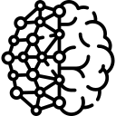
Recommender System - 4. Implementation
Models
Random
Popularity
FM - Factorization Machine
NCF - Neural Collaborative Filtering
Notes:
Objective to unlock the maximum potential of customers purchases
This impact businesses or e-commerce by for example…

Slide 13
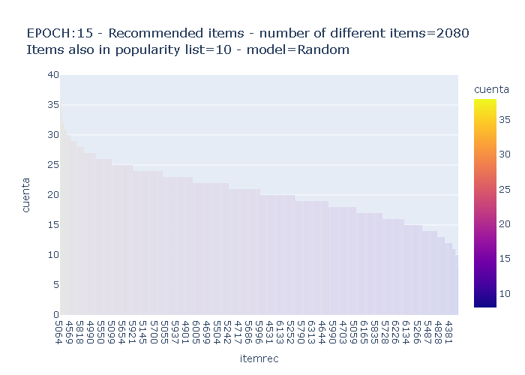
Recommender System - 4. Implementation
Models
Random
Recommend items of the top@k list randomly
Has a coverage of 100% of the products set
Notes:
ampliar un poco aqui a detalle de tipo de producto

Slide 14
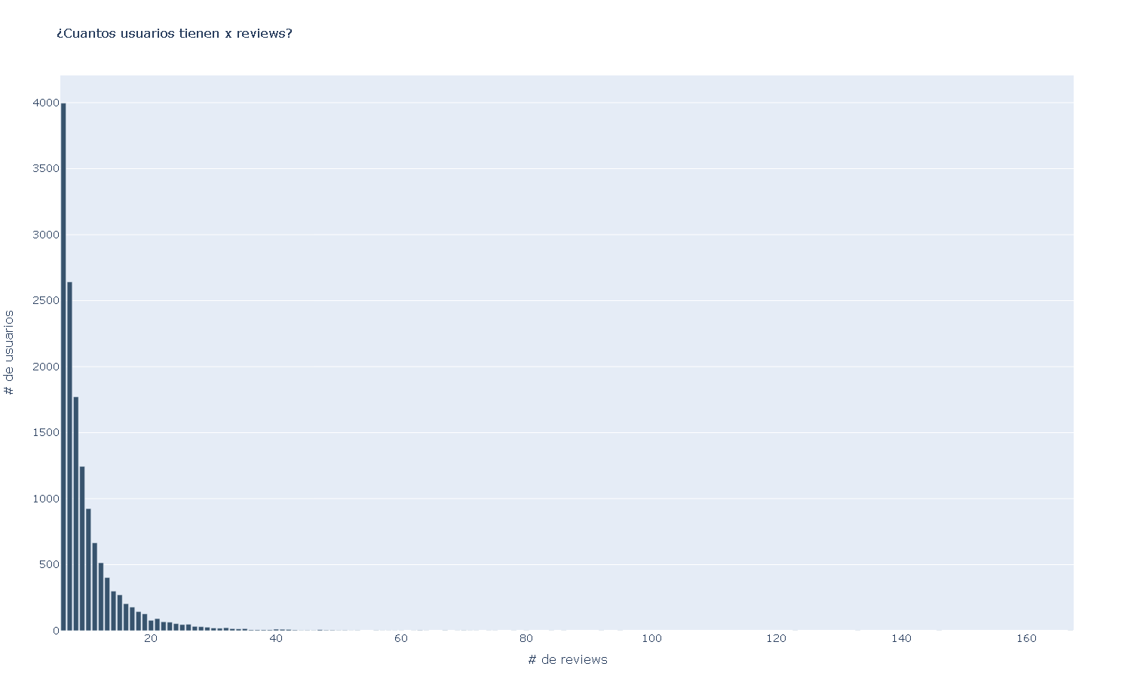
Recommender System - 4. Implementation
Models
Popularity
Most simple statistic method
Select the first top@K items with more ratings
Solves the cold start problem with new users but always recommends the same set of products
Notes:
ampliar un poco aqui a detalle de tipo de producto

Slide 15
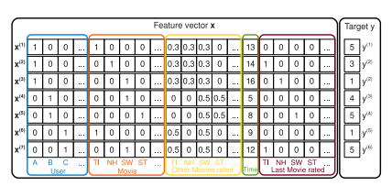
Recommender System - 4. Implementation
Models
FM - Factorization Machine
Implement Factorization Machine to perform a ranking prediction task of top@k
Notes:
ampliar un poco aqui a detalle de tipo de producto

Slide 16
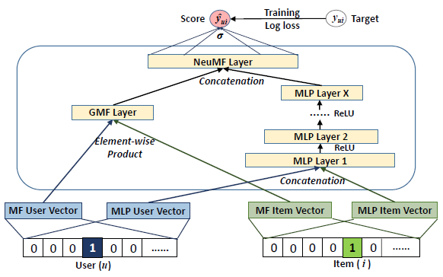
Recommender System - 4. Implementation
Models
NeuMF
We implemented NeuMF Neural Matrix Factorization model that combines MF with Neural MLP
Changed the original last MLP layer activation function SIGMOID followed by BCELoss to use only a BCEwithLogitsLoss function in train
Notes:
ampliar un poco aqui a detalle de tipo de producto

Slide 17

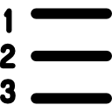

Recommender System - 4. Implementation
Metrics
Hit Ratio HR@topk.
How often is the GT item present in the recommendation list
NDCG Normalized Discounted Cumulative Gain.
Measures ranking quality
Coverage compares the set of total recommended items with the total items in train dataset
Notes:
Recommend a product to one user
Try to apply other models to the dataset
Collaborative - Implicit (review=1, no_review=0)
NFM - Neural Factorization Machine
DeepFM - Deep Factorization Machine
xDeepFM -
WD - Wide&Deep
IPNN
DeepCrossNet
Establish a baseline model (MF model), based on interactions.
Add more explainable variables and do not use only interactions.
Use more complex models (beat the baseline).
To be defined: Study biases in recommendations/ recommend based on last seen etc.

Slide 18
Recommender System - 4. Implementation
Computational resources
GIT repository (recommender system project AIDL2023)
Colab notebooks
CPU (local)
Tensorboard
Miniconda environment
Process average time: 2h
Notes:
Objective to unlock the maximum potential of customers purchases
This impact businesses or e-commerce by for example…

Slide 19
Recommender System – 5. Results. Ablation studies
K negative sampling
Learning rate
Hidden size
Metrics
Illustrative for NeuMF and TLOO
Exp 1
5
1 e-3
32
HR: 0.05 | NDCG:0.02 | COVERAGE: 68.2
Exp 2
6
1 e-4
64
HR: 0.07 | NDCG:0.04 | COVERAGE: 16.2
Exp 3
6
1 e-4
32
HR: 0.06| NDCG:0.03 | COVERAGE: 16.3
…
…
…
…
…
To determine the best hyperparameters, a grid is created with different configurations. The performance is measured in every iteration and the final model is chosen from the best of these experiments.
Notes:
Explicar que esto lo hacemos para cada modelo y nos quedamos con el que de mejor resultado en la ultima interaccion. En este caso mostramos un ilustrativo con soluciones para NeuFM y para TLOO

Slide 20
Recommender System – 5. Results. Final configuration
K negative sampling
Learning rate
Hidden size
Metrics
Best exp NeuMF
5
1 e-4
64
HR: 0.07 | NDCG:0.04 | COVERAGE: 35.8
Best exp
FM
5
1 e-3
64
HR: 0.06 | NDCG:0.03 | COVERAGE: 49.6
Random
-
-
-
HR: 0.004 | NDCG:0.002 | COVERAGE: 100
NeuFM model has the best metrics in terms of HR and NDCG. With the deep learning approach we have an x10 improvement from the random recommendation.
Notes:
Objective to unlock the maximum potential of customers purchases
This impact businesses or e-commerce by for example…

Slide 21



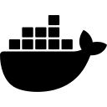



Recommender System – 6. Conclusions
Transparency
Limits
Privacy
Add context
Bias in dataset and models
Control and insertion of bias
Docker & Flask
Ethical
Hypothesis accomplished
Key points in REC
Compliance in business
Next steps
Project Conclusions
Notes:
MODEL RESULTS: Que modelo da mejores resultados?
NCF era el esperado y se confirma
NCF coverage + alta
BUSINESS EFFICIENCY:Importancia del coverage y discusion sobre que un coverage bajo es ineficiente
Importancia de coverage alta/baja
RND cov alto pero no mejor modelo (no hay personalizacion)
POP covera 1/n_users → cold start
NCF y FM con metricas de HR y NDCG parecidas pero cov(NCF) > cov(FM)
Si se ejecuta con poca epochs tiende a recomendarte los más populares
Reconocer/controlar sesgo ya que hay que cumplir un compliance Business (El modelo se ha de adaptar al ComplBuss)- intereses de la empresa
SPECIFIC USE CASE: Utilidad de los diferentes algoritmos segun el caso de uso. Si no conoces a un usuario un recomendador basado en popularity es interesante

Slide 22
Recommender System
Thank you! Questions?
https://github.com/antoniosh97/Recommender-System-2023

