Slide 1
Goal
Setup an infrastructure, development, CI/CD processes that allows Verimi to implement, test, approve and deploy features multiple times per day
Gradual migration from current to proposed new infrastructure without interruption of service

Slide 2
Required features
Could (VPC, ECS, LB) and k8s cluster, environment agile provisioned in minutes
DEV, CI/CD integrated (no manual steps)
Safety Net delivery: feature level acceptance automatic (no manual steps...people pushing buttons at midnight…)
Real time monitoring and telemetry

Slide 3
Basic Concepts
Everything is code (no manual steps...or at least must tend to zero with progressive steps) :
  Cloud infrastructure as code
  Tools infrastructure augmented with state of the art tools
  SW refactoring
    cleanse unnecessary obsolete code and custom made solutions and adapt to new infrastructure

Slide 4
Infrastructure as code
Terraform (OTC provider) to create the VPC, ECS, ...
Kops to create kubernetes.tf (not available on openstack) → Ansible
  Masters,Namespaces, Certificates, kubelets
  Service-account, kube_proxy, kube_dns, canal (flannel+calico), heapster
  Helm/tiller
  Dashboard
  Istio

Slide 5
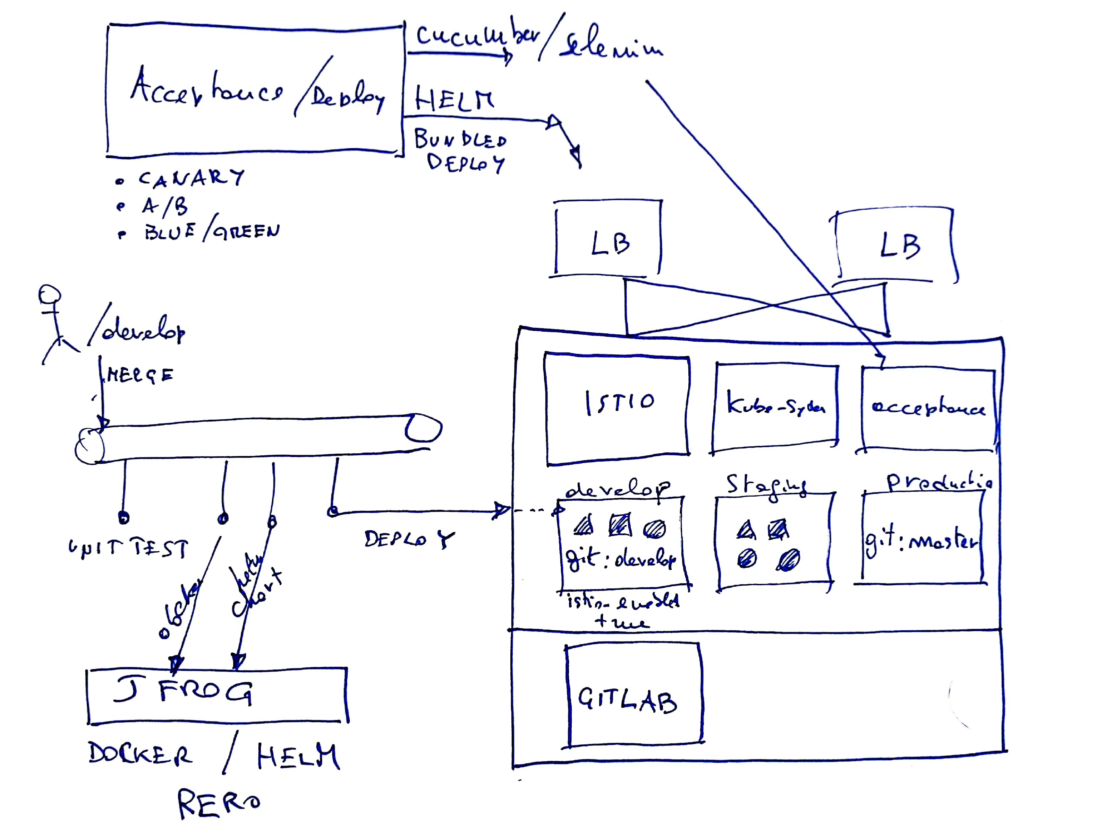
Architecture sketch

Slide 6
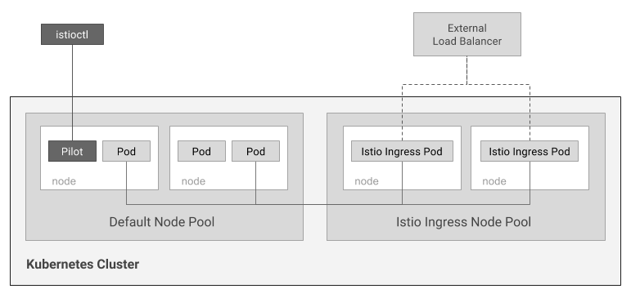
Istio – Google setup
https://github.com/kelseyhightower/istio-ingress-tutorial

Slide 7
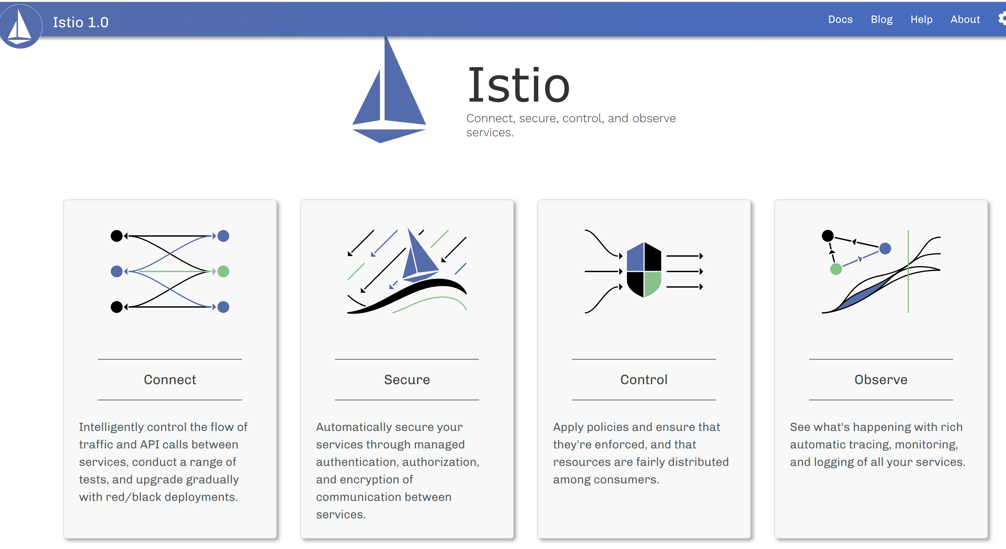
Istio features

Slide 8
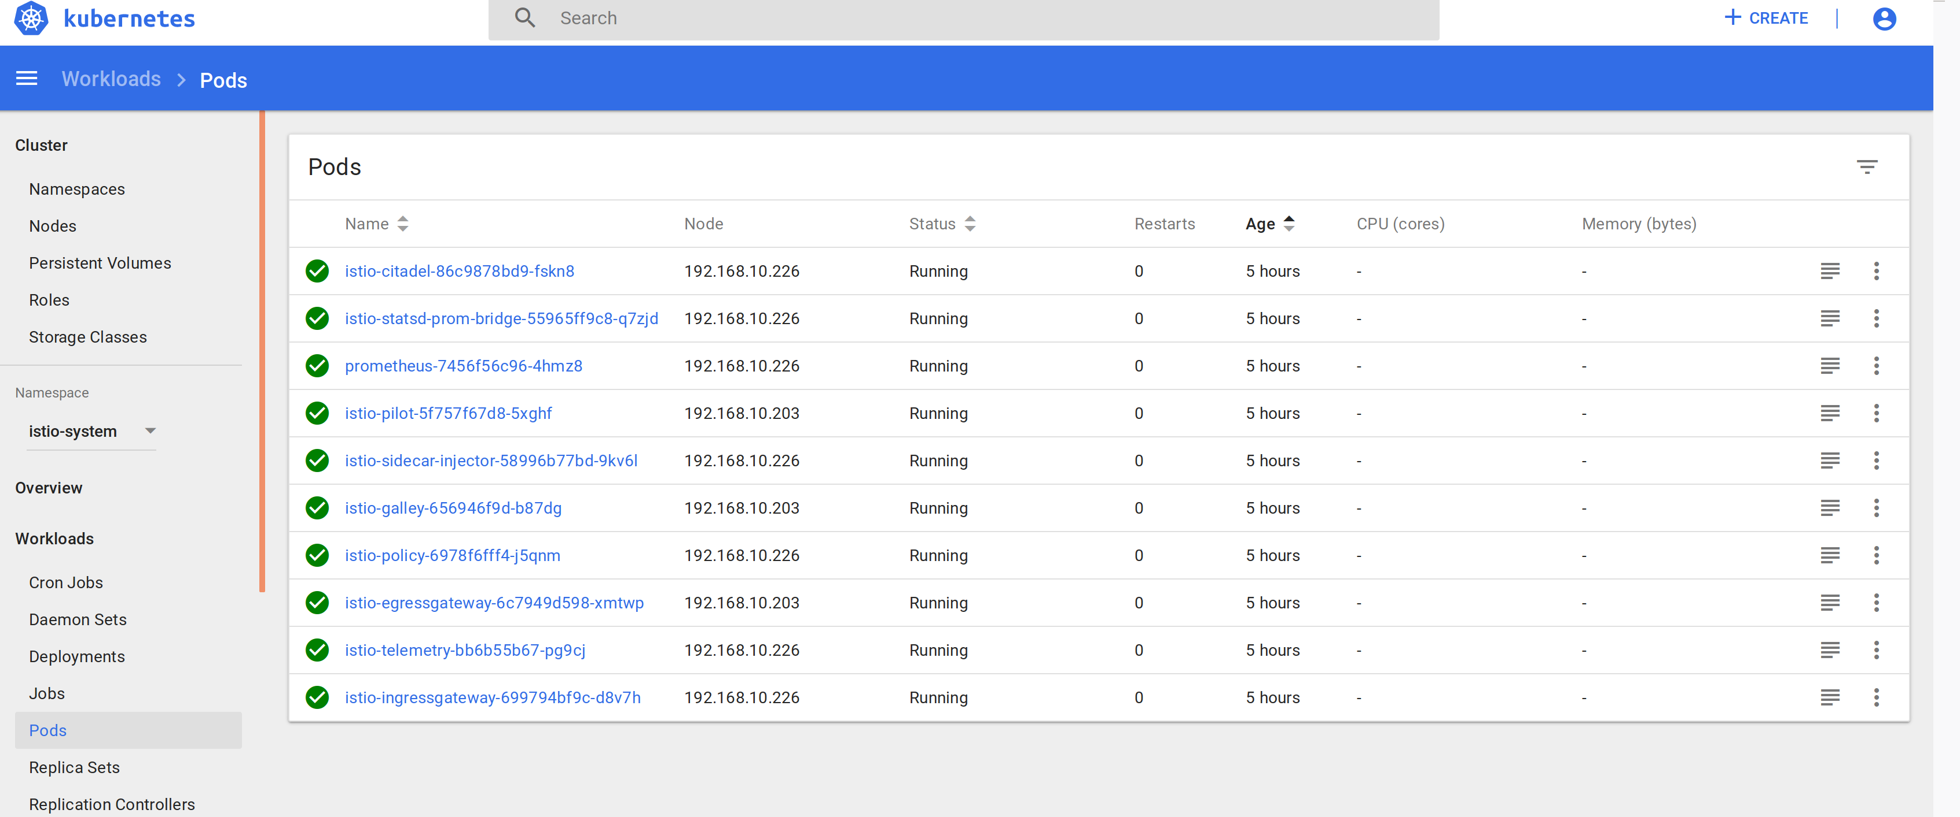
Istio – pods (demo)
HELM minimal installation

Slide 9
Git – CI/CD - K8S
Git brancing strategy, k8s namespaces strategy and CI/CD pipelines are integrated
  Git branches: develop, staging, master mapped to K8s namespaces
    Allow to add more environments:
      Git repo + K8S namespace
  Developers branch per feature and follow normal git flow: commit, push, rebase from develop, PR → build, unit test

Slide 10
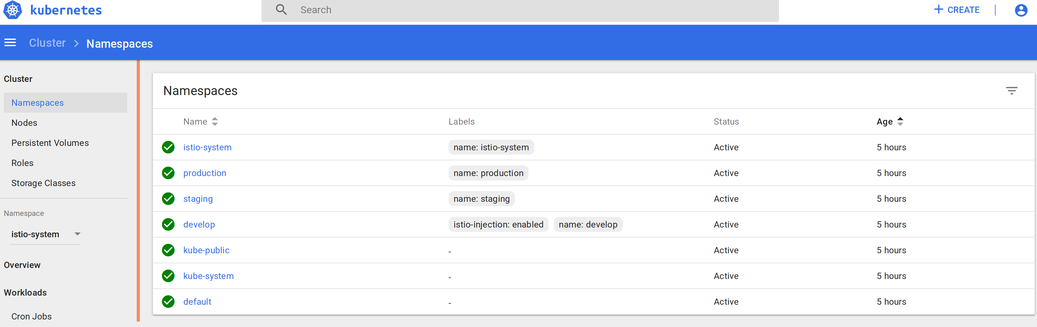
Git/namespaces mapping
develop/staging/production

Slide 11
CI/CD - pipeline
Code review & approval, merge in develop branch
CI/CD pipeline kicks at each merge:
  Build and unit test,
  docker packaging → JFrog
  Helm package → JFrog
  Deploy to namespace with name as current branch

Slide 12
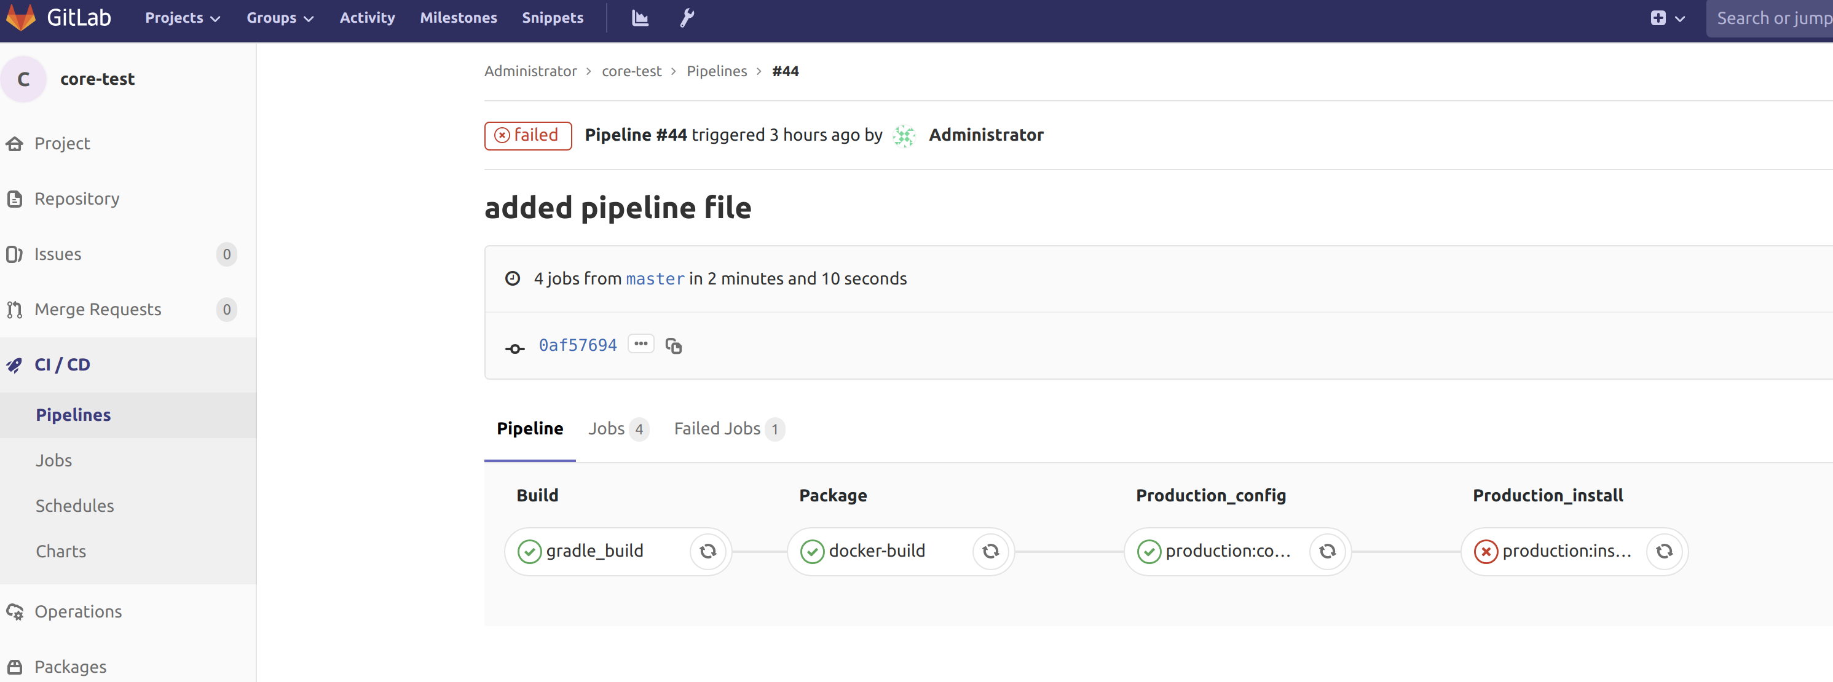
Pipeline – branch master

Slide 13
CI/CD - Promotion
Promotion to staging:
  Git checkout “staging” → git rebase “develop” → PR (build, UT)
  Review & approval → CI/CD to namespace “staging”
Promotion to production (single service):
  Git checkout “master” → git rebase “staging” → PR (build, UT)
  Review & approval → CI/CD to namespace “production”

Slide 14
SW cleansing
Use Spring Cloud Kubernetes:
  https://dzone.com/articles/quick-guide-to-microservices-with-kubernetes-sprin
Application (backend and mobile) in branch develop must run locally
  Spring profiles: local, build (all external dependencies mocked by @Profile), deploy ($ENV updated by HELM Charts per service)
    Drop the mocked external services
      @Profile (“mocked”) → mock
      @Profile (“!mocked”) → real

Slide 15
SW cleansing - cont
Remove configuration service (unnecessary coupling – micro service anti-pattern)
Adopt K8s service discovery (kube_dns): remove Eureka discovery
  Feign will continue working
Remove grafana, zipkin, prometheus, ELK dependencies from core → replaced by Istio
Remove any TLS from code→ replaced by Istio Auth
Remove Ingress/NGINX → Istio-Ingress

Slide 16
SW cleansing – service
Spring boot service is self contained for build, package deploy locally and k8s
  Dockerfile
  Helm Chart
  Cluster admin certificate, kubectl config
  Gitlab-ci.yml
    See spring boot template service

Slide 17
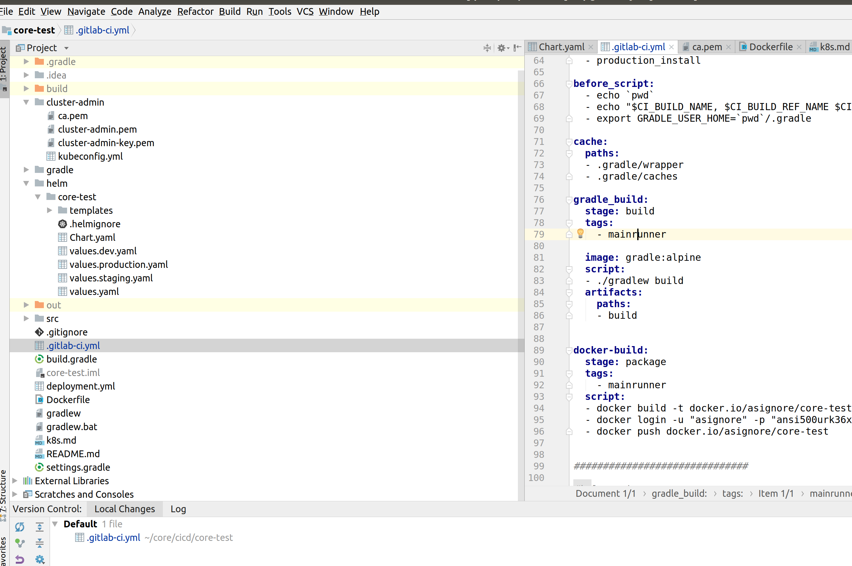
Spring boot template

Slide 18
SW cleansing
Remove Kafka → Axon server
BFF → GraphQL (node.js app) to decouple FE form BE
Integrated in Istio

Slide 19
Acceptance & Delivery
Developer work on develop only
Spring boot BDD (Cucumber + selenium)
  Feature behavior test
  Automated acceptance tests
  Use cases modeled as UML Sequence diagrams → cucumber features)
  HELM Umbrella charts for individual service deployment or bundled umbrella HELM charts (equivalent to current assembly)

Slide 20
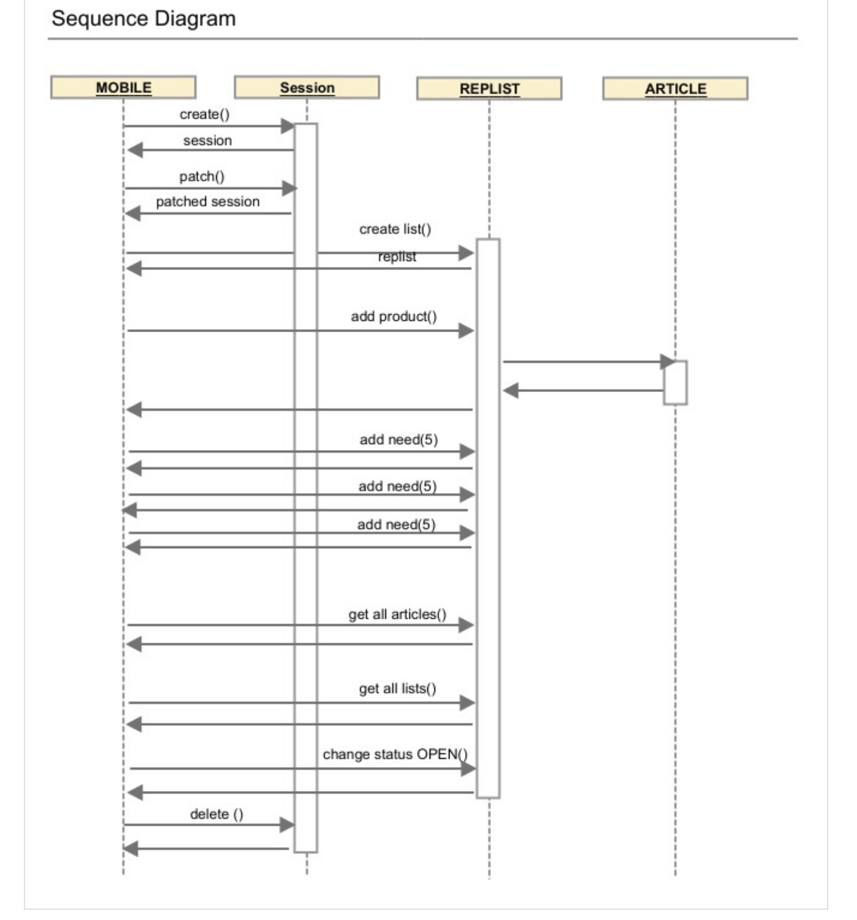
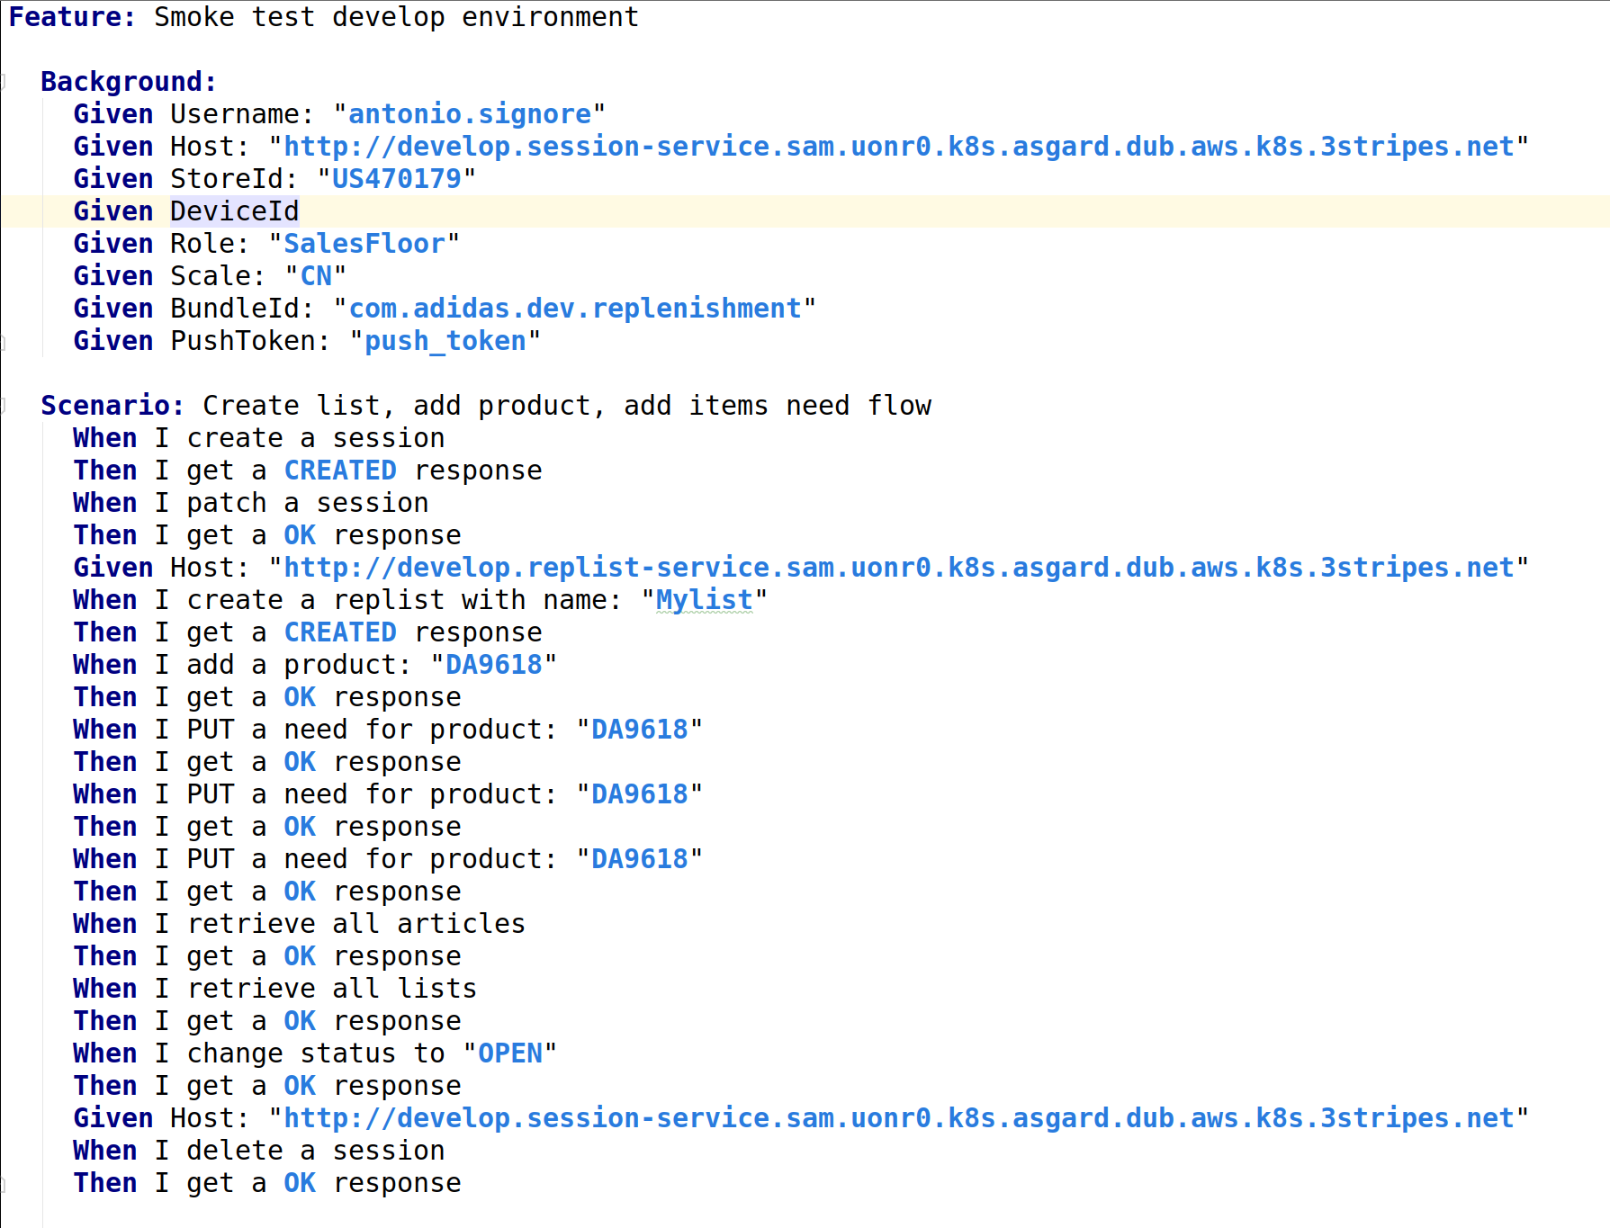
UML – Cucumber - BDD

Slide 21
Acceptance and deployment
Cucumber pipeline runs tests as UT on git branch “develop”
Deploy umbrella to staging:
git checkout staging → rebase develop → PR → Tests executed on staging
Charts
  A/B testing
  Canary
  Rollbacks
MOBILE automatic testing(???)

Slide 22
Code Quality
Code coverage at unit test : > 70%
BDD cucumber/selenium automatic tests
Mobile automatic test
Chaos monkey test → Istio
SONAR clean up
Fortress (or equivalent) security vulnerabilities
Dredd: tool for validating API description document against backend implementation of the API (added to the build CI/CD step)

Slide 23
Project management - questions
Waterfall or Agile?
  If Agile:
    Scrum of scrum
      Scrum master?
      How does the PO backlog distribute the US to distributed teams
      How to gain access to the teams Sprint boards
      Scrum master at teams planning
US points, burn down charts, velocity

Slide 24
Actions todo
Workshop with SII:
  Current infrastructure and come to consensus for a new architecture
Infrastructure Project: terraform/ansible project setup
  Terraform data in S3 bucket
Jfrog artifactory upgrade to support HELM repo
Setup Gitlab on dedicated ECS:
  http://160.44.200.172/

Slide 25
Actions todo
Setup K8s cluster: possibly KOPS or else Ansible
Setup HELM (Tiller)
Setup Dashboard by HELM
Setup Bastian + VPN +, Proxy
Setup HQ LB (if approved in infrastructure)
Setup ISTIO Service Mesh

Slide 26
Actions todo
Spring boot template micro-service
  Dockerfile
  Helm/Chart.yaml
  Clusteradmin → kubectl
  Gitlab-ci.yml
    Build – unit test
    Docker package (Jfrog)
    HELM package (Jfrog)
    Configure K8s
    Deploy to namespace = git branch

Slide 27
Actions todo
Setup Istio
  Configure Istio Ingress with OTC LB
  Grafana, Fluentd/ElasticSearch/Kibana
  Zipkin
  ServiceGraph
Delete Kafka –
  replace with Axon server (Event driven framework)
  Migration from current kafka touch points

Slide 28
Actions todo
Create Acceptance&Deploy App
  Cucumber/Selenium test writing, pipeline
  Define logic for:
    Bundled deploy (HELM umbrella)
    Canary (with Istio)
    A/B testing (traffic)
    Blue/green deployment
      Git flow / approval

Slide 29
Actions todo
Services migration
  Contact dev teams
  Contact test teams
Migrate one service at the time

Slide 30
DEMO
Simple demo as proof of concept:
  Spin a k8s cluster by terraform + ansible
  HELM to install apps to the cluster
  Spring boot template to code, test, package, promote, delivery
  Demo Code available at:
    http://160.44.200.172/root/infrastructure-demo
    http://160.44.200.172/root/core-test
      username/pwd: root/PincoPallino11

Slide 31
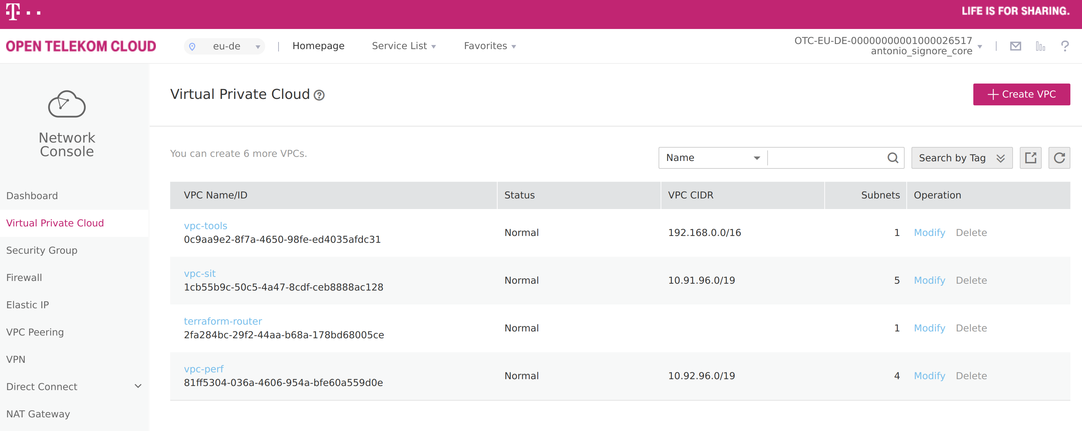
VPC: terraform-router

Slide 32
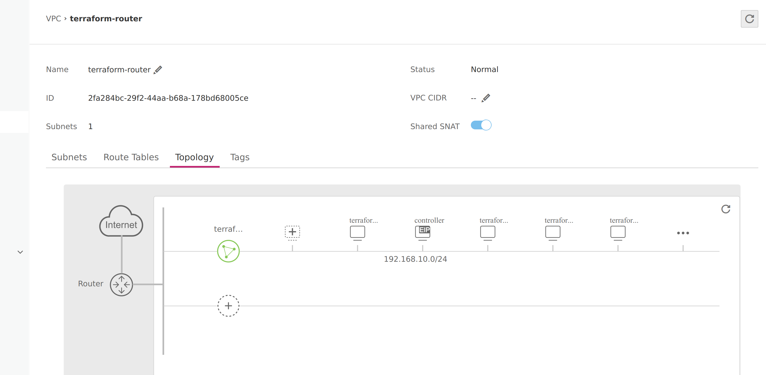
Topology

