Slide 1
Εξαμηνιαία Εργασία Κατανεμημένα Συστήματα
Spring Ermis – Expense Report Management Information System

Slide 2
Features
Login with company SSO (OAuth2)
Employee – Manager Relationship
For Employees:
Manage Expense Reports
For Managers:
Approve / Reject Expense Reports of subordinates

Slide 3
Functional Design
Actors
Employee, Manager
Basic Use Cases
Create Expense Report, Approve / Reject Expense Report
Login, Create Employees / Expense Types… etc.

Slide 4
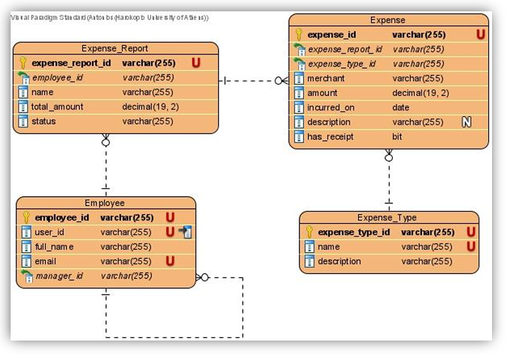
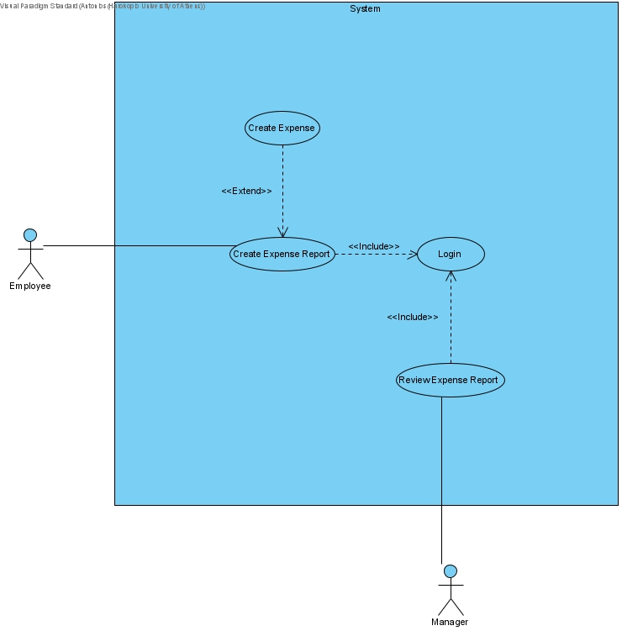
Functional Design

Slide 5
Technical Design
Client-Server Architecture
Next.js Web App (client)
Spring REST API (server)
Identity and Access Management (IAM)
Auth0 SaaS
OAuth2 + OpenID Connect
Containerization
Docker

Slide 6
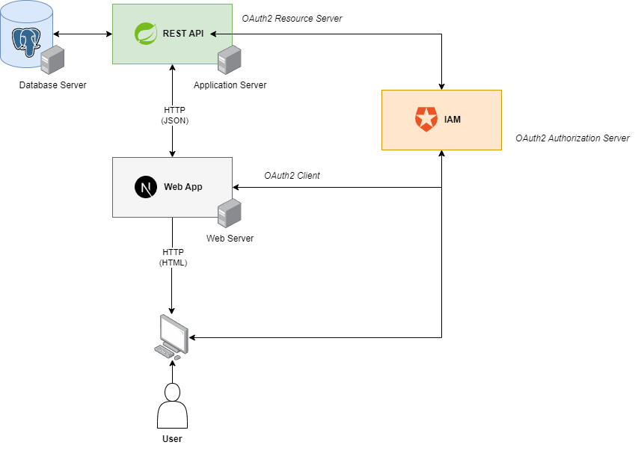
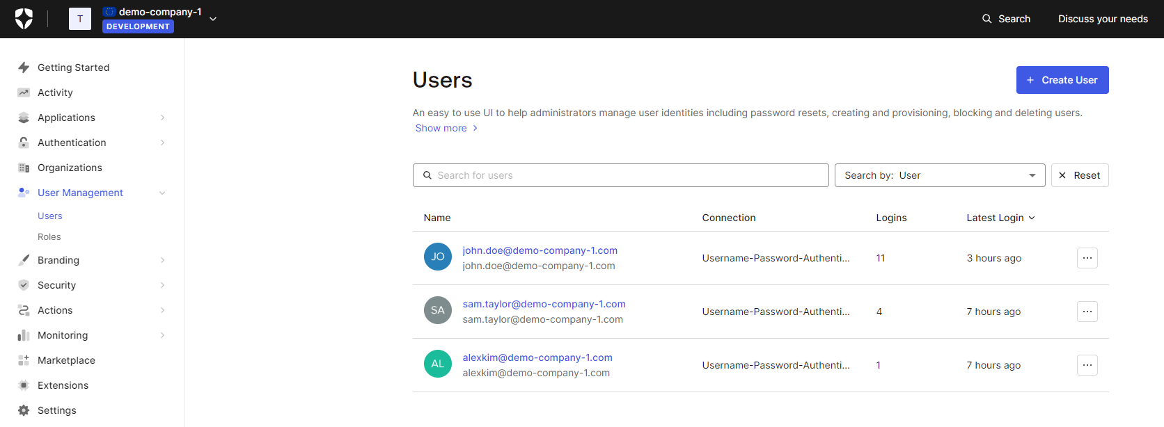
Technical Design

Slide 7
Technical Design
OAuth2
Industry standard for authentication
Roles: Resource Owner, Client, Authorization Server, Resource Server
HATEOAS
Hypermedia as the engine of application state (HATEOAS)
Spring Data REST

Slide 8
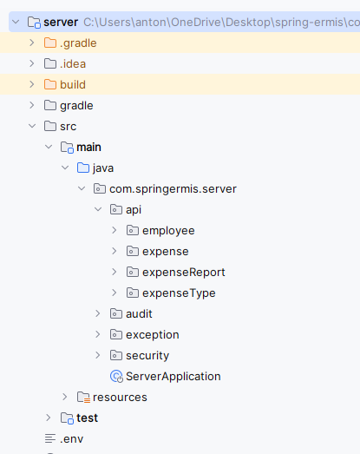
Technical Design
Domain-driven file structure

Slide 9
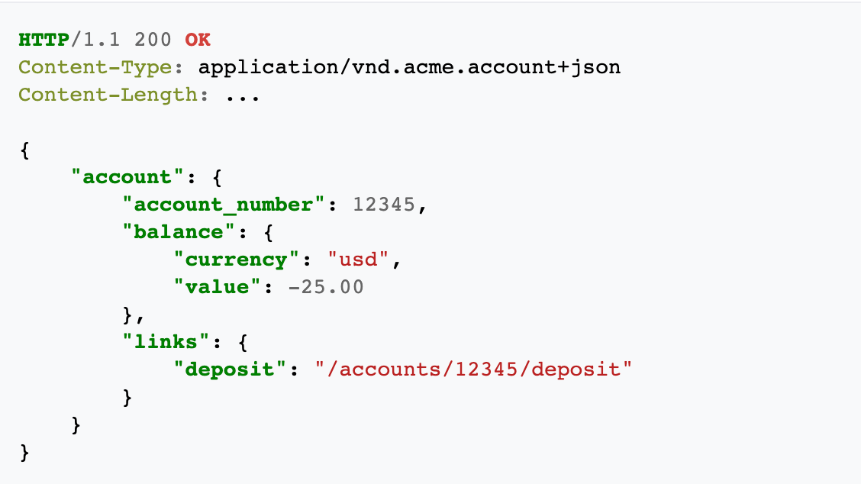
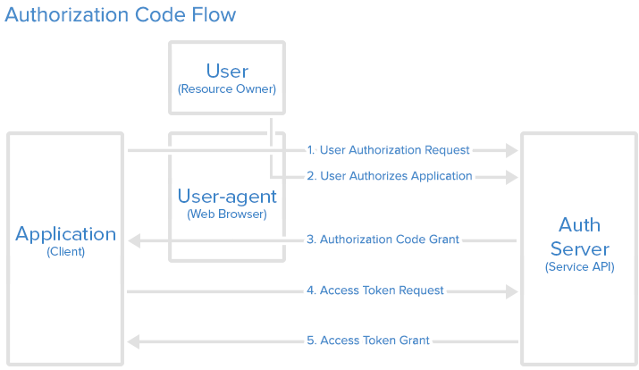
Technical Design

