Slide 1
CIS 362 Project 1
Cody Camara, Ryan Medeiros, Michael Rdultowski, Oluseyi Omobomi, Walid Abousoukkar

Slide 2
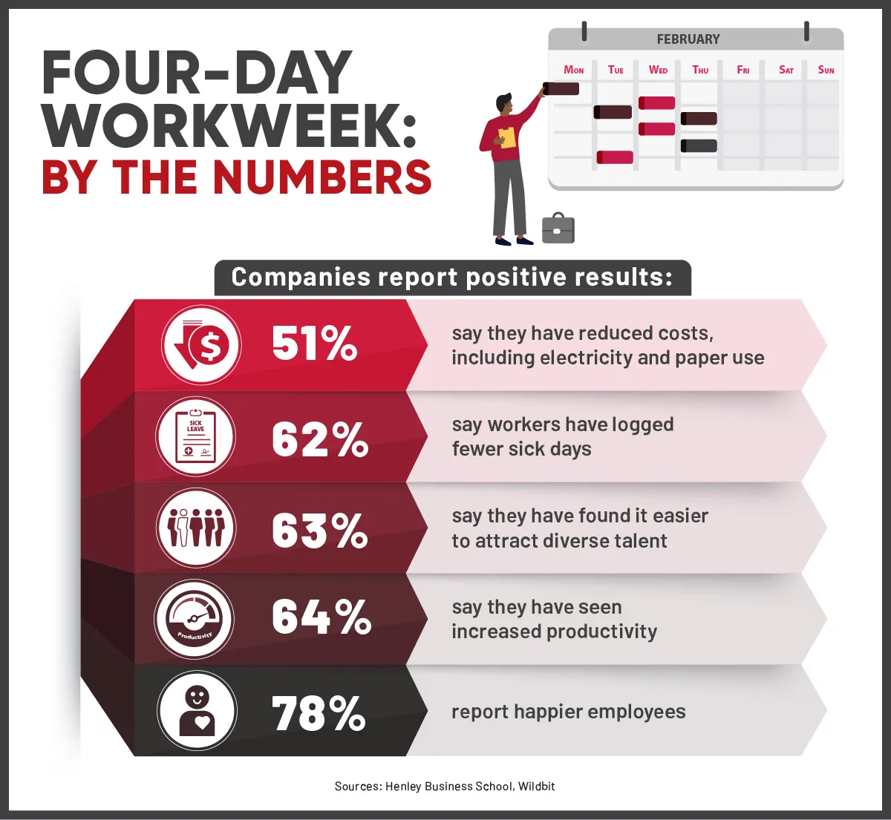
General scope and objectives/purpose/usefulness of study
This case study looks at how a 4-day workweek affects employees and businesses. We want to see if having a shorter workweek makes employees happier, more productive, and better at balancing work and life. We also want to know if it helps the company perform better. By studying this, we hope to figure out if switching from a 5-day to a 4-day workweek is a good idea for companies. Understanding this can help companies make their employees happier and their business more successful.
Walid

Slide 3
Hypotheses
Although there are less work days, productivity may increase due to heightened focus and greater efficiency.
The employees will be able to mitigate stress in their lives by having an improved work to life balance.
Four day work weeks can also increase the morale of the employees, This will in turn lead to higher retention of the work being done and lower turnover.
The companies are able to gain money from employees as they would be more efficient in there work from being refreshed.

Slide 4
Counter Hypotheses
Customer and client interactions may decrease as the work weeks are shorter and will be less flexible for meeting times.
Less work days may decrease the profits as having less days to work may lose money for certain companies.
Some companies may not be able to sustain a four day work week such as for essential workers

Slide 5
Literature Review
Article 1: "Moving forward"
High satisfaction among employers and employees observed.
Improved productivity, revenue growth, and well-being reported.
Reduction of low-value activities and improved work-life balance.
Potential for lower healthcare costs and improved recruitment.
COVID-19 pandemic accelerates adoption due to stress and burnout.
Article 2: "How to Actually Execute a 4-Day Workweek"
Increased prevalence of remote work prompts interest in four-day workweeks.
Successful trials showcase benefits in productivity and well-being.
Substantial work redesign needed for successful implementation.
Resetting employee expectations and buy-in from leadership is needed.
Competitive advantage in talent recruitment and retention.

Slide 6
Literature Review
Article 3: "A four-day workweek: the pros and cons"
Technological advancements render traditional five-day workweek unnecessary.
Successful trials demonstrate increased productivity and employee satisfaction.
Pros include reduced costs, happier employees, and improved well-being.
Challenges include longer hours and work-related stress.
Practical considerations for managing holiday entitlement and blended working discussed.
Emphasis on adapting to changing workplace dynamics while prioritizing employee welfare.

Slide 7
Units of Analysis and Data Collection Techniques
Interview: An interview before and during the study would allow us to correlate a change in employee happiness and wellbeing.
Observation: Observing employees in the workplace before and during the study could allow us to show a change in employees productivity at work.
Transactional Tracking: This would allow us to show a change in the business’ profits. And in comparison with the above metrics could show a correlation between employee wellbeing and happiness and profits.
Social Media: This would allow us to see if the employees are enjoying the extra day off whether it be enjoying their hobbies or resting. It would also allow us to see their insight on the 4 day work week whether they are for it or against it.
Units of Analysis:
Employee happiness and wellbeing
Productivity
Business expenses
Quality of work

Slide 8
Linking logic/interpretation criteria that explains what we will do with the data
Happiness and Well-being:
Analyze pre/post-study interview responses.
Identify themes indicating increased satisfaction, reduced stress, and improved work-life balance.
Business Costs:
Use transactional tracking data.
Compare financial metrics before and after implementation.
Anticipate potential reductions in overhead costs.
Quality of Work:
Examine observational data.
Assess changes in engagement, efficiency, and effectiveness at work.
Productivity:
Combine data sources (observational, self-reports, transactional).
Look for increased output per hour worked and overall productivity gains.
Interpretation:
Prioritize finding correlations and trends across data sets.
Seek consistency in changes (ex. happier employees leading to increased productivity).
Explore factors like improved work-life balance contributing to higher job satisfaction and productivity.

Slide 9
Potential weaknesses/threats to validity
Productivity: Some say a shorter workweek makes people happier and more focused, but less time might mean less work gets done. Employers need to watch closely to make sure everyone is still doing well.
Operational Challenges: Some jobs need people around all the time, like customer service. Changing to a 4-day week might make it hard to keep up with customers.
Workload Management: With fewer days to work, people might feel stressed to finish everything on time. Bosses need to help make sure everyone's job is manageable.
Client/Partner Expectations: People we work with might expect us to be around 5 days a week. Switching to a shorter week might confuse them. We need to explain what's happening and make sure they understand.
Employee Preferences: Some people might like the idea of a shorter week, but others might not. It's important to listen to everyone and find a solution that works for everyone.
Salary and Benefits: If we work less, we might get paid less too. Companies need to think about how this change might affect their workers' pay and benefits.
Training and Development: Working fewer days might mean less time for learning new things. Companies need to find other ways to help their employees grow and get better at their jobs.
Walid

