Slide 1
mile
zero
mile
zero
©
“Zero stress, all the miles.”
4MOBILITY TEAM
Antonio Frungillo
Eren Hamza Kocabas
Jonathan Ludoyo
Bernardo Piccioli Aguiar

Slide 2





the DEal
MileZero
≈€30
Optimizes efficieny of app based taxi driver working hours for ~€30/month in Amsterdam.
MONTH
Aims to increase efficiency
Subscription based
B2C

Slide 3
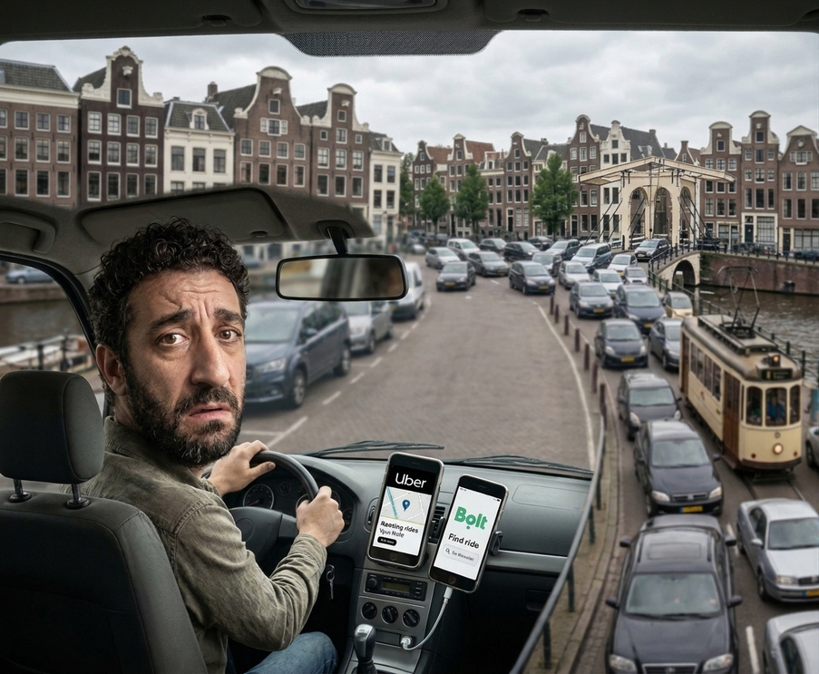
beacheadmarket&market segmentation
Initial goal: 500 drivers (10% of SOM)
€180,000 Annually
  Amstedam
  Taxi drivers who’s working with online platforms
TAM:
Total Addressable Market (EU)
~285,000 Drivers
≈€103M Annually
SAM:
Serviceable Addressable Market (Netherlands)
11,400 Drivers
€4.1M Annually
SOM:
Serviceable Obtainable Market (Amsterdam)
Sources
5,000 Drivers
€1.8M Annually
Revenue model: €30 per driver/month
Amsterdam data: ROA
Netherlands data: KVK
EU estimate: NL figure x 25
All figures are estimates

Slide 4
competetive analysis
Who drivers use today
Uber,Bolt, NLCabs
WhatsApp and Facebook groups
Worker Info Exchange
Komoot
Show the fare, not your profit
Peer-to-peer sharing, per day
Fights Uber on pay data
Plans the route, not earnings
Free · NL
Free · NL
Free · NL
£4.99/mo
Mystro
Gridwise
Solo
Para
Auto-accepts by your filters
Tracks earnings and miles
Pay guarantee and protection
Shows pay before you accept
≈ $19/mo · US only
$15/mo · US only
$10–20/mo · US only
US only
Nobody answers whether it’s worth it in 10 seconds. MileZero does.

Slide 5
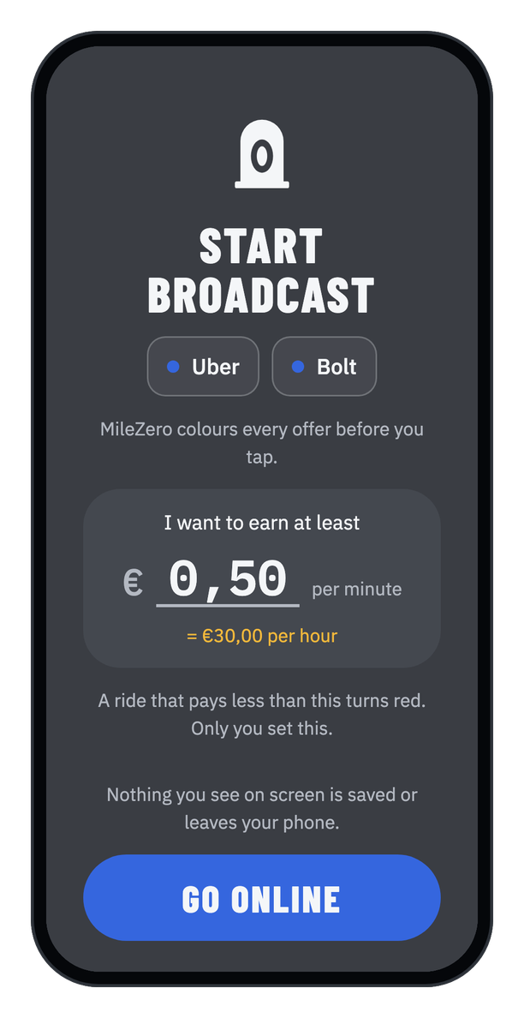
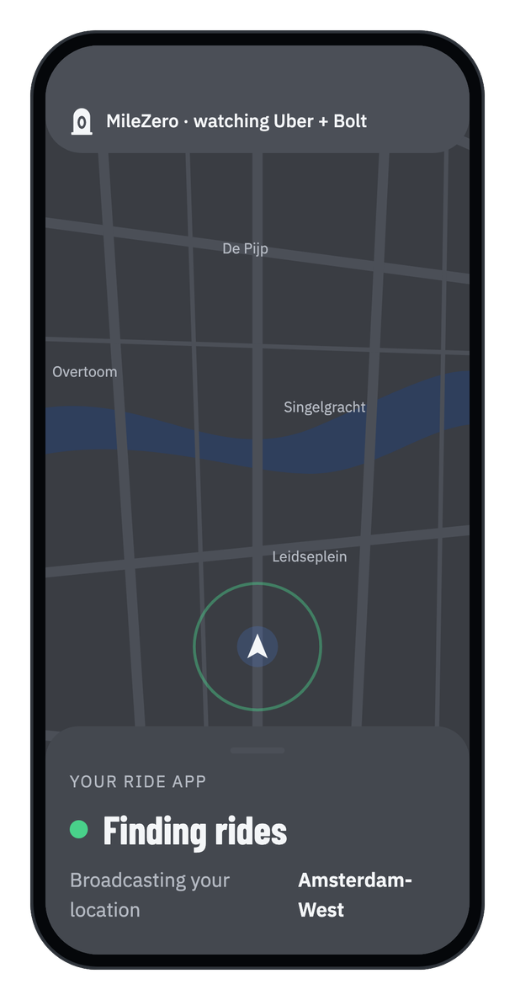
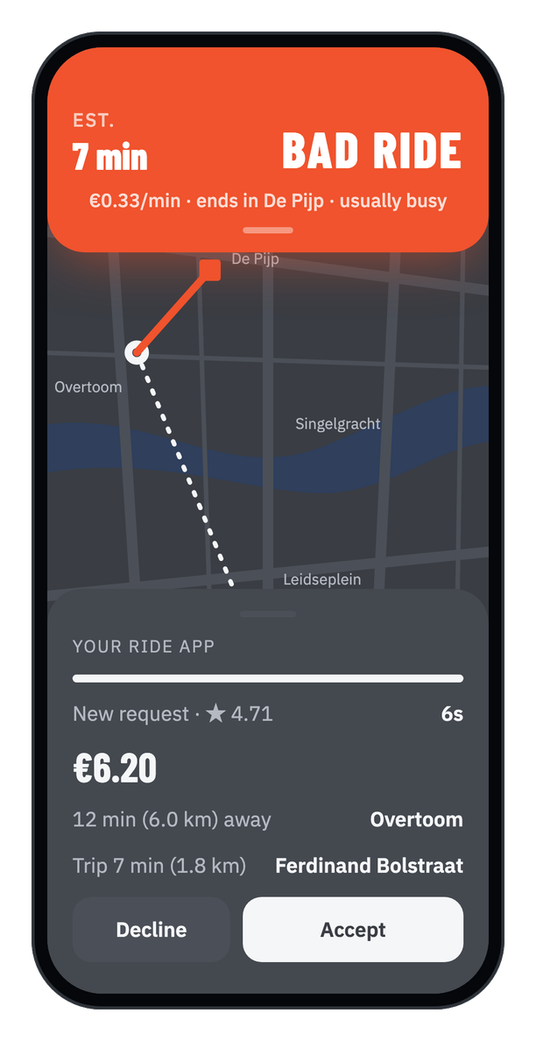
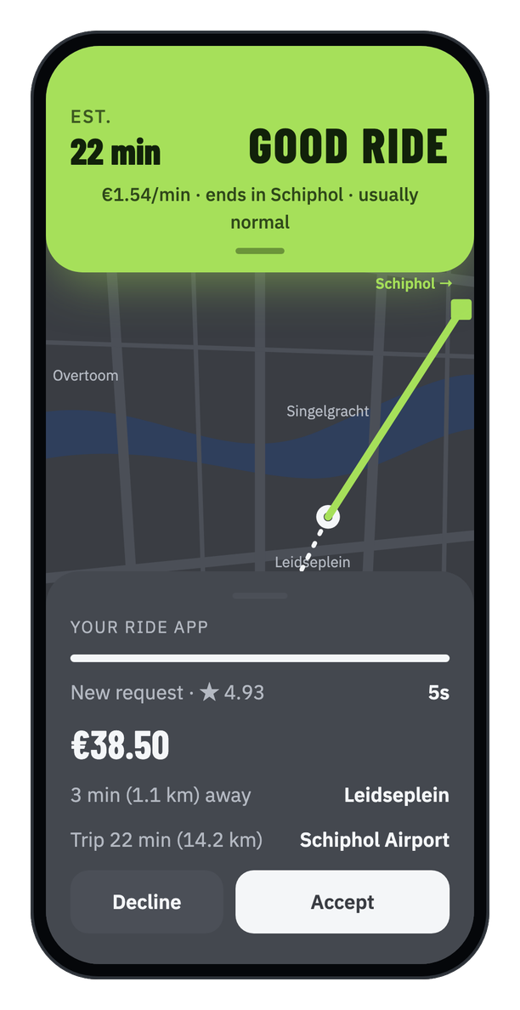
SERVICE
Start broadcast
Online
Bad ride
Good ride
One limit, set by the driver
A grey band watches Uber and Bolt
Red when it pays less than your limit
Green when it pays at least your limit

Slide 6

persona without milezero
“I can’t calculate real profit in time.”
BIO & STORY
GOALS
  Seasoned online taxi driver
  Sees his car as a micro-business
  Rushes snap judgments in 10 seconds
  Judge a ride in about 10 seconds
  Maximize net profit per hour
  Regain control from the algorithms
NEEDS
PAINS (FRUSTRATIONS)
Ibrahim
Full-time online taxi driver
  More time to decide on offers
  Upfront transparency on costs
  Automatic net-profit calculation
  Hidden destination and commissions
  Unpredictable fuel prices
  Guessing instead of calculating
Middle-to-lower middle class (dependent on daily driving volume)

Slide 7
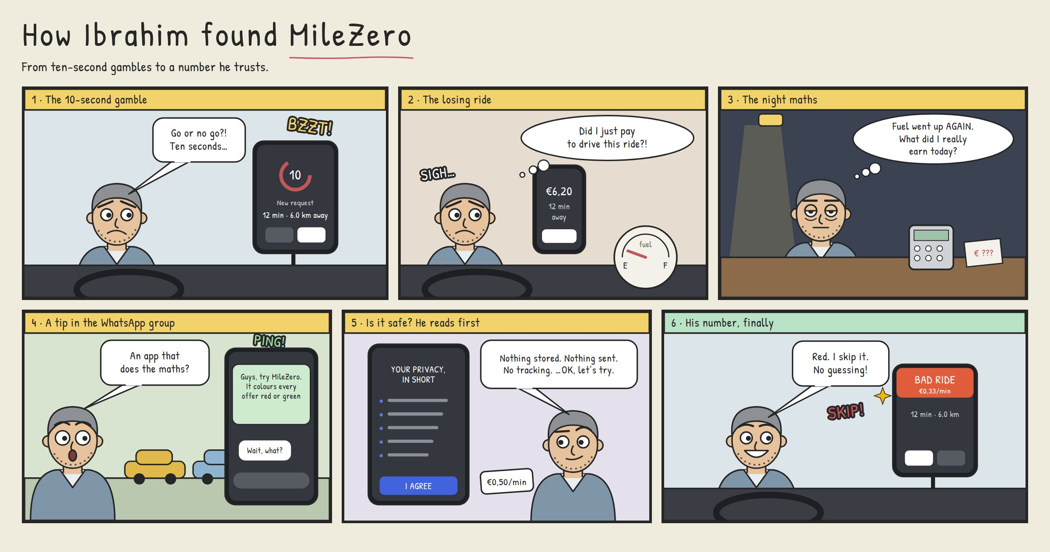
customer JOURNEY
1 · The 10-second gamble

Slide 8
customer JOURNEY
2 · The losing ride

Slide 9
customer JOURNEY
3 · The night maths

Slide 10
customer JOURNEY
4 · A tip in the WhatsApp group

Slide 11
customer JOURNEY
5 · Is it safe? He reads first

Slide 12
customer JOURNEY
6 · His number, finally

Slide 13
CUSTOMER DISCOVERY
Amsterdam-area drivers: Uber, Bolt and independent street taxi
50
2
70+
8
interviews
prototype testing
desk research sources
competitors studied
Open questions, not leading ones
Development process and Validation
Papers, reports, news, apps, law
In the Netherlands and abroad
Best findings
30 of 50
20 of 50
“I can’t tell if a ride is profitable in time.”
drivers can’t tell in time if a ride pays
feel a cost and pricing squeeze
Our number one finding
Across all 50 interviews
A second, separate problem
Backed by research: a 454-worker study (Pires, 2024) and a 2023 Amsterdam court ruling

Slide 14

FOundersdream&team
ANTONIO: RESEARCH & DIGITAL KNOWLEDGE
EREN: STRONG CONNECTIONS WITH INDUSTRY & CREATIVITY
JONATHAN: CRITICAL THINKING &ANALYTIC THINKING
BERNARDO: LOGICAL THINKING & COMMUNICATION SKILLS
Replacing algorithmic uncertainty with instant financial clarity in every 10-second window
Empowering drivers to maximize shift earnings through smarter choices, not longer hours.

Slide 15
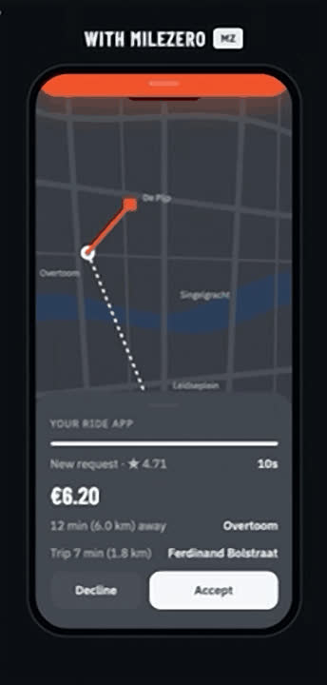
THANK
YOU!

Slide 16
References
  Pires, P. (2024). How much can you make? Misprediction and biased memory in gig jobs [Unpublished manuscript]. Nova School of Business and Economics.
  Rechtbank Amsterdam. (2021, September 13). ECLI:NL:RBAMS:2021:5029, FNV v. Uber B.V. Rechtspraak.nl.
  Roberts, I. D., Teoh, Y. Y., & Hutcherson, C. A. (2021). Time to pay attention? Information search explains amplified framing effects under time pressure. Psychological Science, 33(1), 90–104
  The Guardian. (2026, September 2). Uber drivers launch European class action over 'soulless' and 'scary' AI algorithm.
  APA: van Doorn, N., & Badger, A. (2020). The Hidden Space of Platform Capitalism: Producing Data Assets in the Gig Economy. Antipode, 52(5), 1475-1495. https://doi.org/10.1111/anti.12641
  Fouarge, D., Dijksman, S. I. 0., Steens, S. I., Hendrickx, S., & Hendrikse, A. I. 0. (2023). Gebruikers Uber app, gemaakte trips, verdiensten en tevredenheid. In Research Publications (Maastricht University). https://doi.org/10.26481/umarep.2023001
  Vergelijkingsonderzoek inkomsten Uber chauffeurs. (n.d.). Openresearch.Amsterdam. https://openresearch.amsterdam/nl/page/85697/vergelijkingsonderzoek-inkomsten-uber-chauffeurs?
  Dynamicpay. (2026, May 1). New research exposes deepening exploitation of Uber drivers by algorithmic pay - Stichting WIE International. Stichting WIE International. https://workerinfoexchange.nl/new-research-exposes-deepening-exploitation-of-uber-drivers-by-algorithmic-pay/?
  Market Reports World. (2026, September 3). Ride-Hailing and taxi market. https://www.marketreportsworld.com/market-reports/ride-hailing-and-taxi-market-14721759
  Statista. (n.d.). Ride-hailing - Netherlands | Statista market forecast. https://www.statista.com/outlook/mmo/shared-mobility/ride-hailing/netherlands/
  Market Reports World. (2026, September 3). Ride-Hailing and taxi market. https://www.marketreportsworld.com/market-reports/ride-hailing-and-taxi-market-14721759
  Statista. (n.d.). Ride-hailing - Netherlands | Statista market forecast. https://www.statista.com/outlook/mmo/shared-mobility/ride-hailing/netherlands/
  Tourism, A. (2026, October 3). Amsterdam Taxi & Uber Guide 2026: Costs, Tips & How to Pay - Amsterdam Tourism Guide. Amsterdam Tourism Guide. https://www.amsterdamtourism.org/amsterdam-taxi-uber-cost/
  8 miljoen Amsterdamse taxiritten per jaar | Website Onderzoek en Statistiek. (n.d.). https://onderzoek.amsterdam.nl/video/animatie-taximarkt
  Arets, M. (2023, March 6). Martijn Arets. Martijn Arets. https://www.martijnarets.com/nieuwsbrief/research-income-of-uber-drivers-in-amsterdam-an-analysis/
  Statista Citation:
  Statista Research Department. (2025, January 31). Ride sharing/hailing / online taxi usage by brand in the Netherlands 2024. Statista. statista.com
  TGM Research Citation:
  TGM Research. (2024). Most frequently used ride-hailing services in Europe. TGM Statbox. tgmstatbox.com

Slide 17
References (continued)
Kamer van Koophandel. (2024, May 21). Data Dinsdag: toename aantal taxibedrijven weer in hogere versnelling. https://www.kvk.nl/pers/data-dinsdag-toename-aantal-taxibedrijven-weer-in-hogere-versnelling/
FNV. (2020, June). Witboek Uber. https://www.fnv.nl/getmedia/b7059a93-7b55-4ae3-b9bc-16ba418a34c4/Witboek-Uber.pdf
Henao, A., & Marshall, W. E. (2019). The impact of ride-hailing on vehicle miles traveled. Transportation, 46(6), 2173–2194. https://doi.org/10.1007/s11116-018-9923-2
Google. (n.d.). Google Maps Platform pricing list. https://developers.google.com/maps/billing-and-pricing/pricing
Google. (n.d.). Routes API usage and billing. https://developers.google.com/maps/documentation/routes/usage-and-billing
GigU. (n.d.). GigU. https://gigu.co
Mystro. (n.d.). Mystro driver app. https://mystrodriver.com/
Gridwise. (n.d.). Gridwise: gig driver assistant. https://gridwise.io/
Gridwise. (n.d.). Gridwise vs Everlance vs Stride. https://gridwise.io/blog/gridwise-vs-everlance-vs-stride
Arcoverde, L. (2025, May 14). Brazil's GigU launches earnings optimization app for US gig workers. The Brazilian Report. https://newsletters.brazilian.report/p/gigu-uber-gig-economy
The Rideshare Guy. (n.d.). This driver got 526 offers and declined 508 of them. https://therideshareguy.beehiiv.com/p/this-driver-got-526-offers-and-declined-508-of-them
4mobility. (2026). Primary research: six driver trip-offer screenshots, fare breakdown screenshots and 34 driver interviews in Amsterdam (Uber, Bolt). Segment and city scoring, team Miro board.

