Slide 1
Forecasting daily Closing Prices for Equity symbols using ANNs
Alexandros Antoniou
1908855

Slide 2
Presentation Outline
Why forecasting is important
What research already exists
How the project works
How we collect and evaluate the data

Slide 3
Why forecasting is important in the finance sector
Why do we want to predict stock prices?
Build a robust trading strategy
Automate the trading process
Minimise risk involved in trading
What problems make this difficult?
Efficient market hypothesis¹
Approximate traditional solutions not accurate enough^{2,3}
Notes:
1 - Fama, Eugene (1970). "Efficient Capital Markets: A Review of Theory and Empirical Work". Journal of Finance. 25 (2): 383–417. doi:10.2307/2325486
2 - Qing Cao, et al (2004). “A comparison between Fama and French's model and artificial neural networks in predicting the Chinese stock market”, Computers & Operations Research. 32 (10): 2499-2512. doi:10.1016/j.cor.2004.03.015.
3 - S.L Ho, M Xie, T.N Goh (2002), “A comparative study of neural network and Box-Jenkins ARIMA modeling in time series prediction”, Computers & Industrial Engineering, 42 (2–4): 371-375. doi:10.1016/S0360-8352(02)00036-0.

Slide 4
What has already been done to tackle this problem
Researchers are applying all kinds of ANN architectures to financial problems with increasing accuracy
Data mining⁴ and Natural Language processing (NLP)⁵ have found their places in finance related research through the use of Neural networks
From simple MLP networks to genetic algorithms⁶ to intricate GANs⁷ to beat the market
Notes:
4 - David Enke, Suraphan Thawornwong (2005). “The use of data mining and neural networks for forecasting stock market returns”, Expert Systems with Applications, 29 (4): 927-940. doi:10.1016/j.eswa.2005.06.024
5 - M. R. Vargas, B. S. L. P. de Lima and A. G. Evsukoff (2017) "Deep learning for stock market prediction from financial news articles," IEEE International Conference on Computational Intelligence and Virtual Environments for Measurement Systems and Applications (CIVEMSA), Annecy, pp. 60-65, doi:10.1109/CIVEMSA.2017.7995302
6 - R.J. Kuo, C.H. Chen, Y.C. Hwang (2001). “An intelligent stock trading decision support system through integration of genetic algorithm based fuzzy neural network and artificial neural network”, Fuzzy Sets and Systems, 118 (1): 21-45. doi:10.1016/S0165-0114(98)00399-6.
7 - Xingyu Zhou et al (2018), “Stock Market Prediction on High-Frequency Data Using Generative Adversarial Nets“, Computational Intelligence in Data-Driven Modelling and Its Engineering Applications, 2018 doi:10.1155/2018/4907423
CNN based model: CNNPred: Ehsan Hoseinzade and Saman Haratizadeh (2018). “CNN-based stock market prediction using several data sources”. https://arxiv.org/abs/1810.08923

Slide 5
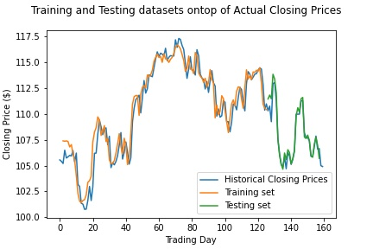
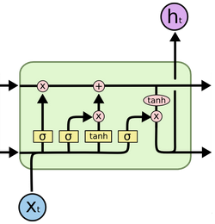
The what and how of the project
The network:
3-layer RNN Sequential model
2 LSTM⁸ layers
1 Dense Layer
Adam optimizer
11 input nodes for 11 features in the dataset
Results compared against ARIMA models
Image: Long Short-Term Memory
cell architecture
Notes:
8 - Sepp Hochreiter, Jurgen Schmidhuber (1997), “Long Short-Term Memory”, Neural Computation, 9 (8): 1735-1780. https://www.bioinf.jku.at/publications/older/2604.pdf
LSTMs are powerful time series modelling networks.
Dense are fully-connected NN layer, all of its inputs are connected to the previous layers outputs.
https://keras.io/api/models/sequential/
https://keras.io/api/layers/recurrent_layers/lstm/
https://keras.io/api/layers/core_layers/dense/
LSTM Architecture Image: https://colah.github.io/posts/2015-08-Understanding-LSTMs/

Slide 6
How the data was collected, curated and evaluated
Open, High, Low, Close, Volume values for stocks in the NYSE
Rolling averages for Close with window of 14 days
Stochastic Oscillator index
Exponential Moving Average with window of 14 days
160 rows of historical data alongside new indices for a total of 160 rows and 11 total features
The data are scaled down, split into training and testing sets
Notes:
A stochastic oscillator is a momentum indicator comparing a particular closing price of a security to a range of its prices over a certain period of time. The sensitivity of the oscillator to market movements is reducible by adjusting that time period or by taking a moving average of the result. It is used to generate overbought and oversold trading signals, utilizing a 0-100 bounded range of values.
https://www.investopedia.com/terms/s/stochasticoscillator.asp
An exponential moving average (EMA) is a type of moving average (MA) that places a greater weight and significance on the most recent data points. The exponential moving average is also referred to as the exponentially weighted moving average. An exponentially weighted moving average reacts more significantly to recent price changes than a simple moving average (SMA), which applies an equal weight to all observations in the period.
https://www.investopedia.com/terms/e/ema.asp
Bollinger Bands are a highly popular technique. Many traders believe the closer the prices move to the upper band, the more overbought the market, and the closer the prices move to the lower band, the more oversold the market.
https://www.investopedia.com/terms/b/bollingerbands.asp

Slide 7
Acknowledgements
I would like to thank my supervisor for her continued support and guidance during these trying times.

Slide 8
A few minutes for Q&A
Thanks for attending!

