Slide 1
Toy Data

Slide 2
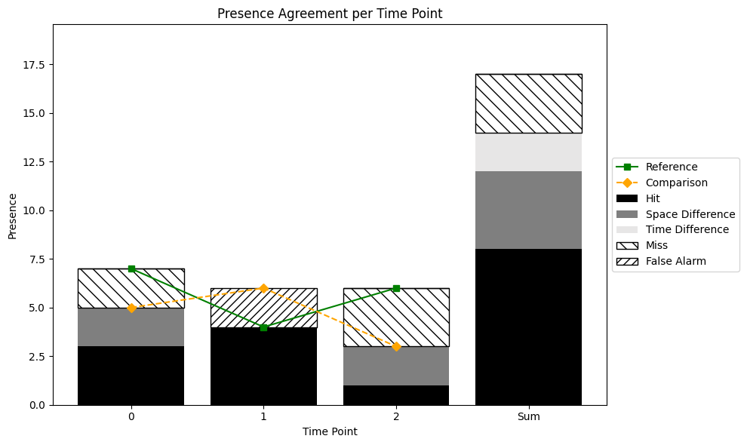
Presence Agreement graphic using Toy data

Slide 3
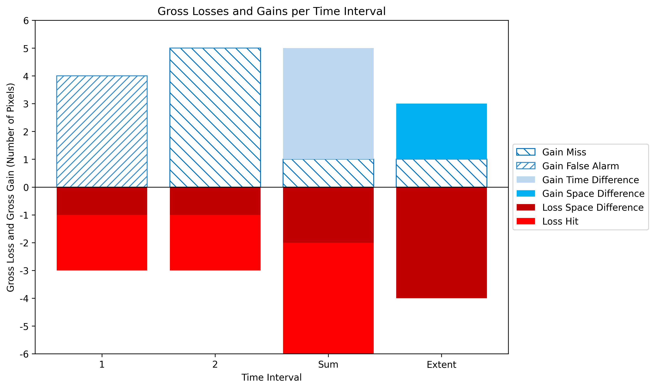
Gross Losses and Gross Gains graphic using Toy data

Slide 4
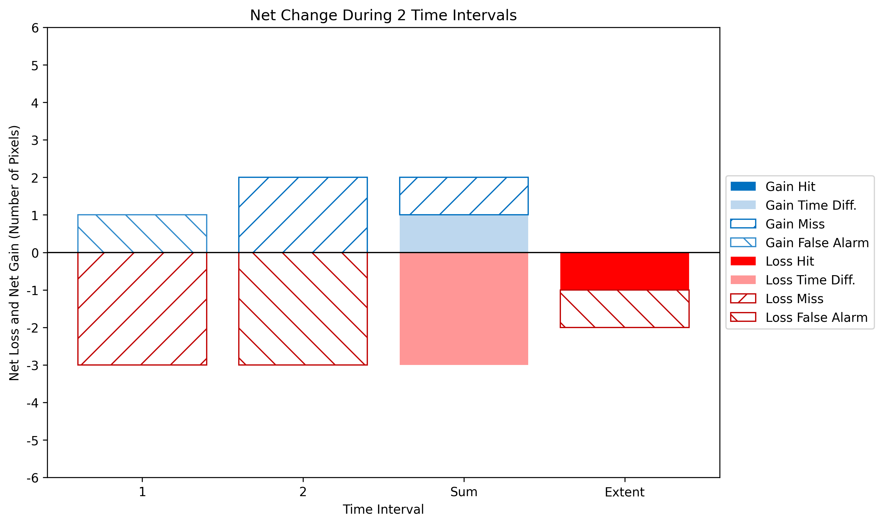
Net change graphic using Toy data

Slide 5
Savanna
MapBiomas Collection 6 and Collection 8

Slide 6
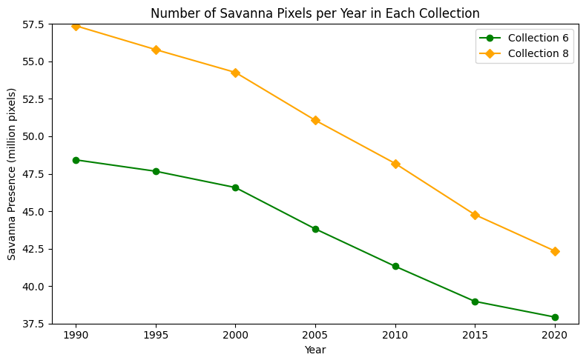

Slide 7
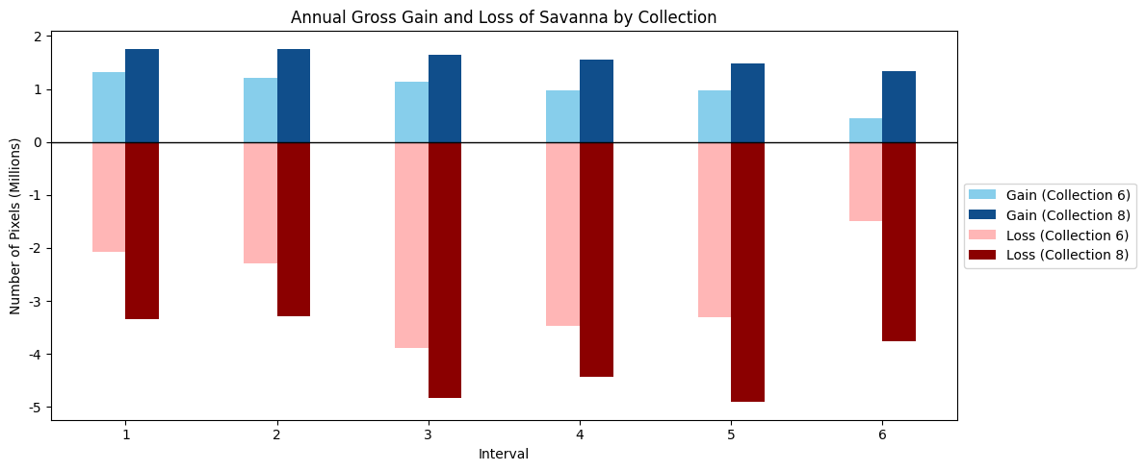

Slide 8
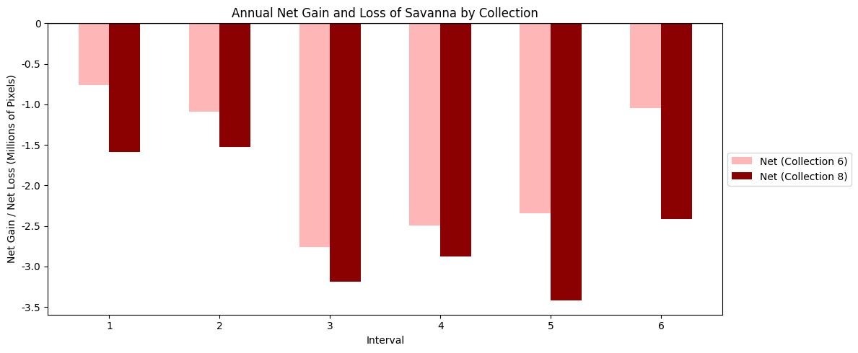

Slide 9
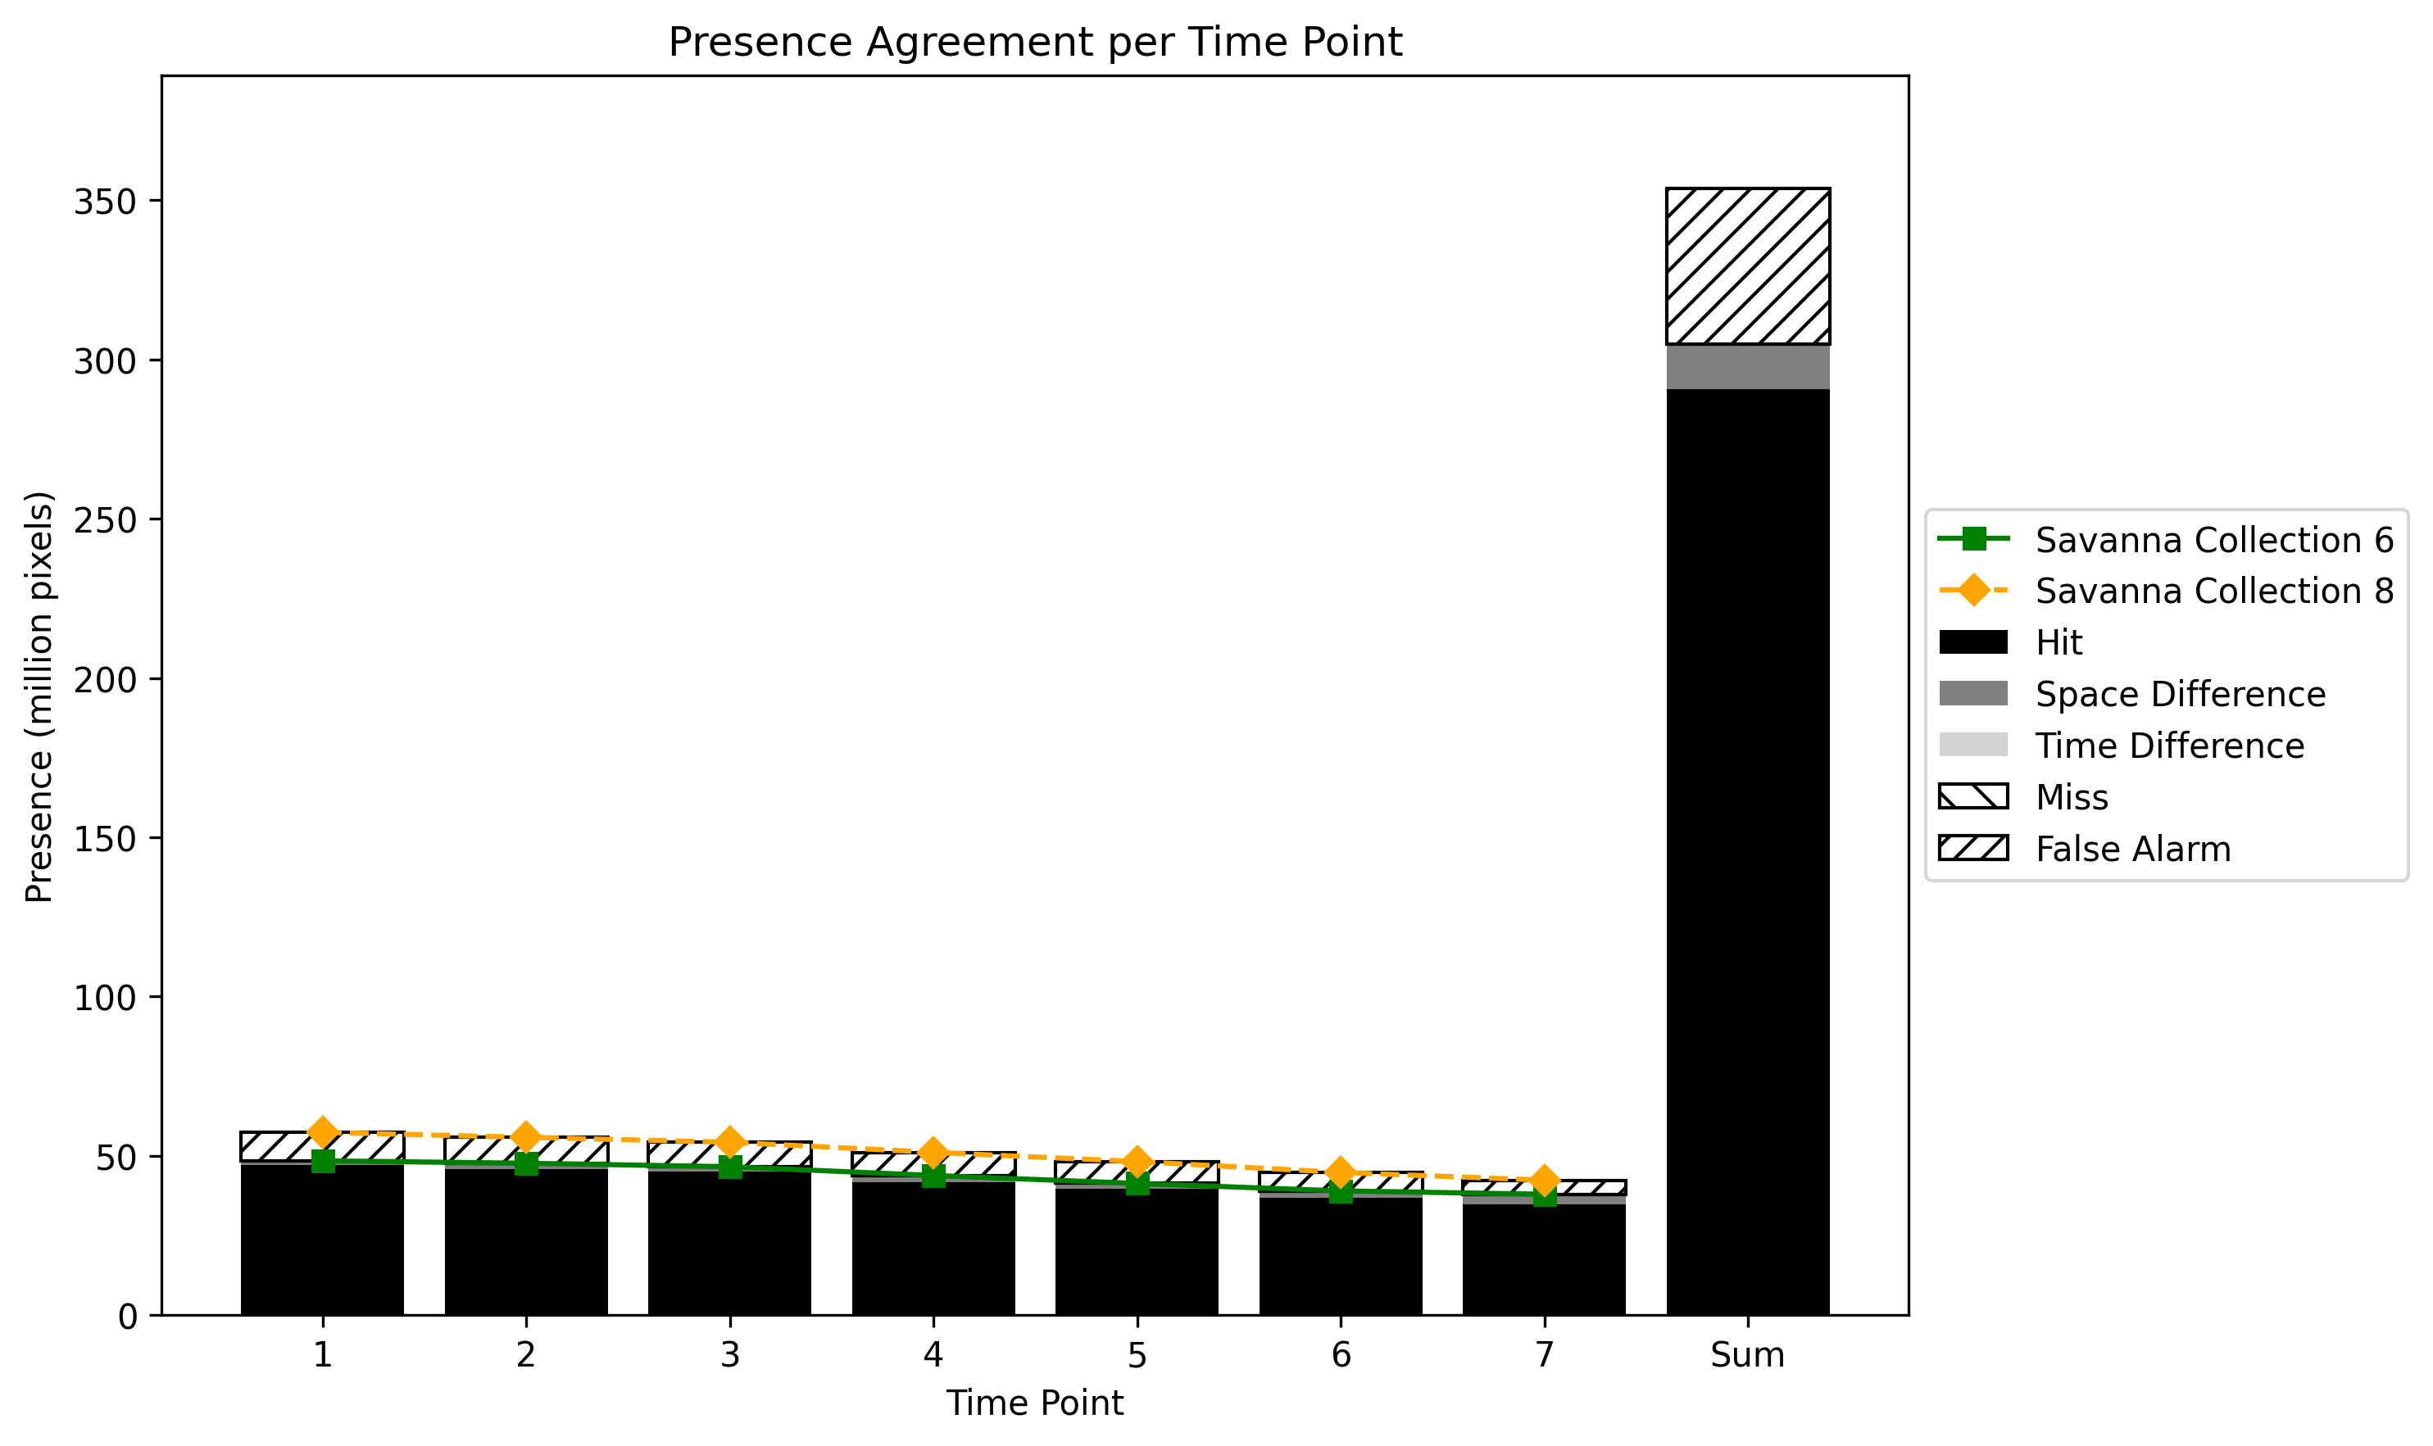
Presence Agreement graphic using Savanna class

Slide 10
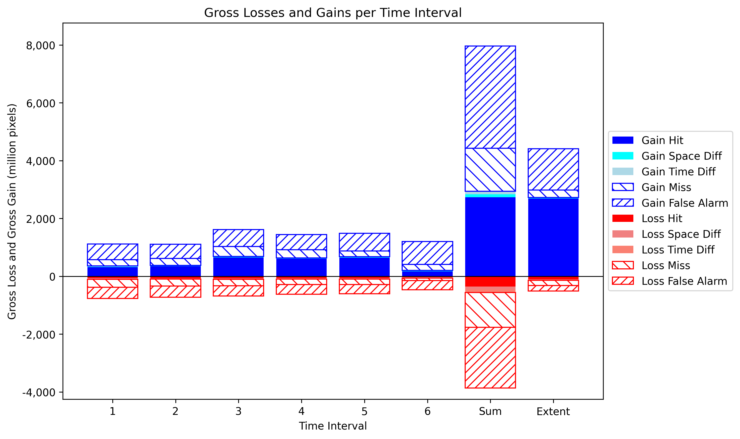
Gross Losses and Gross Gains graphics using Savanna class
This graphic needs to be reviewed

Slide 11
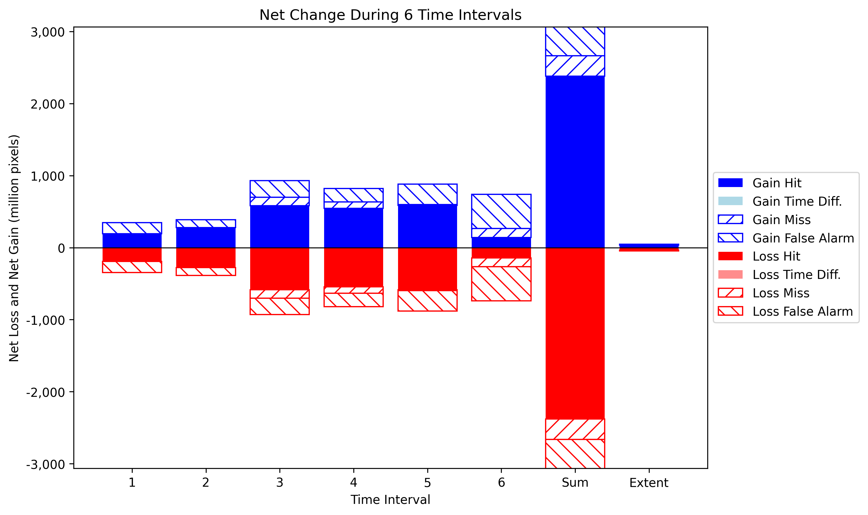
Net change graphic using Savanna class
This graphic needs to be reviewed

