Slide 1
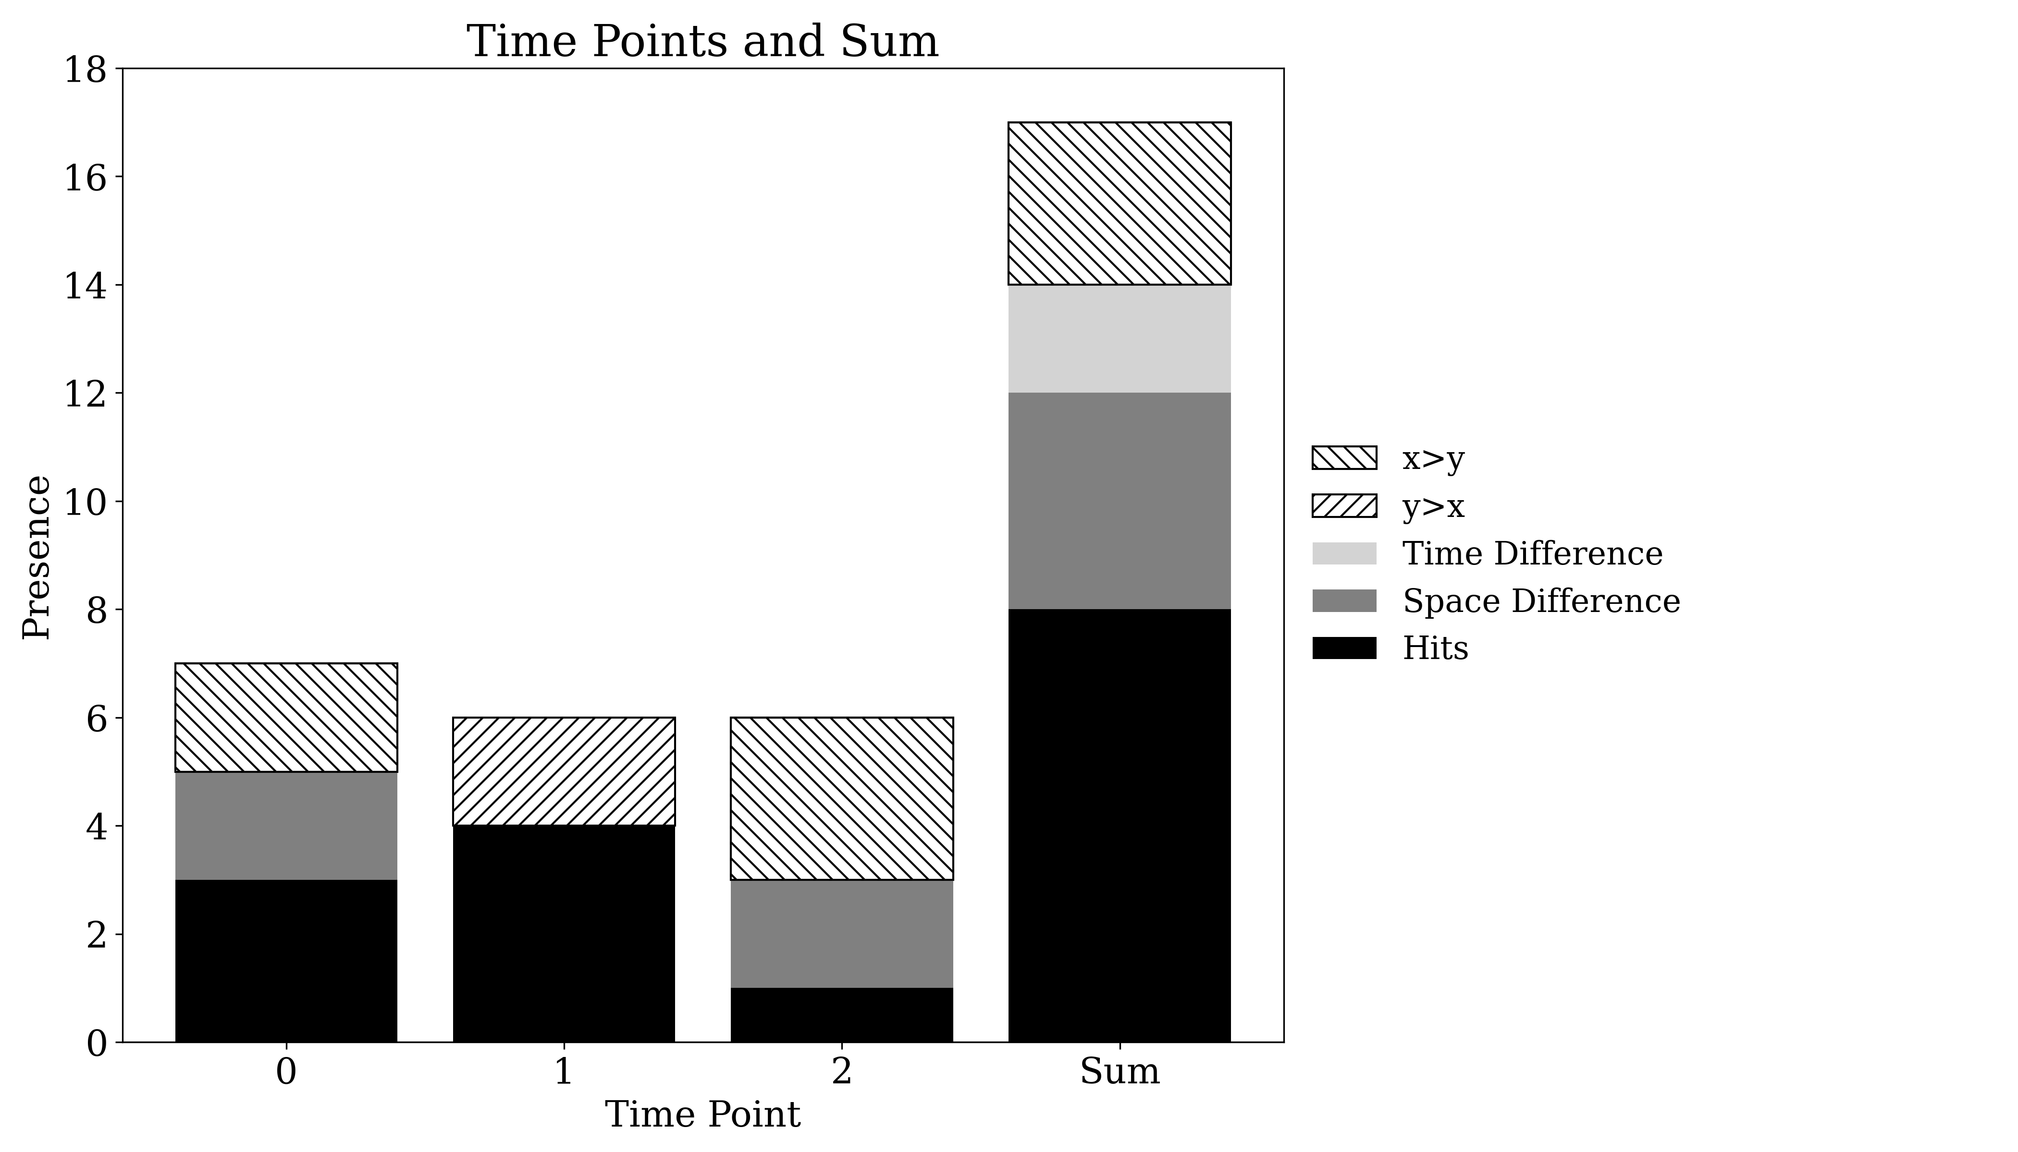
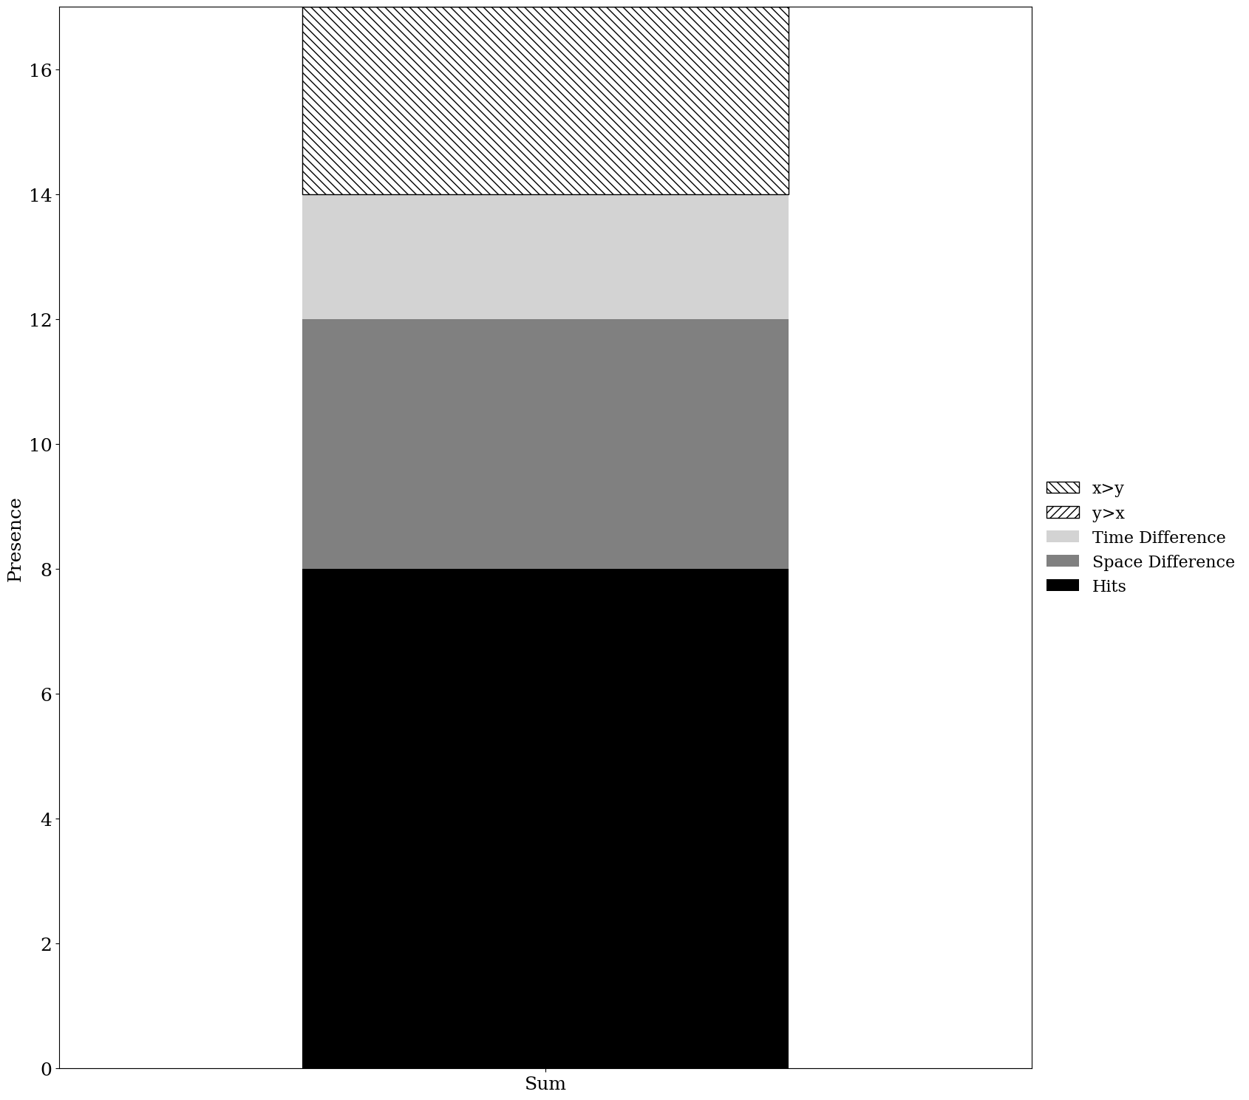
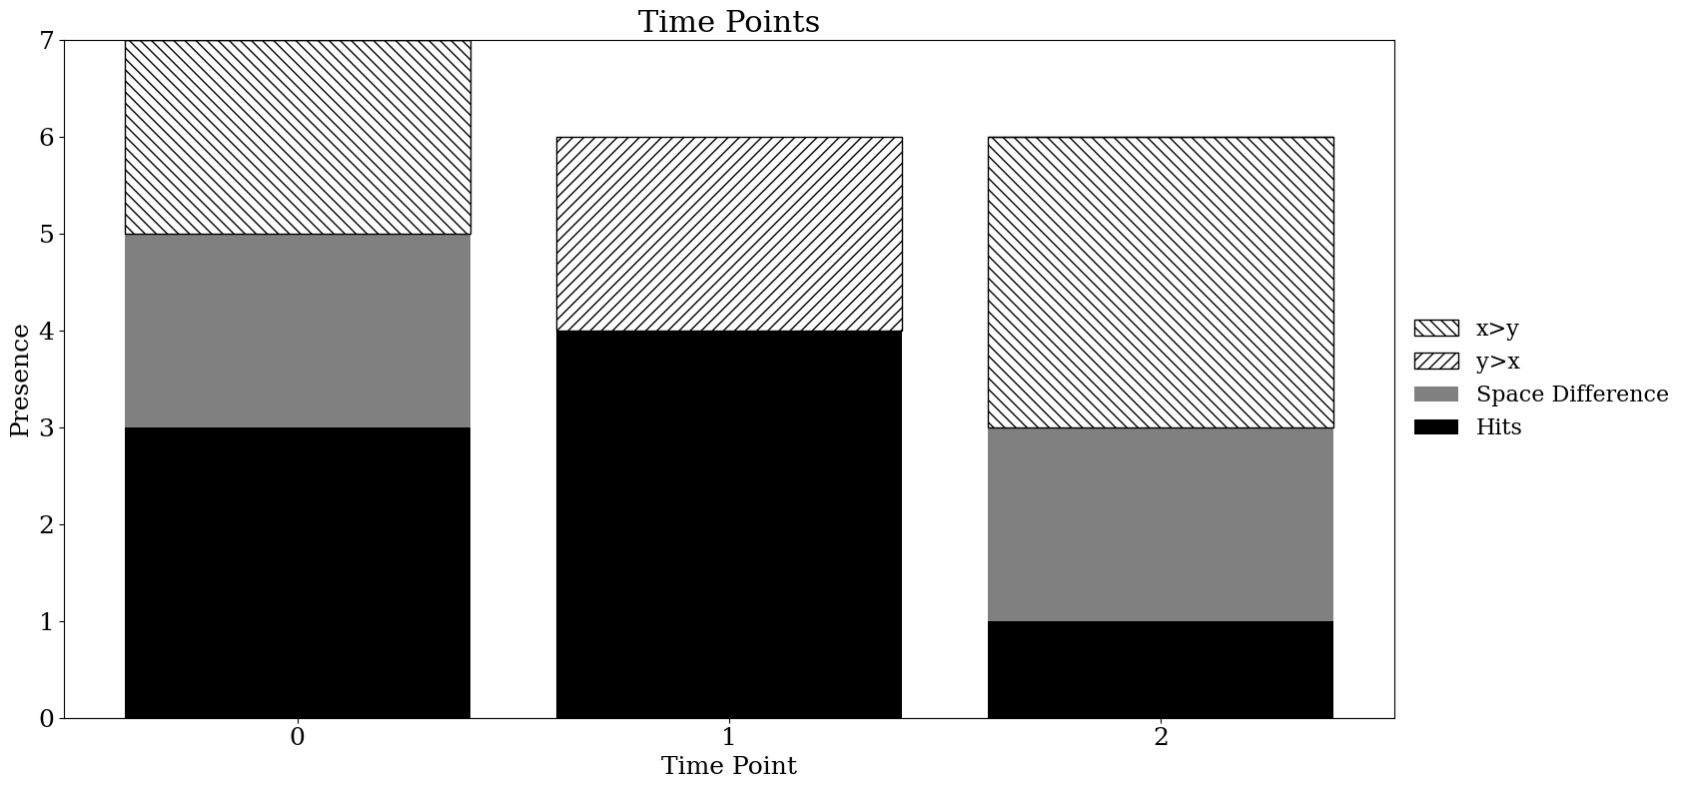
Old version
New version

Slide 2
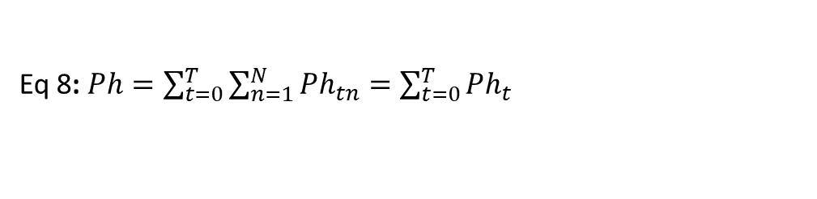
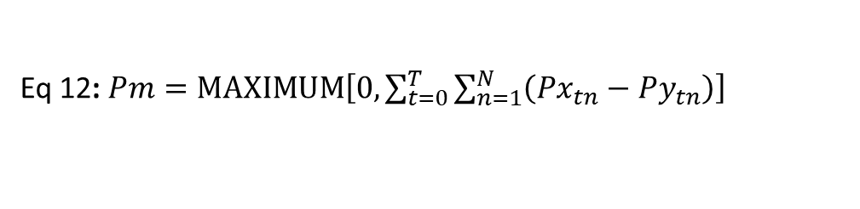
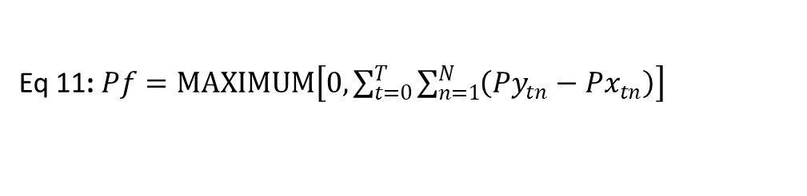
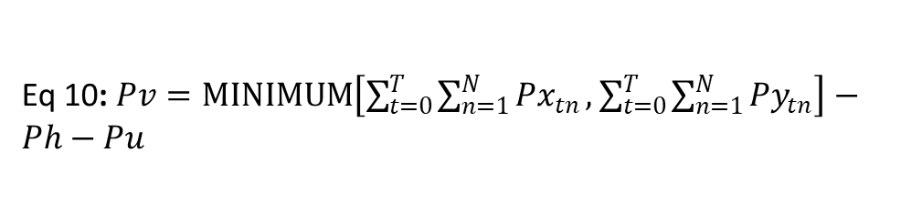
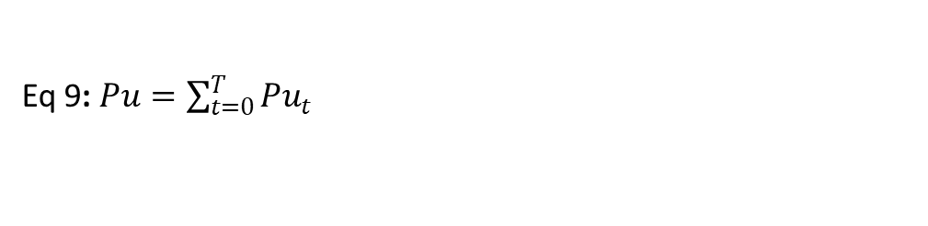
Eq 8: $Ph=\sum_{t=0}^{T}{\sum_{n=1}^{N}{{Ph}_{tn}}}=\sum_{t=0}^{T}{{Ph}_{t}}$
Eq 9: $Pu=\sum_{t=0}^{T}{{Pu}_{t}}$
Eq 10: $Pv=MINIMUM\left[\sum_{t=0}^{T}{\sum_{n=1}^{N}{{Px}_{tn}}},\sum_{t=0}^{T}{\sum_{n=1}^{N}{{Py}_{tn}}}\right]−Ph−Pu$
Eq 11: $Pf=MAXIMUM\left[0,\sum_{t=0}^{T}{\sum_{n=1}^{N}{\left({Py}_{tn}−{Px}_{tn}\right)}}\right]$
Eq 12: $Pm=MAXIMUM\left[0,\sum_{t=0}^{T}{\sum_{n=1}^{N}{\left({Px}_{tn}−{Py}_{tn}\right)}}\right]$
Hit (Eq. 8): Sum the hits across time points to measure agreement in presence.
Space Difference (Eq. 9): Sum the space difference across time points to measure disagreement in spatial allocation.
Time Difference (Eq. 10): Take the MINIMUM of the summed totals of $Px$​ and $Py$​; subtract Hit(Sum) and Space Difference(Sum) to measure temporal allocation disagreement.
y>x — False Alarm (Eq. 11): Use $MAXIMUM$to measure where the summed presence of y exceeds that of x.
x>y — Miss (Eq. 12): Use to measure where the summed presence of x exceeds that of y.

Slide 3
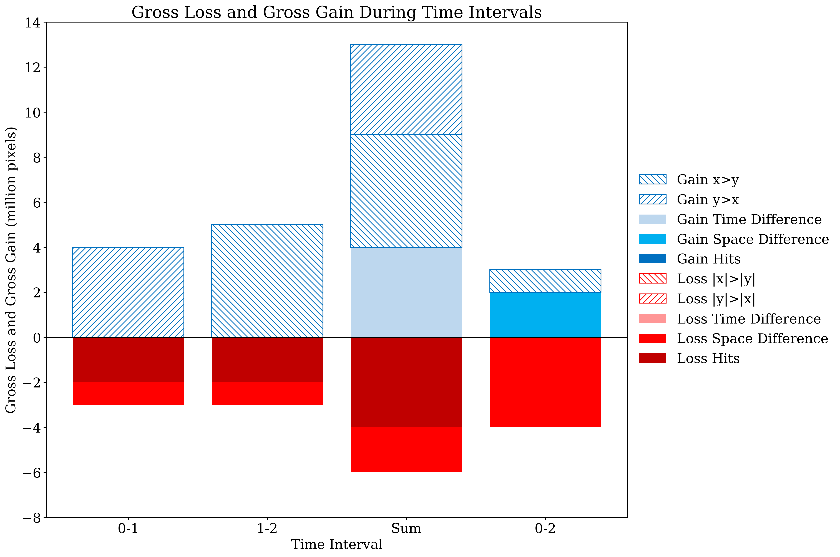
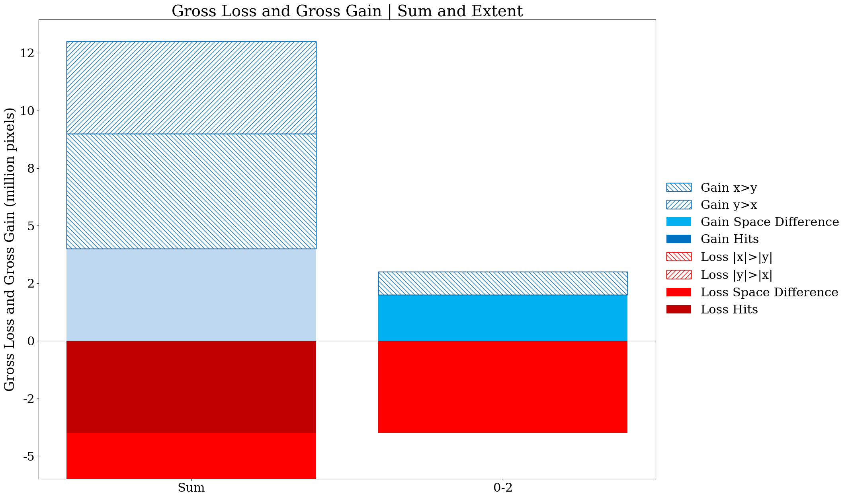
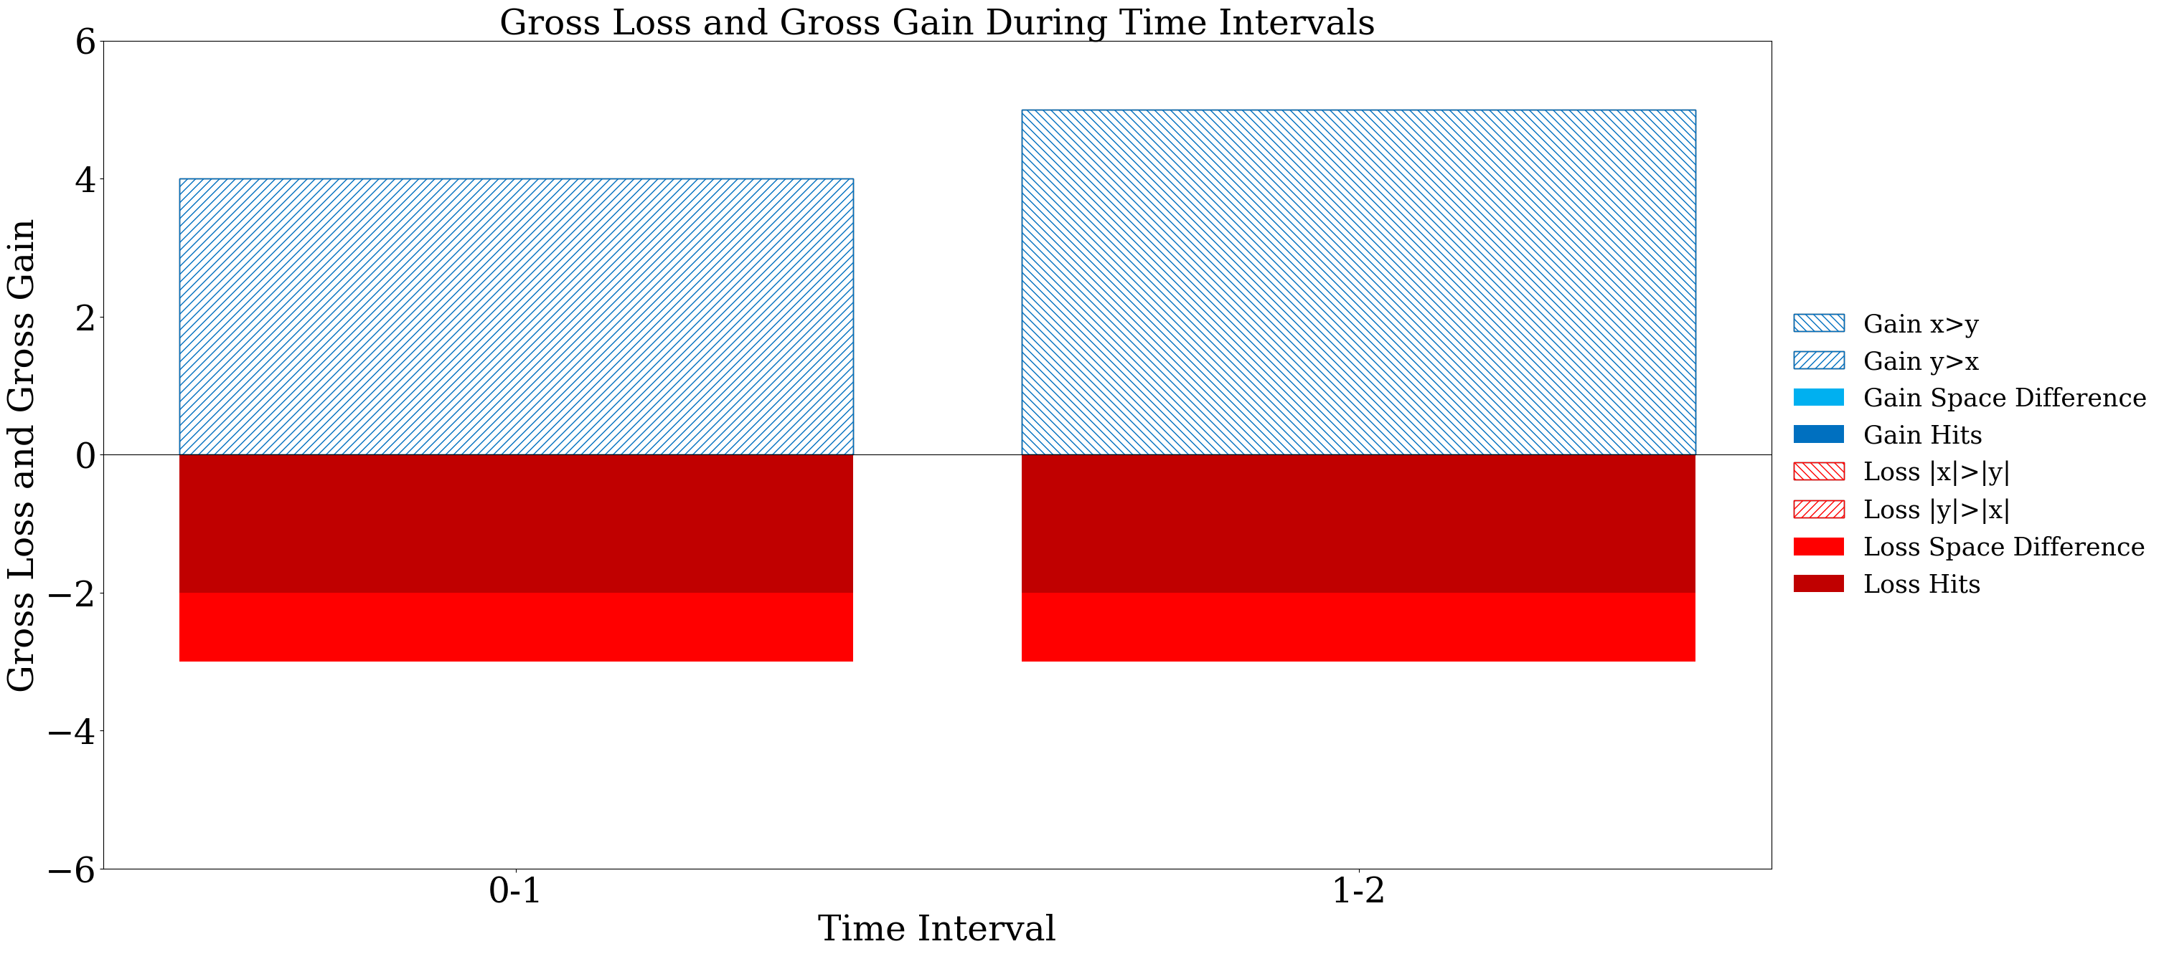
Old version
Gain time difference component should be in the legend
New version

Slide 4
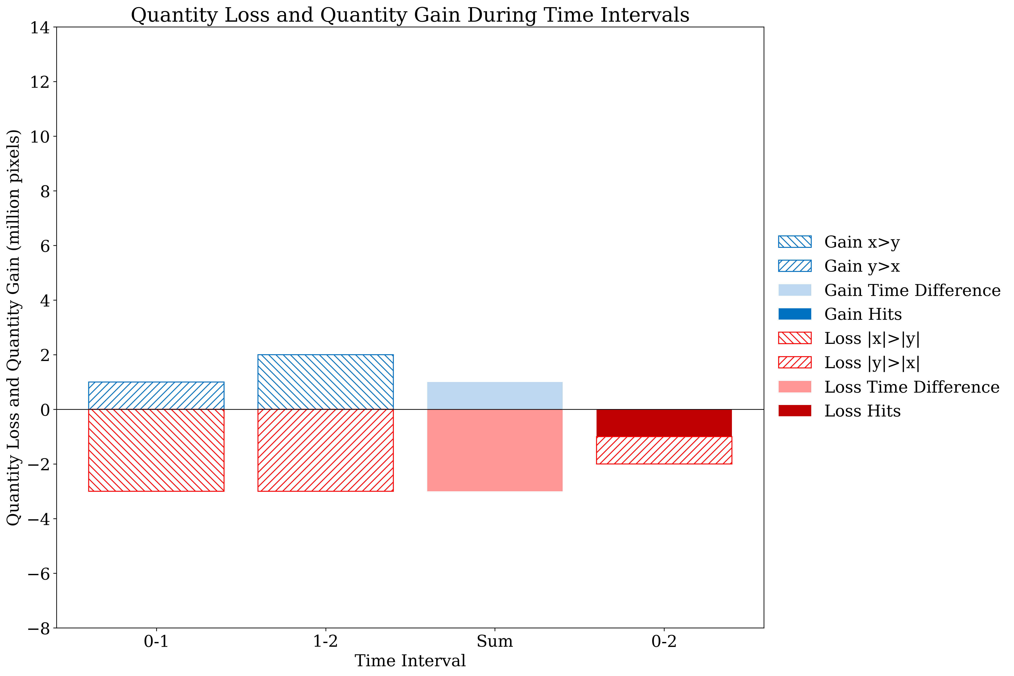
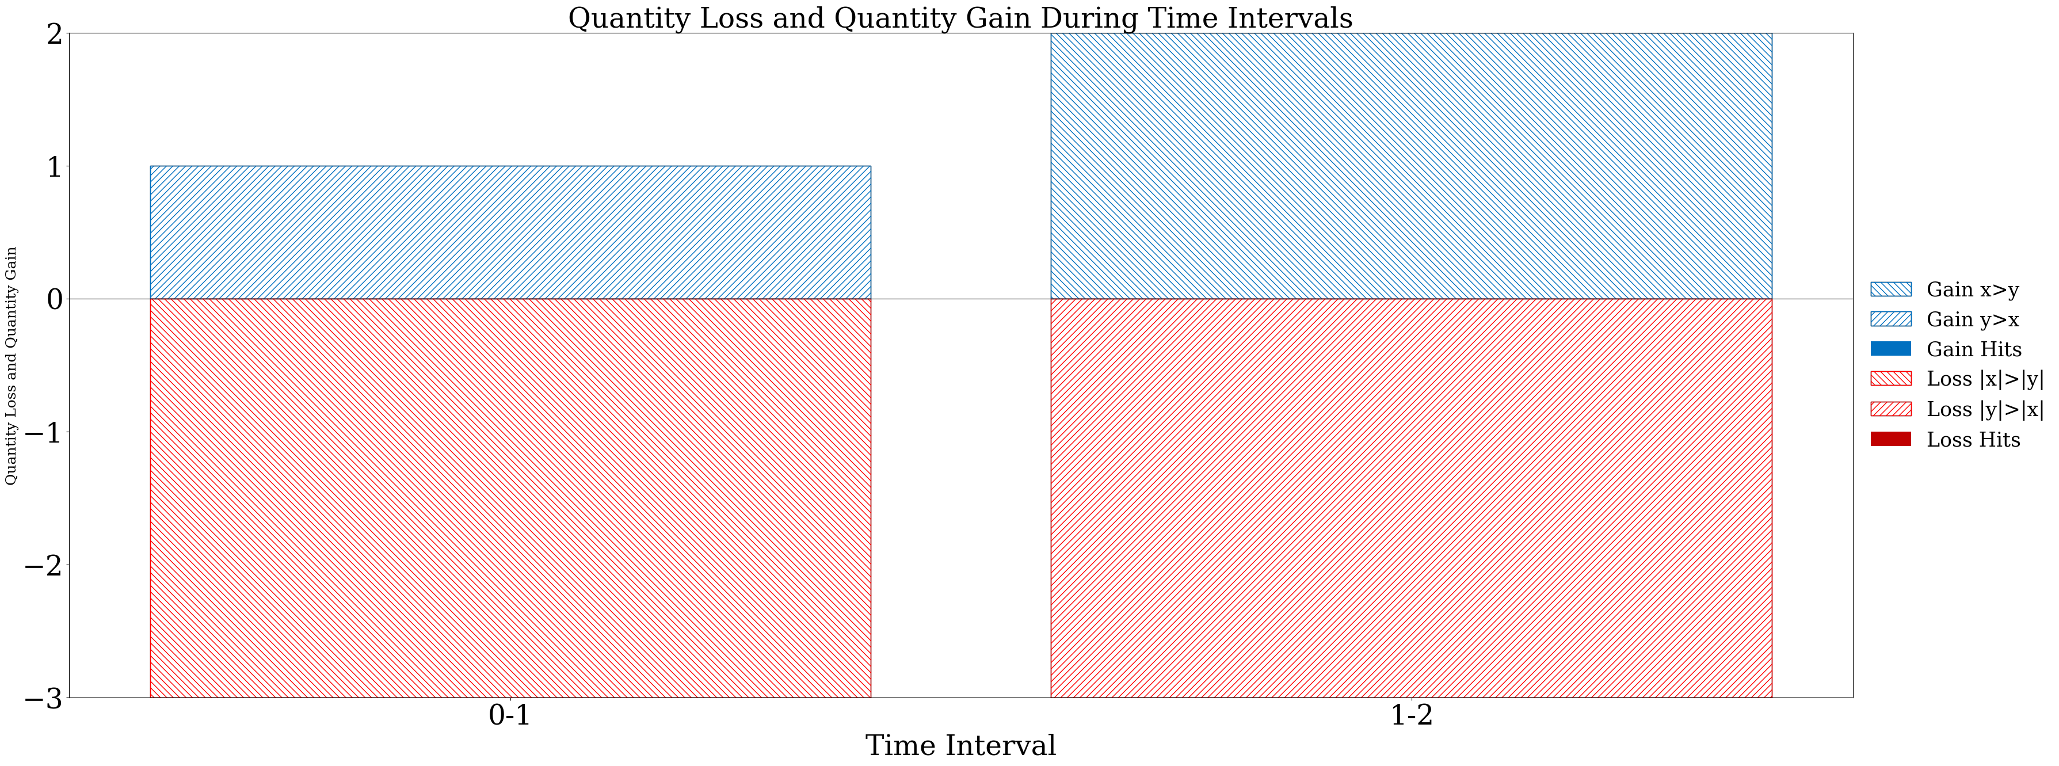
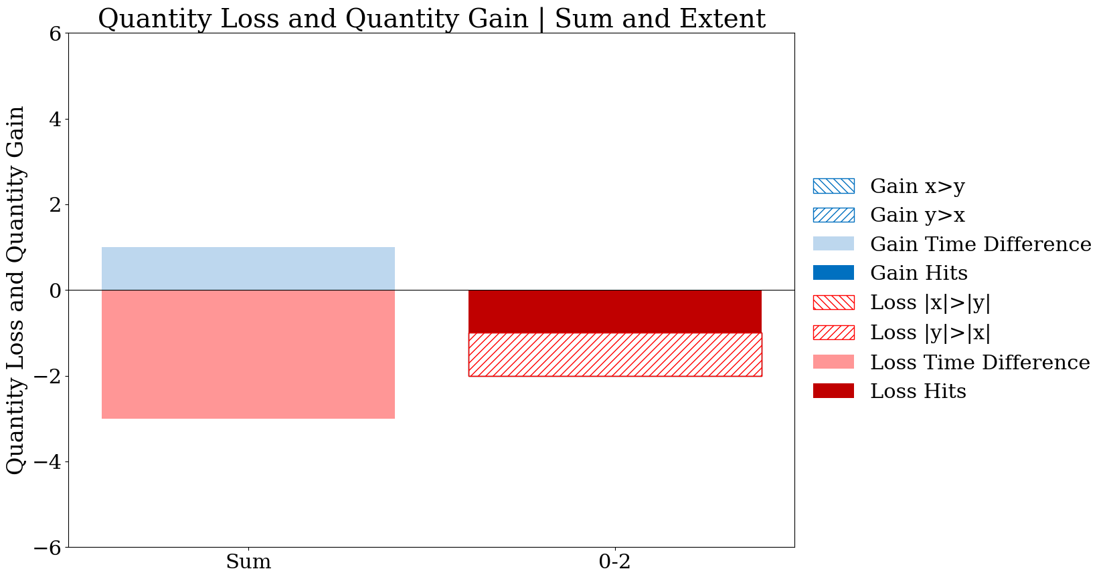
Old version
Gain time difference component should be in the legend
New version

Slide 5







X series
Y series
Equation 51
2
5
4
1
Pontius gets
6 for left pixel and 6 for right pixel
t0
Temporal Allocation Difference Result
0
4
1
5
0
1
t1
We must improve the explanation. The explanation Pontius wrote in version 10 of the manuscript is poor.
This is the temporal allocation difference, which we could call an alternation difference.
This is positive if and only if (y>x at one time point and x>y at a different time point).
5
1
0
3
t2

Slide 6

X series
Y series
Equation 53
2
5
4
1
Pontius gets
-7 for left pixel and 6 for right pixel
t0
Result
0
4
1
5
-2
2
t1
I hope you meant to write
Positive values mean more total presence in series y than in x.
Negative values mean more total presence in series x than in y.
5
1
0
3
t2

Slide 7

X series
Y series
Equation 54
2
5
4
1
Pontius gets
0 for left pixel and 0 for right pixel
t0
Result
0
4
1
5
-7
6
t1
5
1
0
3
t2

Slide 8
Pontius gets the following computing with pencil and paper.
Equation 49 Left pixel = 2, Right pixel = 6
Equation 50 Left pixel = -2, Right pixel = -1
Equation 51 Left pixel = 6, Right pixel = 6
Equation 52 Left pixel = 2, Right pixel = 2
Equation 53 Left pixel = -7, Right pixel = 6
Equation 54 Left pixel = 0, Right pixel = 0
Antonio, you should first do this with pencil and paper to see whether you get the same results as me.
Then see whether your code gets the results of both of us.

