Slide 1
PIE data
Zoom 1. Code made the raster results. QGIS made the maps.
X=pixel based
Y=object based
2010, 2012, 2014, 2016, 2018, 2021

Slide 2
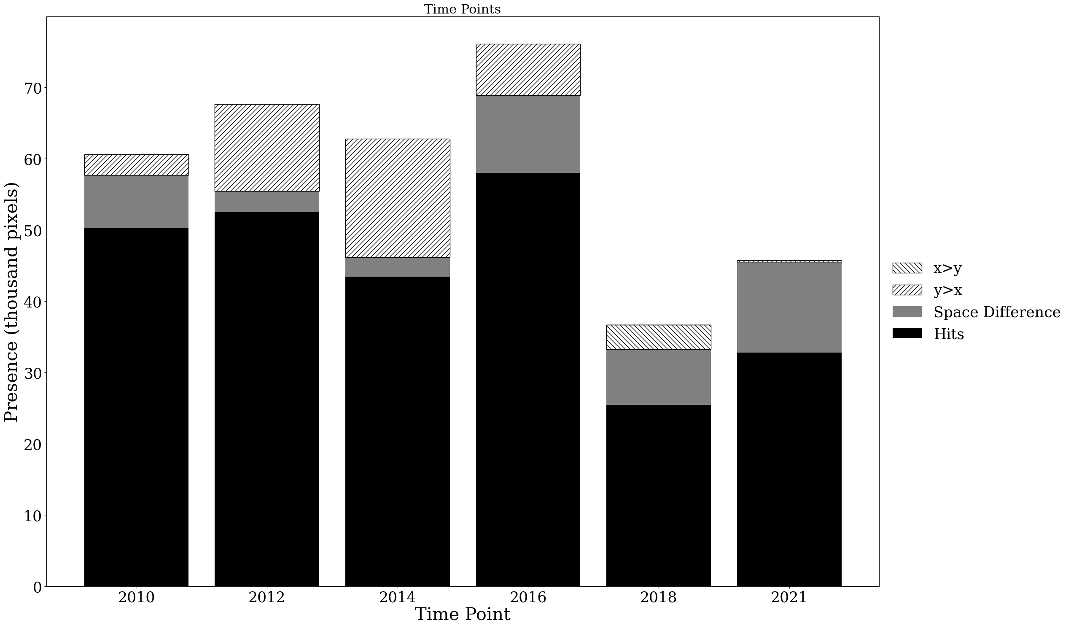

Slide 3
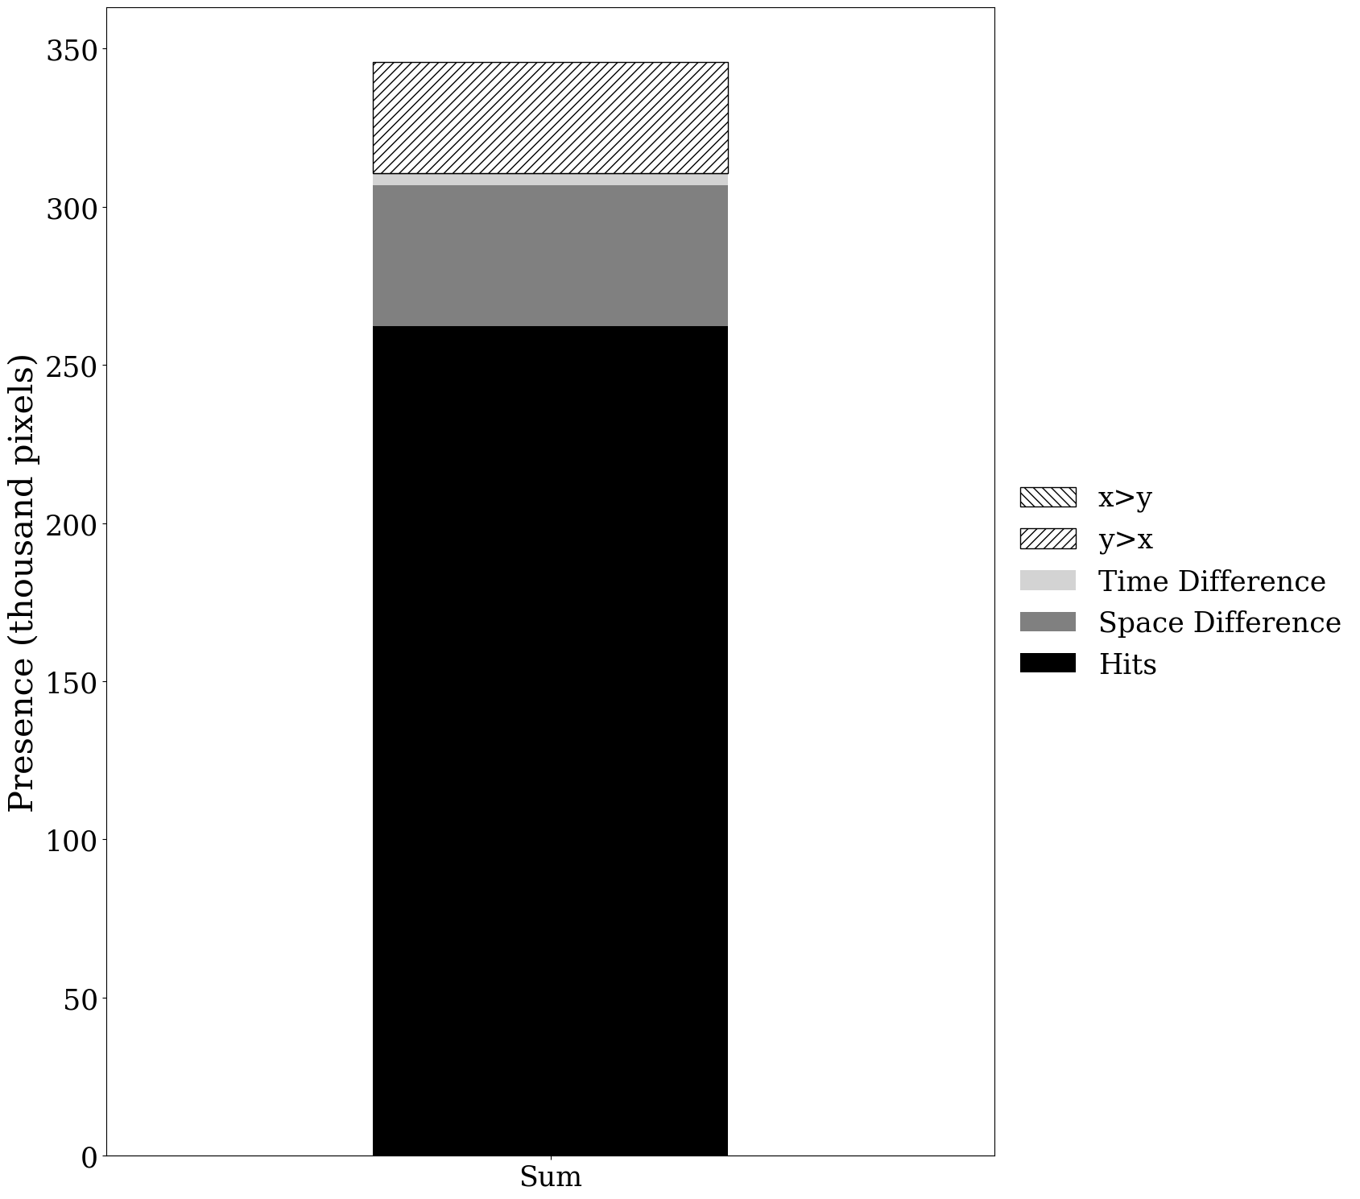

Slide 4
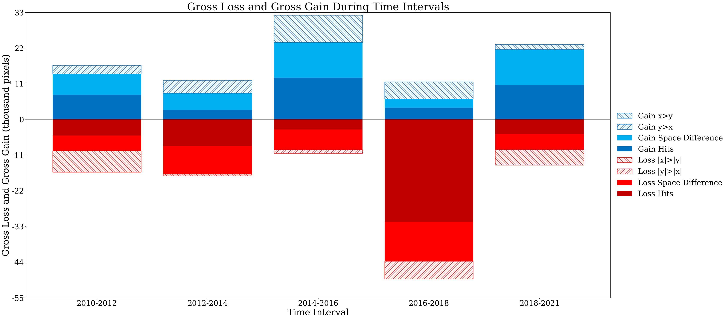

Slide 5
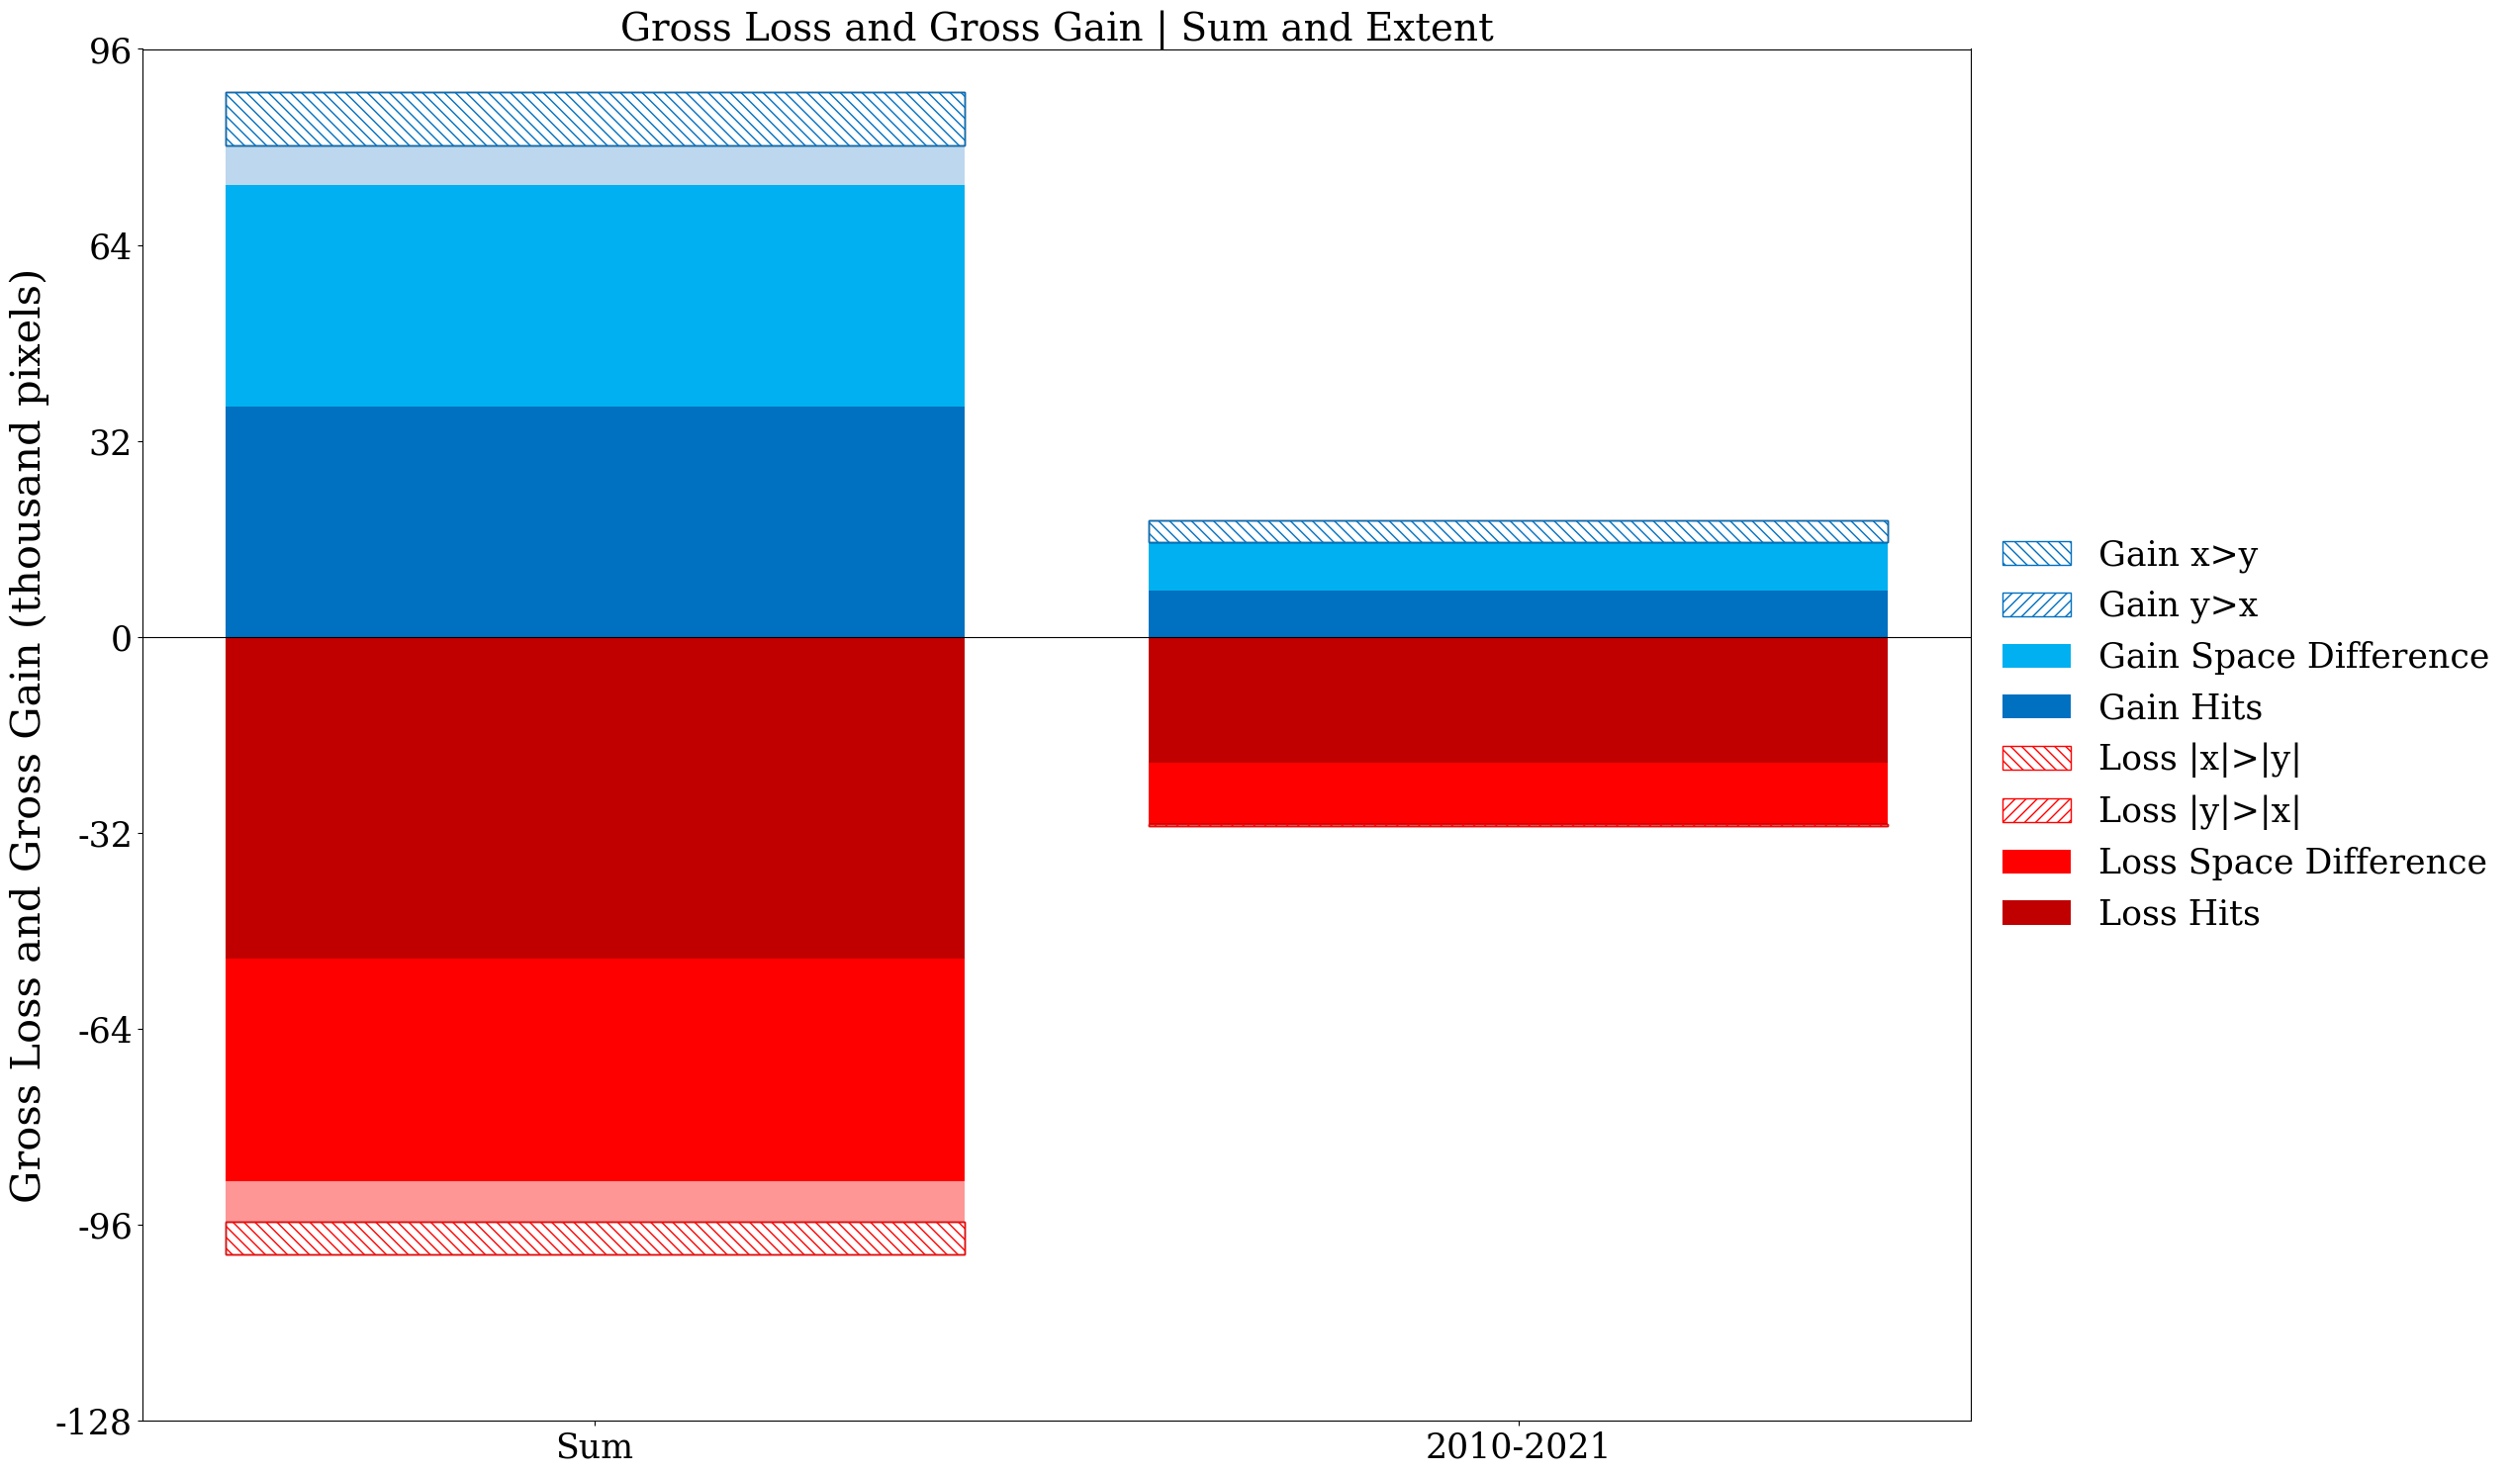

Slide 6
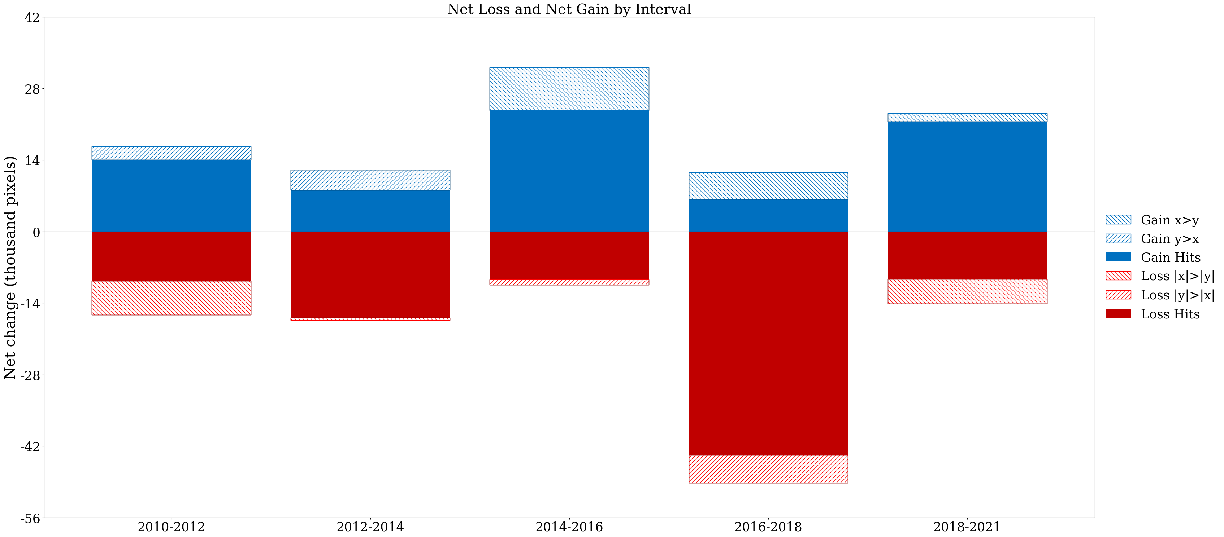

Slide 7
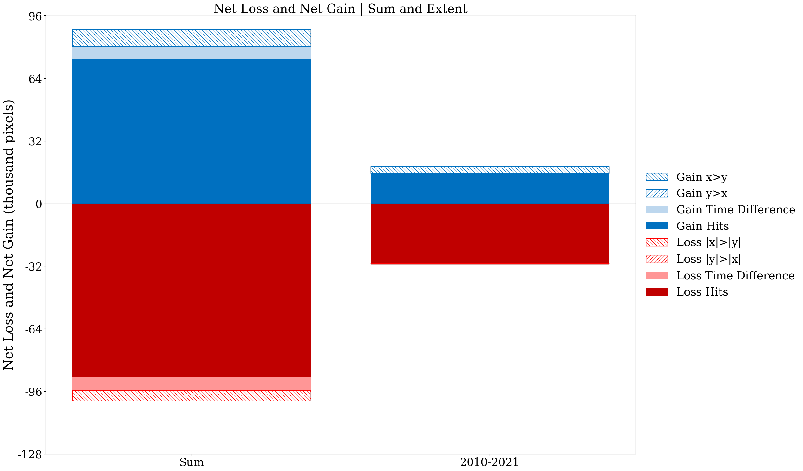

Slide 8
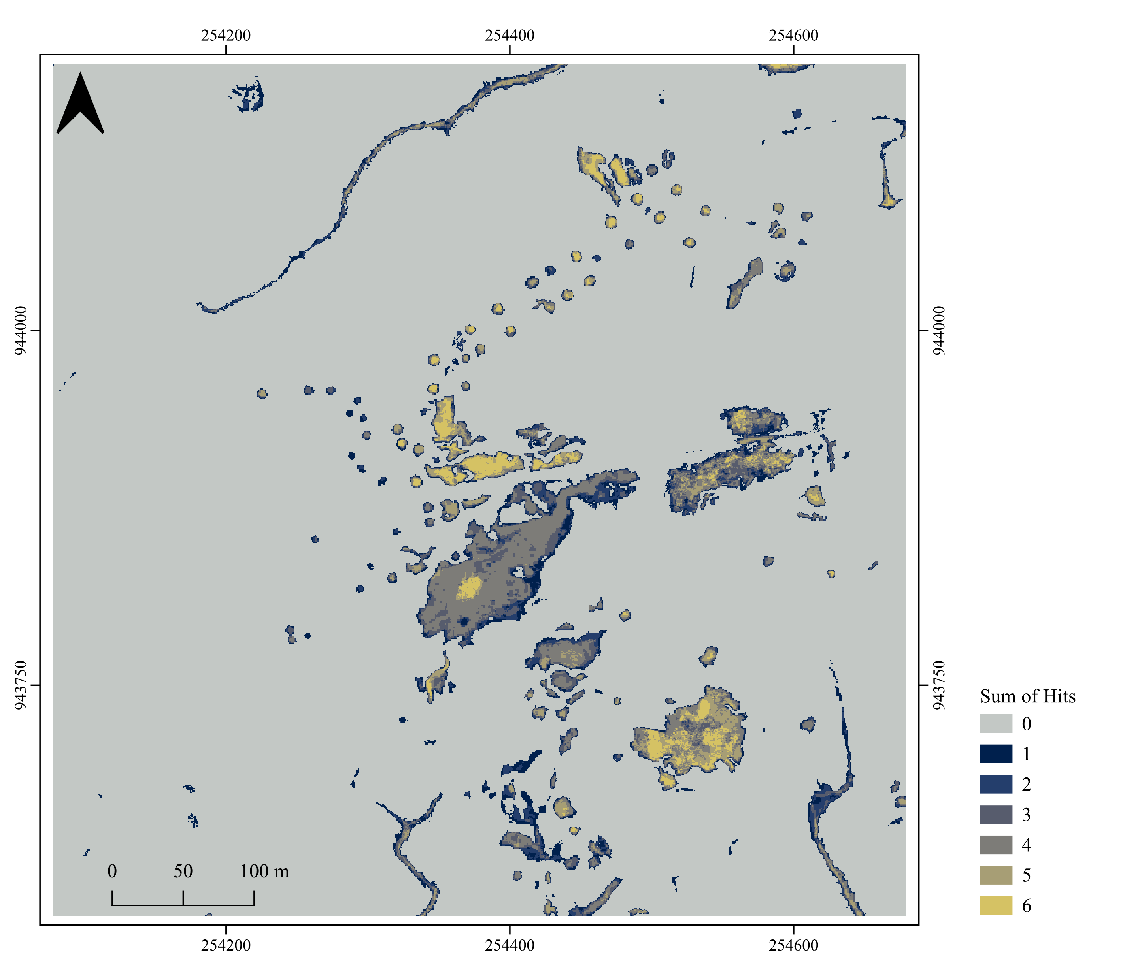

Equation 49
$$A_{n}=\sum_{t=0}^{T}{{Ph}_{tn}}$$
Hit means both maps mapped that pixel present the same time point.
Each pixel’s value shows how many times the two maps registered a Hit at that location across all time points.
High values mean many Hits through time in that pixel.
Low nonzero values mean only a few Hits through time in that pixel.

Slide 9
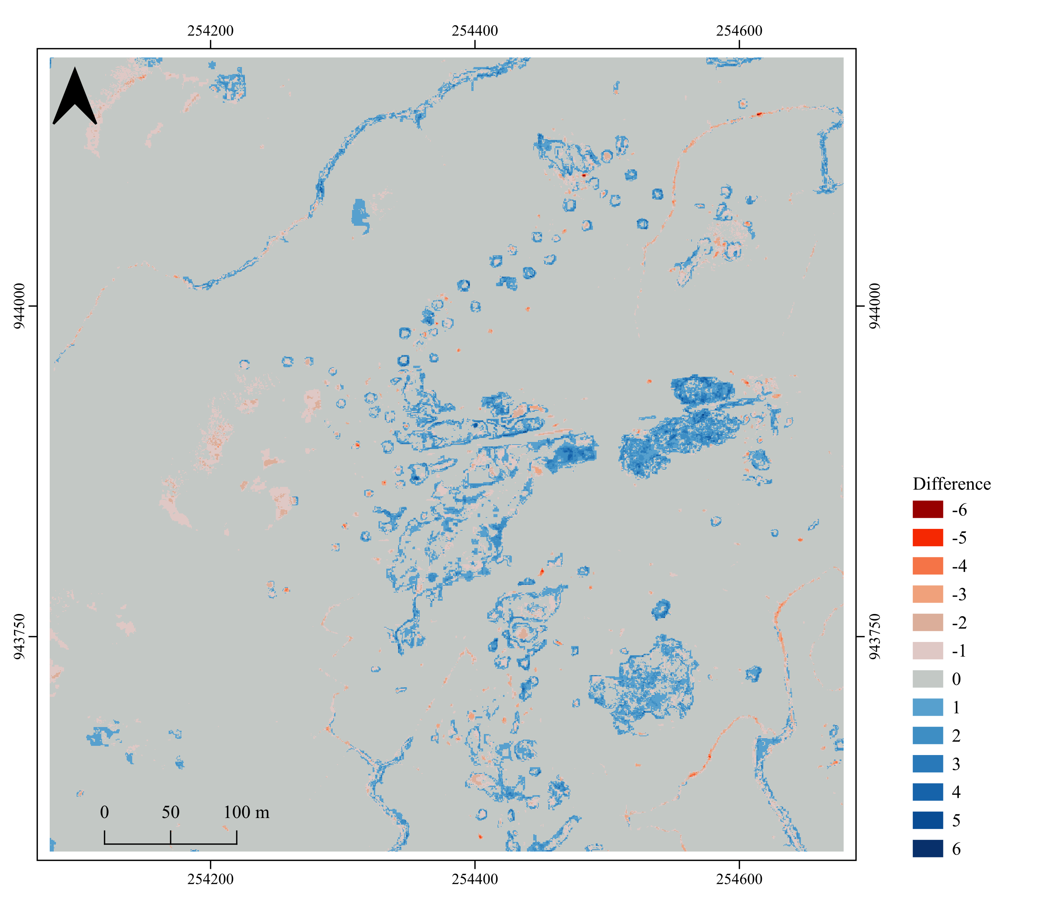

Equation 50
$$B_{n}=\sum_{t=0}^{T}{\left({Py}_{tn}−{Px}_{tn}\right)}$$
Each pixel’s value shows the cumulative difference in presence between the two maps across all time points.
Positive values mean more total presence in object-based series than in pixel-based series.
Negative values mean more total presence in pixel-based series than in object-based series.
Zero means both time series marked presence the same number of time points.
Zero also means absence of the class!
Start the legend from positive values.

Slide 10
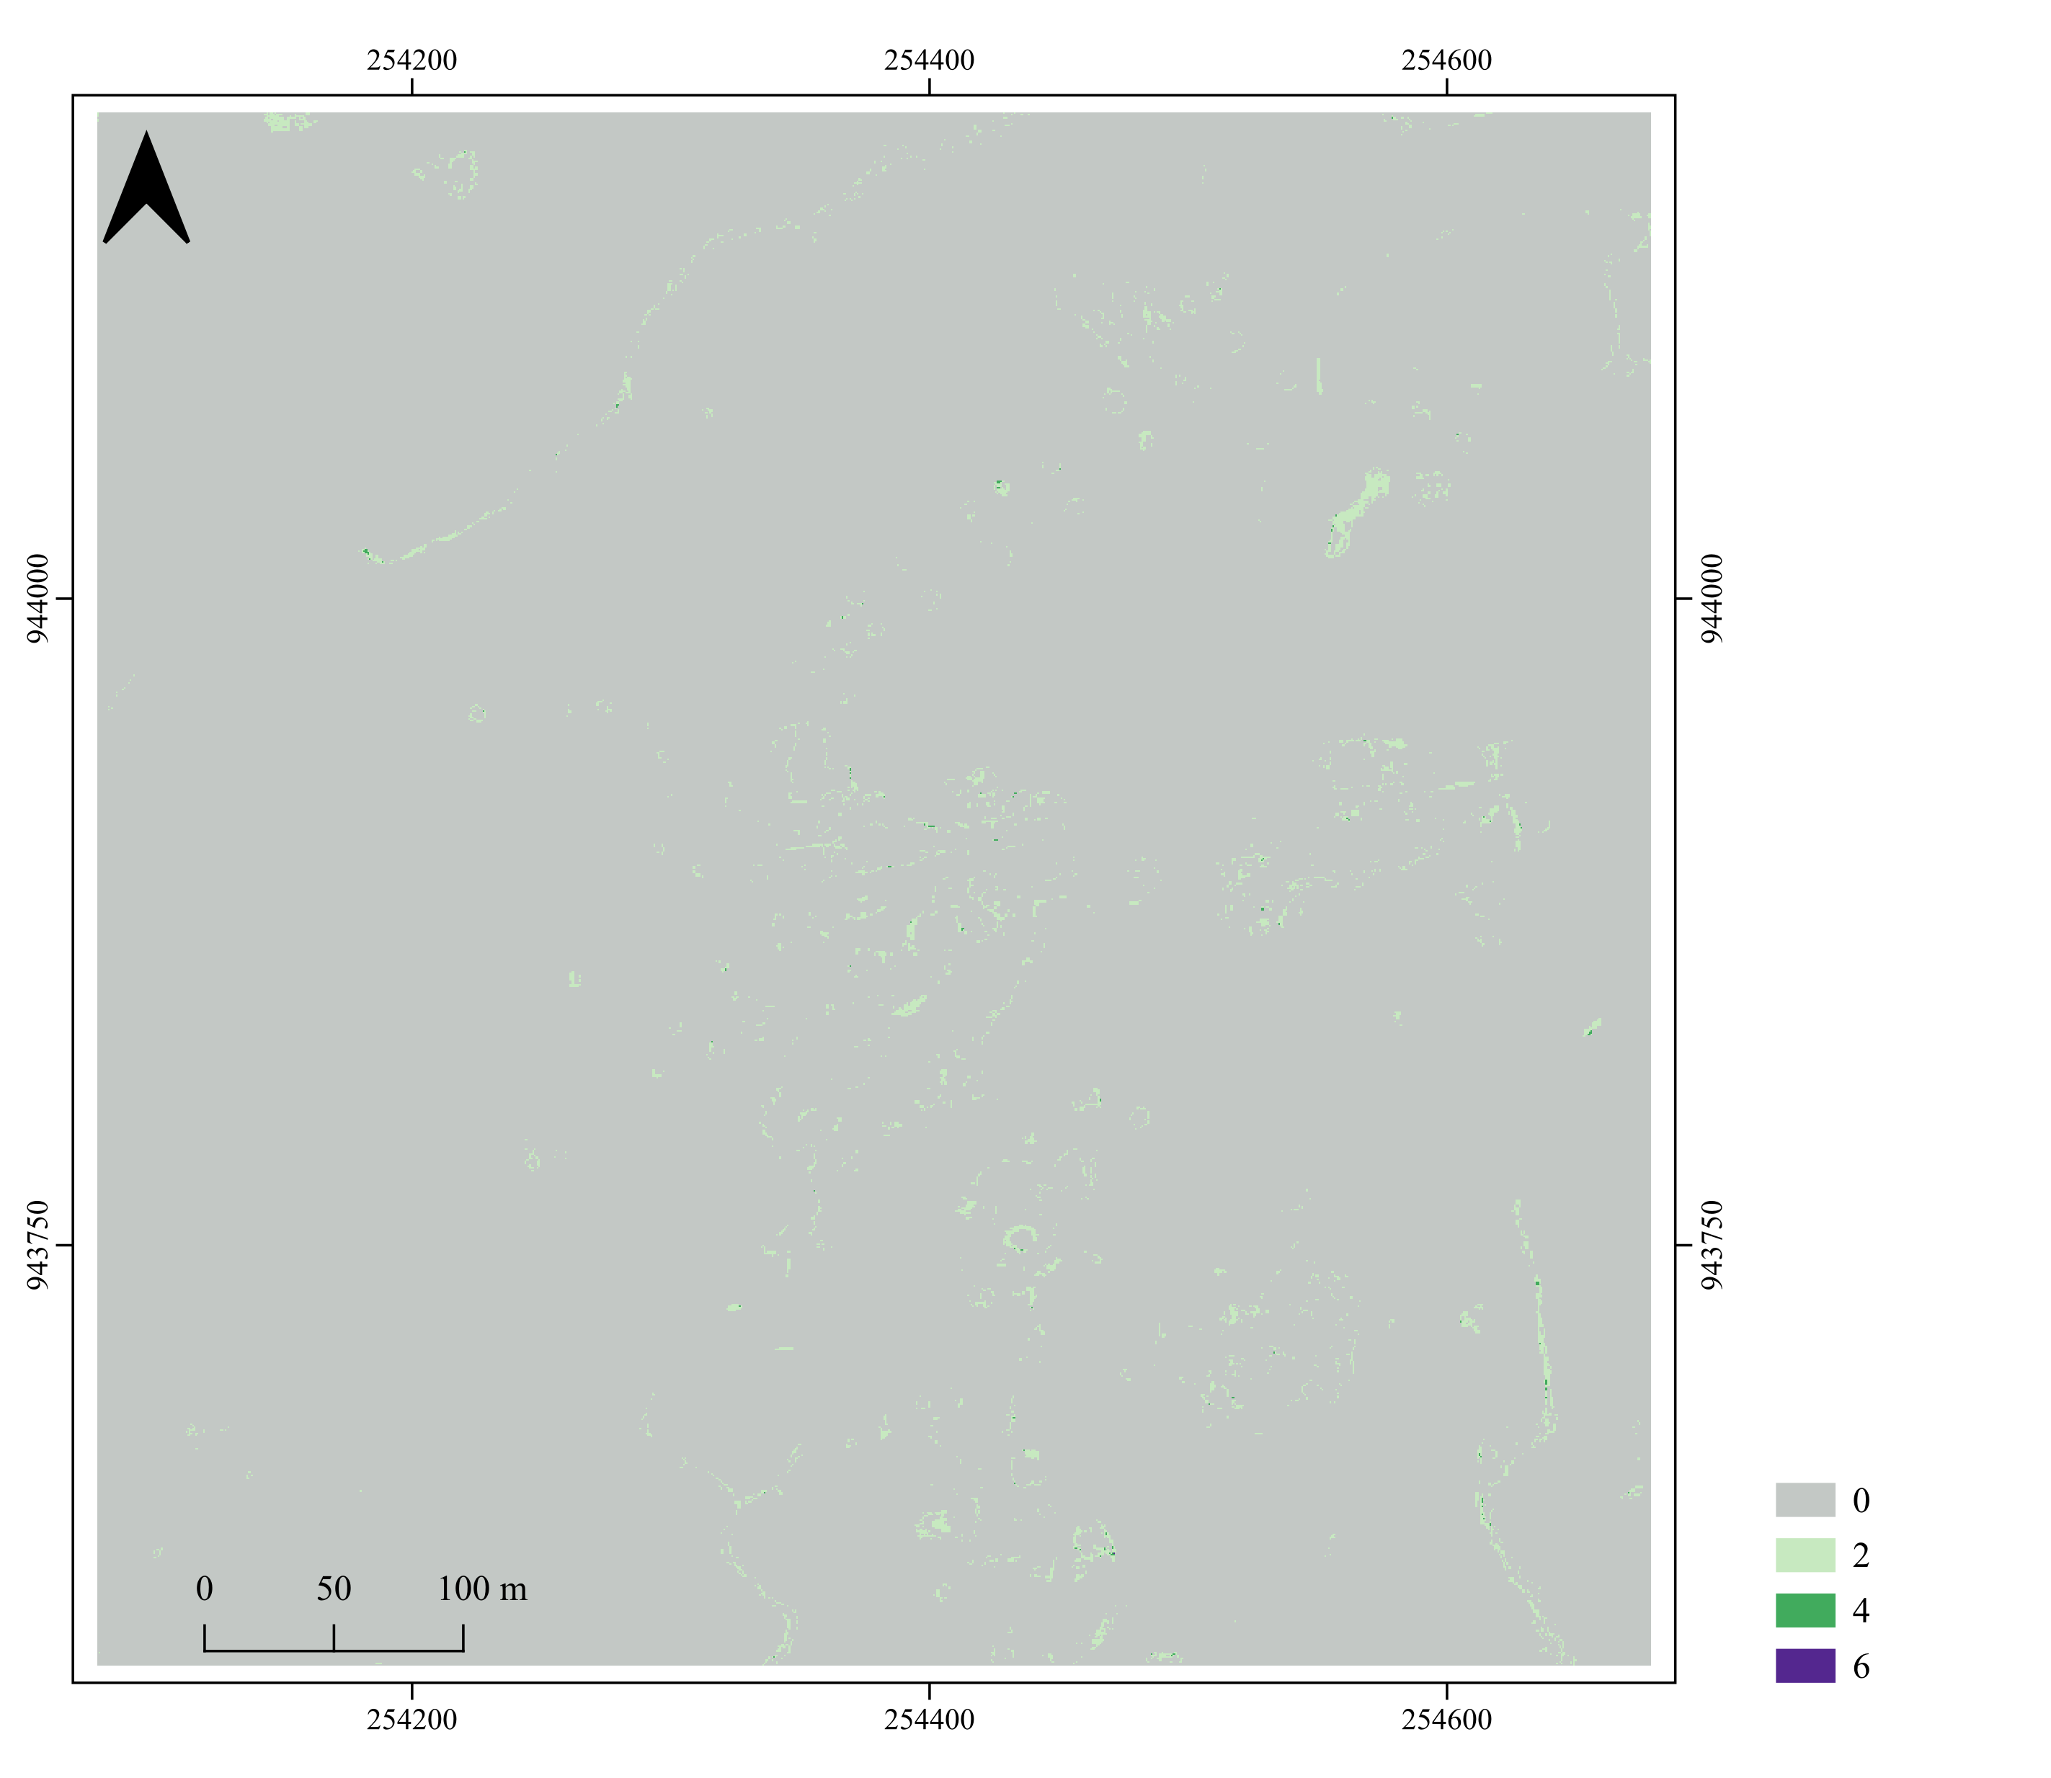

Equation 51
$$C_{n}=\left(\sum_{t=0}^{T}{\left|{Py}_{tn}−{Px}_{tn}\right|}\right)−\left|B_{n}\right|$$
The map shows temporal allocation difference at each pixel across time points, after removing net extent difference.

Slide 11
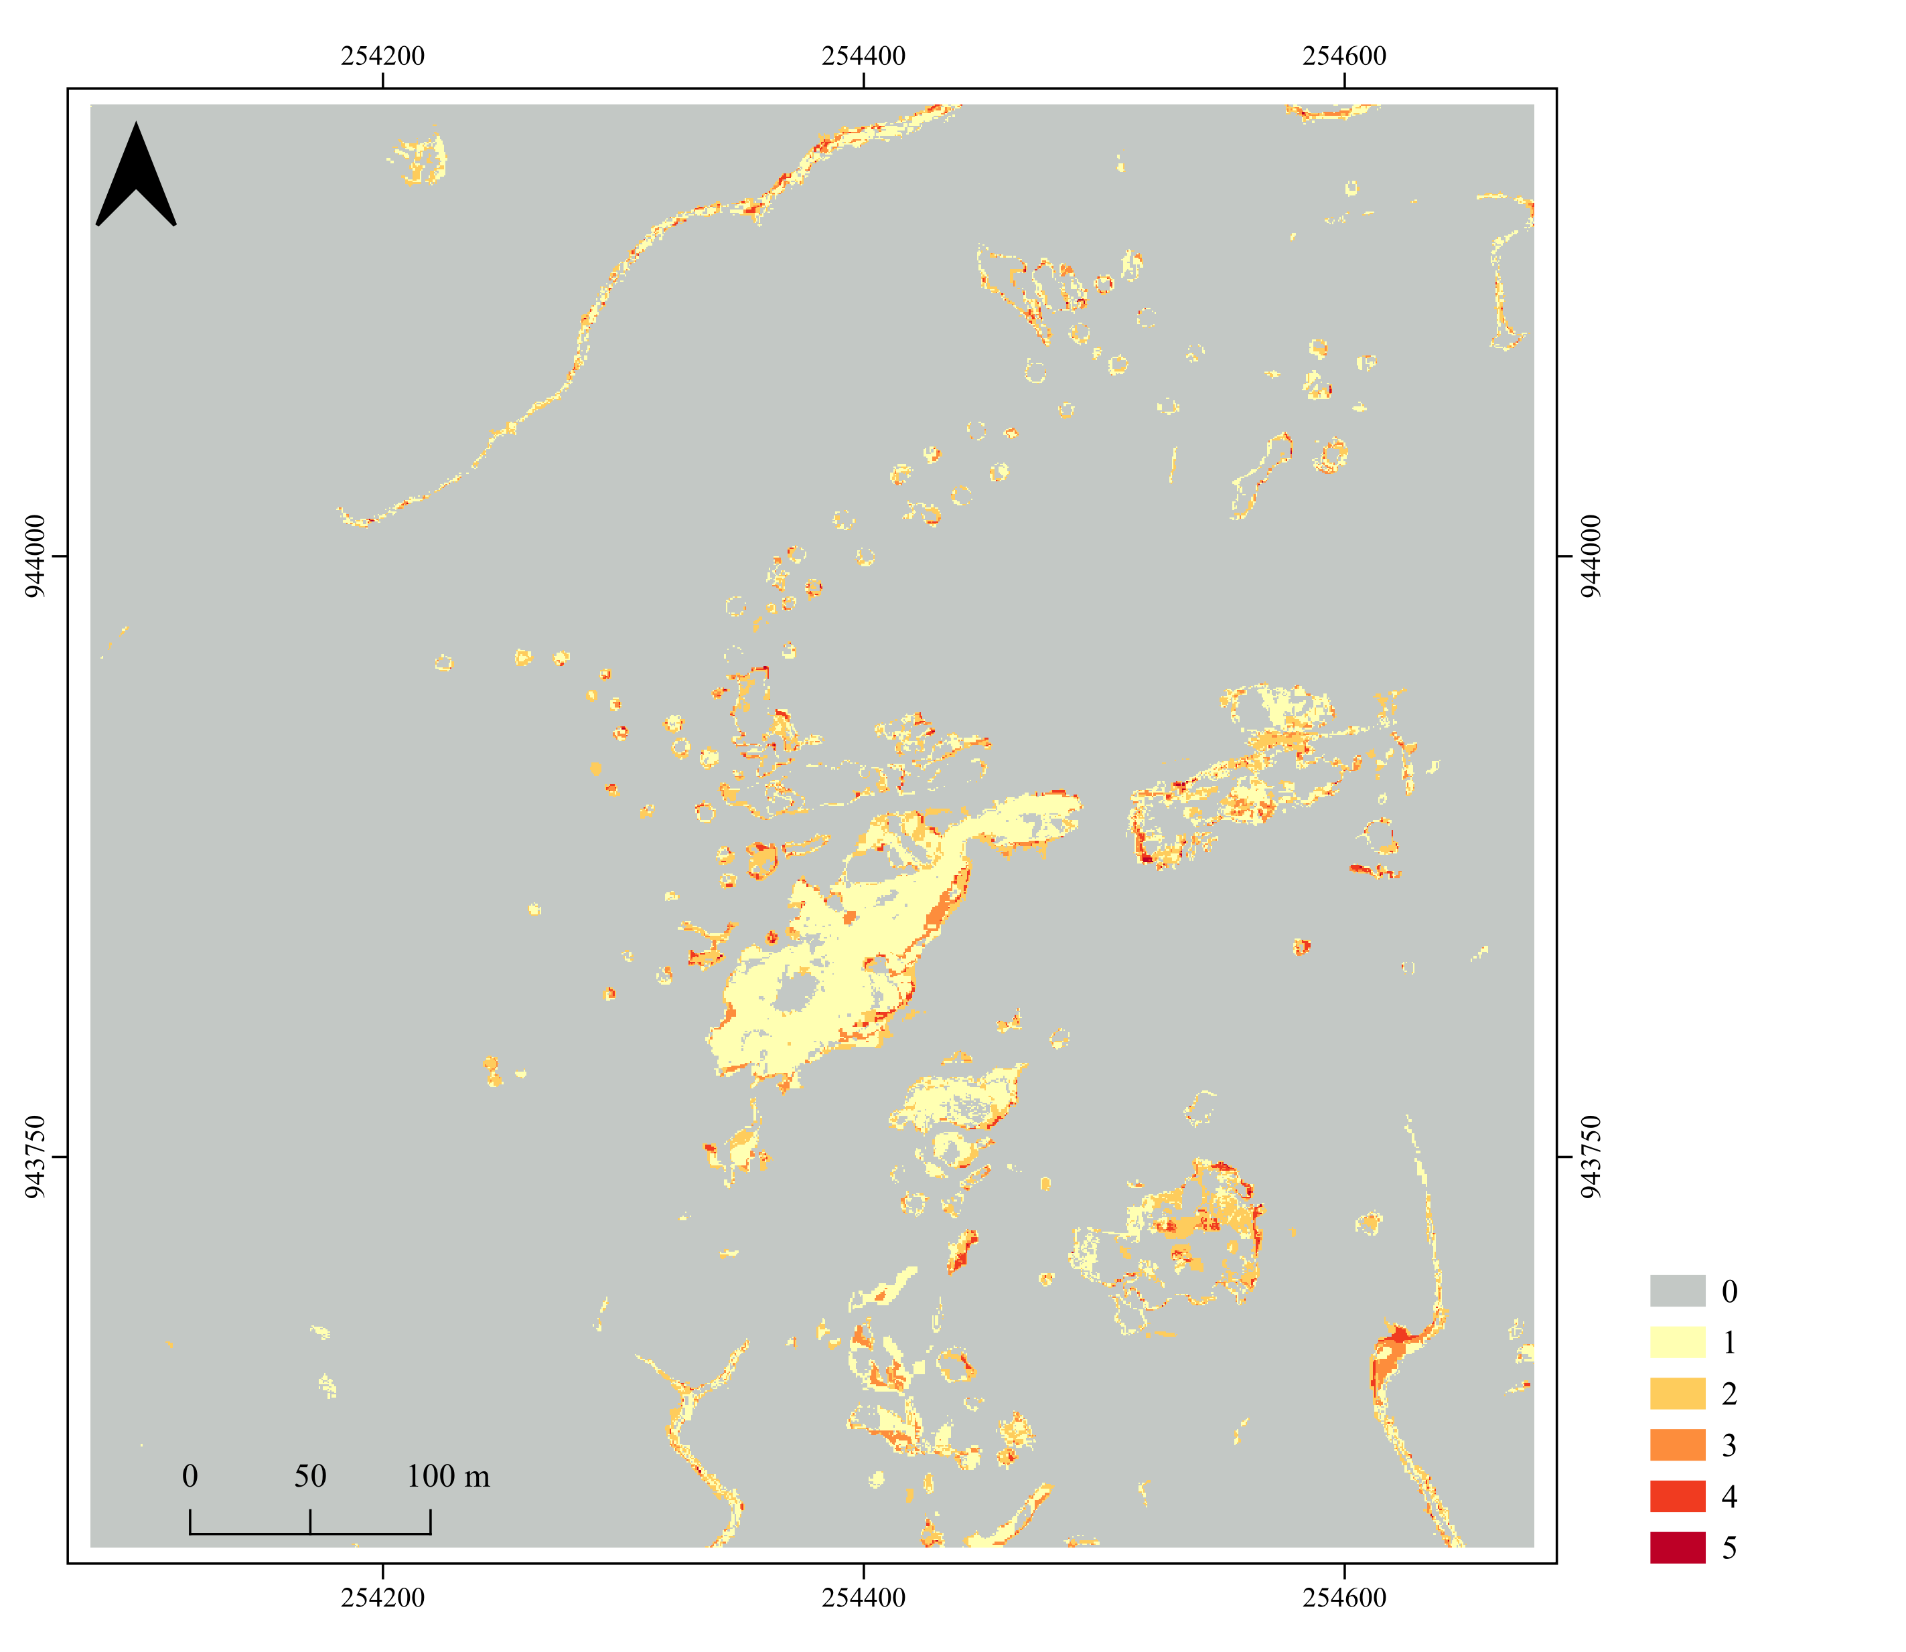

Equation 52
$$D_{n}=\sum_{t=1}^{T}{\left({Gh}_{tn}−{Lh}_{tn}\right)}$$
The map reports, for each pixel, how many time intervals show a change hit.
At a time interval, count one when both series gain at the pixel. Count one when both series lose at that pixel. Otherwise count zero.
Zero means the series never change in the same direction at that pixel.
Zero also means absence of the class!

Slide 12
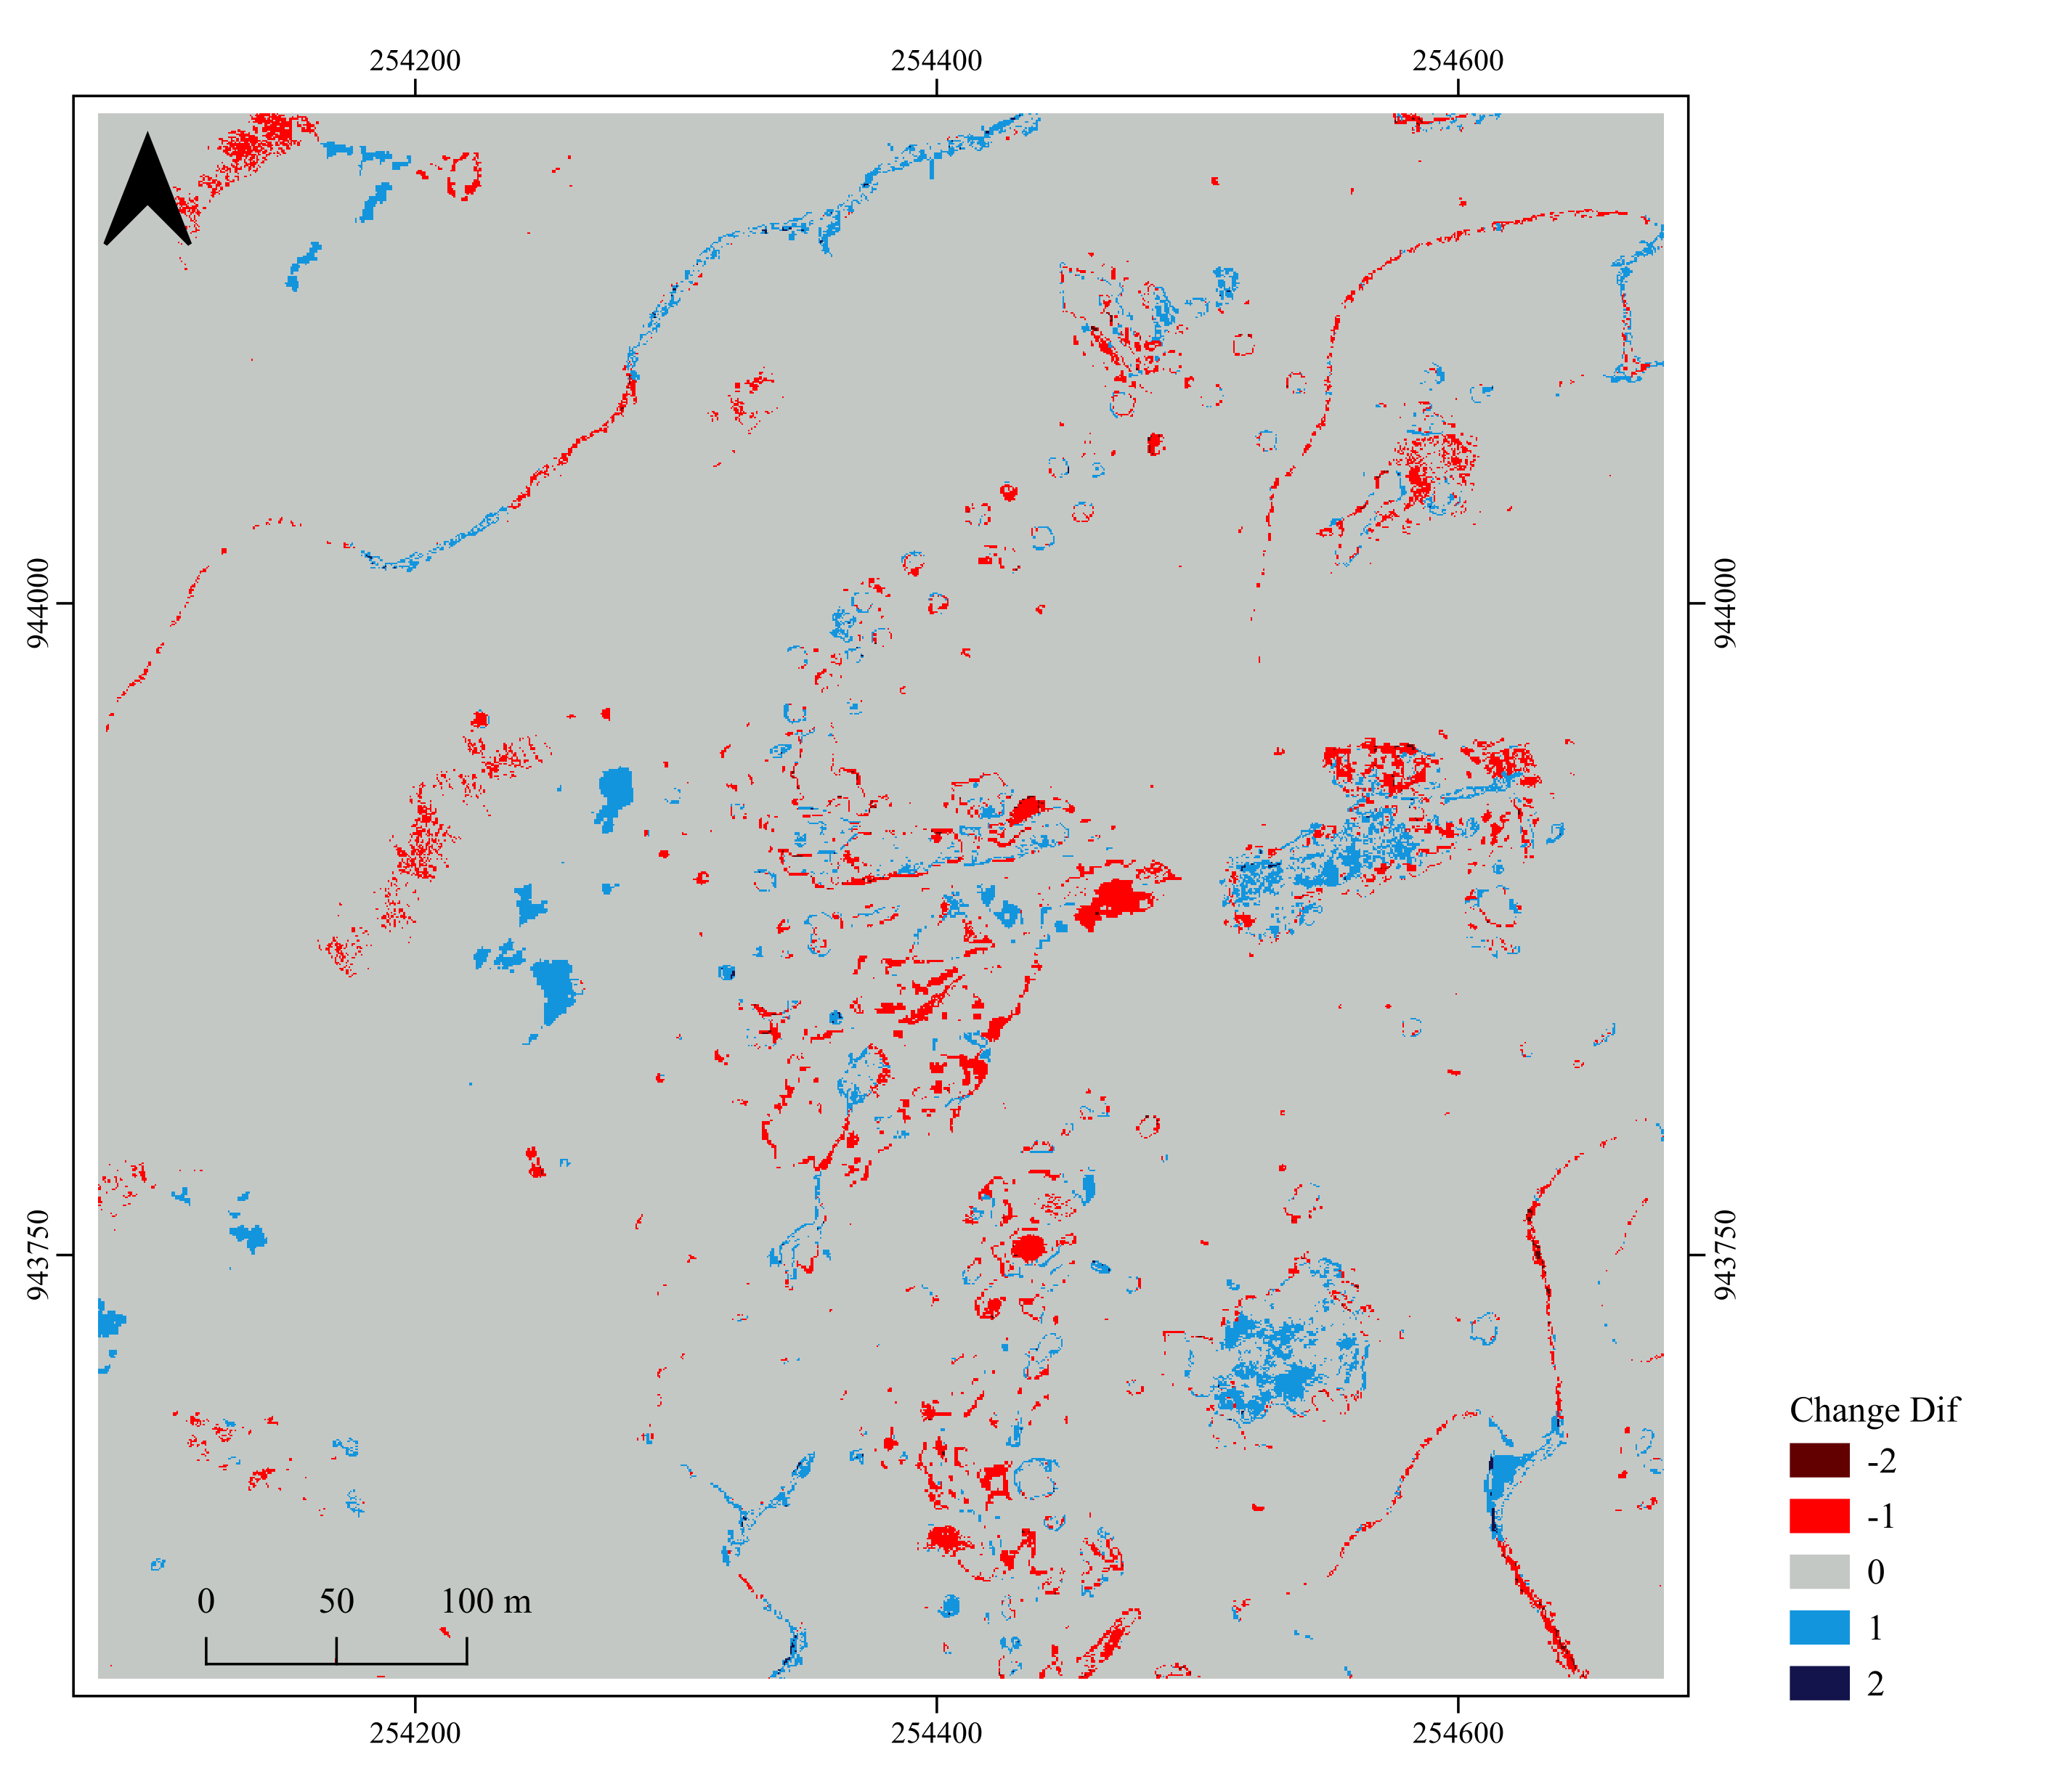
Equation 53
$$E_{n}=\left({Py}_{Tn}−{Py}_{0n}\right)−\left({Px}_{Tn}−{Px}_{0n}\right)$$
The map shows the net extent difference between the first and last time point at each pixel.
Positive values mean the object-based series ends higher than the pixel-based series (gained more or lost less).
Negative values mean the pixel-based series ends higher than the object-based series.
Zero means both series share the same start-end state at that pixel.
Notes:
+2 = Gain in X and Loss in Y (2-(-1))
+1 = Gain in X and Y does not change. Or X does not change and Y loss. (1-0) and (0-(-1))
0= no change or both change in the same direction.
-1=Loss in X and no change in Y. X does not change and Gain in Y. (-1-0) and (0-1)
-2=Loss in X and Gain in Y. (-1-(1))

Slide 13
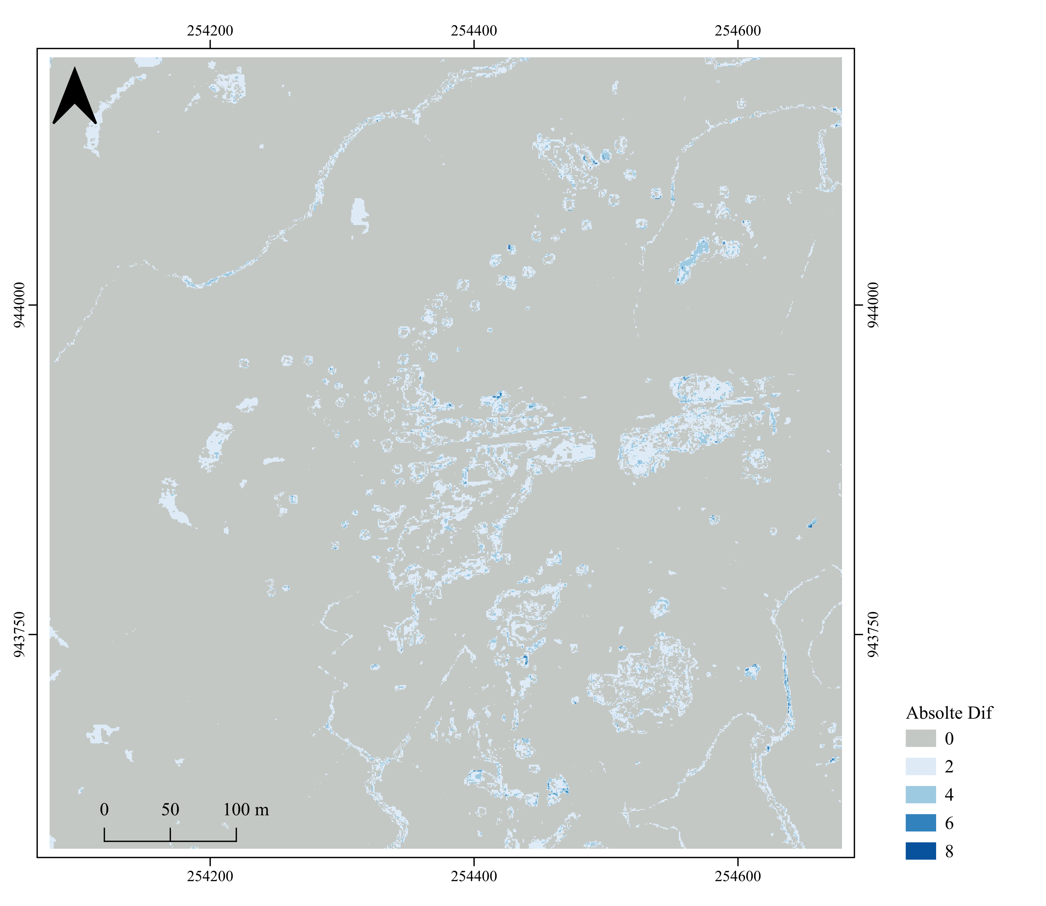
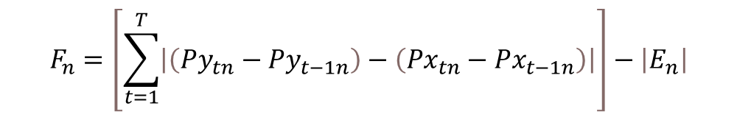
Equation 54
$$F_{n}=\left[\sum_{t=1}^{T}{\left|\left({Py}_{tn}−{Py}_{t−1n}\right)−\left({Px}_{tn}−{Px}_{t−1n}\right)\right|}\right]−\left|E_{n}\right|$$
The map shows the change absolute difference summed across time intervals for each pixel.
Are these statements true to equation 54?
score 0 when both gain, both lose, or both stay stables.
core1 when one changes and the other stays stable.
score 2 when one gains while the other loses.
Notes:
Gain=+1 Loss = -1 No change =0

Slide 14
PIE data
Zoom 2. Code made the raster results. QGIS made the maps.
X=pixel based
Y=object based
2010, 2012, 2014, 2016, 2018, 2021

Slide 15
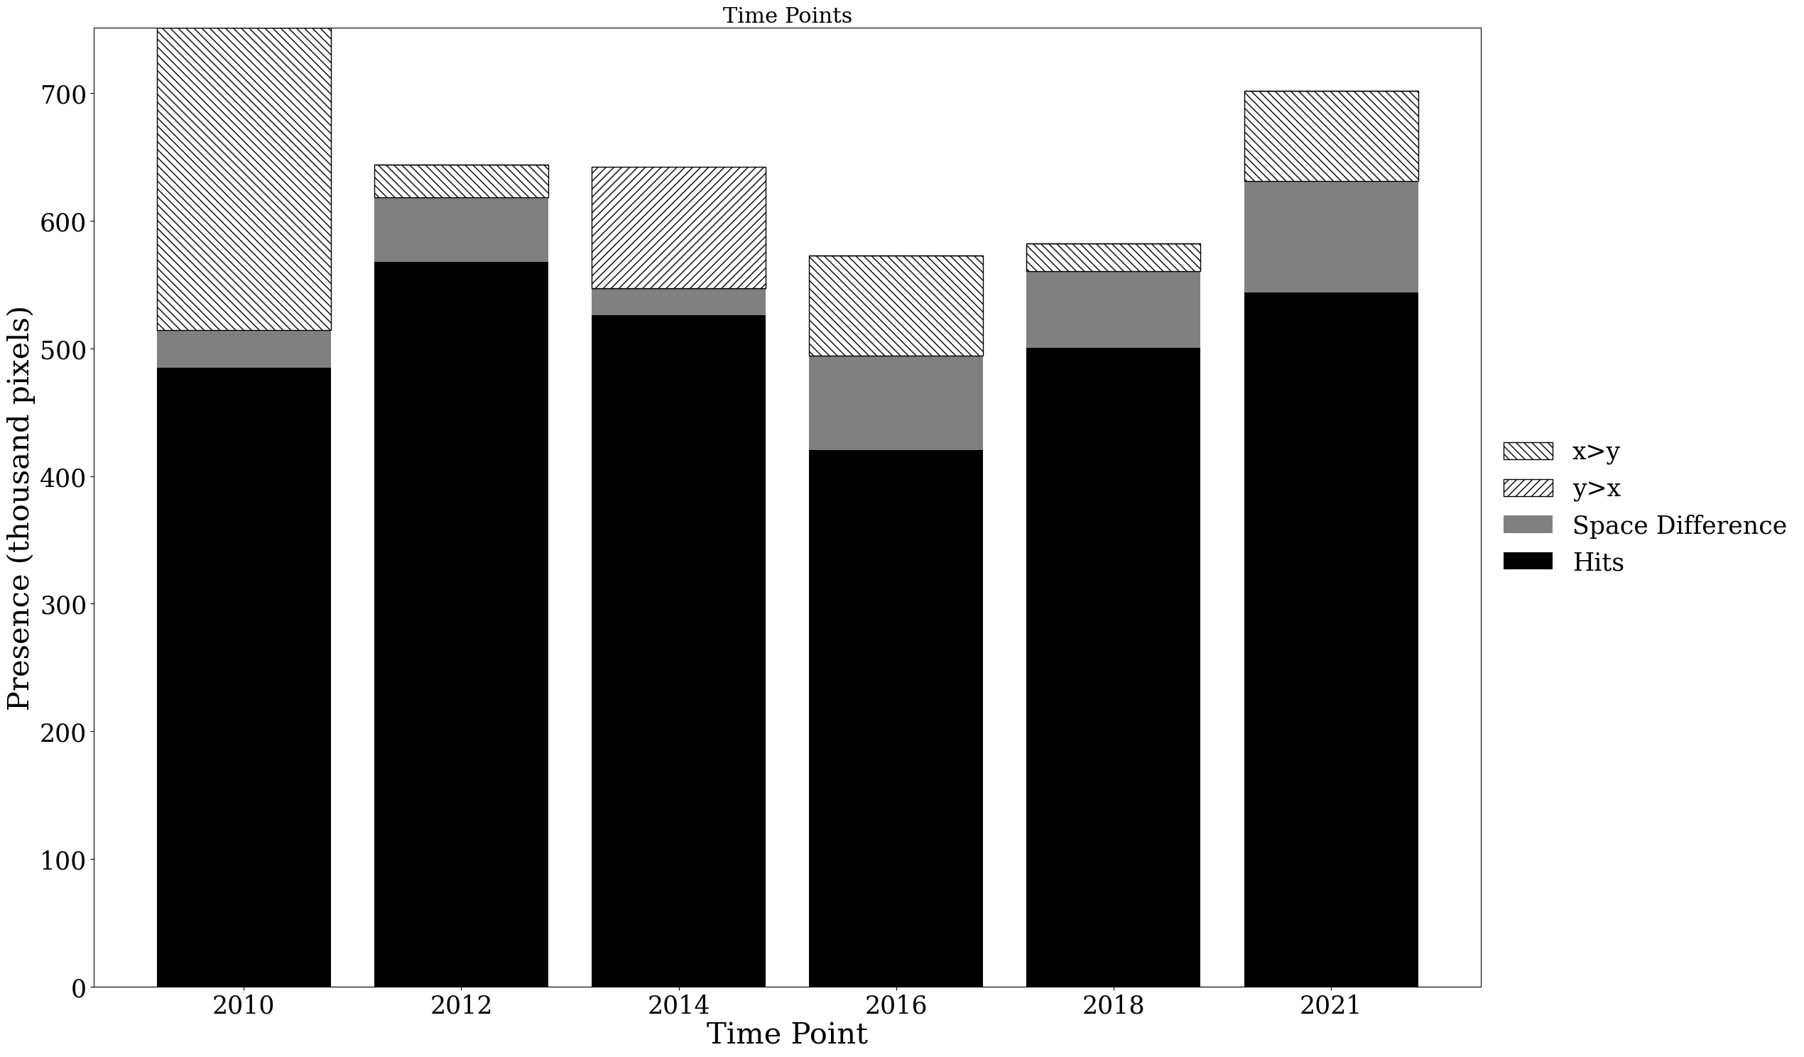

Slide 16
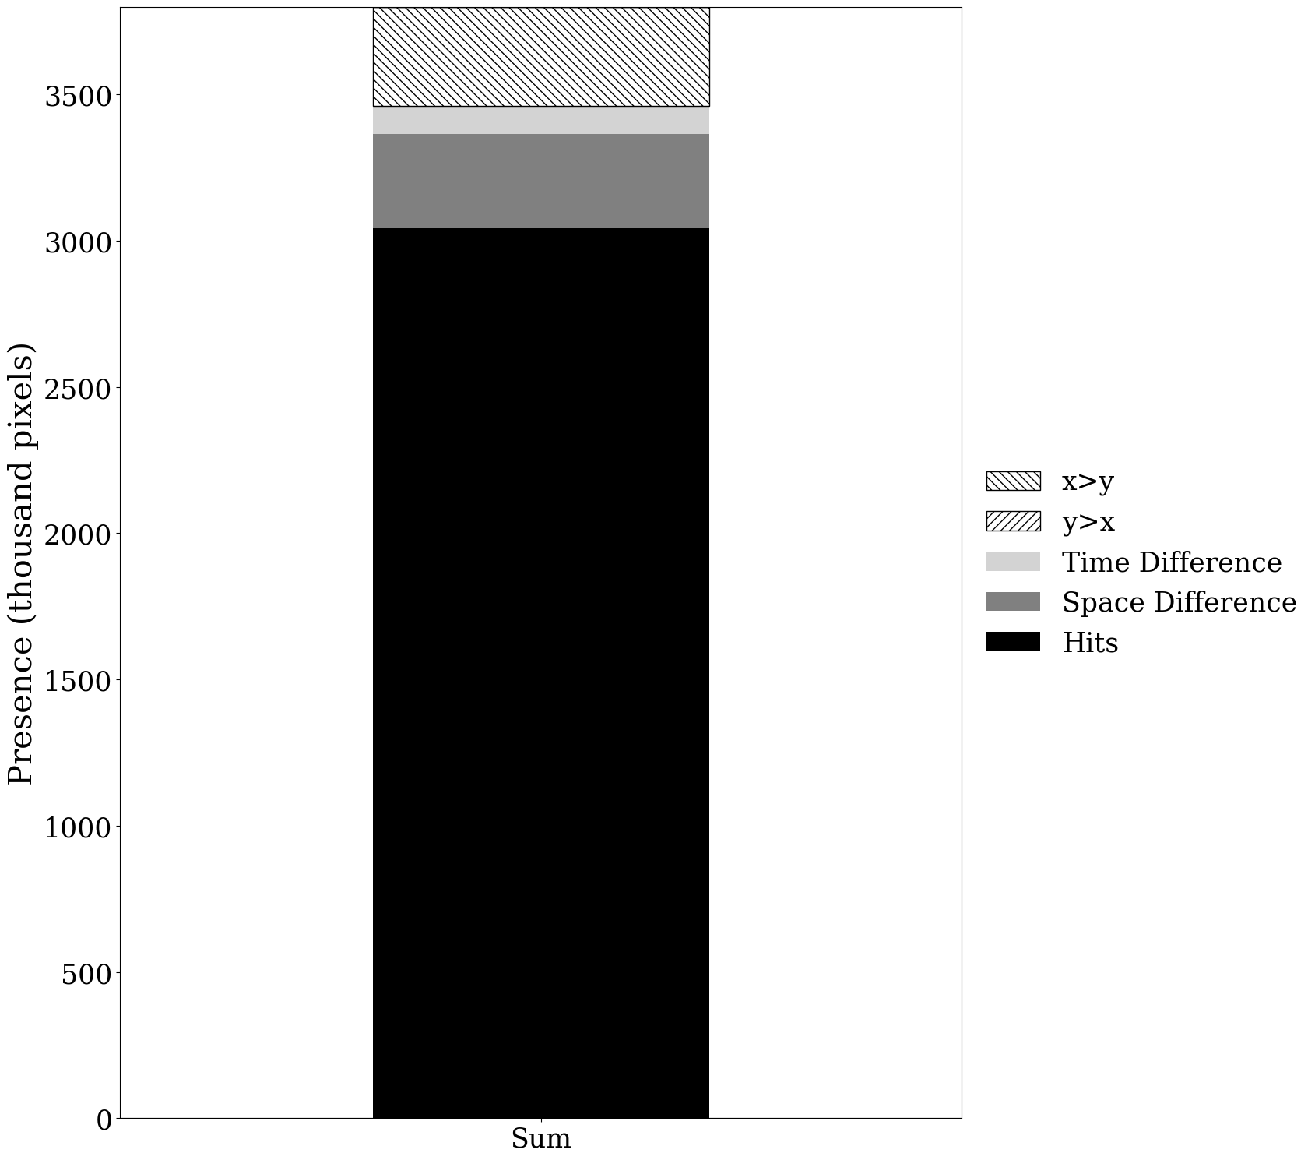

Slide 17
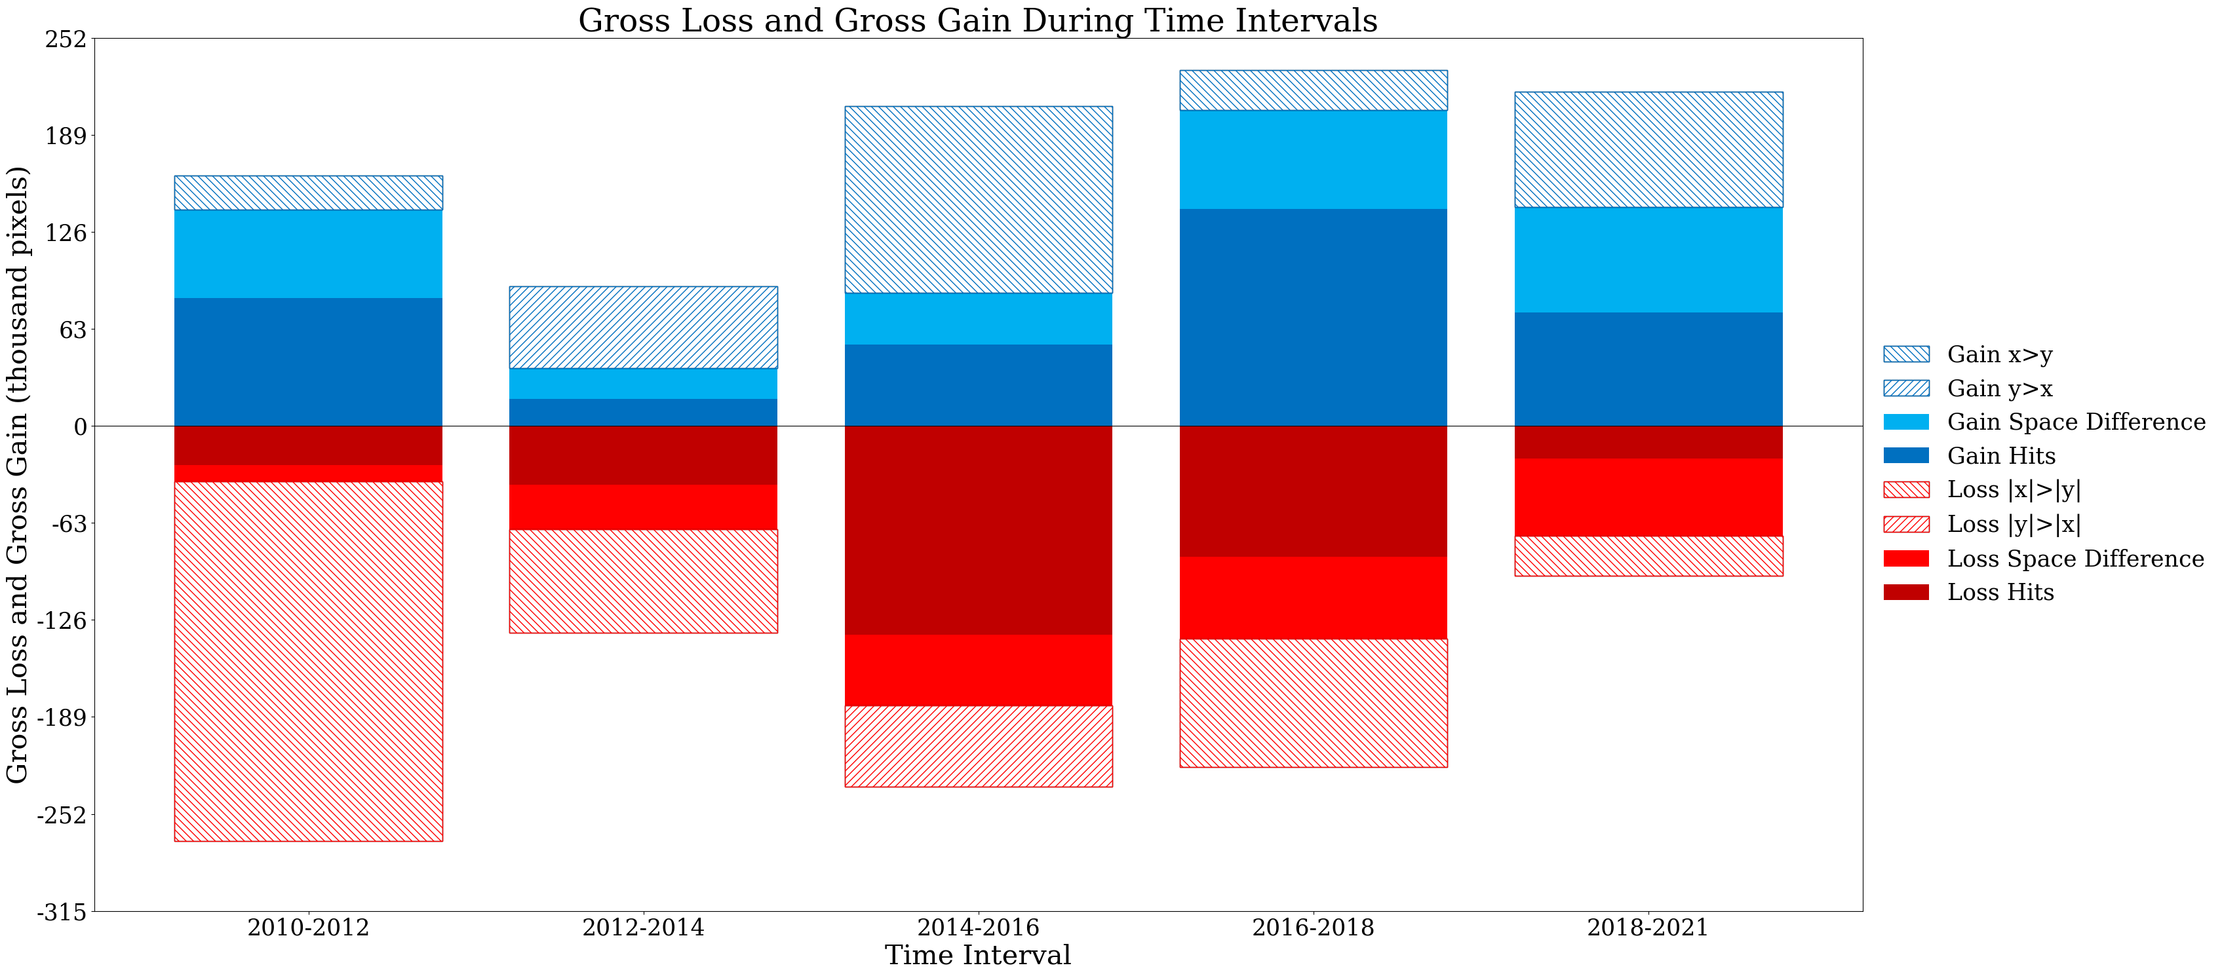

Slide 18
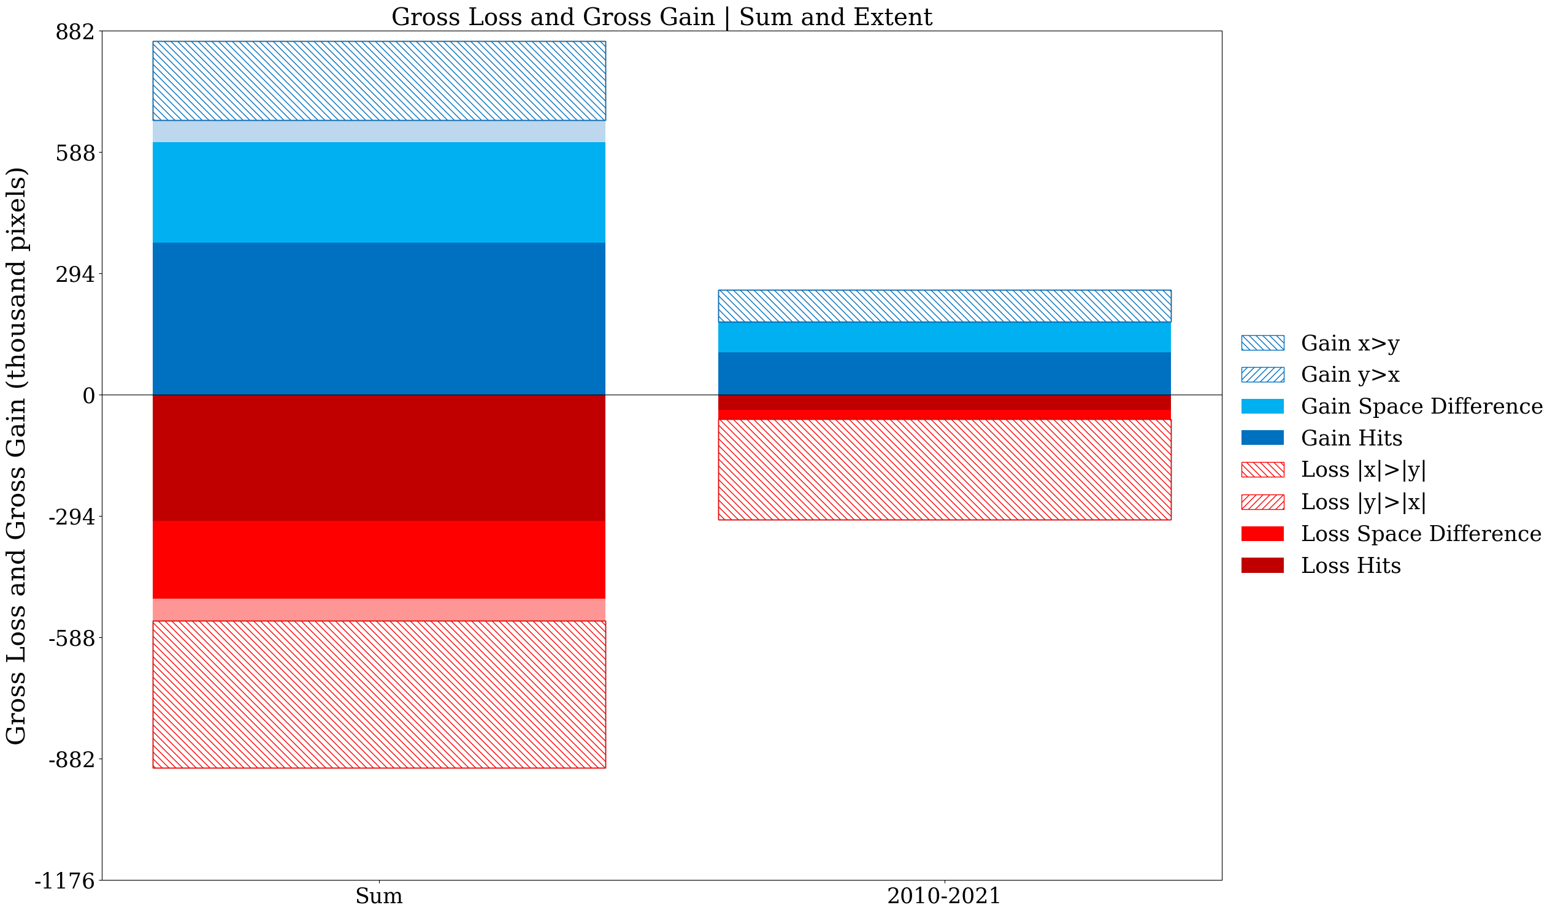

Slide 19
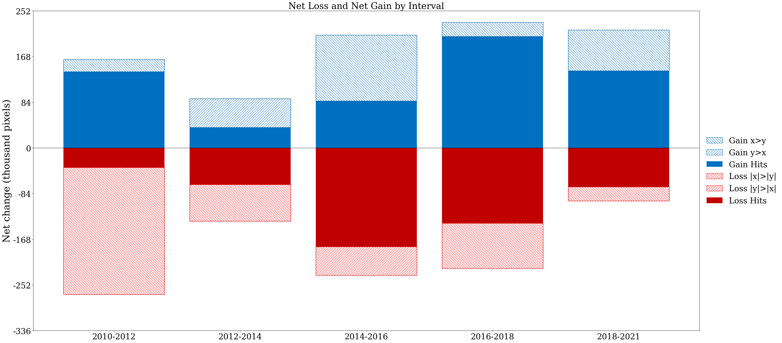

Slide 20
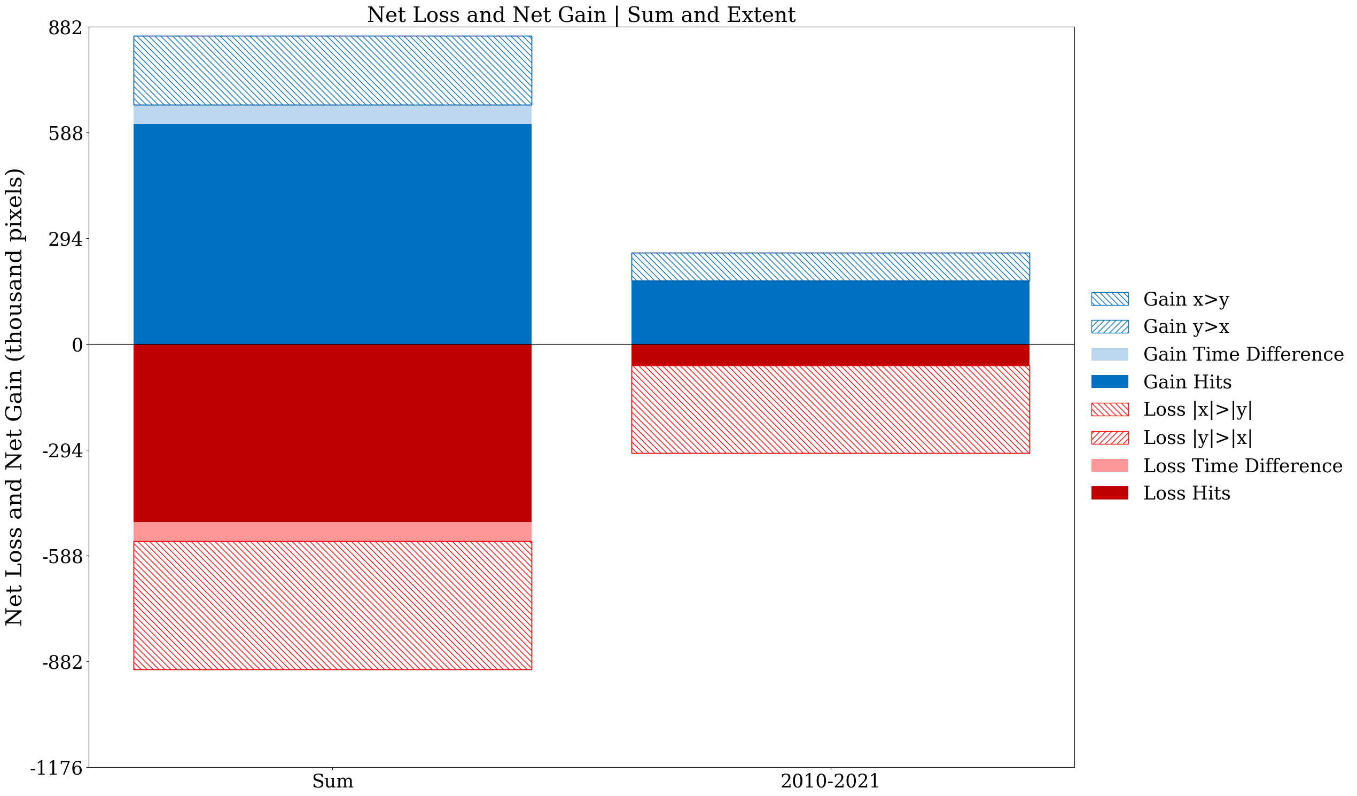

Slide 21
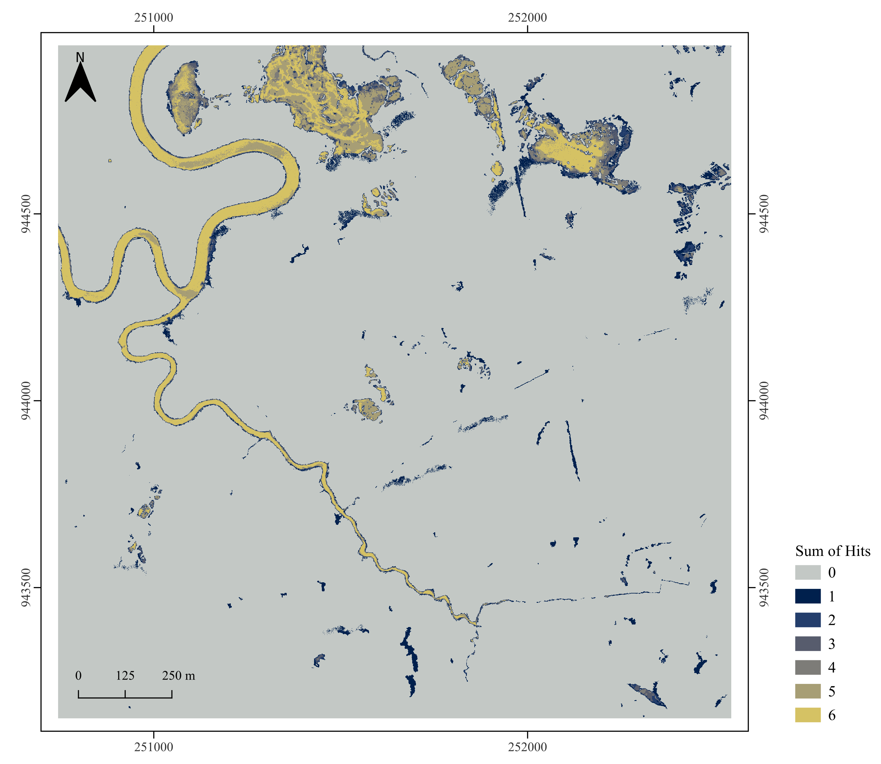
Equation 49
$$A_{n}=\sum_{t=0}^{T}{{Ph}_{tn}}$$
Hit means both maps mapped that pixel present the same time point.
Each pixel’s value shows how many times the two maps registered a Hit at that location across all time points.
High values mean many Hits through time in that pixel.
Low nonzero values mean only a few Hits through time in that pixel.

Slide 22
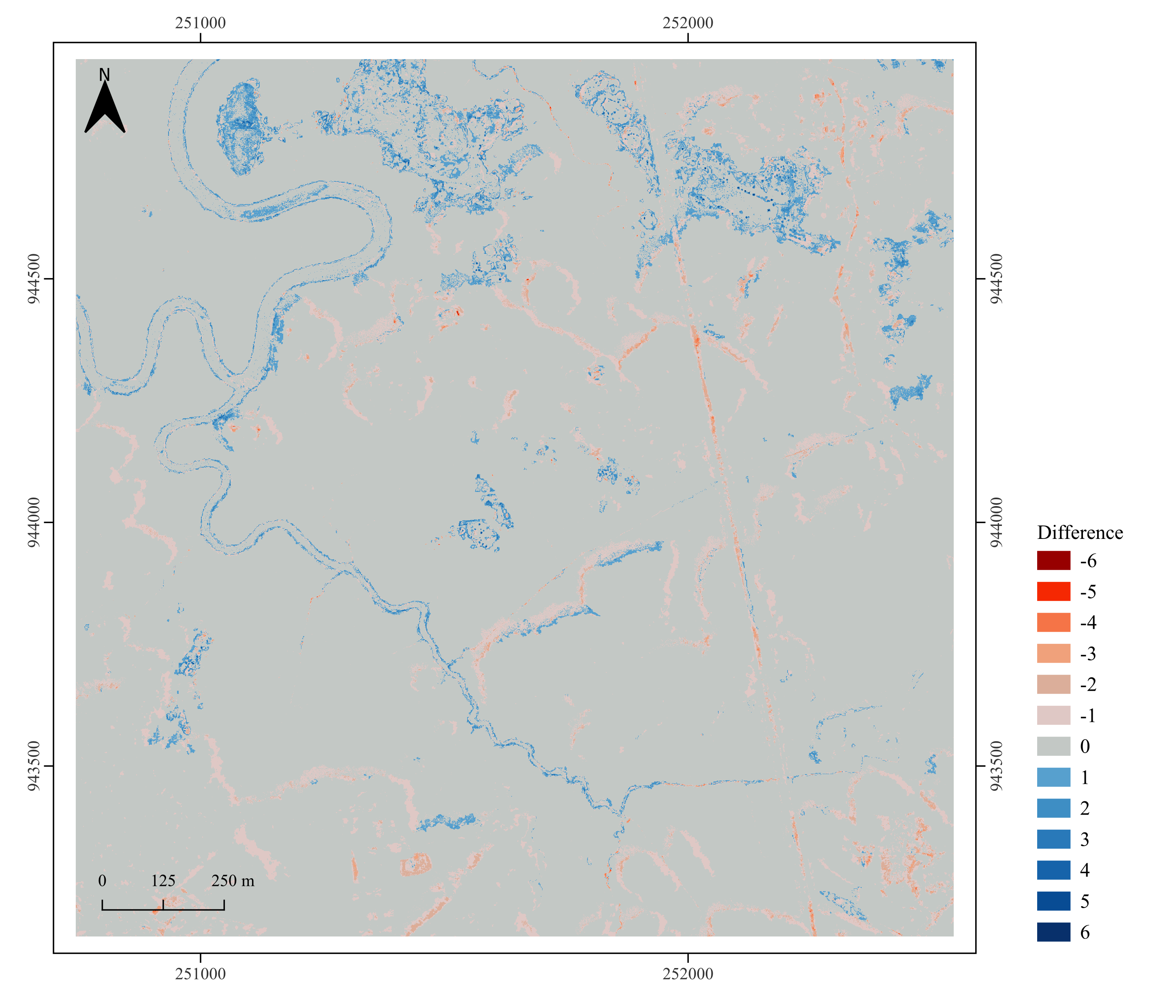
Equation 50
$$B_{n}=\sum_{t=0}^{T}{\left({Py}_{tn}−{Px}_{tn}\right)}$$
Each pixel’s value shows the cumulative difference in presence between the two maps across all time points.
Positive values mean more total presence in object-based series than in pixel-based series.
Negative values mean more total presence in pixel-based series than in object-based series.
Zero means both time series marked presence the same number of time points.
Zero also means absence of the class!
Start the legend from positive values.

Slide 23
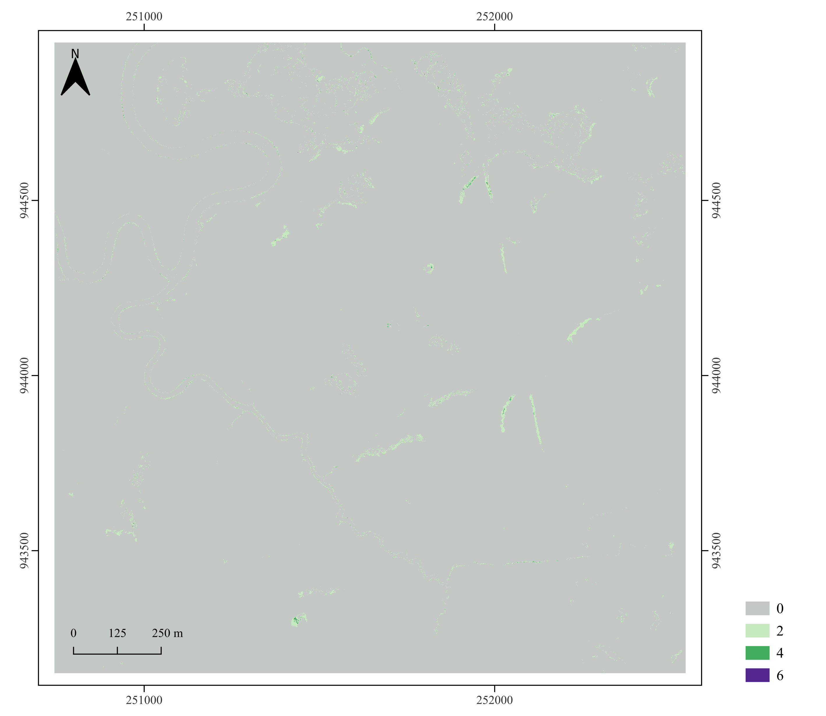
Equation 51
$$C_{n}=\left(\sum_{t=0}^{T}{\left|{Py}_{tn}−{Px}_{tn}\right|}\right)−\left|B_{n}\right|$$
The map shows temporal allocation difference at each pixel across time points, after removing net extent difference.

Slide 24
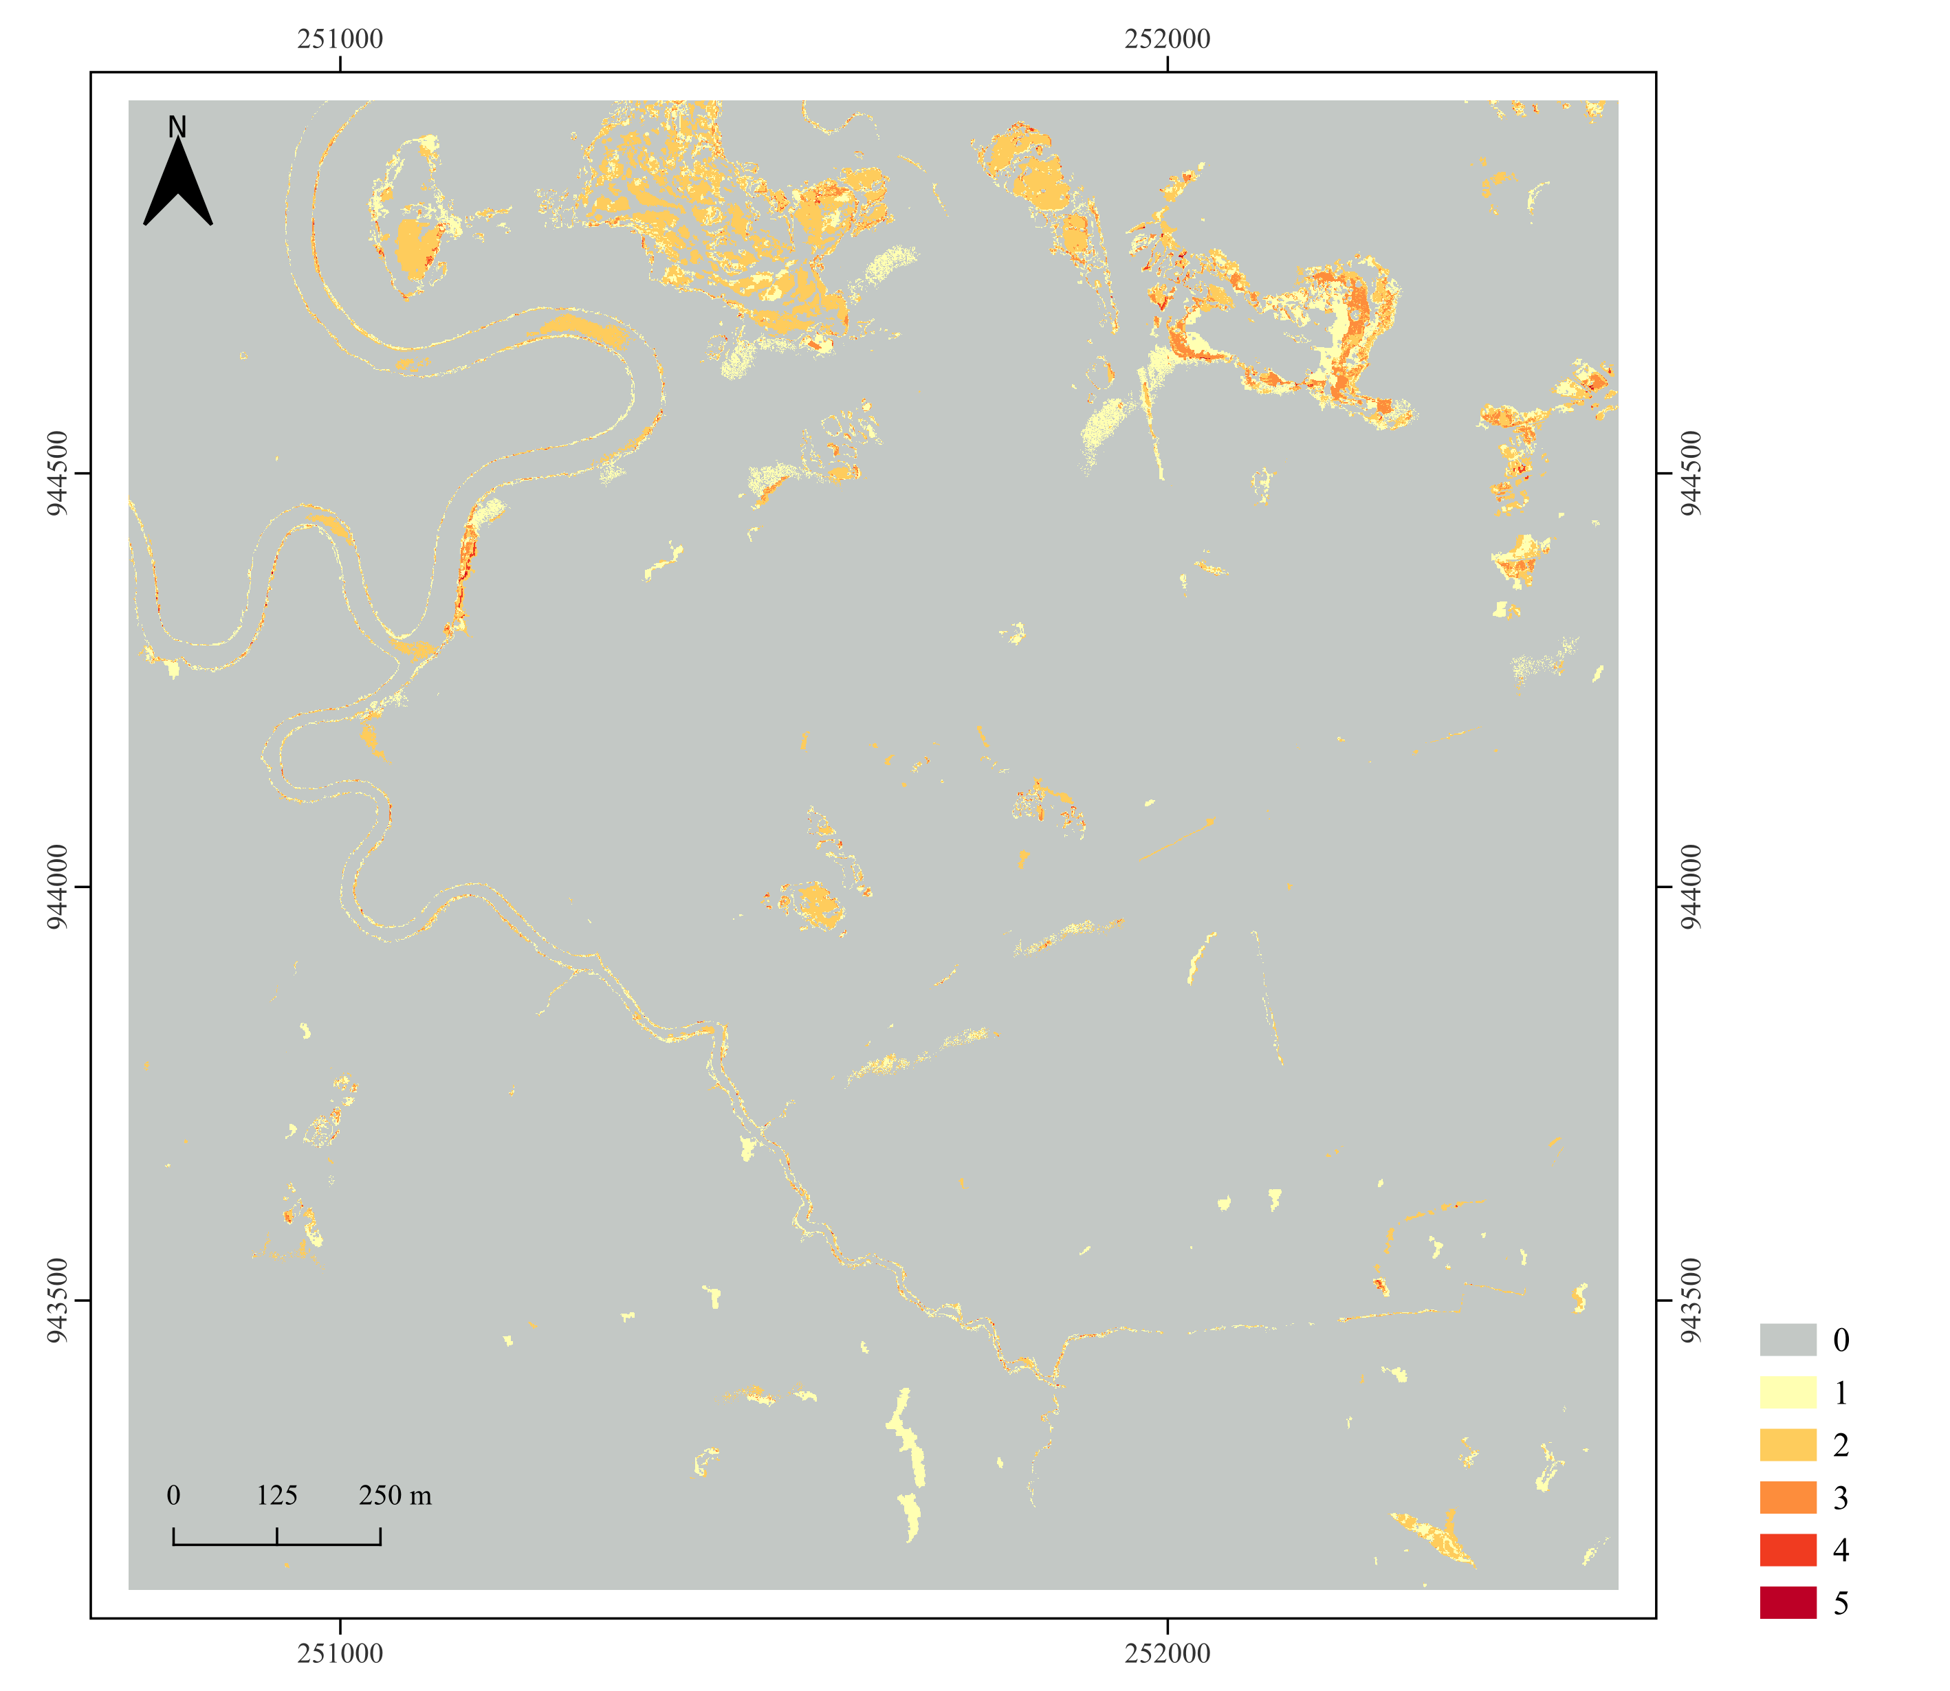
Equation 52
$$D_{n}=\sum_{t=1}^{T}{\left({Gh}_{tn}−{Lh}_{tn}\right)}$$
The map reports, for each pixel, how many time intervals show a change hit.
At a time interval, count one when both series gain at the pixel. Count one when both series lose at that pixel. Otherwise count zero.
Zero means the series never change in the same direction at that pixel.
Zero also means absence of the class!

Slide 25
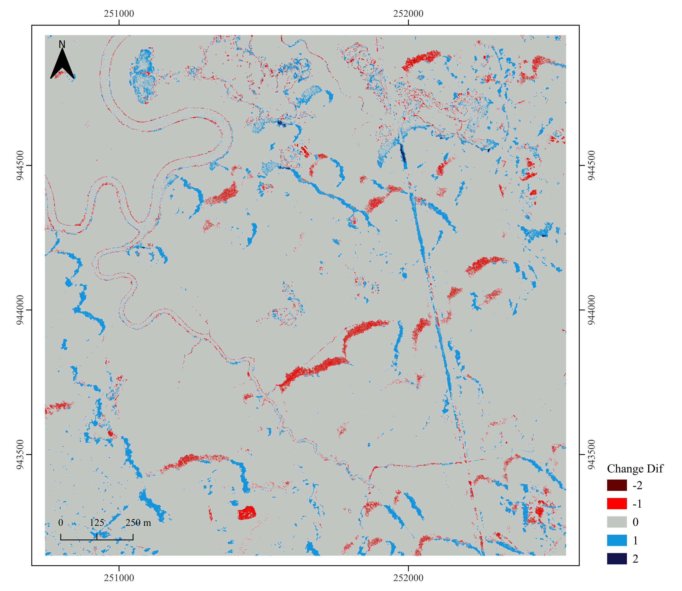
Equation 53
$$E_{n}=\left({Py}_{Tn}−{Py}_{0n}\right)−\left({Px}_{Tn}−{Px}_{0n}\right)$$
The map shows the net extent difference between the first and last time point at each pixel.
Positive values mean the object-based series ends higher than the pixel-based series (gained more or lost less).
Negative values mean the pixel-based series ends higher than the object-based series.
Zero means both series share the same start-end state at that pixel.
Notes:
+2 = Gain in X and Loss in Y (2-(-1))
+1 = Gain in X and Y does not change. Or X does not change and Y loss. (1-0) and (0-(-1))
0= no change or both change in the same direction.
-1=Loss in X and no change in Y. X does not change and Gain in Y. (-1-0) and (0-1)
-2=Loss in X and Gain in Y. (-1-(1))

Slide 26
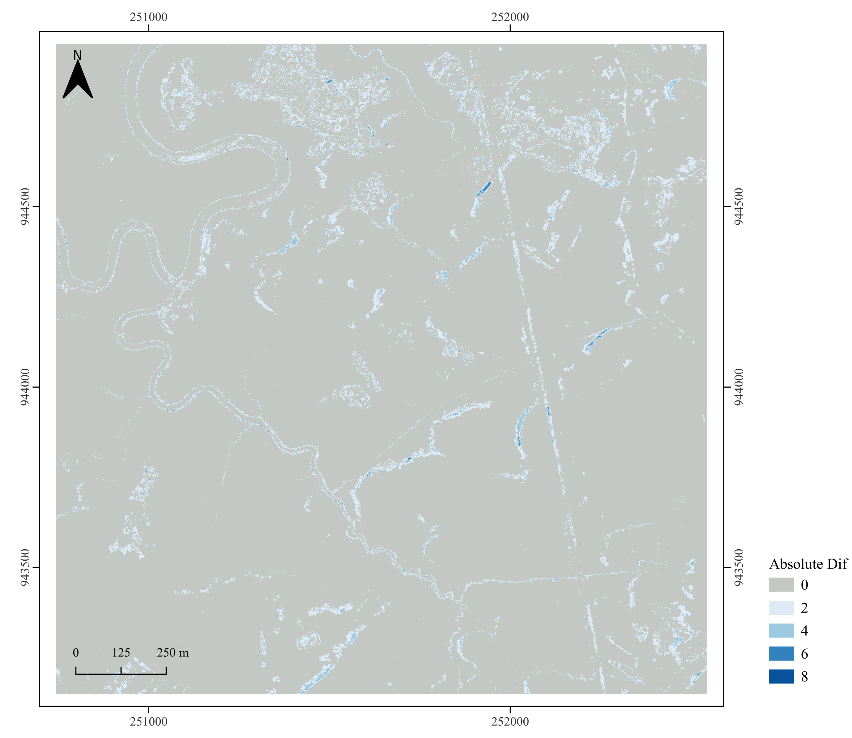
Equation 54
$$F_{n}=\left[\sum_{t=1}^{T}{\left|\left({Py}_{tn}−{Py}_{t−1n}\right)−\left({Px}_{tn}−{Px}_{t−1n}\right)\right|}\right]−\left|E_{n}\right|$$
The map shows the change absolute difference summed across time intervals for each pixel.
Are these statements true to equation 54?
score 0 when both gain, both lose, or both stay stables.
core1 when one changes and the other stays stable.
score 2 when one gains while the other loses.
Notes:
Gain=+1 Loss = -1 No change =0

