Slide 1
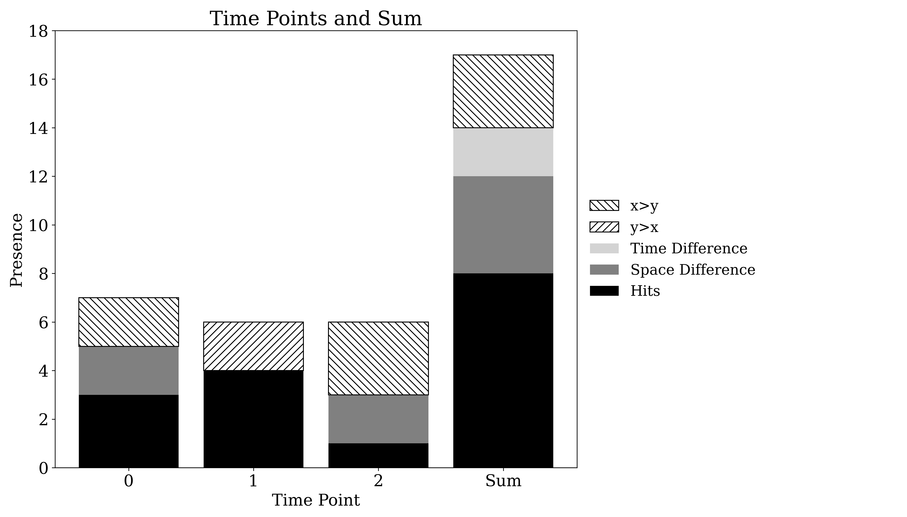
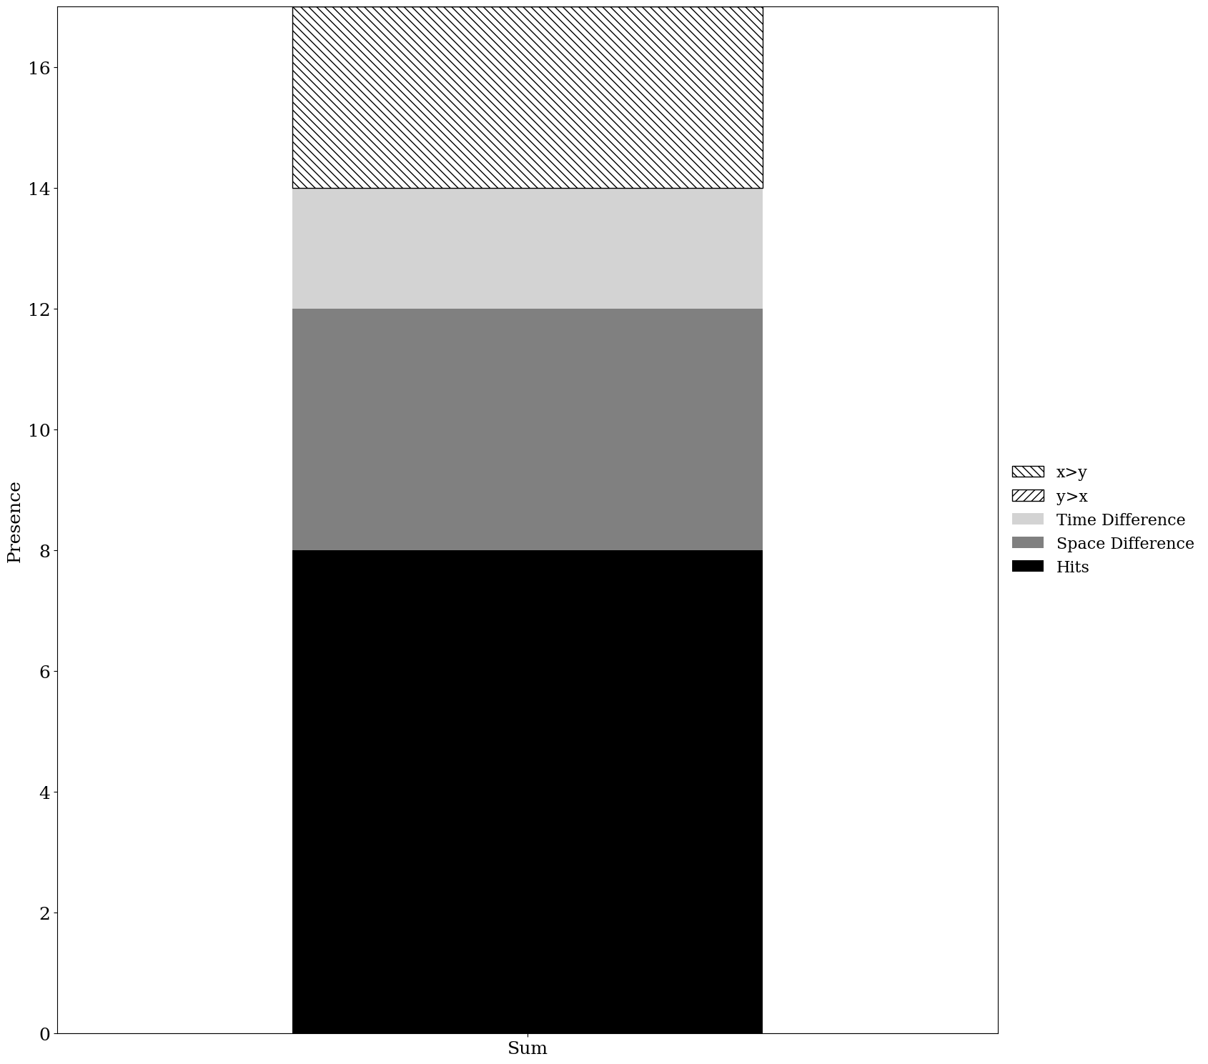
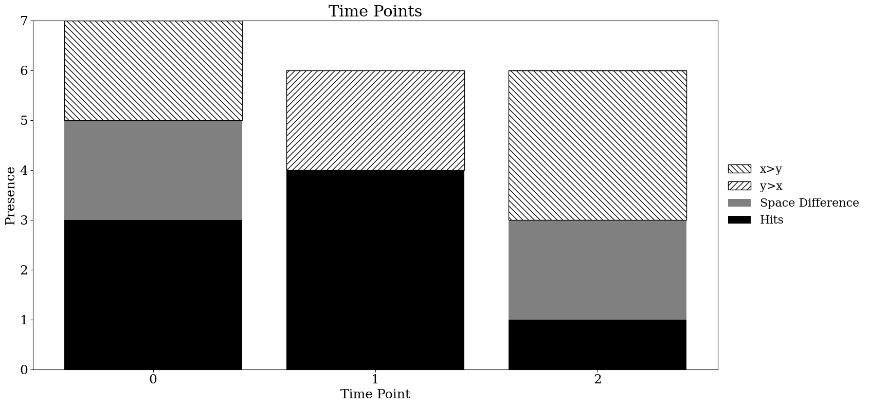
Old version
New version

Slide 2
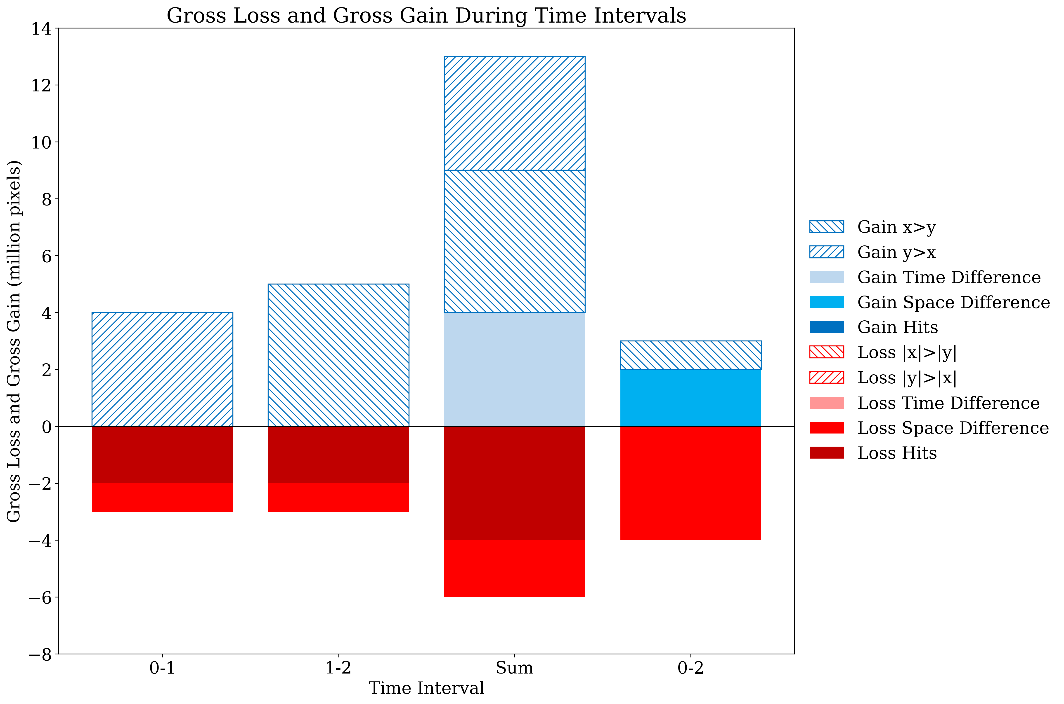
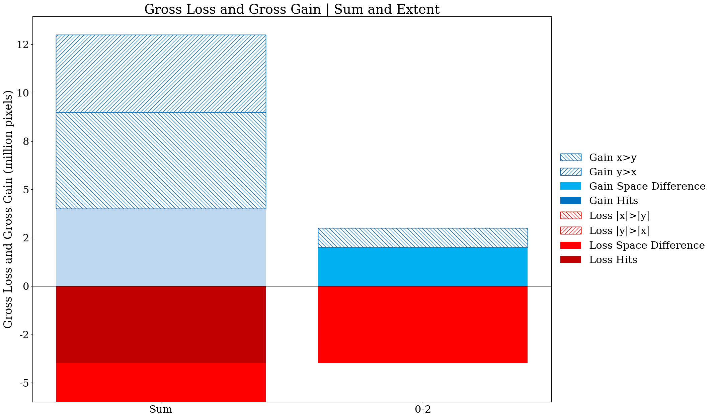
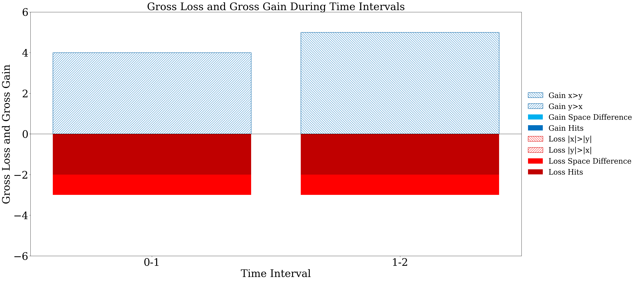
Old version
Gain time difference component should be in the legend
New version

Slide 3
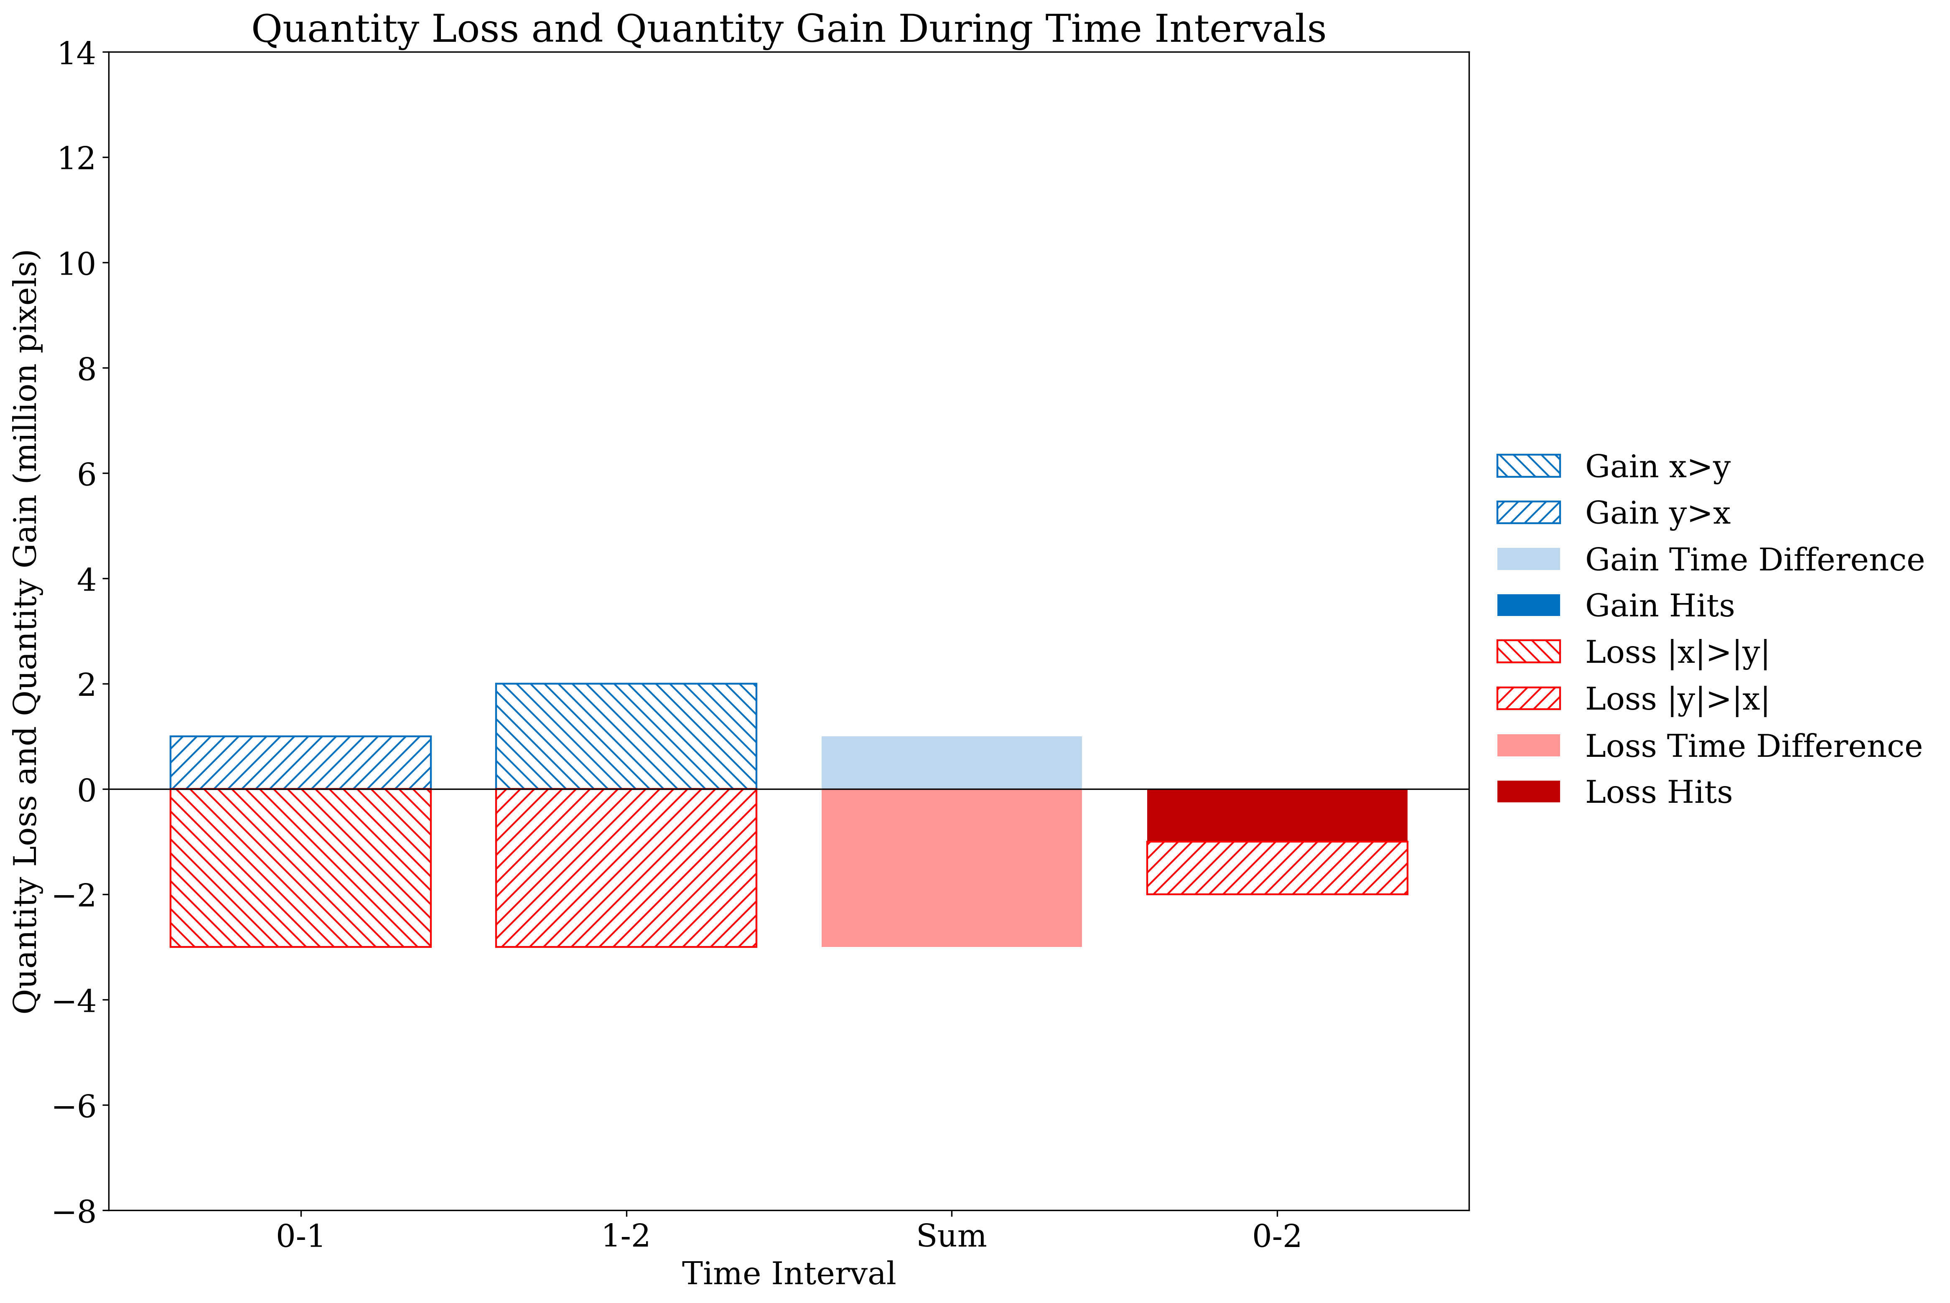
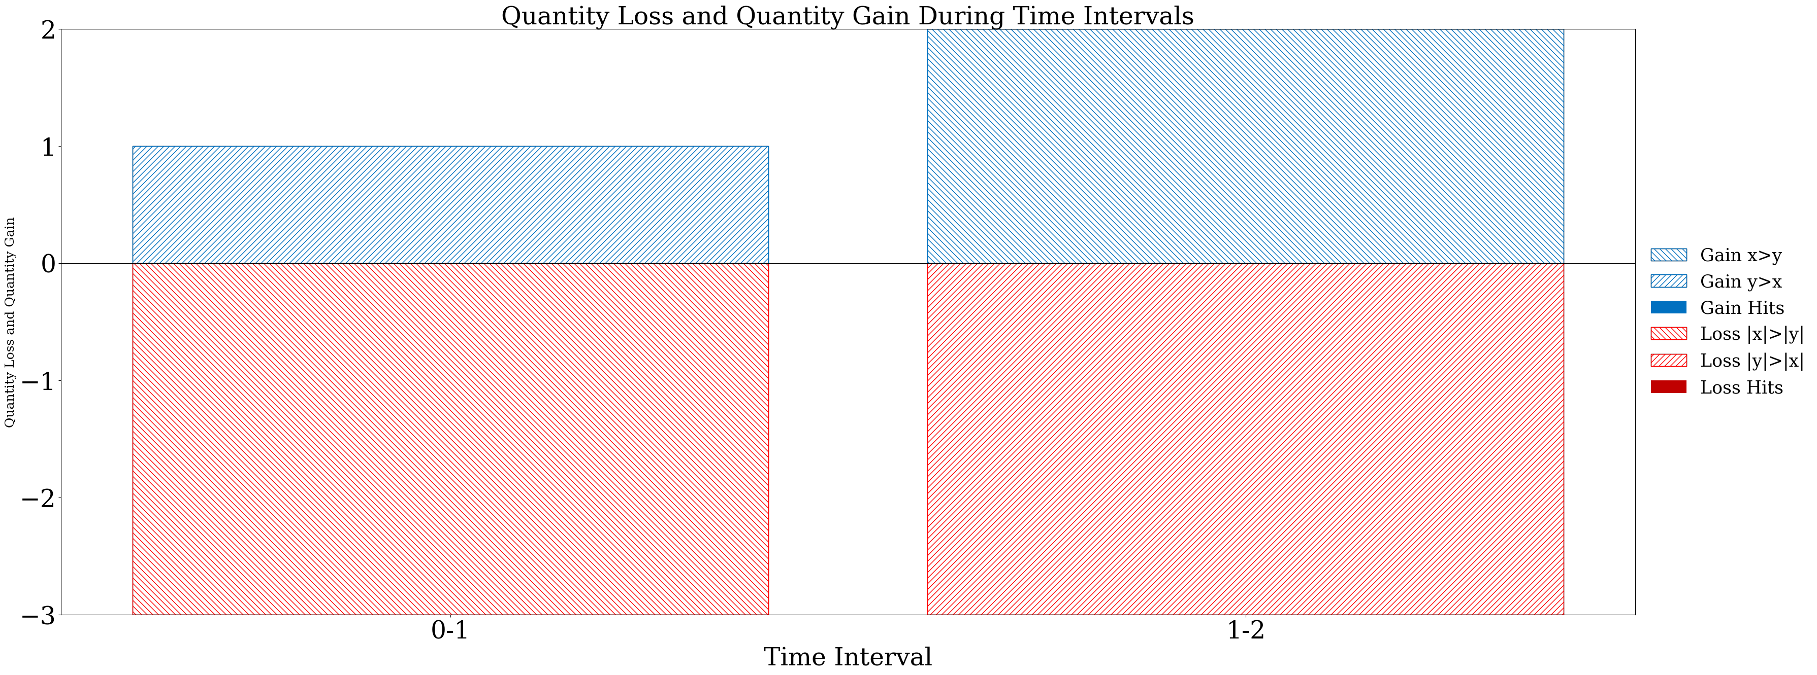
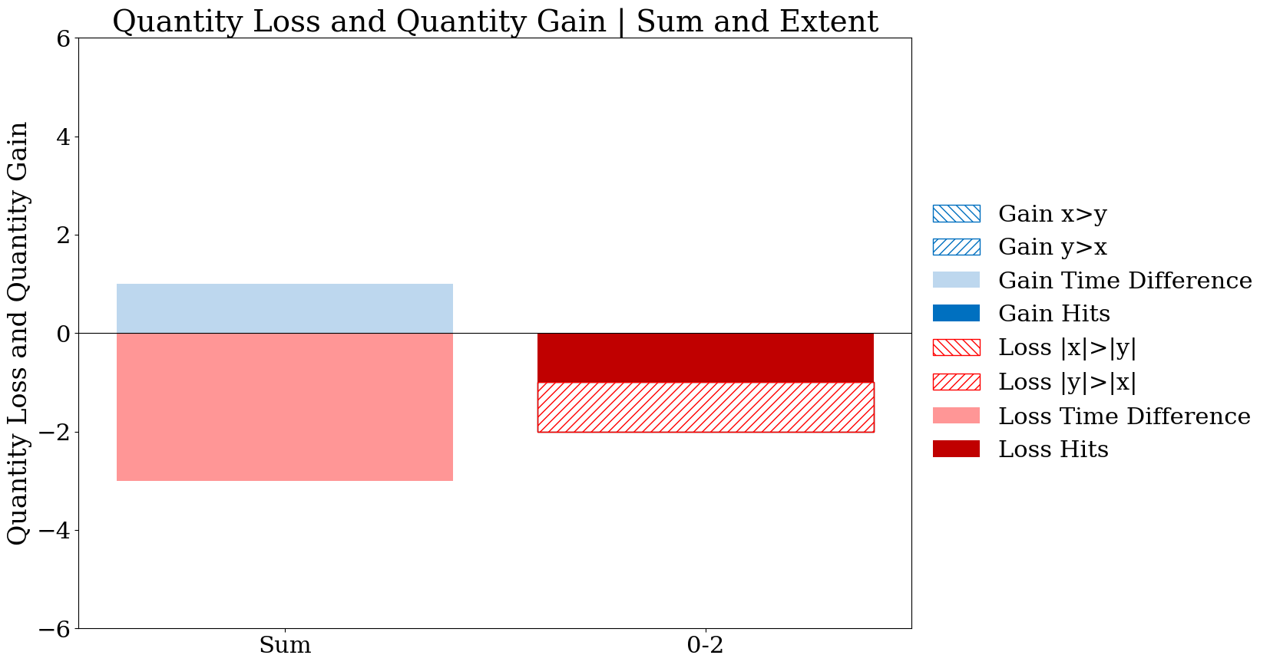
Old version
Gain time difference component should be in the legend
New version

Slide 4







X series
Y series
Equation 51
2
5
4
1
t0
Temporal Allocation Difference Result
0
4
1
5
0
1
t1
We must improve the explanation. The explanation Pontius wrote in version 10 of the manuscript is poor.
This is the temporal allocation difference, which we could call an alternation difference.
This is positive if and only if (y>x at one time point and x>y at a different time point).
5
1
0
3
t2

Slide 5

X series
Y series
Equation 53
2
5
4
1
t0
Result
0
4
1
5
-2
2
t1
I hope you meant to write
Positive values mean more total presence in series y than in x.
Negative values mean more total presence in series x than in y.
5
1
0
3
t2

Slide 6

X series
Y series
Equation 54
2
5
4
1
t0
Result
0
4
1
5
-7
6
t1
5
1
0
3
t2

