Slide 1
PIE data
Zoom 1. Code made the raster results. QGIS made the maps.

Slide 2
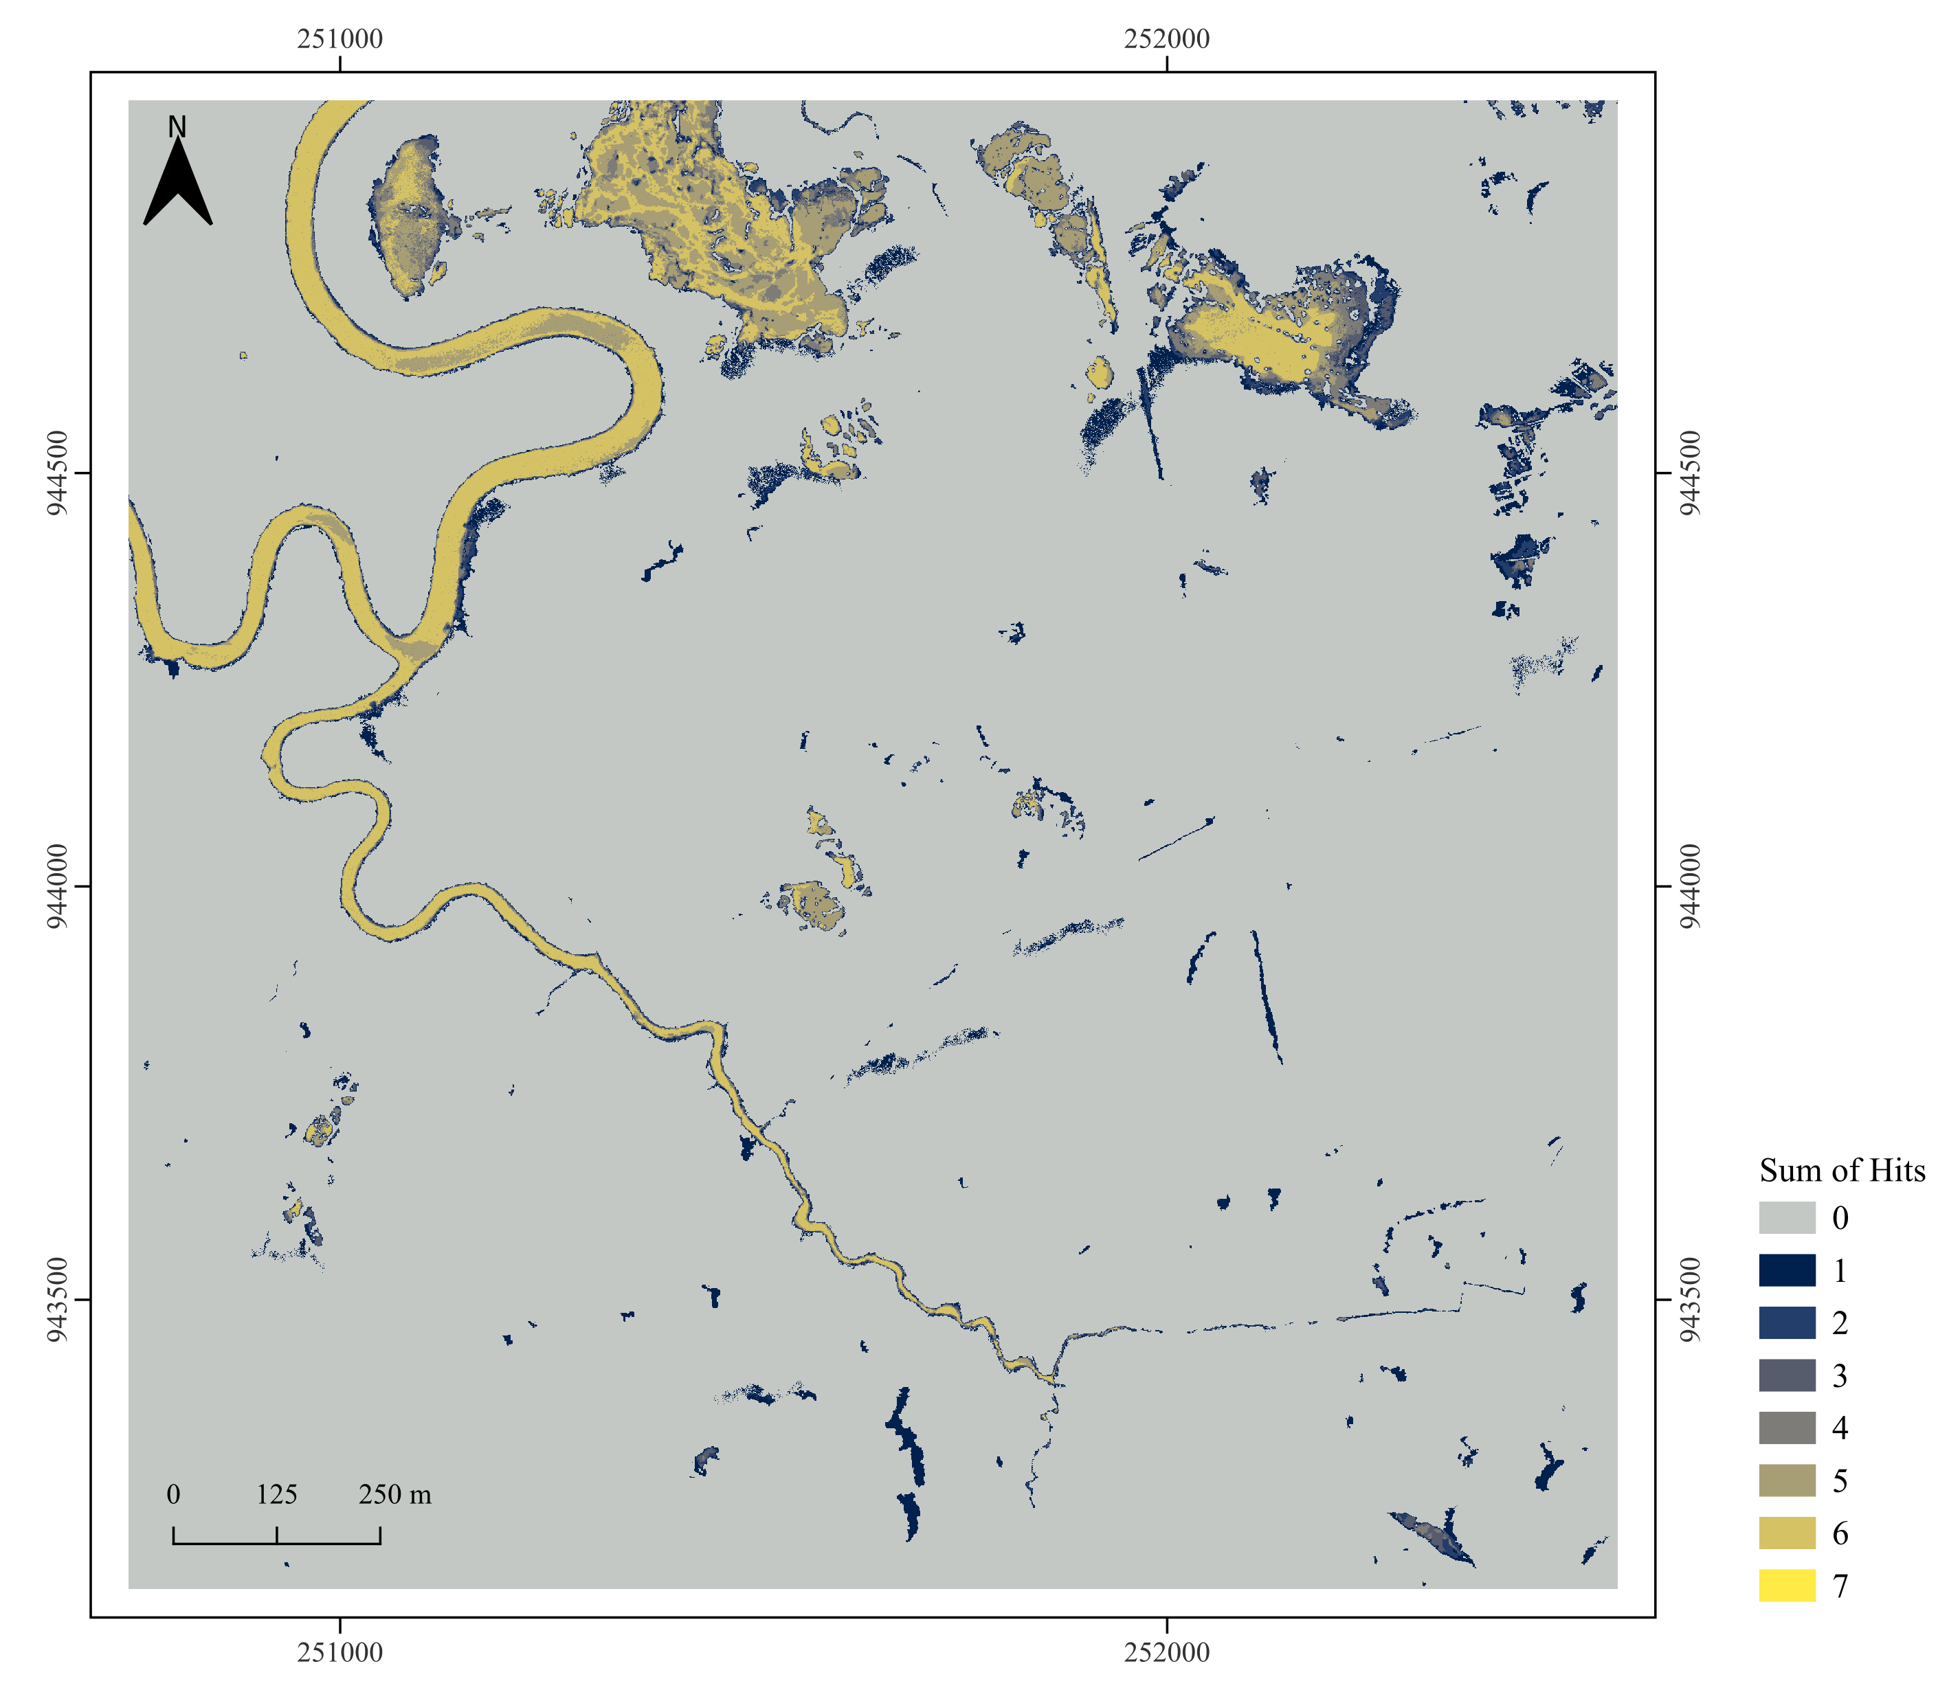
Equation 49

Slide 3
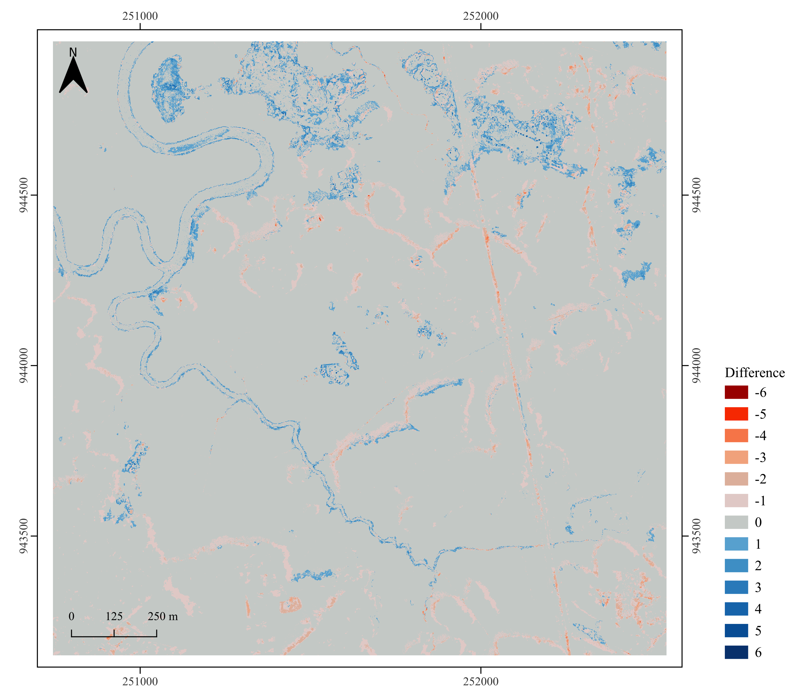
Equation 50

Slide 4
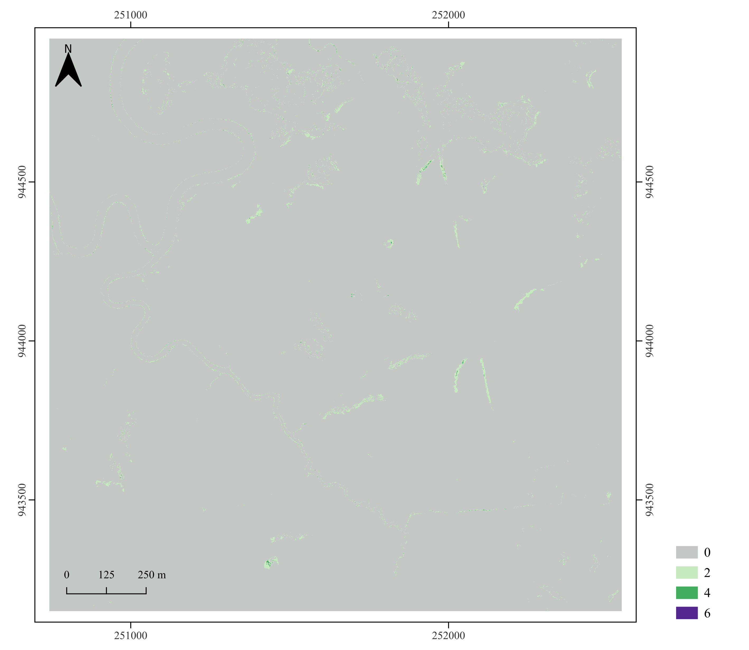
Equation 51

Slide 5
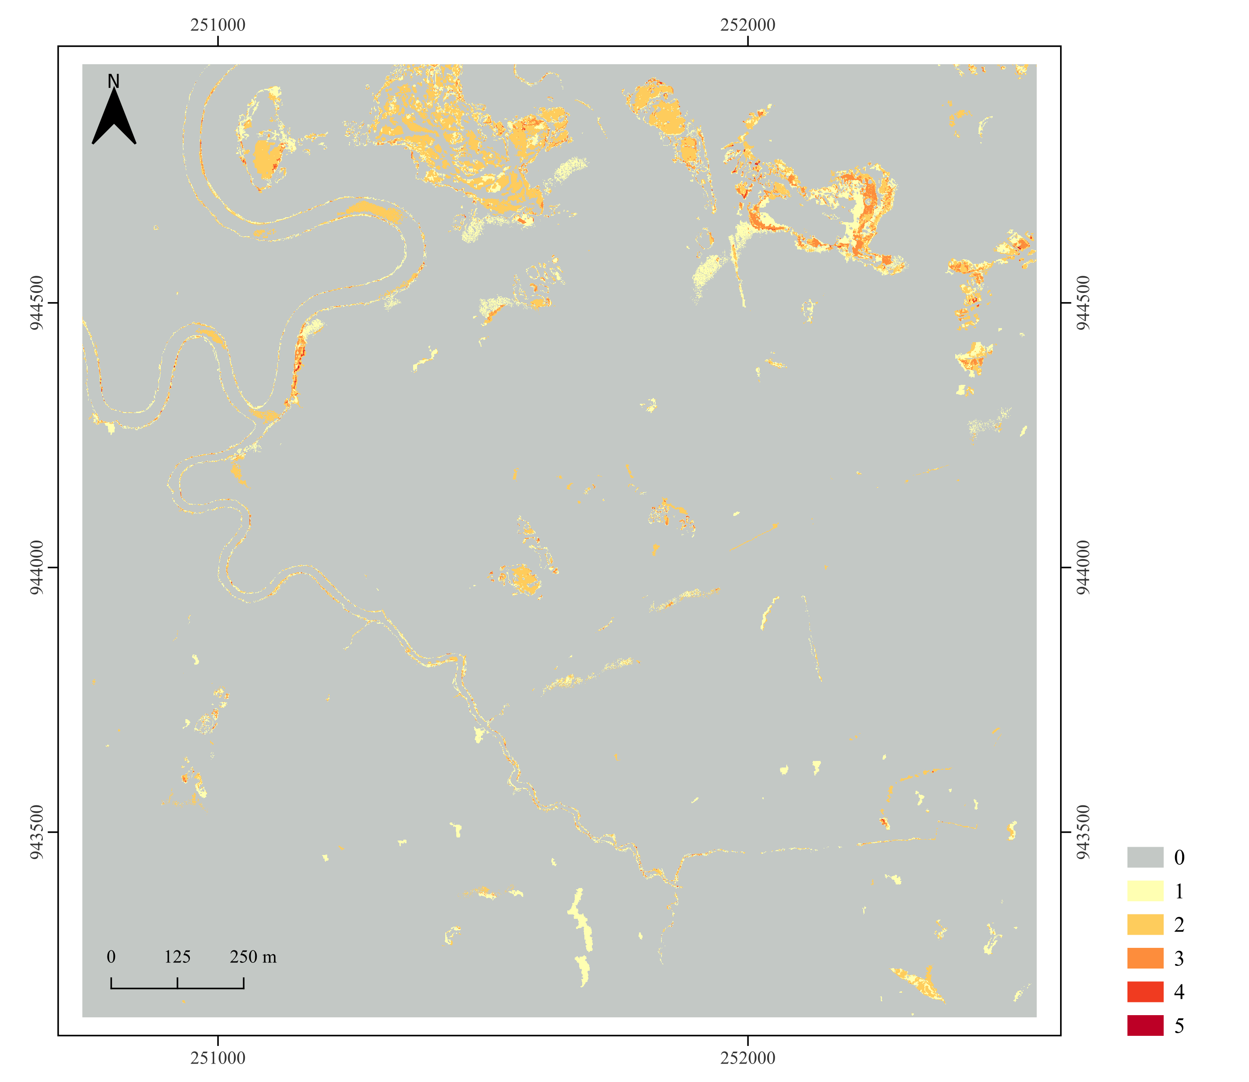
Equation 52

Slide 6
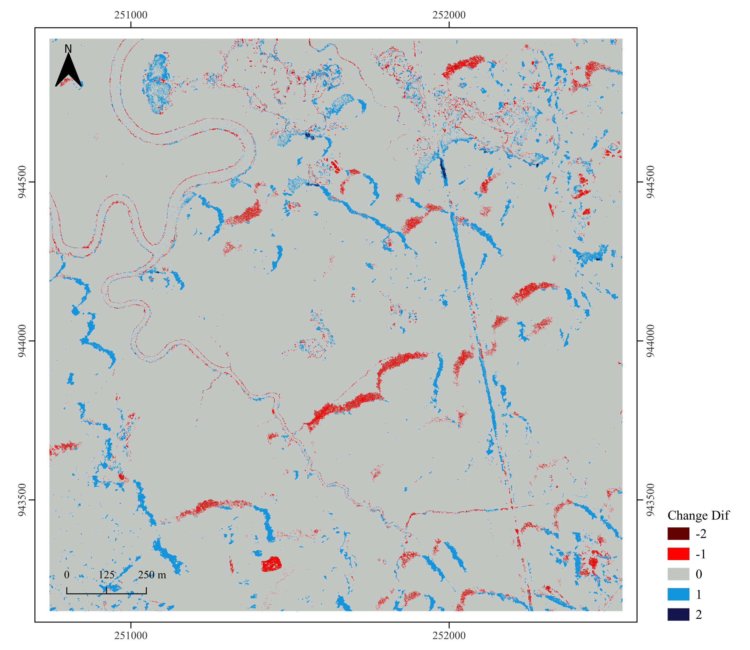
Equation 53

Slide 7
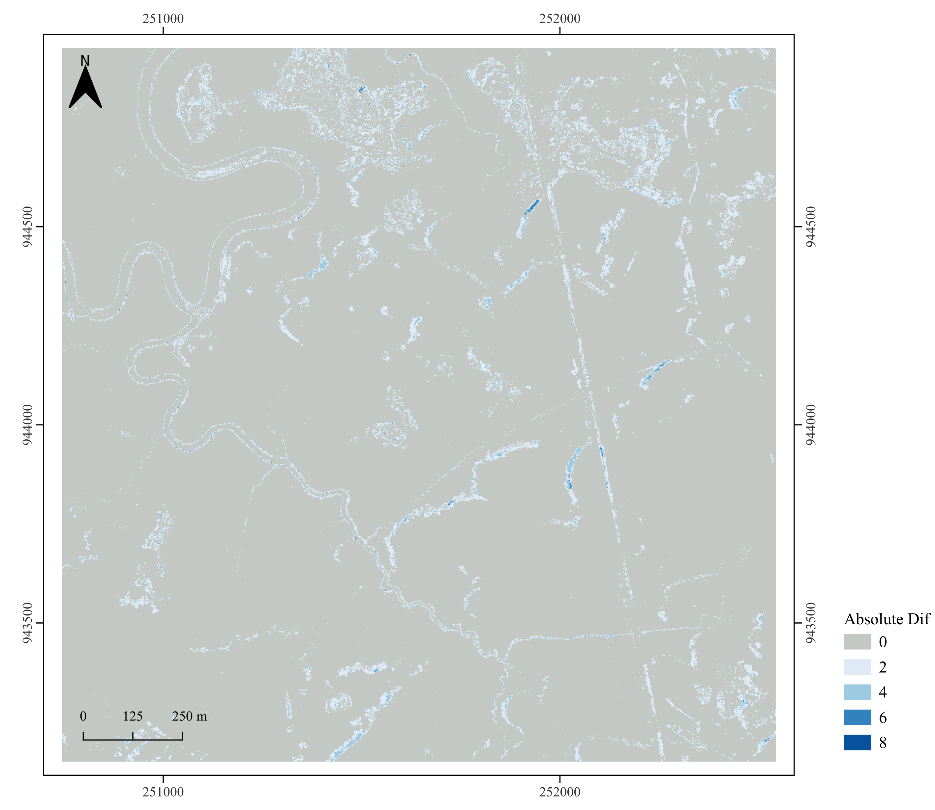
Equation 54

Slide 8
Toy data

Slide 9
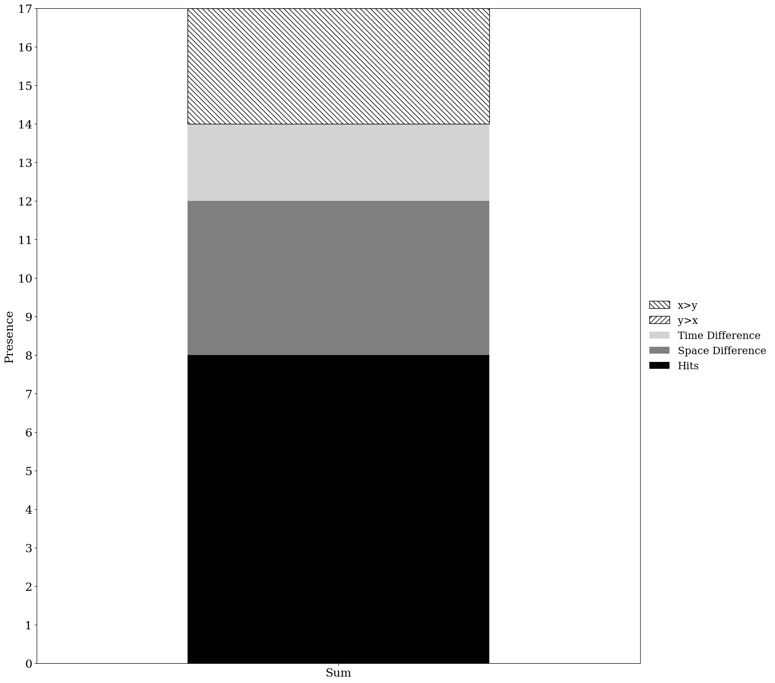
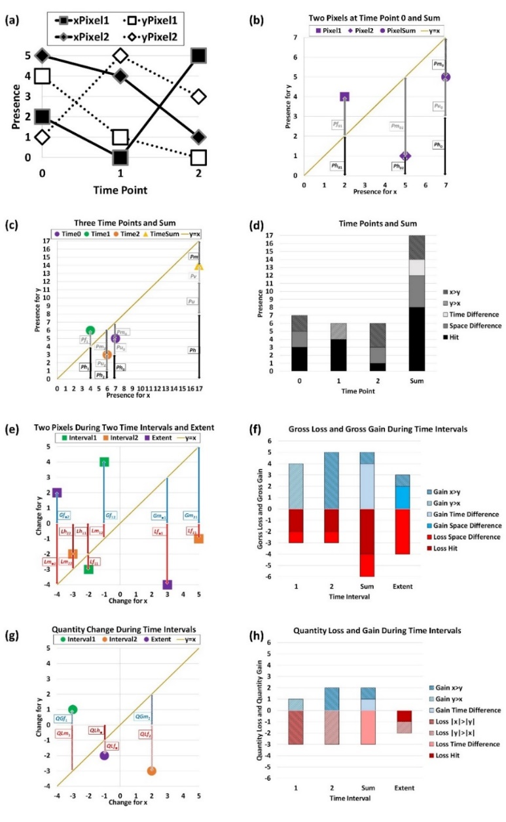
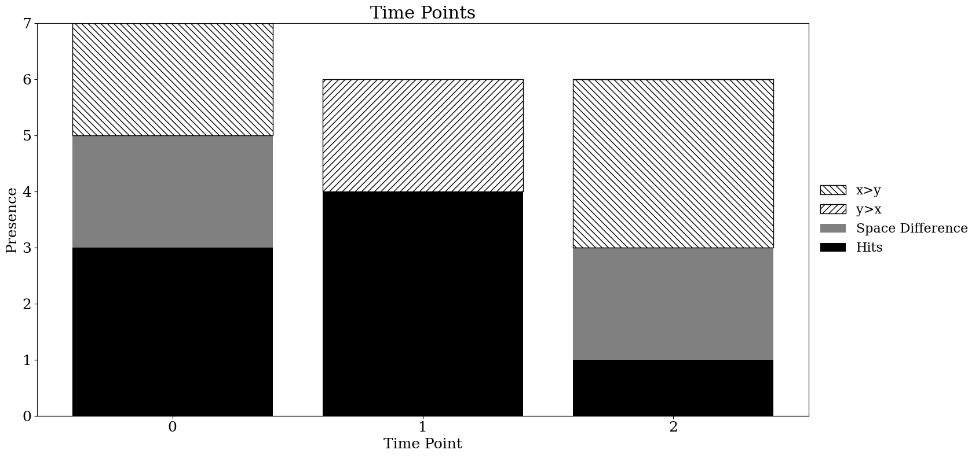
Presence and Sum

Slide 10
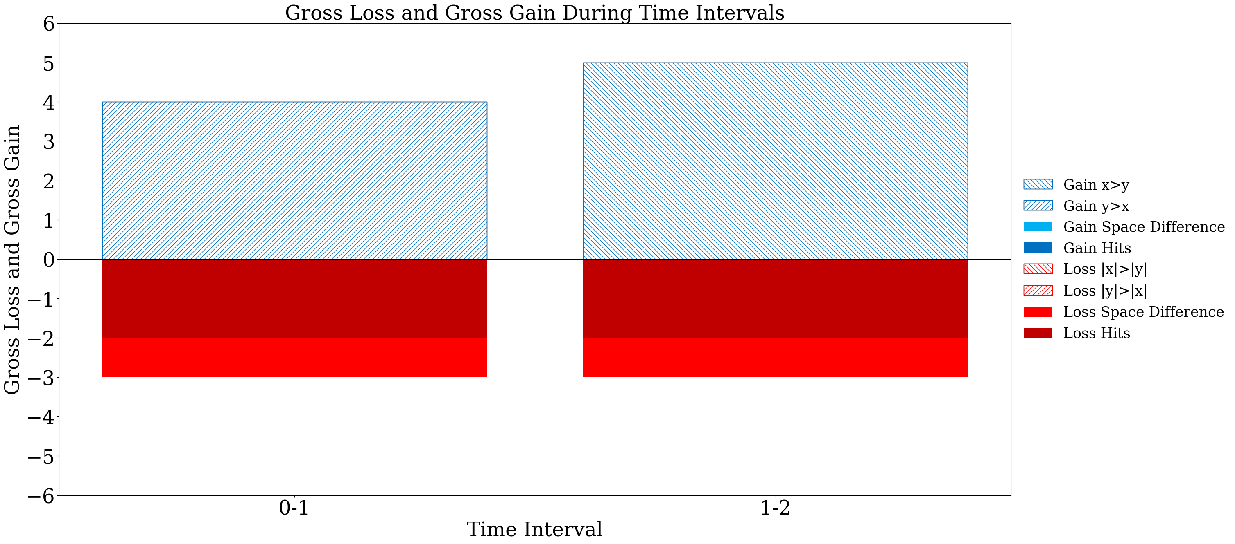
Gross Loss and Gross Gain

Slide 11
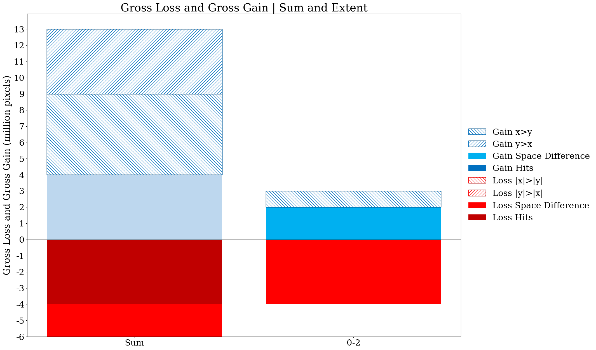
Gross Loss and Gross Gain

Slide 12
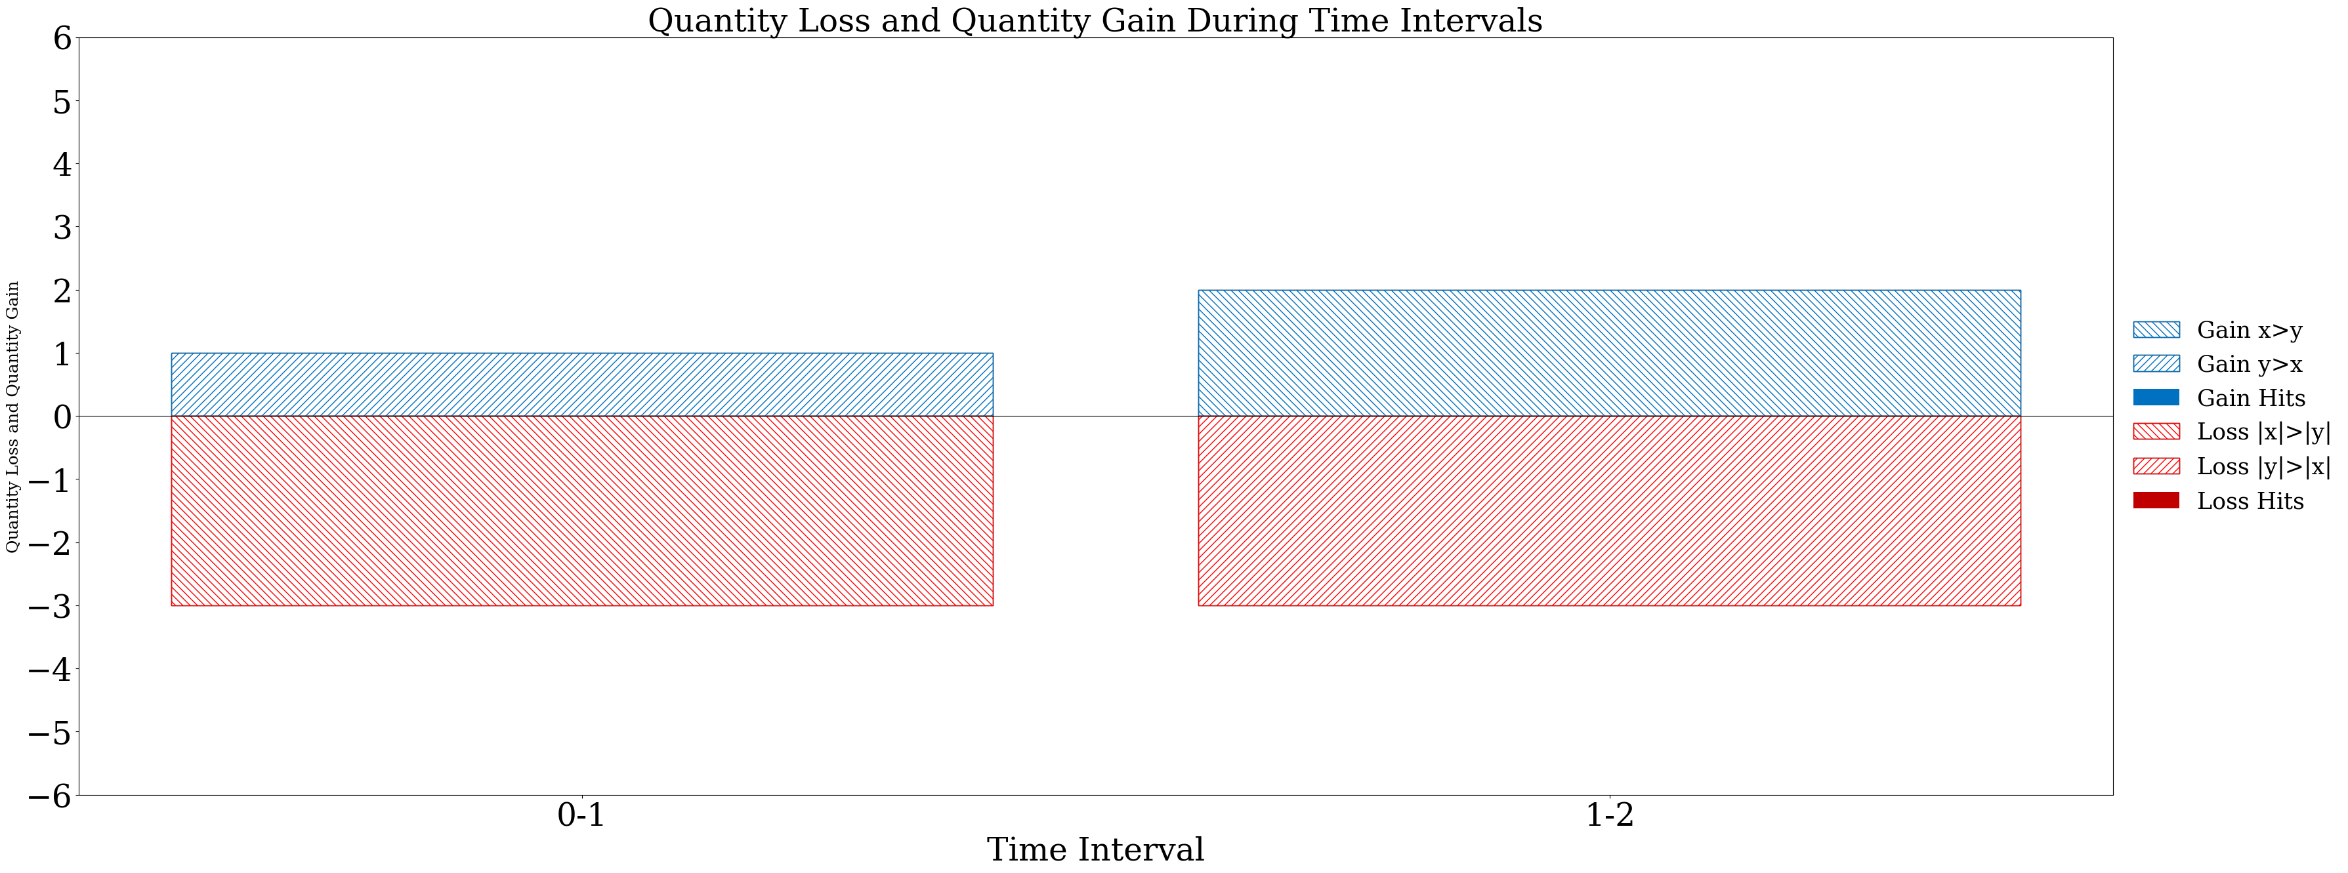
Net Loss and Net Gain

Slide 13
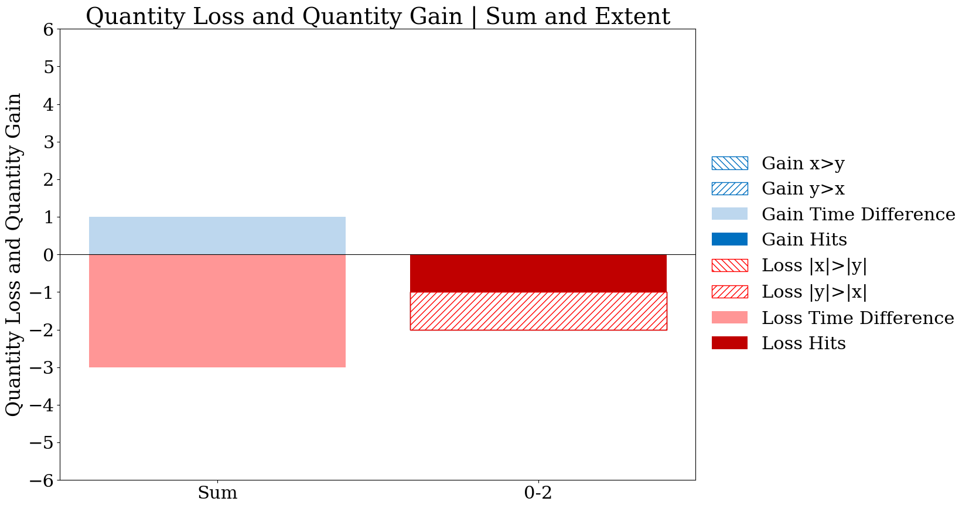
Net Loss and Net Gain

Slide 14

Equation 49
2
6

Slide 15

Equation 50
-2
-1

Slide 16

Equation 51
6
6

Slide 17

Equation 52
2
2

Slide 18

Equation 53
-7
6

Slide 19

Equation 54
0
0

