Slide 1
Savanna
MapBiomas Collection 6, Collection 8, and Collection 10

Slide 2
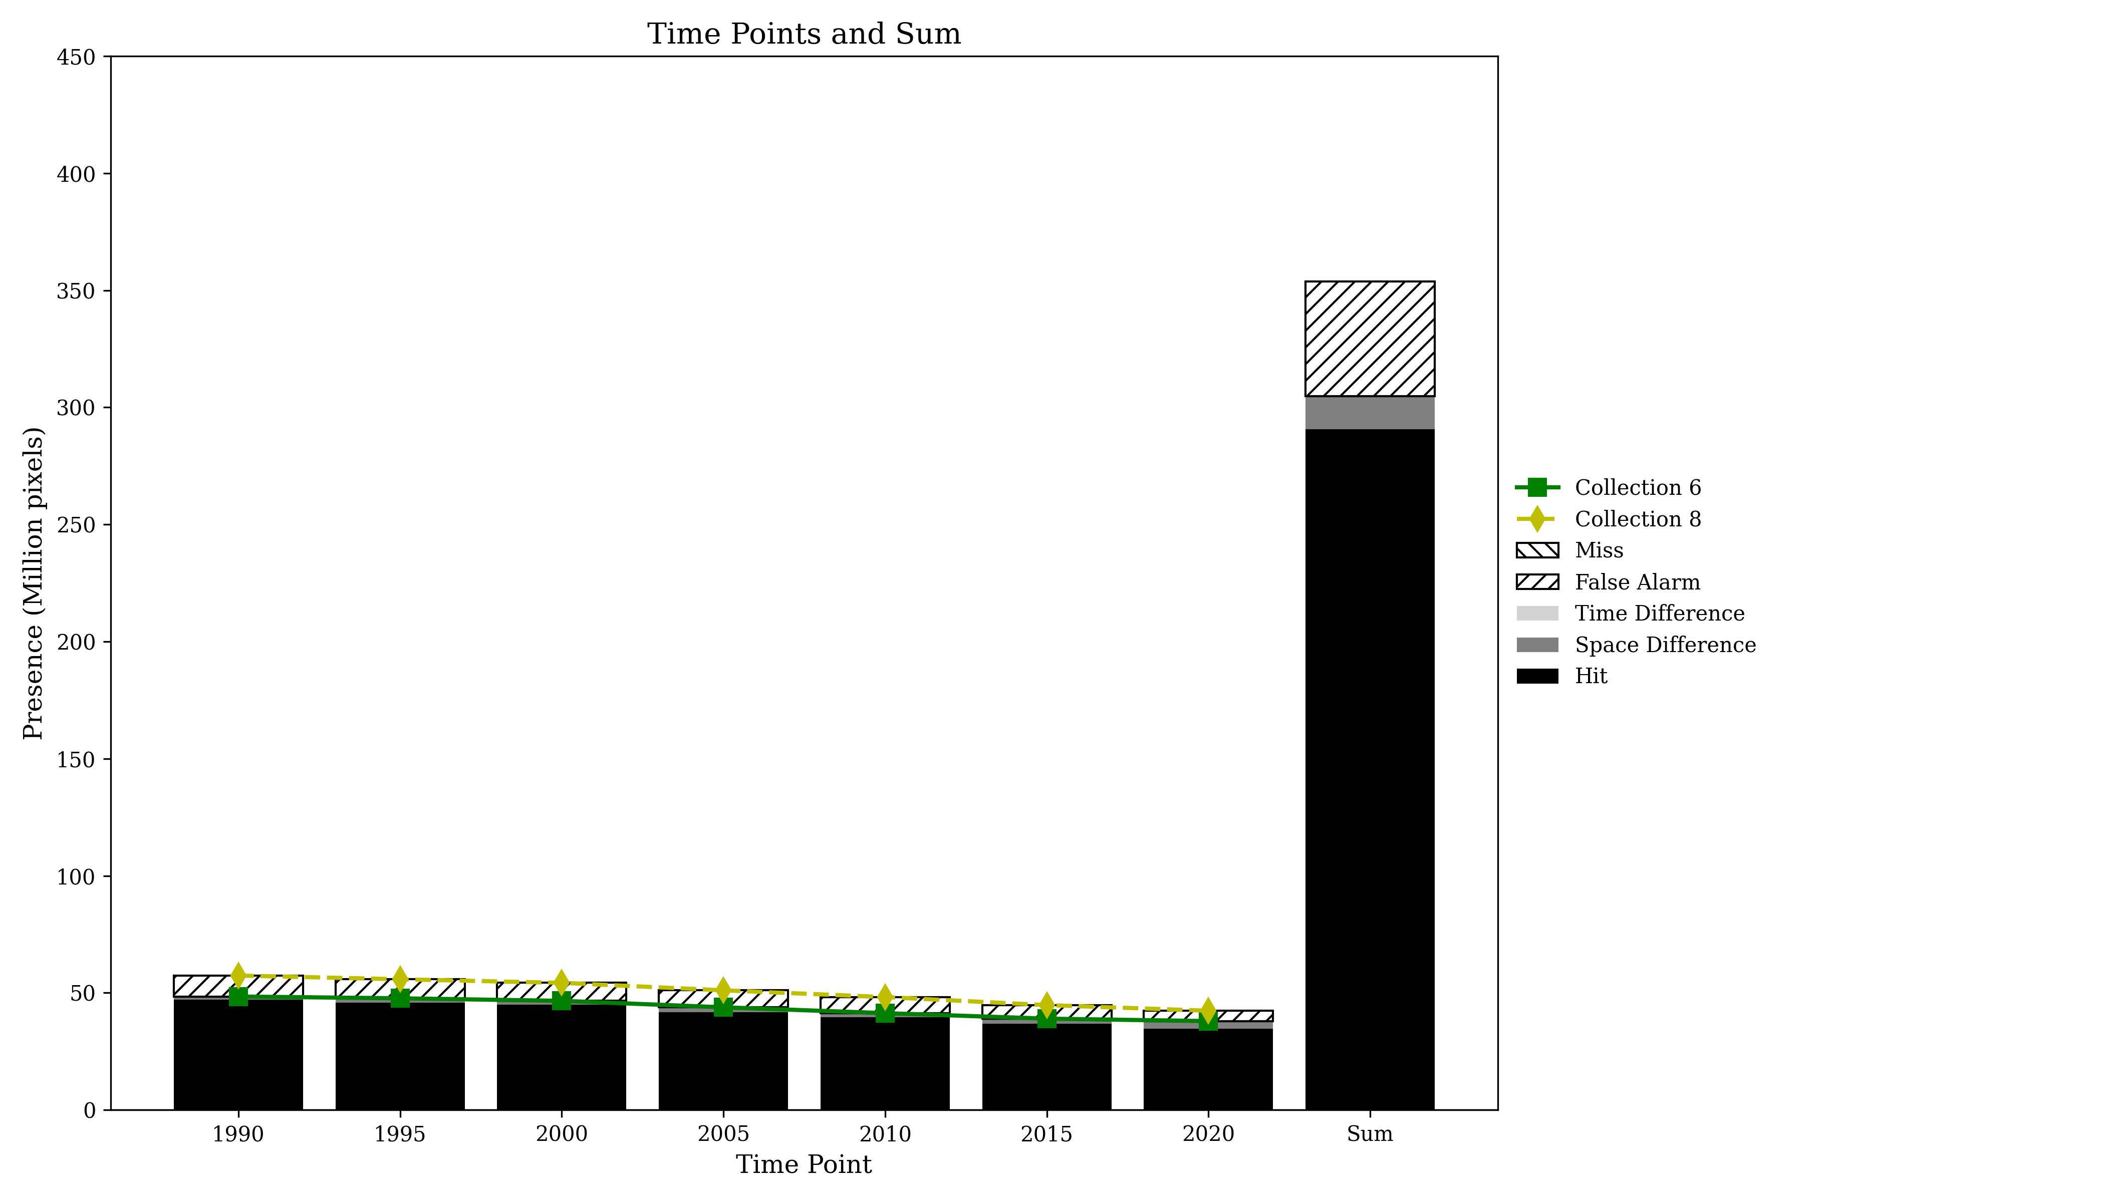
Presence Agreement graphic using Savanna class (Collection 6 and 8)

Slide 3
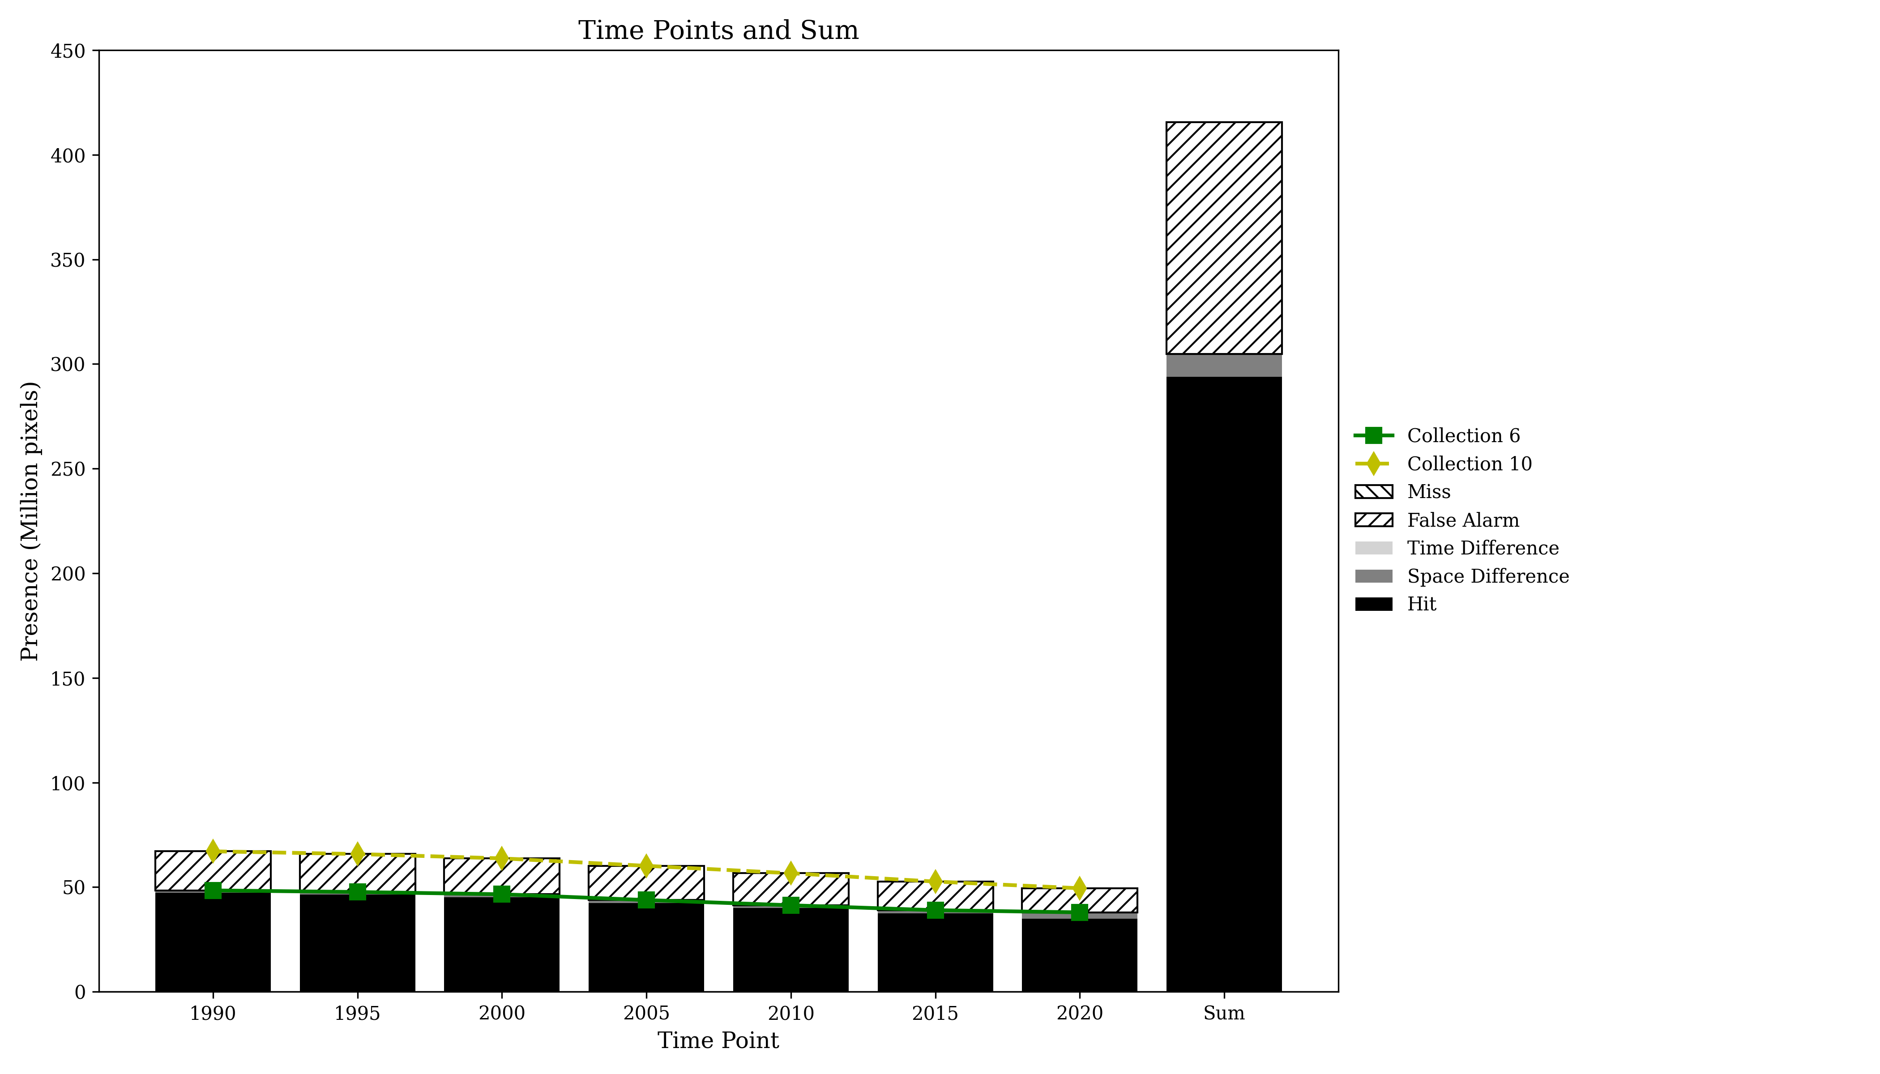
Presence Agreement graphic using Savanna class (Collection 6 and 10)

Slide 4
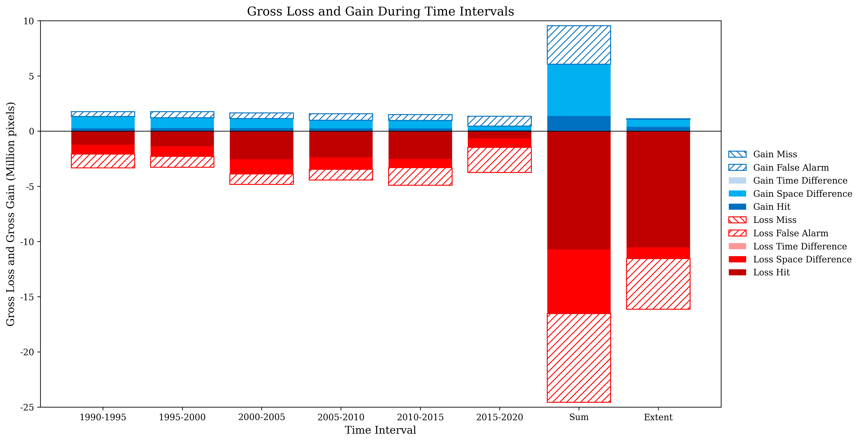
Gross Losses and Gross Gains graphics using Savanna class (Collection 6 and 8)

Slide 5
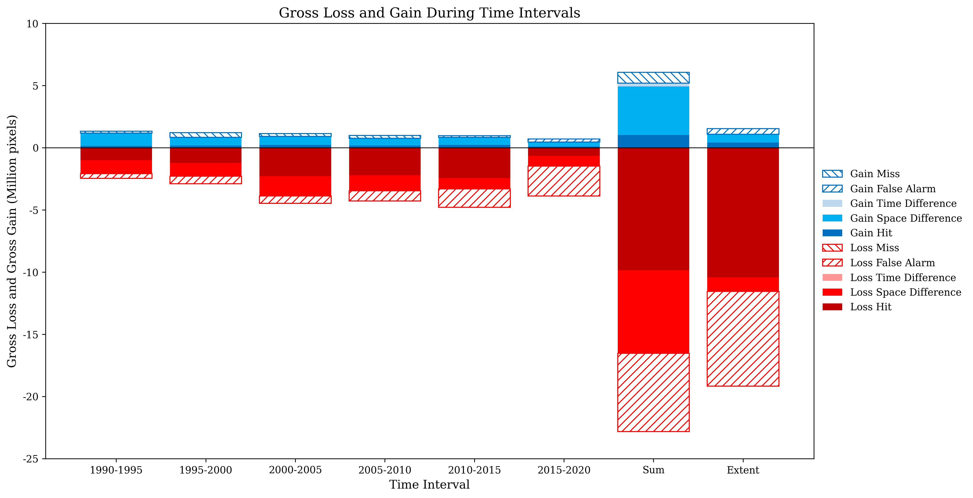
Gross Losses and Gross Gains graphics using Savanna class (Collection 6 and 10)

Slide 6
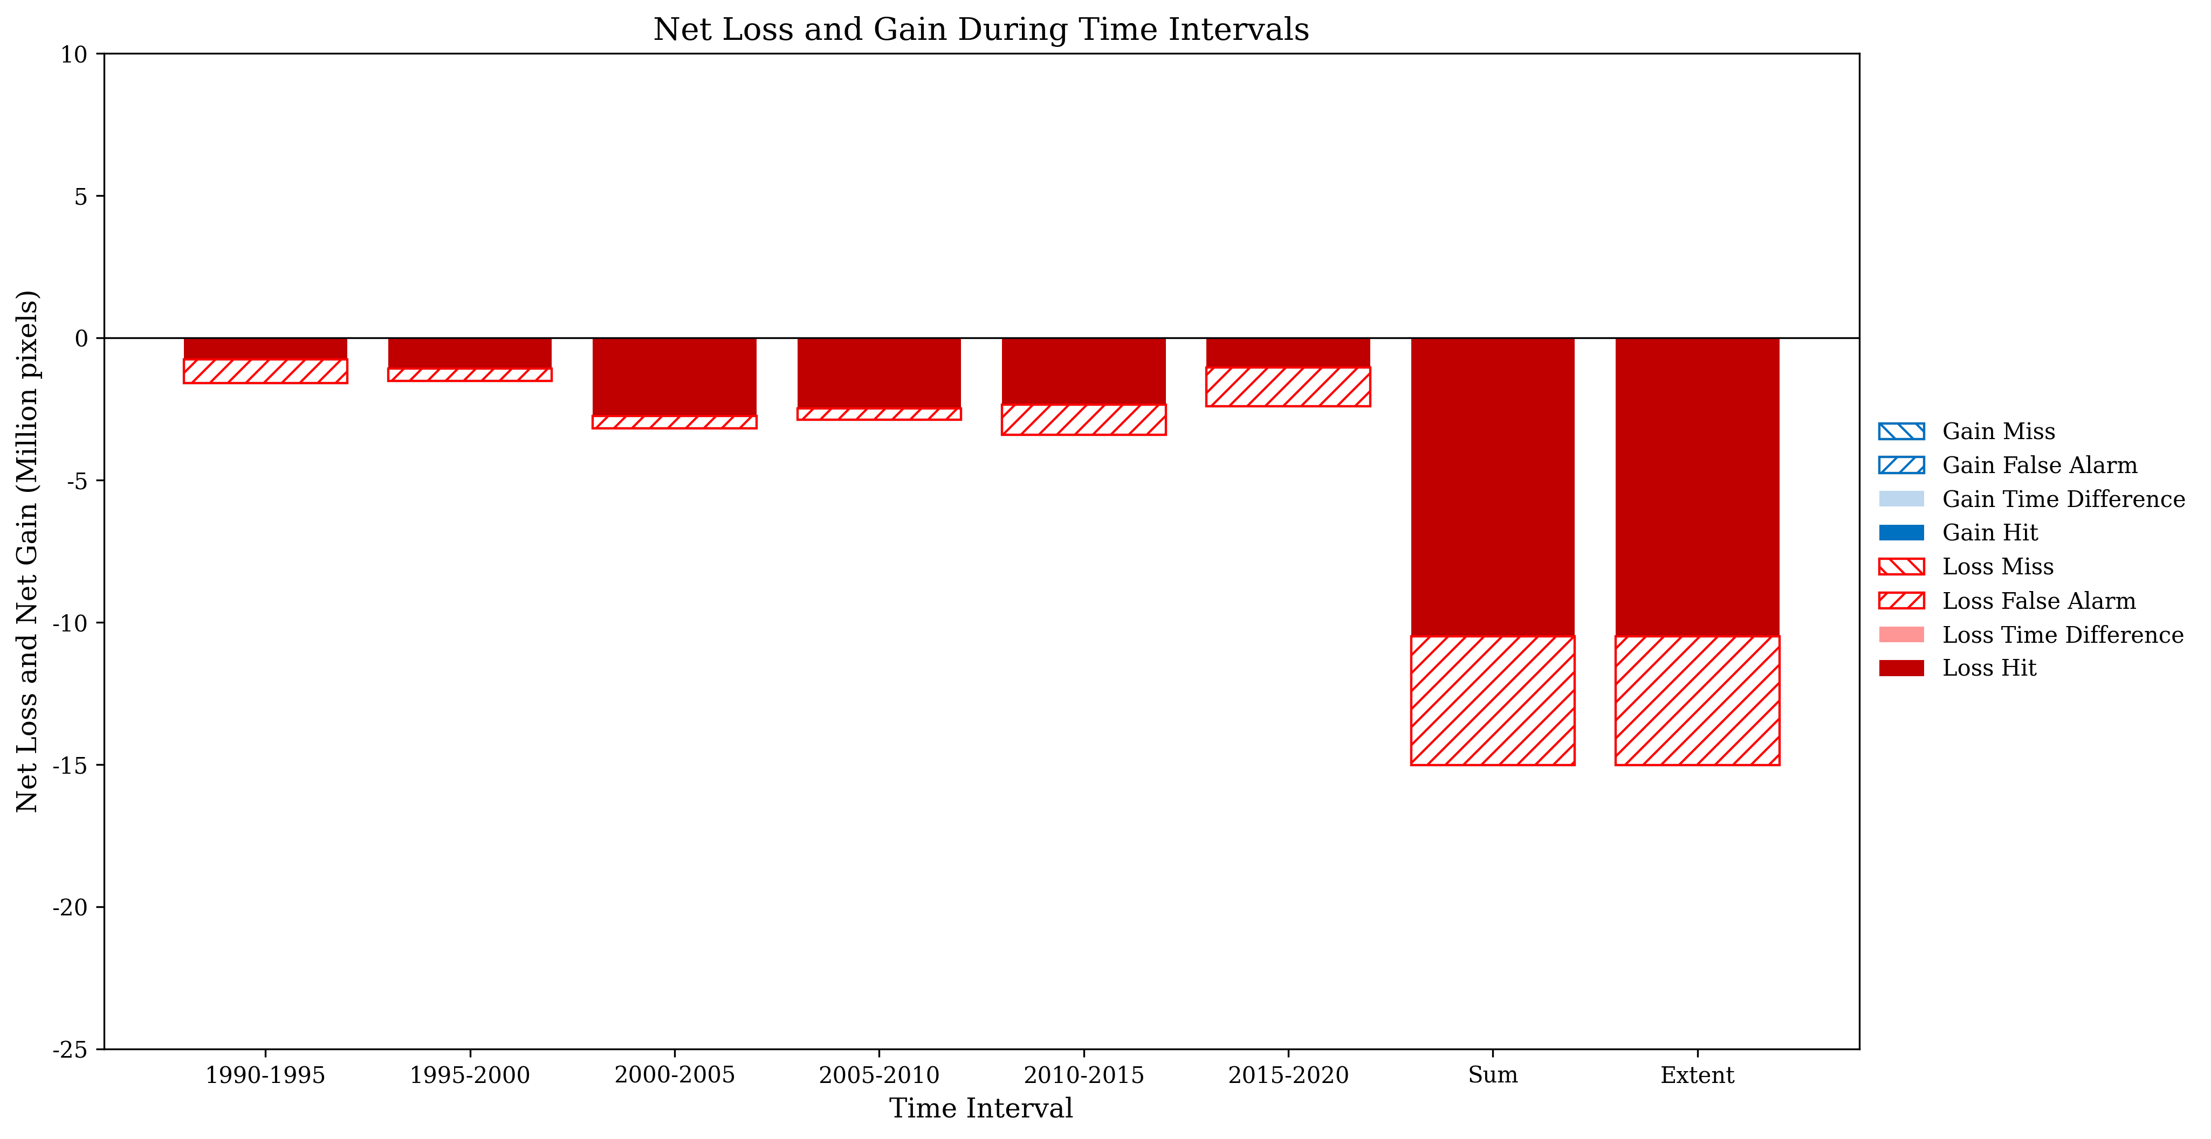
Net Losses and Net Gains graphics using Savanna class (Collection 6 and 8)

Slide 7
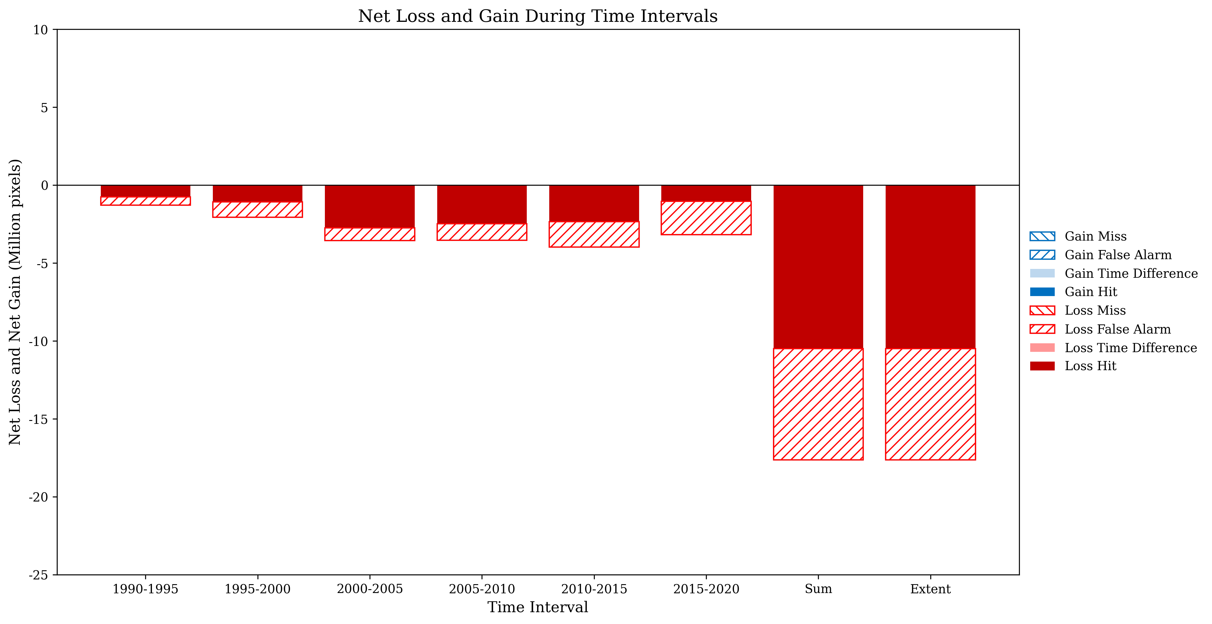
Net Losses and Net Gains graphics using Savanna class (Collection 6 and 10)

Slide 8
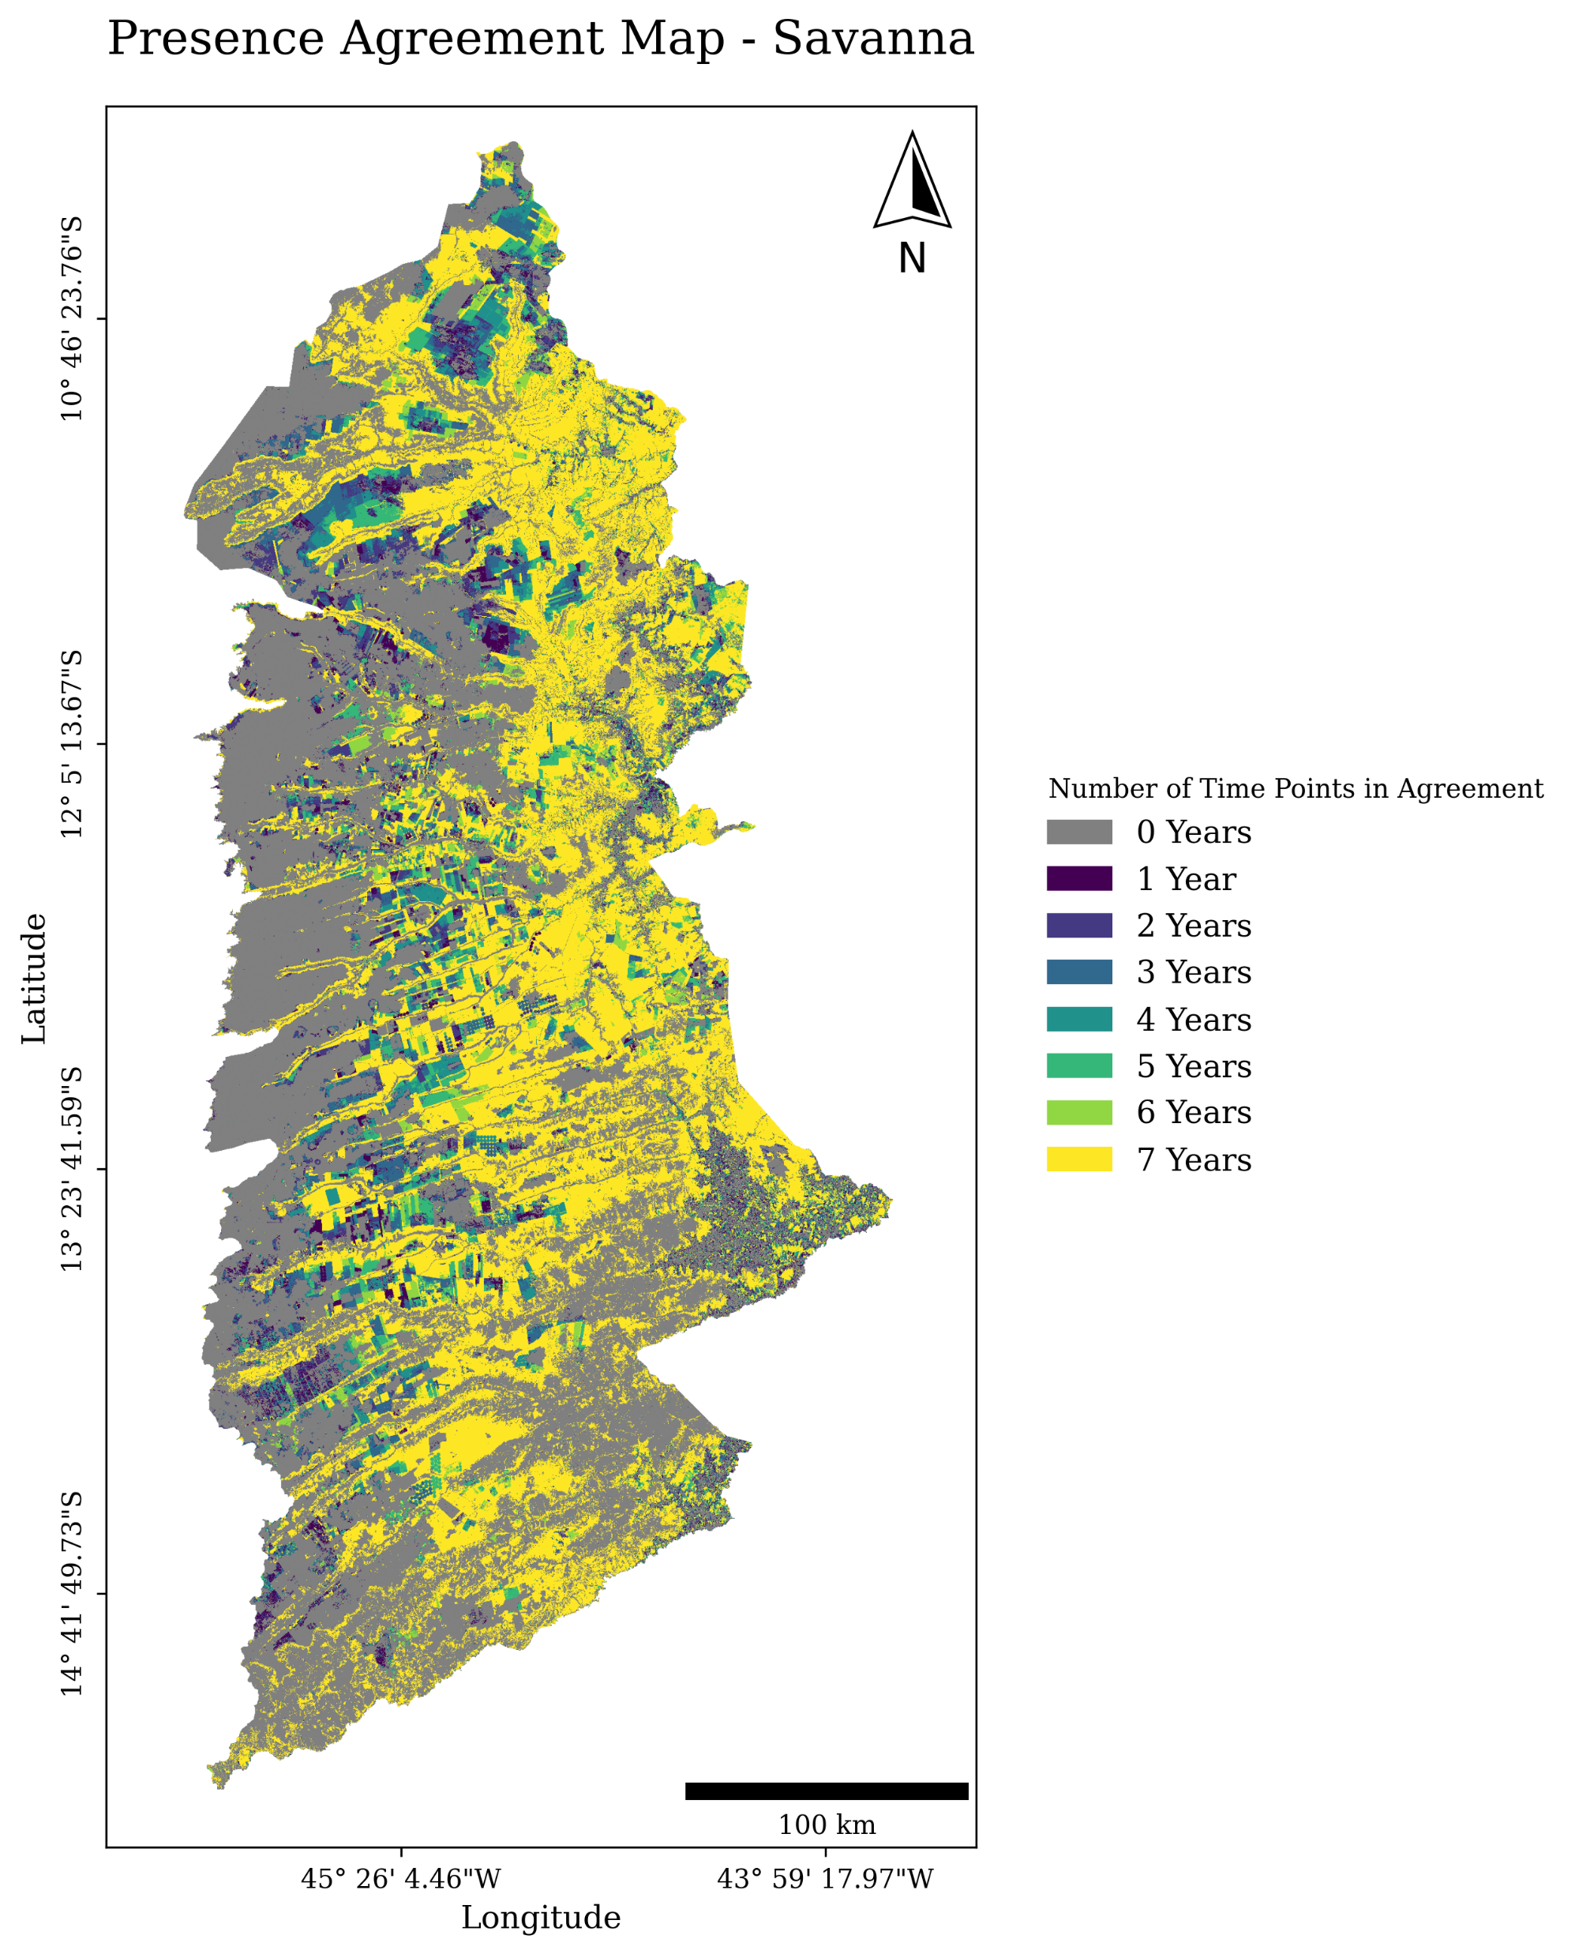
(Collection 6 and 8)

Slide 9
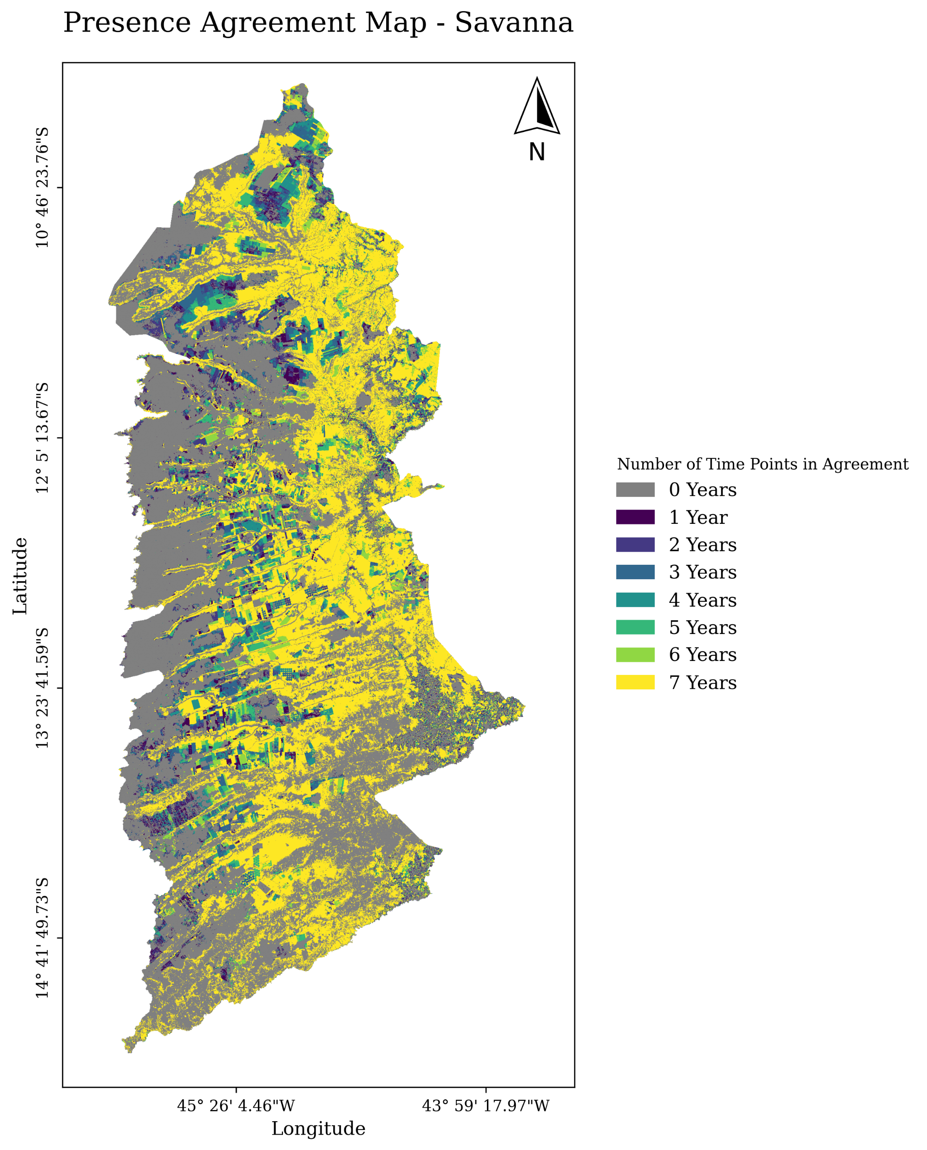
(Collection 6 and 10)

Slide 10
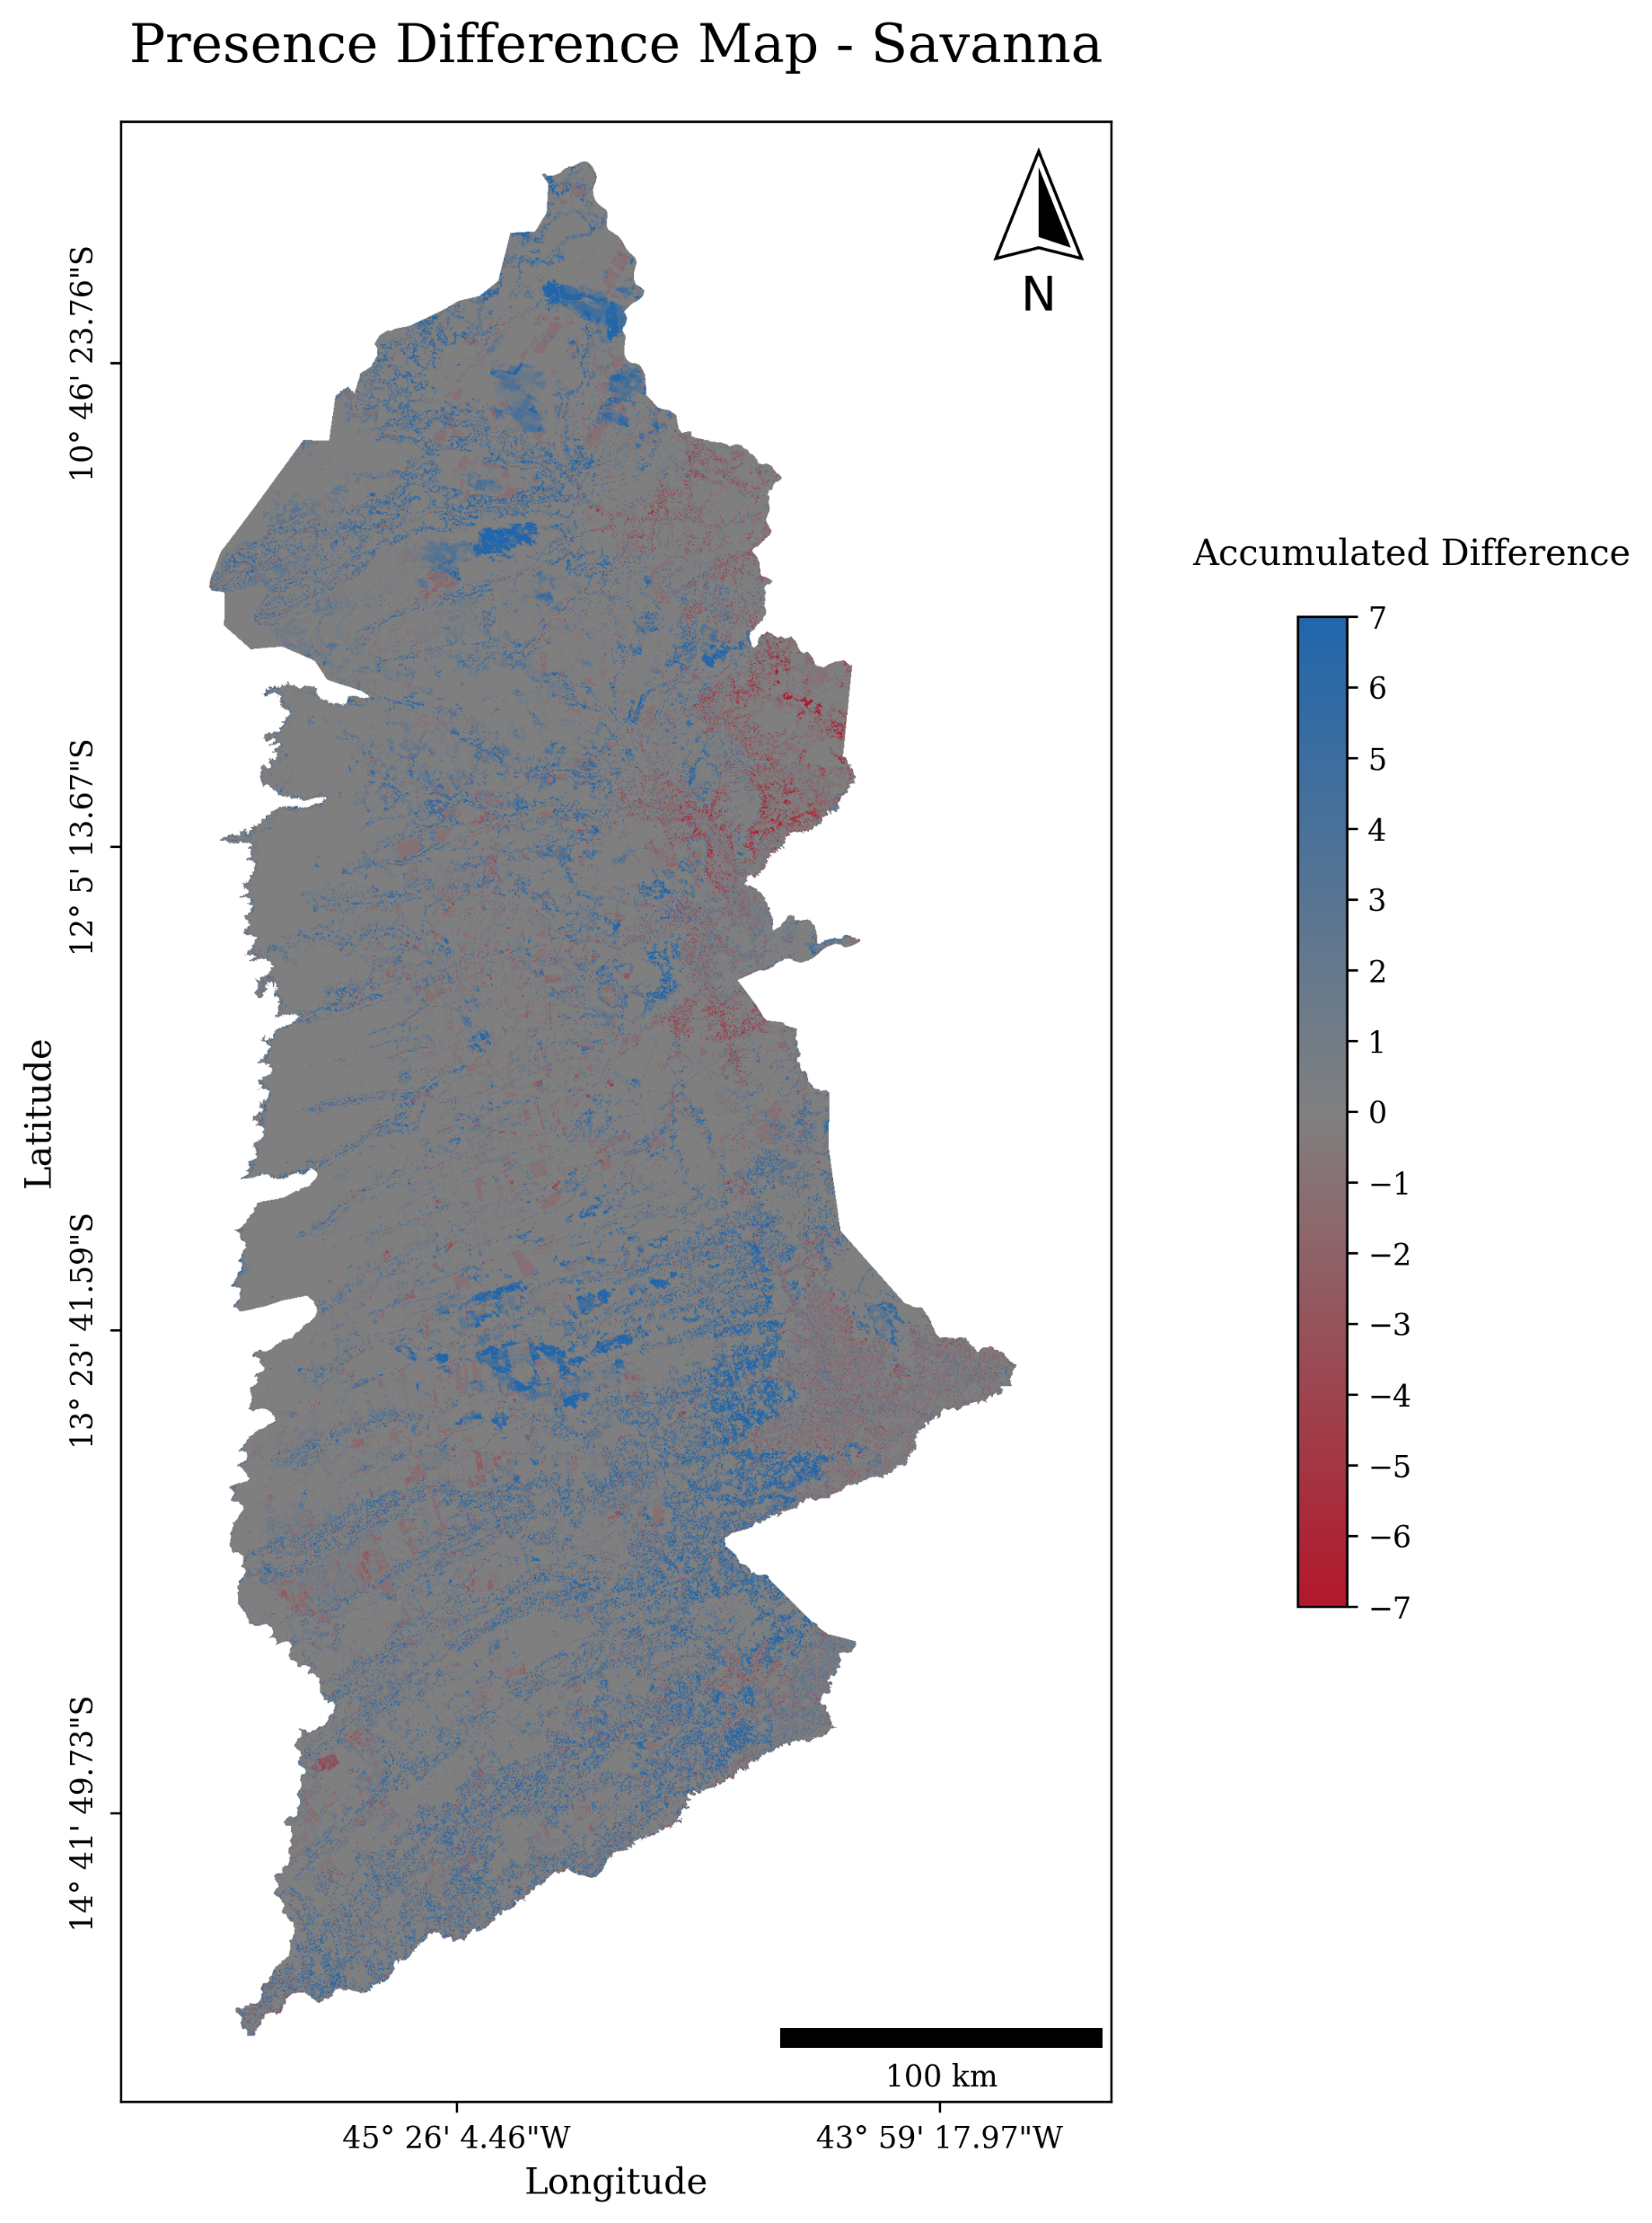
(Collection 6 and 8)

Slide 11

(Collection 6 and 10)

Slide 12
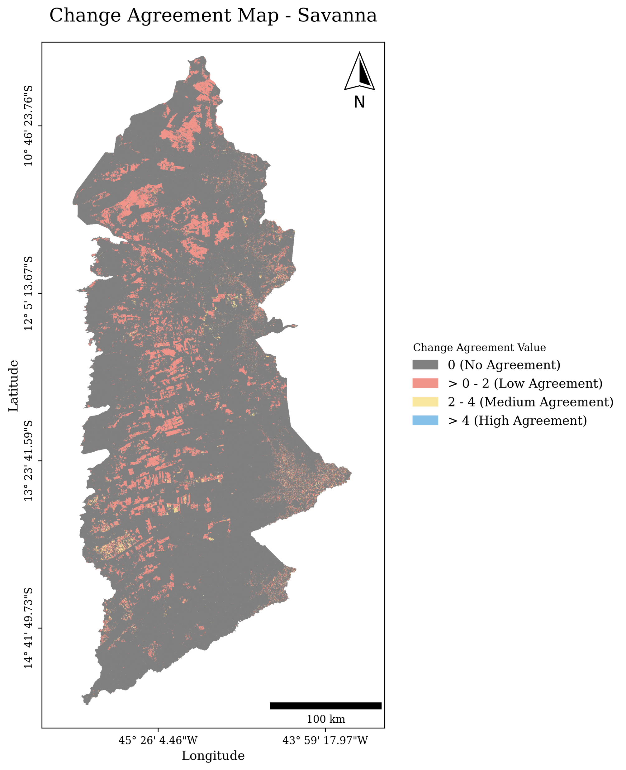
(Collection 6 and 8)

Slide 13

(Collection 6 and 10)

Slide 14
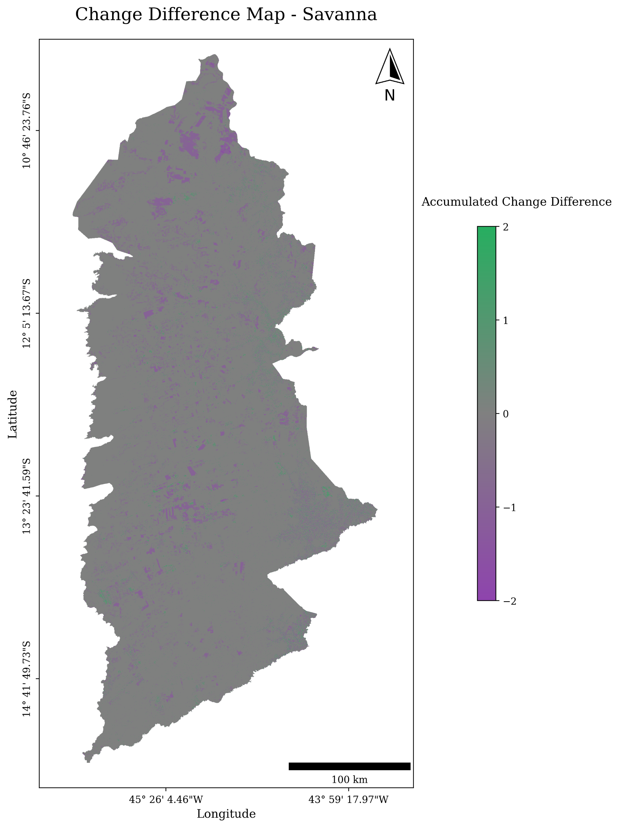
(Collection 6 and 8)

Slide 15
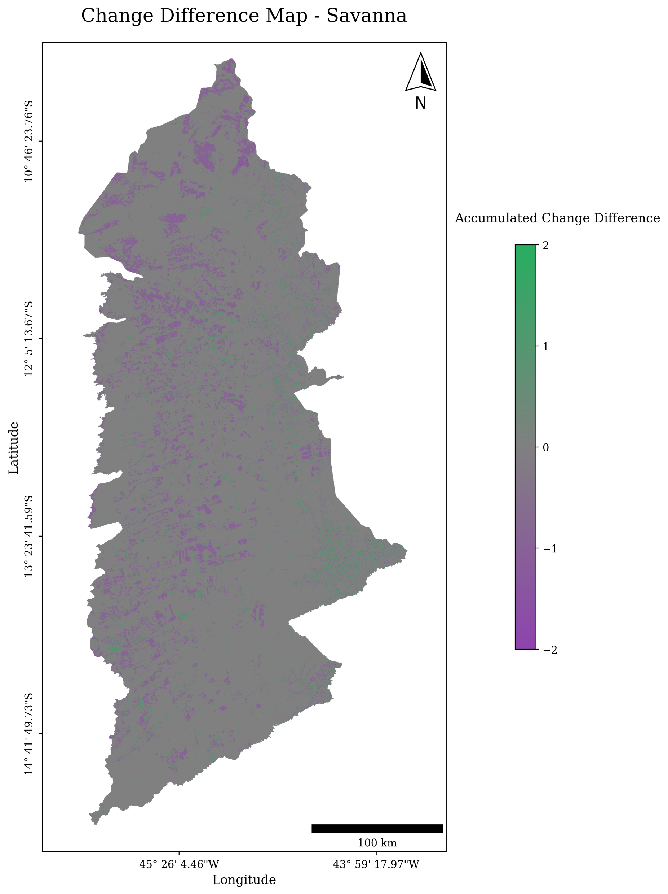
(Collection 6 and 10)

