Slide 1
Updates
I am glad you are eager to test with non-binary maps. You suggest MapBiomas Água Collections
I think MapBiomas has better variables to use as examples that have interesting maps for western Bahia.
I recently visited the MapBiomas website to find some interesting possibilities.
See Biomass under Pasture. See annual cropping frequency under Agriculture. See several variables under Fire. See several variables under Soil. Abbie Philips is looking into these variables.
I do not know for which of these variables we can compare collections.
See the figures 3-6 in CompareMain09.docx.
We need fonts, legends and palettes so that the reader can see the relevant information clearly when each of figure 3, 4, 5, and 6 is a figure on a page in a journal article’s PDF which the reader reads on a laptop computer.
Eliminate the lines from the format on slide 2 of validation_results2.pptx that shows the size of presence.
In the legend for the figures that have stacked bars, instead of misses, write y<x for presence and gain. Instead of misses, write |y|<|x| for loss. Instead of false alarms, write x>y for presence and gain. Instead of false alarms, write |x|>|y| for loss. Pontius does not know whether we should change the legend from Hits to Agreement. Hits is more specific than Agreement but Hits seems to be jargon

Slide 2
Toy Data

Slide 3
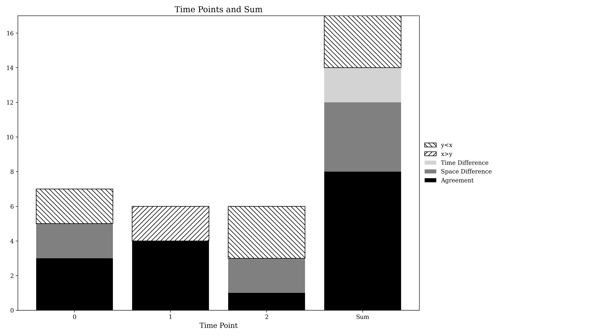
Presence Agreement graphic using Toy data
Please increase font size.
Please change from Agreement to Hits.
Label vertical axis as Presence.
Change from x>y to y>x.
Change from y<x to x>y.

Slide 4
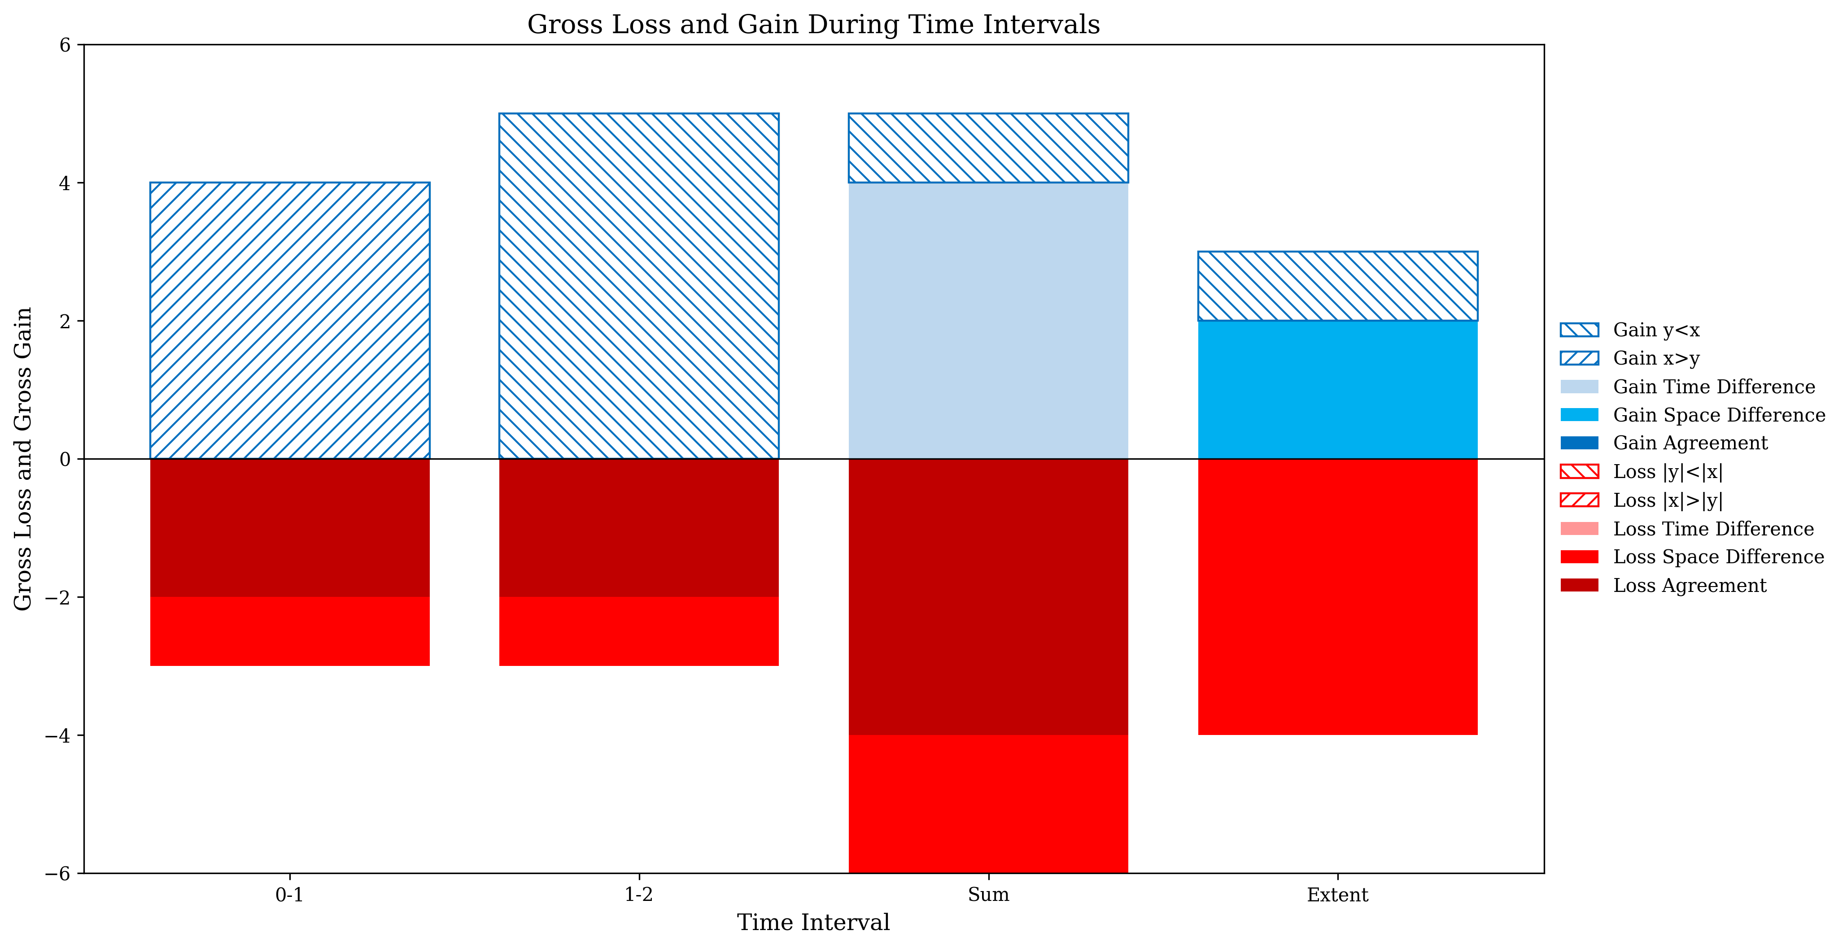
Gross Losses and Gross Gains graphic using Toy data
Please increase font size.
Please change from Agreement to Hits.
Change from Gain to Gross Gain in title.
Change from x>y to y>x.
Change from y<x to x>y.
Change from |x|>|y| to |y|>|x|.
Change from |y|<|x| to |x|>|y|.
Change from Extent to 0-1.

Slide 5
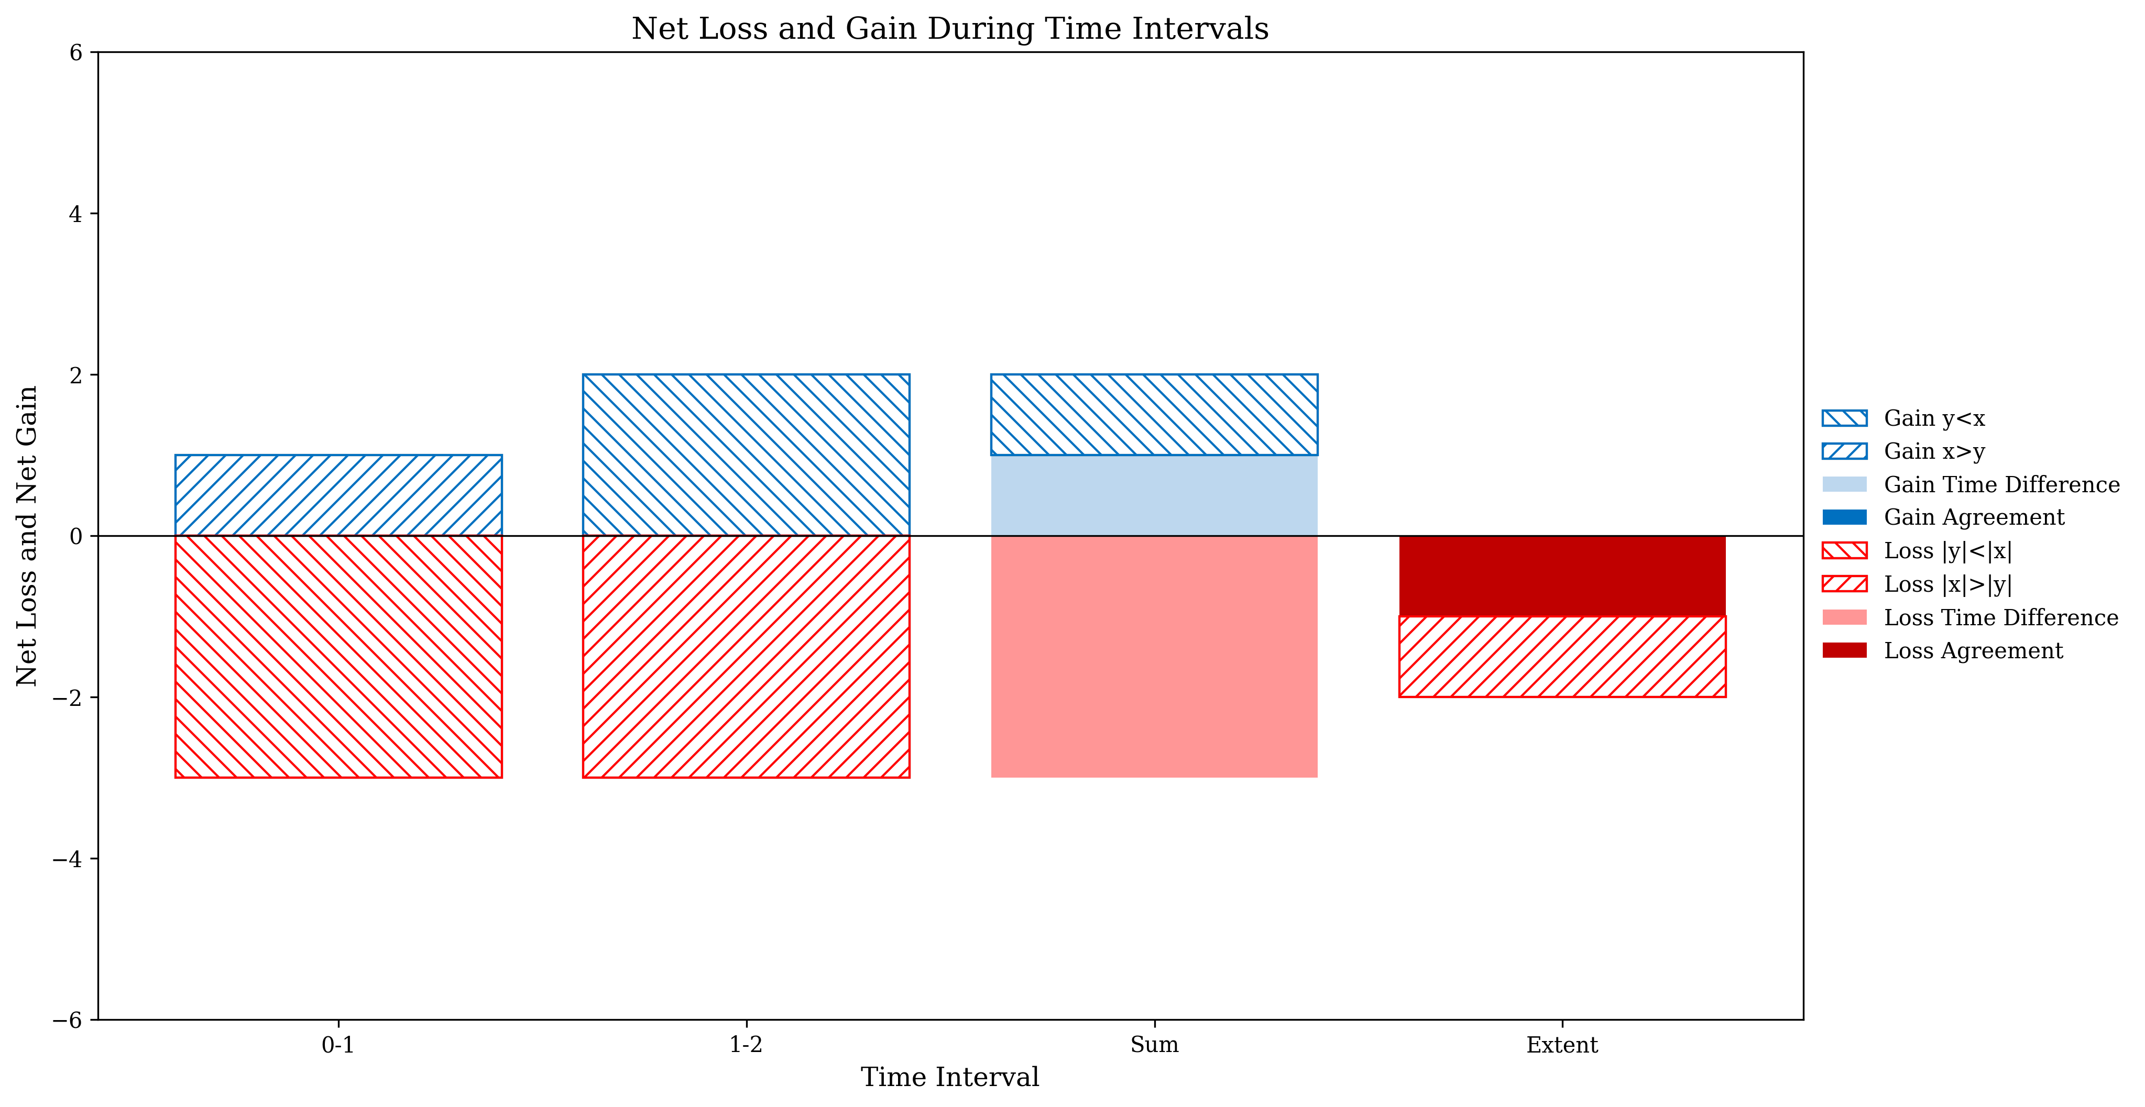
Net change graphic using Toy data
Please increase font size.
Please change from Agreement to Hits.
Change from Net Loss and Gain to Quantity Loss and Quantity Gain in title.
Change from Net to Quantity twice in axis label.
Change from x>y to y>x.
Change from y<x to x>y.
Change from |x|>|y| to |y|>|x|.
Change from |y|<|x| to |x|>|y|.
Change from Extent to 0-1.

Slide 6
Updates
Eliminate the lines from the format on slide 2 of validation_results2.pptx that shows the size of presence.
In the legend for the figures that have stacked bars, instead of misses, write y<x for presence and gain. Instead of misses, write |y|<|x| for loss. Instead of false alarms, write x>y for presence and gain. Instead of false alarms, write |x|>|y| for loss. Pontius does not know whether we should change the legend from Hits to Agreement. Hits is more specific than Agreement but Hits seems to be jargon

Slide 7
Savanna
MapBiomas Collection 6 and Collection 8

Slide 8
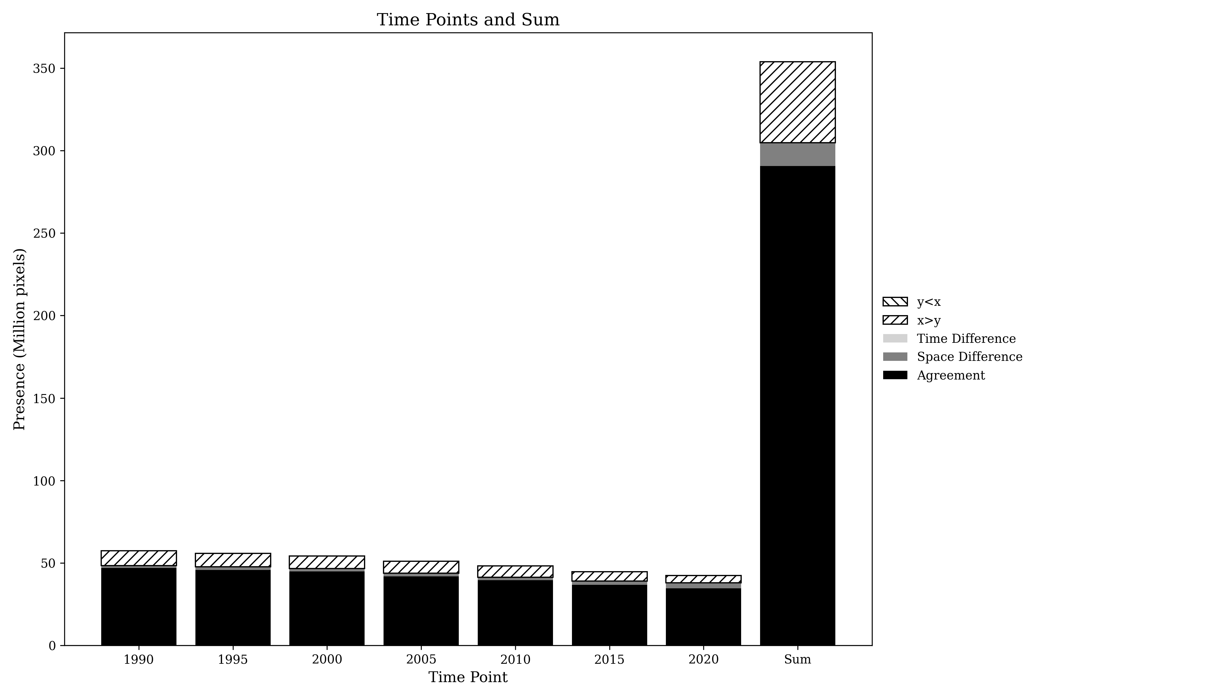
Presence Agreement graphic using Savanna class
Please increase font size.
Please change from Agreement to Hits.
Change from Million to million.
Change from x>y to y>x.
Change from y<x to x>y.

Slide 9
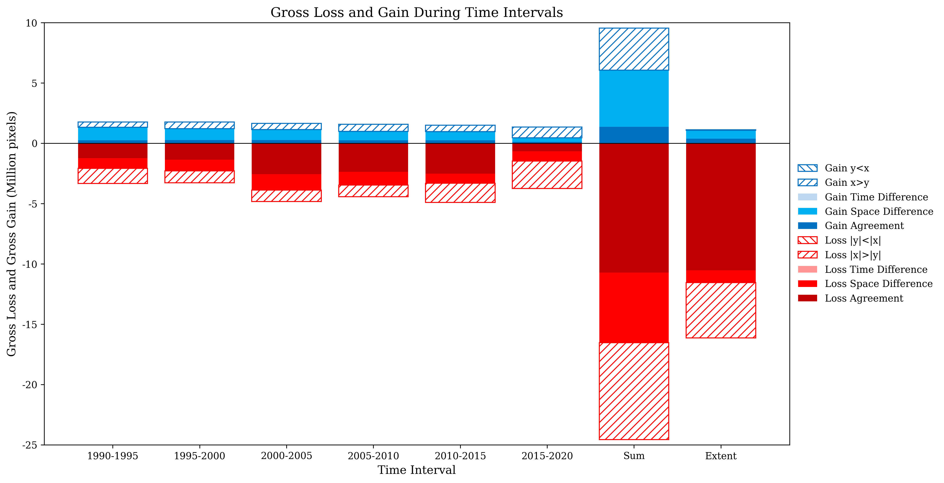
Gross Losses and Gross Gains graphics using Savanna class
Please increase font size.
Please change from Agreement to Hits.
Change from Million to million.
Change from Gain to Gross Gain in title.
Change from x>y to y>x.
Change from y<x to x>y.
Change from |x|>|y| to |y|>|x|.
Change from |y|<|x| to |x|>|y|.
Change from Extent to 1990-2020.

Slide 10
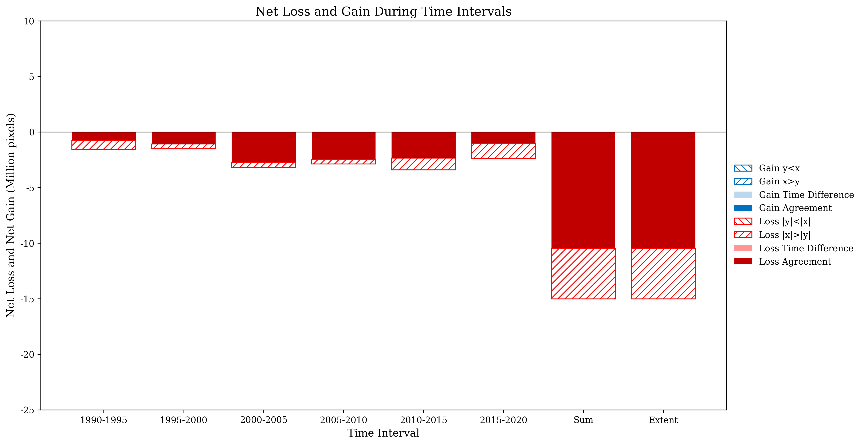
Net Losses and Net Gains graphics using Savanna class
Please increase font size.
Please change from Agreement to Hits.
Change from Million to million.
Change from Net Loss and Gain to Quantity Loss and Quantity Gain in title.
Change from Net to Quantity twice in axis label.
Change from x>y to y>x.
Change from y<x to x>y.
Change from |x|>|y| to |y|>|x|.
Change from |y|<|x| to |x|>|y|.
Change from Extent to 1990-2020.

Slide 11
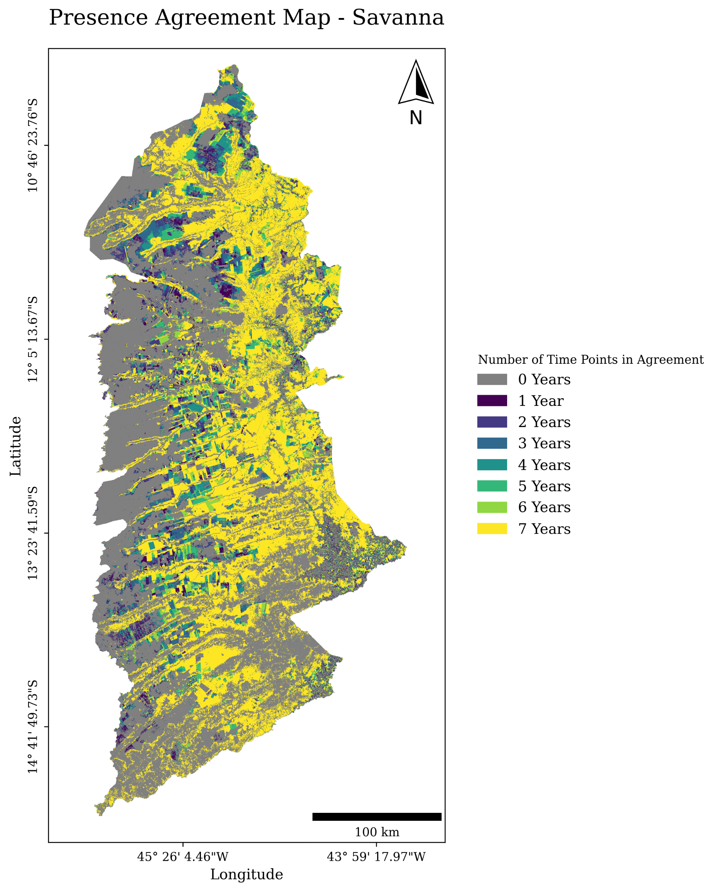
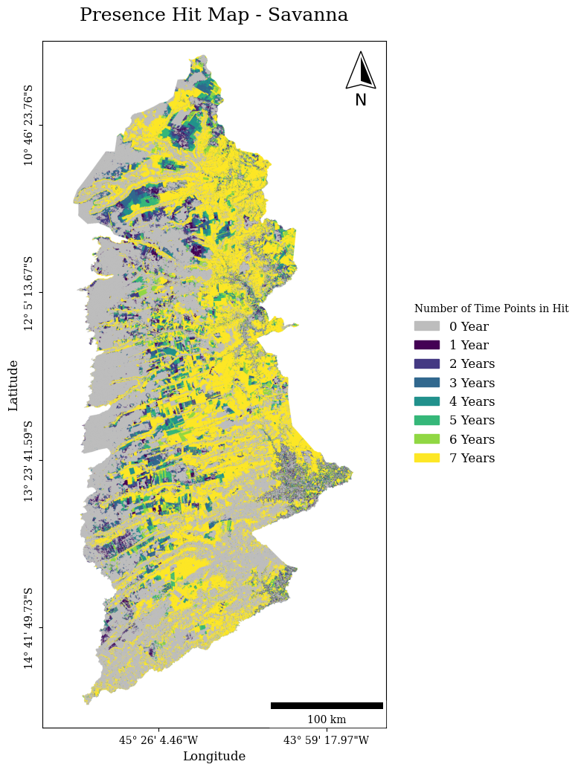
Old Version
New Version
Change from “Hit Map” to “Hits” in title.
Legend should change from “Number of Time Points in Hit” to “Sum of Hits”.
Eliminate years from legend because the legend already says time points. The time points might be months or days.
We want the code to be sufficiently general to apply to cases where the hits are not the number of time points for when the variable is not binary.
I am glad your code uses discrete legend for binary data and continuous for continuous data.

Slide 12
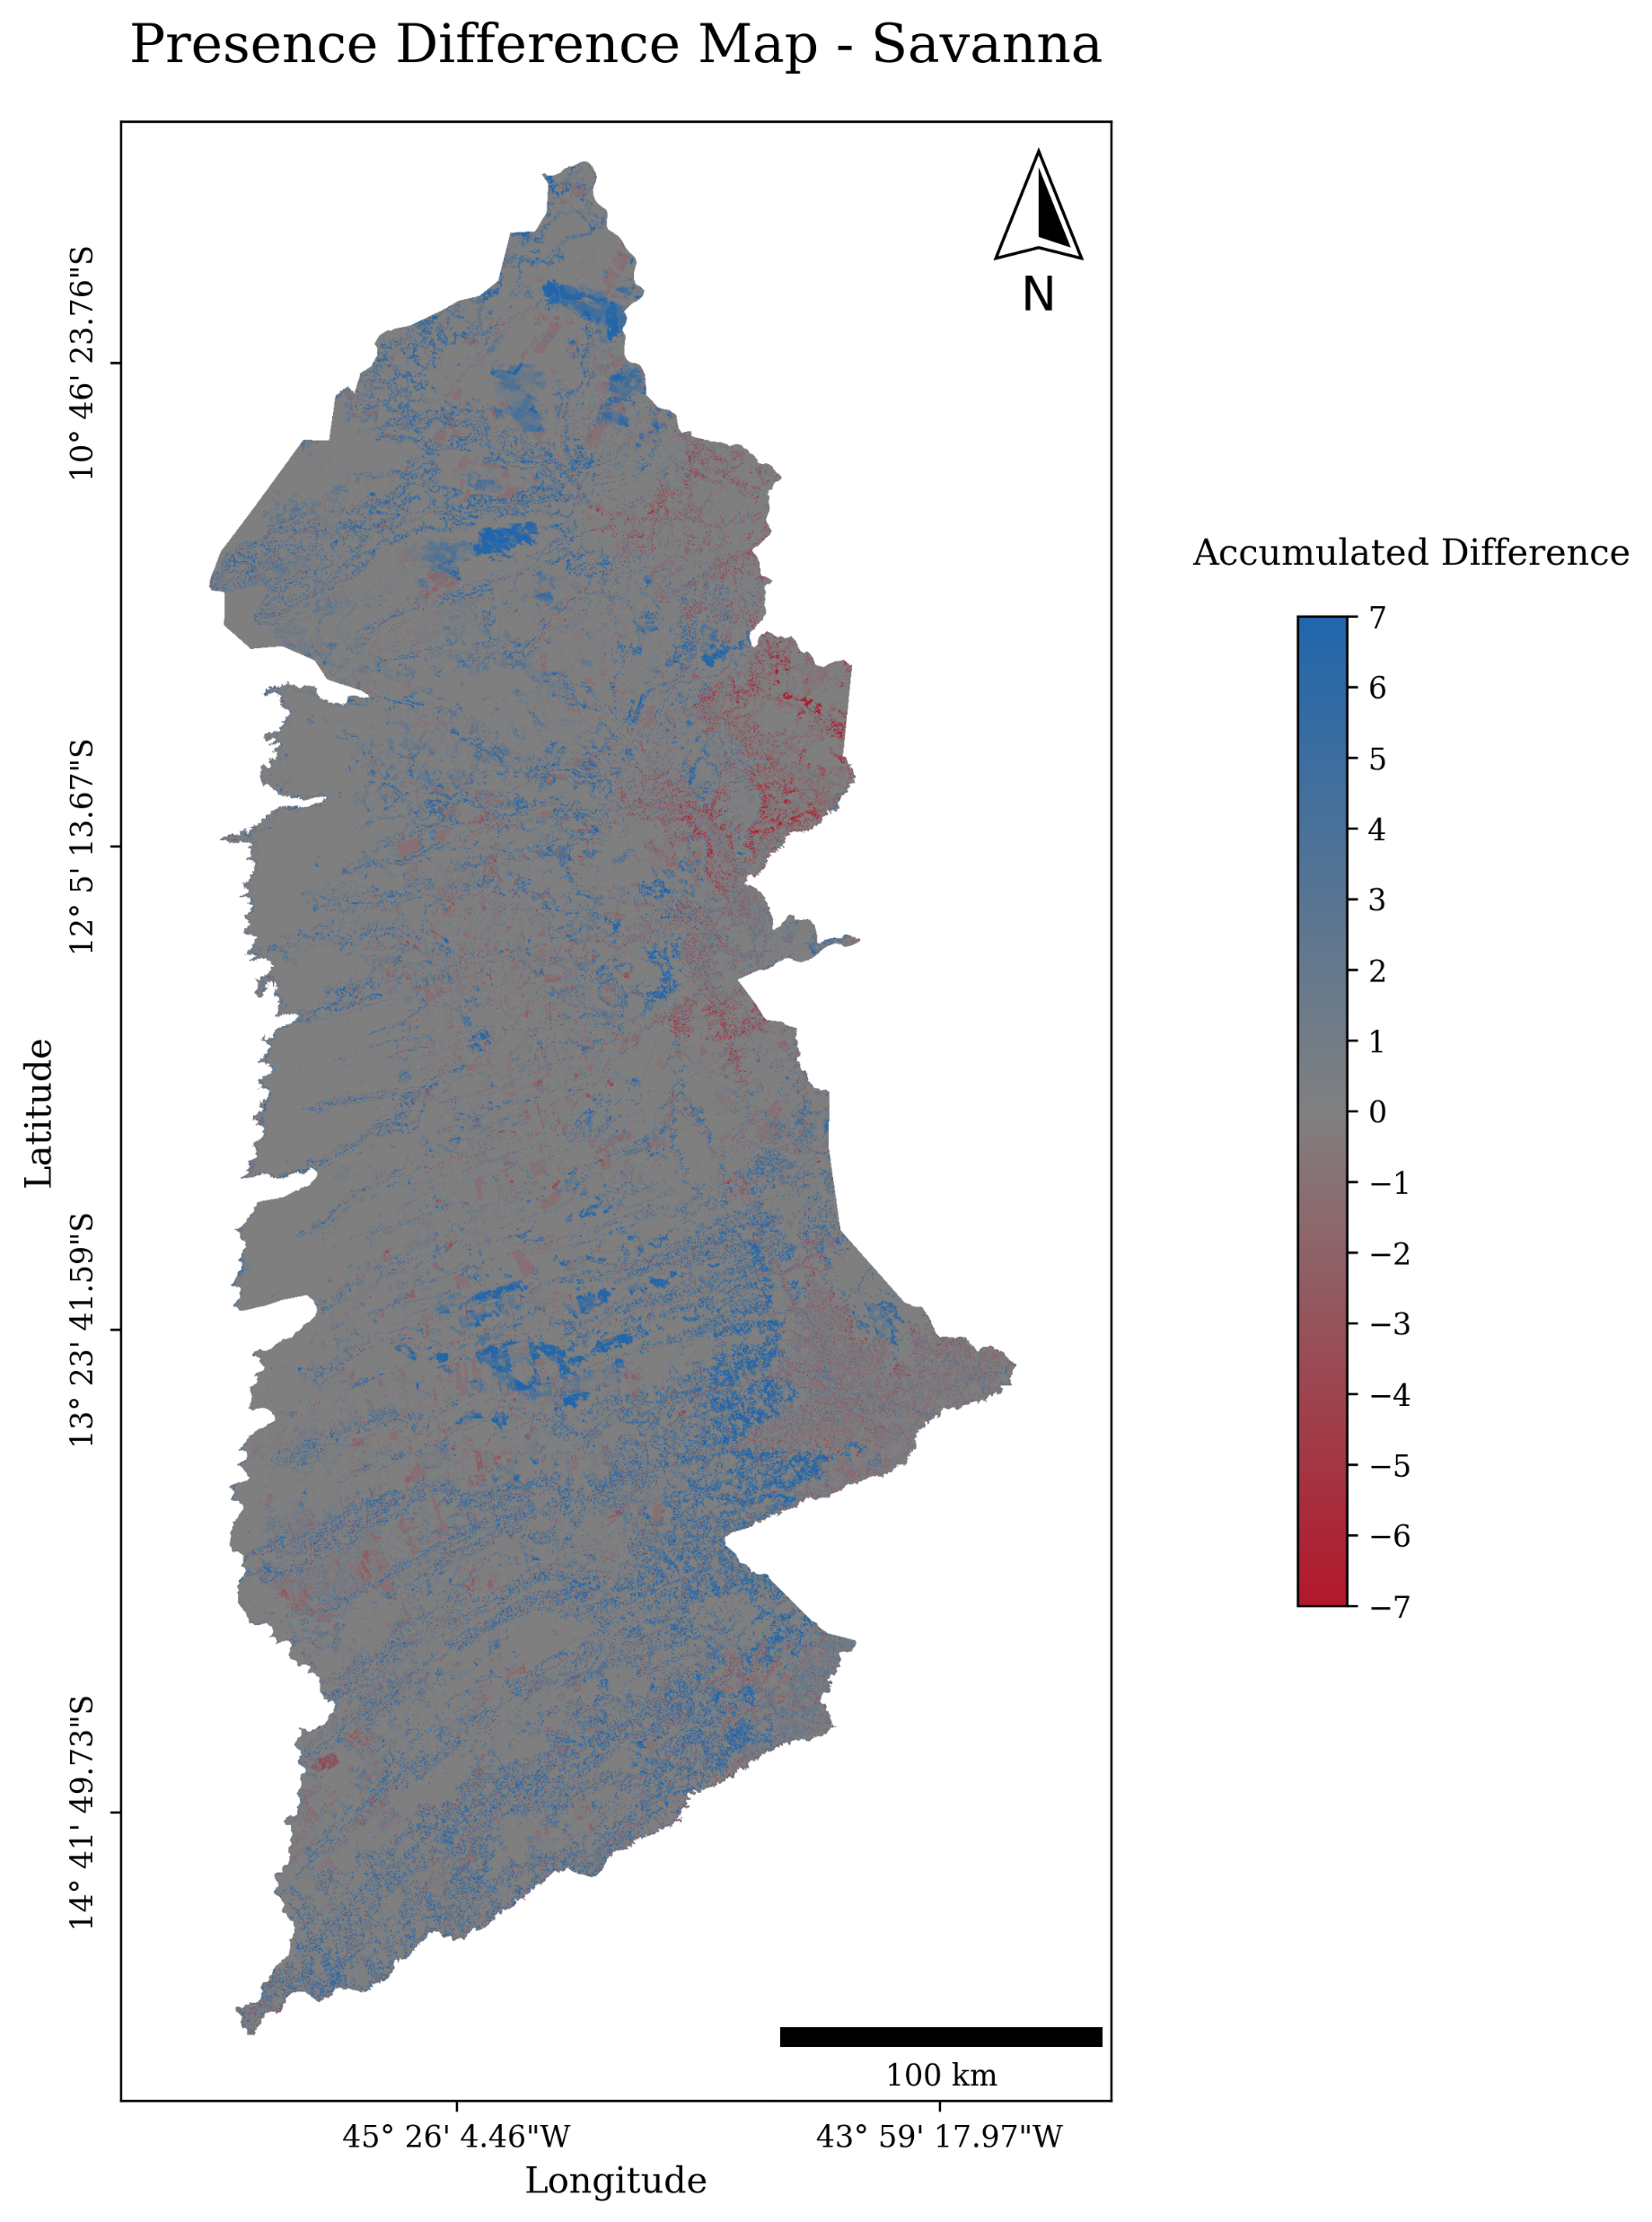
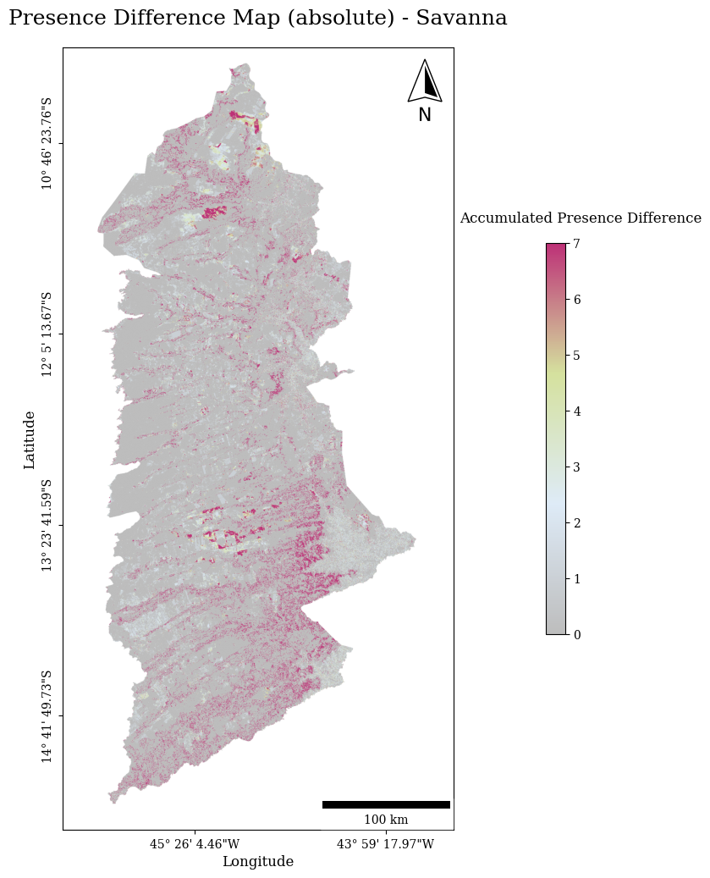
Old Version
New Version
We should keep both of these maps.
Title for map on left is “Presence Difference – Savanna” which is equation 50 in CompareMain09.docx .
Legend for map on left is Difference.
Title for map on right is “Presence Absolute Difference – Savanna” which is equation 51 in CompareMain09.docx.
Legend for map on right is Absolute Difference.
Pontius is not convinced that the map on the right is computed properly.
The absolute difference must be greater than or equal to difference, but it looks like some pixels show the opposite, but maybe I am fooled by the colors in the legend .
It seems it would make more sense to have the legend on the right use darker blue for larger numbers, similar to the map on the left. Make the legend monotonic from light to dark.
Here the data are binary, so the legend could be discrete which could allow more color variation.

Slide 13
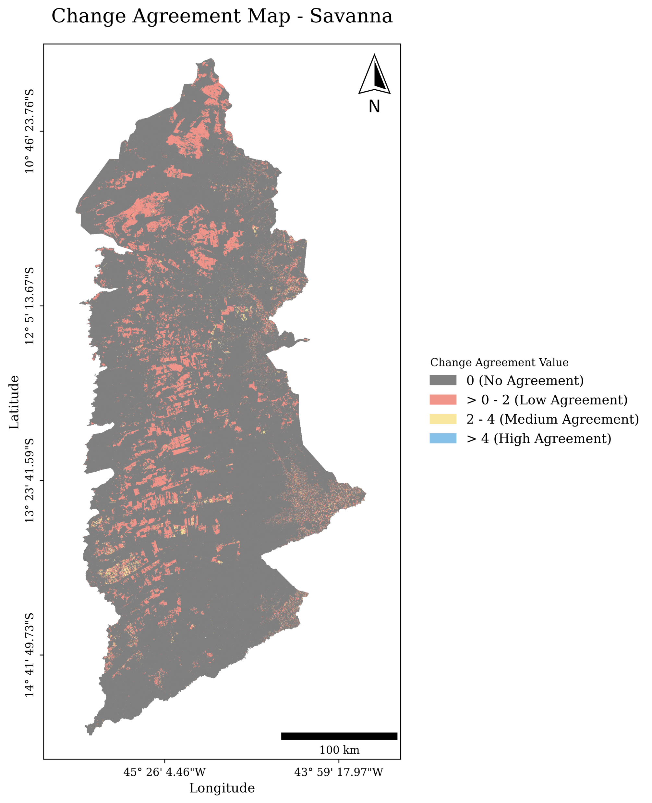
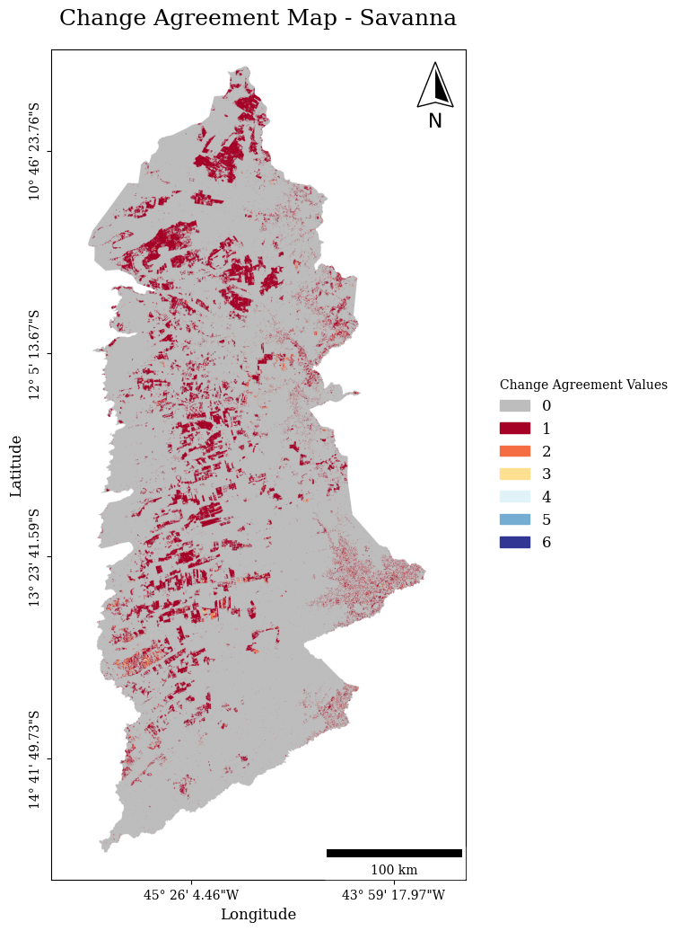
Old Version
New Version
Change from “Agreement Map” to “Hits” in title.
Legend should change from “Change Agreement Values” to “Sum of Hits”.
It is nice that the legend is discrete for this binary variable.
The legend should be a continuum for a continuous variable.
Please test the program with the continuous toy data to make maps with the toy data of two pixels to test that the legend becomes continuous for continuous data.

Slide 14
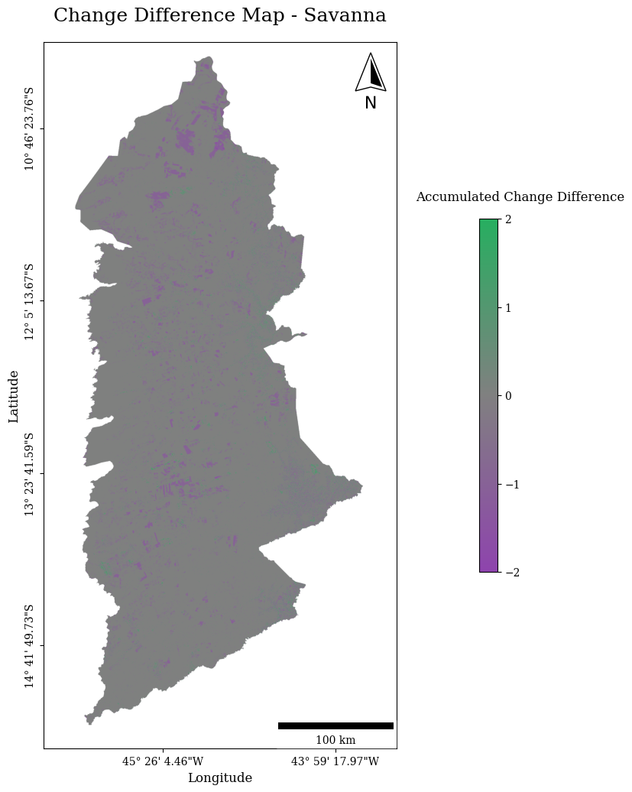
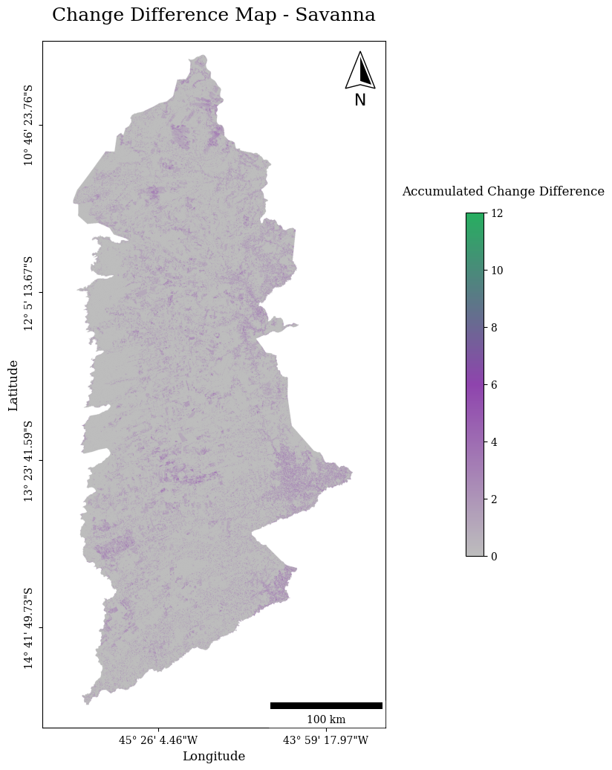
Old Version
New Version
We should keep both of these maps.
Title for map on left is “Change Difference – Savanna” which is equation 53 in CompareMain09.docx .
Legend for map on left is Difference.
Title for map on right is “Change Absolute Difference – Savanna” which is equation 54 in CompareMain09.docx.
Legend for map on right is Absolute Difference.
The color legend on the right is poor. We have a one dimensional non-negative variable, so we should not use three colors.
Use colors in the legend that match the color logic in slide 12. Pontius likes blue to be positive and red to be negative.
It is a good idea to automate the legend to be discrete for a binary variable and continuous for a continuous variable.
The main problem with these maps is that there is so much gray and very little visual variation.
If the legend were discrete, then we could control the colors better thus see the patterns better.

Slide 15
PIE water time series data
Pixel-based method and object-based

Slide 16
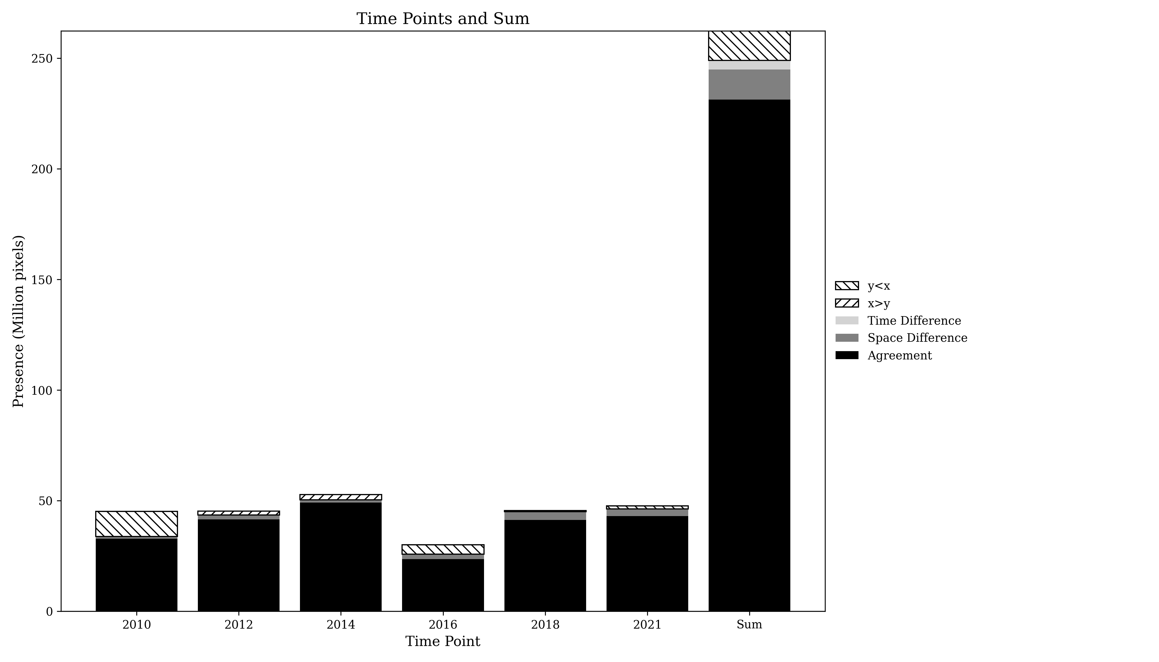
Presence Agreement graphic using PIE data

Slide 17
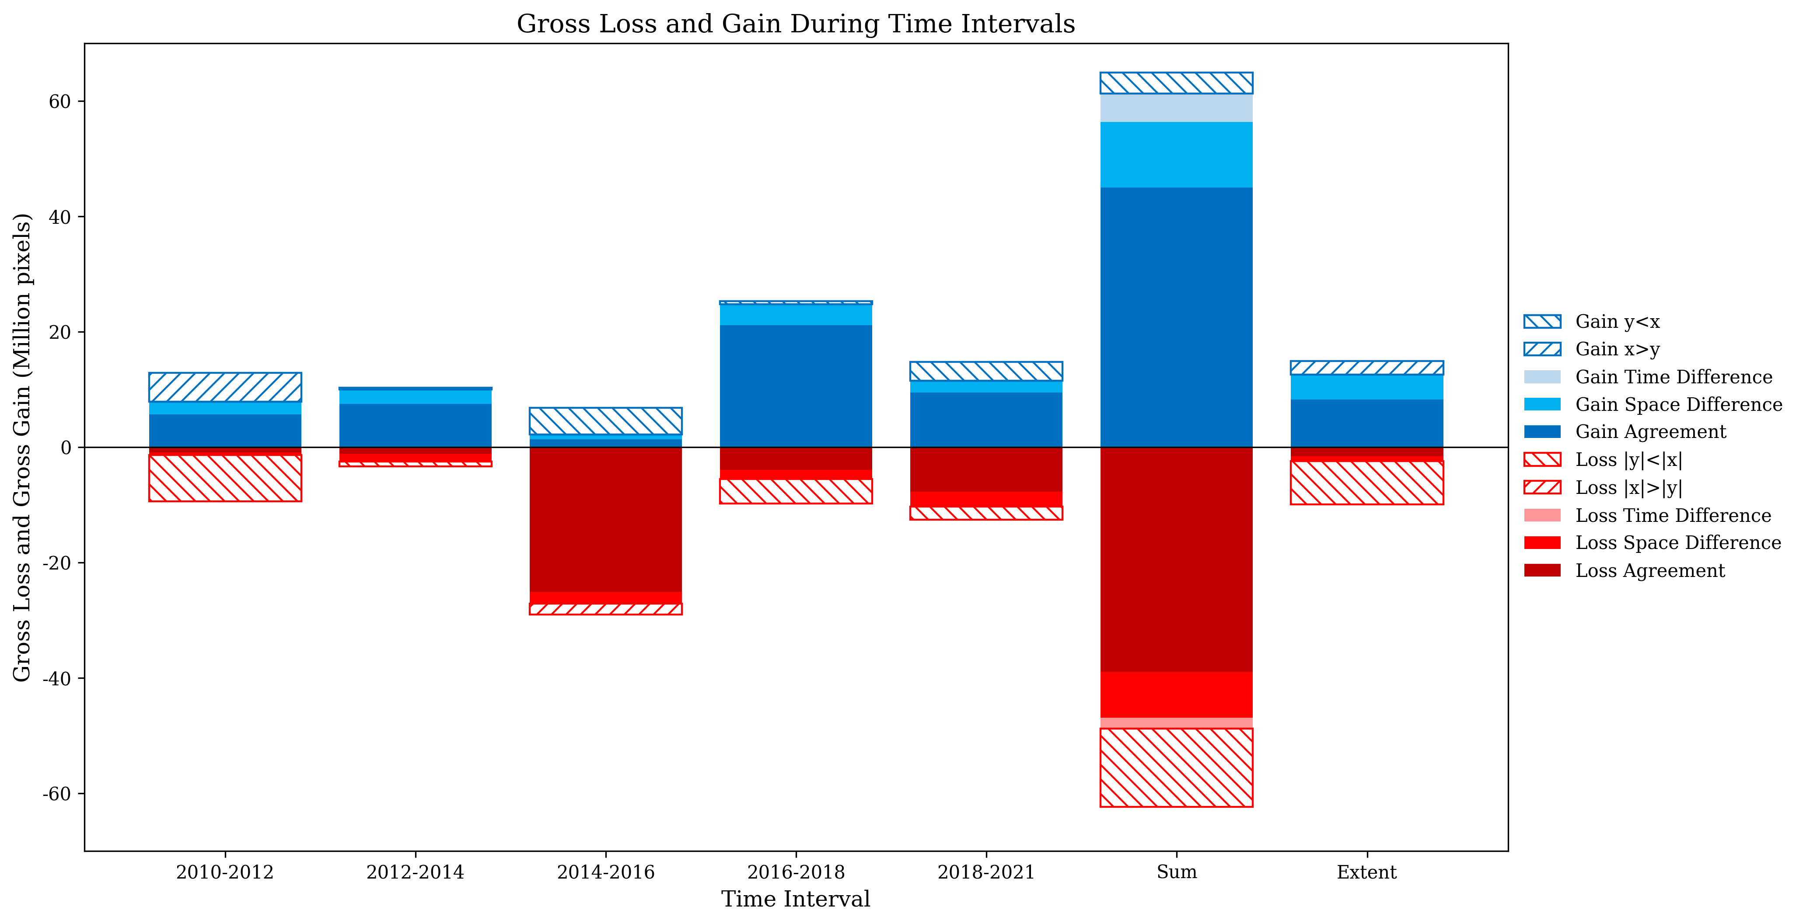
Gross Losses and Gross Gains graphics using PIE data

Slide 18
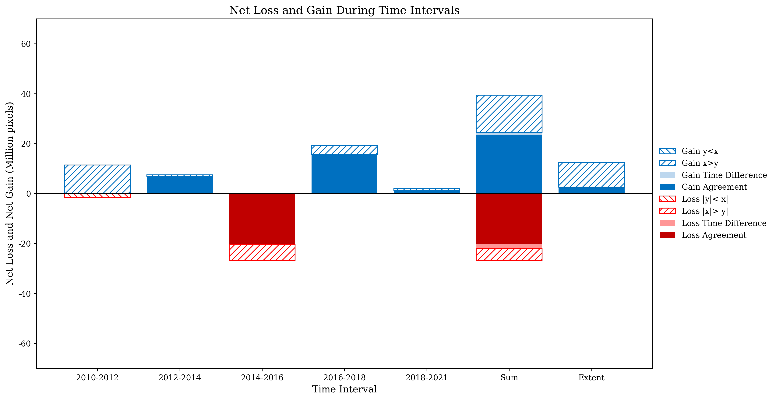
Net Losses and Net Gains graphics using PIE data

Slide 19
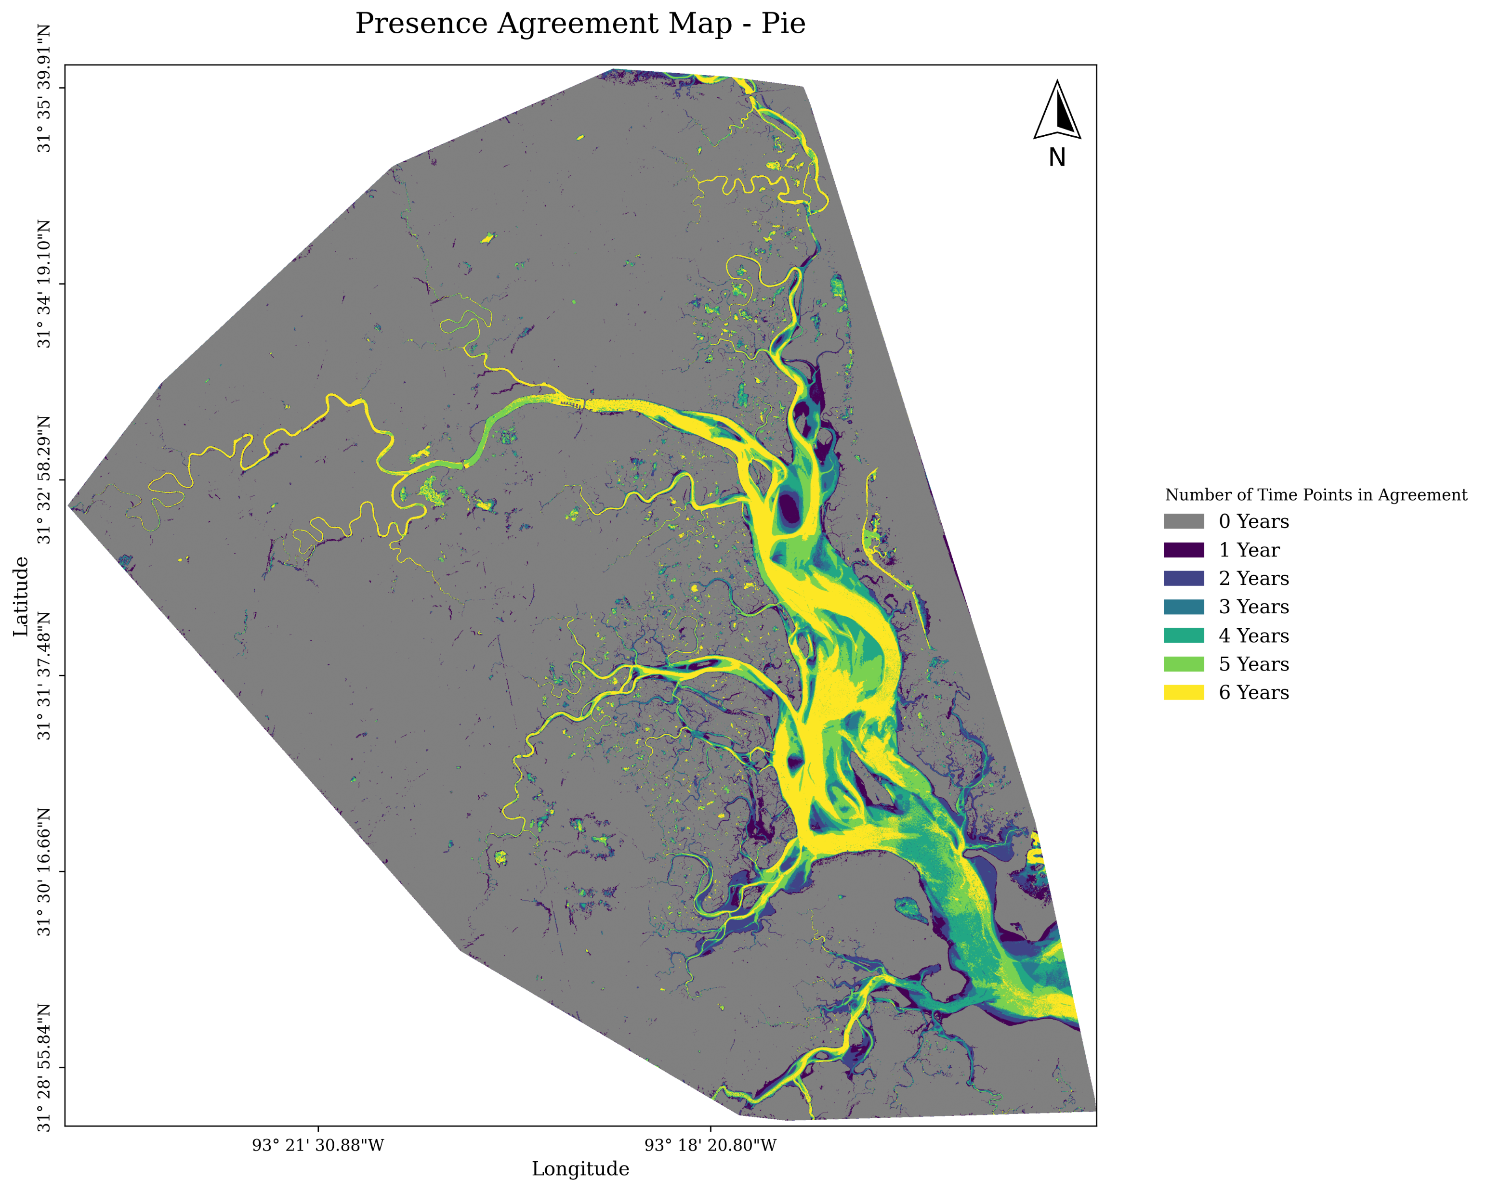
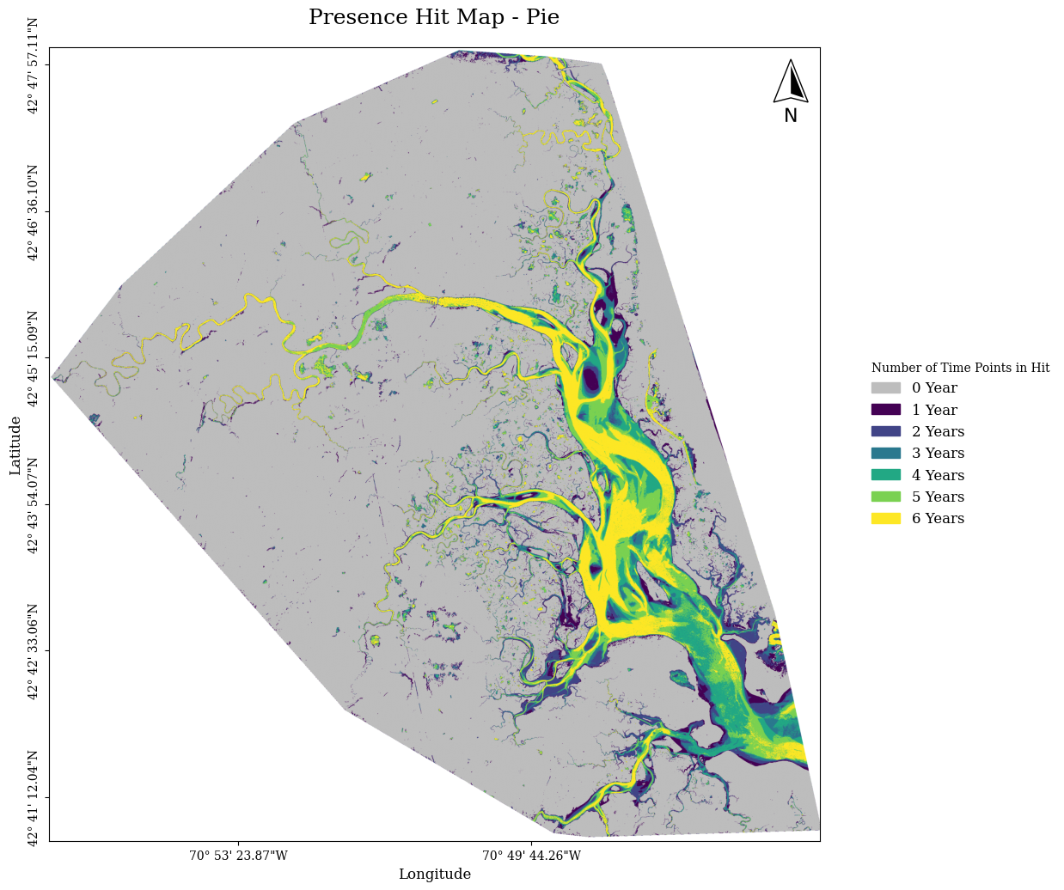
Old Version
New Version

Slide 20
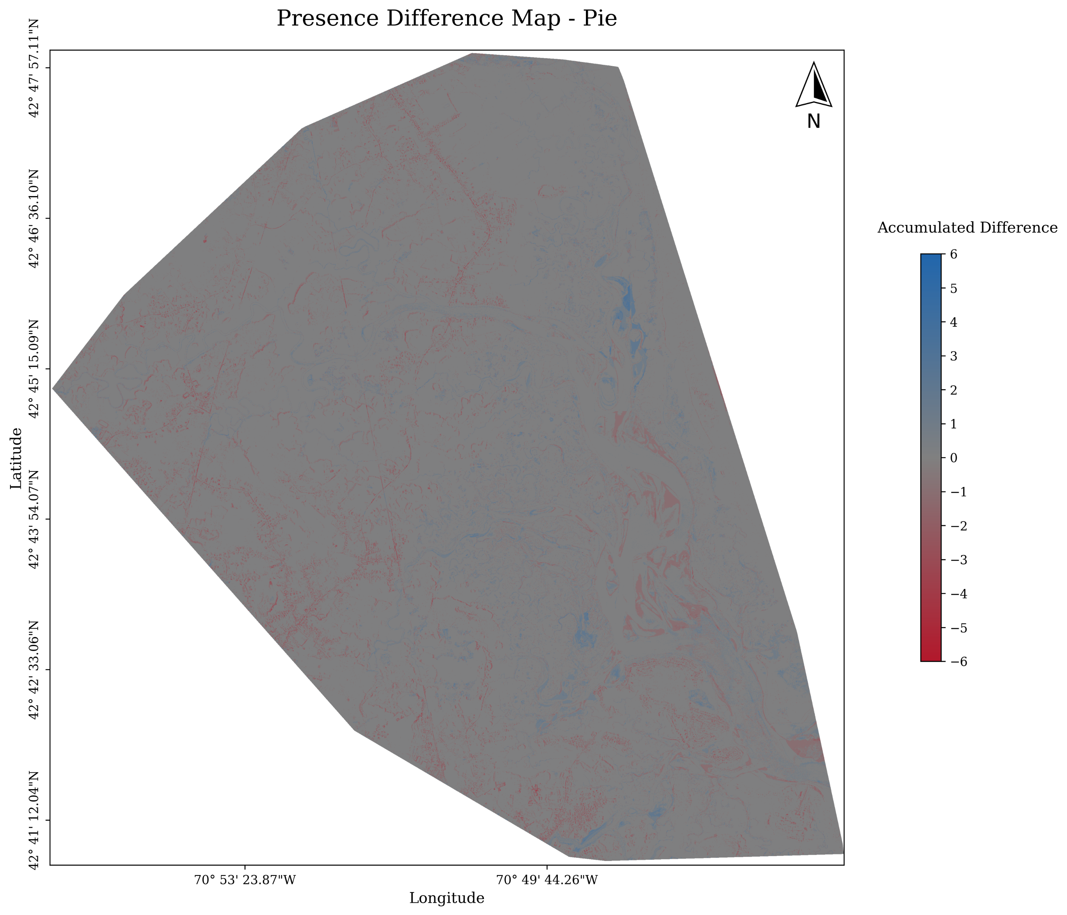
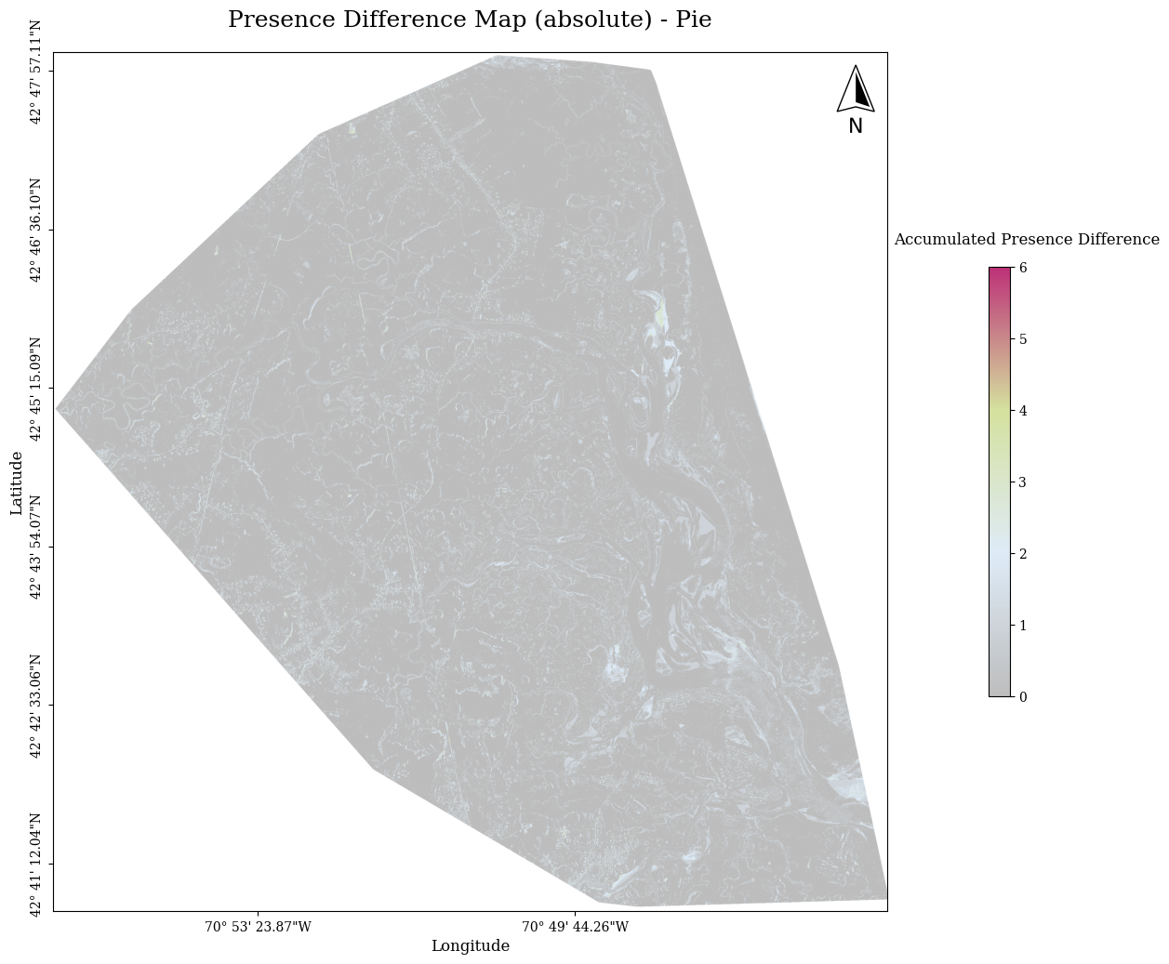
Old Version
New Version

Slide 21
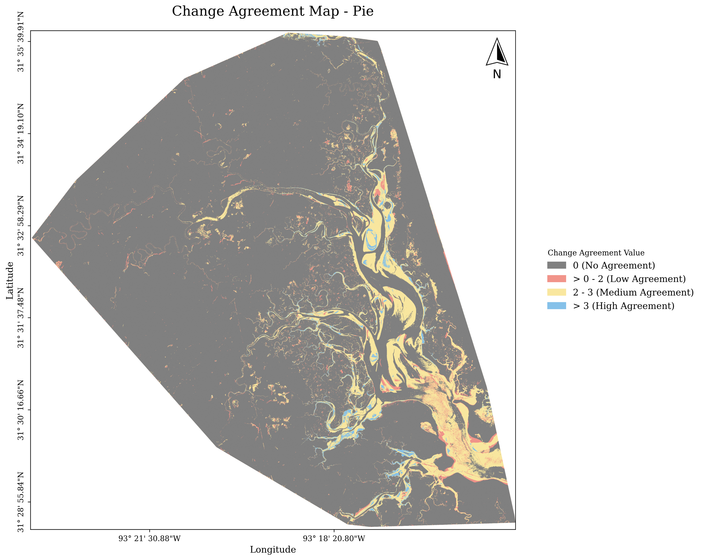
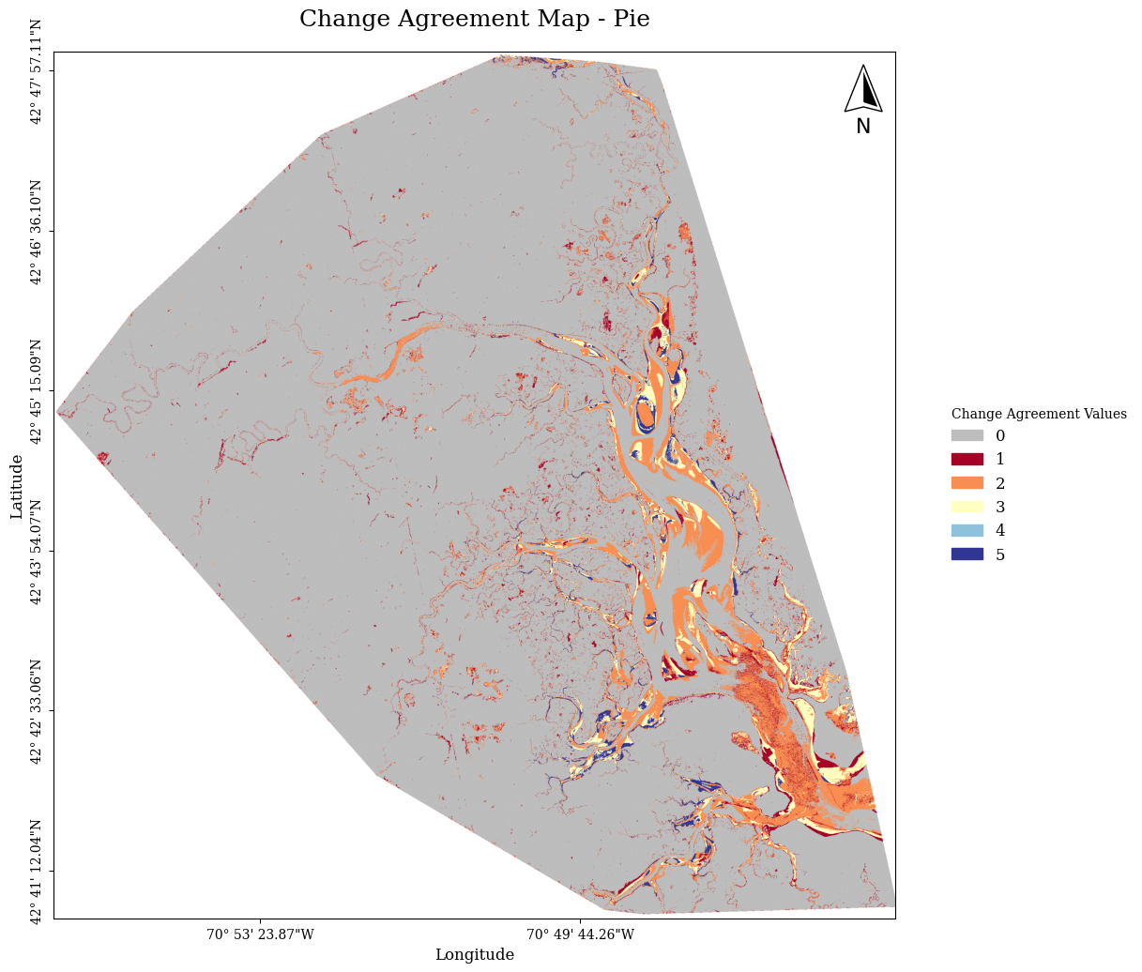
Old Version
New Version

Slide 22
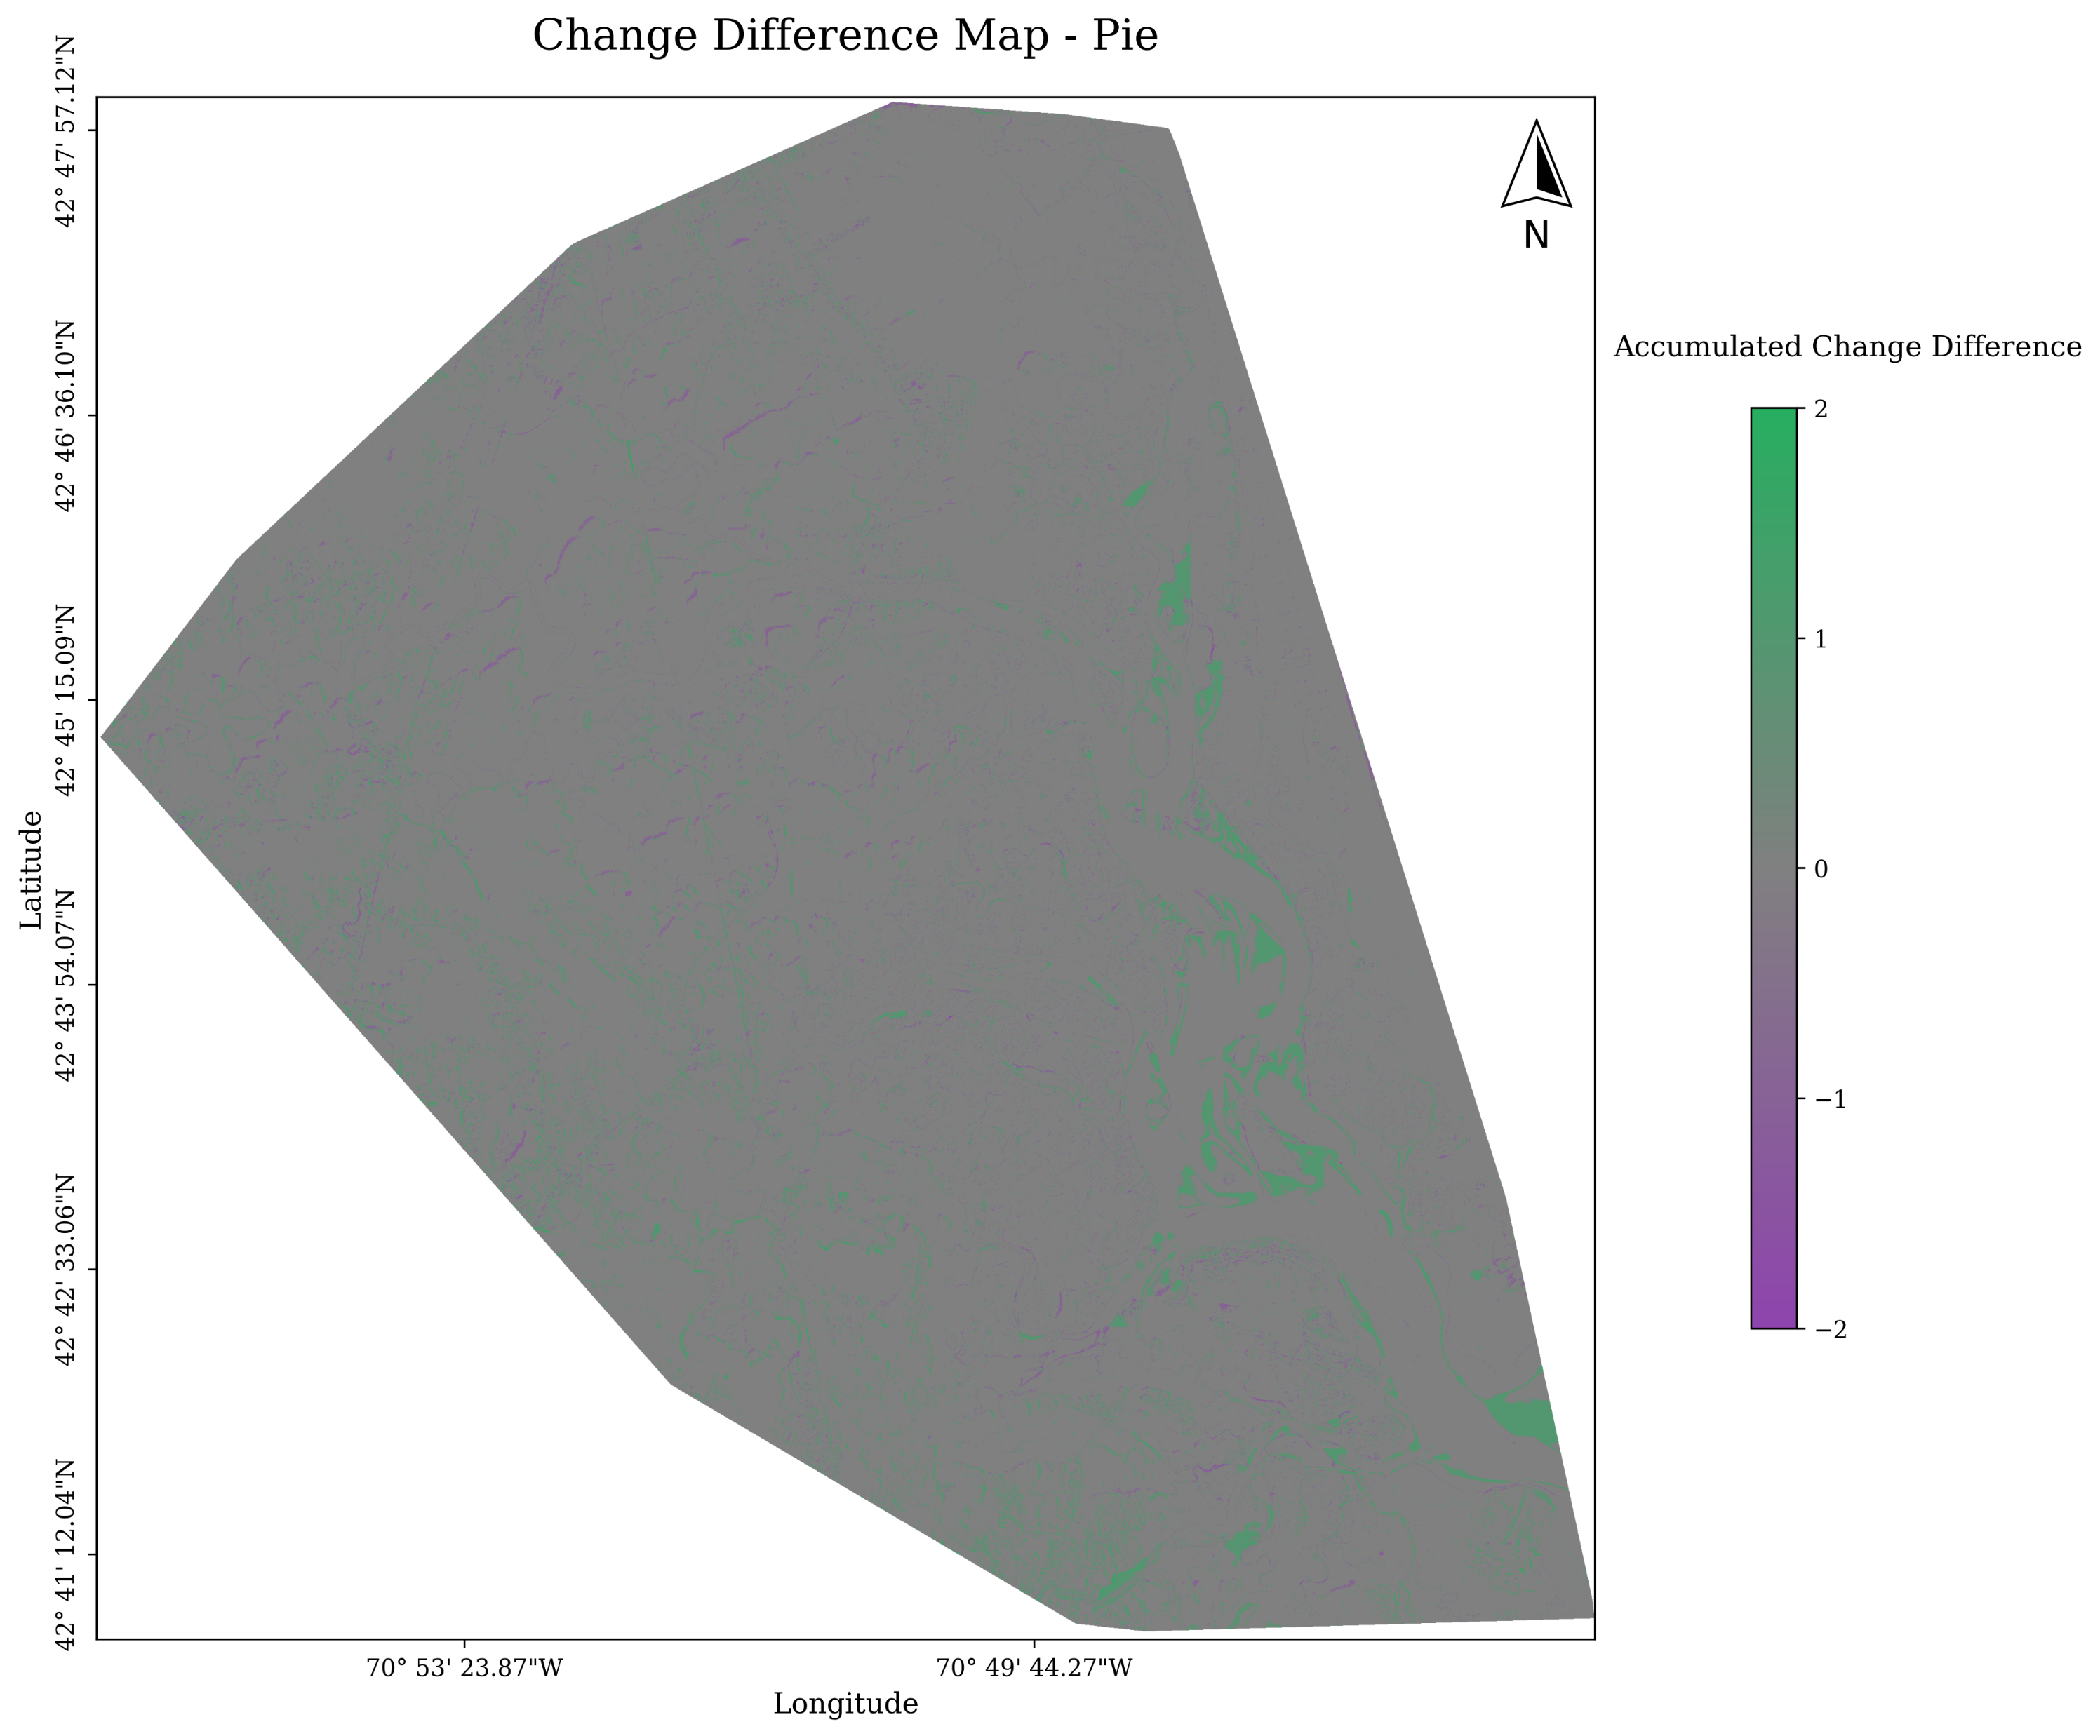
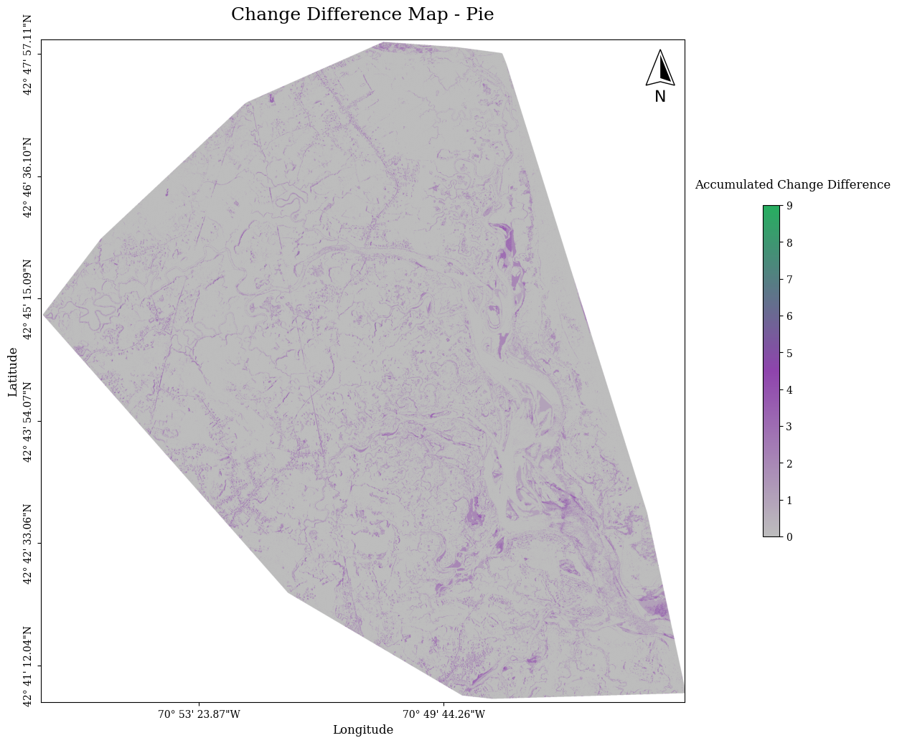
Old Version
New Version

