Slide 1
Toy Data
x and y time series

Slide 2
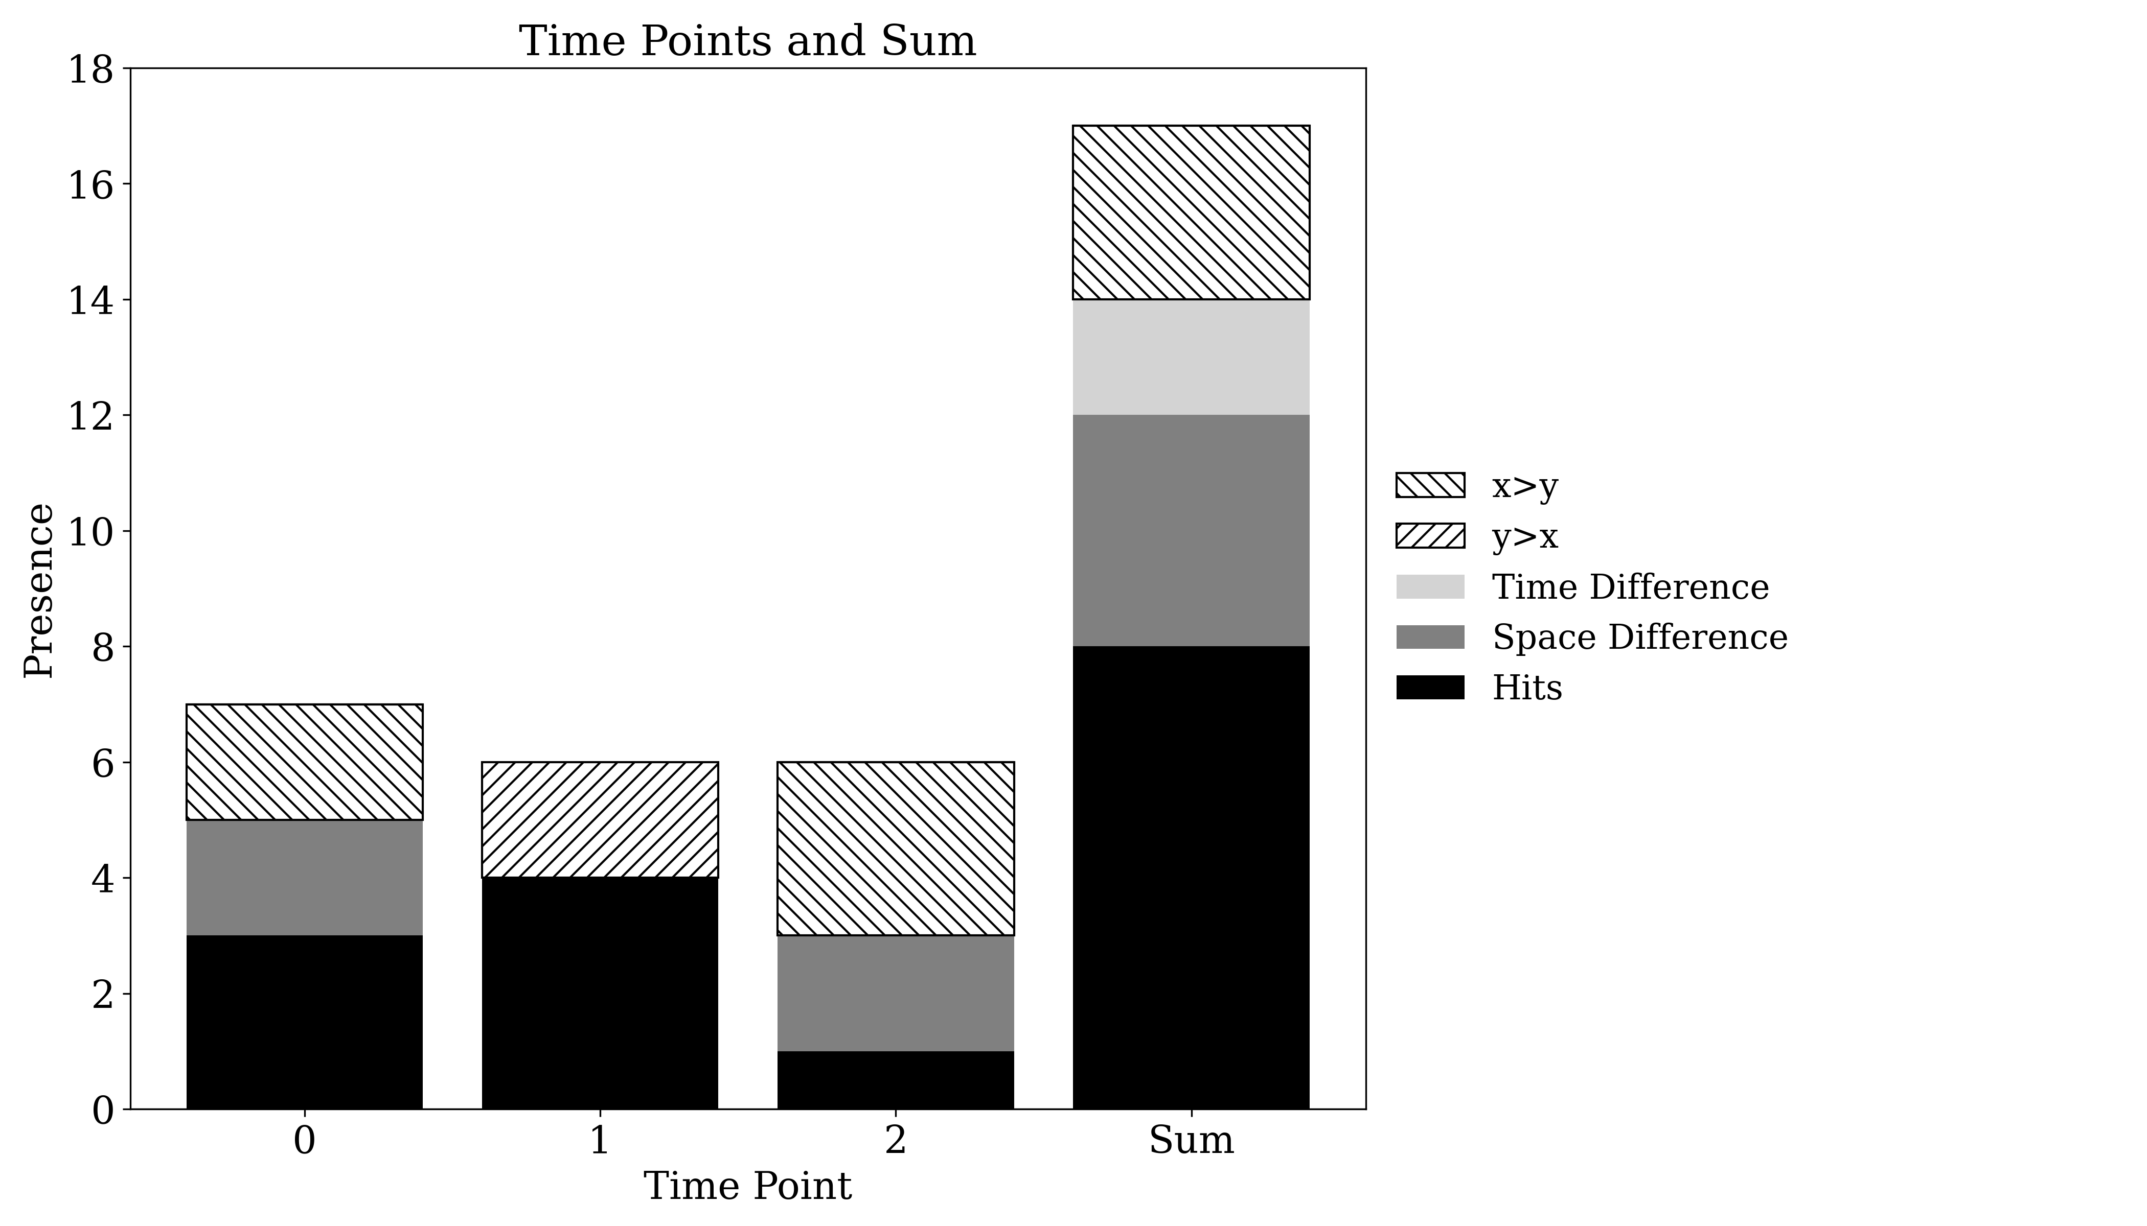
Presence

Slide 3
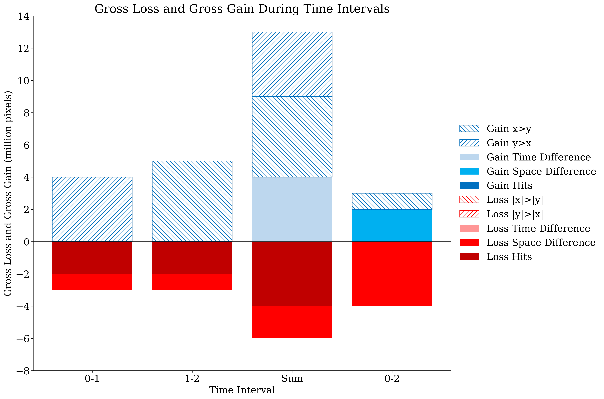
Gross Change

Slide 4
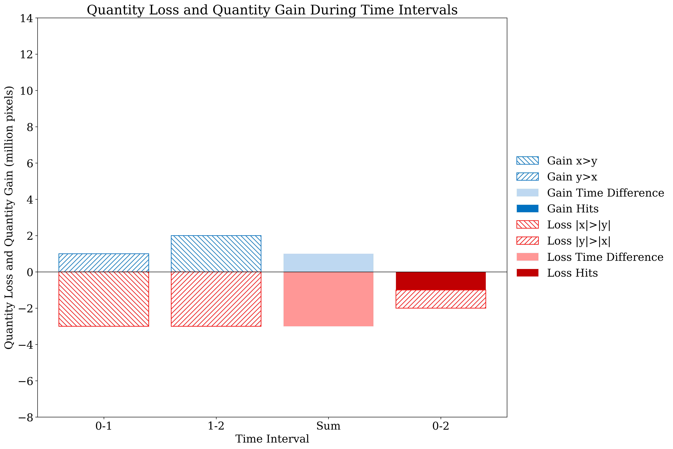
Net Change

Slide 5
Savanna
MapBiomas Collection 6 and Collection 8

Slide 6
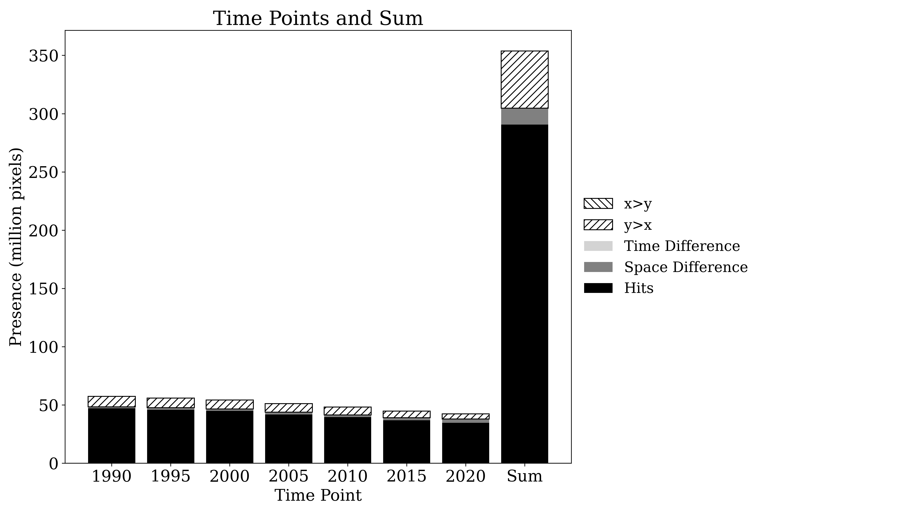
Presence

Slide 7
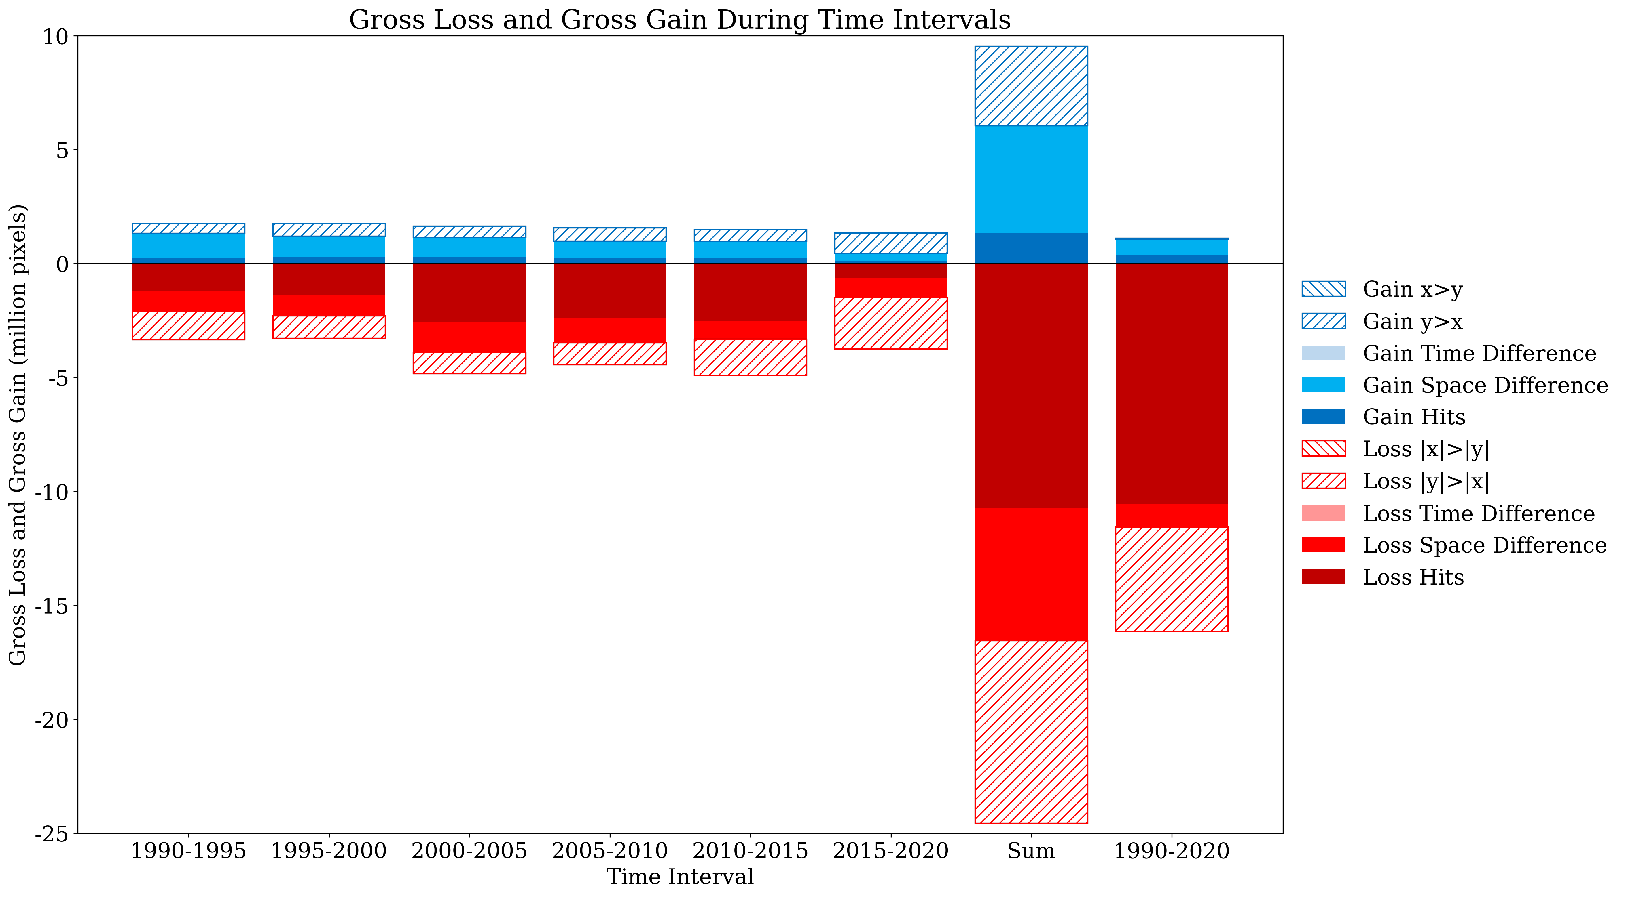
Gross Change

Slide 8
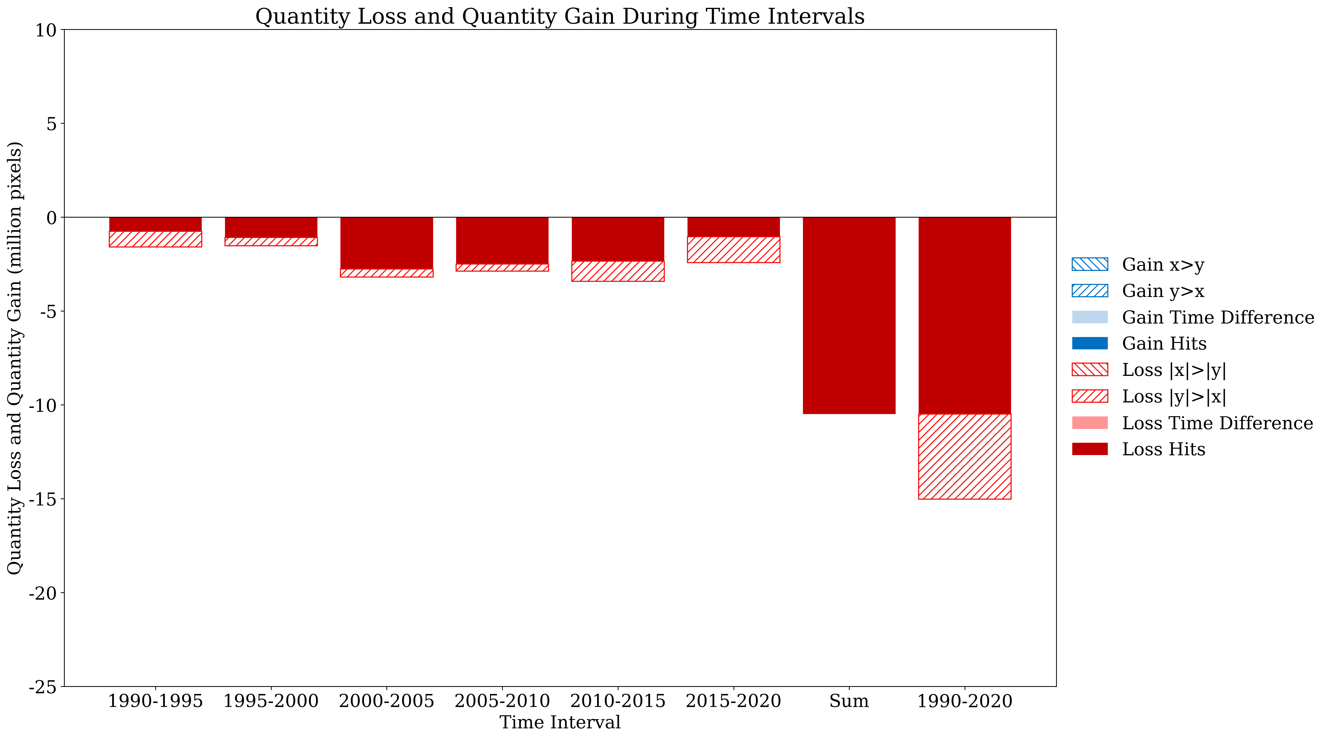
Net Change

Slide 9
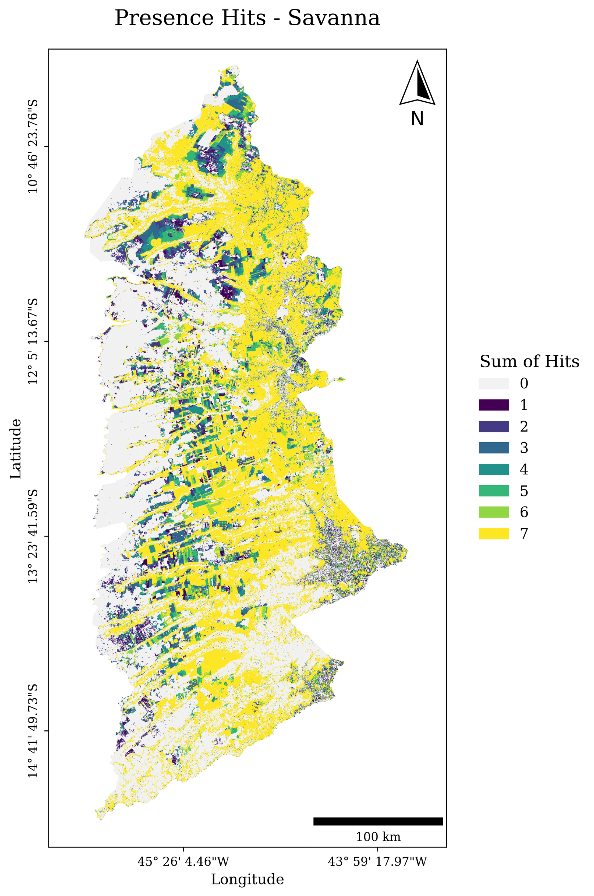
Presence Hits Map

Slide 10
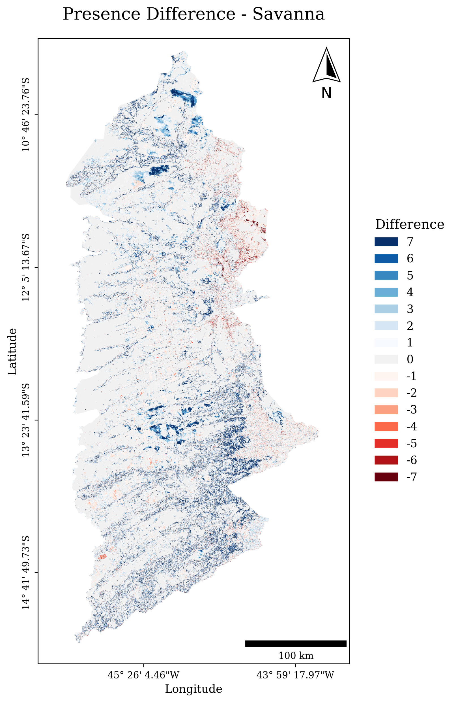
Presence Difference Map

Slide 11
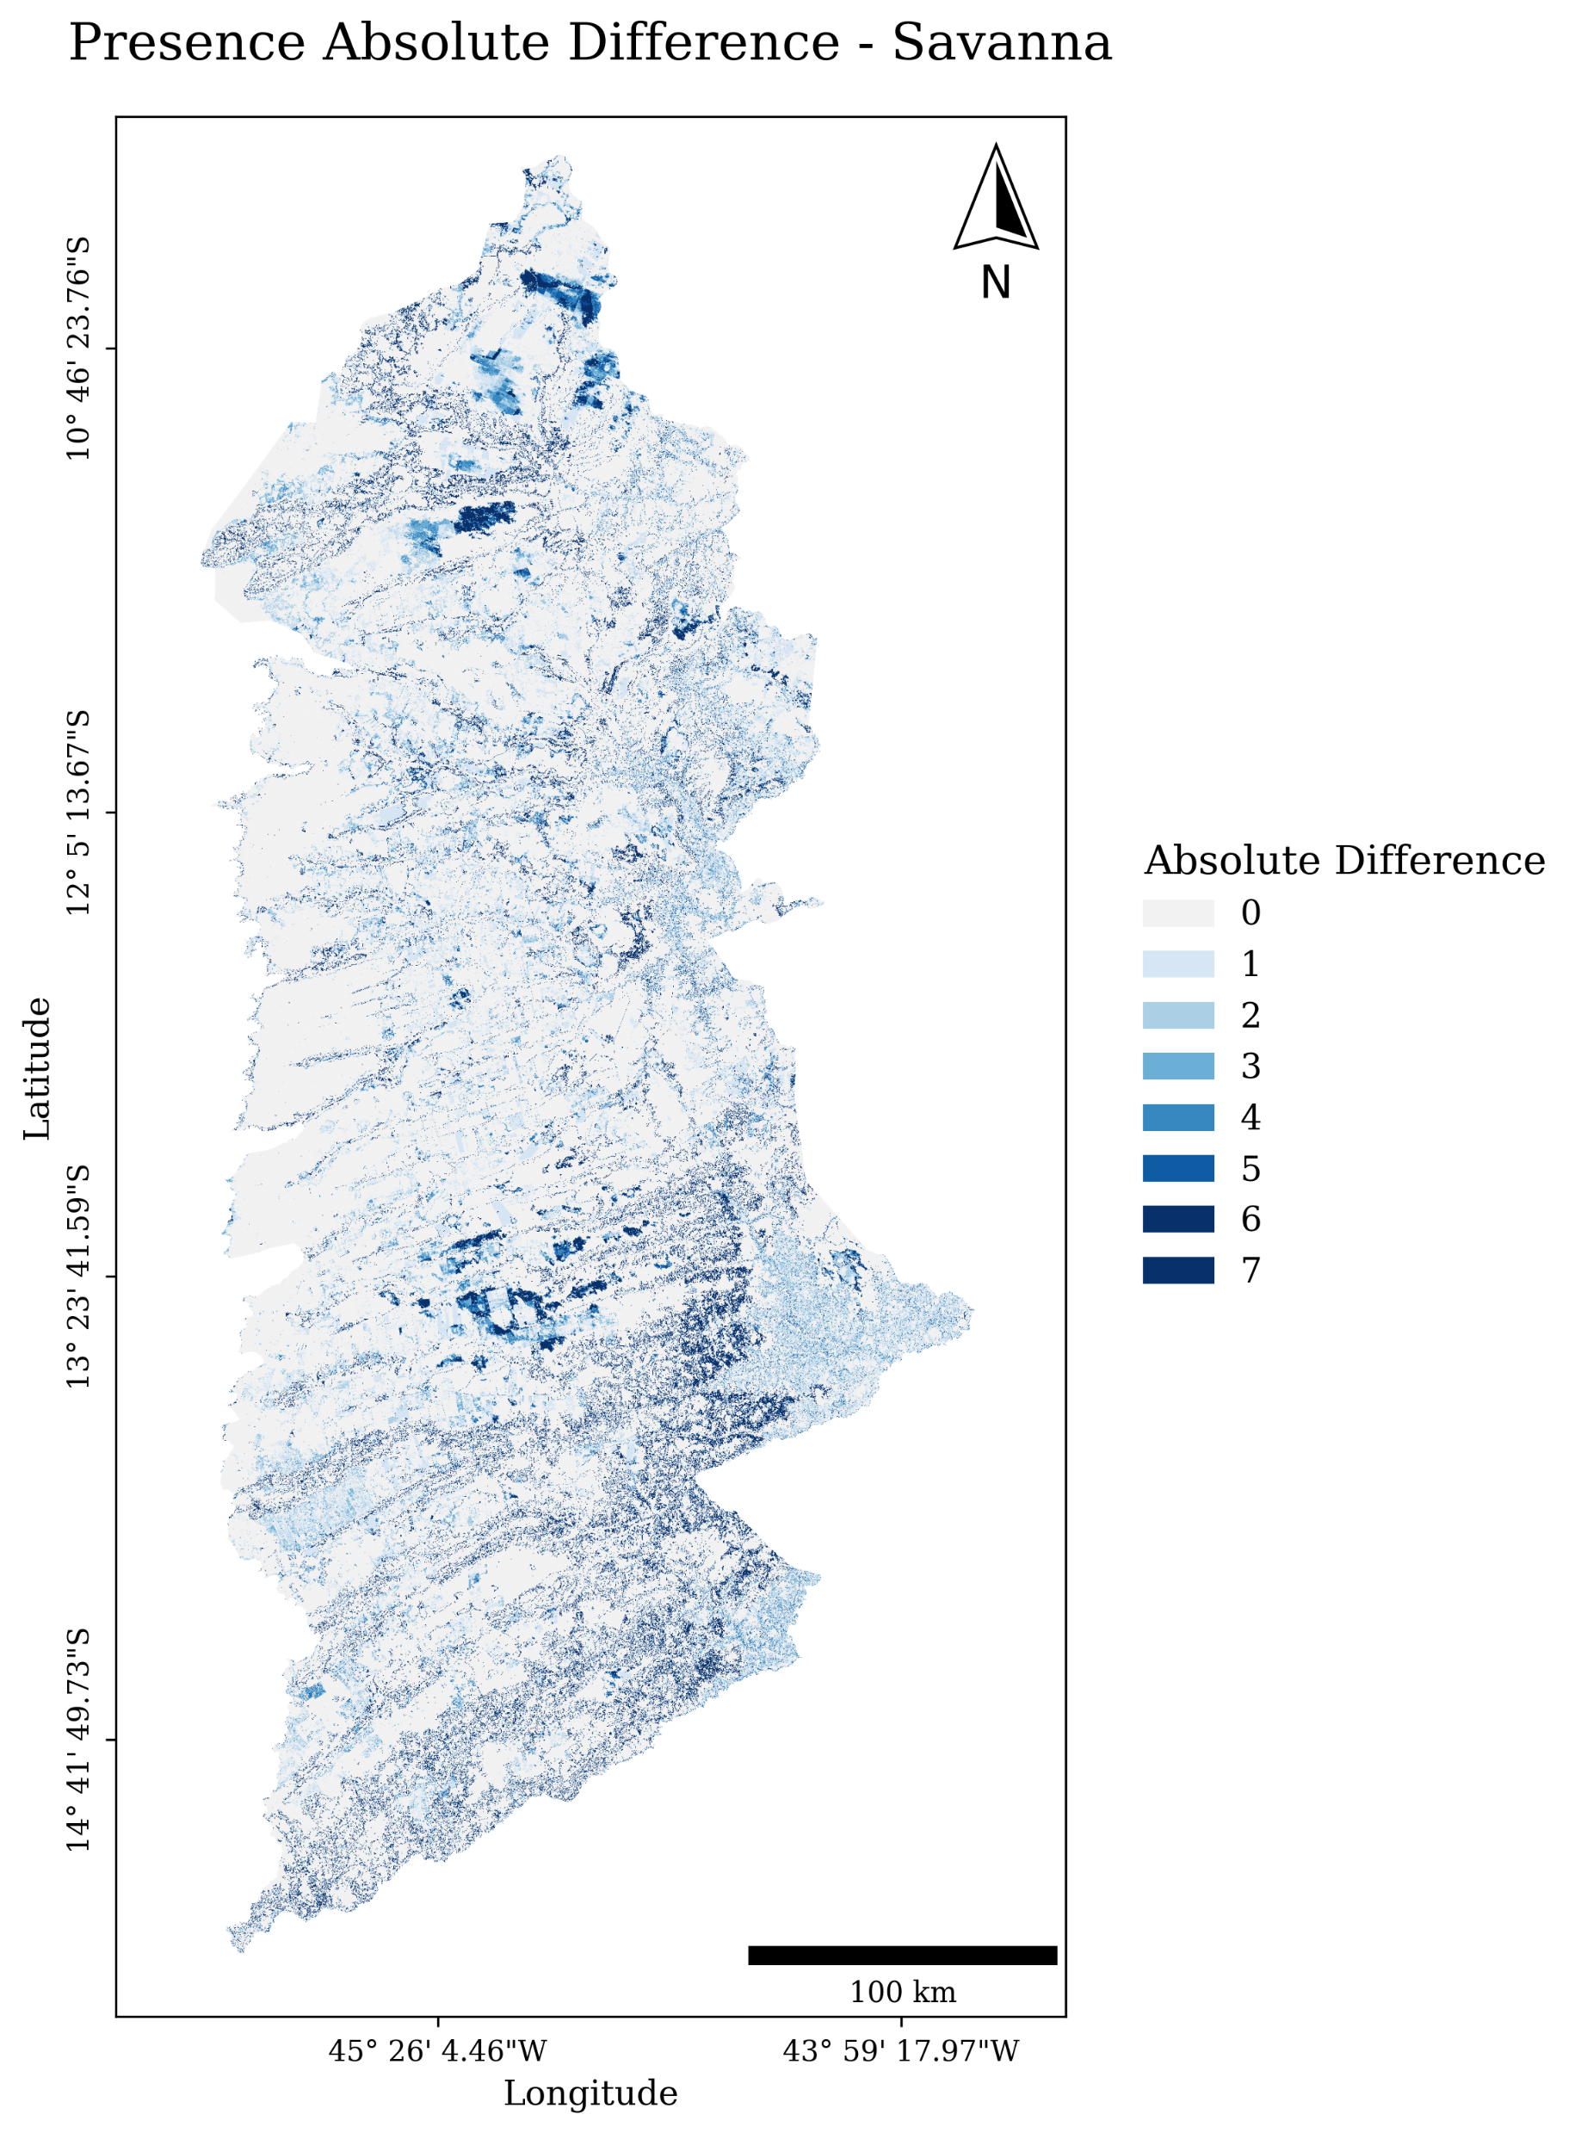
Presence Absolute Difference Map

Slide 12
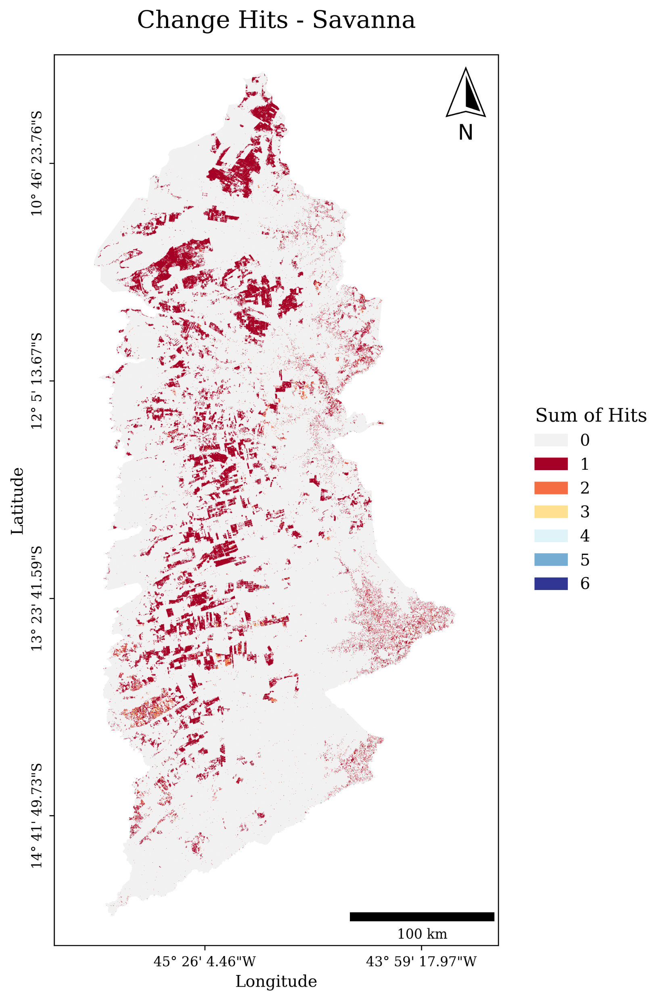
Change Hits Map

Slide 13
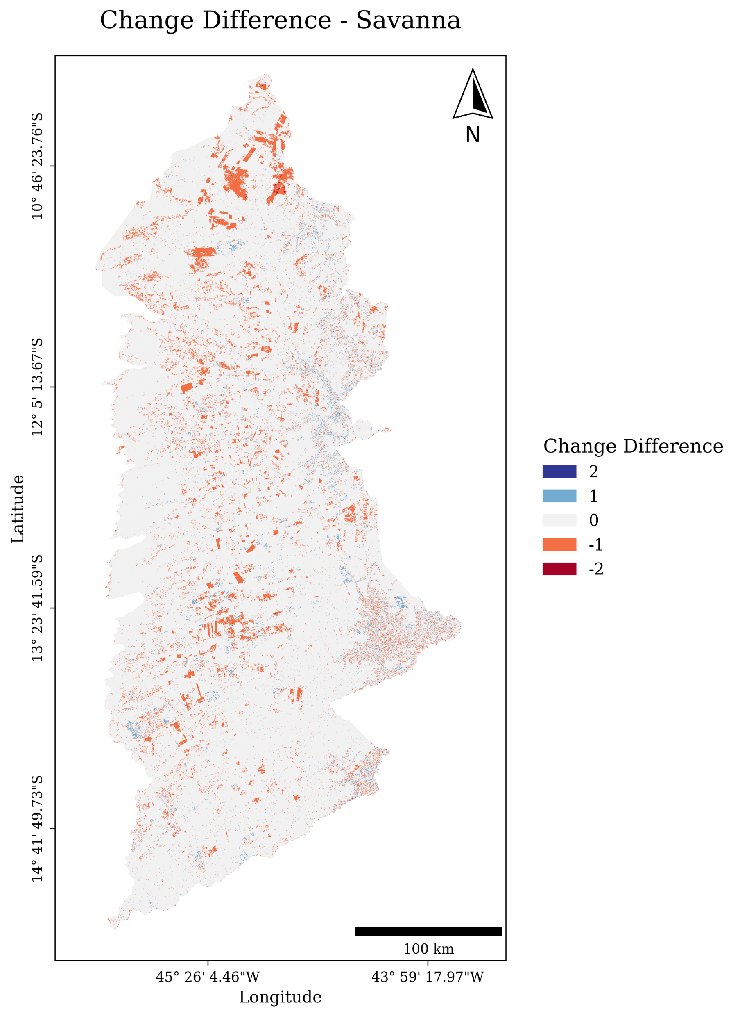
Change Difference Map

Slide 14
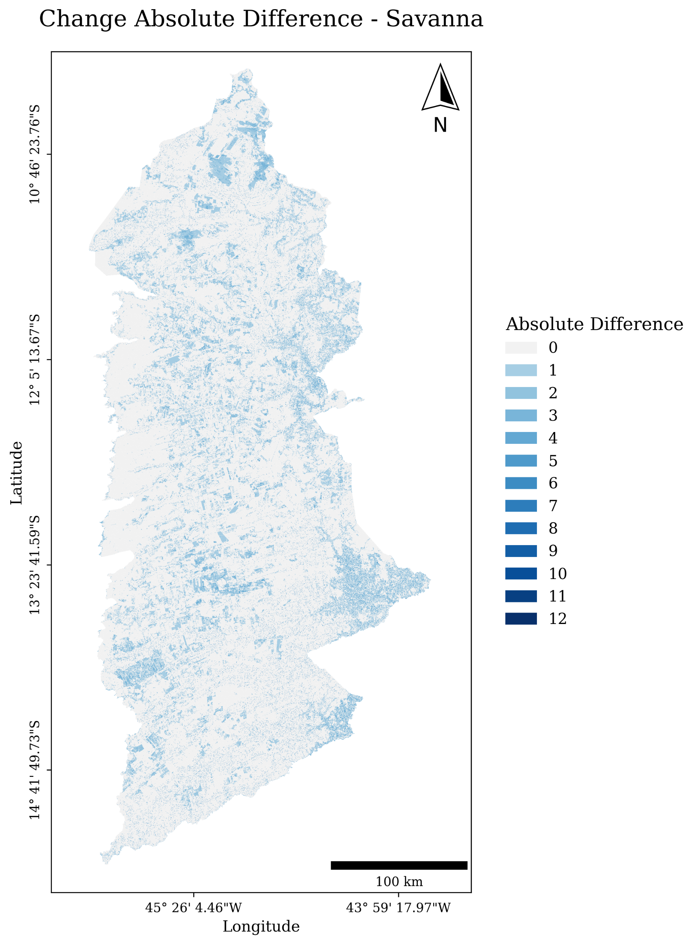
Change Absolute Difference Map

Slide 15
Soil
Collection 1 and Collection 2 1990, 2000, 2010

Slide 16
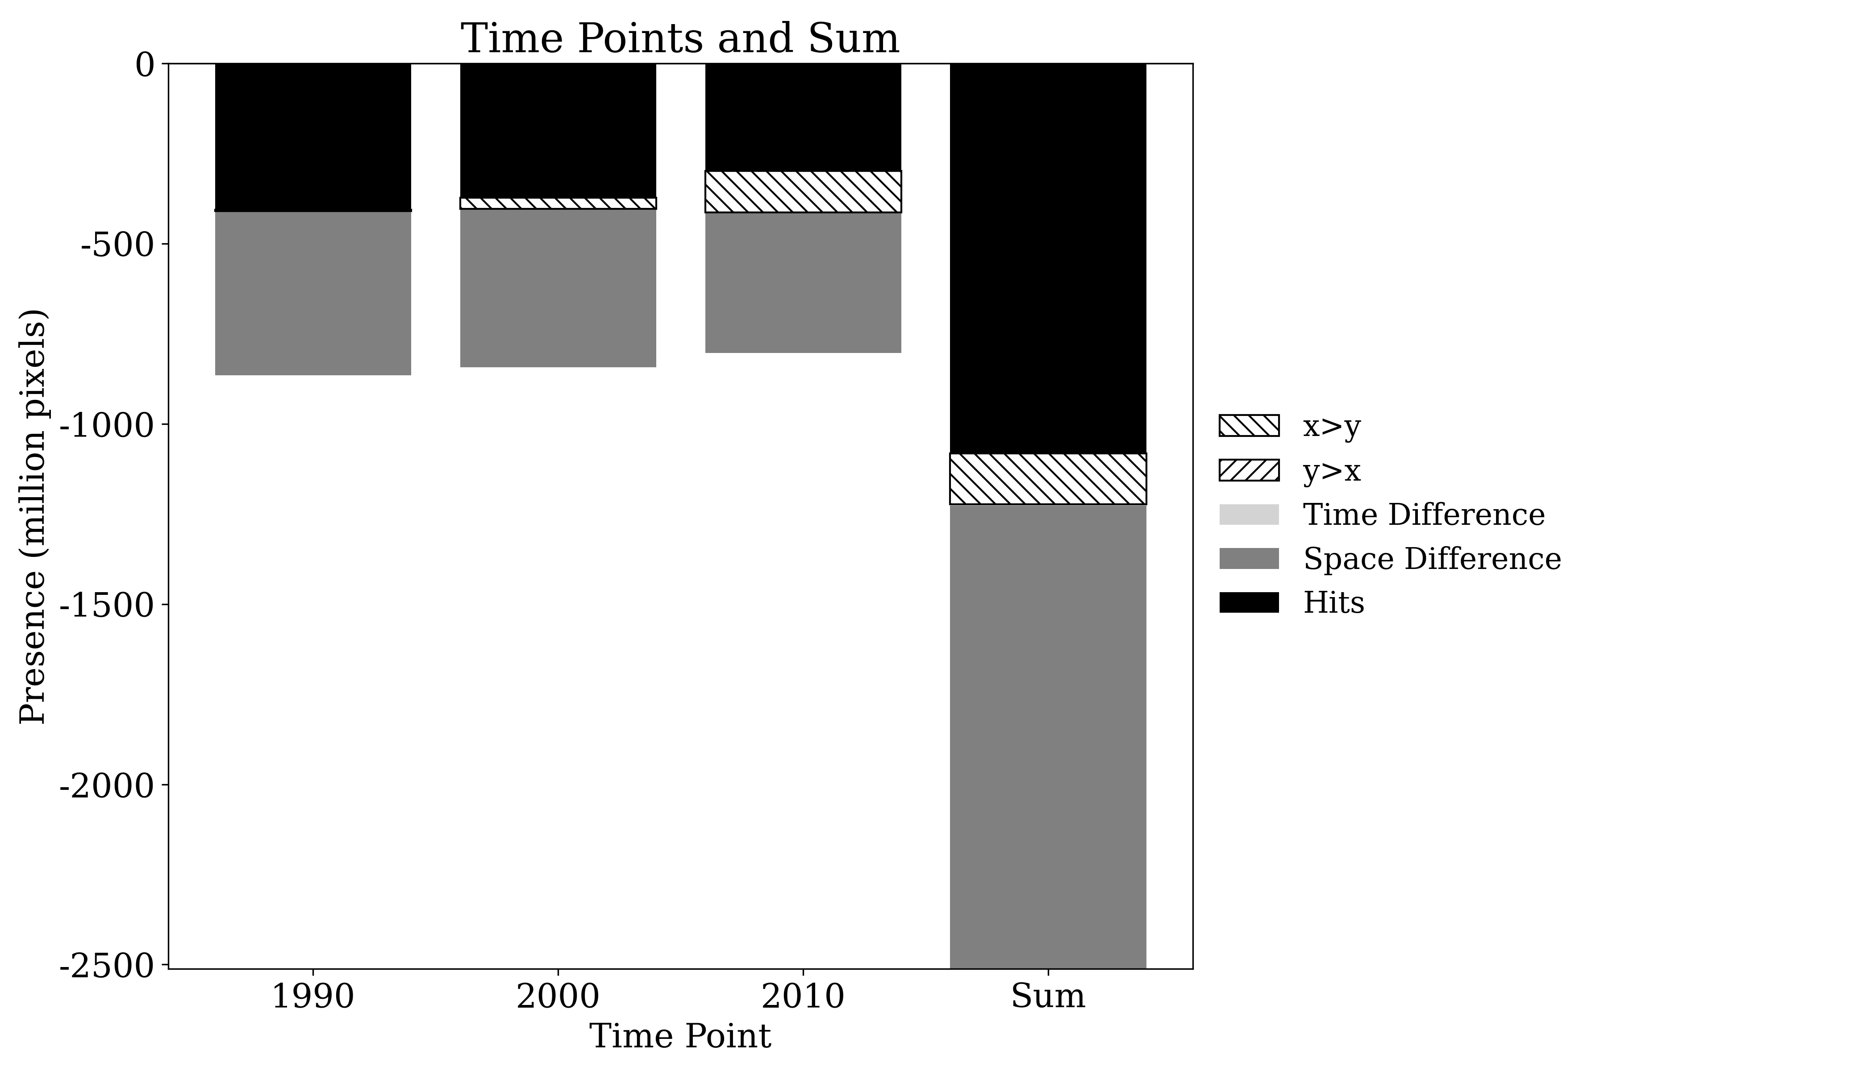
Presence

Slide 17
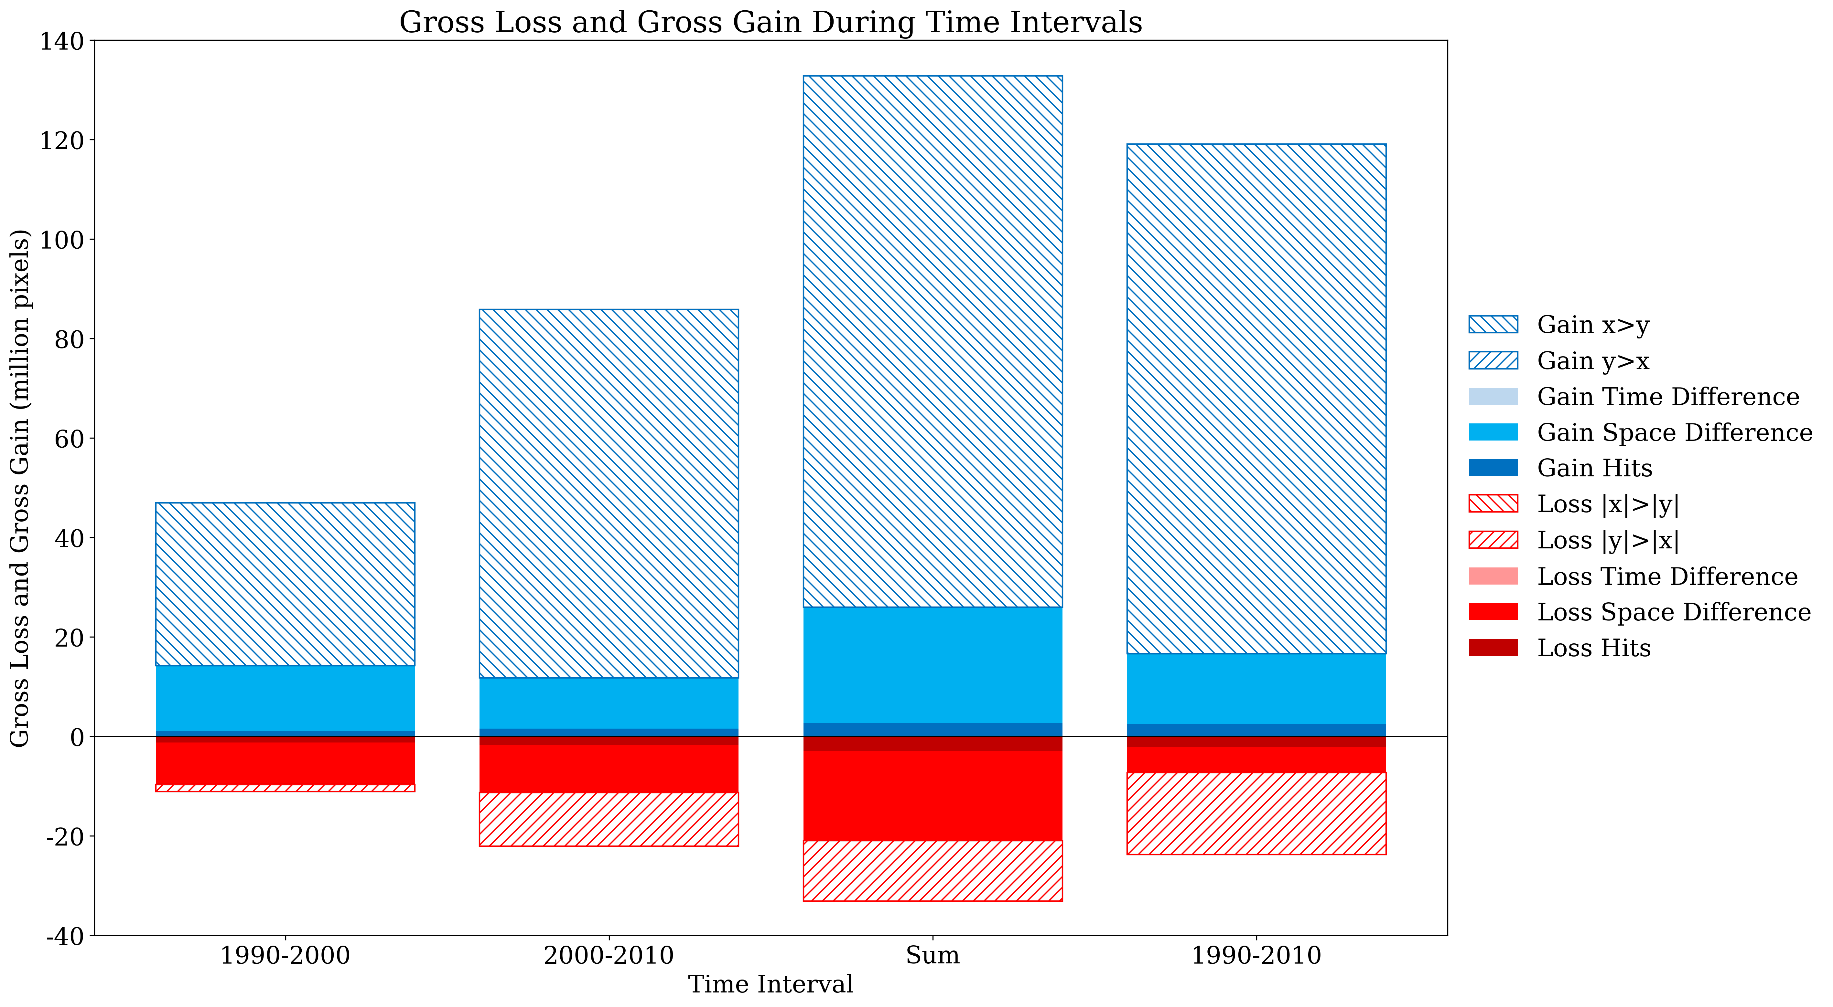
Gross Change

Slide 18
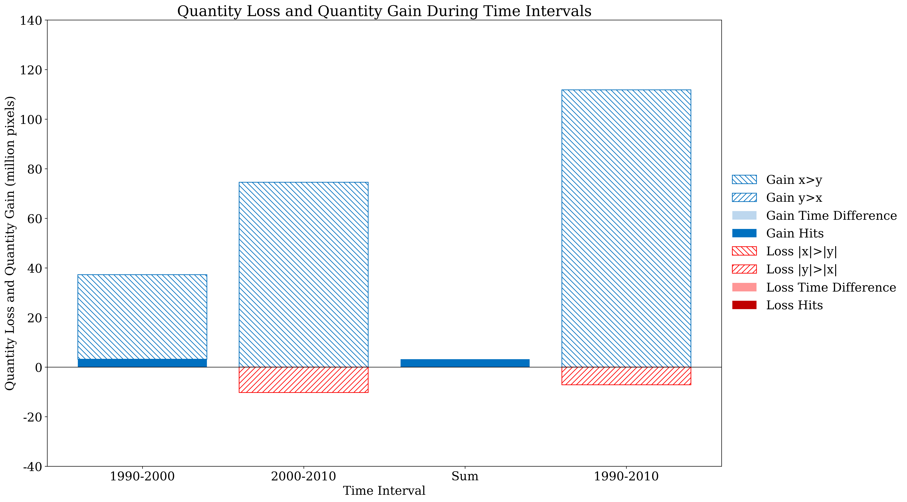
Net Change

Slide 19
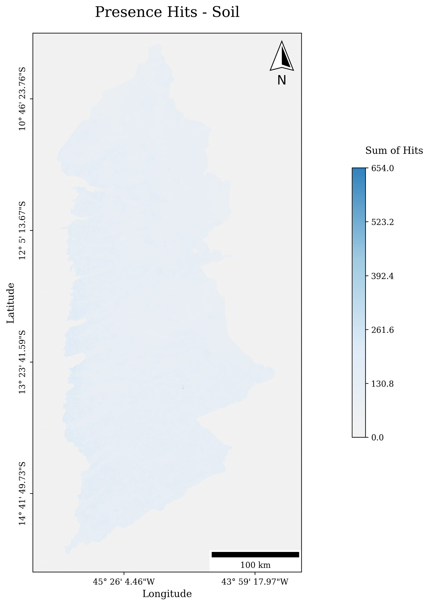
Presence Hits Map

Slide 20
Presence Difference Map

Slide 21
Presence Absolute Difference Map

Slide 22
Change Hits Map

Slide 23
Change Difference Map

Slide 24
Change Absolute Difference Map

Slide 25
PIE
Pixel Based and Pixel Object

Slide 26
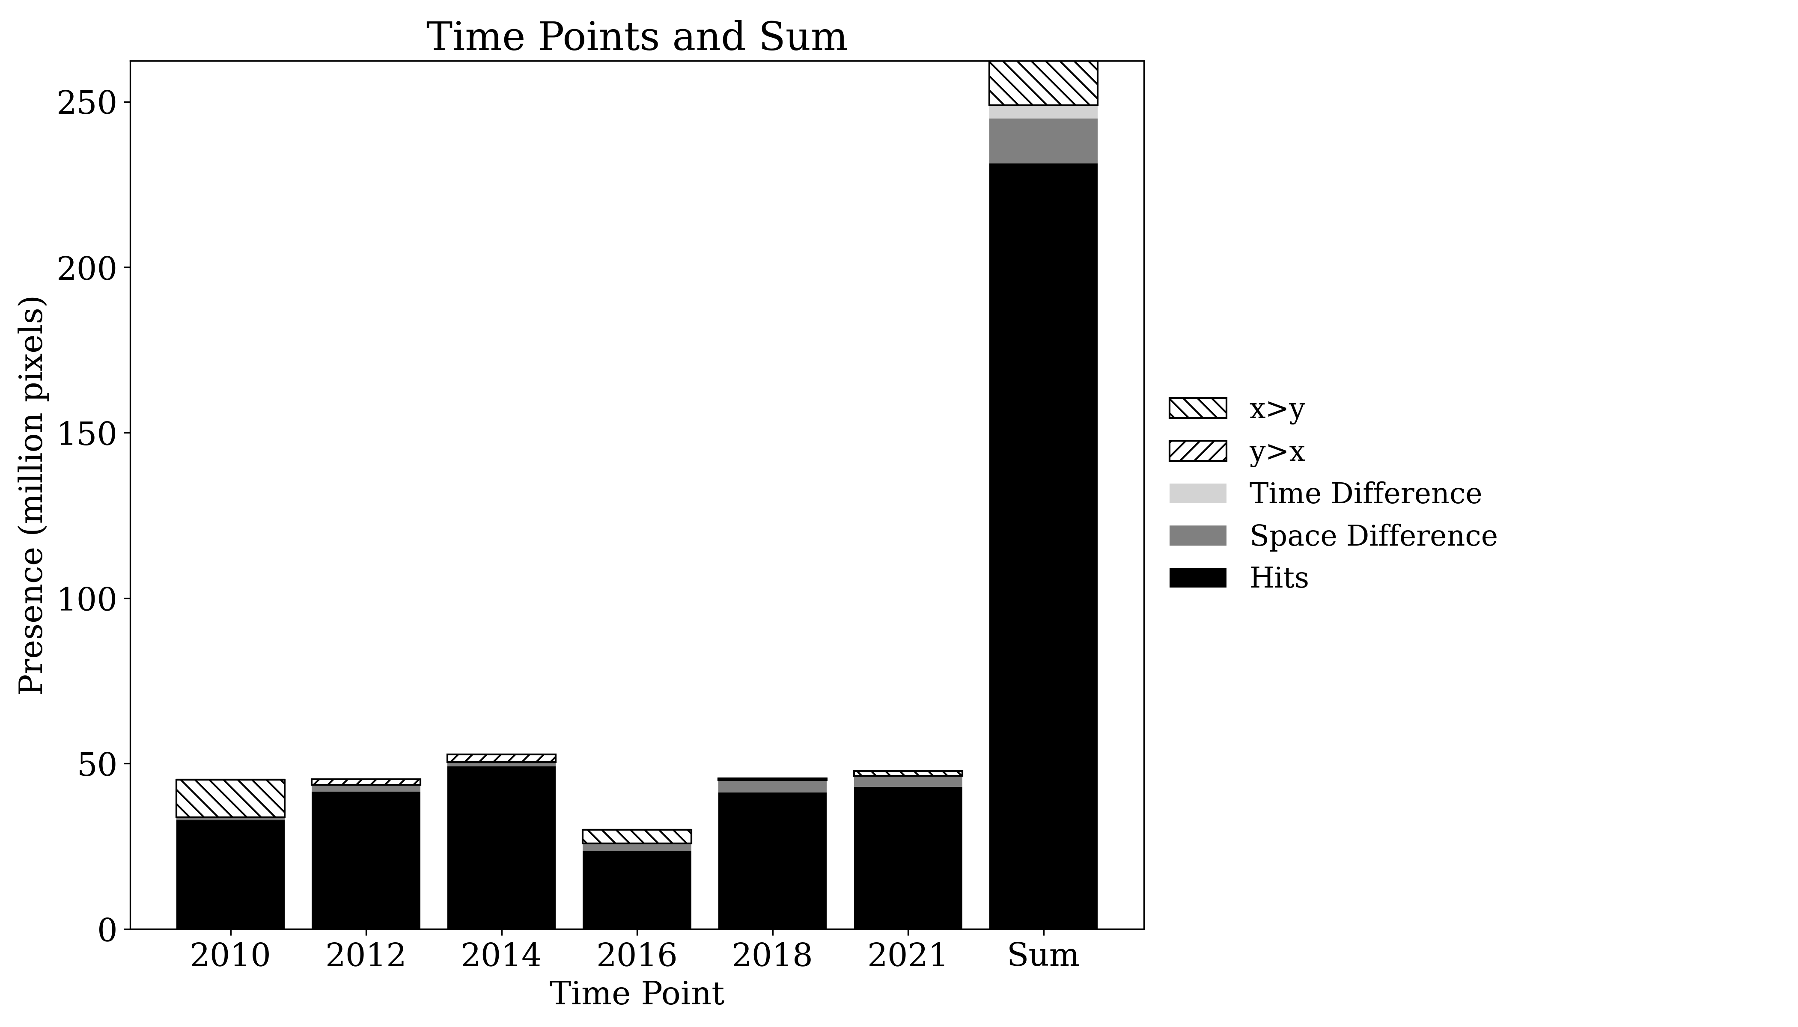
Presence

Slide 27
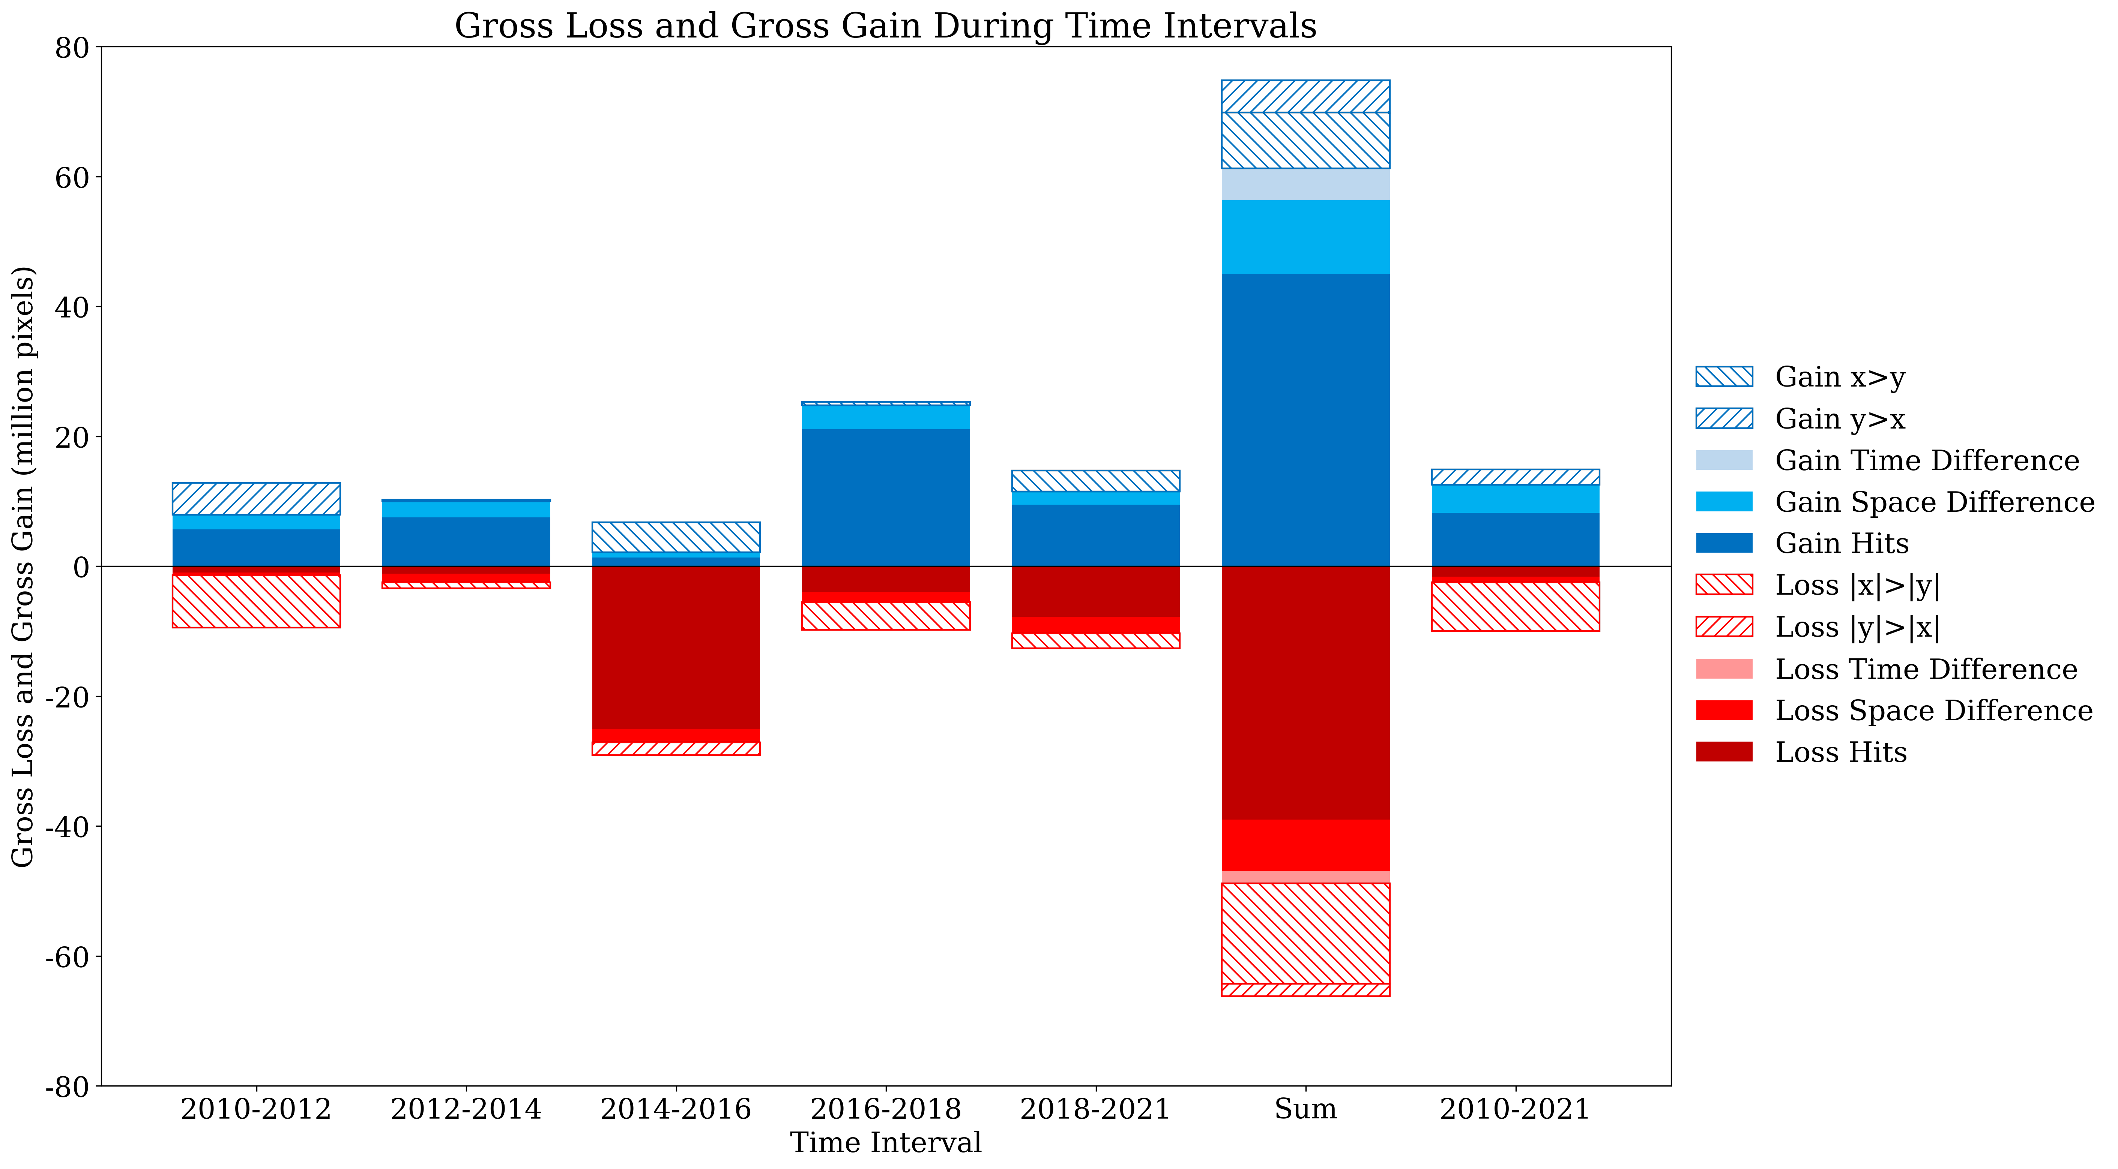
Gross Change

Slide 28
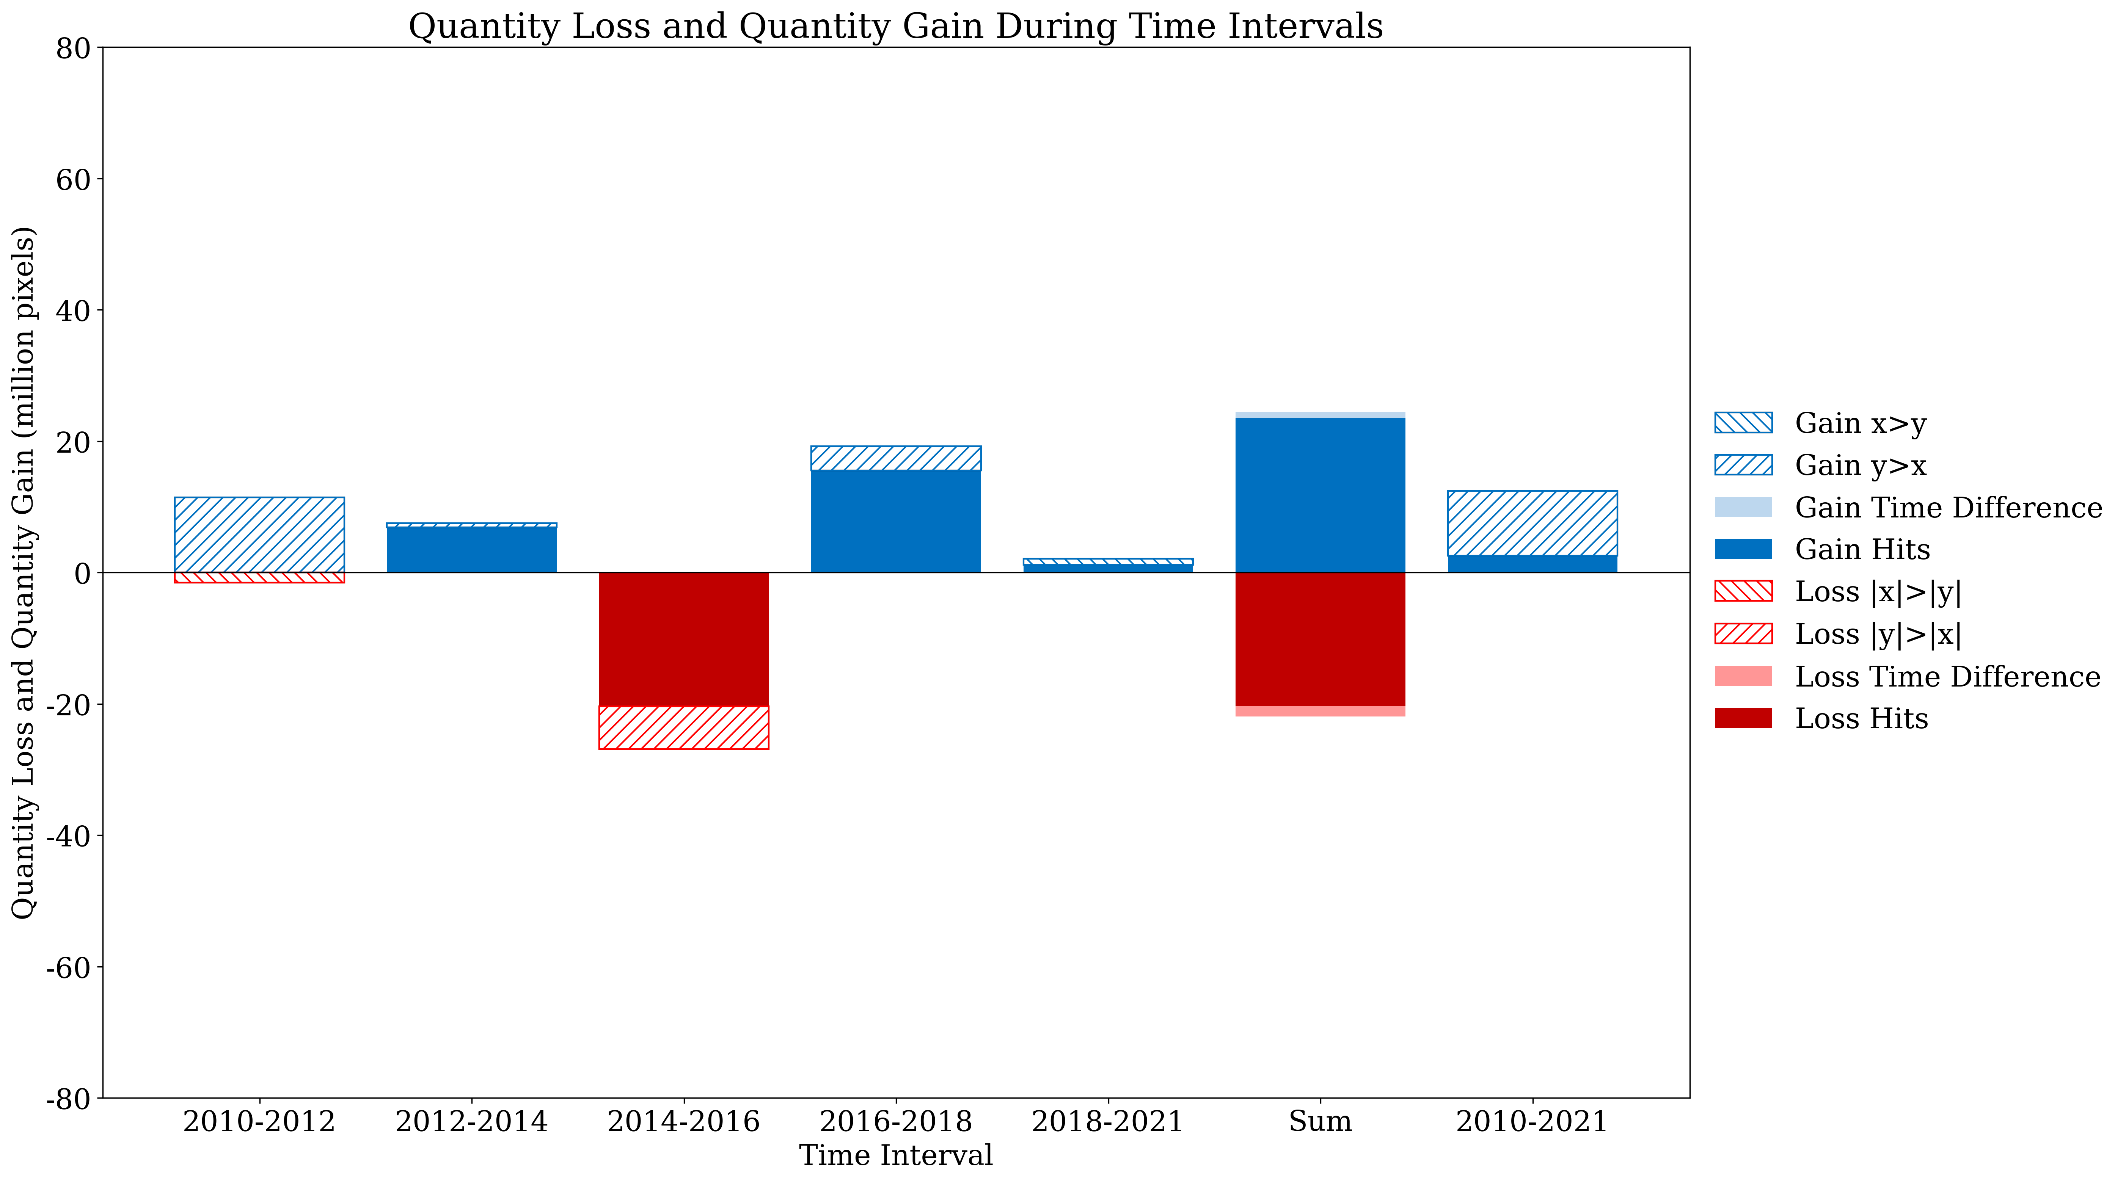
Net Change

