Slide 1
Updates
Eliminate the lines from the format on slide 2 of validation_results2.pptx that shows the size of presence.
In the legend for the figures that have stacked bars, instead of misses, write y<x for presence and gain. Instead of misses, write |y|<|x| for loss. Instead of false alarms, write x>y for presence and gain. Instead of false alarms, write |x|>|y| for loss. Pontius does not know whether we should change the legend from Hits to Agreement. Hits is more specific than Agreement but Hits seems to be jargon

Slide 2
Toy Data

Slide 3
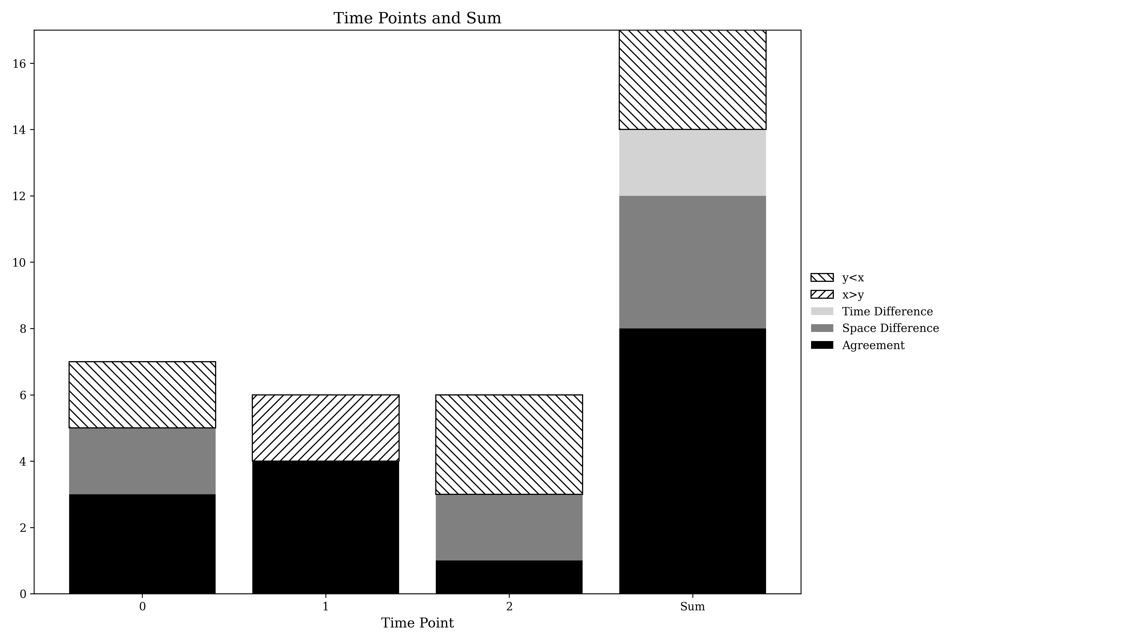
Presence Agreement graphic using Toy data

Slide 4
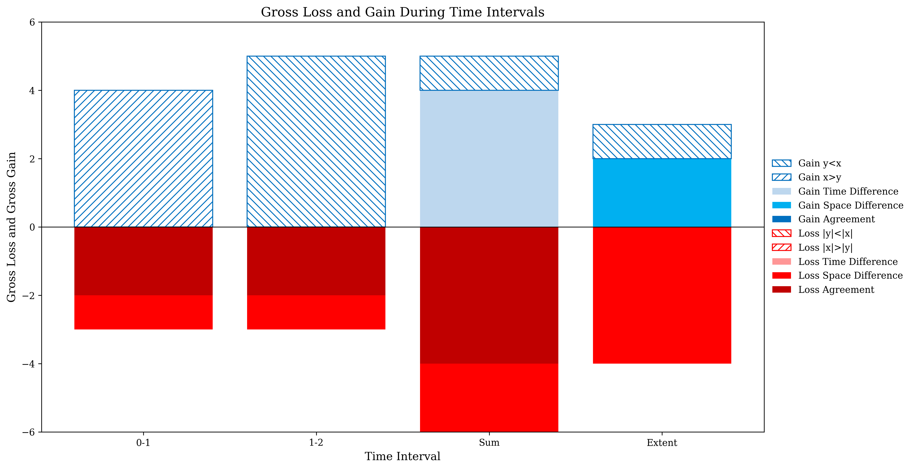
Gross Losses and Gross Gains graphic using Toy data

Slide 5
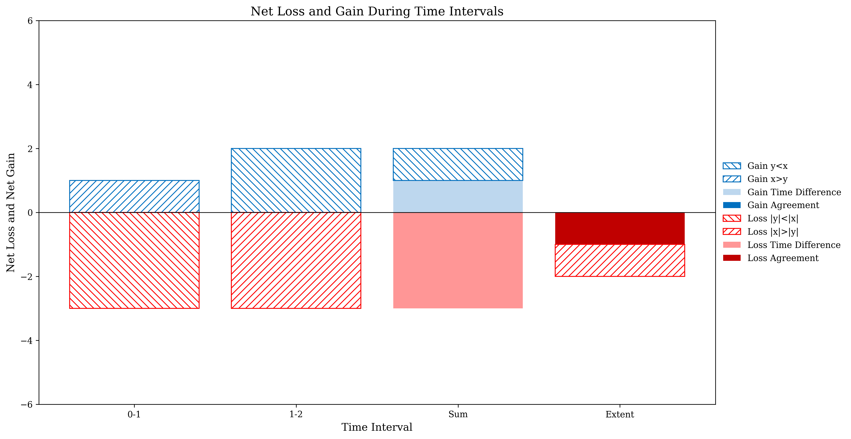
Net change graphic using Toy data

Slide 6
Savanna
MapBiomas Collection 6 and Collection 8

Slide 7
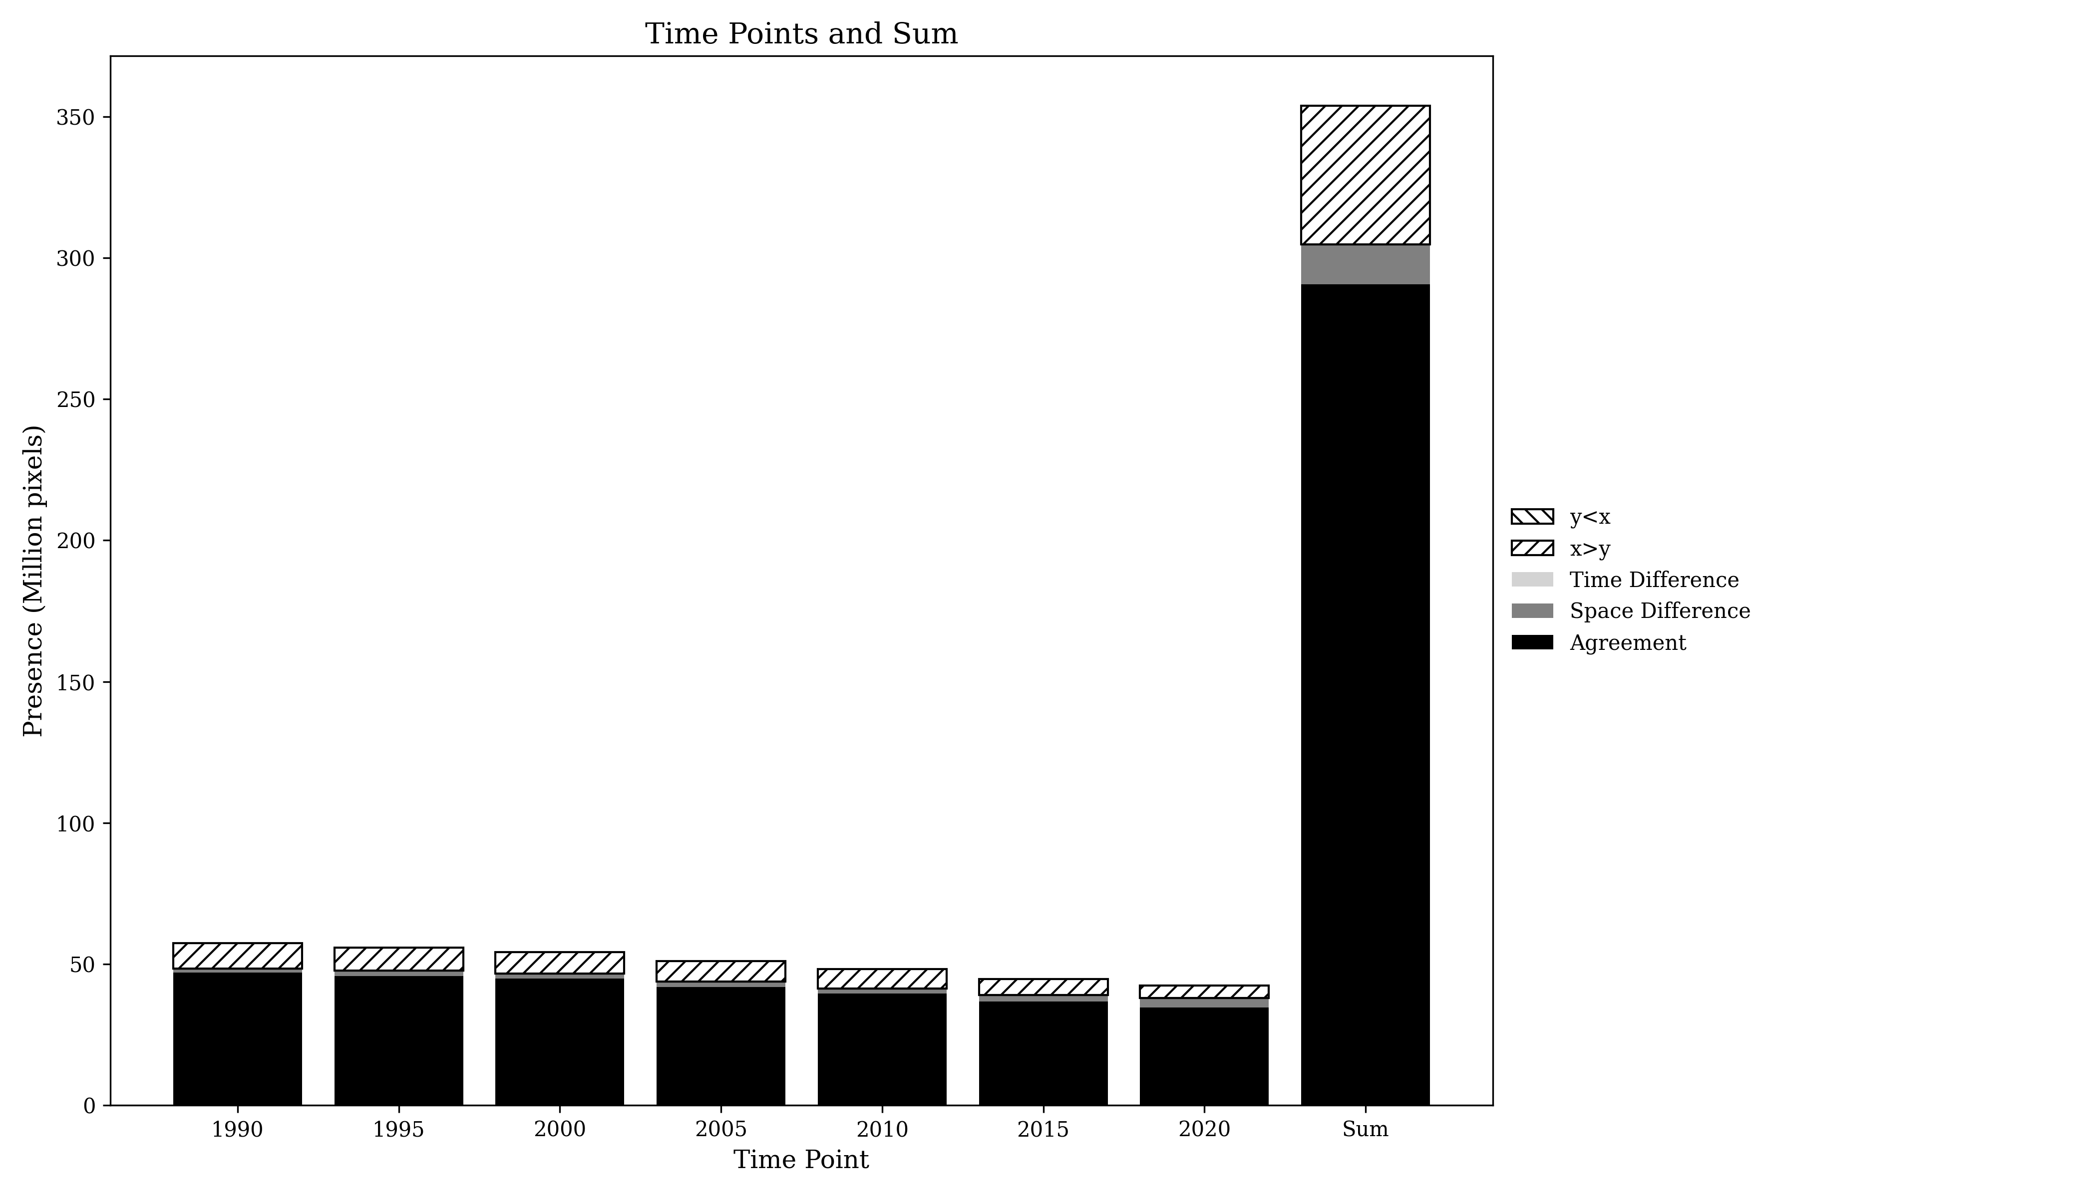
Presence Agreement graphic using Savanna class

Slide 8
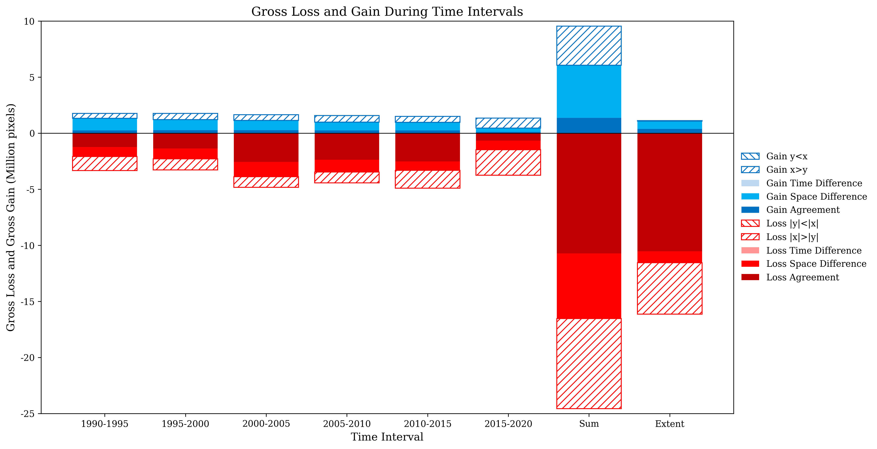
Gross Losses and Gross Gains graphics using Savanna class

Slide 9
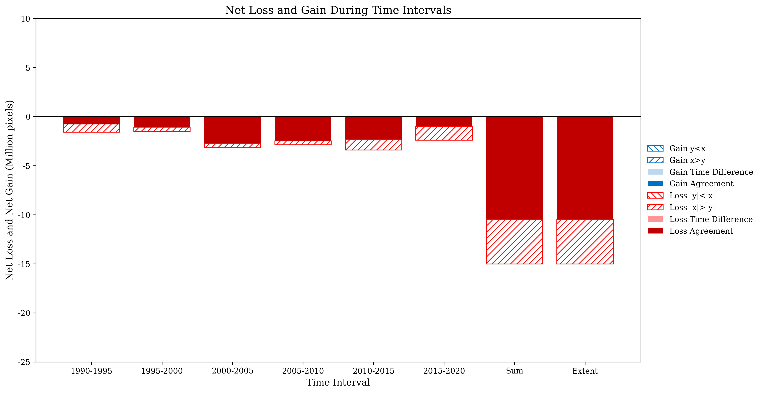
Net Losses and Net Gains graphics using Savanna class

Slide 10
PIE water time series data
Pixel-based method and object-based

Slide 11
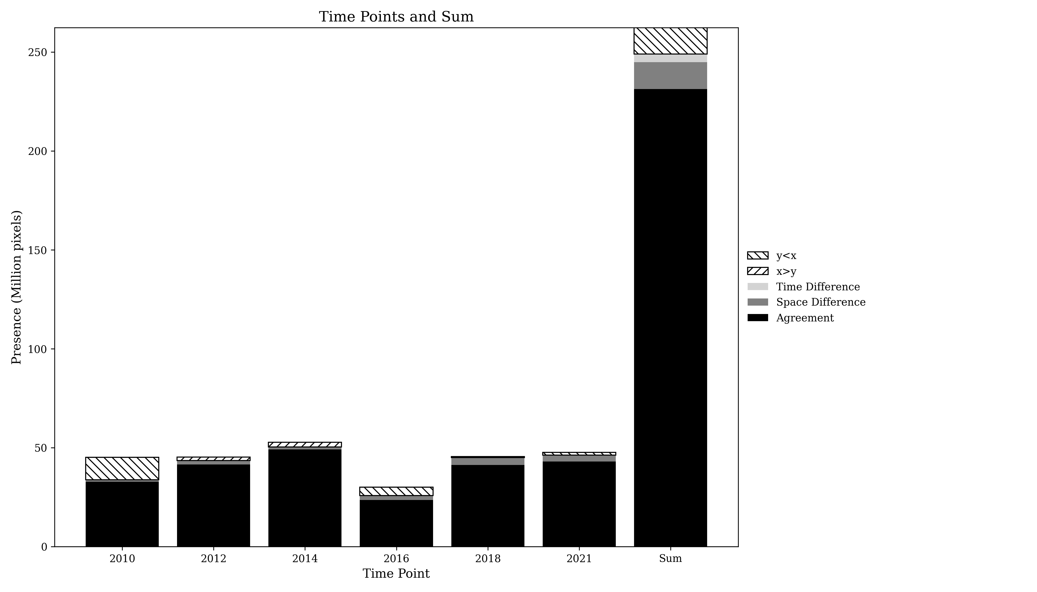
Presence Agreement graphic using PIE data

Slide 12
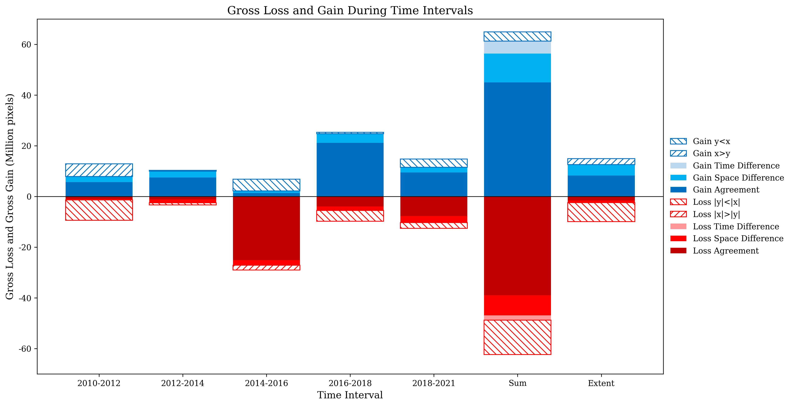
Gross Losses and Gross Gains graphics using PIE data

Slide 13
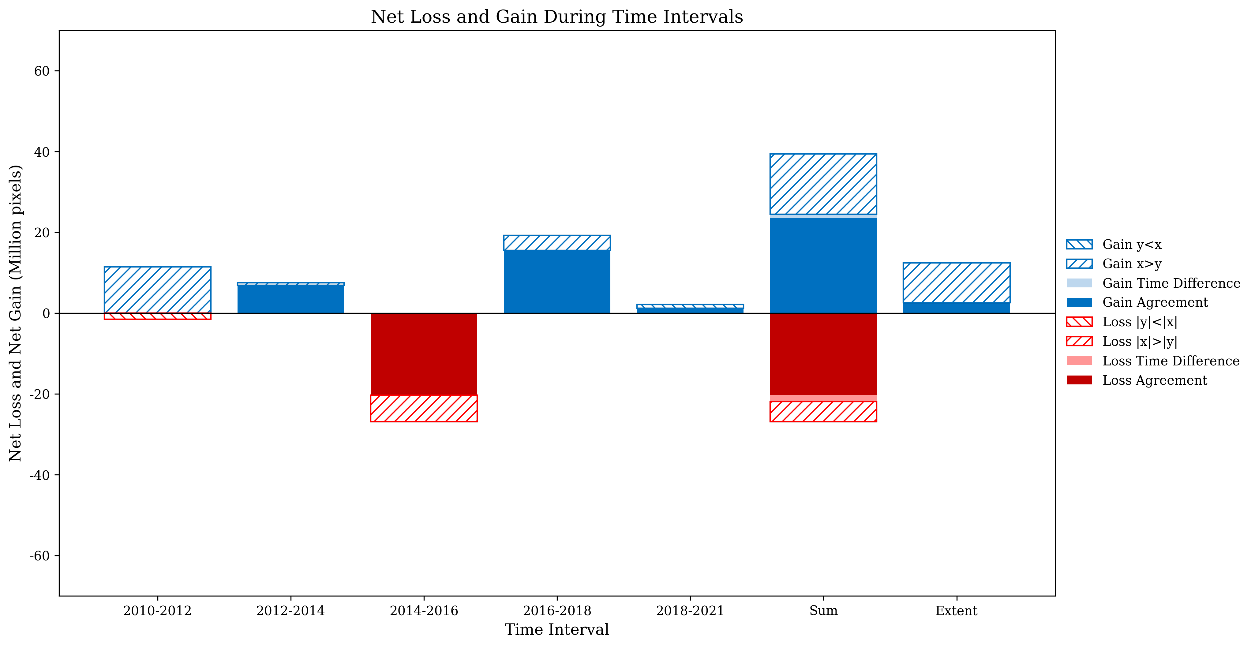
Net Losses and Net Gains graphics using PIE data

