Slide 1
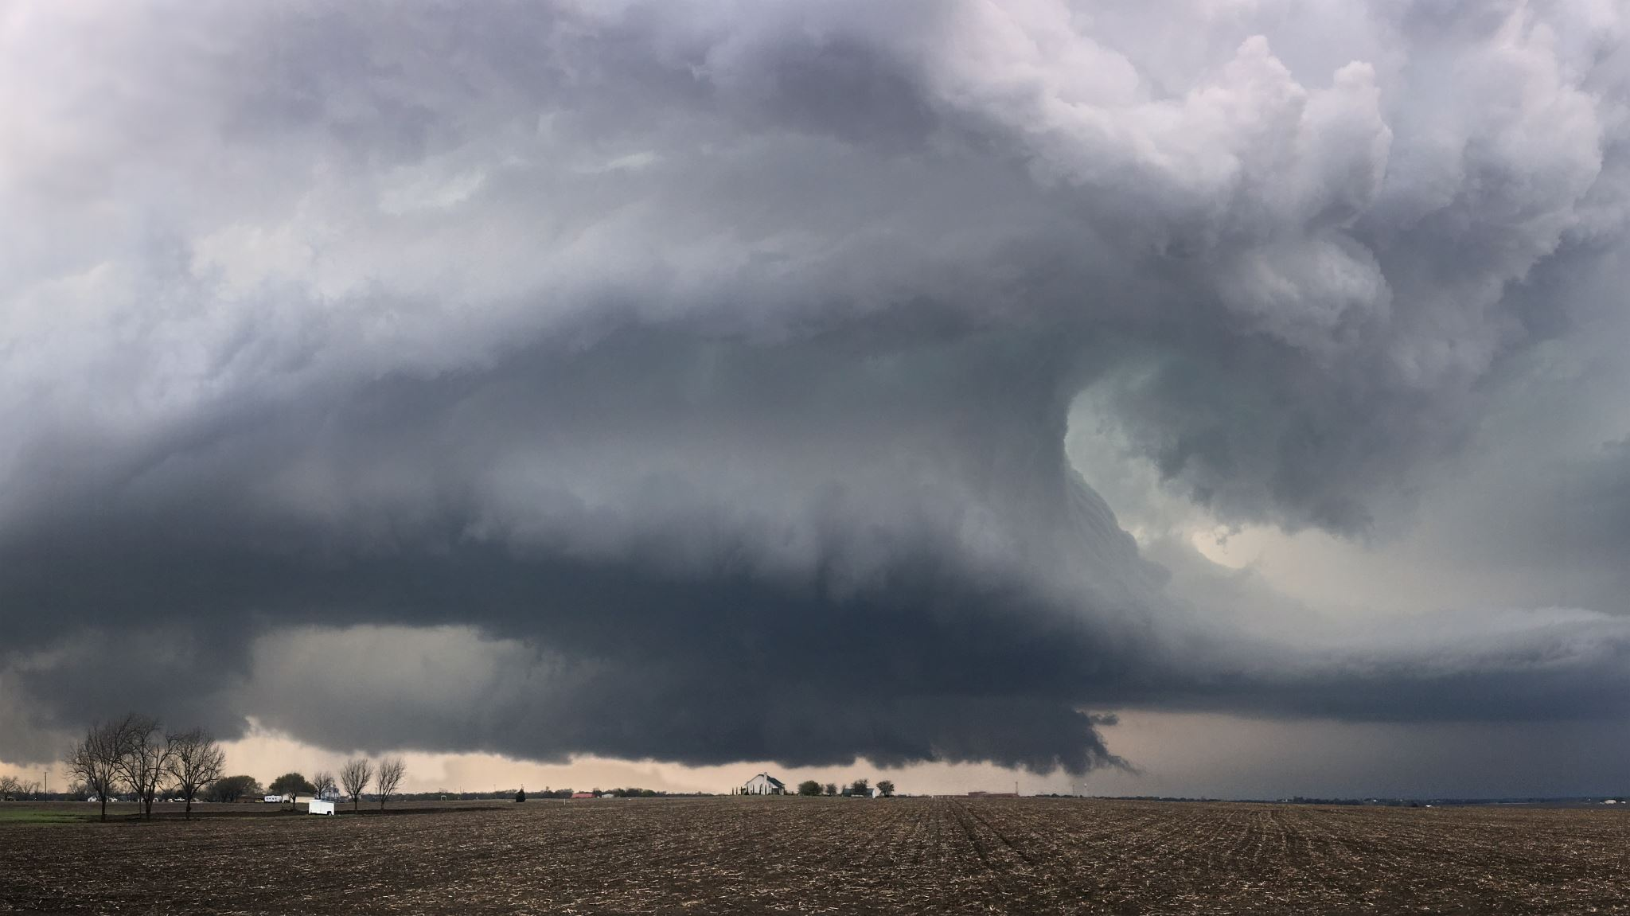
Climate Change Project
Assessment for Pharmaceutical Greenfield Factory

Slide 2
From the 2000s on
Relevance to Current Climate Conditions
Technological Advancements
Healthcare Policy changes

Slide 3
Taking into consideration for the location
Infrastructure
Compliance with Local Regulations
Proximity to Academic Institutions
Drug Approval Processes
Distribution Network

Slide 4
Regulation - Distribution
United States
South America
European Union
Switzerland
Israel

Slide 5
Natural disasters & Pharmaceutical industry
42% of FDA-registered manufacturing companies are in high-risk tornado areas
California, Florida, and Texas have the highest risk exposure
Hurricane Maria struck Puerto Rico in 2017, the damage caused shortages of IV saline bags
Pfizer had to limit emergency orders for several medicines after a tornado damaged its manufacturing facility in Rocky Mount, N.C

Slide 6
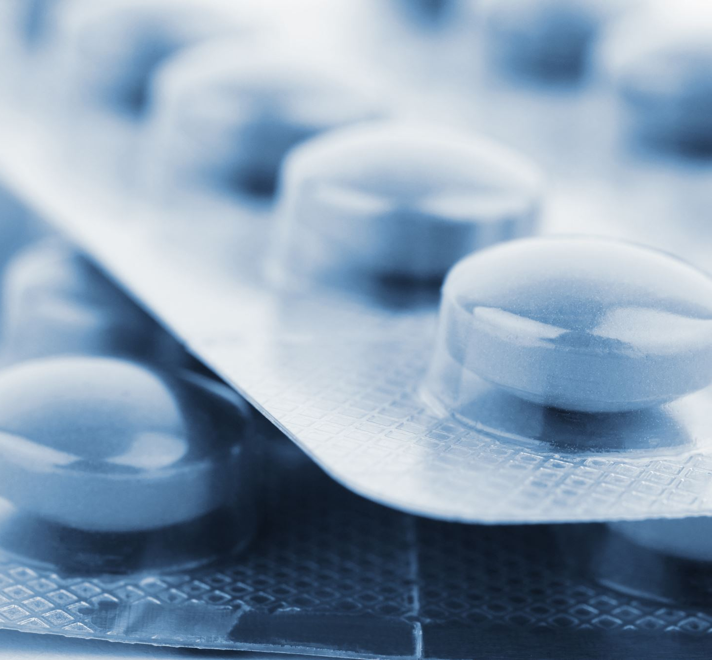
Having the ability to know where potential hazard risk exists can be of enormous value to drug manufacturers
Clifford Rossi, risk management

Slide 7
Tools Used
Power BI
Python

