Slide 1

Spotify EDA project

Slide 2

Business Case
Analytics team for a mall to create playlists suitable for the buyers focusing on the suitable parameters proposing the selected songs and artists

Slide 3

Variables(Spotify-specific)
Popularity
Danceability
Energy
Loudness
Speechness
Acousticness
Instrumentalness
Liveness
Valence

Slide 4
Genre Consideration
114 genres
1000 tracks per genre

Slide 5
Summary of Genre Choice Request for picking the most suitable genres according to:
Customer request
Preferences
Popularity

Slide 6
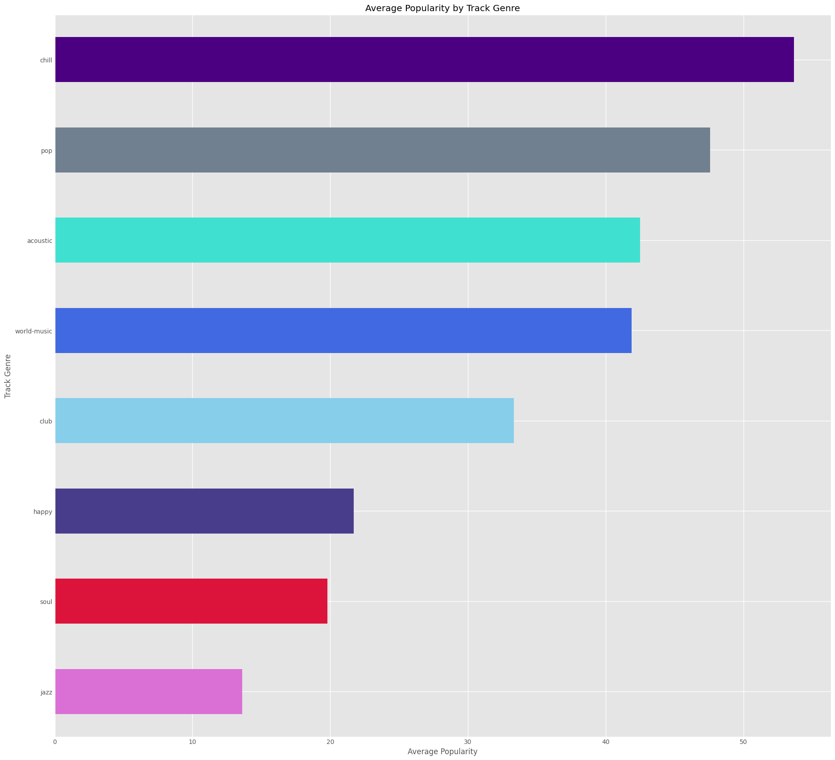
Average popularity of the genres we decided that are more suitable

Slide 7
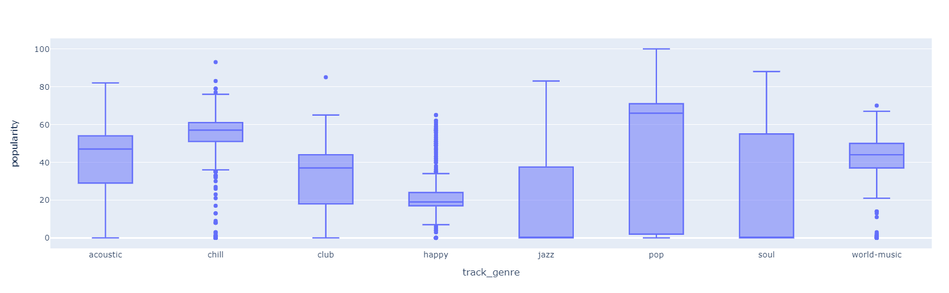

Slide 8
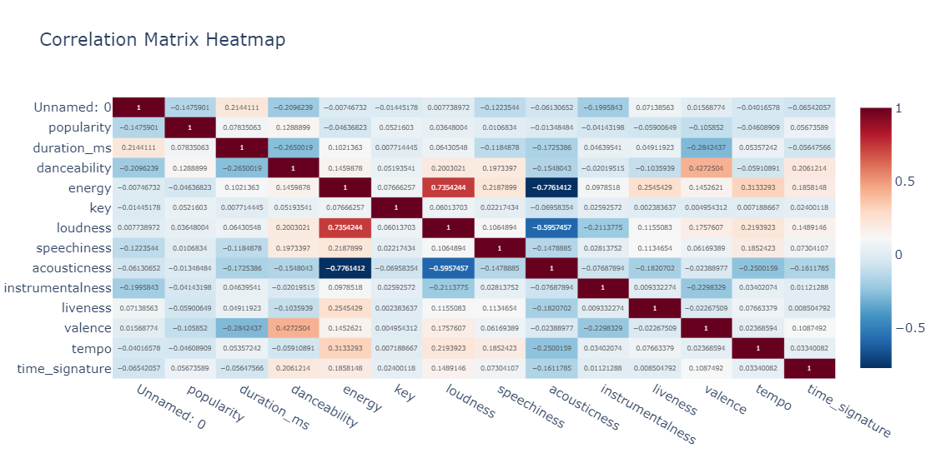

Slide 9
Association with Popularity
Danceability 14%
Energy 20%
Valence 20%
Loudness 22%
Acousticness -15%
Instrumentalness -15%

Slide 10
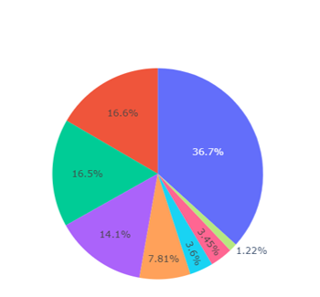
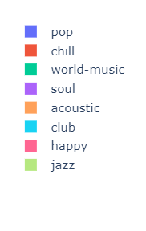
Genre Pie Chart

Slide 11
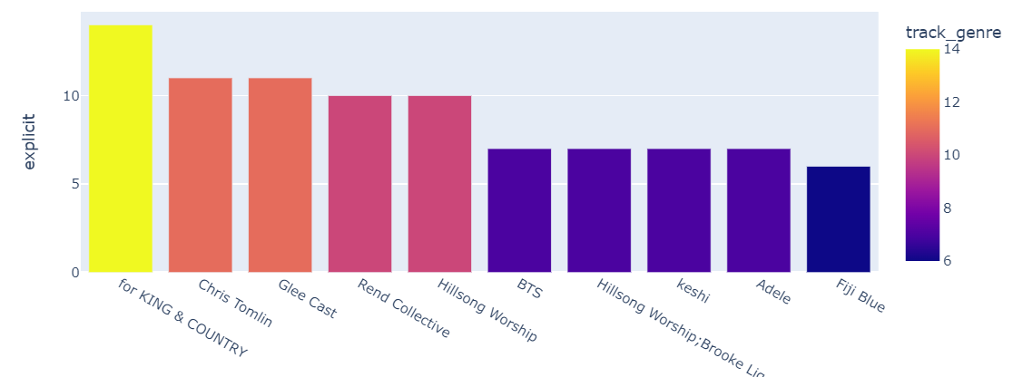
Top 10 Artists
The final selection of artists taking under consideration popularity,

Slide 12
Thank you

