Slide 1
♞ ChessLoop
Self-Hosted Spaced-Repetition Chess Opening Trainer
Python/FastAPI · React/TypeScript · SQLite · Chessground · Docker

Slide 2
What ChessLoop Does
The Core Loop
▹ Teach — play moves on the Teaching Board; each move saves to a Line in a Library
▹ Practice — the SRS engine (SM-2 variant) picks your weakest positions and quizzes you
▹ Feedback — wrong answers show a red flash + correct-move arrow; you must replay the right move
▹ Track — the Stats page shows accuracy heatmaps by move number and mastery % per opening

Slide 3
Core Capabilities
Feature Overview
▹ Opening Library Builder — teach by playing moves, per-move notes, PGN export
▹ Spaced-Repetition Drill Engine — modified SM-2, leech detection, weakness-biased selection
▹ Public Library Discovery — browse/search/filter, fork, star, read-only viewer
▹ Admin & Security — TOTP MFA, backup/restore, user role management

Slide 4
Teaching Board
Build Your Repertoire Visually
▹ Move navigation: ⟪ First · ‹ Previous · Next › · Last ⟫
▹ ↓ PGN export with [Event] header
▹ ⧭ Duplicate a line (full copy of all moves)
▹ Delete a move and everything after it

Slide 5
Move Annotations
Document Your Strategy
▹ Click a move → Add note → type (Ctrl+Enter to save)
▹ Notes persist across every session
▹ Visible in Teaching, Unrated Learning, and Practice modes
▹ Use for: why a move is played, trap warnings, links to analysis

Slide 6
Spaced Repetition Engine
Modified SM-2 with Leech Detection
▹ Correct: interval grows by ease factor (default 2.5x); Easy +0.15 ease, Hard -0.15
▹ Wrong: interval reset to max(1, interval × 0.25), requeued in 10 minutes
▹ Leech threshold: 4 cumulative wrong answers flags the position

Slide 7
Practice Sessions
Drill Your Weaknesses
▹ Weakest First — auto-starts the most overdue positions
▹ Rated / Unrated — choose whether a session counts toward metrics
▹ Leech Drill — dedicated mode for positions with 4+ wrong answers
▹ Priority: overdue → leeches → new items (20%) → weakness bias (2x under ease 1.8)

Slide 8
Intelligent Feedback
Motor Memory Through Physical Execution
▹ Board flashes red immediately on a wrong answer
▹ Animated arrow shows the correct move
▹ You must physically play it before continuing — recognition alone doesn't count

Slide 9
Progress Tracking
See Your Improvement Over Time
▹ Accuracy heatmap by move number — green ≥80%, yellow 50-79%, red <50%
▹ Mastery badges: not_started → learning → developing → advanced → mastered
▹ Per-library breakdown

Slide 10
Public Library Discovery
Share and Learn from the Community
▹ Search/filter by ECO code, color, difficulty
▹ Star favorites, leave comments
▹ Fork / Add to My Library — copies to your account
▹ Learn / View — read-only viewer, no forking required

Slide 11
Security & Auth
JWT + TOTP MFA
▹ Access token: 15-minute TTL, memory-only storage
▹ Refresh token: 30-day TTL, httpOnly cookie
▹ TOTP MFA via pyotp — Google Authenticator compatible, QR code setup

Slide 12
Backups & Recovery
Admin Panel, No Downtime
▹ full — entire database (users, libraries, lines, SRS progress)
▹ content — libraries and lines only, portable to another instance
▹ progress — SRS cards and review log only
▹ 10-backup retention, create/download/restore/upload from Admin panel

Slide 13
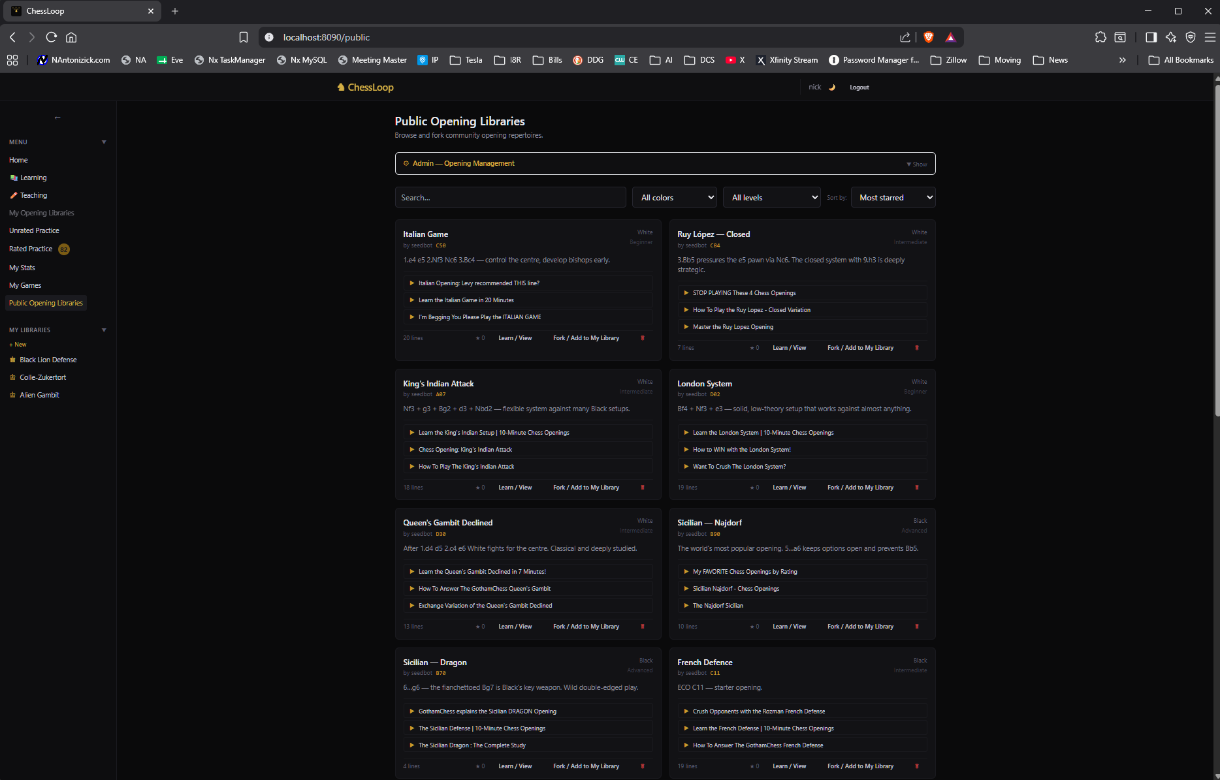
Opening Library Browser
Your collection at a glance

Slide 14
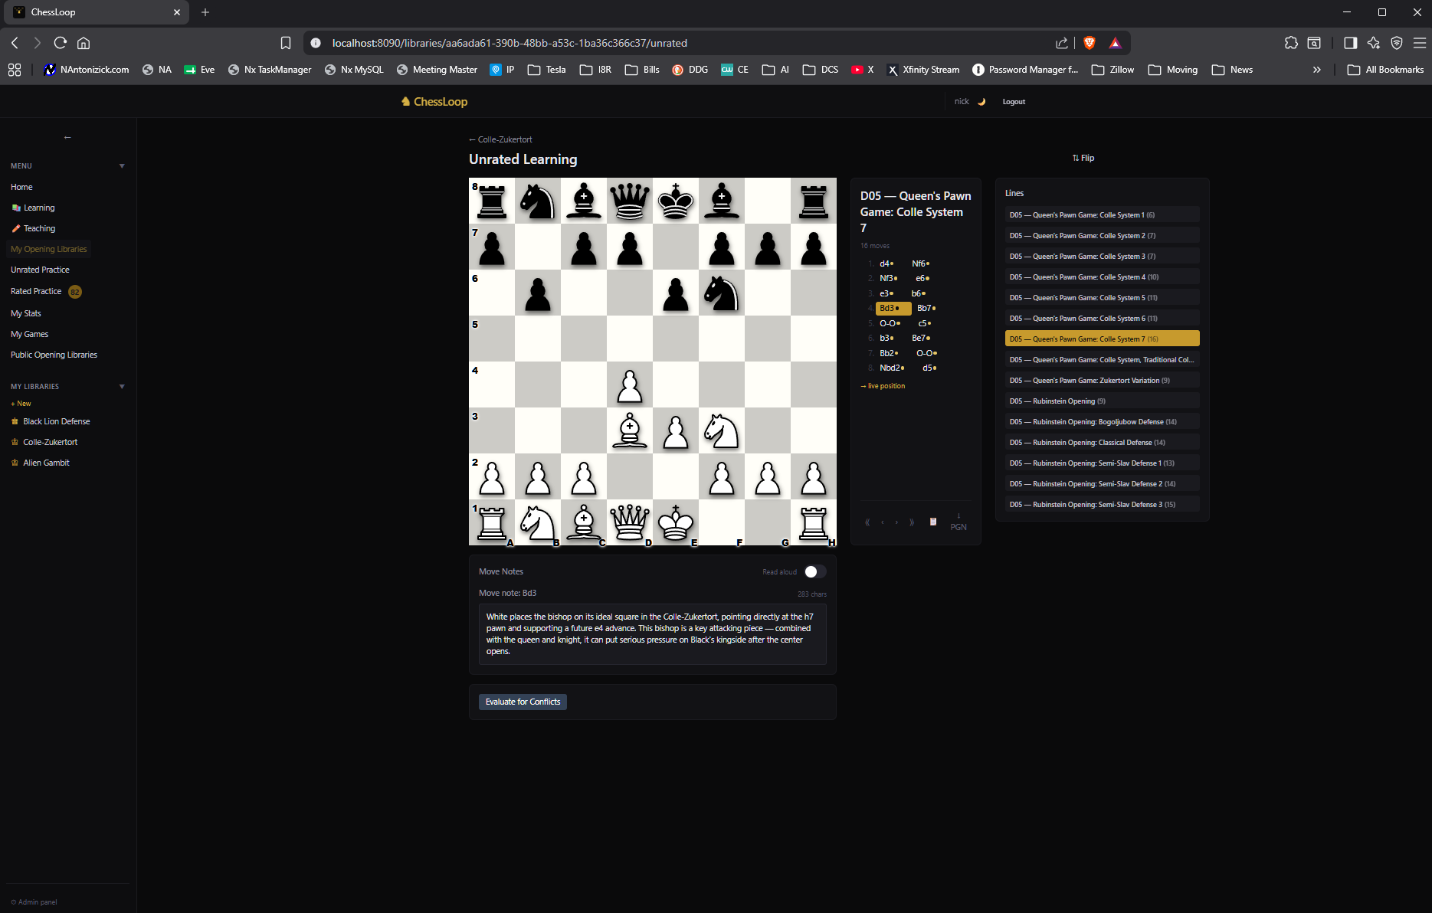
Learning & Training Arenas
Read-only study mode

Slide 15
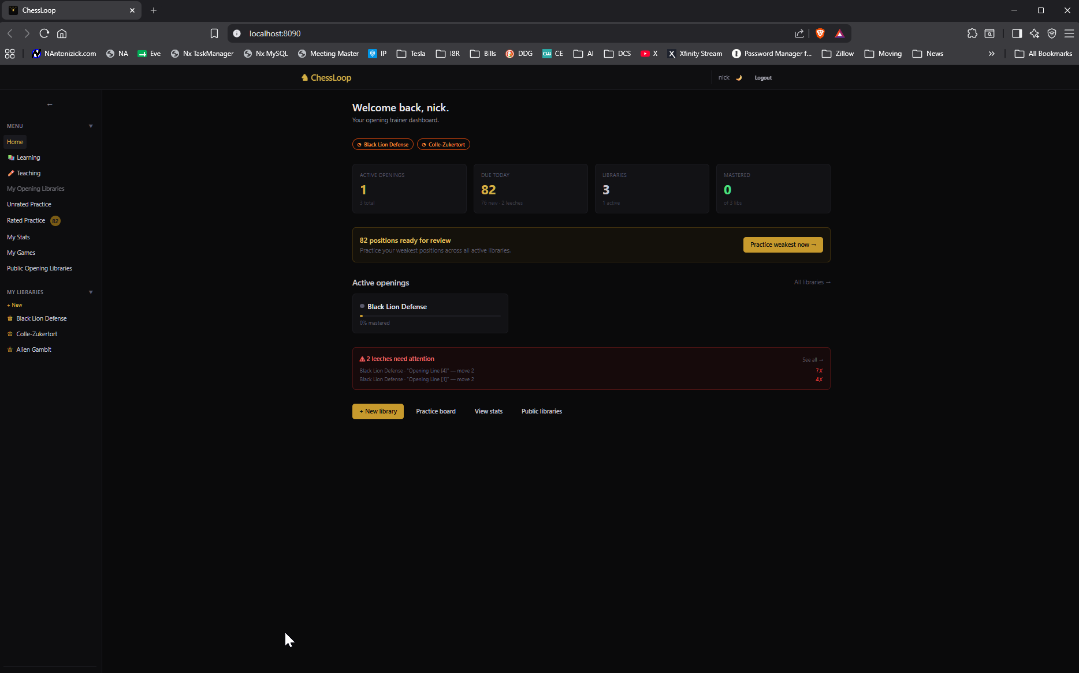
Tracking Dashboard
Accuracy heatmaps & mastery badges

Slide 16
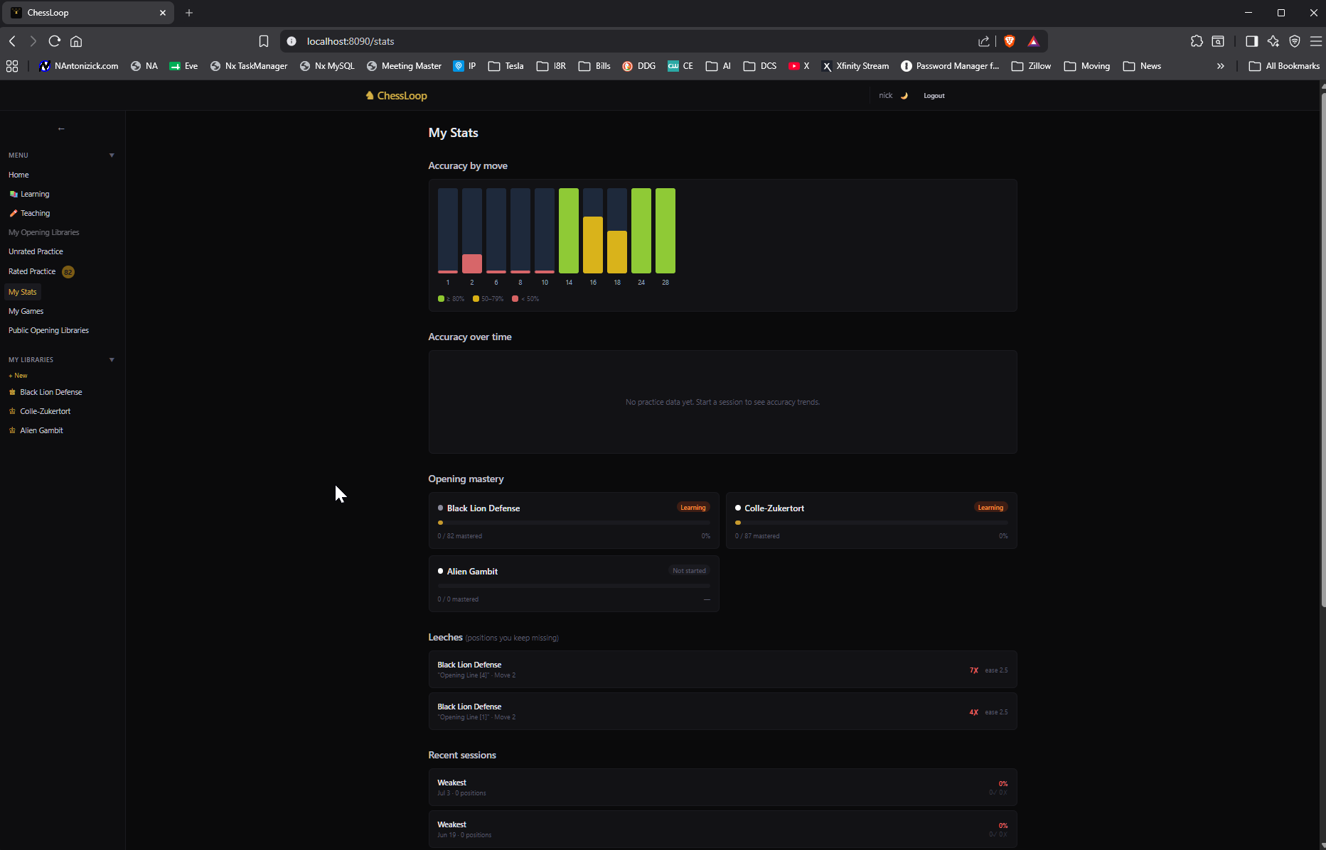
Statistics Tracking
Session-level performance detail

Slide 17
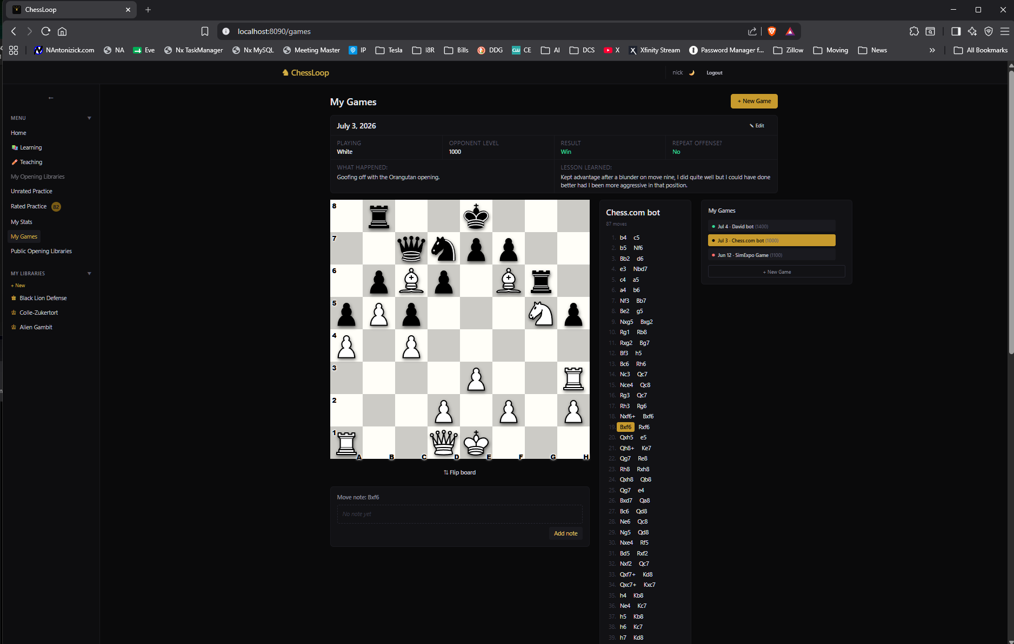
Game Tracking & Self-Analysis
Review every practice session

Slide 18
Appearance & Customization
Dark/Light Theme, Board & Piece Sets
▹ Board themes: Brown (default), Blue, Green, Ice, Purple
▹ Piece sets: CBurnett (default), Alpha, Mono, Shadow
▹ App theme: Dark (default) or Light — persists per-user, syncs across devices

Slide 19
Self-Hosted Deployment
One Command, Any Linux Box
▹ curl -fsSL .../deploy.sh | bash
▹ Auto dependency install: git, curl, openssl, Docker
▹ Port scan + conflict-free suggestion
▹ Localhost-only vs. all-interfaces bind choice, health check, systemd autostart

Slide 20
16 Seeded Opening Libraries
Ready on First Install
▹ Italian Game — Main Line (White, C50, Beginner)
▹ Ruy López — Closed (White, C84, Intermediate)
▹ Sicilian — Najdorf (Black, B90, Advanced)
▹ Sicilian — Dragon (Black, B70, Advanced)
▹ French Defence — Classical (Black, C11, Intermediate)
▹ + 11 more, auto-published to Public Discovery

Slide 21
Tech Stack
Full Breakdown
▹ Backend — Python 3.12, FastAPI, SQLModel, SQLite (WAL)
▹ Auth — python-jose (JWT), passlib (bcrypt), pyotp (TOTP)
▹ Frontend — React 18, Vite, TypeScript, Chessground, chess.js, TailwindCSS
▹ State — Zustand (auth), TanStack Query (server data)
▹ Infra — Docker Compose, Nginx reverse proxy

Slide 22
API Surface
Full OpenAPI Docs Included
▹ /api/auth/ — register, login, MFA setup/confirm, refresh
▹ /api/libraries/ — CRUD, publish, fork, active toggle
▹ /api/lines/ — CRUD, moves, per-move notes
▹ /api/practice/ — session start/next/answer/end, due-count
▹ /api/stats/ — heatmap, mastery, leeches, recent sessions
▹ /api/public/ — browse, search, star, comments
▹ /api/admin/ — backups, user management

Slide 23
Engineering Highlights
Notable Design Decisions
▹ Strict move recording — no fuzzy matching, enforces repertoire discipline
▹ Canonical position keys — normalized FEN enables SRS dedup across transpositions
▹ SQLite WAL mode — concurrent readers + one writer, file = backup

Slide 24
Start Training Today
Self-hosted, private, built for real spaced-repetition practice.

