Slide 1
Eagle
By Nikol Panova, Tsvetomir Dimitrov, Bojidar Mangarov, Anton Kalitsov, Ognqn Petkov

Slide 2
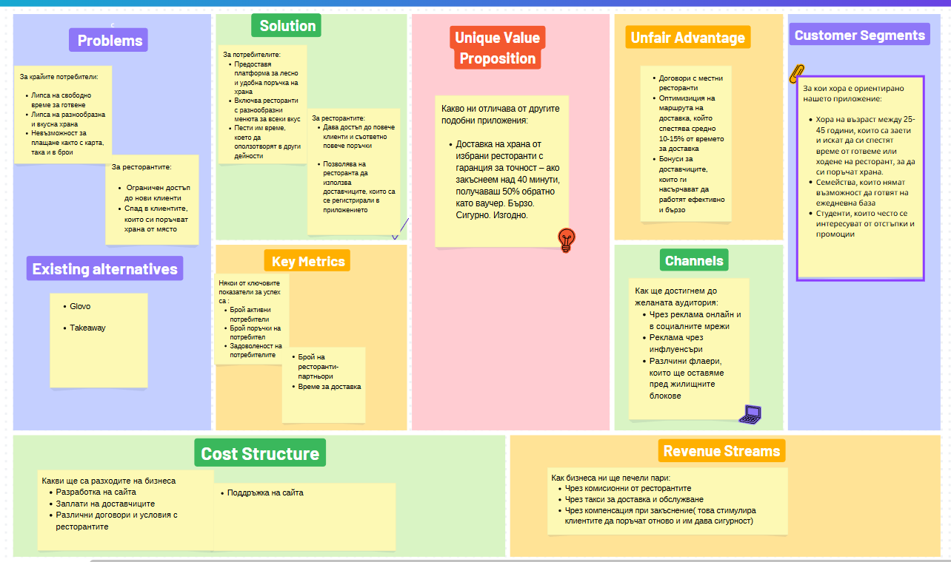
Bsiness model

Slide 3
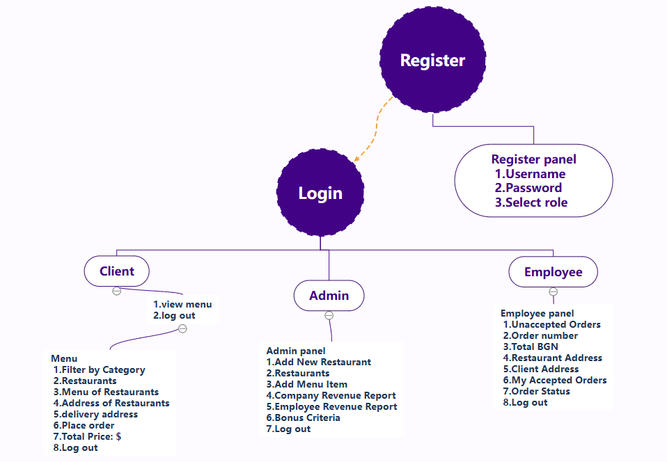
Architecture diagram

Slide 4
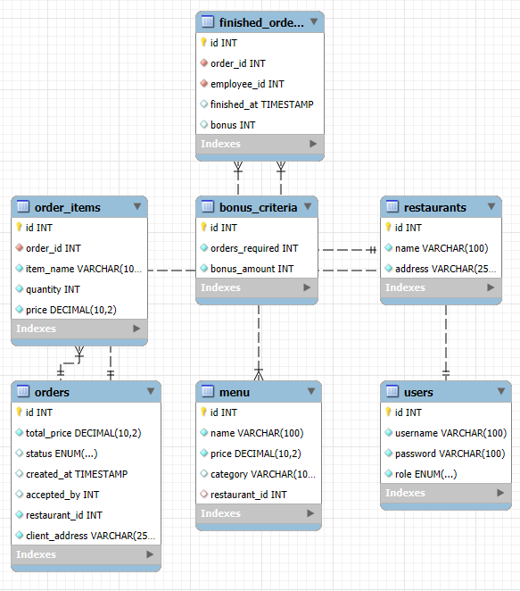
Database diagram

Slide 5
Testing
Test of functionality – OK
Test of database – OK
Test of adding new restaurants and menu items – OK
Test of ordering and accepting order – OK
Test of admin revenue generation – OK
Test of bonus calculation - OK

Slide 6
Source code
Review database
Review backend
Review frontend

Slide 7
documentation
EAGLE_DOCUMENTATION_CLIENT
EAGLE_DOCUMENTATION_EMPLOYEE
EAGLE_DOCUMENTATION_ADMIN
EAGLE_TECHNICAL_DOCUMENTATION

