Slide 1
C♯ Dependency Injection Unit Testing EF
Rasmus Lystrøm
External Associate Professor
ITU

Slide 2
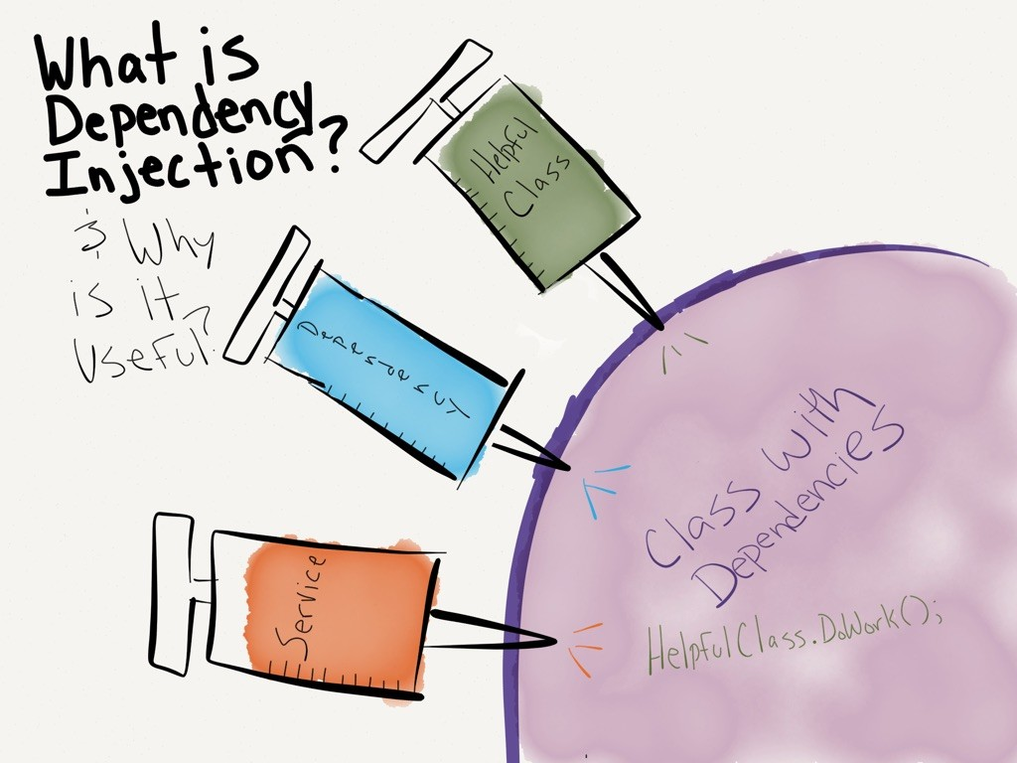
http://dwiardiirawan.com/index.php/2016/05/18/what-is-dependency-injection-and-what-are-the-advantage/

Slide 3
Dependency Injection (DI)
Software design pattern which implements Inversion of Control (IoC)
Constructor Injection
Property (setter) Injection
Interface Injection

Slide 4
Structered readable code More testable code Dependency Inversion Principle AWESOME!!

