Slide 1


Recommendation Systems
Anton nahhas & Sameer jbara

Slide 2
Table of contents
1.1 real-life example
1.2 long tail phenomenon
1.3 applications of recommendation systems
1.4 Utility matrix
2.0 different approaches of recommendation systems
3.1 content-based systems 4.1 collaborative filtering systems
3.2 item profiles 4.2 Jaccard and cosine distance in CF
3.3 items lacking features 4.3 rounding the data
3.4 TF.IDF and similarity measures 4.4 normalizing ratings
3.5 representing item profiles 4.5 the duality of similarity
3.6 user profiles 4.6 clustering users and items
3.7 recommending items to users

Slide 3

Let’s begin with an example
Physical stores have limited storage; Thus, they suggest a fairly small quantity of items for a customer, not depending on each customer’s preferences. But rather provides the items with the highest ranking and more popular in the world.
On the other hand, online stores do not have such issues, they can provide a vast amount of resources and items.

Slide 4
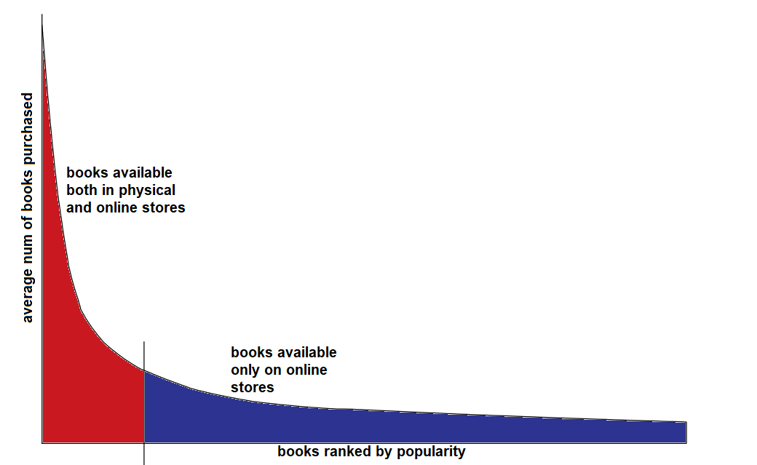
Long-tail Phenomenon
in this vast amount of resources, it is difficult for a customer to explore new items, thus we need a recommendation system. This is the Long-tail Phenomenon.

Slide 5







Applications of recommendation systems
Product Recommendations: online retailers, such as Amazon, Asos, Ali-express, and more. These applications recommend their items according to other customers’ similar interests or past visits of the customer to the site.
Movie Recommendations: such as Netflix, HBO, Disney, and more. These applications recommend users’ movies depending on the ratings of each movie given by the user himself or other similar ratings.
News Articles: such applications recommend users depending on past letters read, or important words shared by multiple articles.

Slide 6
Utility Matrix in recommendation systems
A Utility Matrix is a way to represent the data collected for two groups, users and items.
Each user-item pair represents how much a user would rank a specific item.
The matrix is sparse, meaning it contains empty cells.
A recommendation system’s goal is to predict the values of as much as empty cells as possible.

Slide 7
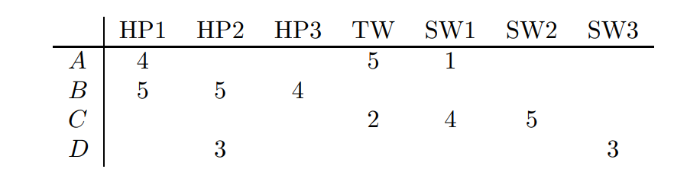
An Instance of a Utility Matrix
**
Movies
Users

Slide 8


Different approaches for recommendation systems
Content-Based Systems: recommending the user items according to the properties of the user. Basically, we find the most suitable features of an item for the user’s preferences.
Collaborative Filtering Systems: recommending the user items according to other similar users and/or items. In other words, comparing the rows and cols in order to fill a blank entry in the matrix.

Slide 9
Content-Based Systems
Item-Profile
Build a profile of features of an item that specify the specialty of that item.
User-Profile
Build a profile of preferences for a user that specify the user’s taste.
Comparison
Compare the two profiles in order to know if the system should recommend a specific item for a user.

Slide 10




Items profile
Each item has multiple features, we can build a profile of features for each item.
Genre could be specified as a feature, but it is preferred not to use it.
features for items could also be obtained from available data entered by hand from the creator of the item.

Slide 11


Items lacking features
Not all items could have features obtained easily such as documents and images.
Recommendation systems can’t read all documents, especially when documents are published daily, and compare them with others.
While Images data structure is basically an array of pixels, each pixel representing a color, the only data we can extract is the color of an image which is not very helpful for recommendation systems.

Slide 12

Discovering features for images
As mentioned before images are arrays of pixels it is difficult to determine features defining images.
The most suitable way is to describe image features by tags. The purpose of this tagging is to provide meaningful comments about a certain image that we can count on as a feature.
The tags are given by the creators of this image or even by users, however, we can’t depend on users to give these tags since it requires their own effort.
Using these tags, we can recommend images that have similar topics.

Slide 13
Discovering features of documents
The most suitable feature for a document is the set of frequent words describing this document, we can do so using this algorithm.
Firstly, we need to eliminate stop words(words that do not describe the document topic, such as, then, and, the, is, and more).
Secondly, we calculate the TF.IDF score for the remaining words, the higher the score the more suitable of a feature it is.

Slide 14
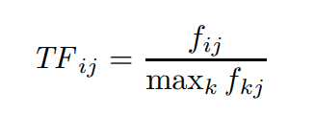



TF.IDF Term Frequency-Inverse Document Frequency
Frequency of word I in document j
N is the number of documents
**
The maximum number of occurrences
of any term in the same document
Ni number of documents the word occurred in
=

Slide 15
TF.IDF example
Let us assume that we have a word w, a document j, and 2^20 documents. And w reoccurred 2^10 times in these documents and 20 times in document j (max reoccurrences).
Then the TF for w in j = 20 / 20 = 1.
the IDF for w = log(2^20/2^10) = 10. (log to the base of 2)
TF.IDF = 1 * 10 = 10.

Slide 16

Representing item profiles
We can represent features using vectors, 0’s and 1’s if the values are discrete, for instance, a set of actors.
Otherwise, features like movie ratings are represented by the numerical value given.
Vectors can, as well, be represented by both numerical and Boolean values.
**

Slide 17

User Profiles
We also represent user profiles as vectors, representing the user’s likings.
If we have a utility matrix of Boolean numbers, we can take the average of a certain feature in the item profiles to be the profile for the user of that specific feature.
On the other hand, if the utility matrix has non-Boolean values, such as the rating of movies (1-5), we take the average weight of the vectors representing the item profiles.

Slide 18
User Profiles
Example for a utility matrix consisting of Boolean numbers
Example for a utility matrix consisting non-Boolean numbers
 | Movie 1 | Movie 2 | Movie 3 | Movie 4 | Movie 5
User | 1 | 1 | 1 | 1 | 1
Kevin Hart-40% The Rock-60%
[ 0.4 , 0.6 ]
Kevin Hart movies
 | Movie 1 | Movie 2 | Movie 3
User 1 | 3 | 4 | 5
User 2 | 2 | 3 | 5
User1 avg rating = 3
User2 avg rating =4
User1 = ( 3-3 + 4-3 + 5-3 ) / 3=1
User2 = ( 2-4 + 3-4 + 5-4 ) / 3=-2/3
User1 = [ 1, … ]
User2 = [ -2/3, … ]

Slide 19
Recommending items to users
Now we have two vectors each representing the profiles of users and items.
For example, the items are movies that have actors as features, and the profile for the user is how much he likes the actors of different movies, in order to recommend a new movie for the user, we calculate the cosine distance between the 2 vectors. The distance calculated closer to 0 is more recommended for the user.

Slide 20

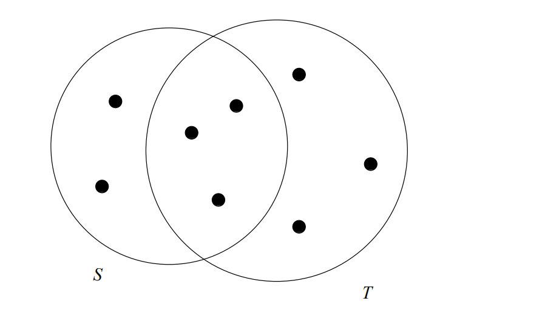
Jaccard distance
The Jaccard similarity of sets S and T is
**
The Jaccard distance = 1 – Jaccard Similarity

Slide 21
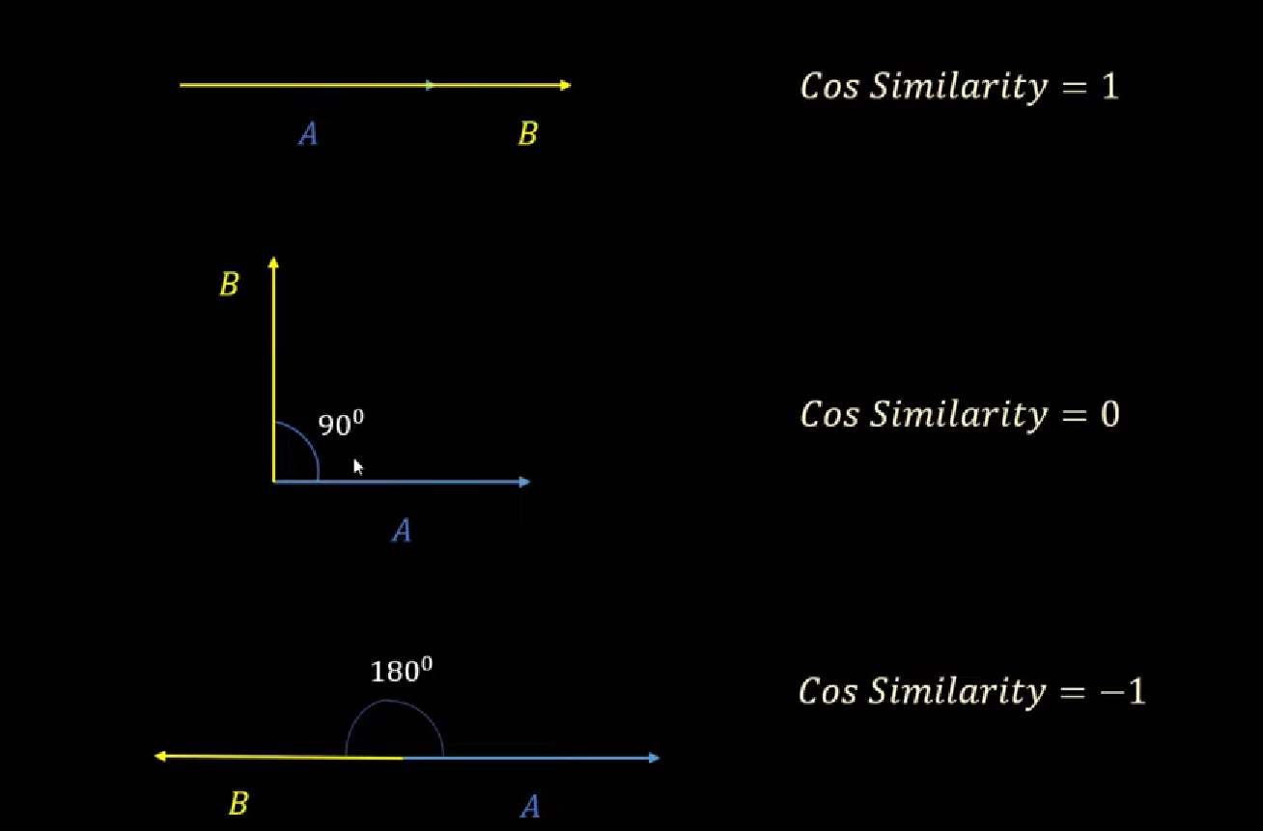
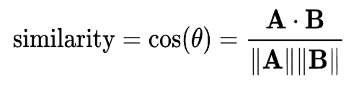
Cosine Distance
Reference from
https://www.youtube.com/watch?v=m_CooIRM3UI
Given two vectors u and v.
We need to figure out the cosine angle between the two vectors.
Calculate the dot product of u.v
Calculate the norm of both vectors, Lu and Lv.
The cosine angle, in other words, the cosine similarity, is u.v / (Lu * Lv).
The cosine distance = 1 – cosine similarity.
**

Slide 22
Recommending documents to users
In order to recommend a new document to user from a set of documents, we need to extract the features of each document as we mentioned before.
We need to calculate the similarity between the user profile and each other document profile.
We can use these distance measures:
The Jaccard Distance
The Cosine Distance.

Slide 23
Cosine and Jaccard distance examples
Let us assume we have two documents were:
First document Second document
………………..
………apple…...
……..
………...apple.
…..android…….
………………….
……apple………
….android..
…………………..
…..ipad.………..
…watch…………..
……android……
…………………..
..apple………….
……….apple…..
..
android………..
…………android.
…..android…….
tablet.. ……tablet
.....android………
……….tablet
First doc vector = [3,2,1,0,1]
Second doc vector = [2,5,0,3,0]

Slide 24


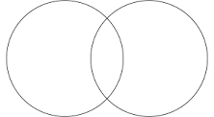
Jaccard Distance for documents
First doc vector = [3,2,1,0,1]
Second doc vector = [2,5,0,3,0]
Let us assume we have two sets S and T
Were S consists of document 1 features, and T of document 2 features.
S T
= 2
= 3
Jaccard similarity = 2/3
Jaccard distance = 1 – 2/3 = 1/3

Slide 25
Cosine Distance for documents
First doc vector = [3,2,1,0,1]
Second doc vector = [2,5,0,3,0]
Let us assume that A and B are vectors.
Where A is the vector for document 1 and B is the vector for document 2
In order to calculate the cosine angle first we convert the vectors to Boolean values (1’s if the word is found in the document and 0 if not) thus we get:
A = [3,2,1,0,1] = [1,1,1,0,1] and B = [2,5,0,3,0] = [1,1,0,1,0] then we calculate:
A.B = 2, ||A|| = √4, ||B|| = √3
Cosine similarity = 1/√3
Cosine distance = 1 - 1/√3 = (3 - √3)/3

Slide 26
An instance of recommendation system
Let us recall a previous example, we want to recommend a new movie for this user
Given two new movies with these item profiles of the cast only
Movie 1 : [1,1,1,1], the cast of the movie: Kevin, TheRock, Jennifer Lawrence, Zendaya
Movie 2 : [0,0,1,1], the cast of the movie: Jennifer Lawrence, Zendaya.
And our user profile will look like this: [0.4, 0.6, 0, 0]
Kevin Hart-40% The Rock-60%
[ 0.4 , 0.6 ]
 | Movie 1 | Movie 2 | Movie 3 | Movie 4 | Movie 5 | Movie 6
User | 1 | 1 | 1 | 1 | 1 | ?

Slide 27
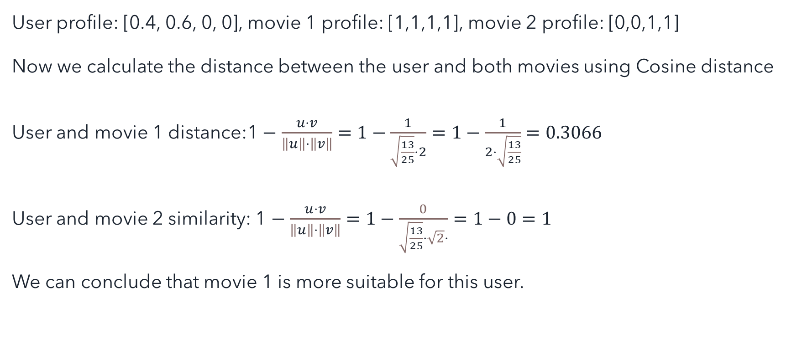
An instance of recommendation system
User profile: [0.4, 0.6, 0, 0], movie 1 profile: [1,1,1,1], movie 2 profile: [0,0,1,1]
Now we calculate the distance between the user and both movies using Cosine distance
User and movie 1 distance:1 $−$ $\frac{u⋅v}{\left\|u\right\|⋅\left\|v\right\|}=1−\frac{1}{\sqrt{\frac{13}{25}}⋅2}=1−\frac{1}{2⋅\sqrt{\frac{13}{25}}}=0.3066$
User and movie 2 similarity: 1 $−$ $\frac{u⋅v}{\left\|u\right\|⋅\left\|v\right\|}=1−\frac{0}{\sqrt{\frac{13}{25}}⋅\sqrt{2}⋅}=1−0=1$
We can conclude that movie 1 is more suitable for this user.

Slide 28
Collaborative filtering recommendation systems
This is a whole different approach, instead of user and item profiles, we use vectors of the rows and columns of the utility matrix.
Using distance measurements such as cosine and Jaccard distance, we can measure the similarities of users and the similarities of items in order to fill an empty blank in the matrix.

Slide 29
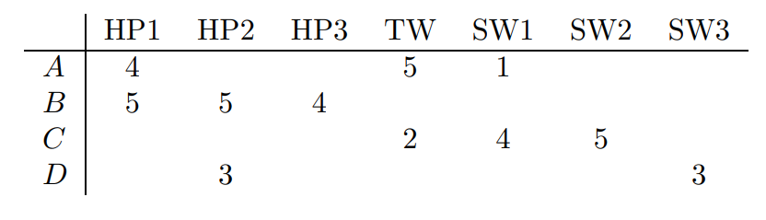
Jaccard distance in collaborative filtering
**
Blank values could be ignored
A ^ B = 1, A v B = 5 => Jaccard similarity = 1/5, Jaccard Distance = 4/5.
A ^ C = 2, A v C = 4 => Jaccard similarity = 2/4, Jaccard Distance = 2/4.
Even though, A is closer to B than C intuitively, the distance between A and C is closer than the distance to B.

Slide 30
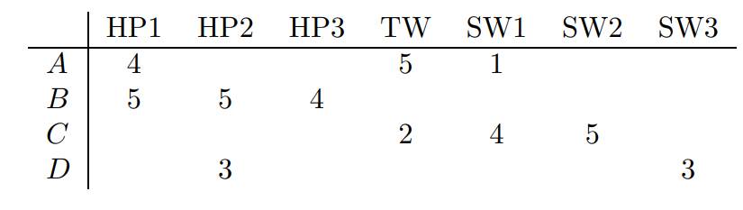
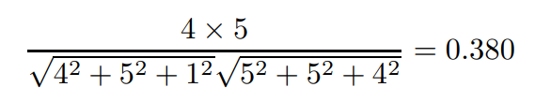
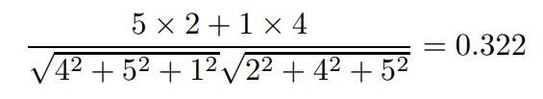
Cosine distance in collaborative filtering
**
We treat blanks as 0’s.
Cosine angle between A and B
Cosine angle between A and C
A is closer to B than C, however the distance is similar.

Slide 31
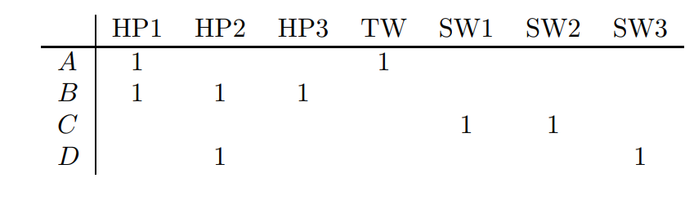
Rounding the data
In order to get more accurate results, we can round up the data in the matrix.
For the same example as before, rating of 3, 4, and 5 are rounded up to 1, the ratings of 1 and 2 are unrated.
A ^ B = 1, A v B = 4 => Jaccard similarity = 1/4, Jaccard Distance = 3/4.
A ^ C = 0, A v C = 4 => Jaccard similarity = 0, Jaccard Distance = 1.
**

Slide 32
Normalizing ratings
We have seen improvements in the Jaccard calculations.
However, this method improves the calculations for cosine distance.
We normalize ratings, meaning, giving weight by subtracting each rate from the average rating of that user and dividing the number of items.
This will give each low rating a negative value while higher ratings are positive.

Slide 33
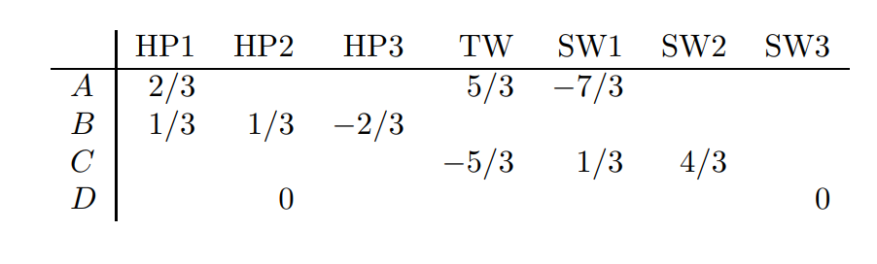
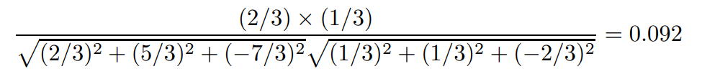
Normalizing ratings
**
Cosine angle between A and B
Cosine angle between A and C
We can conclude that the distance between A and B is way closer than A to C.

Slide 34
The Duality of Similarity
There are 2 ways of predicting an empty cell of a utility matrix.
User-user CF: for a given user U and item I (that we need to recommend for user U); It is better to normalize the matrix first.
We find n users that are most similar to U.
Calculate the average for the users rating for item I.
Average the differences for those users who have rated I and then add this average to the average ratings that U gives for all items.

Slide 35
The Duality of Similarity
Item-item CF: for a given user U and item I (that we need to recommend for user U); It is better to normalize the matrix first.
Find the m items that are similar to I.
Take the average rating among the m items of the ratings that U has given.
Then fill in the blank with the average we got.

Slide 36
Clustering Users and Items
In collaborative filtering it is hard to distinguish user-item pairs, since we have limited information about these pairs in a sparse utility matrix.
Few users would buy or rate the same couple of items even if they are from the same genre.
On the same note, even if similar users have the same favorite genre or genres, does not mean they have to buy the same items of this genre or genres.
Clustering users and items will help us solve this issue.

Slide 37

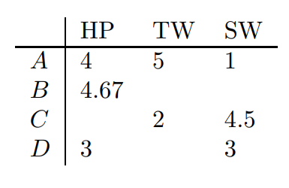
Clustering Users and Items
Using one of the distance measures, we can cluster similar item groups or/and similar user groups using a hierarchical approach, meaning, clustering the groups until we have at least half the number of items in that group.
In this instance we have clustered similar movies, such
As all the harry potter franchise to one cluster.
We can even cluster similar users. This will reduce the
Number of empty blanks. In order to find the entry I for user U in the original matrix we need to find the clusters to which U and I belong. If the cell found was not blank use the value to fill the original matrix, if the cell is blank, we can use the method of duality of similarity.
**

Slide 38
References
Everything we mentioned in this project was solely understood from this book
-http://infolab.stanford.edu/~ullman/mmds/book.pdf
all pictures that have ** near them are also from the same book above
Other pictures in examples are self-made.

Slide 39
Q&A
Thank you for your time..
Sincerely Anton & Sameer

Slide 40

small quiz

