Slide 1

בין תאוריה למעשה
תרגיל 2
Logical fallacies and Biases
אנטון נחאס

Slide 2
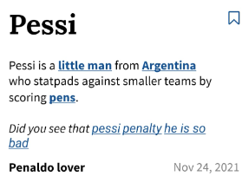
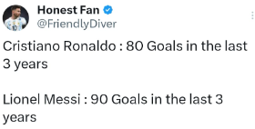
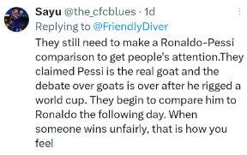

Logical Fallacies in Social Media
the fallacies committed in this example are Ad Hominem.

Slide 3

Cognitive Bias
This story shows an example of me committing an Overconfidence effect and the Anchor biases.
I consider myself a decent player at table tennis.
A woman challenged me to a game of tennis.
I started showing off and lost!

Slide 4
Two other examples
Hasty Generalization:- immigrant crimes in Turkey.
Availability heuristics:- what is more likely? Death by homicide or death by stomach cancer?

