Slide 1
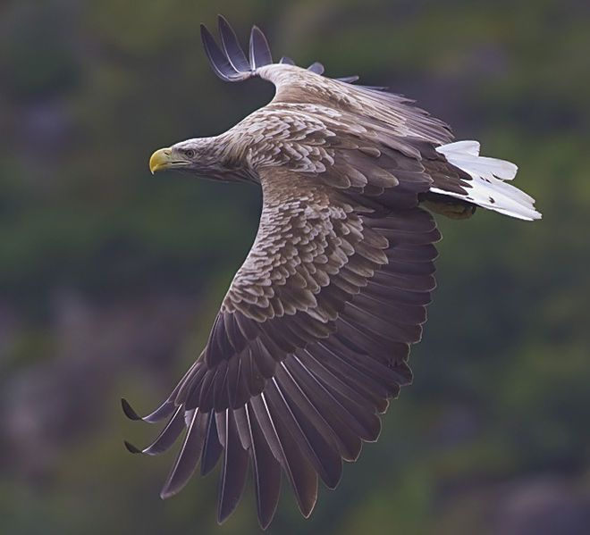
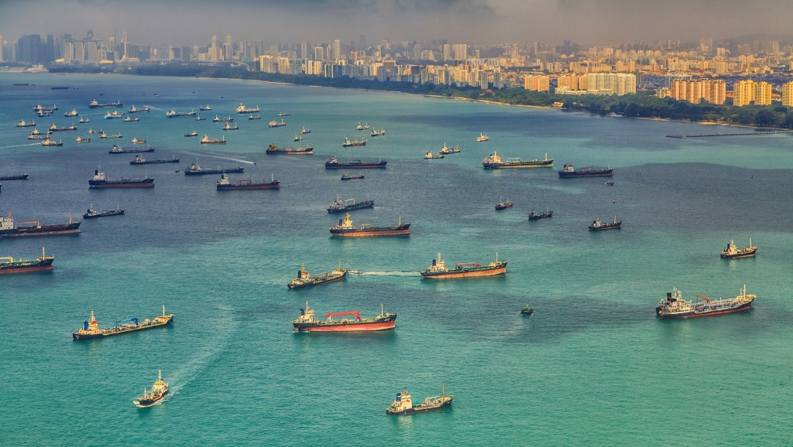
Ship detection
Erns:
Bellos Adam (f2822009)
Nakos Antonios (f2822010)
Ziou Alexandros (f2822020)

Slide 2
Definitions
Maritime Domain Awareness
Maritime Surveillance
Ship detection

Slide 3
The current situation
Existing systems:
Automatic Identification System (AIS)
Long-Range Identification and Tracking (LRIT)
Vessel Monitoring System (VMS)
Drawbacks:
Most small vessels do not need to carry AIS or LRIT.
The vast majority of fishing vessels do not carry VMS depending on the region.
The illegally operating vessels turn off these systems
The data collected are subject to different governments and legal systems
There is not a efficient data exchange system to ensure comprehensive maritime awareness

Slide 4
Ship Detection
Remote access In a nutshell, in many scenarios it can offer
Global reach
Regular update
High data collection volume
Feasibility
Lower costs

Slide 5
Applications
Detect illegal behaviors such as:
Smuggling
Piracy
Irregular migration
Illegal Fishing
Monitor maritime traffic and aid spatial planning
Support defense and security
Monitor maritime pollution

Slide 6
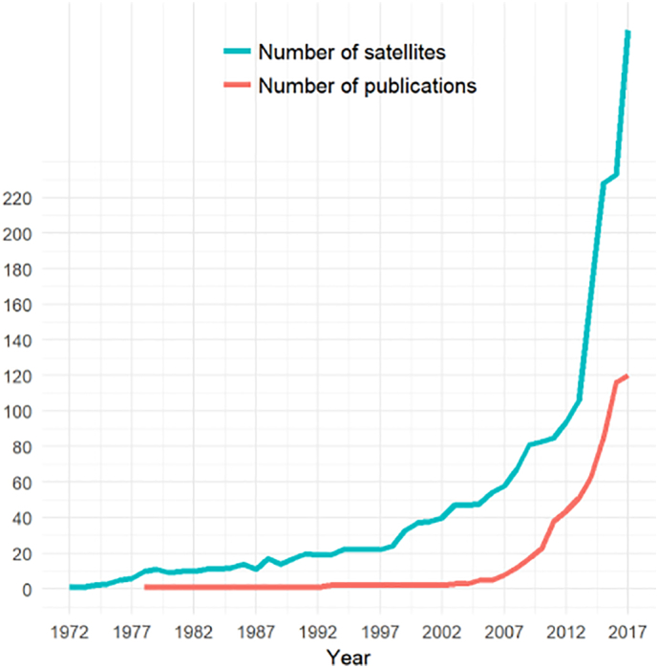
Is it a growing field?

Slide 7
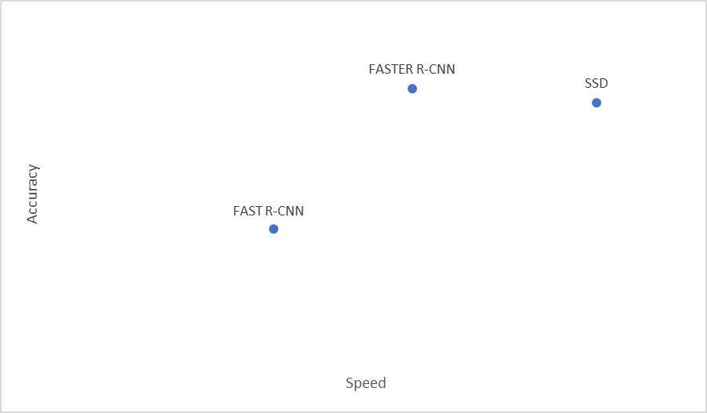
Our project
Objective
Create a model with high accuracy and speed
We analyzed various algorithms in literature to find the best one for our project
Some of the best ones are shown below

Slide 8
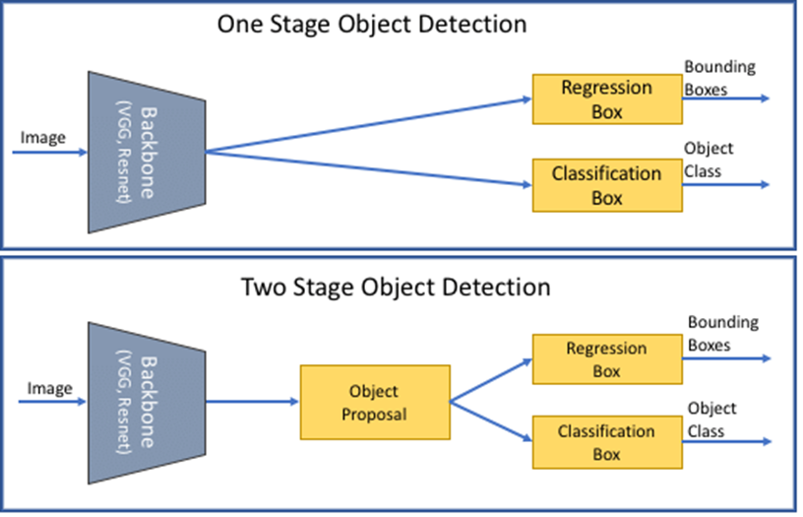
SSD
We selected Single Shot Detector (SSD) for its balanced accuracy and speed
SSD works in one step compared to most of the other algorithms which work in two steps

Slide 9
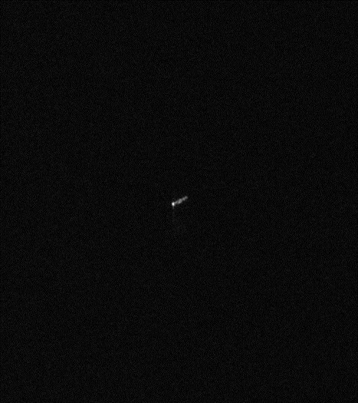
Dataset
The dataset consists of around 1,600 SAR images containing ships
It mainly depicts the South African exclusive economic area

Slide 10
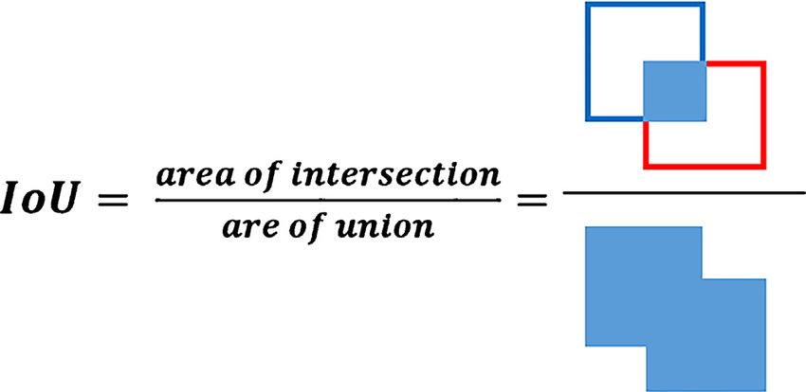
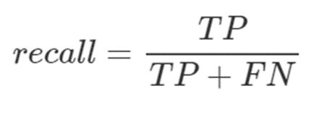


Model
After various processing steps, configurations and experiments we created a model with the following results

Slide 11
Model

Slide 12
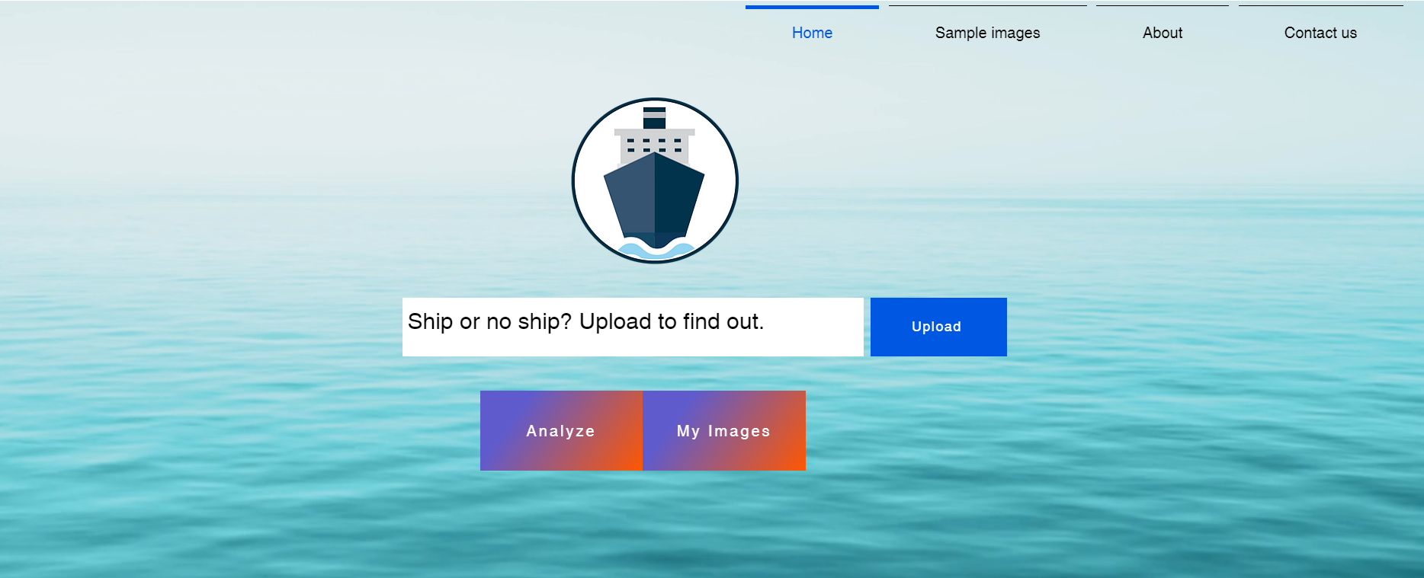
Prototype
https://shipdetection.wixsite.com/home

Slide 13
Future work
Expanding the size of the dataset
Increasing the number of geographic areas
Comparing with other state-of-the-art models
Implementing multiclass classification

Slide 14
Thank you for your attention!

