Slide 1
Microservices with Spring Cloud
August 2019

Slide 2
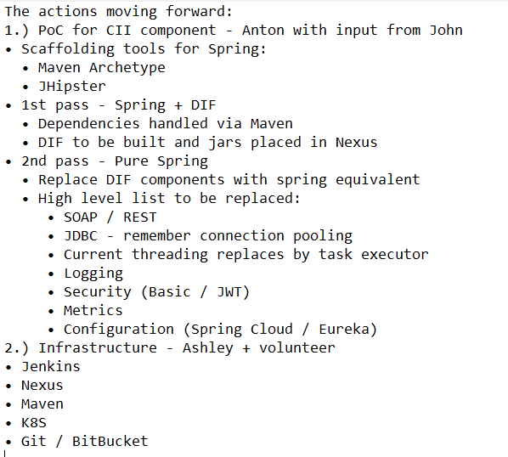
The conclusions from the previous discussion

Slide 3
The Microservices Technological Stack The initiative name: Spring Cloud & Microservices
Microservices
Spring Cloud
Spring Boot
Based on
Spring Framework
JAVA

Slide 4
CII/CIM/Metrics (the current implementation)
SOAP
CORBA
CII
CIM
framework
Metrics
IM DB
CIM DB
*
JVM

Slide 5
CII/CIM/Metrics (Microservices implementation)
SOAP
Eureka
REST
CII
CIM
Messaging Broker (Kafka)
CIM DB
Metrics
*
IM DB
JVM

Slide 6
Multilayer Spring Application
Parent pom.xml
cim_service
pom.xml
dependency
cim_persistence
pom.xml

Slide 7
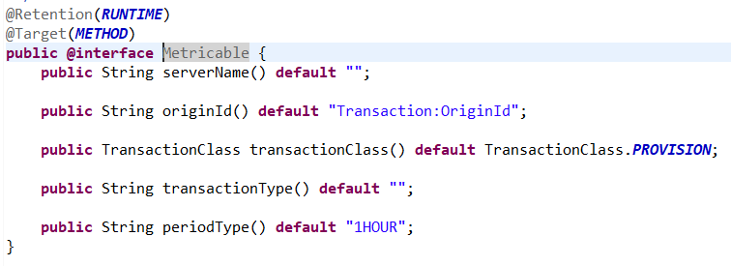
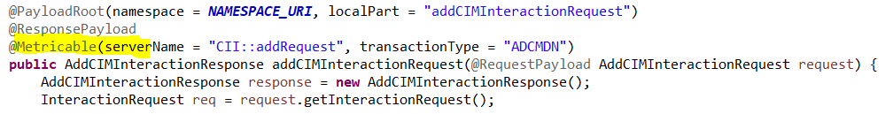
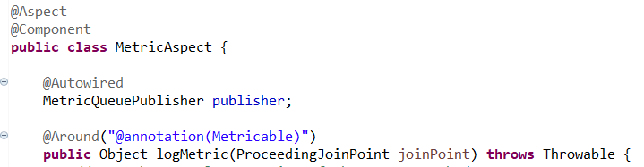
Implementing the Metrics- service async call as an aspect
The custom annotation:
The @Metricable method in CII- service:
The implementation of the aspect:

Slide 8


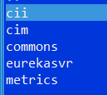

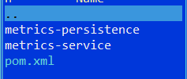
The “Pilot” Artefacts
The design principles:
The Microservices are fine-grained and have to be kept “small”;
Use the standard Spring- components wherever it is possible;
Logging -> LOGBACK (standard for Spring Boot);
Zero Spring configuration in XML. Use annotations instead;
Each Microservice is a separated Maven project;
No domestic frameworks (Spring is the only framework has to be used);
Services are maximally isolated from each other; The common classes have to be stored in Commons (a dedicated Maven project);
The database layer based on JPA/Hibernate, the connection pooling is standard for Spring;
The Microservices are stateless;
+ async
version

Slide 9
Not included into the concept
* Configuration: the Spring Could Config Server with the Git- based storage of the config files for all environments;
Idea:
Legacy Service
Microservices
Git Repository
Legacy Service
Config Importer Microservice
Legacy Service
DB allocated configuration data
Config Service
Microservice
Microservice

