Slide 1
Microservices with Spring Cloud
August 2019

Slide 2
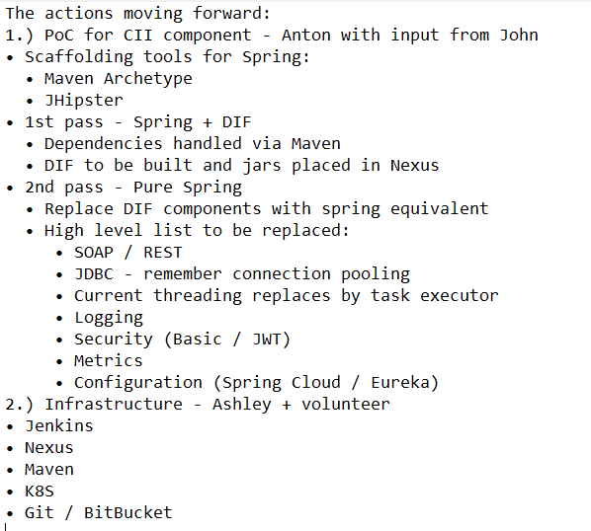
The minutes from the previous discussion

Slide 3
The Microservices Technological Stack The initiative name: Spring Cloud & Microservices
Microservices
Spring Cloud
Spring Boot
Based on
Spring Framework
JAVA

Slide 4
CII/CIM/Metrics (the current implementation)
SOAP
CORBA
CII
CIM
framework
Metrics
IM DB
CIM DB
*
JVM

Slide 5
CII/CIM/Metrics (Microservices implementation)
SOAP
Eureka
REST
CII
CIM
Messaging Broker (Kafka)
CIM DB
Metrics
*
IM DB
JVM

Slide 6
Multilayer Spring Application
Parent pom.xml
cim_service
pom.xml
dependency
cim_persistence
pom.xml

Slide 7
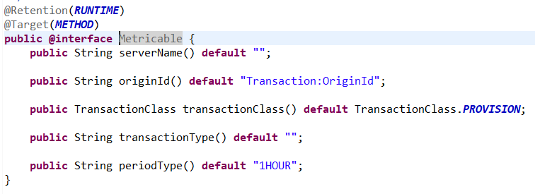
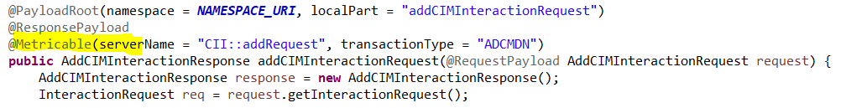
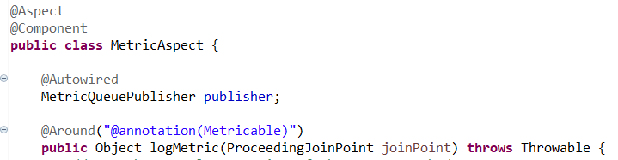
Implementing the Metrics- service async call as an aspect
The custom annotation:
The @Metricable method in CII- service:
The implementation of the aspect:

Slide 8


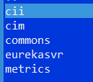

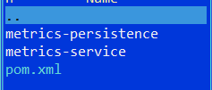
The “Pilot” Artefacts
The design principles:
The Microservices are fine-grained and have to be kept “small”;
Use the standard Spring- components wherever it is possible;
Logging -> LOGBACK (standard for Spring Boot);
Zero Spring configuration in XML. Use annotations instead;
Each Microservice is a separate Maven project;
No domestic frameworks (Spring is the only framework has to be used);
Services are maximally isolated from each other; The common classes (preferably – interfaces) have to be stored in Commons (a dedicated Maven project);
The database layer based on JPA/Hibernate, the connection pooling is standard for Spring;
The Microservices are stateless;
JUnits are essential (75-80% coverage).
+ async
version

Slide 9
The Deployment Model
Messaging
Eureka
(8761)
Zookeeper
(2181)
SOAP
REST
Kafka
(9092)
CII Service
(8100)
CIM Service
(8070)
CIM Service
(8071)
Metric Service
(8090)

Slide 10
The Integration Patterns
1
Synchronous
Discovery Service (Eureka)
Service A
Service B
Service C
@EnableAsync
@Async
2
Asynchronous
Messaging Broker
Pseudo Async,
see cim_async
3
Service A
Service B

Slide 11
Not included into the concept
* Configuration: the Spring Could Config Server with the Git- based storage of the config files for all environments;
Idea:
Legacy Service
Microservices
Git Repository
Legacy Service
Config Importer Microservice
Legacy Service
DB allocated configuration data
Config Service
Microservice
Microservice

Slide 12
Not included into the concept (continued)
* The deployment model (Docker + Kubernetes);
* Security (OAuth?);
* Failure Handling;
* ………..

Slide 13
The Implementation Model
Option 1: mixed model
Microservices
Service B
App 1
Service A
Legacy
App 1
App 1
App 2
App n

Slide 14
The Implementation Model
Option 2: parallel model
Microservices
Service B
Legacy
Service A
App 1
App 2
App n

Slide 15
The implementation of the parallel model
App 20
1
Identify an Island;
App 10
Legacy
App 1
Island
2
The express analysis and
Reverse Engineering;
App 2
3
The Implementation of the Microservices
Testing/Load Testing;
App 3
4
The parallel run with the limited workload
(in parallel with the legacy services);
App 30
5
The final migration to the Microservices
of the island;
Island A
Island B
Island N

Slide 16
Concerns/Risks
The Microservices solution is resource demanding;
Database (1): no DB pool coordination between services/service- instances;
Database (2): the business logic implemented in the stored procedures;
The learning curve: Spring Framework->Spring Boot->Spring Cloud

Slide 17
The Source Code in Git- repository
>git clone https://github.com/antonnazarov/altron-pilot.git
Use branch: demo-august-2019

