Slide 1
what do u want to see?
weird fishes.
jellyfish.

Slide 2
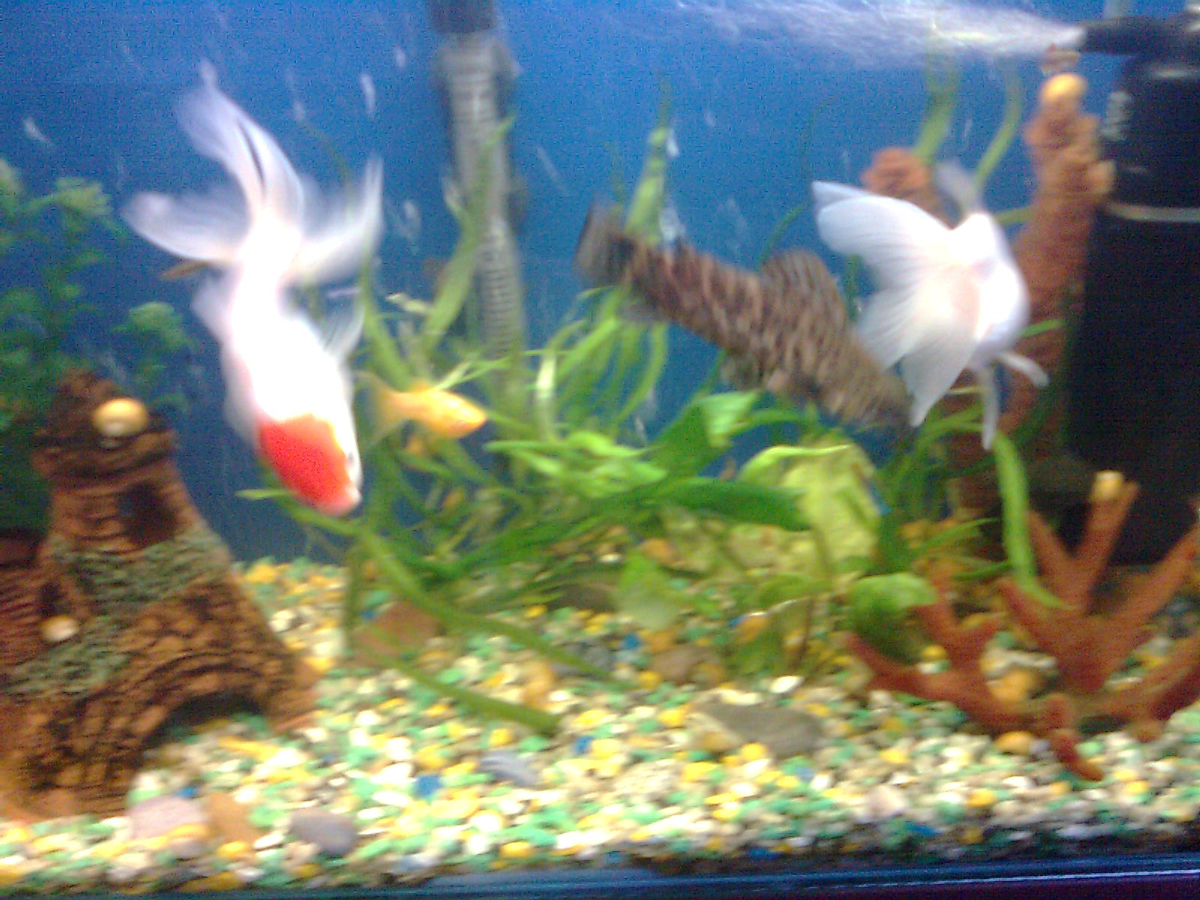
escape.

Slide 3
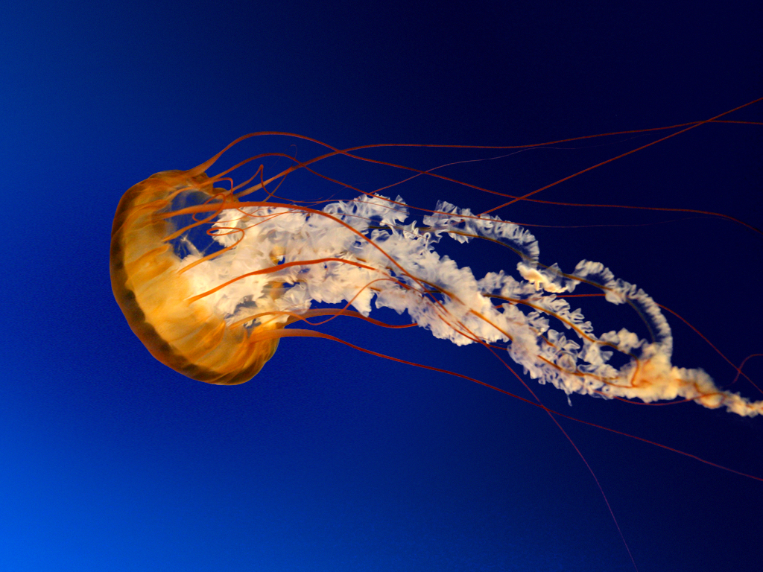
leave.

