Slide 1
what do u want to see?
weird fishes
jellyfish

Slide 2
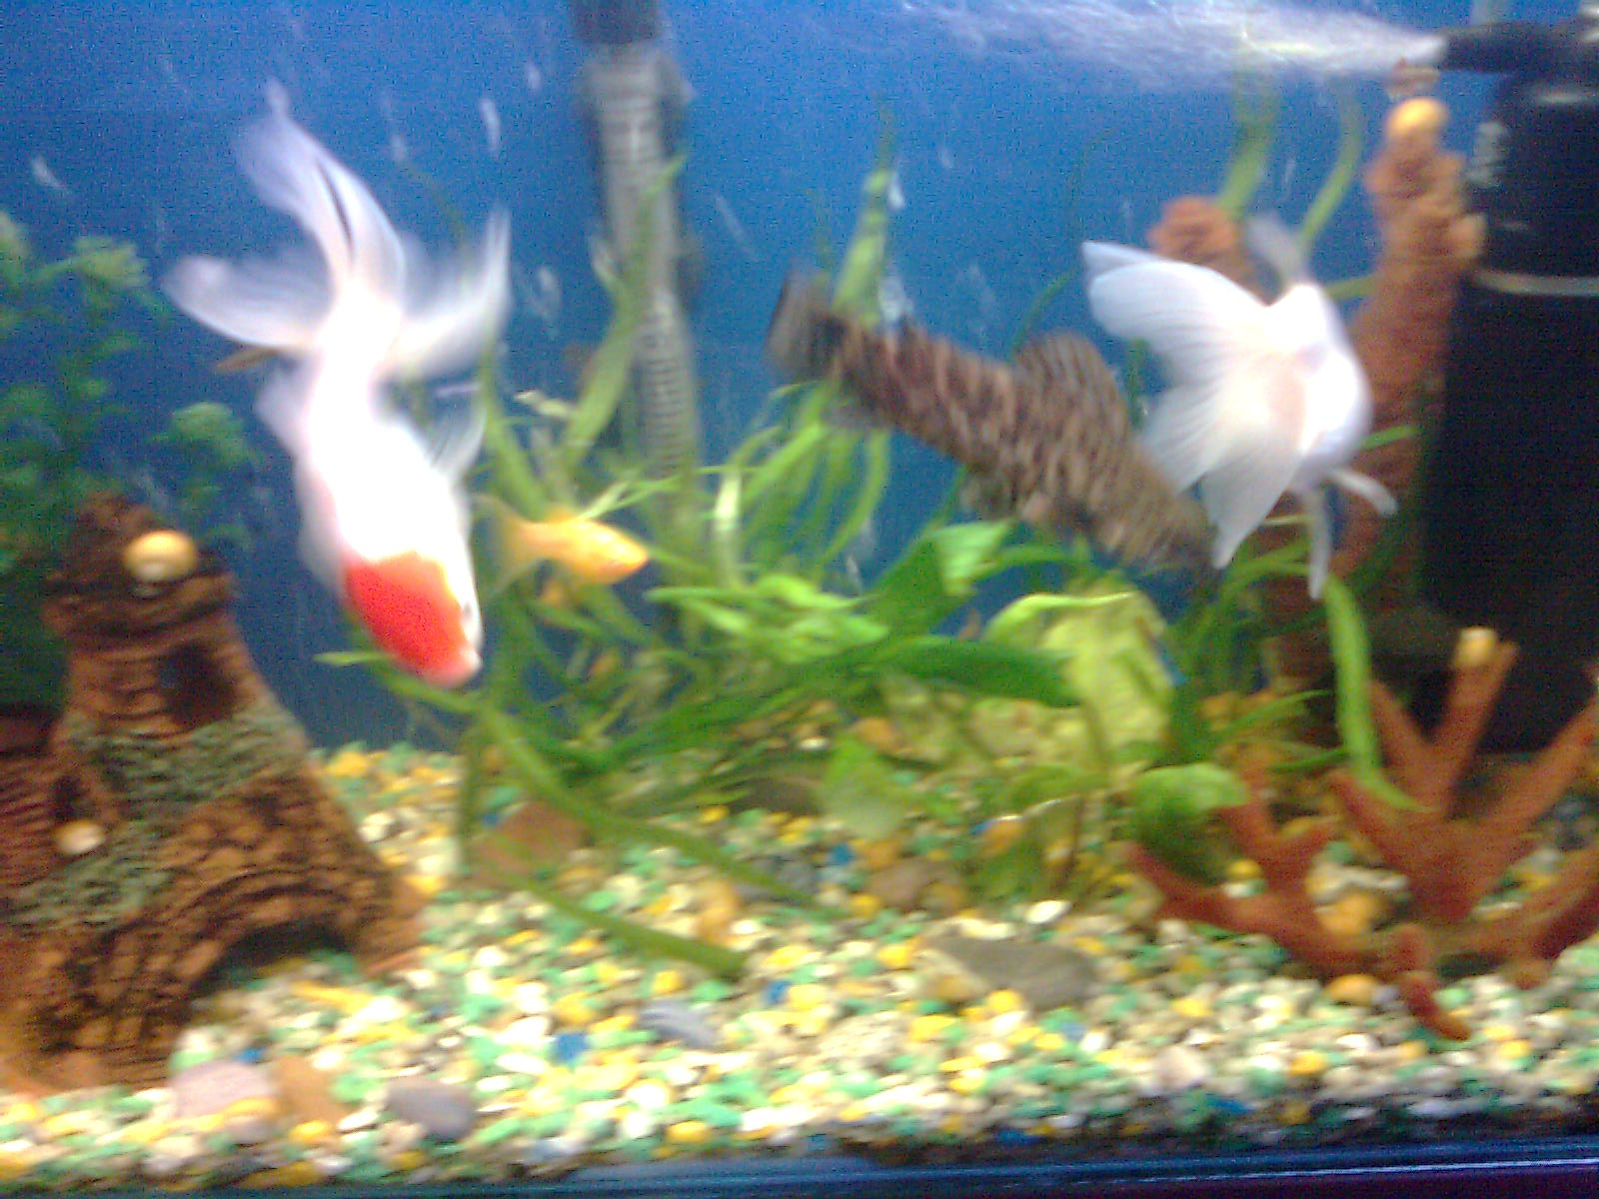

Slide 3
