Slide 1
Protein Language Models for AI4Health
AI for Health

Slide 2
Module Outline
sequence as language
representation models
structure prediction
generative design
AI-for-health applications
Core question:
what do protein foundation models learn, and how can we use them in health?
Notes:
The metadata already generates the title slide.

Slide 3
Why this protein language model matters
Proteins sit between genotype and phenotype.
Sequence data is abundant; structural and functional labels are much scarcer.
Protein language models let us learn from raw sequence scale before task-specific supervision.
In AI for health, that matters for variant interpretation, therapeutic design, and target biology.
Notes:
This slide sets the foundation-model framing for the rest of the lecture.

Slide 4
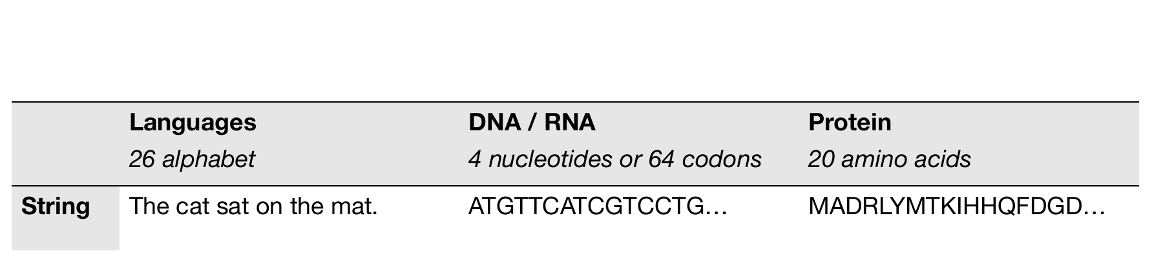
Proteins as a language
Notes:
Visual adapted from Sarah Gurev, MLCB 2024, using the user’s local Lecture 11 deck.

Slide 5
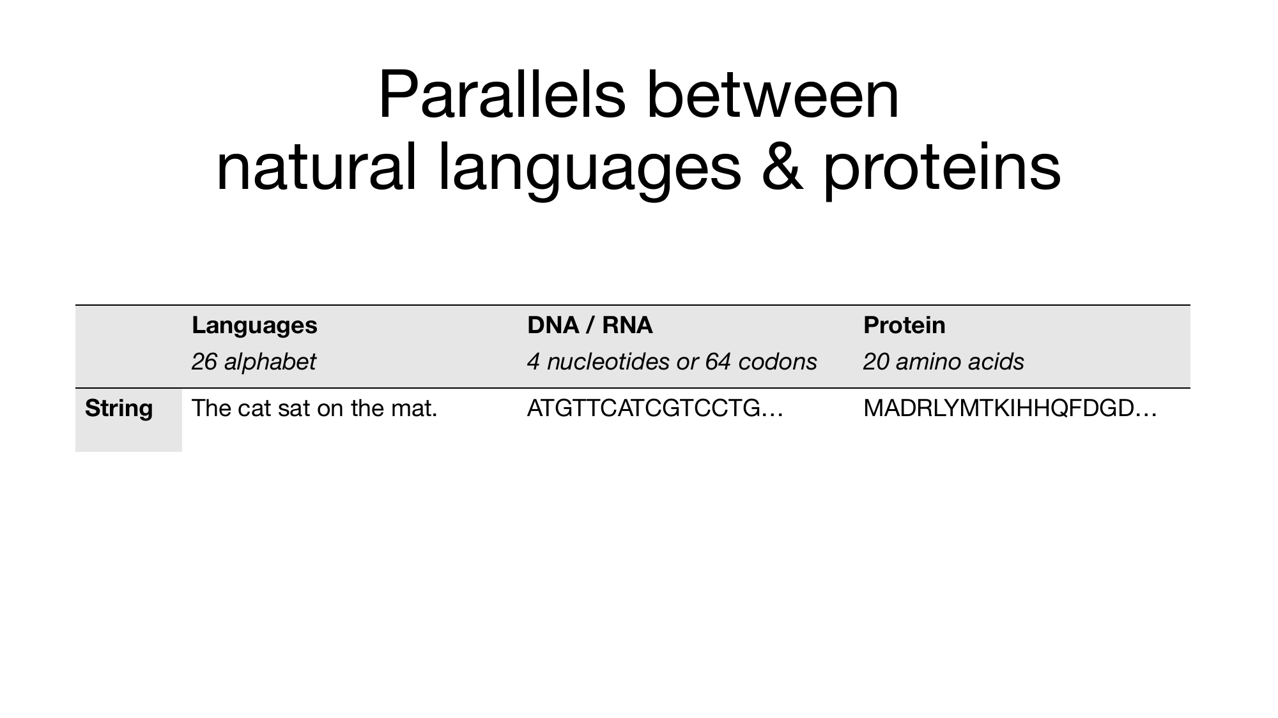
What the language analogy gives us
Amino-acid sequences have local syntax, long-range dependencies, and biological meaning.
“Meaning” in protein space includes fold, stability, binding, localization, and function.
Notes:
This verbal follow-up slide prevents the image slide from becoming overcrowded in the export.

Slide 6
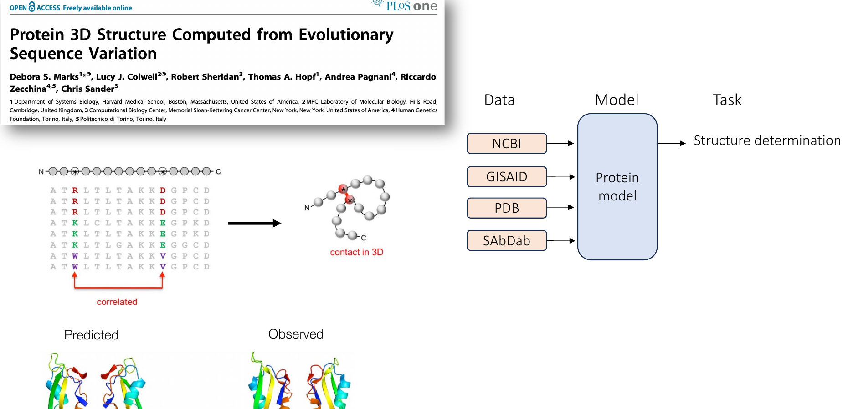
The foundation-model view of proteins
Notes:
Layout adapted from Madani et al. via Sarah Gurev, MLCB 2024. This figure frames pLMs as a bridge between data scale and biomedical tasks.

Slide 7
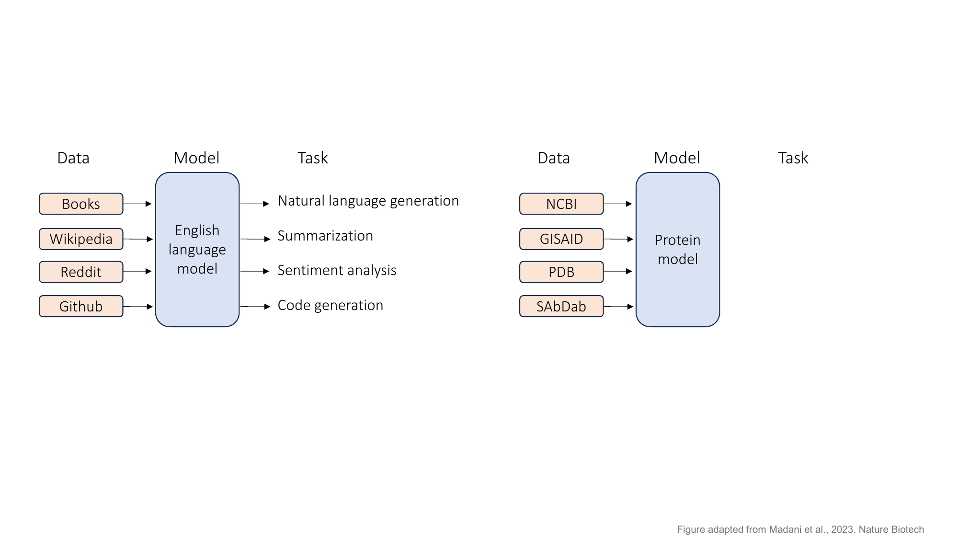
Why this framing matters
Data: sequence repositories, structures, antibodies, and interaction datasets
Model: a protein foundation model
Tasks: structure, mutation effects, interactions, and design
Notes:
This slide makes the analogy to NLP explicit and also shows why protein ML is broader than structure prediction.

Slide 8
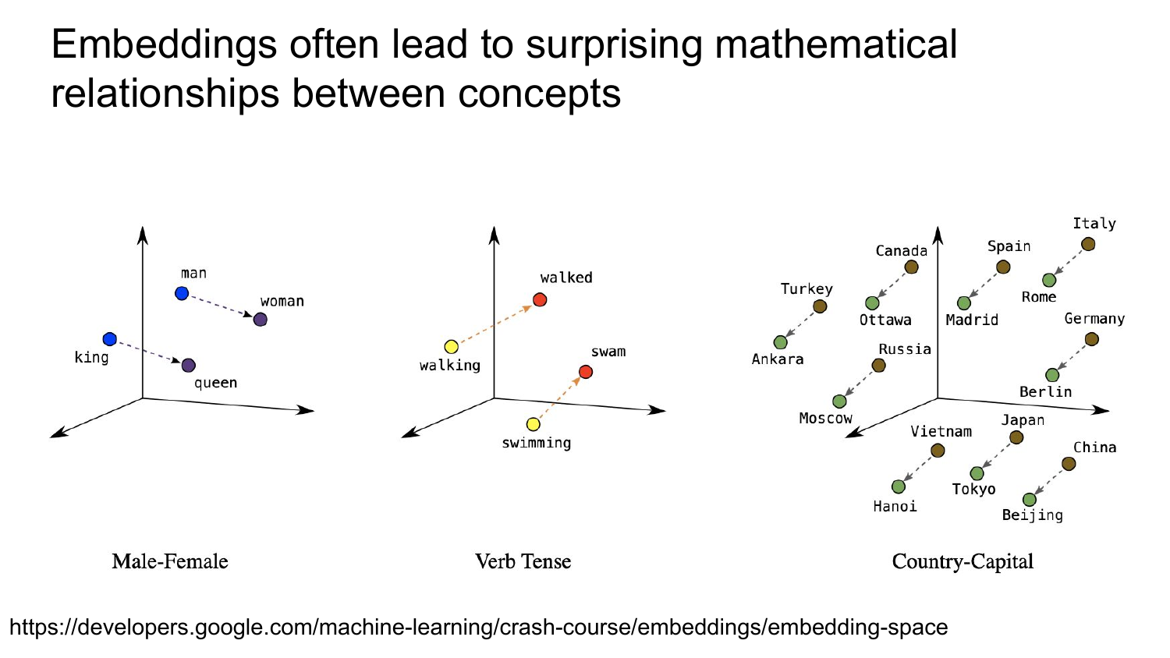
What protein language models learn
Local biochemical regularities
Remote residue dependencies
Evolutionary constraints
Signals related to structure and mutation effects
Rough mental model:
representation models embed protein sequences
prediction models infer structure or function
generation models design new sequences or structures
Notes:
Key citation: Rives et al., 2021. Use this slide to distinguish model families early.

Slide 9
A practical taxonomy
Family | Canonical examples | What goes in | What comes out
Representation | ProtTrans, ESM-1/2 | sequence | embeddings, scores
Structure prediction | AlphaFold2, ESMFold, AlphaFold3 | sequence, MSA, templates, or single sequence | 3D structure and confidence
Generation | ProtGPT2, ProteinMPNN, RFdiffusion, ESM3 | sequence, structure, prompts | new sequences, structures, functions
Notes:
Keep students from lumping all protein models together.

Slide 10
How these models are used in practice
Pretrain once on large unlabeled protein corpora
Reuse embeddings for downstream tasks
Fine-tune only when the task or dataset justifies it
Pair language models with structure models and wet-lab validation
Teaching message:
Universities usually use pretrained models far more often than they train them from scratch.
Teaching framing adapted from Galaxy Training Network protein language model materials (CC BY 4.0).
Notes:
Online teaching source: Galaxy GTN “Fine-tuning the Protein Language Model”.

Slide 11
ProtTrans and the scale story
ProtTrans is a good first example of protein transfer learning at scale.
ORNL reports training on up to 393 billion amino acids.
Reported compute included 5616 GPUs and up to 1024 TPU cores.
Takeaway:
The main classroom lesson is not the exact number.
It is that large protein corpora support reusable biological representations.
Notes:
Primary source: ORNL ProtTrans page.

Slide 12
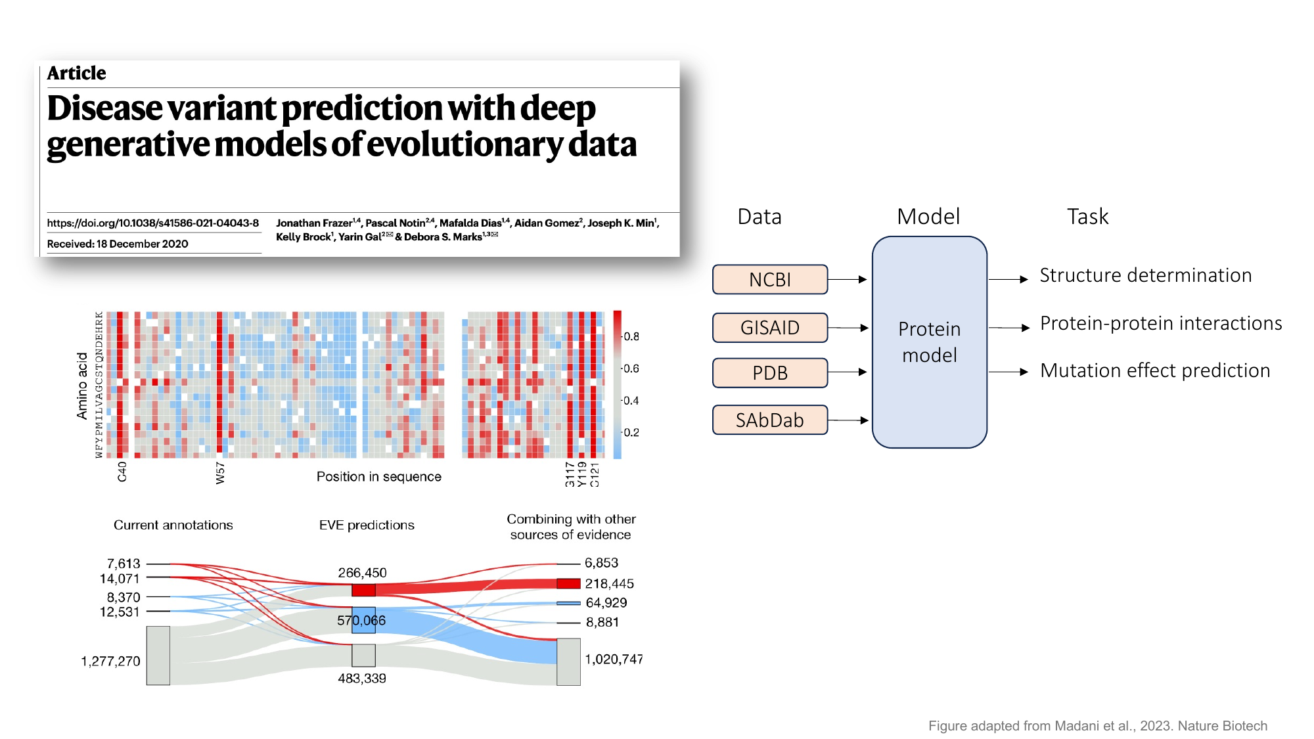
ESM and zero-shot mutation effects
ESM models are core sequence representation models.
They show that structure- and function-related information can emerge from sequence-only pretraining.
Protein language models can also support zero-shot mutation-effect prediction.
Health connection:
This is one of the clearest paths from pLMs to disease-variant interpretation.
Notes:
Key sources: Rives et al., 2021 and Meier et al., NeurIPS 2021.

Slide 13
Structure from language: ESMFold
ESMFold predicts structure from a single sequence using protein LM representations.
It avoids the full MSA + template pipeline used by AlphaFold2.
This makes it the cleanest bridge from pLMs to structure prediction.
Classroom framing:
AlphaFold2 changed structure prediction.
ESMFold showed how far single-sequence language models had progressed.
Notes:
Reference summary from Hugging Face ESM docs and the ESMFold paper summary.

Slide 14
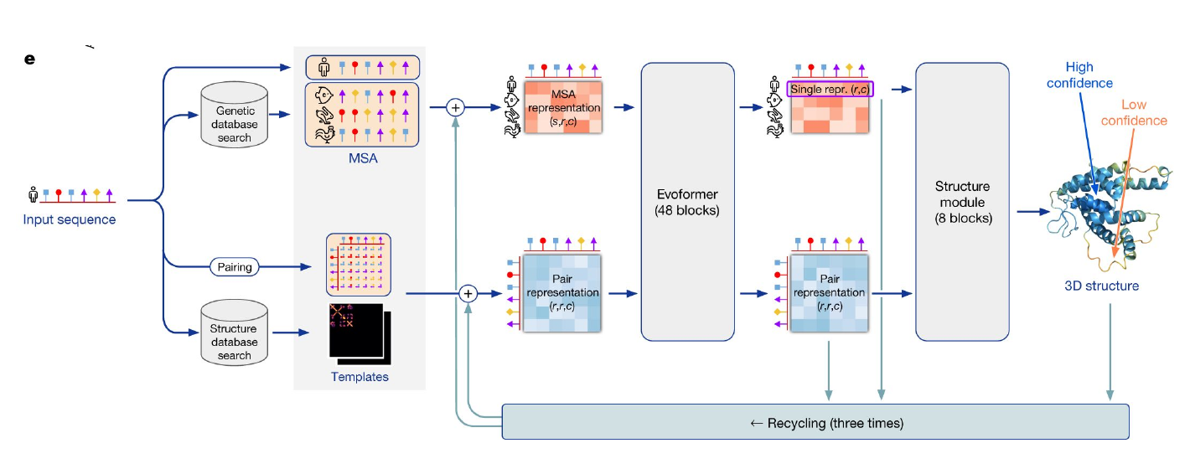
AlphaFold2 remains the comparison point
Notes:
Workflow figure adapted from the user’s local Lecture 09/10 deck, originally citing Jumper et al., Nature 2021.

Slide 15
What to remember about AlphaFold2
Input sequence plus MSA and optional templates
Evoformer updates sequence and pair representations
Structure module predicts 3D coordinates and confidence
Notes:
Keeping the bullets on a separate slide avoids awkward content splitting in the PPTX export.

Slide 16
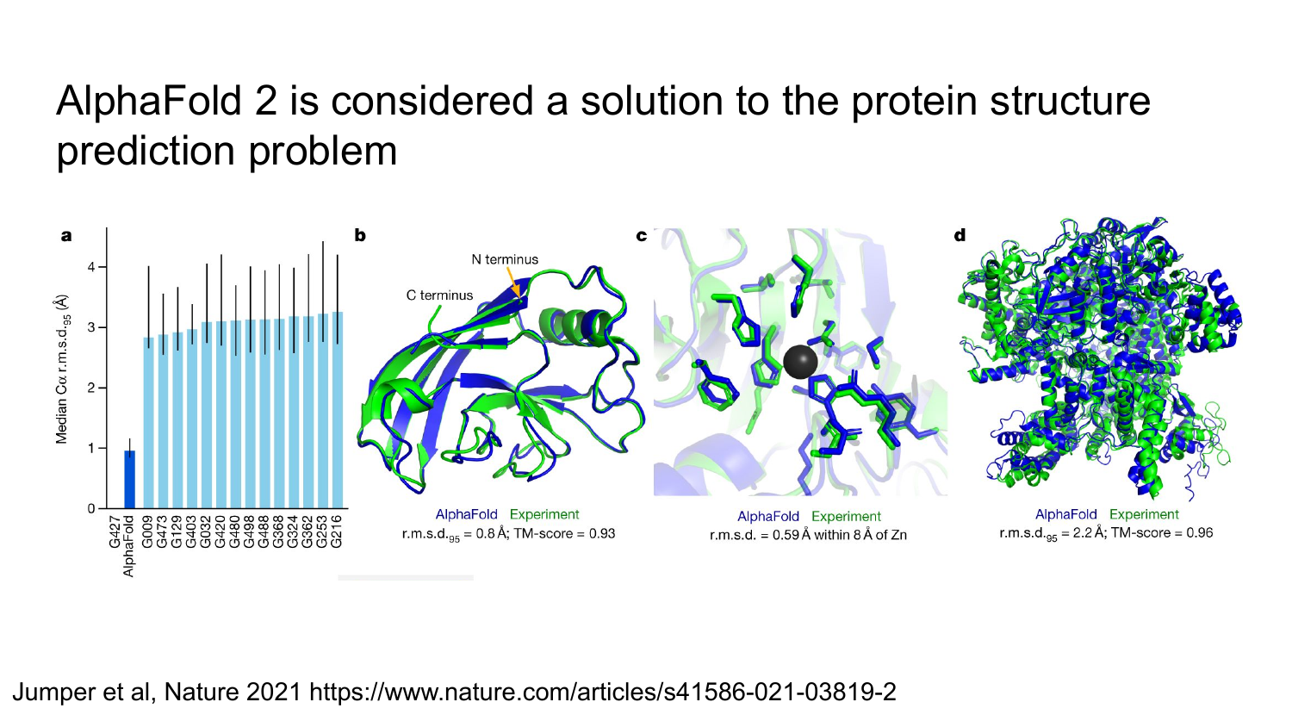
AlphaFold2, ESMFold, and AlphaFold3
AlphaFold2 strongest historical reference point; relies heavily on MSA information
ESMFold single-sequence structure prediction powered by protein language model representations
AlphaFold3 extends the task to broader biomolecular interactions involving proteins, nucleic acids, and ligands
Teaching rule:
Present AlphaFold inside this module as a partner and comparison model, not as a generic protein LM.
Notes:
Sources: AlphaFold 2021 and AlphaFold 3 papers.

Slide 17
Reading structure predictions responsibly
Confidence matters: pLDDT and PAE are not optional extras
High structural confidence is not the same as validated function
Disorder, complexes, ligands, and alternate conformations remain hard cases
Three warnings for students:
pretty structure is not proof
monomer structure is not the whole biology
experimental validation still decides utility
Pedagogical framing adapted from EMBL-EBI AlphaFold course slides (CC BY 4.0).
Notes:
Online source: EMBL-EBI AlphaFold course slides.

Slide 18
From prediction to design
Once we can model protein space, we naturally ask whether we can also generate new proteins.
This splits into three design settings: sequence generation, inverse folding, and structure generation.
Use this as the transition slide before generative models.
Notes:
This slide is a section divider.

Slide 19
Sequence generation: ProtGPT2
Autoregressive model for de novo protein sequence generation
Useful to introduce the idea of “writing” protein sequences directly
The paper reports that 88% of generated sequences were predicted as globular
Main teaching point:
Natural-looking sequence is an encouraging signal, but not the same as function
Notes:
Primary source: ProtGPT2, Nature Communications 2022.

Slide 20
Structure-conditioned design: ProteinMPNN
Input: backbone structure
Output: a sequence expected to realize that structure
This is inverse folding rather than generic language modeling
Why it matters:
It is a standard step in modern protein design pipelines
It connects structure generation to actual sequence design
Notes:
Primary source: ProteinMPNN, Science 2022.

Slide 21
Structure generation: RFdiffusion
Diffusion model for generating protein backbones
Strong for motif scaffolding, binder design, and de novo structural design
Often paired with ProteinMPNN after backbone generation
Takeaway:
This is one of the most important modern design workflows for students to recognize
Notes:
Primary source: RFdiffusion, Nature 2023.

Slide 22
Multimodal generation: ESM3
ESM3 moves beyond sequence-only modeling
Jointly reasons over sequence, structure, and function
A good capstone example because it unifies representation learning and generation
Frontier message:
Protein foundation models are moving toward multimodal, prompted biological generation
Notes:
Primary sources: EvolutionaryScale repository and Hayes et al., Science 2025.

Slide 23
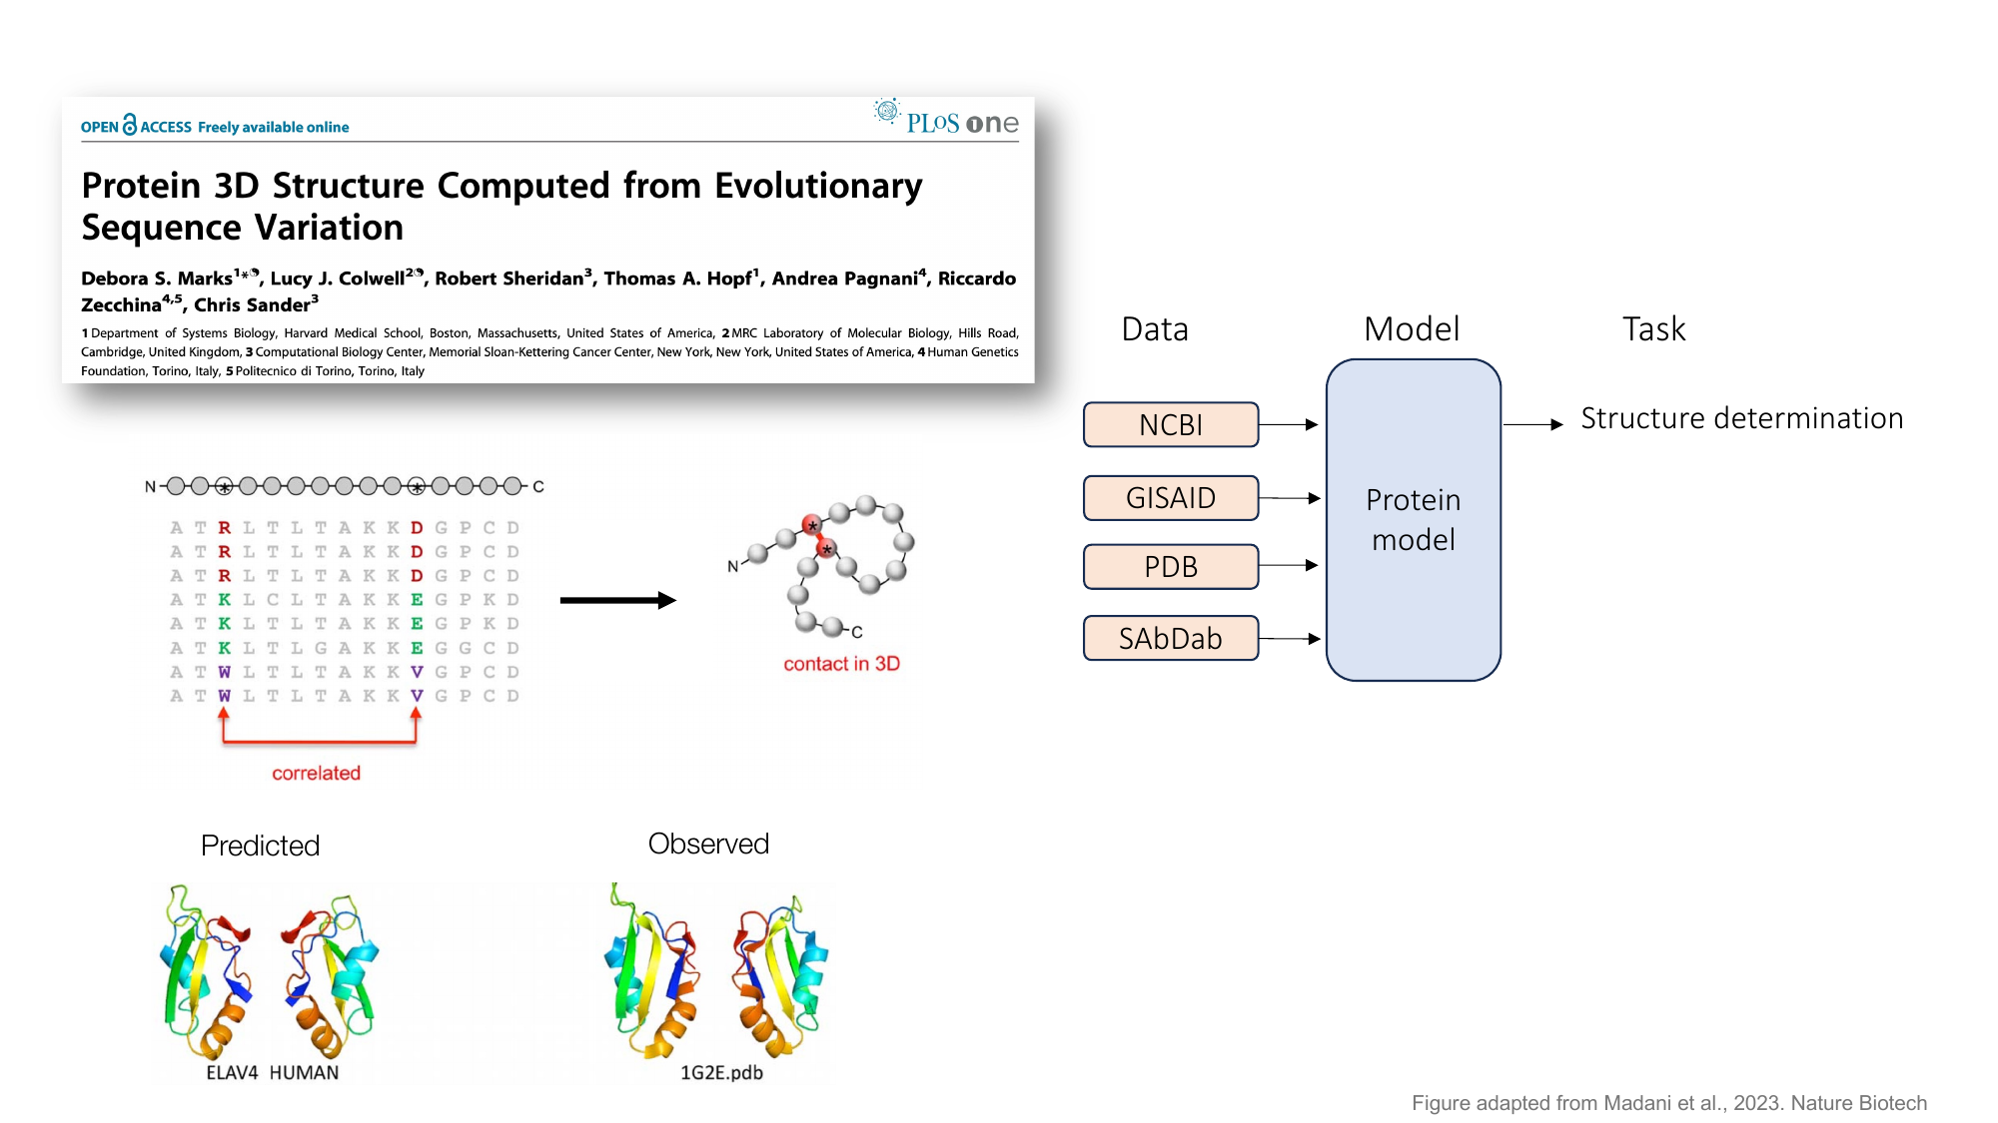
AI-for-health applications
Missense variant interpretation
Antibody and binder design
Vaccine and antigen design
Enzyme engineering for diagnostics and therapeutics
Structure-guided target understanding
Balanced conclusion:
These models accelerate hypothesis generation
They do not replace biological experiments or clinical evidence
Notes:
You can tie this slide back to examples in the user’s local Lecture 11 deck on mutation effects and vaccine design.

Slide 24
Limitations, evaluation, and safety
Training-data overlap and benchmark leakage are real risks
Generated proteins may be plausible but unstable, nonfunctional, or unexpressed
Dual-use concerns apply to open generative models
Evaluation should combine novelty, structure, assay performance, and biological relevance
If students remember one sentence:
structure confidence is useful, but function is the real endpoint
Notes:
This slide is important for keeping the module grounded.

Slide 25
Take-home messages
Protein language models learn meaningful biological representations from sequence alone
AlphaFold2, ESMFold, and AlphaFold3 belong in this module because they anchor the prediction side of the field
Generative models now span sequence, inverse folding, and diffusion-based structure design
The field is moving toward multimodal protein foundation models
In health applications, model output is a starting point, not the final answer
Notes:
End on distinctions, not just a model list: represent, predict, generate, validate.

Slide 26
References
Rives, A., Meier, J., Sercu, T., Goyal, S., Lin, Z., Liu, J., Guo, D., Ott, M., Zitnick, C. L., Ma, J., & Fergus, R. (2021). Biological structure and function emerge from scaling unsupervised learning to 250 million protein sequences. Proceedings of the National Academy of Sciences, 118(15), e2016239118. https://doi.org/10.1073/pnas.2016239118
Jumper, J., Evans, R., Pritzel, A., Green, T., Figurnov, M., Ronneberger, O., Tunyasuvunakool, K., Bates, R., Žídek, A., Potapenko, A., Bridgland, A., Meyer, C., Kohl, S. A. A., Ballard, A. J., Cowie, A., Romera-Paredes, B., Nikolov, S., Jain, R., Adler, J., … Hassabis, D. (2021). Highly accurate protein structure prediction with AlphaFold. Nature, 596(7873), 583–589. https://doi.org/10.1038/s41586-021-03819-2
Abramson, J., Adler, J., Dunger, J., Evans, R., Green, T., Pritzel, A., Ronneberger, O., Willmore, L., Ballard, A. J., Bambrick, J., Bodenstein, S. W., Evans, D. A., Hung, C.-C., O’Neill, M., Reiman, D., Tunyasuvunakool, K., Wu, Z., Žemgulytė, A., Arvaniti, E., … Jumper, J. M. (2024). Accurate structure prediction of biomolecular interactions with AlphaFold 3. Nature, 630(8016), 493–500. https://doi.org/10.1038/s41586-024-07487-w
Ferruz, N., Schmidt, S., & Höcker, B. (2022). ProtGPT2 is a deep unsupervised language model for protein design. Nature Communications, 13(1), 4348. https://doi.org/10.1038/s41467-022-32007-7
Watson, J. L., Juergens, D., Bennett, N. R., Trippe, B. L., Yim, J., Eisenach, H. E., Ahern, W., Borst, A. J., Ragotte, R. J., Milles, L. F., Wicky, B. I. M., Hanikel, N., Pellock, S. J., Courbet, A., Sheffler, W., Wang, J., Venkatesh, P., Sappington, I., Vázquez Torres, S., … Baker, D. (2023). De novo design of protein structure and function with RFdiffusion. Nature, 620(7976), 1089–1100. https://doi.org/10.1038/s41586-023-06415-8
Hayes, T., Rao, R., Akin, H., Sofroniew, N. J., Oktay, D., Lin, Z., Verkuil, R., Tran, V. Q., Deaton, J., Wiggert, M., Badkundri, R., Shafkat, I., Gong, J., Derry, A., Molina, R. S., Thomas, N., Khan, Y. A., Mishra, C., Kim, C., … Rives, A. (2025). Simulating 500 million years of evolution with a language model. Science, 387(6736), 850–858. https://doi.org/10.1126/science.ads001

